Slide 1

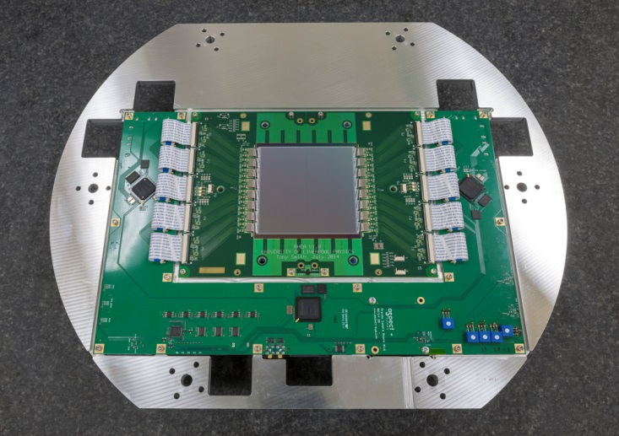
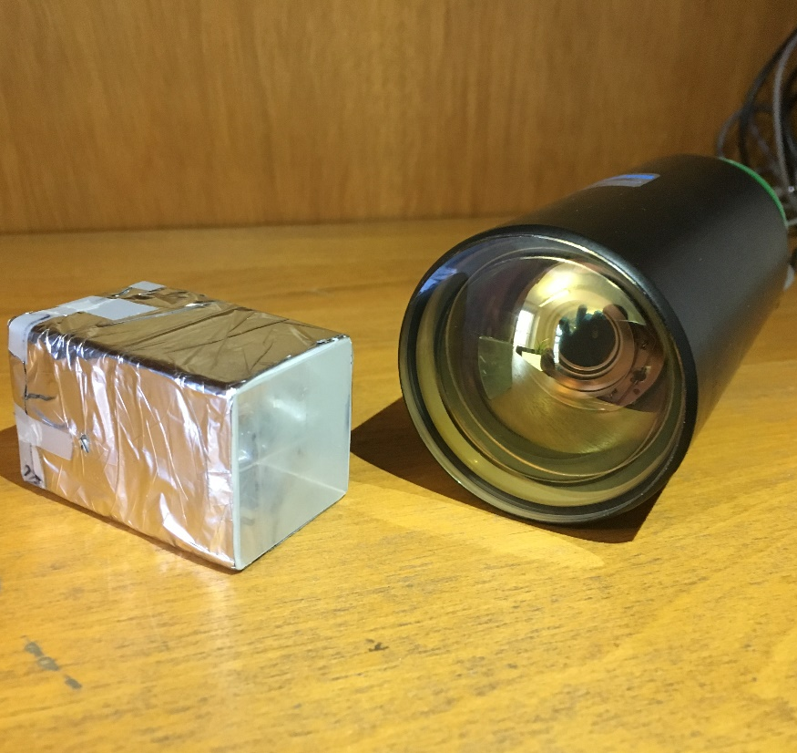
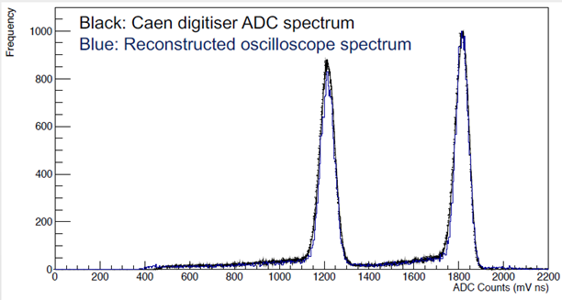
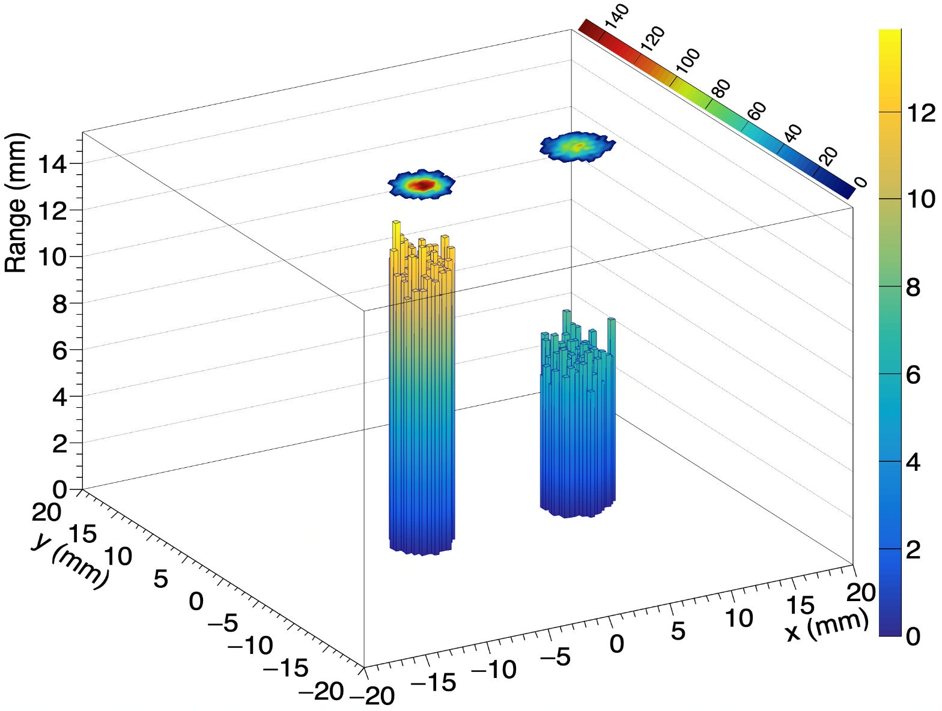
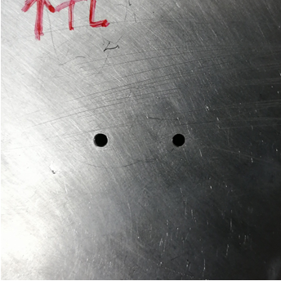





Proof of Principle Detector for Fast Patient Quality Assurance
Tony Priceª, Saad Shaikh^{b}, Raffaella Radogna^{b}, Laurent Kelleter^{b}, Simon Jolly^{b}
ªSchool of Physics and Astronomy, University of Birmingham, B15 2TT
^{b}University College London, Department of Physics and Astronomy, Gower Street, London, WC1E 6BT
Overview
Treatment plan verification (TPV), or patient-specific quality assurance (patient QA), requires detailed information about the volumetric dose deposition within an instrumented volume, to ensure the accurate delivery of dose for a given treatment plan. Current methods of patient QA are time-consuming, necessitating the repeated scanning of water phantoms. A collaboration between the High Energy Physics group at University College London and the Physics Dept. at the University of Birmingham is developing a prototype system for fast patient QA.
Combines a single-module plastic scintillator-based calorimeters developed at UCL for the SuperNEMO high energy physics experiment to measure single proton energy with the silicon trackers developed at Birmingham for the PRaVDA proton CT project to reconstruct 2D proton position.
Also the potential for reconstructing the 3D dose deposition for individual protons and therefore build up the complete volumetric dose distribution for a given treatment plan.
Silicon Strip Trackers
The tracking system uses silicon strip detectors developed by the PRaVDA project to measure the position of the protons. The tracking detector consists of 3 sensors that are rotated at 60˚relative to each other to allow the reconstruction of proton tracks in an x-u-v co-ordinate system. This configuration had been show to reduce ambiguities at higher beam currents [1].
Strip Sensor Parameters:
Active area of 93x96 mm²
150 um thick n-in-p silicon
Strip pitch of 90.8 um
Read out at 26 MHz
Radiation hard
The firmware was modified from the PRaVDA project such that a trigger signal is generated less than 100 ns after a hit over threshold is registered on two or three layers
UCL Proton Calorimeter
Based on the calorimeters developed for the SuperNEMO neutrinoless double beta decay experiment where excellent energy resolution is paramount. 3x3x5cm PVT scintillator block wrapped in mylar foil and read out with a Hamamatsu R13089 PMT
PVT is almost water equivalent
High light output yields excellent
energy resolution
Response time in the order of ns
Previous measurements at Clatterbridge
Cancer Centre have demonstrated an
energy resolution of 0.5% σ @ 60 MeV
Results
Triggering the UCL Proton Calorimeter readout using the PRaVDA tracking unit allowed the two systems to be tied together in space and time. The energy response of the calorimeter for the 36 MeV beam and 36 MeV beam with 4 mm PMMA shows clearly two peaks as expected.
The reconstructed proton ranges are then combined with position information from the PRaVDA tracker to create a 3D range plot. The 2D plot superimposed at the top shows the reconstructed position from the trackers and shows excellent synchronisation between the two systems. Future work will add the full PRaVDA tracking system and investigate the rate capacity of the combined system for pRad and pCT
Experiments
Experiments conducted on the University of Birmingham MC40 cyclotron combining the readout of the silicon tracker and UCL proton calorimeter. Calorimeter read out by both a CAEN digitizer and LeCroy ‘scope triggered by the PRaVDA silicon tracker.
Spot size = 5 mm
Proton current =
Beam Energy = 36 MeV
Energy calibrated by degrading beam
with sheets of 1-6 mm PMMA
Snake bite collimator with one hole
covered with PMMA to mix energies
into the calorimeter volume
This work was supported by the STFC Global Challenge Network+ in Advanced Radiotherapy

