Slide 1

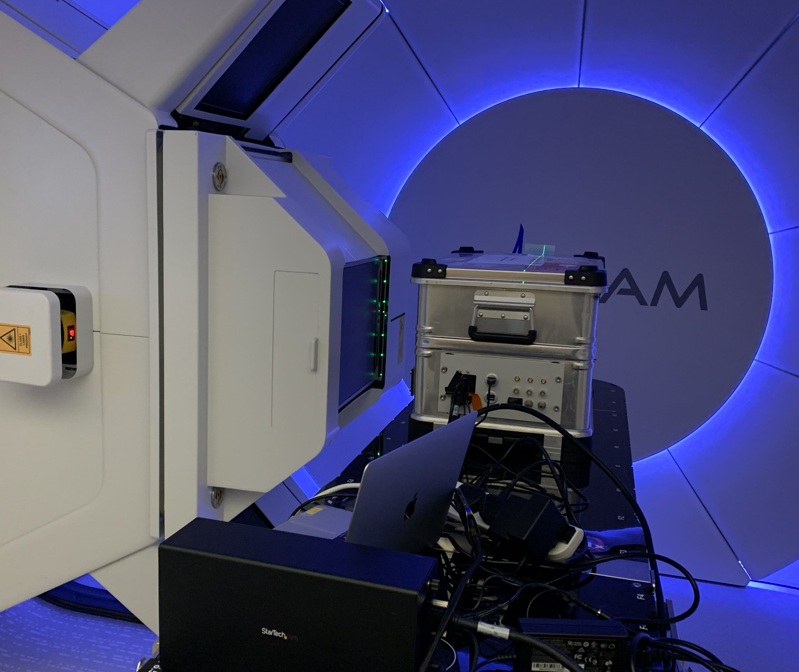
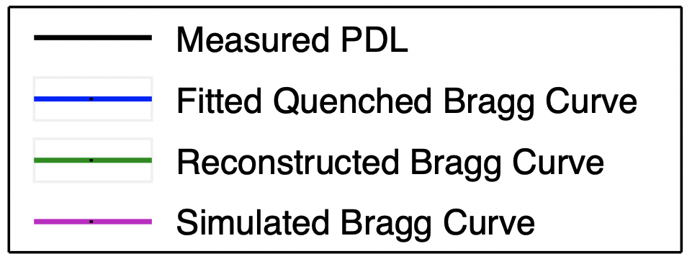
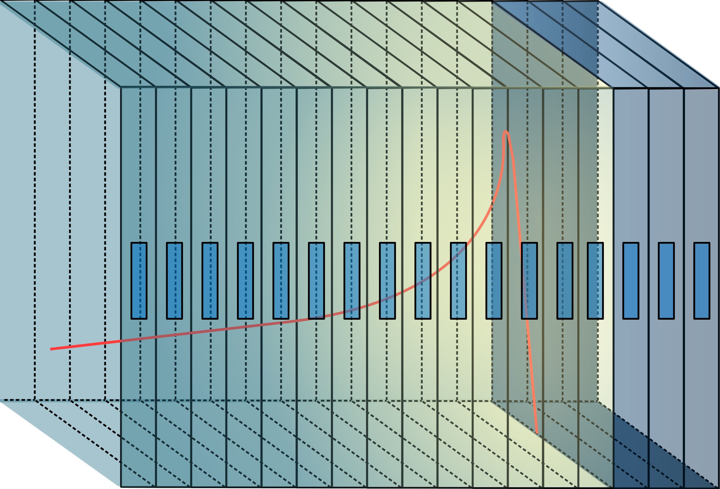
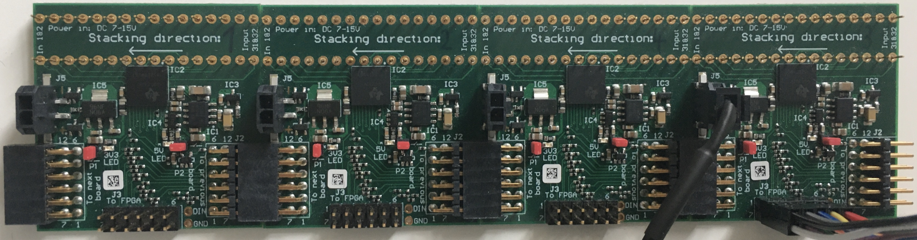

A scintillator-based calorimeter for particle therapy verification
Raffaella Radogna^{1,2}, Saad Shaikh¹, Simon Jolly¹
¹University College London; ²University of Bari
2021 IEEE Nuclear Science Symposium and Medical Imaging Conference – 16-23 Oct. 2021
Motivation
UCLH Test Beam
Future Work
Proton Beam Therapy (PBT) offers significant advantages over conventional radiotherapy due to the highly localised dose delivered by protons. This is largely due to the well-defined range of protons in matter for a given beam energy, where the majority of dose is deposited at the end of the proton path. To optimise patient safety, the range of protons must be known accurately, which is measured as part of facility daily quality assurance. Current methods of range measurement often choose between speed and accuracy. We present a detector capable of real-time range measurements without compromising accuracy.
Tested 32 scintillator sheets (2 ADC modules) with proton beams between 70-110 MeV.
Fit analytical model [2] using the ROOT data analysis framework to depth-light data and reconstruct Bragg curve for comparison against the facility reference curve.
Final detector to have 128 scintillator sheets coupled to 4 DDC232s to cover full clinical beam range.
New DDC232 circuit board prototype, with 1:1 diode-input mapping to allow 32 photodiodes per board and minimise number of channels needed. Additional improvements to noise-shielding and daisy-chaining.
Further development of web-based GUI for data display and detector control.
Additional beam tests to further characterise detector performance.
Fig 3. Set-up at UCLH PBT facility. Shown is the beam nozzle adjacent to the detector housing, containing the scintillator stack and readout electronics. The first scintillator sheet is placed approximately at the beam iso-centre. The light output of each sheet is calibrated by shooting a long-range beam through the front and back mylar detector windows.
Detector Principle
Stack of optically isolated polystyrene-based plastic scintillator sheets [1] that sample proton energy deposition along path length.
Each sheet is coupled to a photodiode to measure light output of each sheet, which is proportional to proton energy (with quenching corrections).
Fig 4. Fit result for 90 MeV proton beam. The black crosses show the measured light output from each sheet, the blue curve shows the fitted depth-light curve, the green curve shows the reconstructed Bragg curve, and the magenta curve shows the facility reference curve. An excellent match is observed with the facility curve.
Data
References
Photodiodes coupled to modular 32-channel analogue-to-digital converters (ADCs) capable of zero-deadtime measurements at over 5kHz, read-out by an FPGA.
Analytical model [2] deployed to fit depth-light curve to reconstruct Bragg curve (red curve in Fig. 1) and recover proton range.
Reference Bragg Curve
[1] L. Kelleter et al. “A Scintillator-based Range Telescope for Particle Therapy”. In: Physics in Medicine & Biology 65.16 (Aug. 2020). doi: 10.1088/1361-6560/ab9415.
[2] L. Kelleter and S. Jolly. “A Mathematical Expression for Depth-Light Curves of Therapeutic Proton Beams in a Quenching Scintillator”. In: Medical Physics 47.5 (Feb. 2020), pp. 2300–2308. doi: 10. 1002/mp.14099.
10 cm
10 cm
2.7 mm
Photodiodes
Scintillator Sheets
Fig 1. Schematic of the scintillator stack showing the detector principle. Protons enter from the left. The red curve shows a typical proton depth-energy relation.
Fig 5. Live fit for a 105 MeV beam, demonstrating the real-time range (R₀) reconstruction capabilities of the detector. Residual plot shows the difference between the data points and the fitted depth-light curve. With 32 data points, a fit rate of up to 40 Hz is achieved using ROOT.
Fig 2. Custom modular circuit board designed by CosyLab housing a Texas Instruments DDC232 ADC with 8 different dynamic ranges (12.5pC – 350pC) to choose from, depending on amount of light in detector.
Contacts:
raffaella.radogna@uniba.it; saad.shaikh.15@ucl.ac.uk; simon.jolly@ucl.ac.uk

