Slide 1
ADC Improved fitting
Meeting 02/11/2016 – Andreas Christou

Slide 2
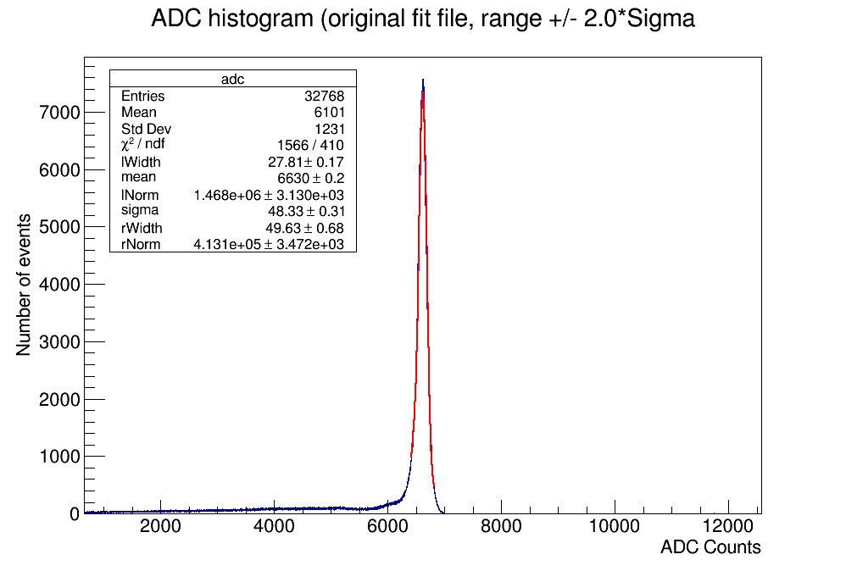
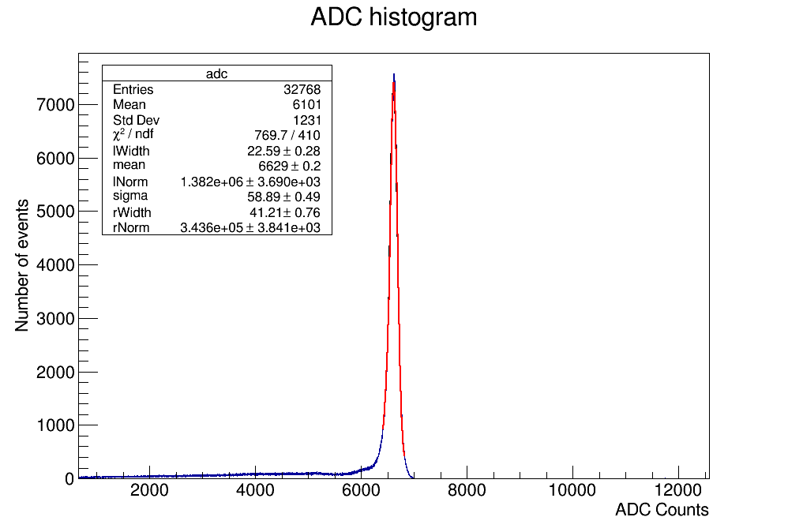
Improved ADC fit:
Landau-Gaussian convolution in old fit only has convolution step number of 100.
Increasing this number seems to consistently increase the goodness of fit as demonstrated by the chi^2/ndf value.

Slide 3
Image on the left is the fit produced when using the original fitting macro. Image on the right is the higher convolution number with the same range.
As can be seen the chi^2 value is much lower for the second image than the first (1.877 vs 3.819).
Current issue however is that peaks still do not match up precisely with ADC peak, unsure as to why.
Energy resolution for original fit = 1.713%, new fit = 2.088%

Slide 4
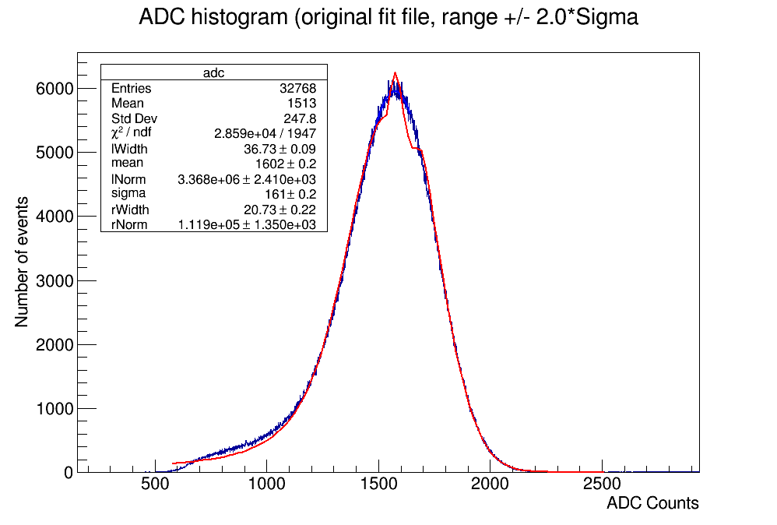
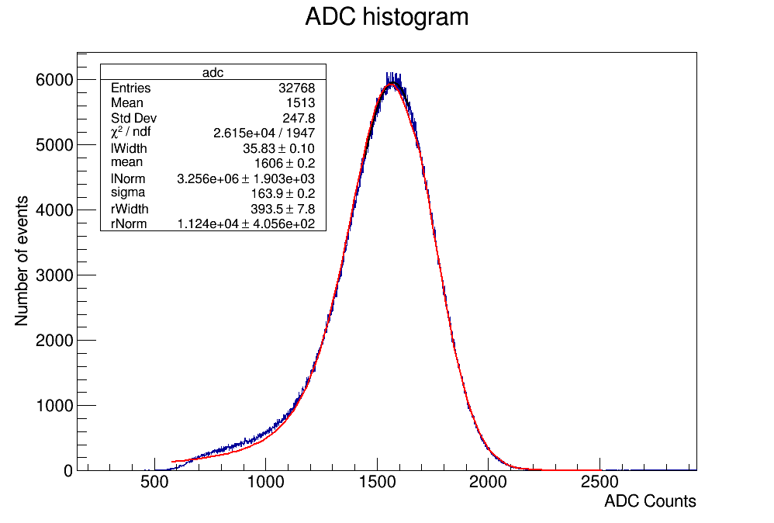
ADC fits with higher range
For fits with a higher range the new fit is also greatly improved visibly and in terms of the chi^2 value.
Left image has unusual shape around peak and fitted peak is too high. Right side image is modified fit which follows the shape of the ADC data much more precisely. Range for these fits was +/- 3.5 sigma. Energy resolution original fit = 23.618%, new fit = 23.984%

Slide 5
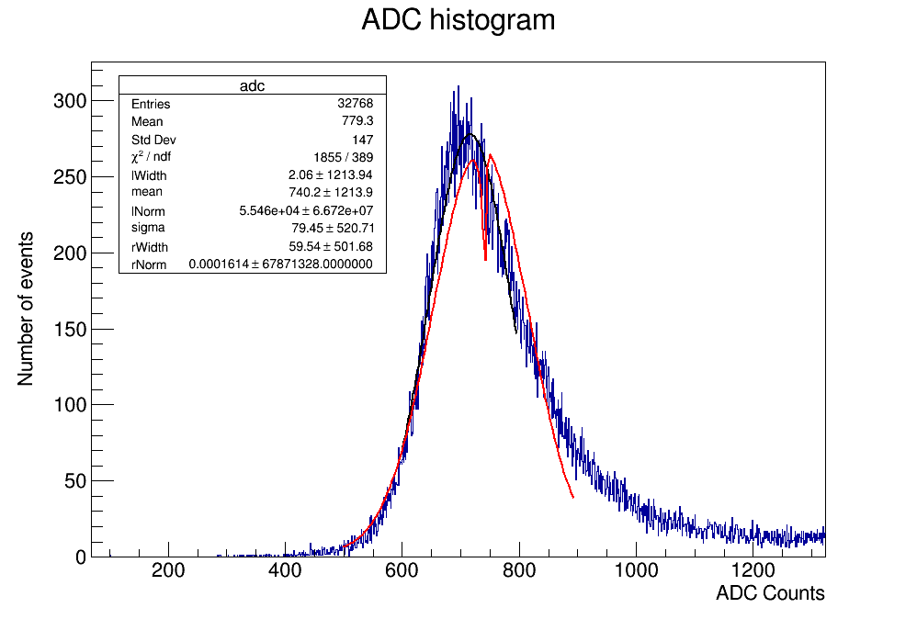
To do:
Possibly continue trying to improve the fit. Higher convolution number will work but takes a lot of time, especially for high range.
May have found a typo in code, double check whether or not it is the correct formula.
Better fits have worse energy resolution, need to find out why.
Also some of the data seems to have a lot of noise. May be able to remove this using Tspectrum analysis function in ROOT.

