Slide 1
ADC: Improving fitting
Meeting 09/11/2016 – Andreas Christou

Slide 2
Limitations of the Landau distribution:
Valid if maximum energy loss in 1 collision >> typical energy loss. In the formal definition of the distribution the maximum energy loss is infinite.
Assumes typical energy loss is >> binding energy of innermost electron.
Assumes particle velocity is constant.
Energy loss computed dependant on step size.

Slide 3
Potential alternative distribution: Vavilov distribution. Seen as a more general form of the Landau distribution
A thick material modelled by the Landau distribution will tend towards the Vavilov distribution.
Issue with Vavilov distribution is it has a complex analytic form, therefore takes a long time to compute results.
A relevant parameter to consider is κ – the significance parameter.
ξ – related to Rutherford scattering cross section, mean energy loss
Emax – maximum allowed energy transfer in a single collision with an atomic electron
For large thicknesses κ tends to be large and vice versa for small thicknesses.
For κ <0.01 the distribution used should be the Landau, 0.01<κ<10 should be Vavilov distribution.
Vavilov distribution does not have same restriction on maximum transferable energy.
May be relevant to attempt to calculate κ and determine if the Vavilov distribution should be used.

Slide 4
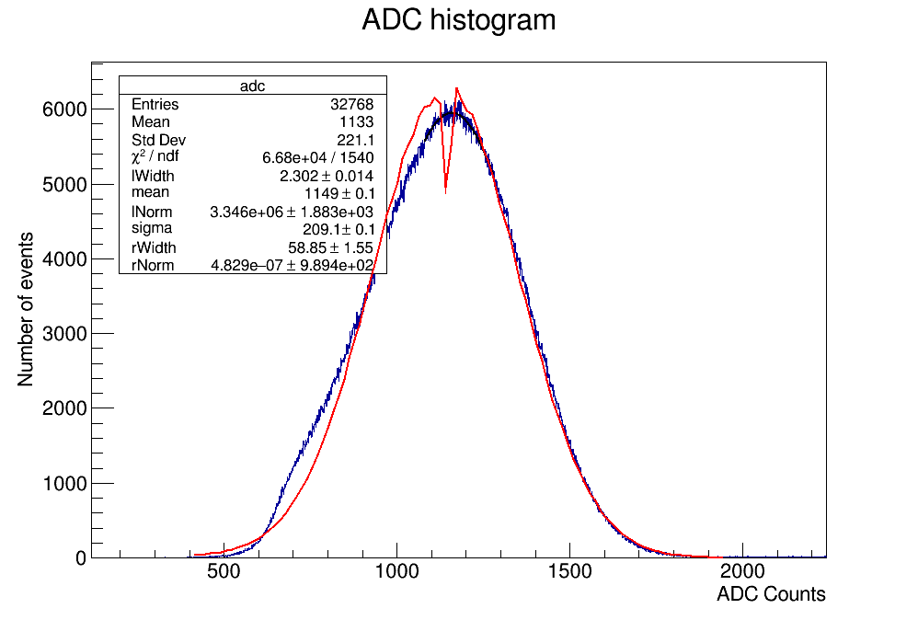
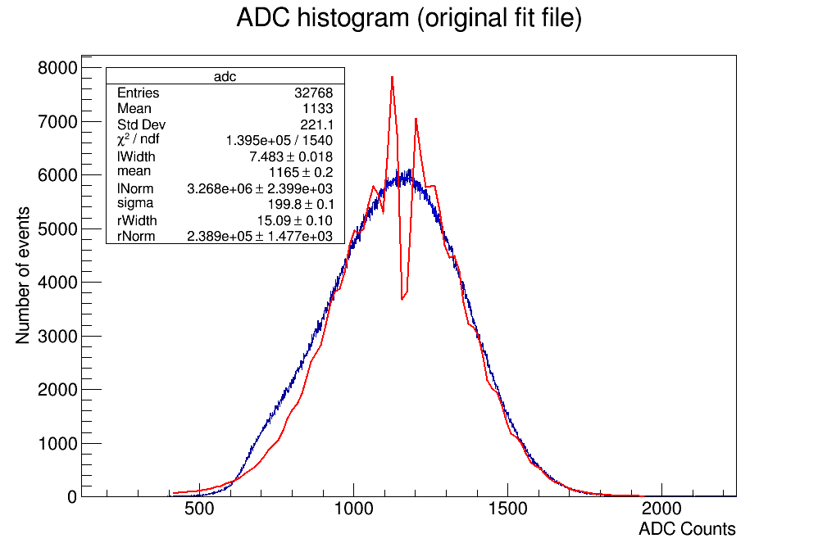
ADC fits with higher range
Have fitted the majority of the ADC spectra with both the original fit and the higher step fit for comparison.
The chi^2 of the fits demonstrate a significant improvement. However visibly the fits still do not as closely match the distribution as they should.
Energy resolution =40.294% Energy resolution = 42.769%

Slide 5
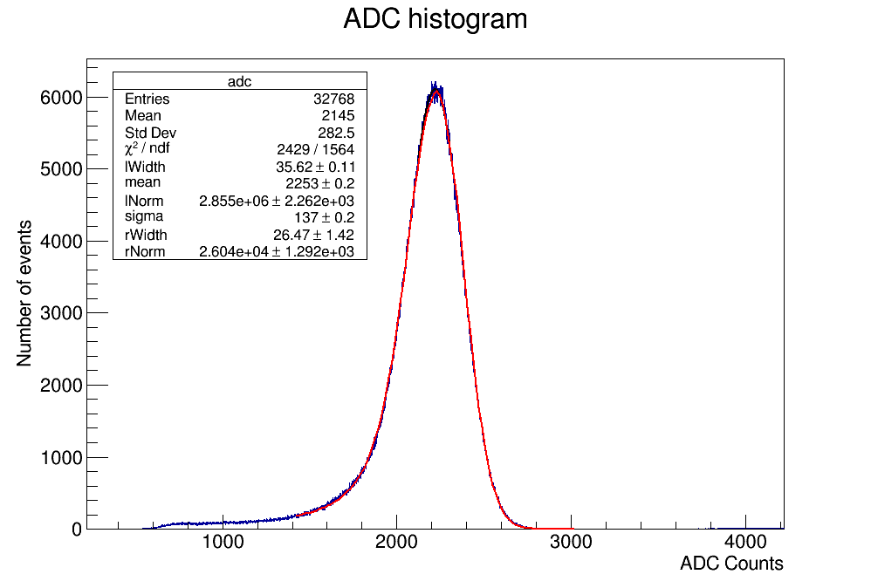
To do:
Potentially implement the Vavilov distribution and compare to current Landau plots.
May also begin working on the waveform spectra.
Energy resolution = 13.845% Energy resolution = 14.292%

