Slide 1
Different Curve fitting method
Jordan Silverman

Slide 2
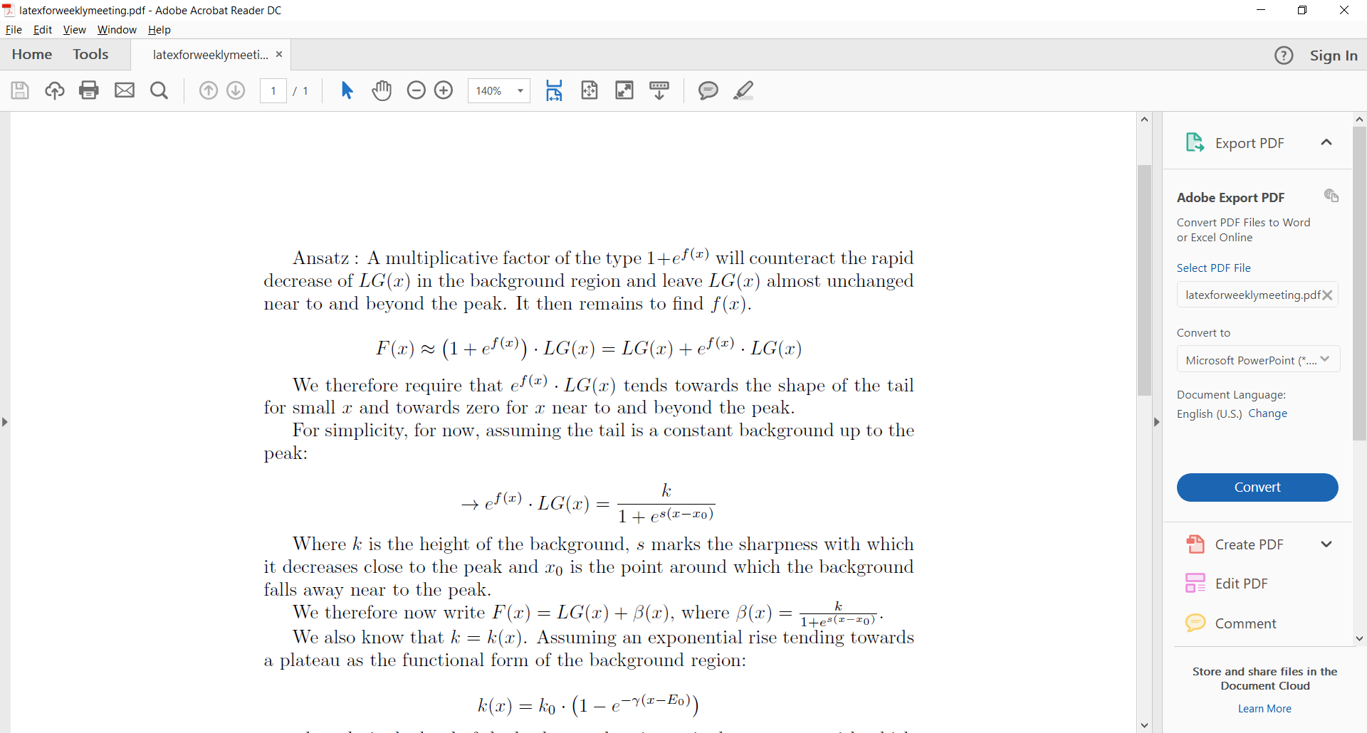
Fitting long tail distributions

Slide 3
Fitting long tail distributions

Slide 4
Fitting long tail distributions

Slide 5
Fitting long tail distributions

Slide 6
Fitting long tail distributions

Slide 7
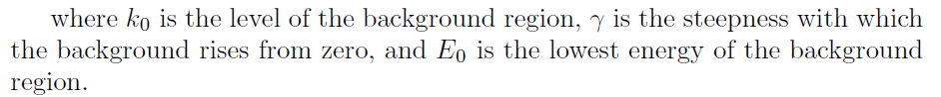
Fitting long tail distributions

Slide 8
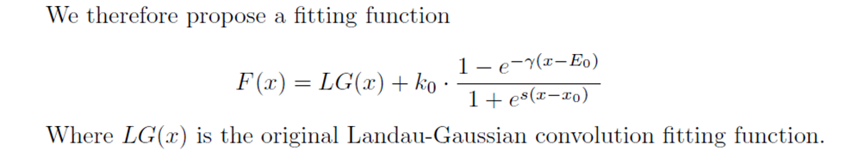
Fitting long tail distributions

Slide 9
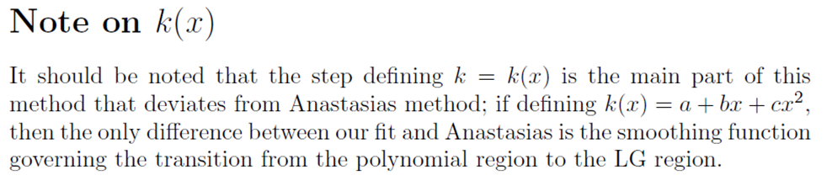
Fitting long tail distributions

Slide 10
Using python to fit the data
Most comfortable quickly writing code in Python.
Installing pyroot to read and analyse the data is not possible on Windows.
Instead, the data was read from the .root file and written into a .csv file, allowing me to perform analysis on my local machine.
  The script to do this is in my user drive on the server.

Slide 11
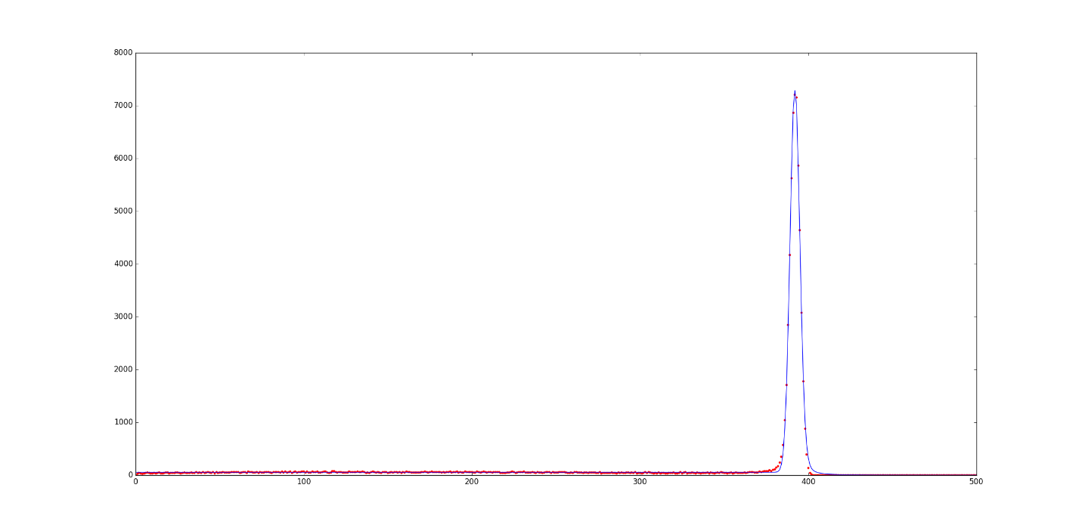
Results
First result was bad, due to an underestimated convolution number required to fit the data.

Slide 12
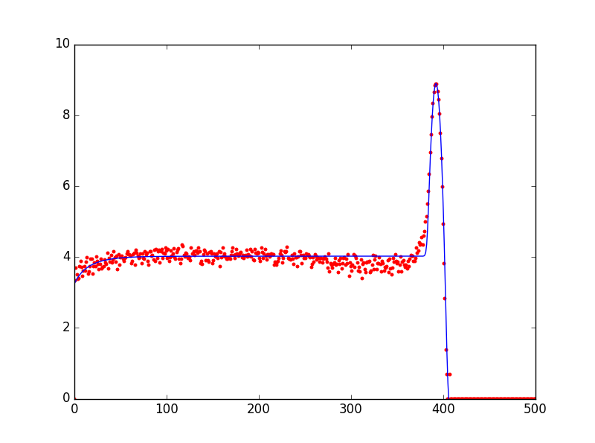
Results
Updating the Convolution count to allow for tighter fits caused a bottleneck in the speed of the program*, but much better results were achieved.
  *i.e. the program now takes ~12 hours to produce each fit
CurveFit parameters: [
2.54816594e-03 # Width of Landau
3.92070257e+02 # Most Probable (MP, location) parameter of Landau density (i.e. x-value of peak)
5.43361874e+04 # Total area (integral -inf to inf, normalization constant)
2.96075739e+00 # Width (sigma) of Gaussian function
5.57535588e+01 # Normalisation constant for 'flat' region (k0)
4.87783381e-02 # 'sharpness' i.e. rapidity of rise of E0 (leftmost rise) curve
8.98996500e+04 # sharpness of changeover in sigmoid
-1.25957982e+01 # x-value of y=0 point of first exponential
3.86665922e+02] # x-value of changeover in sigmoid
CurveFit Chi Squared: 1256.95453572 (~2.5 per d.o.f)

Slide 13
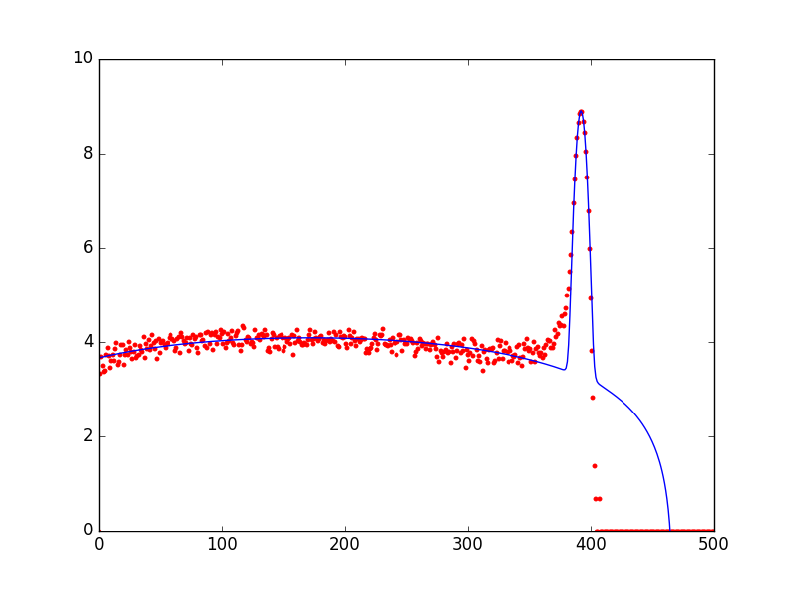
Results
Changing the fitting function such that k(x) was a polynomial gave a fit with a higher Chi Squared value, although the first region seemed to be better fit.
  Interestingly, same parameters were found for LG part of the curve.
CurveFit parameters: [
2.54816594e-03 # Width of Landau
3.92070257e+02 # Most Probable (MP, location) parameter of Landau density (i.e. x-value of peak)
5.43361874e+04 # Total area (integral -inf to inf, normalization constant)
2.96075739e+00 # Width (sigma) of Gaussian function
-1.35883009e-03 # a = x^2 Polynomial constant
4.71704500e-01 # b = x^1 Polynomial constant
7.59795616e+01 # c = x^0 Polynomial constant
1.14640620e-04 # Sharpness of changeover in sigmoid
5.67917880e+02] # x-value of changeover in sigmoid
CurveFit Chi Squared: 3552.39753403 (~7.2 per d.o.f)

Slide 14
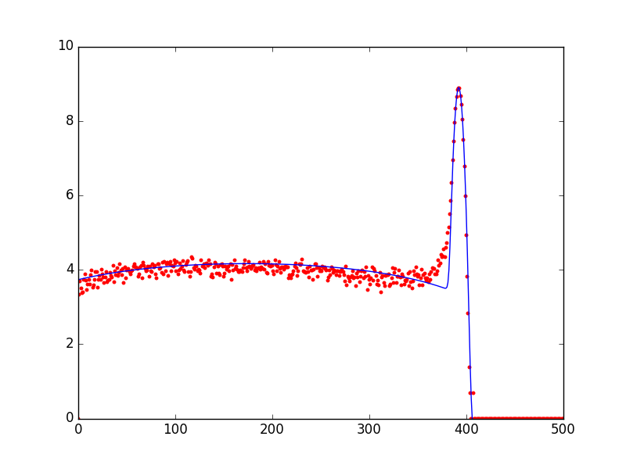
Results
Keeping the Polynomial fit version of k(x) but tweaking the values by hand returned a better Chi Squared value
  Indicative of bad initial values/guess values of fitted parameters in previous attempts
CurveFit parameters: [
2.54816594e-03 # Width of Landau
3.92070257e+02 # Most Probable (MP, location) parameter of Landau density (i.e. x-value of peak)
5.43361874e+04 # Total area (integral -inf to inf, normalization constant)
2.96075739e+00 # Width (sigma) of Gaussian function
-0.0007473565495 # a = x^2 Polynomial constant
0.25943747500000003 # b = x^1 Polynomial constant
41.78875888 # c = x^0 Polynomial constant
1.0 # Sharpness of changeover in sigmoid
400.0] # x-value of changeover in sigmoid
CurveFit Chi Squared: 2360.34893632 (~4.8 per d.o.f)

Slide 15

Results
Using the values from the eye-fit as a better set of guesses gave a better fit
  However, still not as good a Chi Squared as the exponential version of the fit.
CurveFit parameters: [
1.90934540e-03 # Width of Landau
3.92103359e+02 # Most Probable (MP, location) parameter of Landau density (i.e. x-value of peak)
5.42691578e+04 # Total area (integral -inf to inf, normalization constant)
2.96246041e+00 # Width (sigma) of Gaussian function
-3.97951817e-04 # a = x^2 Polynomial constant
1.74773350e-01 # b = x^1 Polynomial constant
4.17817260e+01 # c = x^0 Polynomial constant
9.25730334e-01 # Sharpness of changeover in sigmoid
3.87442547e+02] # x-value of changeover in sigmoid
CurveFit Chi Squared: 1550.37329691 (~3.1 per d.o.f)

Slide 16
Next
This fit has 9 variable parameters, whereas Anastasias has 7 (?) meaning it has a lower number of degrees of freedom.

Slide 17
Next
This fit has 9 variable parameters, whereas Anastasias has 7 (?) meaning it has a lower number of degrees of freedom.
Even with these extra parameters, the Polynomial version of the fit gets a higher Chi Squared (without even considering Chi Squared per degree of freedom).

Slide 18
Next
This fit has 9 variable parameters, whereas Anastasias has 7 (?) meaning it has a lower number of degrees of freedom.
Even with these extra parameters, the Polynomial version of the fit gets a higher Chi Squared (without even considering Chi Squared per degree of freedom).
The exponential version does not take into account the curvature of the long tail of the data.

Slide 19
Next
If this is to be explored further, conversion over to c++ will massively speed up fitting times.
  i.e. if past experience is to go by, an expected speed increase of ~500 times is not unreasonable, giving an expected fitting time of ~a minute.

Slide 20
Next
If this is to be explored further, conversion over to c++ will massively speed up fitting times.
  i.e. if past experience is to go by, an expected speed increase of ~500 times is not unreasonable, giving an expected fitting time of ~a minute.
    However, this may not be as high as expected as the library used to fit is written in C already.

Slide 21
Next
If this is to be explored further, conversion over to c++ will massively speed up fitting times.
  i.e. if past experience is to go by, an expected speed increase of ~500 times is not unreasonable, giving an expected fitting time of ~a minute.
    However, this may not be as high as expected as the library used to fit is written in C already.
Currently believe that Anastasias fit is better than this one will ever get, so moving on from this is probably the best cause of action.

