Slide 1
Benchmarking proton CT reconstruction algorithms
Matthieu Hentz
CDT in Data Intensive Science at UCL
Working on proton CT in the HEP group
Supervised by Simon Jolly, Simon Arridge, Jamie McClelland

Slide 2
Proton Beam Therapy
Amount of energy per unit path length transferred to an absorber is described by Bethe-Bloch equation (Schulte et al., 2005):
$$−\frac{dE}{dx}=4πr_{e}^{2}m_{e}c^{2}z^{2}N_{A}ρ\frac{Z}{A}\frac{1}{β^{2}}\left[\text{ln}\frac{2m_{e}c^{2}β^{2}γ^{2}}{I} −β^{2}\right]$$
Notes:
Mainly electronic interactions

Slide 3
Proton Beam Therapy
Amount of energy per unit path length transferred to an absorber is described by Bethe-Bloch equation (Schulte et al., 2005):
$$−\frac{dE}{dx}=4πr_{e}^{2}m_{e}c^{2}z^{2}N_{A}ρ\frac{Z}{A}\frac{1}{β^{2}}\left[\text{ln}\frac{2m_{e}c^{2}β^{2}γ^{2}}{I} −β^{2}\right]$$
$−\frac{dE}{dx}$ increases rapidly as $β$ approaches zero
Leads to a sharp peak as particle comes to a stop -> Bragg peak

Slide 4
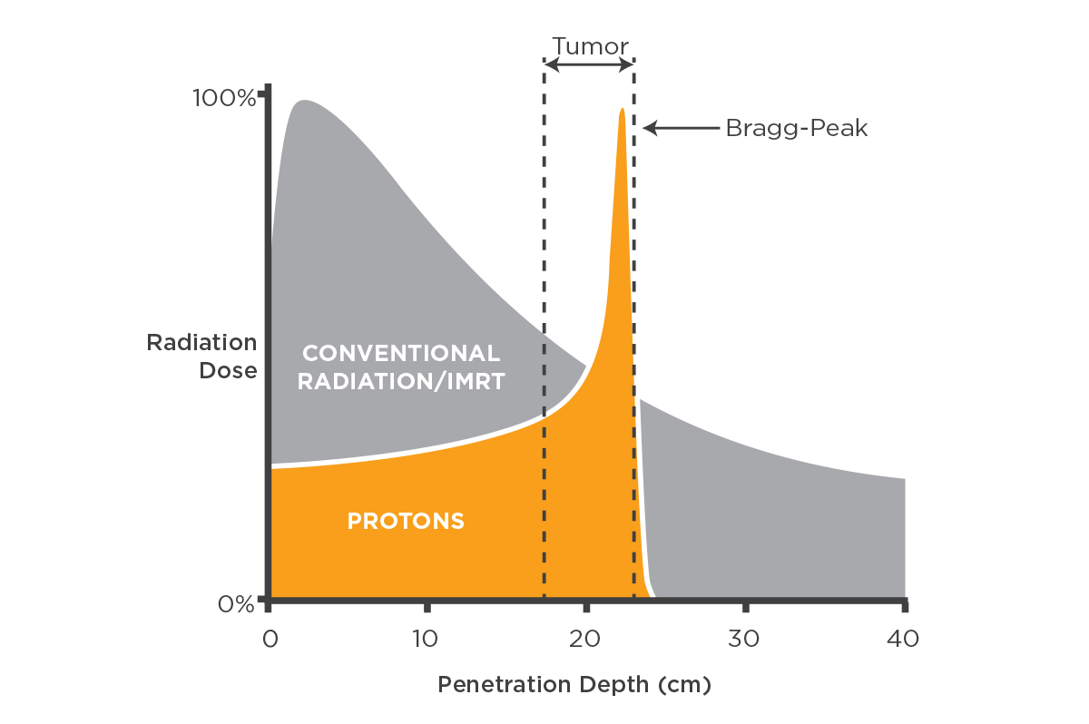
Proton Beam Therapy
Amount of energy per unit path length transferred to an absorber is described by Bethe-Bloch:
$$−\frac{dE}{dx}=4πr_{e}^{2}m_{e}c^{2}z^{2}N_{A}ρ\frac{Z}{A}\frac{1}{β^{2}}\left[\text{ln}\frac{2m_{e}c^{2}β^{2}γ^{2}}{I} −β^{2}\right]$$
$−\frac{dE}{dx}$ increases as $β$ decreases
Leads to a sharp peak as particle comes to a stop

Slide 5
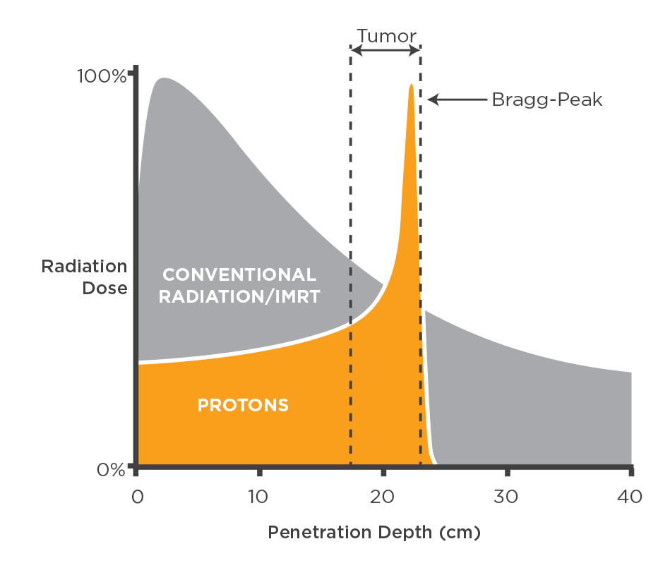
Proton Beam Therapy
Control range of beam inside patient by choosing initial energy
More normal tissue is spared behind the target thanks to sharp drop in fluence
Dose in front of target (and overall) is lower compared to x-rays

Slide 6
Proton Beam Therapy
Control range of beam inside patient by choosing initial energy
More normal tissue is spared behind the target thanks to sharp drop in fluence
Dose in front of target (and overall) is lower compared to x-rays
Under- or overshoot can be very damaging
Need to carefully plan treatment to minimise risk to critical structures
Matthieu Hentz

Slide 7
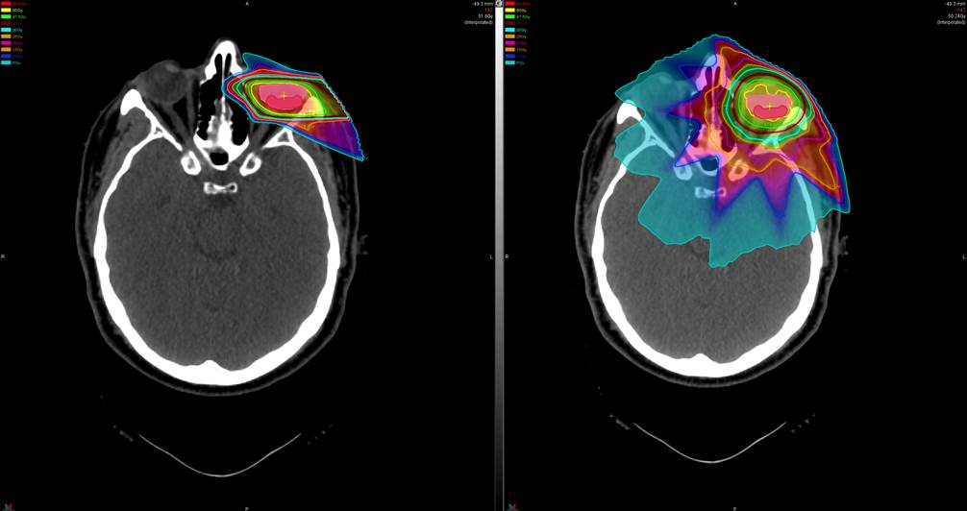
Treatment Planning
Plan for proton beam therapy
Plan for x-ray therapy
Need a map of relative stopping power (RSP) for range and dose calculations
Can specify critical structures and beam directions and optimise plan iteratively
Requires 3D distribution of the attenuation coefficient (x-rays) or RSP (protons) in patient
Acquired using CT

Slide 8
X-ray Computerised Tomography
The integral of a function $f(x,y)$ along the straight line $l$ parametrised by its perpendicular distance from the origin, $s,$and its orientation with respect to the $x$-axis, $θ$, is given by its Radon transform
$$ℛf\left(s,θ\right)= \int_{l(s,θ)}{f\left(x,y\right) dl= \iint_{−∞}^{∞}{f\left(x,y\right) δ\left(s −\left(x\cos{θ}+y\sin{θ}\right)\right) dx dy}}$$
$δ$-function ensures only values of $f(x,y)$ along the path $s=x\cos{θ+y\sin{θ}}$ appear in the integral

Slide 9
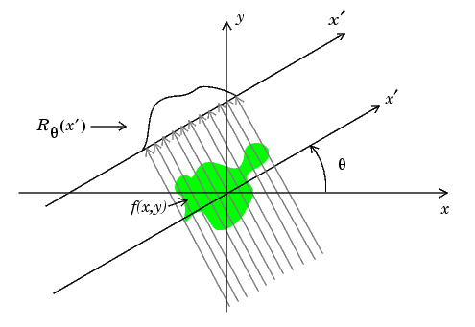
X-ray Computerised Tomography
$$s$$
The integral of a function $f(x,y)$ along the straight line $l$ parametrised by its perpendicular distance from the origin, $s,$and its orientation with respect to the $x$-axis, $θ$, is given by its Radon transform
$$s$$
$$ℛf(x,y)$$
$$ℛf\left(s,θ\right)= \int_{l(s,θ)}{f\left(x,y\right) dl= \iint_{−∞}^{∞}{f\left(x,y\right) δ\left(s −\left(x\cos{θ}+y\sin{θ}\right)\right) dx dy}}$$
$δ$-function ensures only values of $f(x,y)$ along the path $s=x\cos{θ+y\sin{θ}}$ appear in the integral

Slide 10
X-ray Computerised Tomography
The Radon transform is useful because the intensity of a photon beam exiting an absorber is given by
$$I=I_{0} e^{−\int_{l(s,θ)}{μ\left(x\right)dx}}$$
so
$$\int_{l(s,θ)}{μ\left(x\right)dx}= \text{log}\frac{I_{0}}{I}\text{.}$$
Can calculate the right-hand side by measuring $I$
Applying the inverse Radon transform yields a map of the attenuation coefficient $μ$

Slide 11
Analytical Reconstructions
Popular due to their computational simplicity
Example: Fourier transform reconstruction
The 1D Fourier transform of the Radon transform of a function is equal to a central slice of the 2D Fourier transform of that same function:
$$ℱ[ℛf(s,θ)](k,θ)= ℱ_{2}[f(x,y)](k\cos{θ, k\sin{θ})}$$
Can reconstruct $f\left(x,y\right)$ by applying inverse 2D Fourier transform
$$f\left(x,y\right)=ℱ_{2}^{−1}ℱ[ℛf(s,θ)]= \frac{1}{{(2π)}^{2}} \int_{0}^{π}{\int_{−∞}^{∞}{ℱ[ℛf(s,θ)](k,θ)} \left|k\right|dkdθ}$$

Slide 12
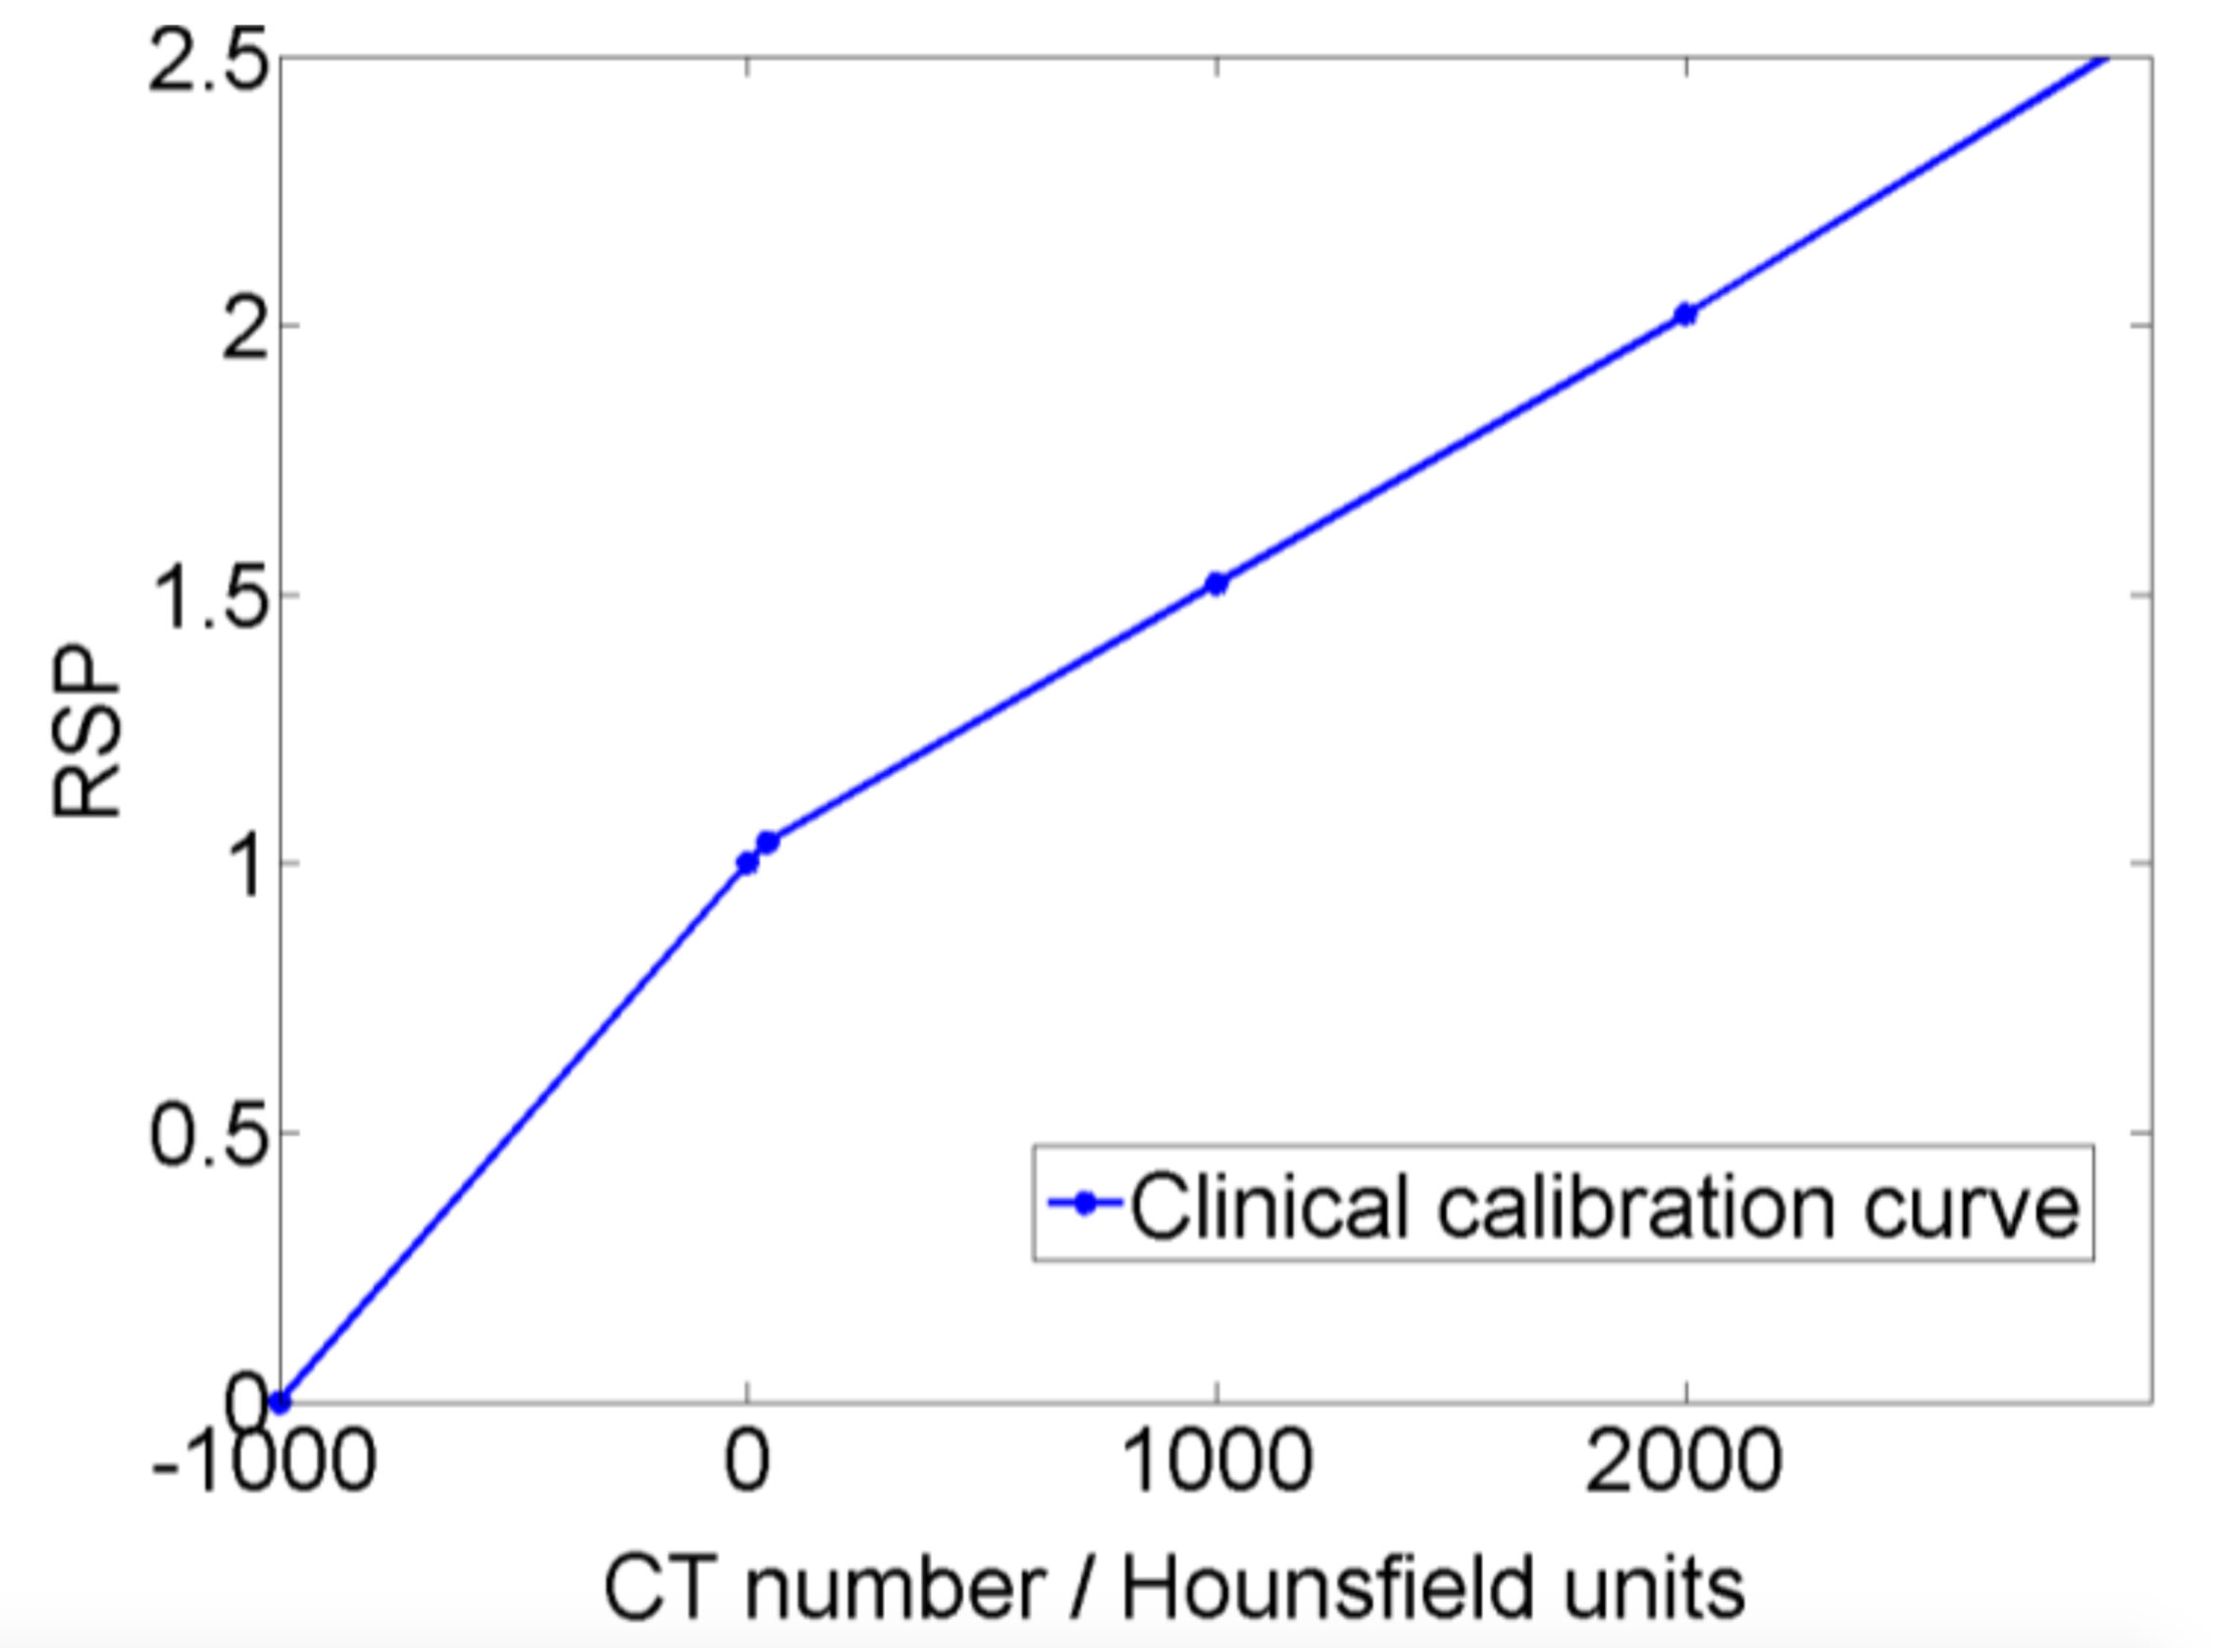
Issues with X-ray CT
RSP map currently obtained by converting from Hounsfield units using calibration curve
Increases range uncertainty
Treatment volume needs to be made larger to account for uncertainty

Slide 13
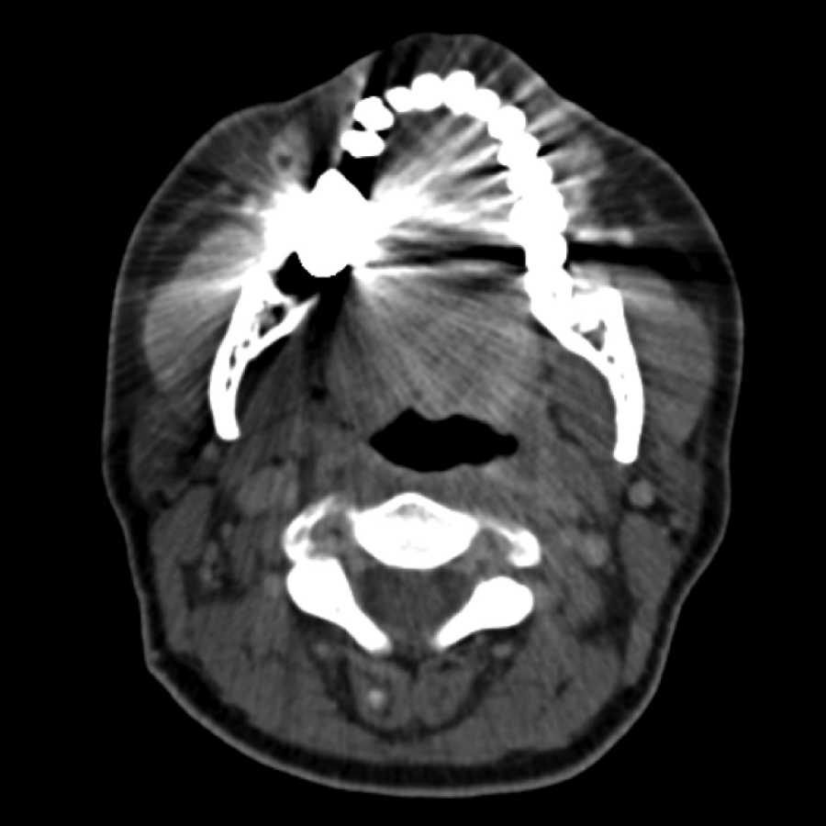
Issues with X-ray CT
RSP map currently obtained by converting from Hounsfield units using calibration curve
Increases range uncertainty
Treatment volume needs to be made larger to account for uncertainty
X-ray CT suffers from streaking artefacts between high-Z regions in material: gold teeth, hip replacements, etc.
Fix: use protons to probe RSP directly and get rid of artefacts for free

Slide 14
Proton CT
Amount of energy per unit path length transferred to an absorber is described by Bethe-Bloch equation (Schulte et al., 2005):
$$−\frac{dE}{dx}=4πr_{e}^{2}m_{e}c^{2}z^{2}N_{A}ρ\frac{Z}{A}\frac{1}{β^{2}}\left[\text{ln}\frac{2m_{e}c^{2}β^{2}γ^{2}}{I} −β^{2}\right]$$
Fundamental constants
Particle properties
Material properties

Slide 15
Proton CT
Amount of energy per unit path length transferred to an absorber is described by Bethe-Bloch equation (Schulte et al., 2005):
$$−\frac{dE}{dx}=4πr_{e}^{2}m_{e}c^{2}z^{2}N_{A}ρ\frac{Z}{A}\frac{1}{β^{2}}\left[\text{ln}\frac{2m_{e}c^{2}β^{2}γ^{2}}{I} −β^{2}\right]$$
Fundamental constants
Particle properties
Material properties
electron number density, $η_{mat}$

Slide 16
Proton CT
Dividing by the stopping power in water, $S(E,I)$:
$$−\frac{\frac{dE}{dx}}{S\left(E,I\right)}=\frac{η_{mat}}{η_{w}} \frac{\left[\text{ln}\frac{2m_{e}c^{2}β^{2}γ^{2}}{I_{mat}} −β^{2}\right]}{\left[\text{ln}\frac{2m_{e}c^{2}β^{2}γ^{2}}{I_{w}} −β^{2}\right]}=\text{RSP}$$

Slide 17
Proton CT
We can therefore express stopping power as
$$−\frac{dE}{dx}(r)=η(r) S(E(r),I_{w}(r))$$
Integrating gives
$$\int_{Γ_{i}}{η\left(r\right)}dl=\int_{E_{out}}^{E_{in}}{\frac{dE}{S(E(r),I_{w}(r))}}=\text{WEPL}$$
This looks a lot like the Radon transform, except that integral is over curves rather than straight lines
$η$: relative electron density
$S$: stopping power in water
$I_{w}$: mean ionisation potential of water
$Γ_{i}$: trajectory of $i^{\text{th}}$ proton

Slide 18
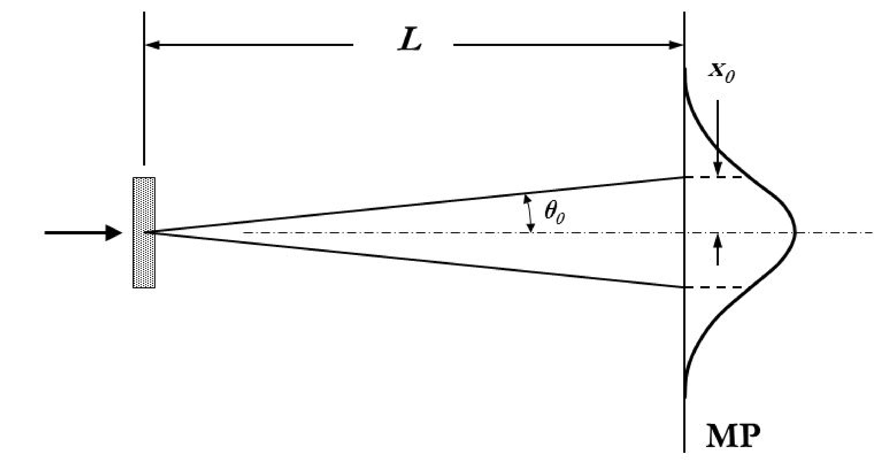
Challenges in Proton CT
Many nuclear small-angle scattering events when traversing matter: multiple Coulomb scattering (MCS)
Lateral and angular displacement are normally distributed via central limit theorem
Leads to blurring in the reconstructed image
Can reduce blurring by estimating most-likely path (MLP) but this requires knowledge of entry and exit positions and directions

Slide 19
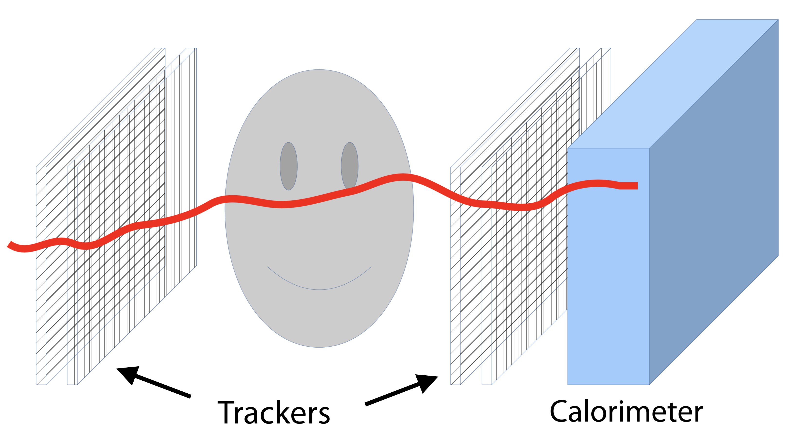
Typical Proton CT Setup
(Krah et al., 2018)
Single tracking has shown best (theoretical) performance
Two trackers on either side required to record entry and exit positions and directions to be used in calculation of MLP estimate
Calorimeter measures residual energy to determine WEPL traversed by the proton

Slide 20
Benchmarking
Most studies investigate algorithms in ideal conditions
Different algorithms have different properties
Convergence and computational speed
Severity of artefacts
Propagation of noise
Want to know how algorithms perform with different imaging parameters
Parameters include the number of protons used, the beam energy, energy spread, detector resolution
Reconstructions performed on simulated data
Notes:
Acquisition time

Slide 21
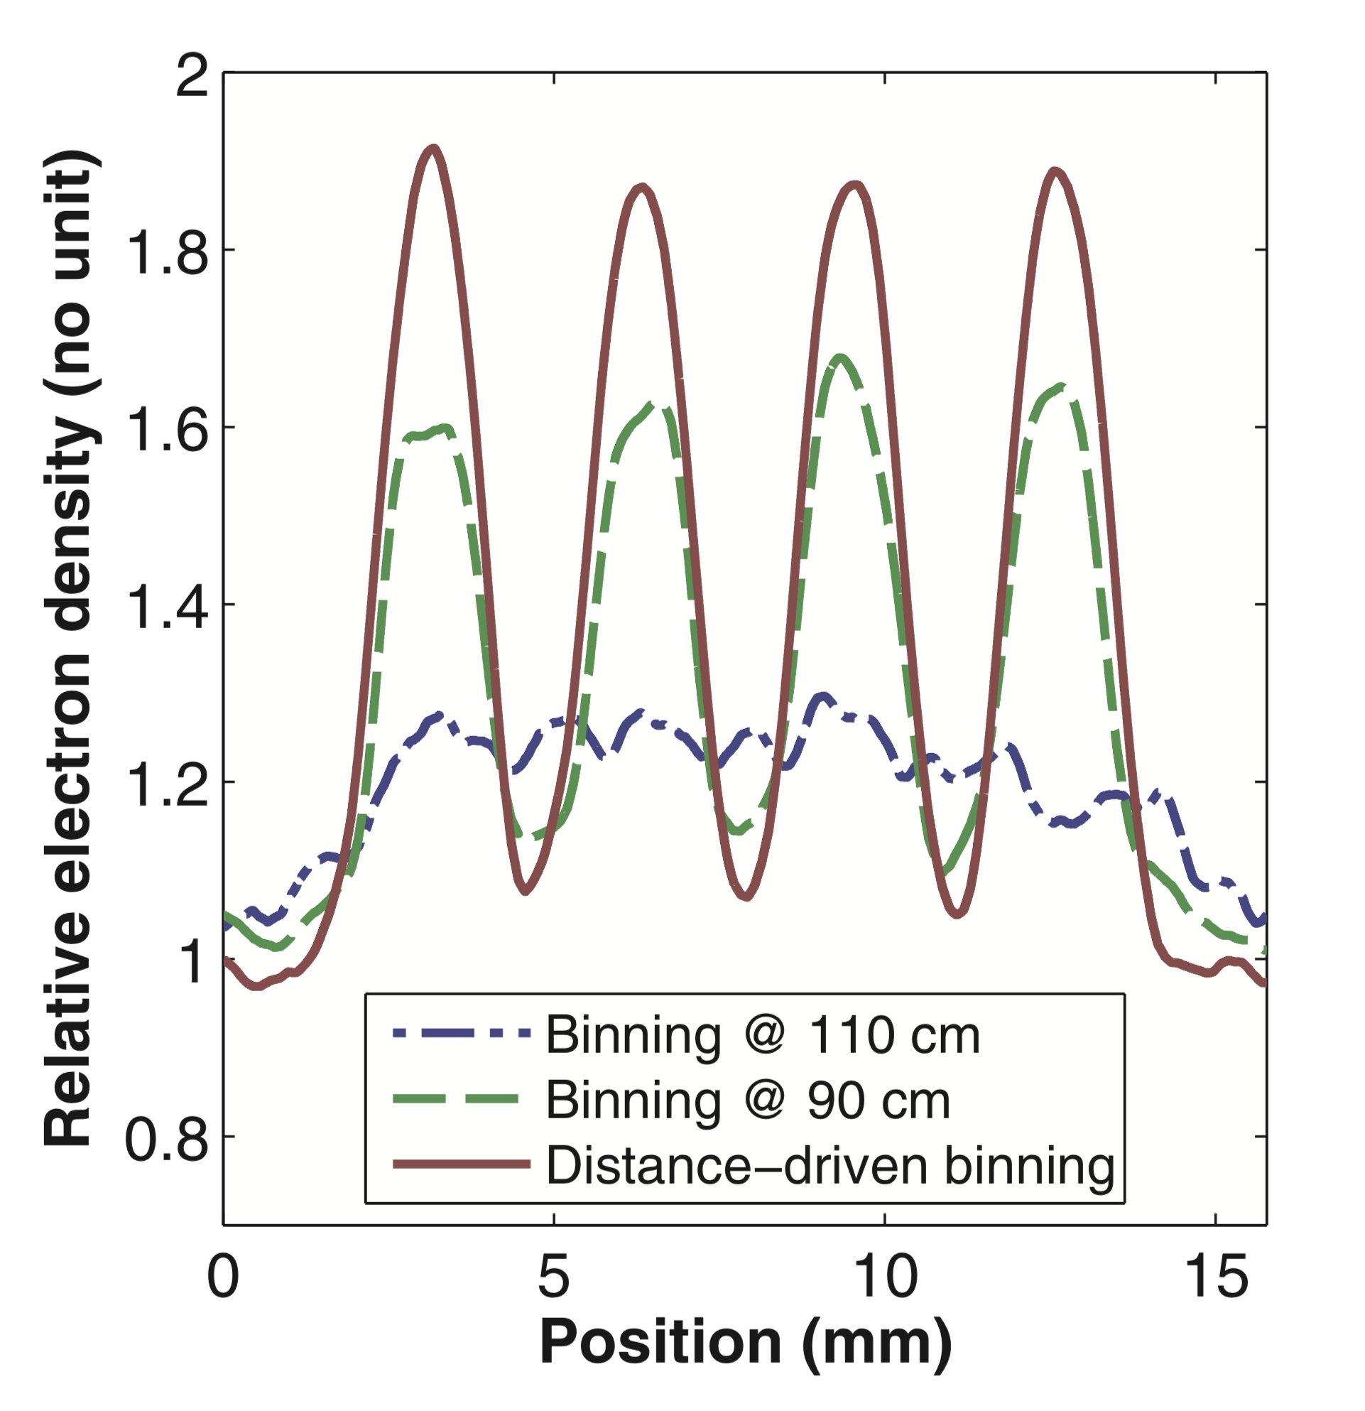
Metrics
Profile across line segment inserts
Edge response across line segment inserts
Modulation transfer function (MTF)
RSP accuracy
(Rit et al., 2013)

Slide 22
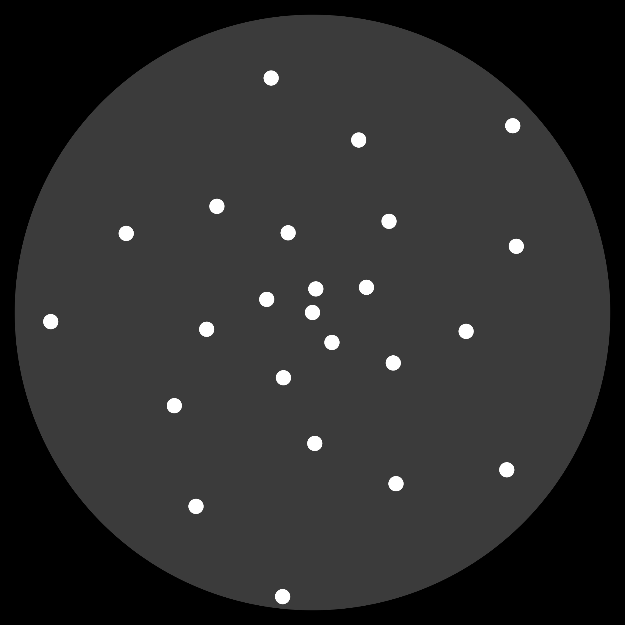
Phantoms
Different phantoms can be used to assess different image properties
Resolution can be measured using CTP528 module of the Catphan phantom
Use phantom with aluminium inserts in spiral pattern to assess radial dependence of resolution
Catphan CTP528 module
Spiral

Slide 23
Preliminary Simulations
Geant4 v10.4.2
Multithreading provides roughly 7x speedup
Fan beam of 200 MeV protons
288e6 protons in total
Phantom is rotated whilst protons are recorded on detector before and after
720 projections, one every 0.5°
Notes:
Acquisition time

Slide 24
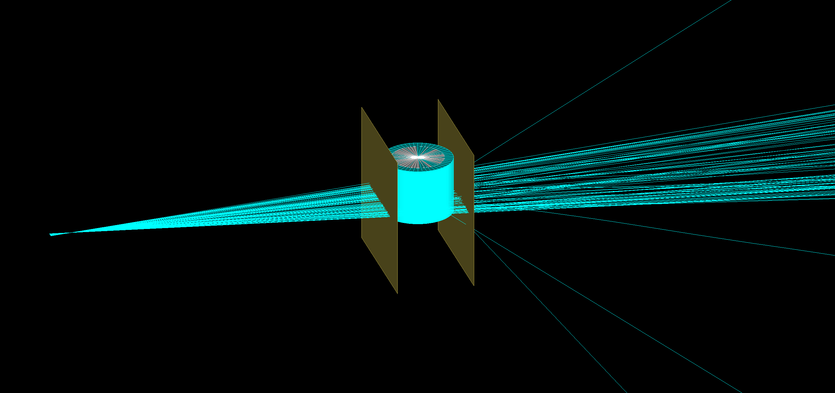
Preliminary Simulations
Geant4 v10.4.2
Multithreading provides roughly 7x speedup
Fan beam of 200 MeV protons
288e6 protons in total
Phantom is rotated whilst protons are recorded on detector before and after
720 projections, one every 0.5°
Notes:
Acquisition time

Slide 25
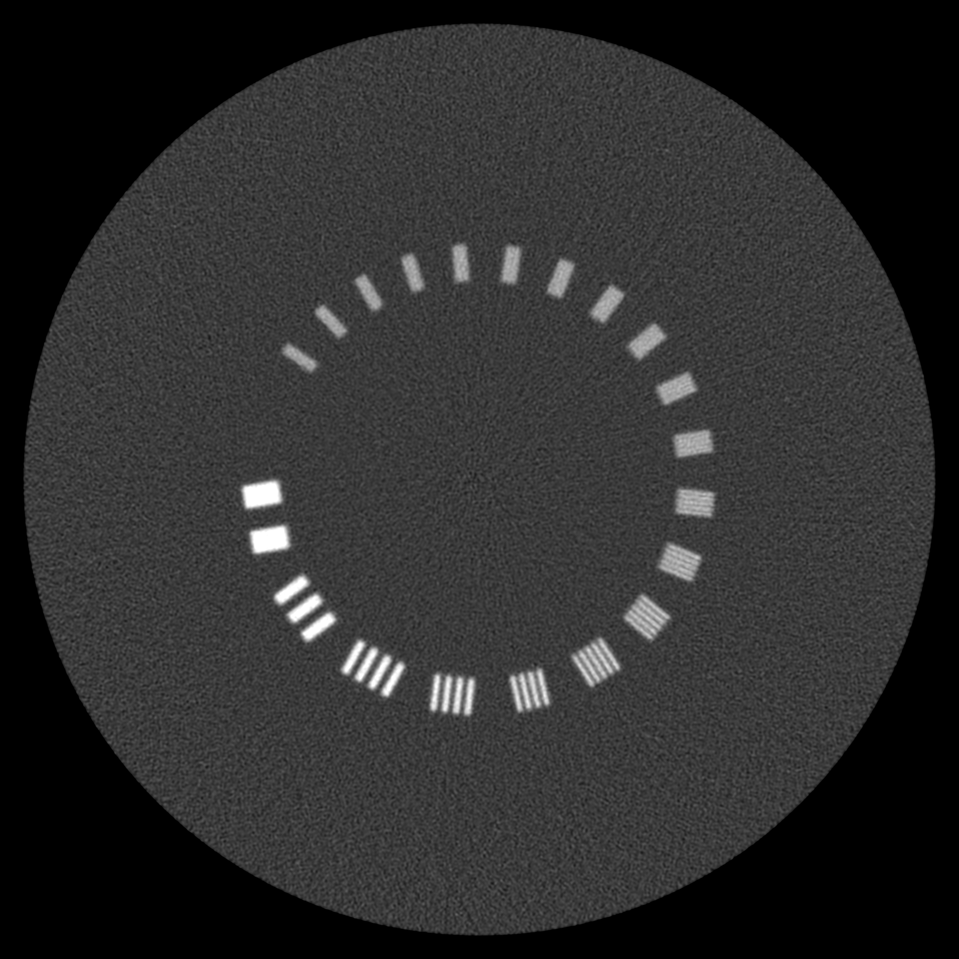
Preliminary Reconstructions
Spiral
Catphan CTP528
Used analytical algorithm (Rit et al., 2013)
This algorithm is popular due to its speed
Both reconstructions took less than 25 seconds to compute
Preprocessing takes about 6 minutes on cluster with 20 nodes
Notes:
Acquisition time

Slide 26
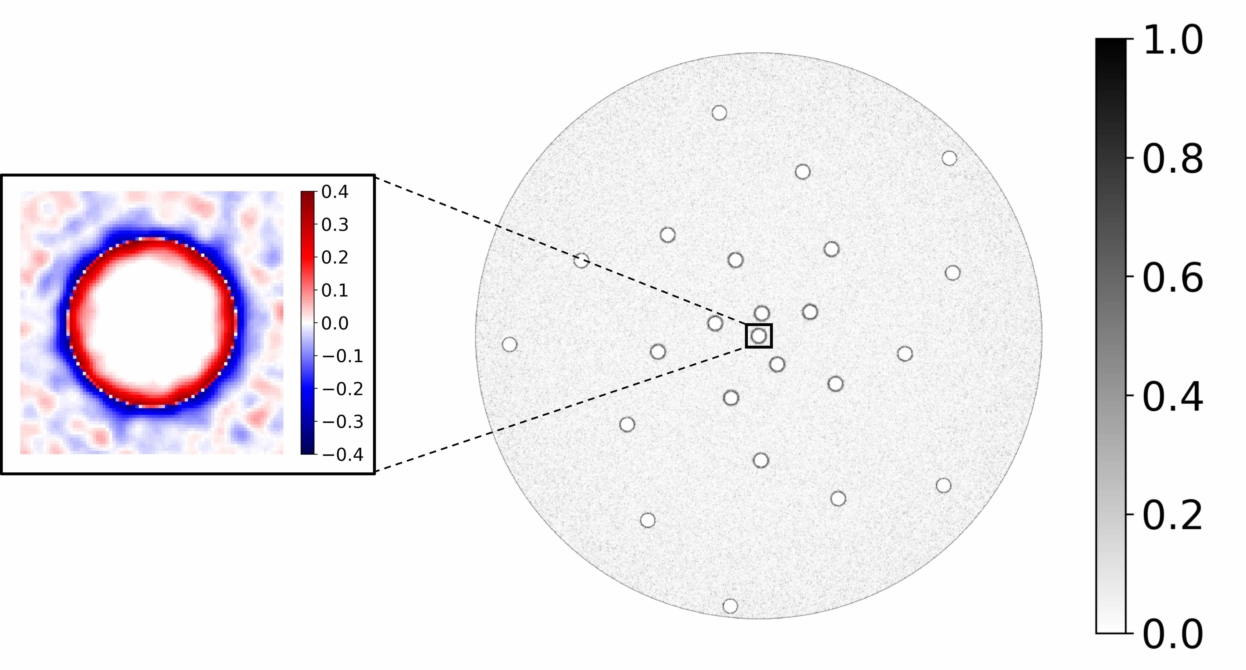
Preliminary Reconstructions
Compared spiral reconstruction to the “perfect” phantom
RSP of aluminium inserts is about 2.13
Absolute difference between reconstruction and phantom is shown
Notes:
Acquisition time

Slide 27
Future Work
Simulate detector effects
Get access to and learn how to use other reconstruction algorithms
Compare algorithms
Notes:
Acquisition time

Slide 28
Questions?
Notes:
Acquisition time

