Slide 1
Quality Assurance in Proton Therapy
Laurent Kelleter
Department of Physics and Astronomy
University College London
Notes:
Hello, my name is Laurent Kelleter. I am a PhD student at University College London. Our group works in detector development for Medical Physics, especially for proton therapy. Proton therapy is a form of radiotherapy used to treat cancer. My work focuses on a detector for quality assurance that I would like to introduce to you. This work is funded by the European Marie Curie Training network OMA- optimisation of medical accelerators. So lets start with a quick motivation.

Slide 2
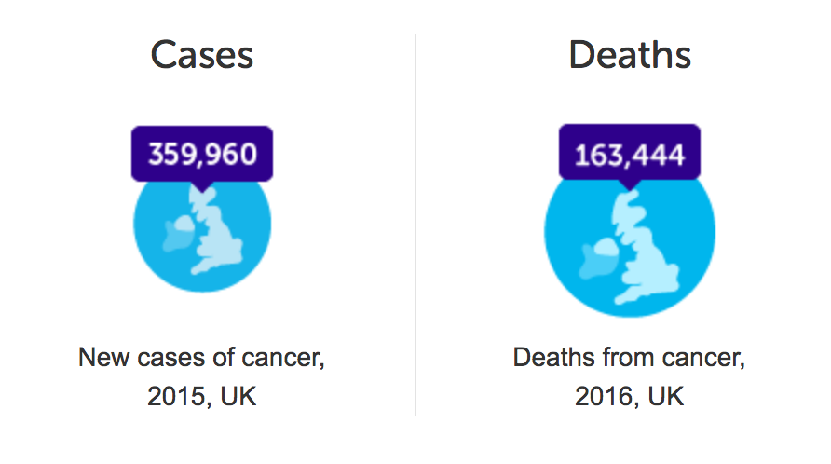
Cancer in the UK
97,000
Credit: Cancer Research UK.
Notes:
In the UK alone we see on the order of 360,000 new cases of cancer every year. About half as many die as a consequence of cancer.
There are many treatment forms patients can undergo as an attempt to cure. From those that get diagnosed with cancer about a quarter or 100,000 people receive conventional radiation therapy.

Slide 3
Proton Therapy - Physics
tumour
Notes:
Conventional radiotherapy makes use of focused X-ray beams in order to kill a tumour. The depth-dose curve of x-rays can be seen here: There is a peak at shallow depths and a consecutive exponential decrease. That is far from ideal when treating a tumour that is situated deeper in the body. Protons however have a much more advantageous depth-dose profile with a peak near the stopping point of the protons. Protons therefore allow to bring the required dose to the tumour in a much more targeted way than x-rays.

Slide 4
Proton Therapy - Example
X-rays
Protons
https://www.mayoclinic.org/
Notes:
This is how a treatment plan would look in real life: the tumour is here at the centre of the brain. We can see that there is a low dose bath around the tumour that could lead to significant side effects of the treatment.
With protons however we can see that the dose to the healthy tissue can be much reduced. This is especially beneficial to patients that have a long life expectancy after the treatment, such as children.

Slide 5
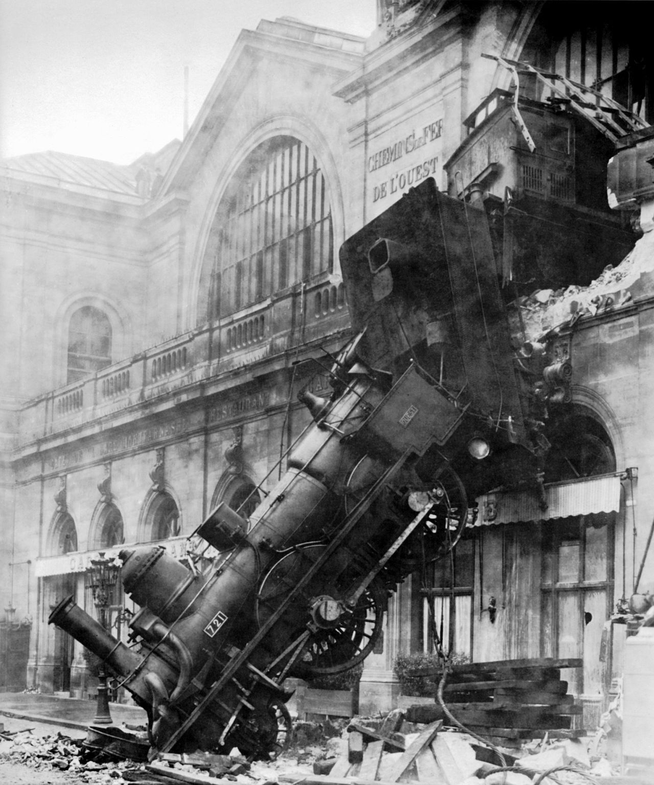
Range Quality Assurance (QA)
Need to know stopping point of protons!
Problem: How far is x MeV in a patient?
Solution: Measure proton range in water at defined position (isocentre)
Requirements for QA detector:
Measure range in water
Precise
Quick
Cheap
Notes:
Since proton have this steep dose gradient at the end of their path, not knowing the precise stopping point of the protons can have devastating effects. Range quality wants to answer the question how far a proton of x MeV travels in water. As a standard procedure, the range of the proton beam is measured in water at a defined position in the room, the isocentre.
A detector for range QA needs to be precise, quick and cheap

Slide 6
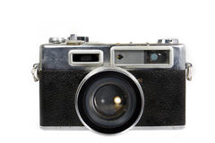
Principle of a range telescope
Plastic scintillator:
Price
Light output
Water-equivalence
Radiation hardness
Quenching
proton
beam
Notes:
We use plastic scintillator because of its low price, high light output and water equivalence which makes it easier to measure proton range in water.
Disadvantages of plastic scintillator are the potential radiation damage and quenching. The latter means that the light production is not linearly proportional to the energy loss. So we need to investigate these effects and come up with solutions.
The principle of our range telescope is the following: A proton beam enters from the side and deposits its energy. We then take a snapshot of the scintillation light and reconstruct the range. The image will be a bit blurred because of refraction effects. Therefore we use a stack of scintillator sheets instead of a single block so we can be sure where the emitted light originates from.

Slide 7
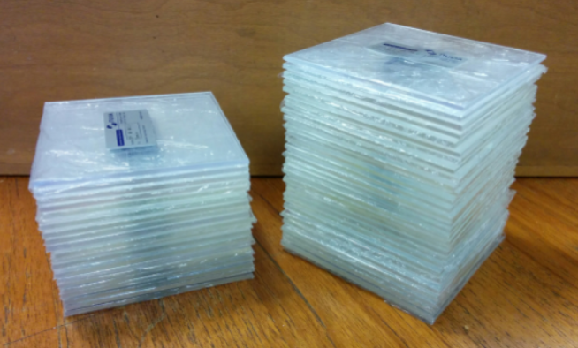
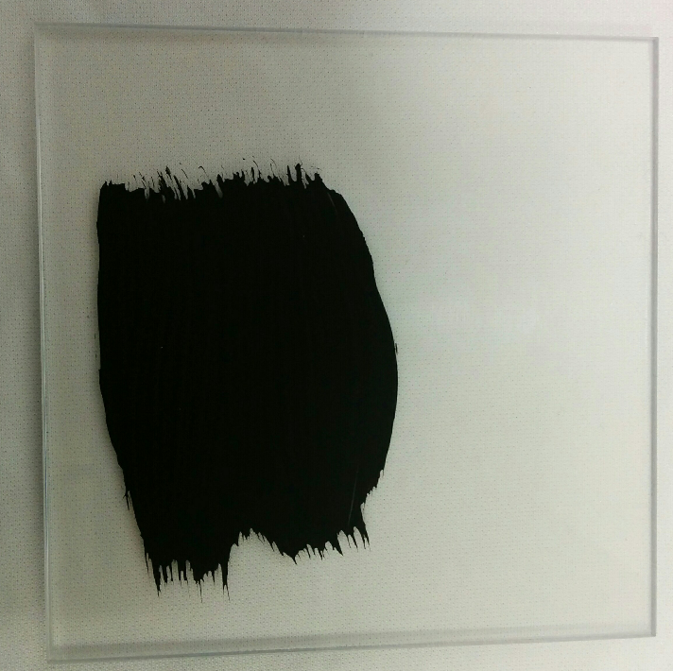
Scintillator Sheets
10 cm x 10 cm x 2-3mm
Notes:
We use 2-3 mm thick scintillator sheets. They have a area of 10 by 10 cm in order to absorb the full beam and even allow some space for scanning in the xy plane. We then painted them black in order optically isolate them from each other. We left the sides unpainted where we want to do the readout of the light output.

Slide 8
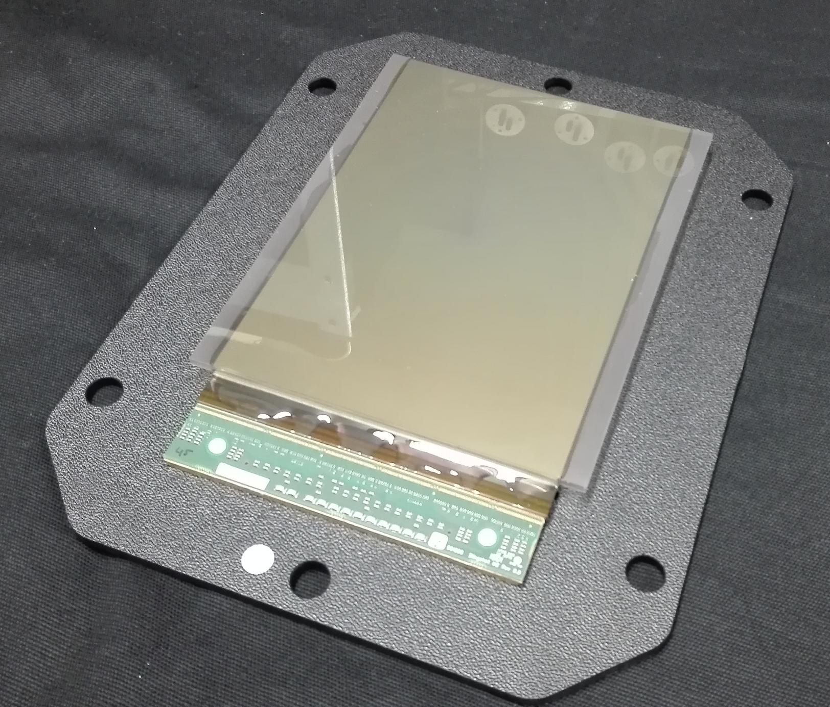
Readout: CMOS Pixel Sensor
15cm
10cm
Notes:
Our initial idea for a readout was to use photodiodes. One photodiode per sheet. Since this requires major hardware developing capacities, we decided to go for an easier option and use a 15 by 10 cm large pixel sensor. It would also be possible to use a DSLR camera. However, these cameras introduce lensing effects which is why we decided to go for the pixel sensor.

Slide 9
97.4 MeV Proton Beam
Beam
10 mm
Notes:
This is what you then get for a 100MeV proton beam entering from the left side. You can see the Bragg peak on the right end. The flickering comes from the fluctuating beam current.

Slide 10
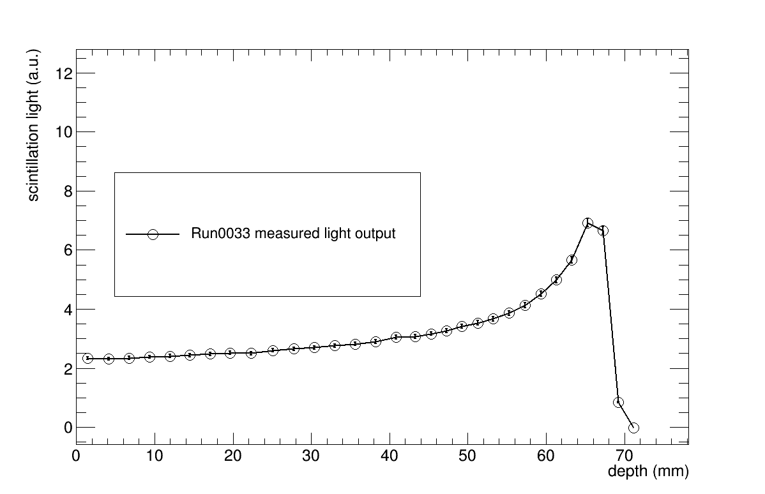
Range reconstruction
Notes:
This is the integrated light output of each individual sheet after background subtraction and calibration.

Slide 11
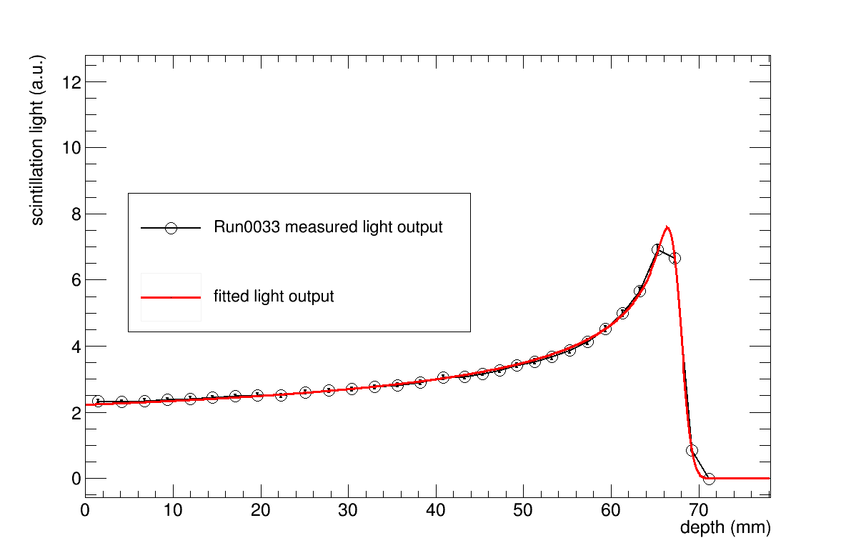
Range reconstruction
Notes:
We can fit the quenched Bragg curve to the data. Marvelous!

Slide 12
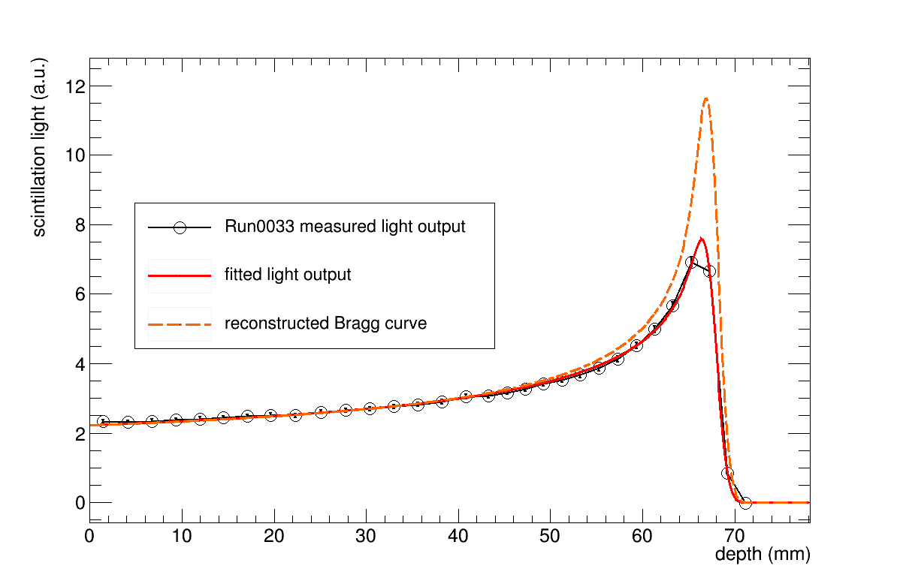
Range reconstruction
Notes:
And reconstruct the pristine Bragg curve by putting the fitted parameters from the quenched Bragg curve in the analytical formula of a pristine Bragg curve.
But we did not just one single energy or range measurement. We measured a couple of beam energies.

Slide 13
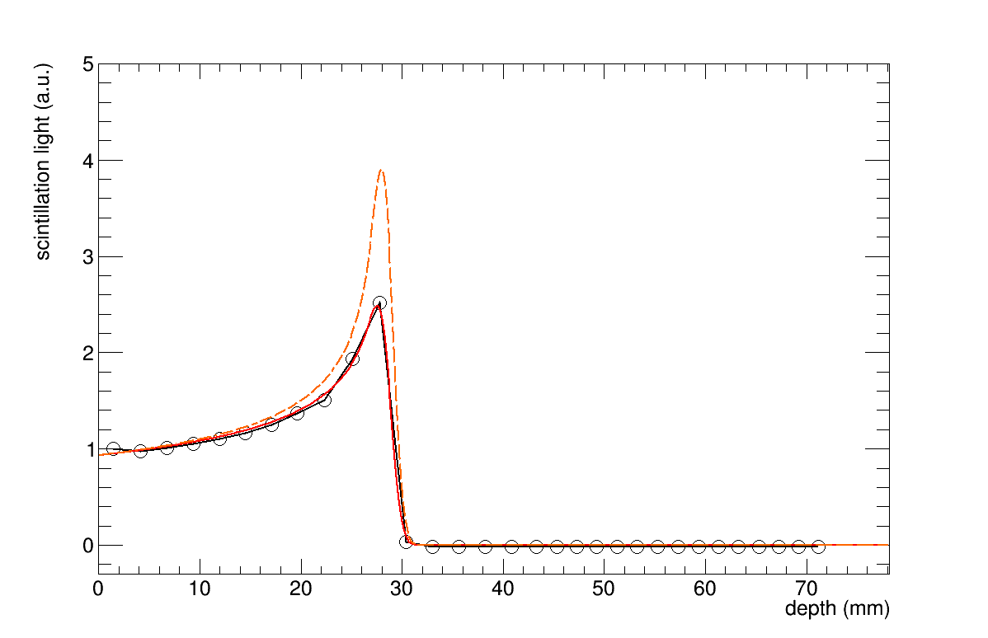
Range Scan
Notes:
And this is it. I was quite happy when it turned out to work that well.

Slide 14
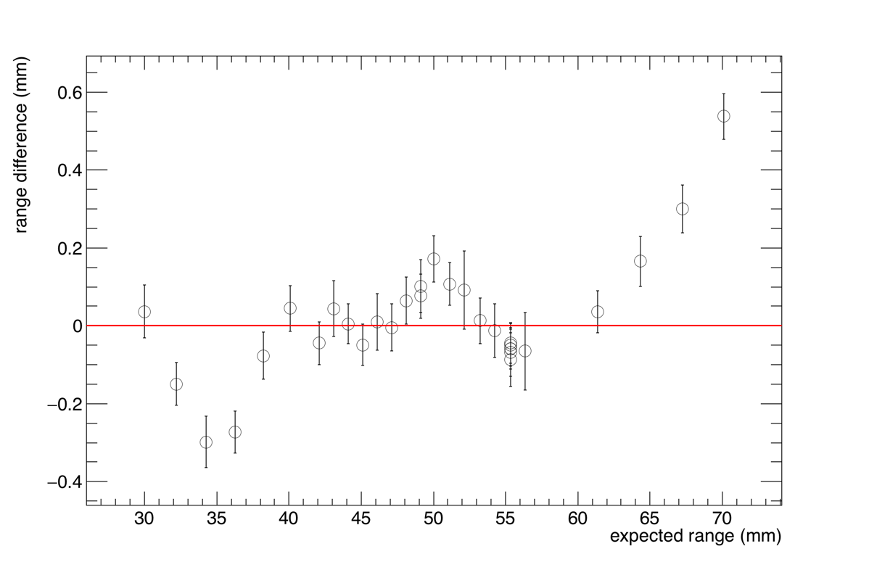
Comparison With Water Phantom
Notes:
Here you can see the range difference between our reconstructed range and the range measured with a regular water phantom. The maximum range difference is 600um and the mean range difference is 100um. We see something that could be systematics which is still under investigation.

Slide 15
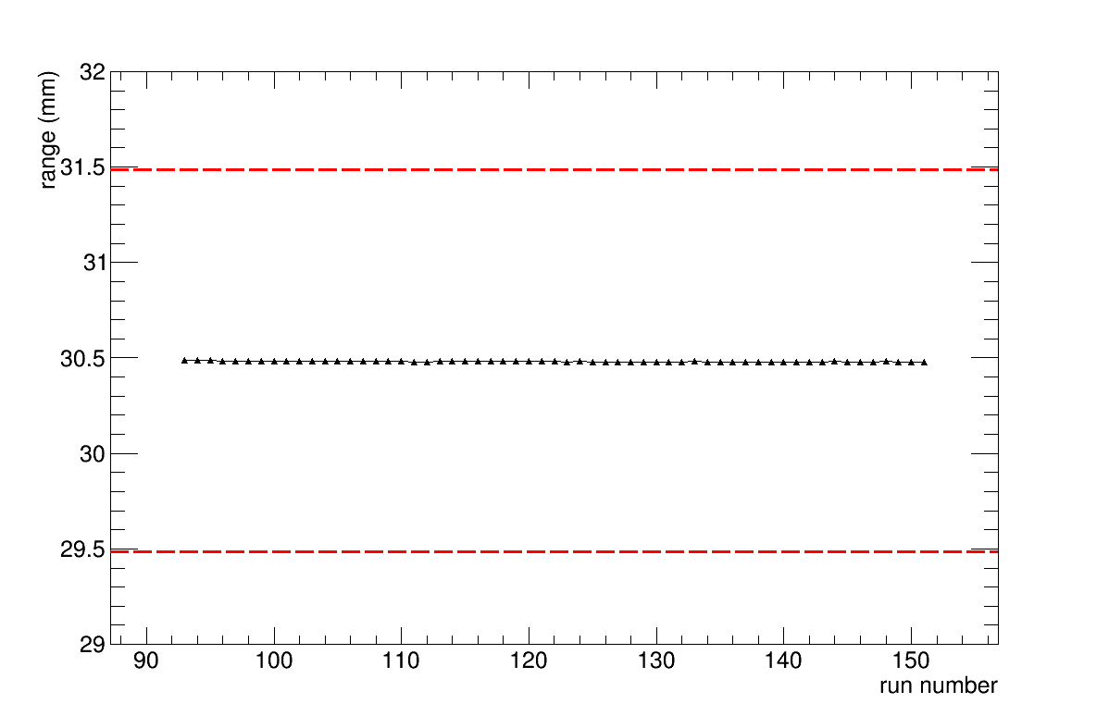
Radiation Damage
0 Gray
6000 Gray
Notes:
We also did some radiation damage tests during another beam test in Clatterbridge. We delivered 6,000Gy peak dose to the scintillator, worth about 1 year of daily QA. We can see a light output reduction of about 3% at the peak. This has a neglegible effect on the range reconstruction and can easily be accounted for by adapting the quenched Bragg model.

Slide 16
Summary
Developed a prototype for fast proton range QA
Found solutions for
Refraction
Quenching
Radiation damage
Bonus: Also tested helium and carbon beams
Outlook:
Build read-out based on photo diodes
Commercialisation
Notes:
We developed and tested a prototype for fast proton range QA
We found solutions for the refraction effects, the quenching and measured the radiation damage.
As a bonus, we also tested our detector in helium and carbon beams which unfortunately I did no have enough time to show.
We would like to rebuild our readout with photodiodes and push forward the commercialisation of the device.

Slide 17
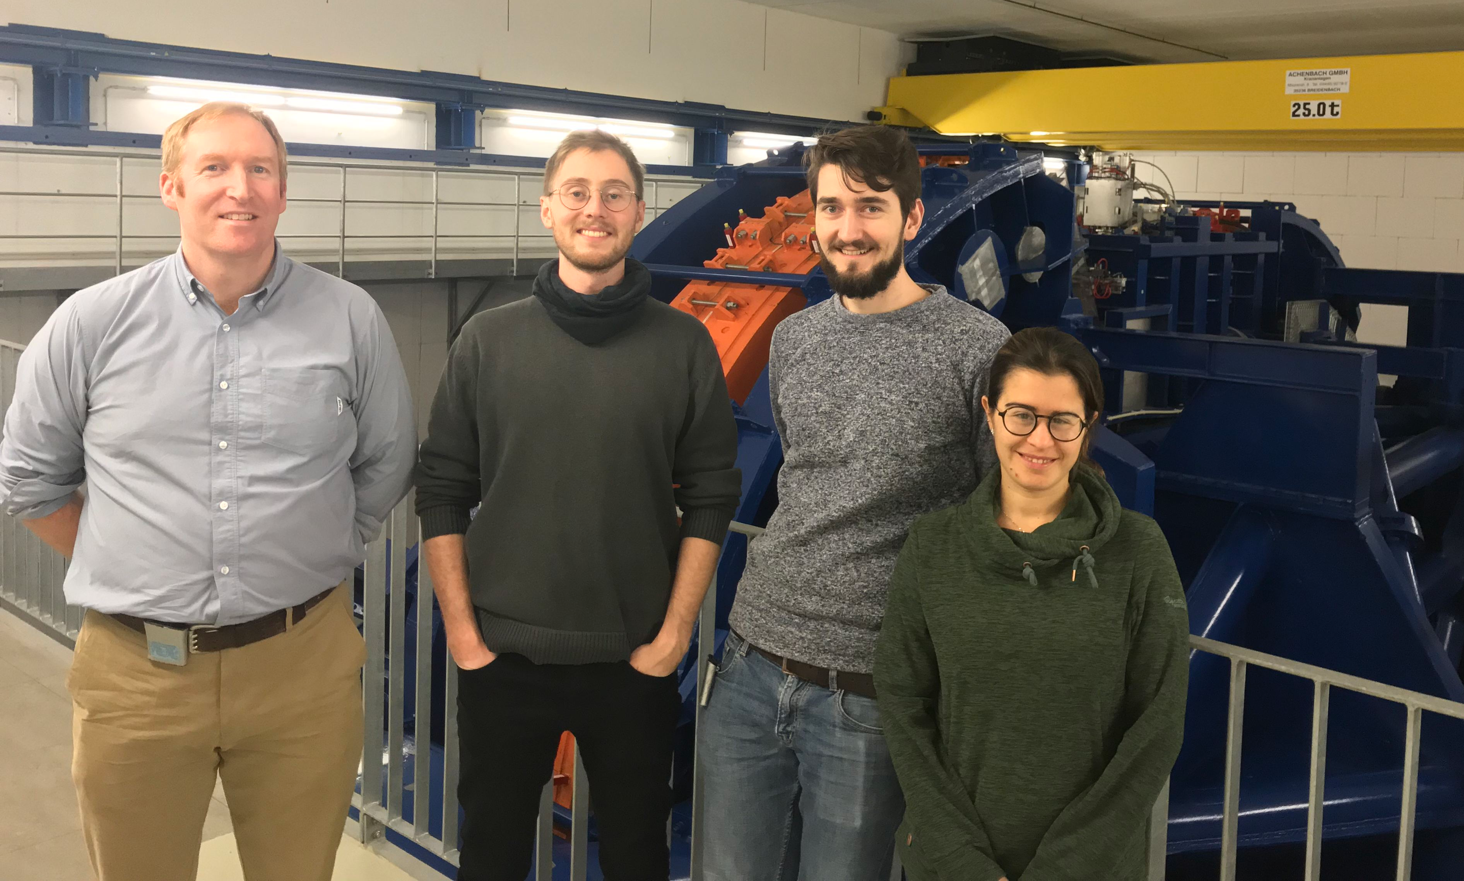
Thank you for your attention
This project has received funding from the European Union’s Horizon 2020 research and innovation programme under the Marie Sklodowska-Curie grant agreement No 675265, OMA – Optimization of Medical Accelerators.
We would like to thank Clatterbridge Cancer Centre, MedAustron and HIT for the opportunity to use their radiotherapy centres. We would also like to thank MedAustron for the offer of the proton range data.
Notes:
In the name of the group, thank you very much for your attention.

Slide 18
Backup

Slide 19
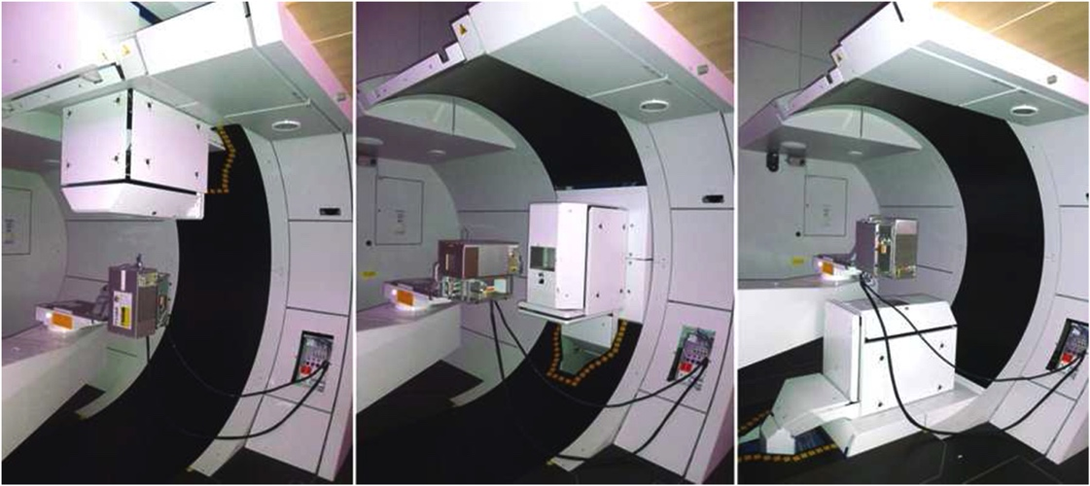
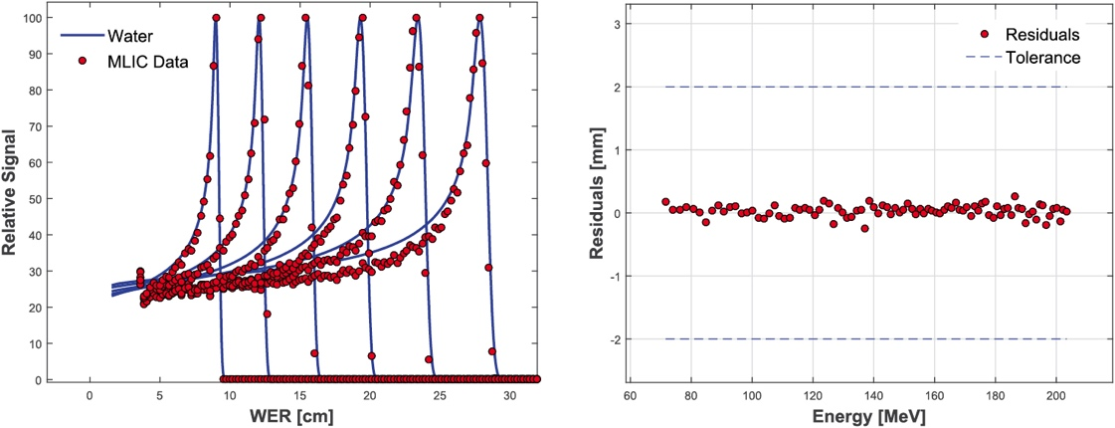
Range Quality Assurance in Particle Therapy
O. Actis et al. 2017 Phys. Med Biol. 62 1661
Notes:
The reason why we are doing this, or the problem we want to tackle is range quality assurance in proton therapy
Carried out daily in every PTC
Example from PSI, really nice integrated custom system, measure all energy steps and check whether they’re within tolerance.
But these detectors are expensive or slow, possibly fragile and take a lot of know=how if you wanna build one

Slide 20
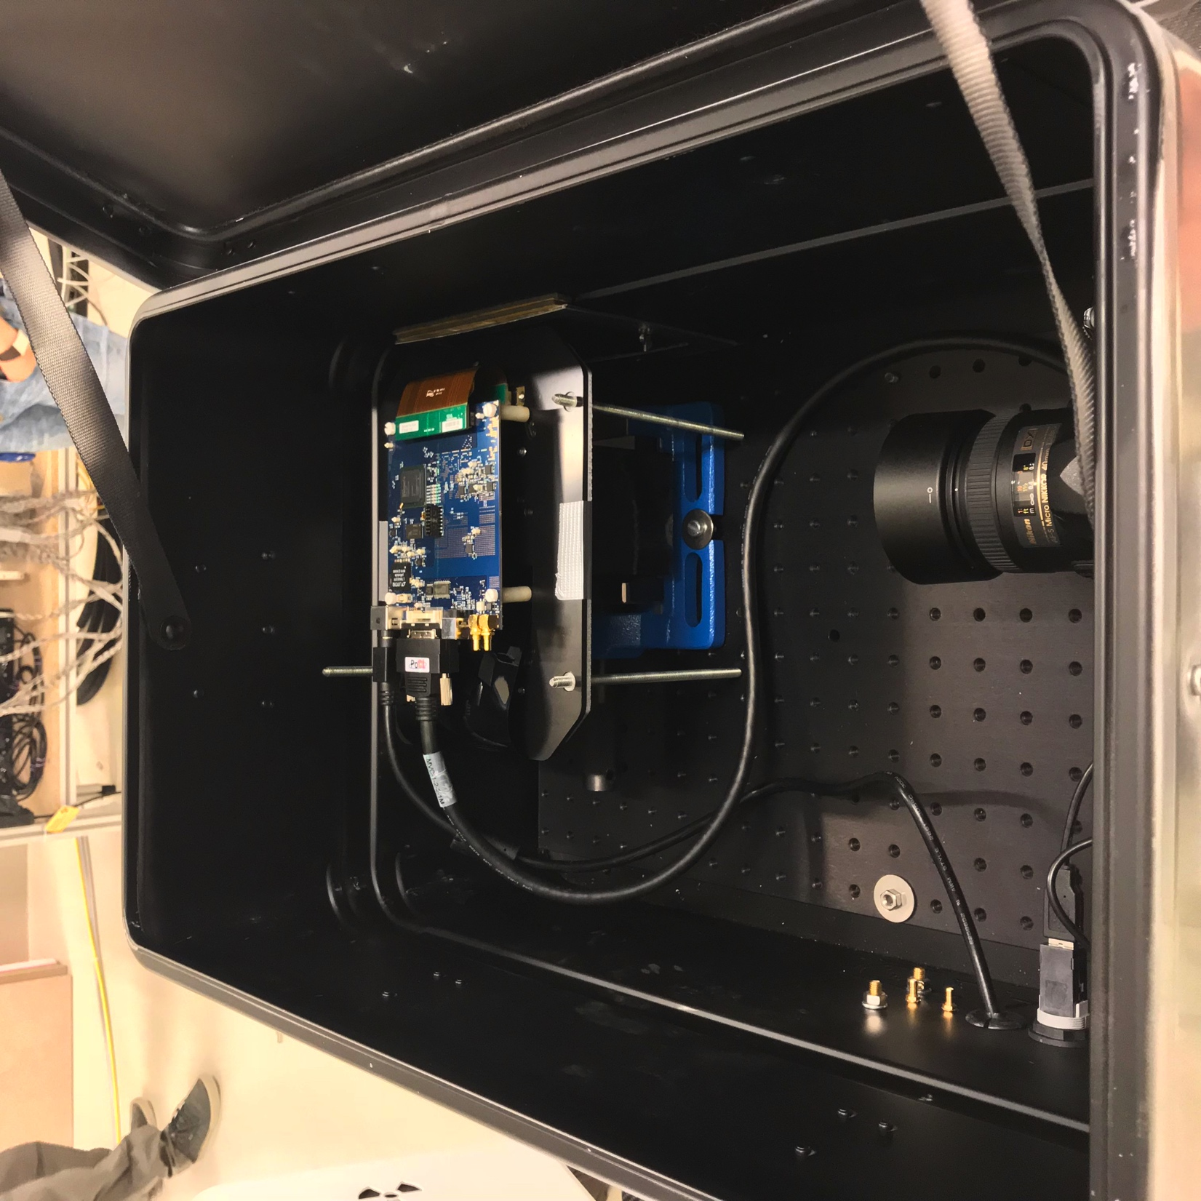
MedAustron Beam Test
Beam
Notes:
You can see the sensor here on top of the scintillator stack. The stack is fixed in a vice and sits on an optical breadboard. As you can see, we also used a DSLR camera as a backup. However, the nicer images are produced by the pixel sensor.

Slide 21
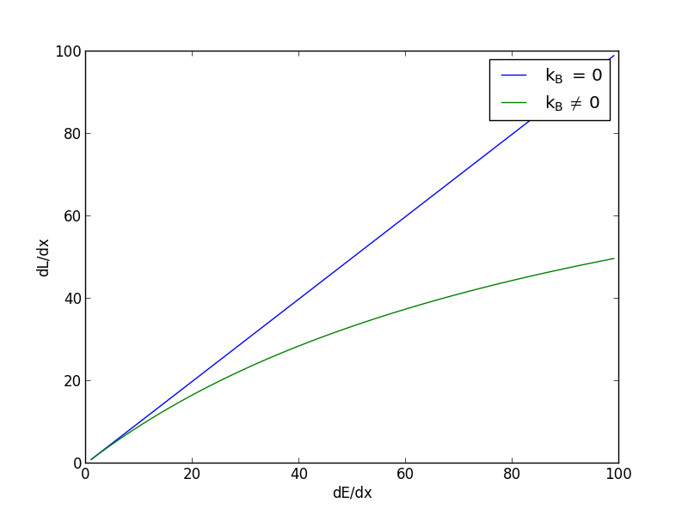
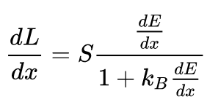
Quenching: Birk’s Law
Notes:
If the ionization density gets very high, the light output stops being linear to the energy deposition. The strength of the ionization dependence of the quenching is described by Birk’s constant.
Since protons have a comparatively large dEdx, the Bragg curve in a plastic scintillator appears mashed-up. The ionization density depends on the energy and nature of the particle and also on the beam current in case of high beam intensities. So we really need to be careful when we try to take into account quenching.

Slide 22
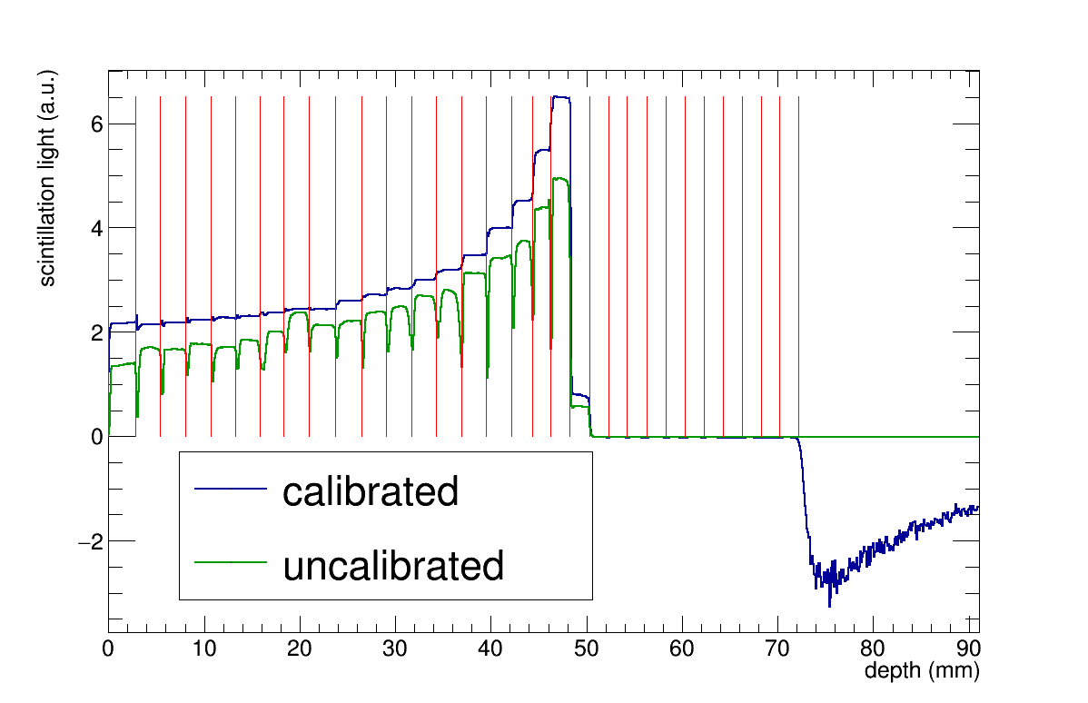
Calibration

Slide 23
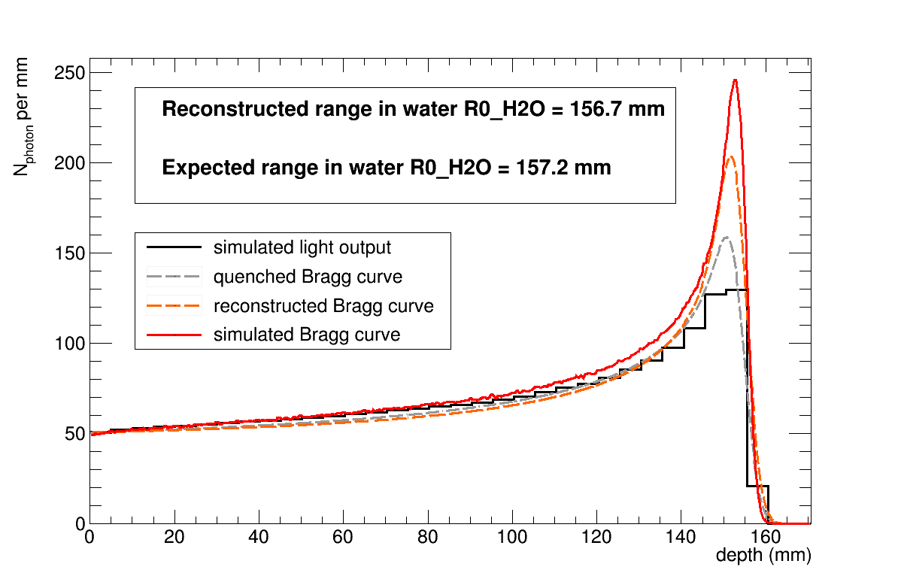
Proton Range Reconstruction
Geant4 simulation
Notes:
It is also possible to convert the range in the scintillator to range in water using simulated R(E) curves. When I compare it to the expected range in water I see that the values deviate by about 3 permille, which gives us the combined model and range reconstruction uncertainty.
So far so good, I did extensive simulations and developed a model for the range reconstruction. Now we can get on with building a prototype.

Slide 24
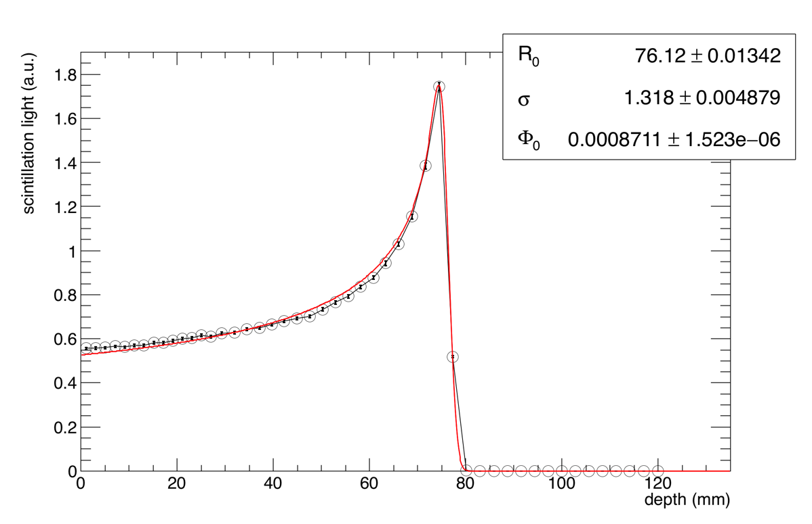
Proton Beam

Slide 25
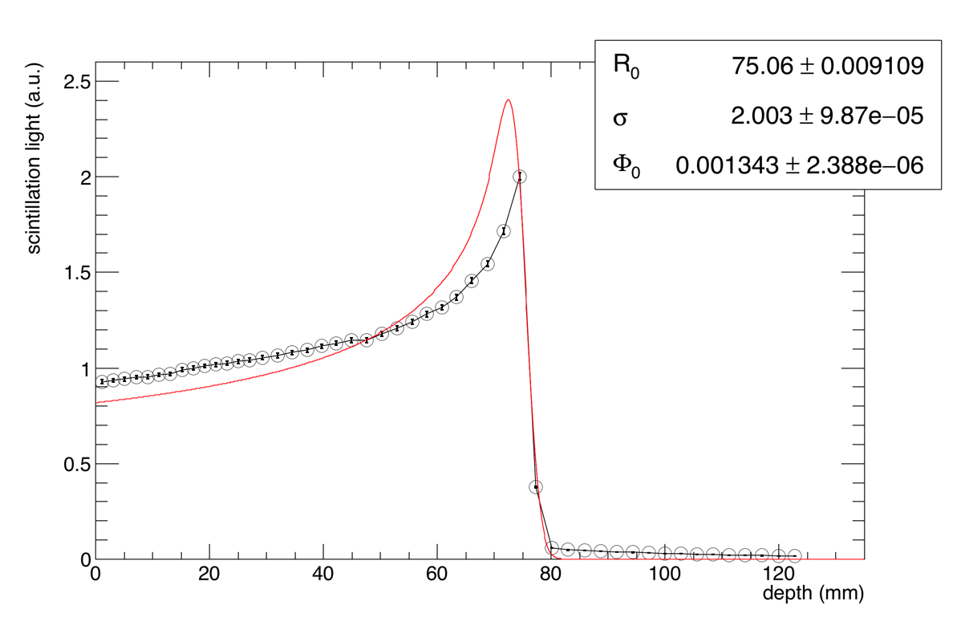
Helium Beam

Slide 26
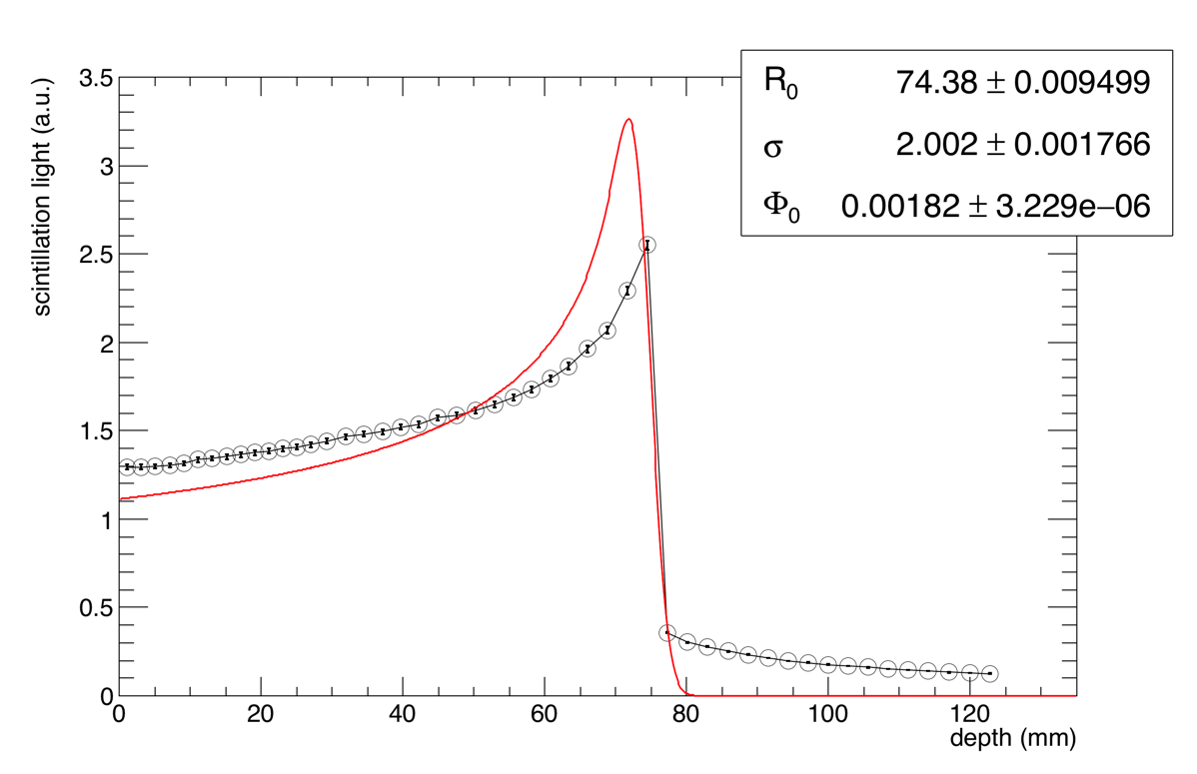
Carbon Beam

Slide 27
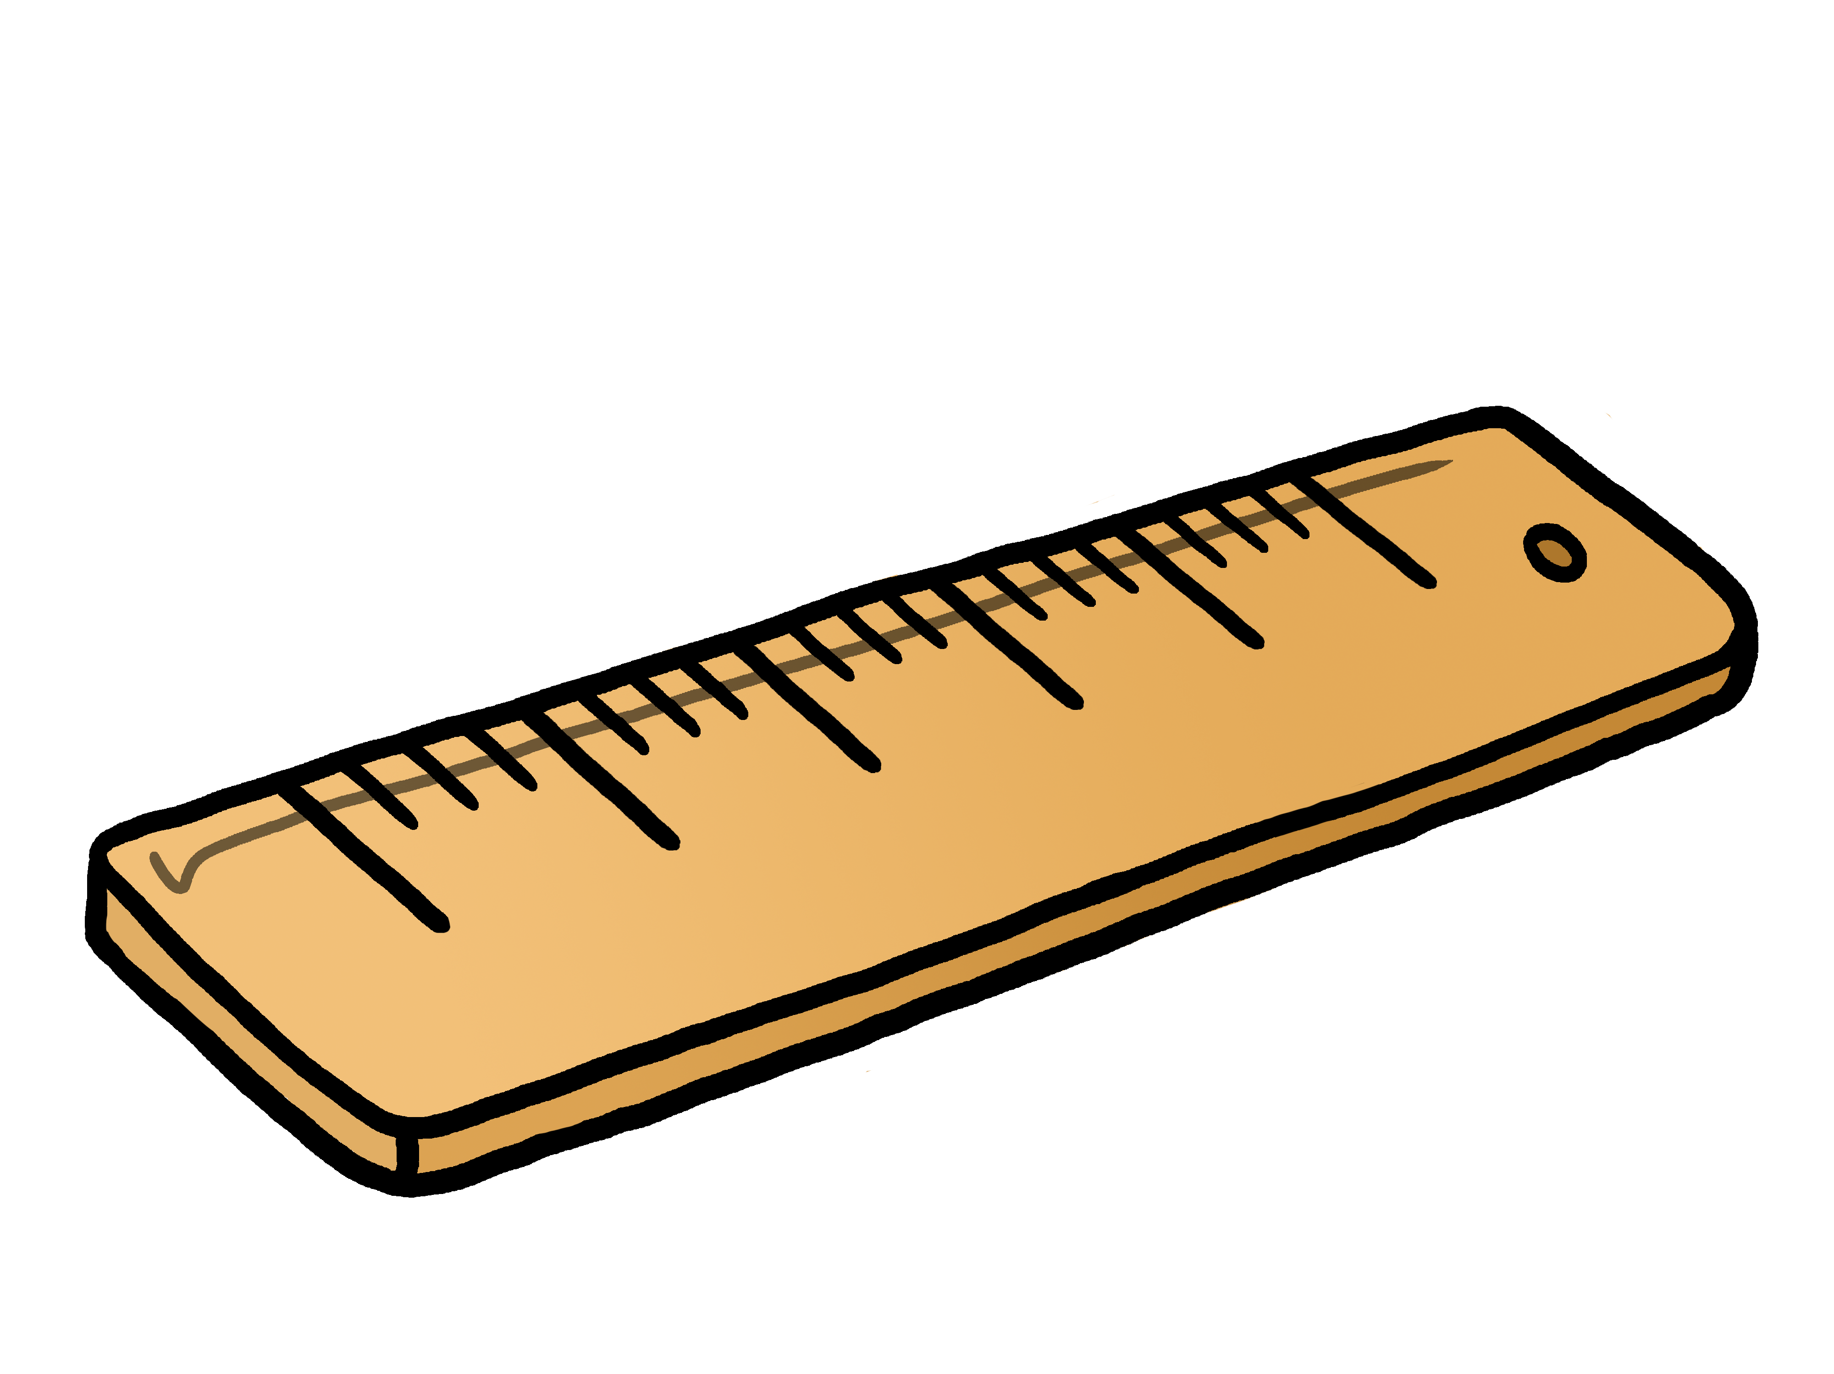
Proton Therapy Centre - Layout
Beam transfer line
Cyclotron
Gantry
Treatment Rooms
Images courtesy of Varian/UCLH

