Slide 1
Mixed Ion Beam Radiotherapy
Laurent Kelleter¹, L. Volz², C. Graeff³, N. Niebuhr², R. Radogna¹, S. Jolly¹ and J. Seco²
¹Department of Physics and Astronomy,
University College London (UCL)
²German Cancer Research Center (DKFZ), Heidelberg
³Gesellschaft fuer Schwerionenforschung (GSI), Darmstadt

Slide 2
Outline
Carbon therapy
Online treatment monitoring
He/C beam mixing
Range telescope
Measurements at HIT
Discussion: He/C in clinics
Notes:
First I am going to quickly talk about carbon therapy and present die idea of He/C beam mixing. I will then introduce a novel range telescope detector that we developed at UCL. Then I will present some measurements we did of a mixed He/C beam using the new range telescope. I will then conclude with a discussion on if and how one would use a mxed He/C beam in a particle therapy centre.

Slide 3
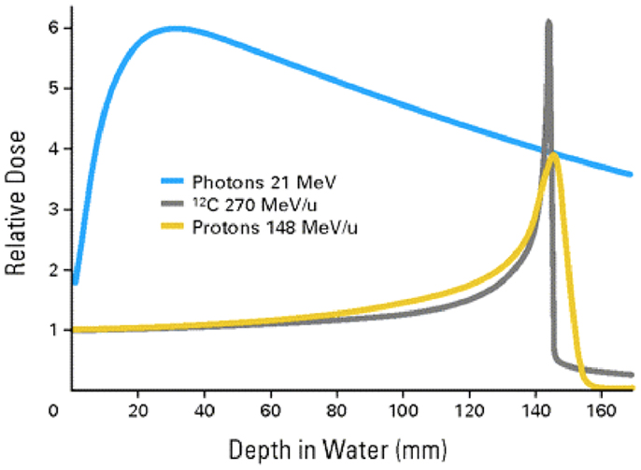
Carbon beam therapy
More conformal dose distributions
High RBE
Low OER
DOI: 10.3389/fonc.2015.00269
Notes:
Carbon ions exhibit a Bragg peak, similar to protons. However there are a few differences: carbon ions have a much higher stopping power due to their charge and therefore have a much sharper peak compared to protons. Due to the high dEdx, carbon has also a very high RBE. This leads to a high oxygen enhancement ratio which means that one can treat hypoxic tumours with carbon that are immune to protons. Since carbon ions are composed of protons and neutrons, some will break apart along their way through the patient into their fragments which then form the tail after the Bragg peak.
Therefore, we have the same issues with range uncertainties in carbon therapy as in proton therapy, but worse due to the sharper peak.

Slide 4
Patient/tumour motion
Inter-fractional movements, e.g.
  Patient misalignment
  Tumour shrinking
  Cavity filling
Intra-fractional motion, e.g.
  Breathing
  Bowel movements
  Rectal gassing
Notes:
A major source for range uncertainties is when the tumour is not where you expect it. We divide tumour motion in two main classes, inter- and intrafractional motion. Inter fractional motion means the patient remains stable during the irradiation, but the tumour might be somewhere else than planned. Examples are (…)
Intra-fractional motion is much harder to come by because it means that the tumour moves during the treatment. Examples are (…)
There is currently no one single method to cope with these movements. The most promising technology at the moment is probably prompt gamma imaging. We would like to add another method which is called helium/carbon mixing

Slide 5
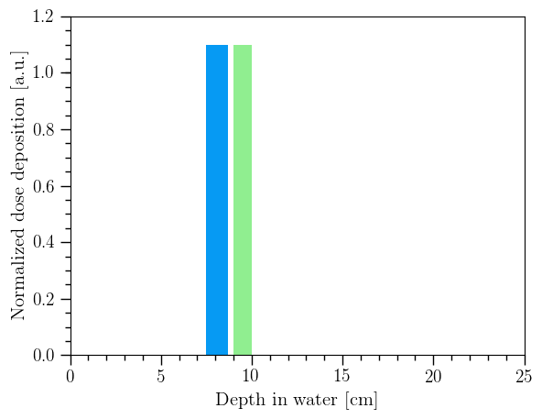
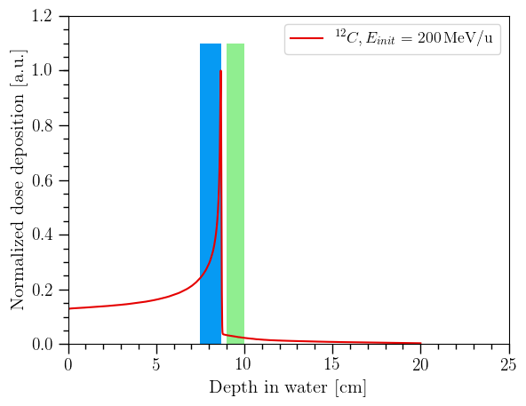
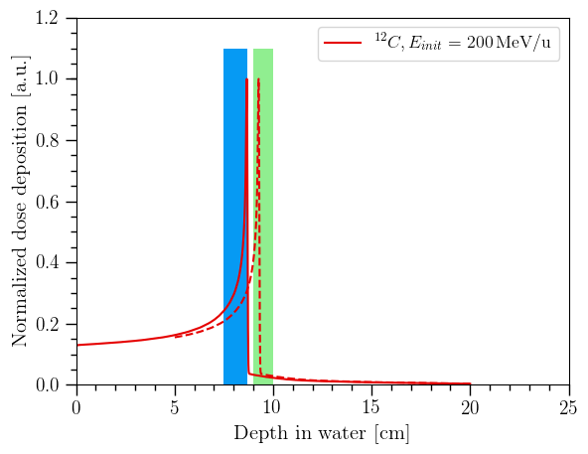


Intra-fractional motion
Patient
Target
Tumour
Organ at Risk
Nozzle
Organ at risk
Needed: Online treatment monitoring

Slide 6


Online treatment monitoring
Prompt gamma
In-beam PET
Nuclear fragments
Iono-acoustic
prompt γ
beam
Nuclear
fragments
β⁺
acoustic

Slide 7
Helium/Carbon mixing
Similar magnetic rigidity: Accelerate together
R₀(He) = 3 x R₀(C): simultaneous treatment and imaging
A/Q = 2
A/Q = 2
p
n
p
n
p
n
p
n
n
p
n
p
n
p
p
He
n
C
C
He
1
3
Notes:
At the same energy per nucleon, helium ions have about three times the range of carbon ions. The mass over charge ratio for fully stripped helium and carbon ions is the same which means that they could potentially be accelerated together. A mixed He/C beam would look like this in a treatment planning system: explain graphic

Slide 8
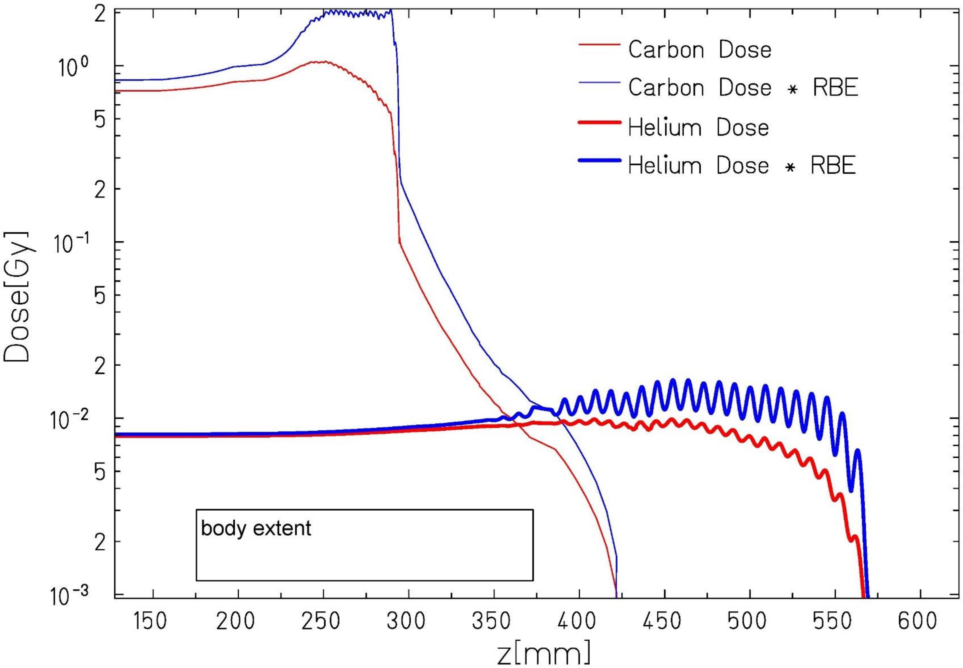
Helium/Carbon mixing
Patient
Detector
Notes:
At the same energy per nucleon, helium ions have about three times the range of carbon ions. The mass over charge ratio for fully stripped helium and carbon ions is the same which means that they could potentially be accelerated together. A mixed He/C beam would look like this in a treatment planning system: explain graphic

Slide 9
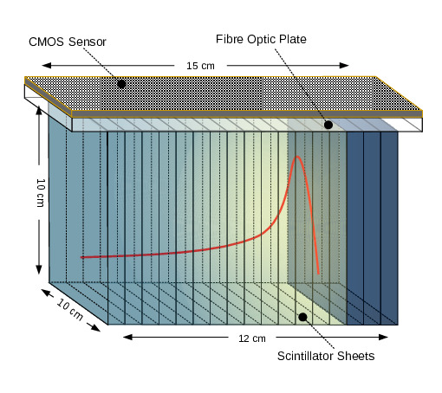
Range telescope
Notes:
The detector we use is a novel range telescope that we built at UCL. It consists on 49 scintillator sheets of 2-3mm thickness that are 10 by 10 cm wide. The light is read out with a large scale CMOS sensor on top of the stack.

Slide 10
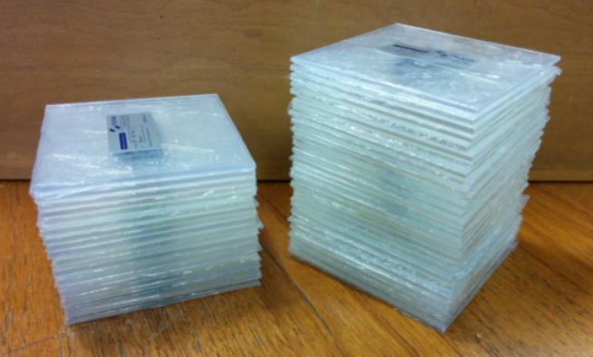
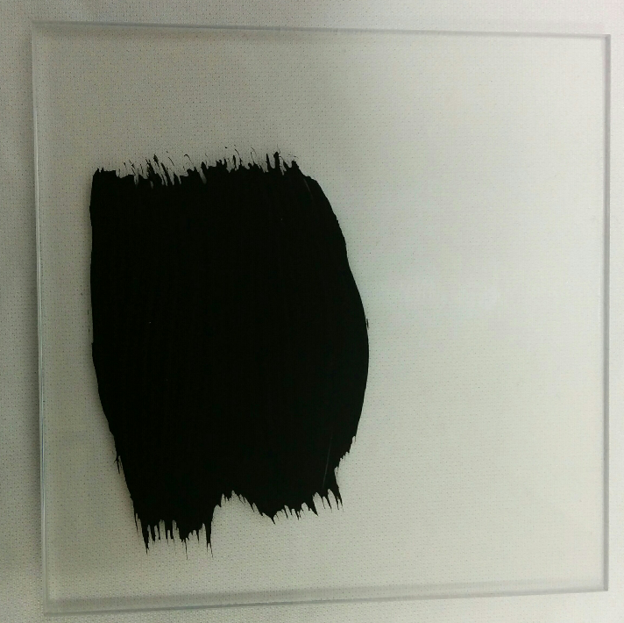
Scintillator Sheets
10 cm x 10 cm x 2-3mm
Notes:
We use 2-3 mm thick scintillator sheets. They have a area of 10 by 10 cm in order to absorb the full beam and even allow some space for scanning in the xy plane. We then painted them black in order optically isolate them from each other. We left the sides unpainted where we want to do the readout of the light output.

Slide 11
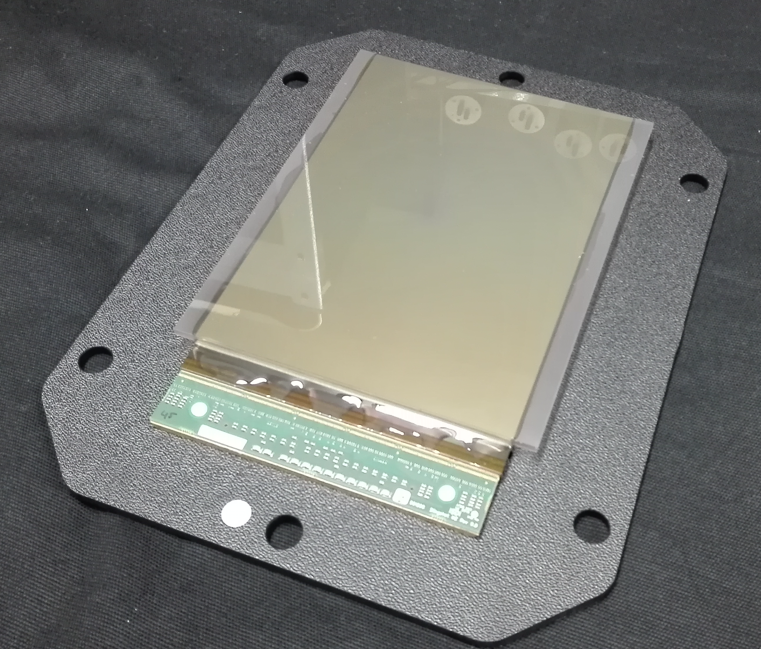
Readout: CMOS Pixel Sensor
15cm
10cm
Notes:
This is the CMOS sensor. The advantage over a DSLR camera is that we don’t have lens effects

Slide 12
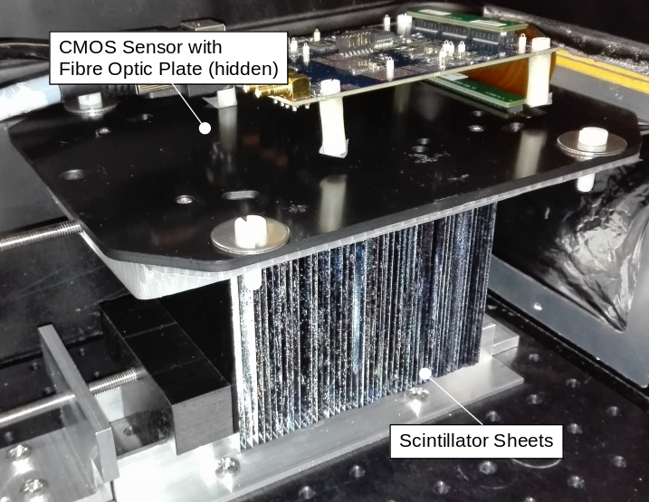
Range telescope
Notes:
This is a picture of the range telescope

Slide 13

Detector performance
97.4 MeV
proton beam
10 mm
Notes:
This is what you then get for a 100MeV proton beam entering from the left side. You can see the Bragg peak on the right end. The flickering comes from the fluctuating beam current.

Slide 14

Detector performance

Slide 15
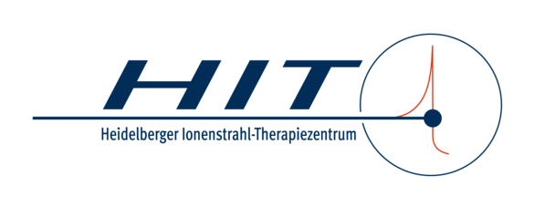
Notes:
We went to HIT to do a beam test with the following goal: Show attainable precision with the mixing technique. And show feasibility with anthropomorphic phantoms

Slide 16
PMMA phantom: setup
~21.9cm
⁴He peak
¹²C peak
CMOS
C
Adjustable
air gap
He
5cm
Range telescope
~10cm
PMMA phantom
Notes:
As a first experiment we want to evaluate the accuracy of the method in a very controlled environment which is why we use a PMMA block as a patient and the range telescope behind.
Since HIT cannot provide a mixed beam at the moment we irradiate a carbon beam and a helium beam subsequently.
This experiment features an adjustable air gap in the middle of the phantom in order to simulate changes in the beam path.

Slide 17
Off-line beam mixing
Notes:
This is the kind of signal we see in our range telescope: a helium peak and a carbon tail that are artificially mixed in the data analysis.

Slide 18
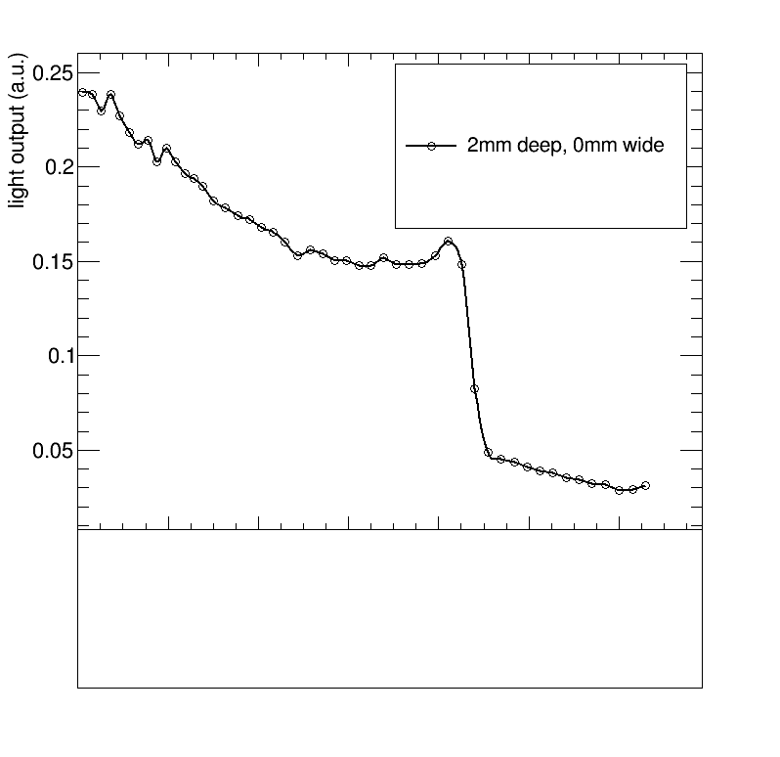
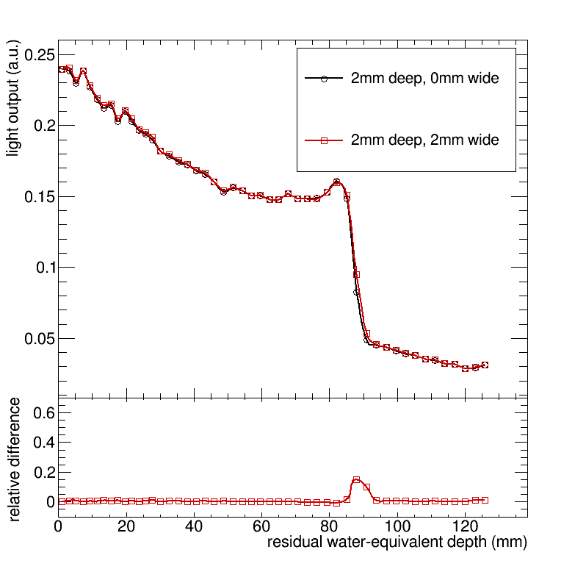
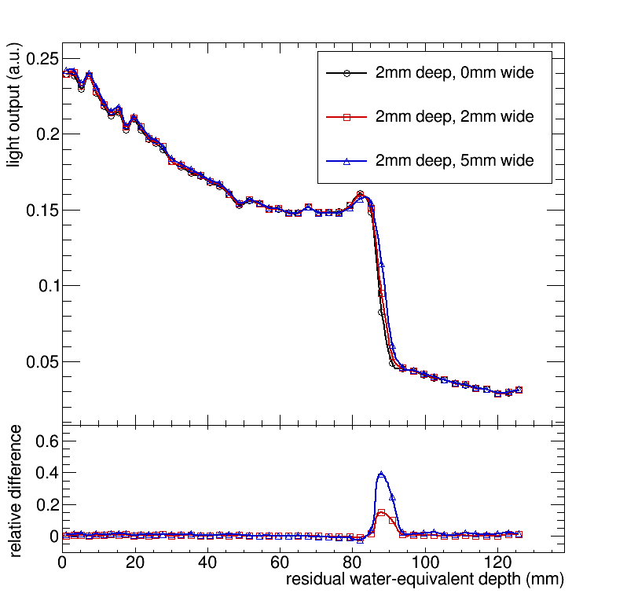
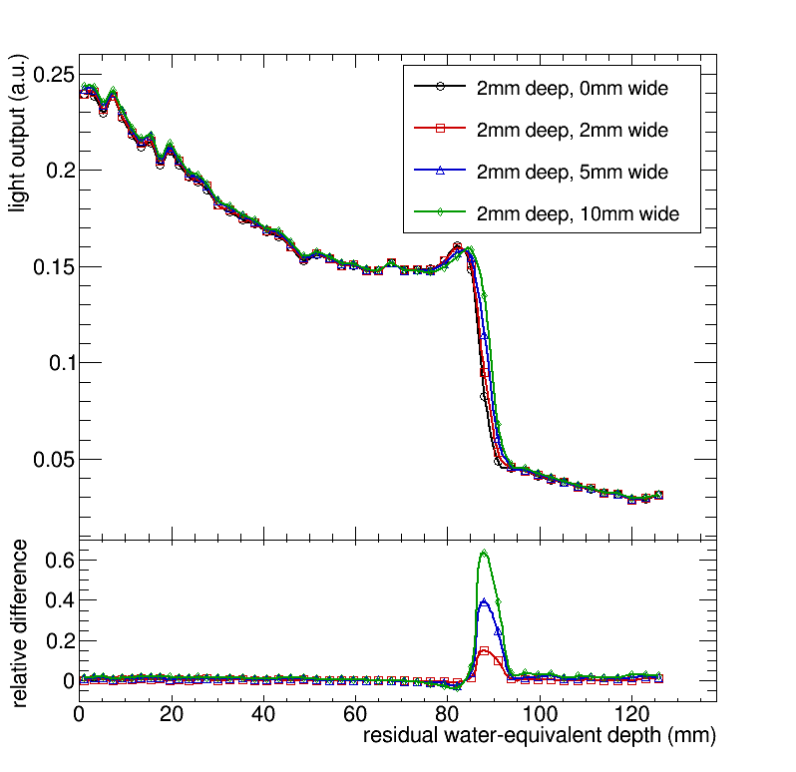
PMMA phantom: results
Air gap depth
Mixed
beam
PMMA phantom
Beam size = 8mm FWHM
Range telescope
Notes:
At first, the air gap is closed. The obtained HeC curve is defined as a reference curve. Then we open the air gap to a width of 2mm. The beam has a FWHM of 8mm, meaning that less than a quarter of the beam sees the gap. Below the depth-light curve we show the relative difference between the 2mm and the reference curve. One can clearly see that there is a shift in the depth-light curve. The peak in the rel diff increases when we open the air gap.

Slide 19

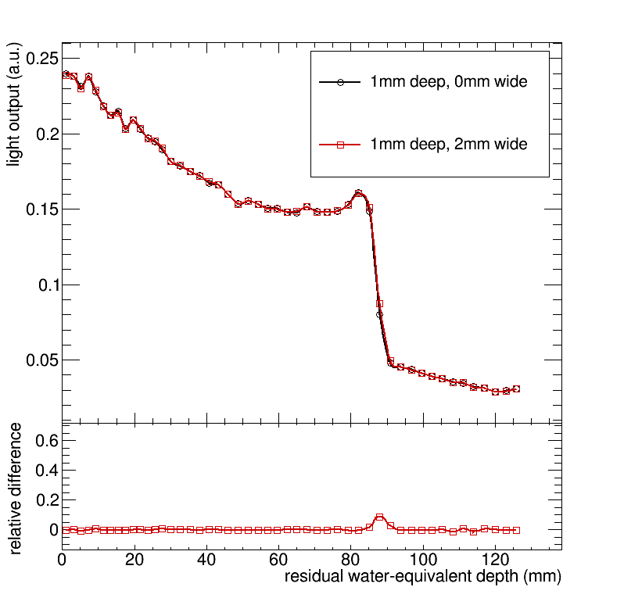
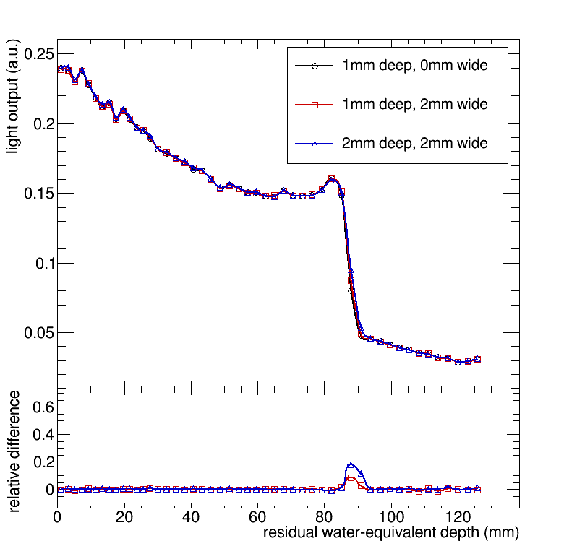
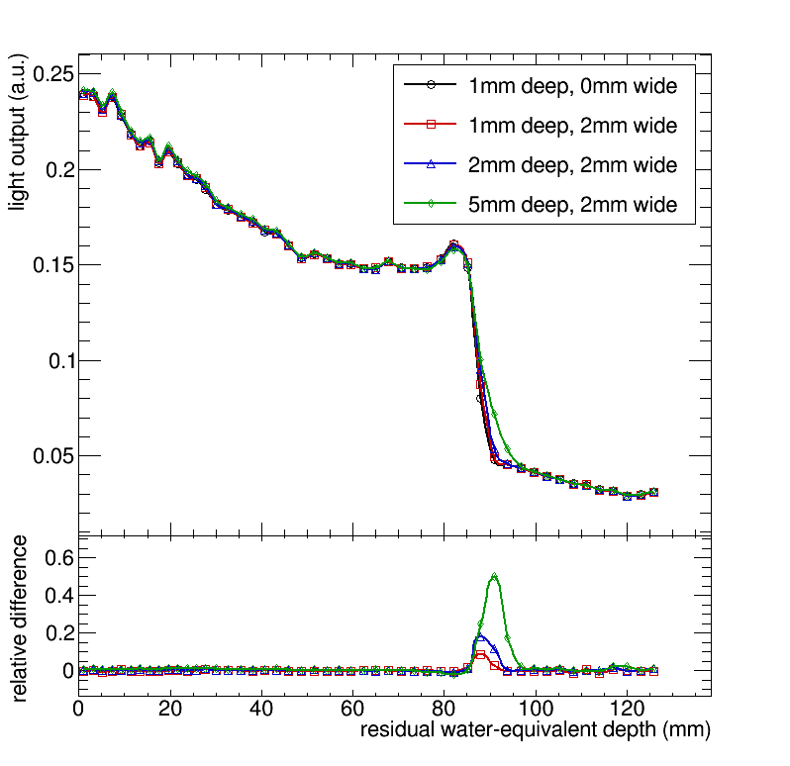
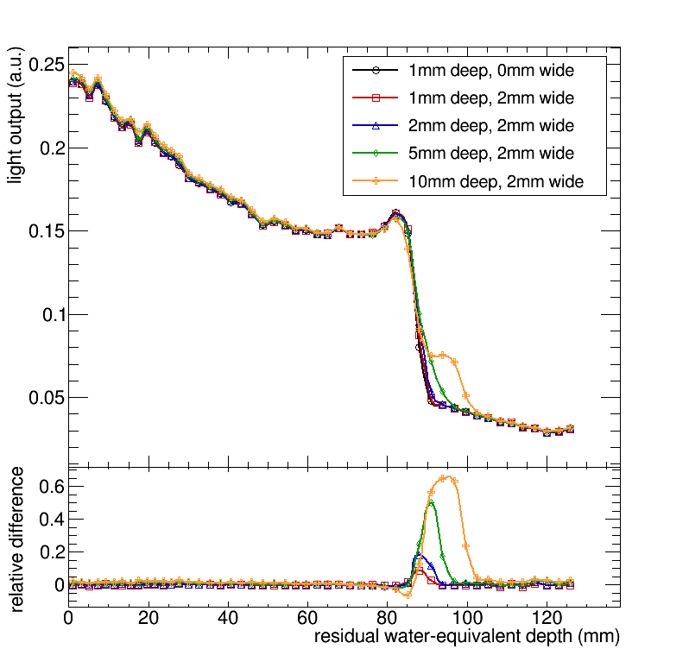
PMMA phantom: results
Air gap depth
Mixed
beam
PMMA phantom
Range telescope
Notes:
Then we try different air gap thickness, or depths. The width is kept constant here. WE start at zero depth, which is the reference curve, the slowly increase the depth. It can be seen that one millimetre deep gap has an effect on the HeC depth light curve.

Slide 20
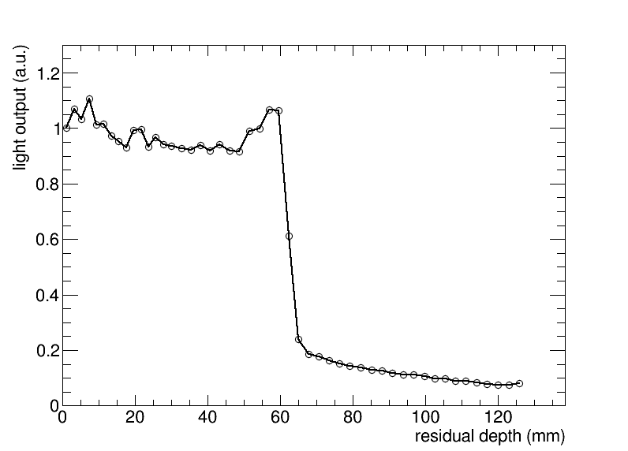
PMMA phantom: results
⁴He peak
~21.9cm
¹²C peak
Mixed
Beam
2mm
5cm
~9.1cm
Notes:
On top of that we did scan the PMMA phantom such that a large air gap was sometimes hit and sometimes missed. The video shows how the range of the helium peak jumps forth and back in the detector. This shows that we can monitor anatomical irregularities online, during the irradiation.

Slide 21
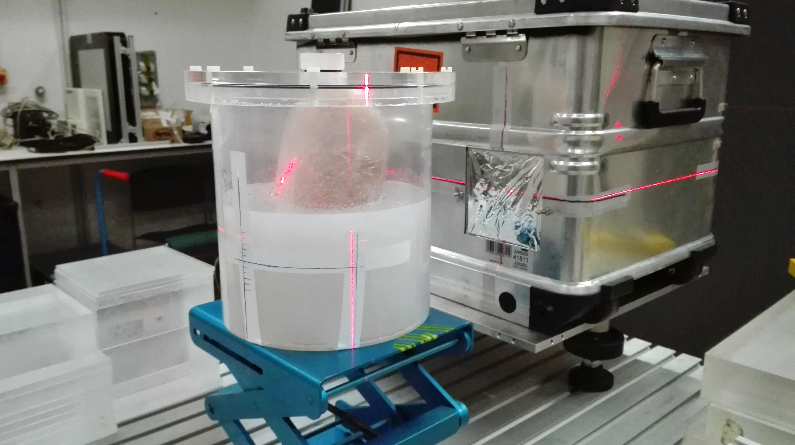
Lung phantom: setup
200 mm
Notes:
In order to explore which tumour types can benefit from HeC mixing we performed a few experiments with anthropomorphic phantoms. I will start with a lung phantom built by Lennart Volz in the phantom workshop of DKFZ. On the left is a CT image of the phantom with the tumour marked in red. Behind the tumour we positioned the detector than can be seen in the left image.

Slide 22
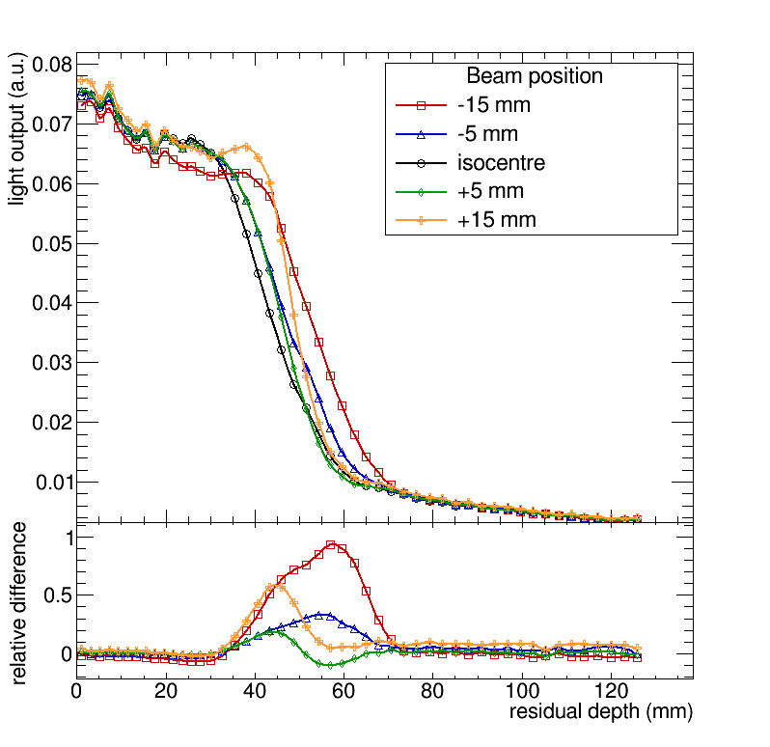

Lung phantom: results
Mixed
Beam
Notes:
We then moved the lung phantom up and down in order to simulate a primitive breathing motion. The result of what we can see in the detector is shown here. We can see that there is a clear change in the helium range when we are hitting or missing the tumour.

Slide 23
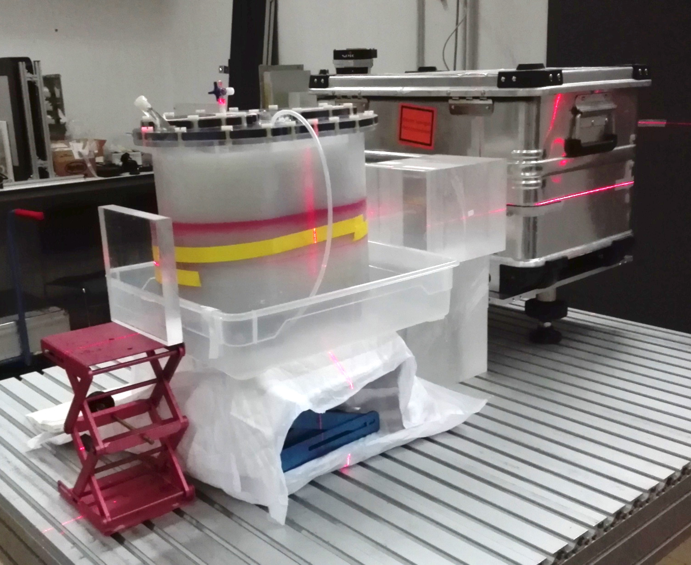
Pelvis phantom 1: setup
Notes:
In a next step we want to explore the use of HeC mixing for prostate cancer patients. For this, we use a pelvis/hip phantom .

Slide 24
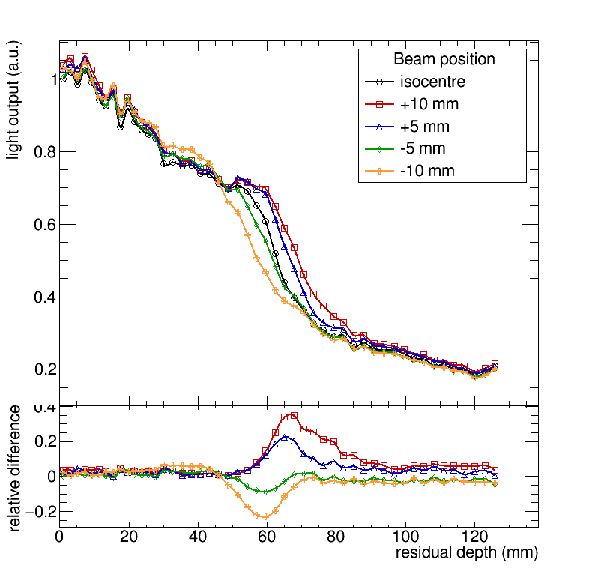
Pelvis phantom 1: translation
Mixed
Beam
Notes:
First we move the phantom up and down to simulate patient misalignment. One can see that we see clear differences between the measured HeC signal and the reference curve when translation is zero.

Slide 25
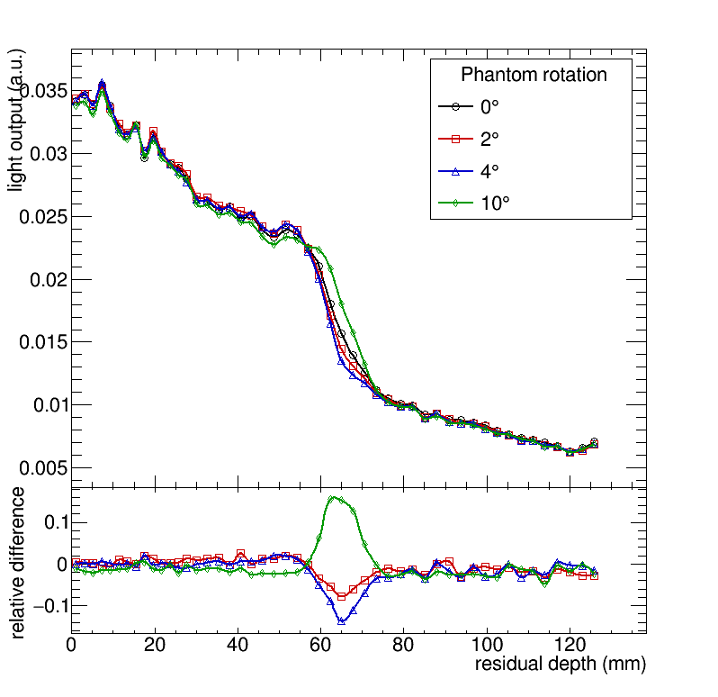
Pelvis phantom 1: rotation
Mixed
Beam
Notes:
Then we rotated the phantom to see if we can tell whether the patient was aligned at a wrong angle. Yes, we can see it.

Slide 26
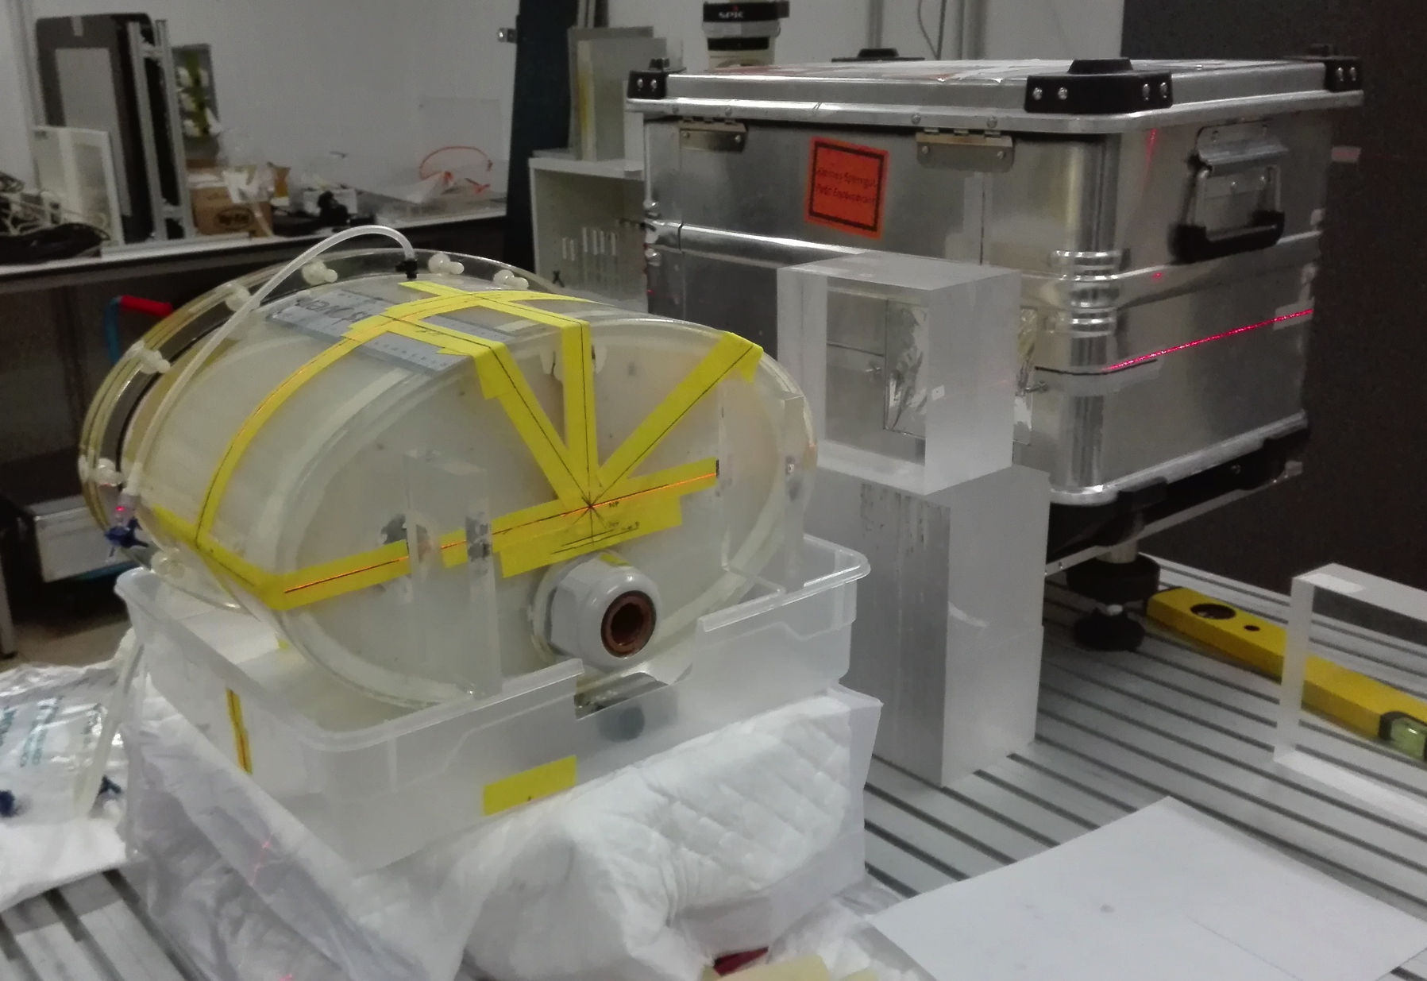
Pelvis phantom 2: setup
Notes:
AS a last experiment we use a second pelvis phantom that has a deformable prostate and an air filled rectum. We then used a rectal balloon that is sometimes used in prostate cancer treatments to immobilise the prostate to actually simulate rectal gassing.

Slide 27
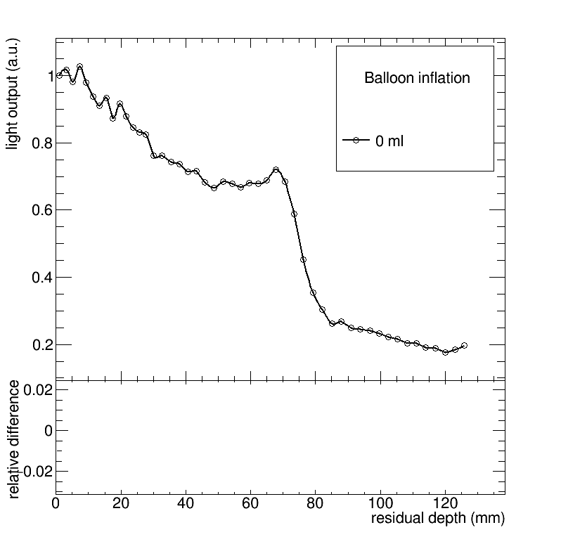
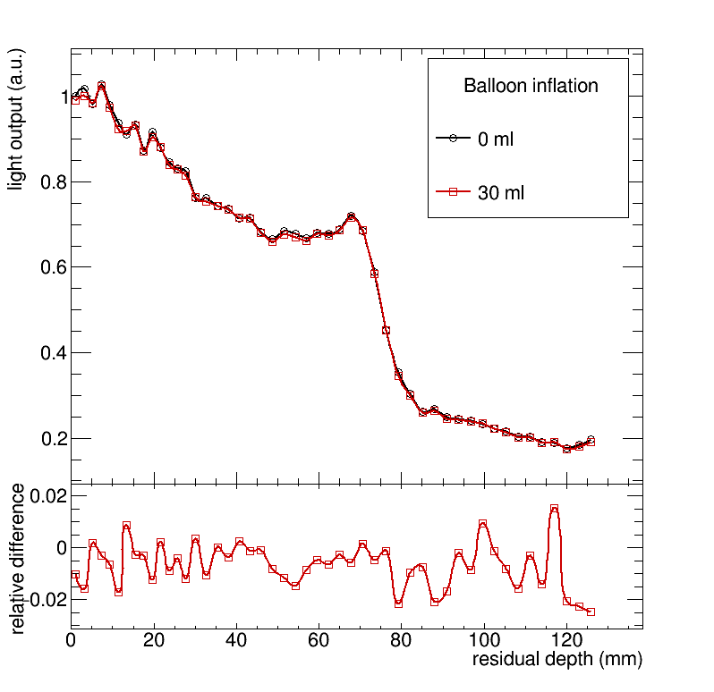
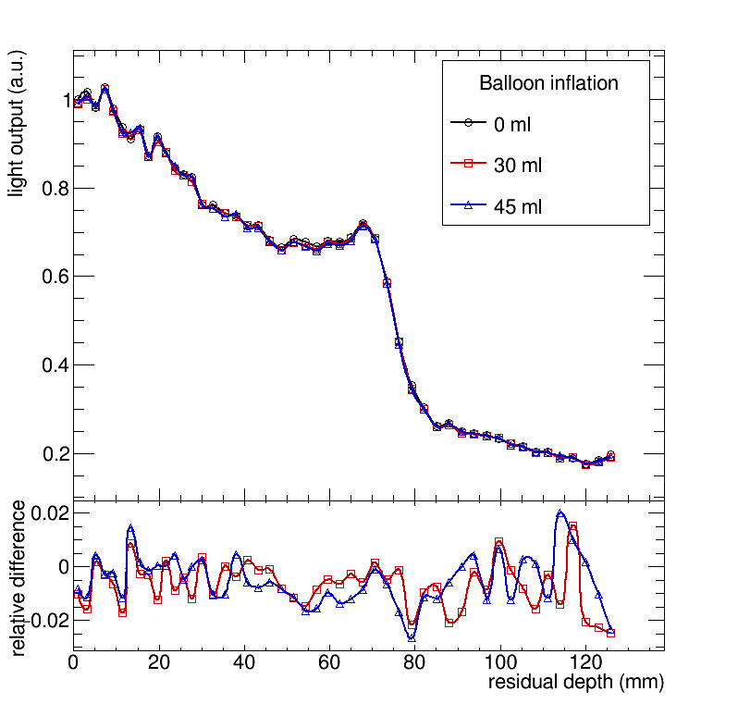
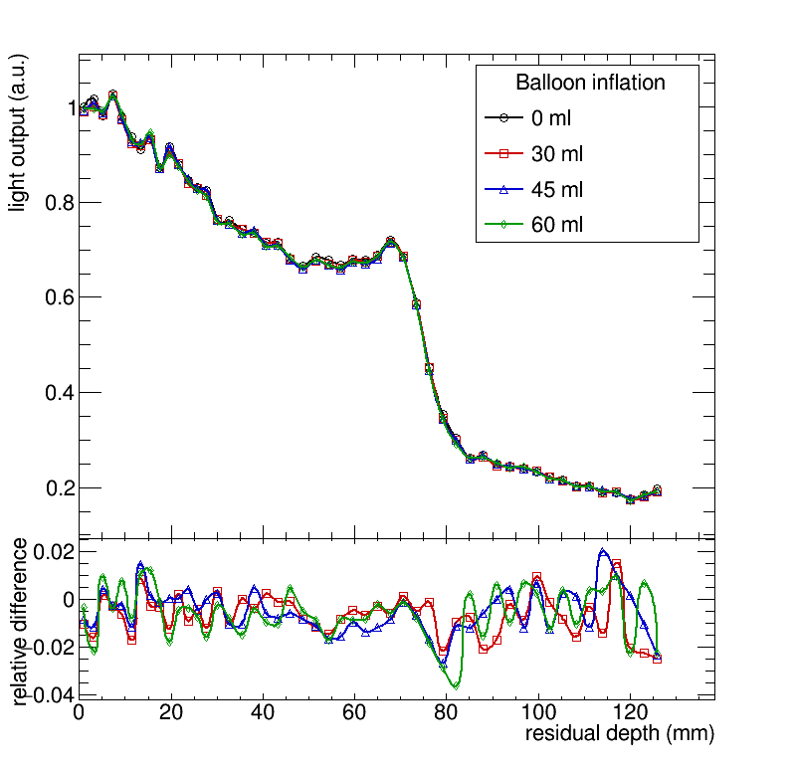
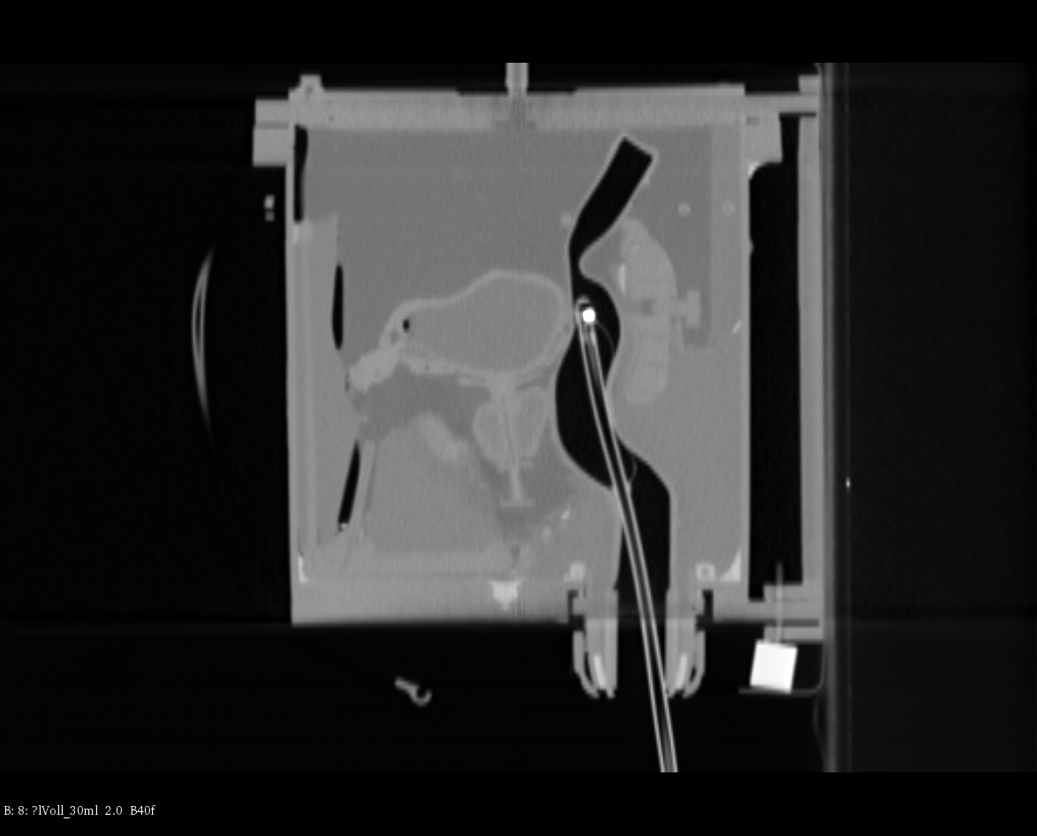
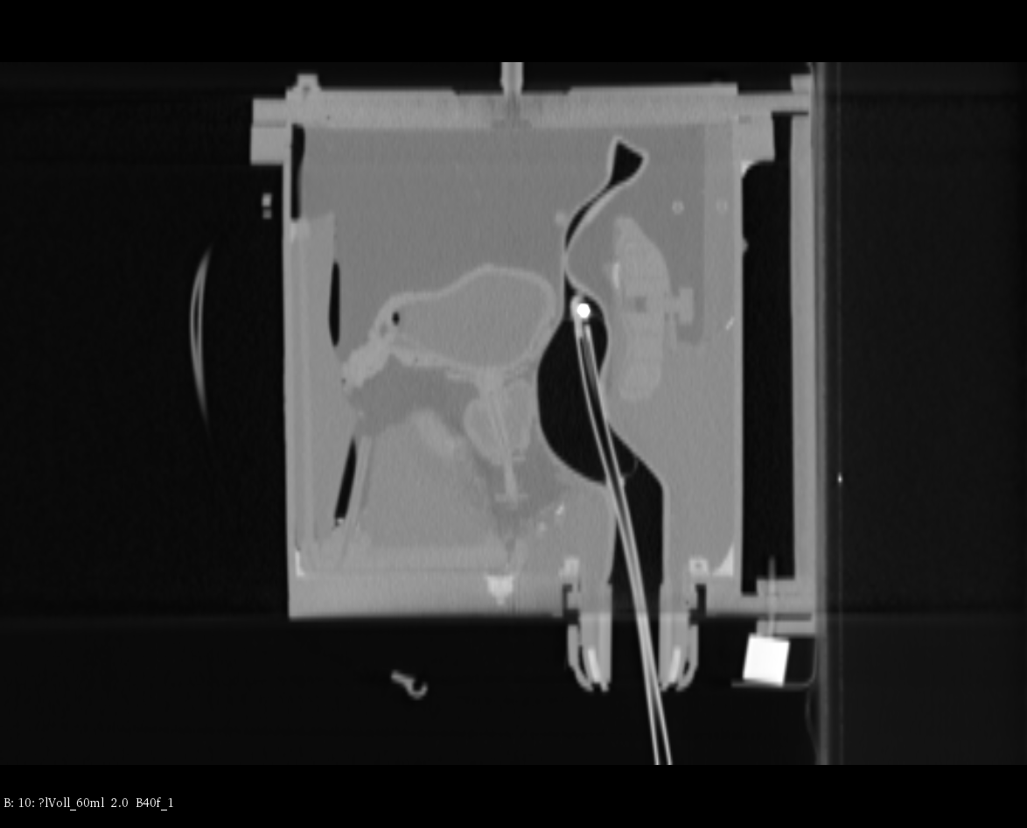
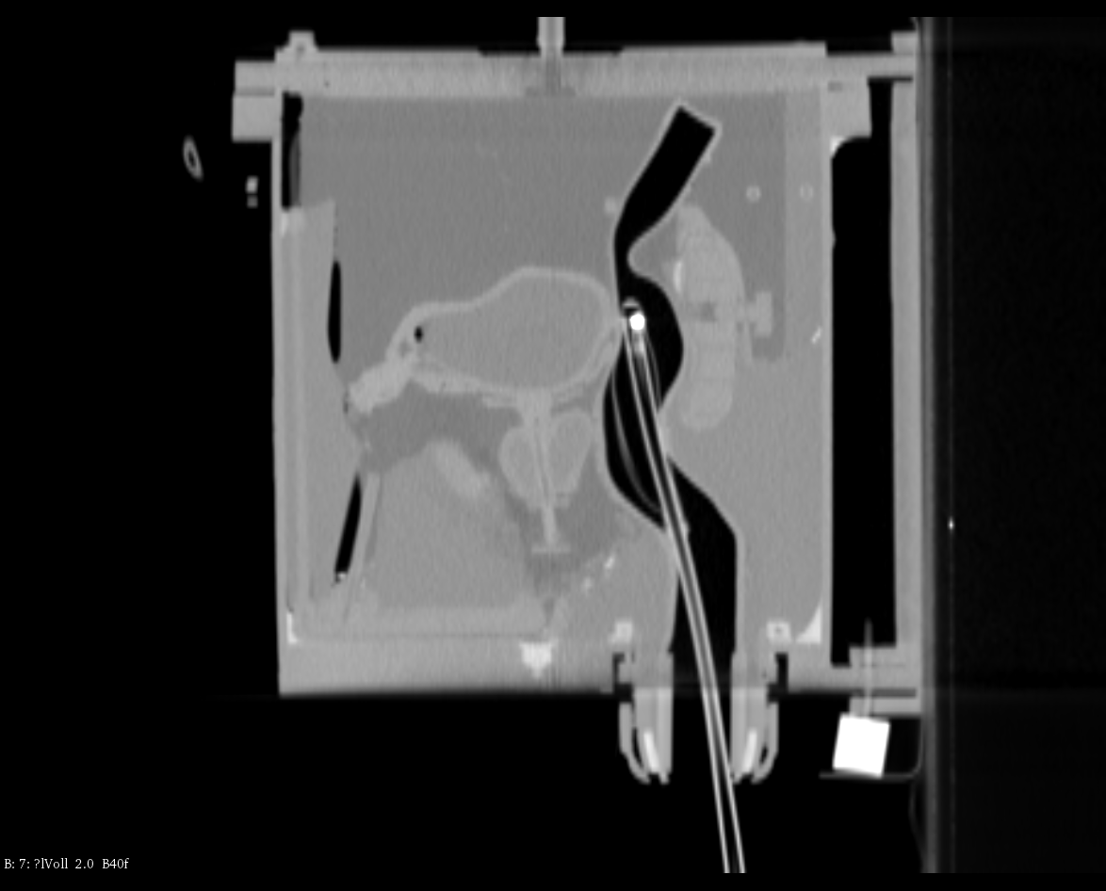
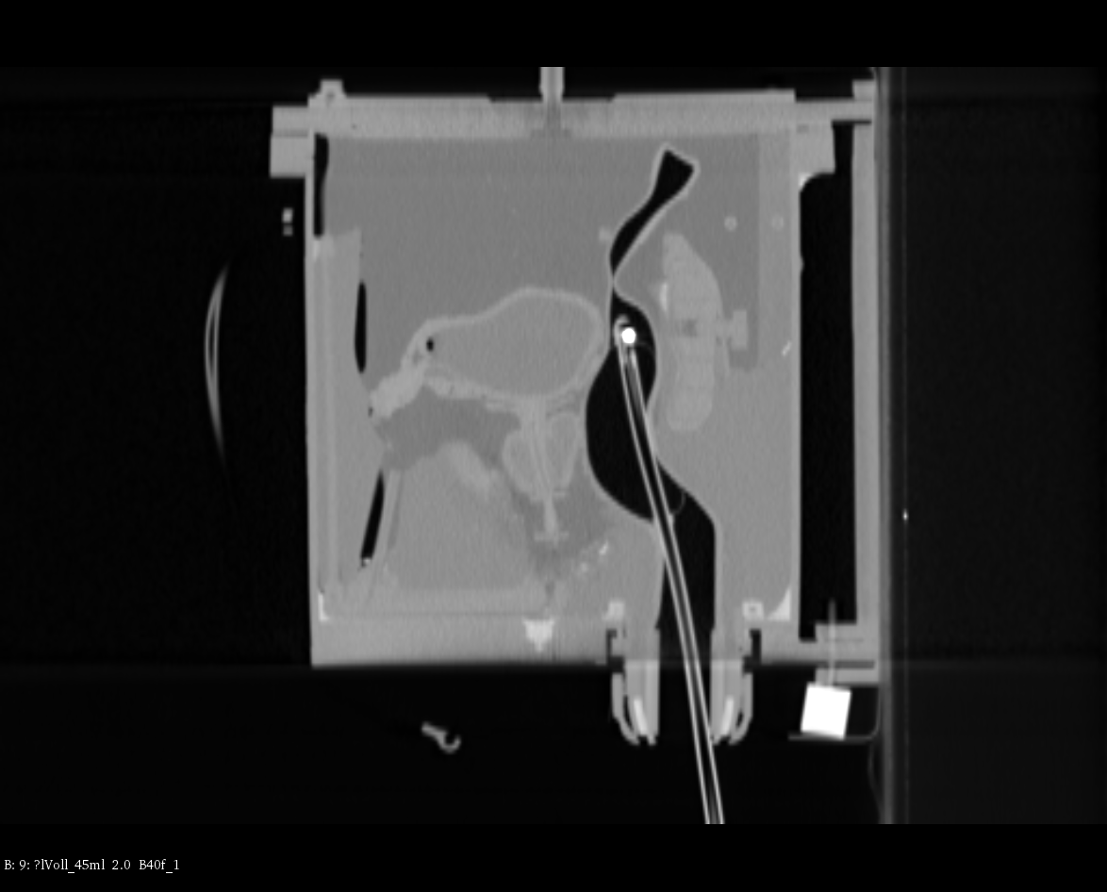
Pelvis phantom 2: results
Beams eye view
Bladder
Prostate
Rectum + balloon
60 ml
45 ml
30 ml
0 ml
Notes:
This is a CT of the rectal balloon in the rectum near the prostate. At first we chose a beam spot in the isocentre of the beam. We then inflate the rectal balloon to see whether we see changes. As we can see in the CT there is no change expected and there is indeed no change observed in the HeC curve.

Slide 28
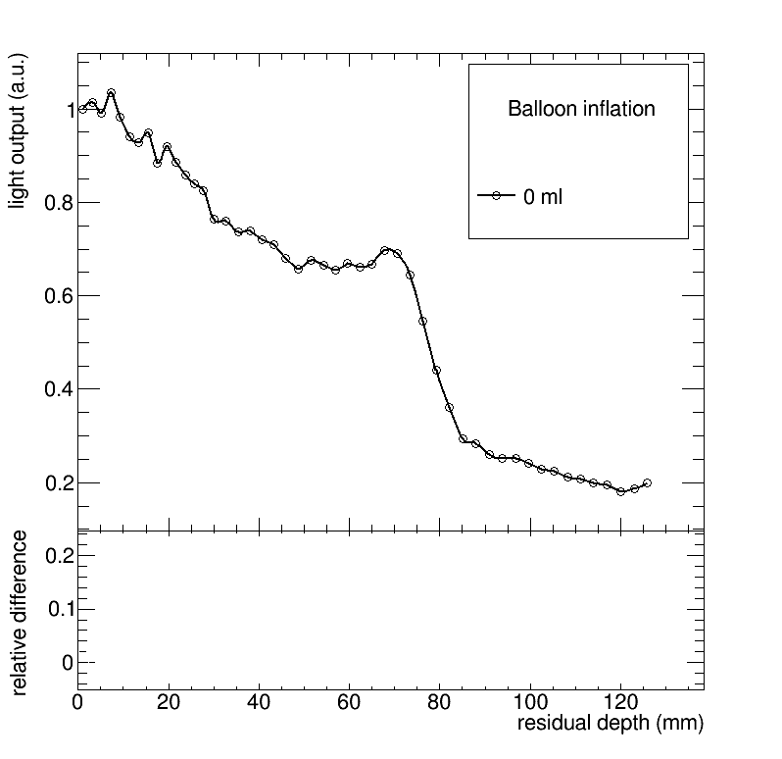
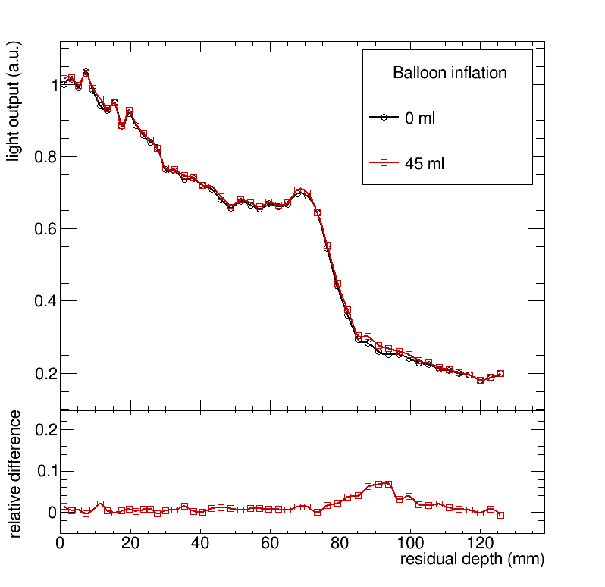
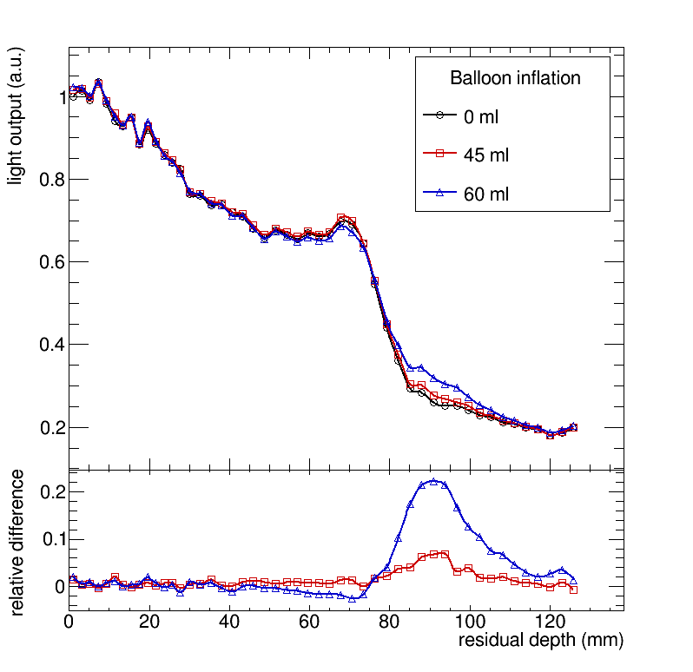
Pelvis phantom 2: results
Beams eye view
Bladder
Prostate
Rectum + balloon
45 ml
0 ml
60 ml
Notes:
Then we chose a beam spot closer to the rectum and measured again. Now we can see small changes in the HeC curve.

Slide 29
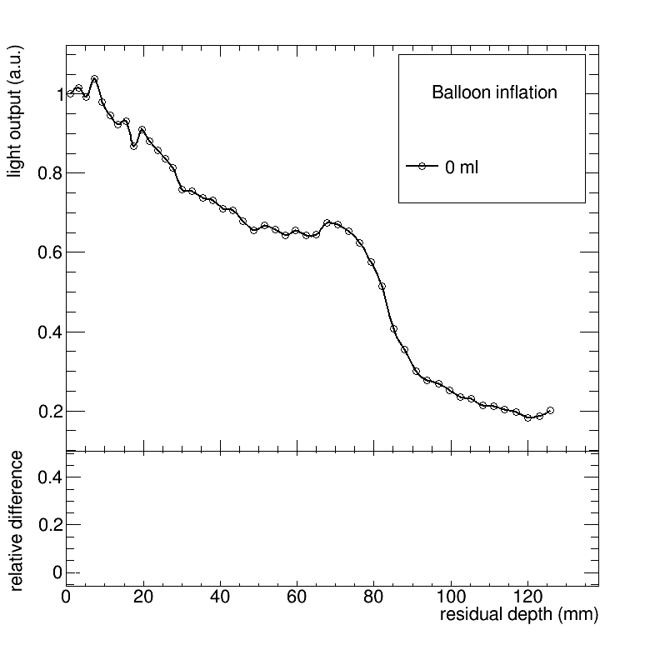
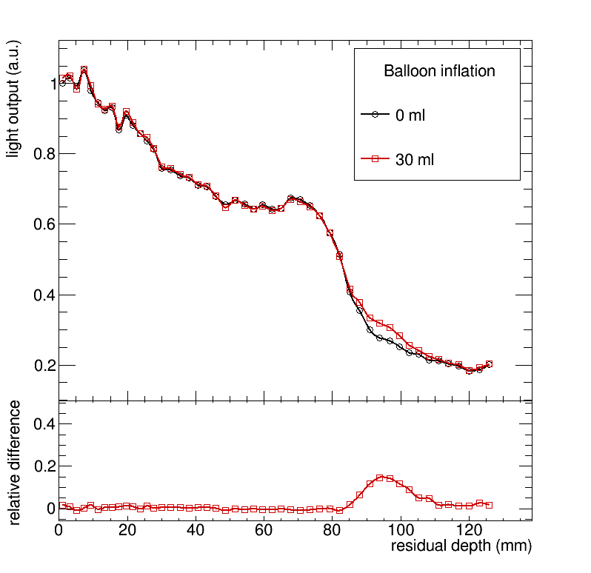
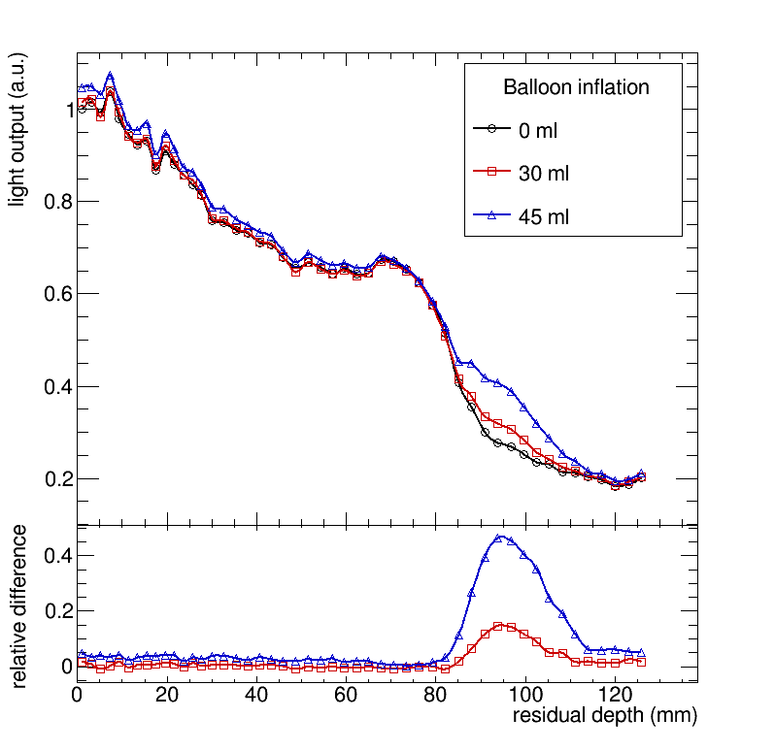
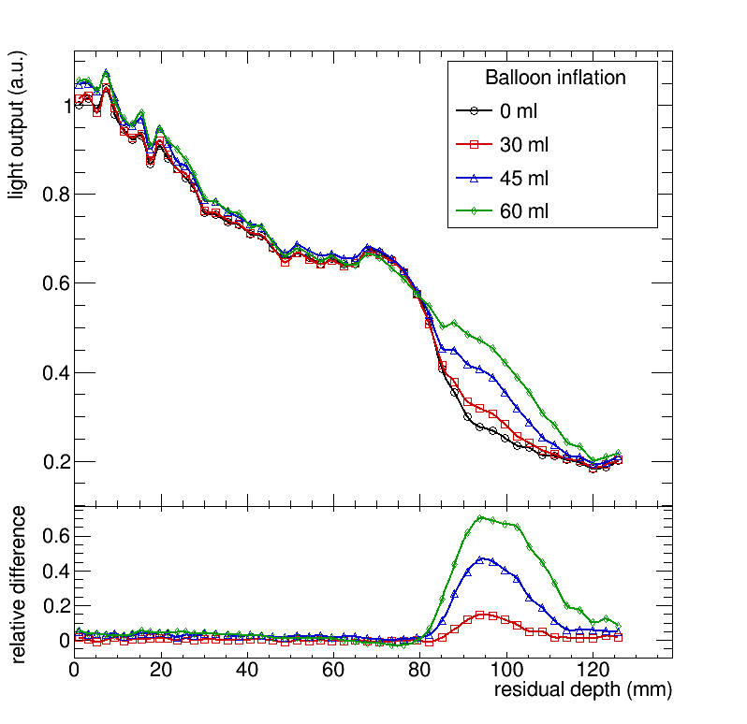
Pelvis phantom 2: results
Beams eye view
Bladder
Prostate
Rectum + balloon
60 ml
45 ml
30 ml
0 ml
Notes:
And hen we chose a point at the edge of the prostate. The observed changes a huge.
We therefore showed that HeC mixing would be able to monitor movements such as rectal gassing and also translations and rotations, common in the treatment of prostate cancer patients.

Slide 30
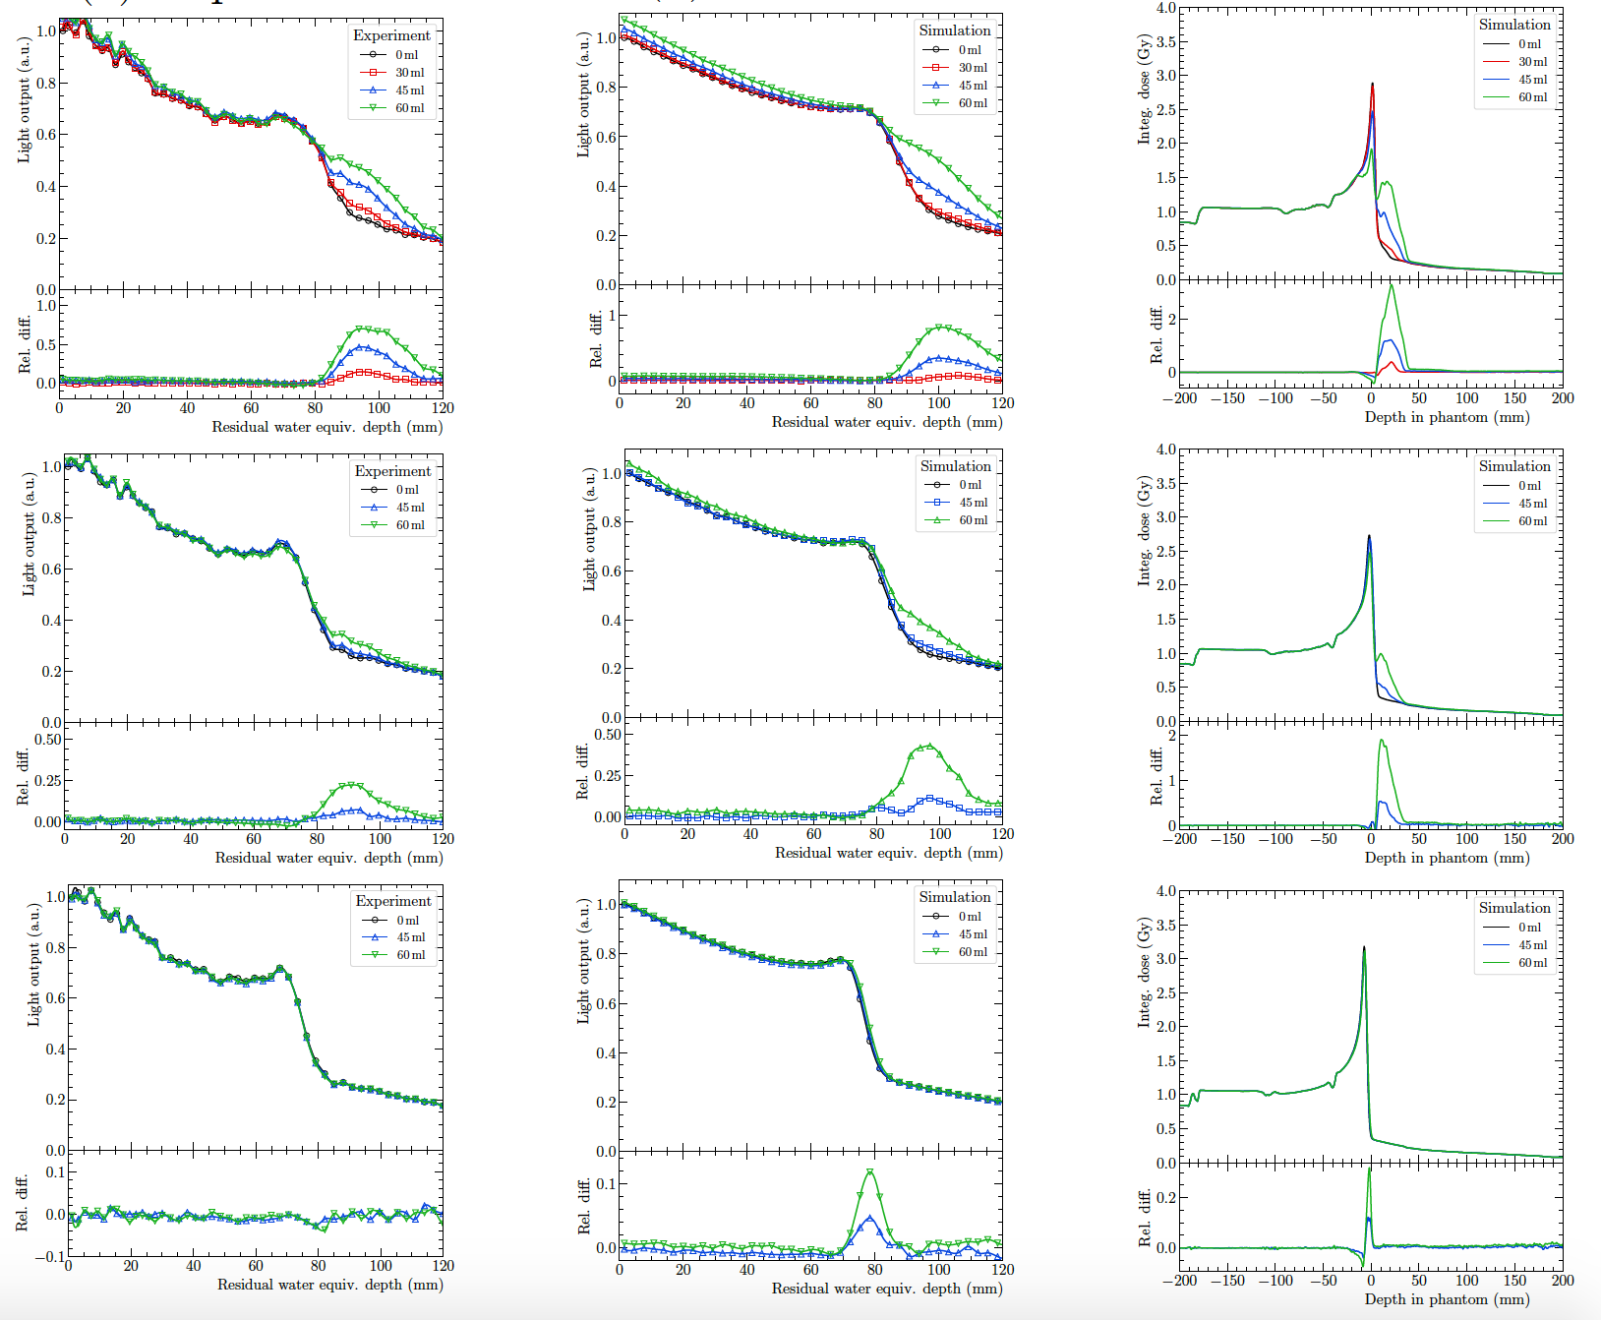
Pelvis phantom 2: simulation
Near rectum
In between
Tumour isocentre

Slide 31
He/C mixing in clinics
Advantages:
  High sensitivity
  No extra room time
  Negligible extra dose
Disadvantages:
  Not extendable to proton therapy
  Changes behind C peak still affect He signal
  Helium beam range might be too low to exit patient
Open questions:
  How to quantify changes?
  How to generate a reference curve?
  How to react if there is a change?
  Which tumours can benefit?
Notes:
We showed the feasibility of HeC. What we discovered is that is has a few advantages: list advantages
The disadvantages are: list disadvantages.
Some open questions are: discuss open questions

Slide 32
Technical aspects of beam mixing
Ion source: use e.g. methane as main gas and helium as support gas
Several possibilities for beam generation:
  Extract C6+ and He2+ (A/Q=2) but low current
  Extract C3+ and He+ (A/Q=4) but Linac too weak
  Extract one ion after another and mix in synchrotron
Simulations need to prove that mixed beam is stable in synchrotron
Notes:
I would also like to quickly discuss some technical aspects concerning the delivery of a mixed helium carbon beam:

Slide 33
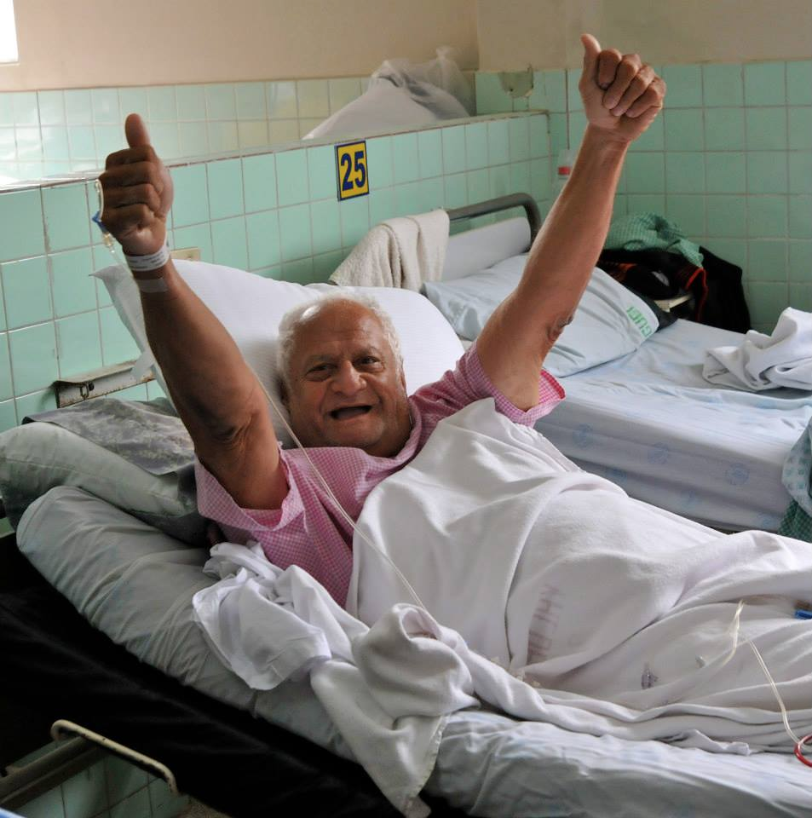

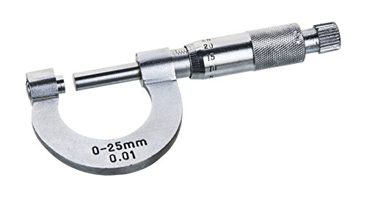
Take-home message
He/C mixing offers online motion monitoring
We demonstrated feasibility in anthropomorphic phantoms
High sensitivity to range changes
Many open questions (technical, workflow…)
?
Notes:
Spot-wise range verification, Motion monitoring, Positioning verification
Very new idea: community has to form

Slide 34
Thank you for your attention
This project has received funding from the European Union’s Horizon 2020 research and innovation programme under the Marie Sklodowska-Curie grant agreement No 675265, OMA – Optimization of Medical Accelerators.
Notes:
In the name of the group, thank you very much for your attention.

Slide 35
Backup

Slide 36
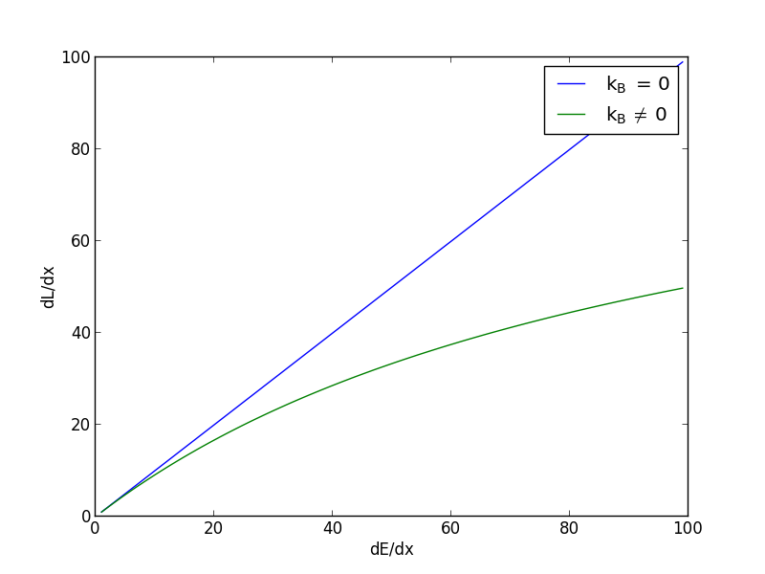
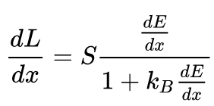
Quenching: Birk’s Law
Notes:
If the ionization density gets very high, the light output stops being linear to the energy deposition. The strength of the ionization dependence of the quenching is described by Birk’s constant.
Since protons have a comparatively large dEdx, the Bragg curve in a plastic scintillator appears mashed-up. The ionization density depends on the energy and nature of the particle and also on the beam current in case of high beam intensities. So we really need to be careful when we try to take into account quenching.

Slide 37
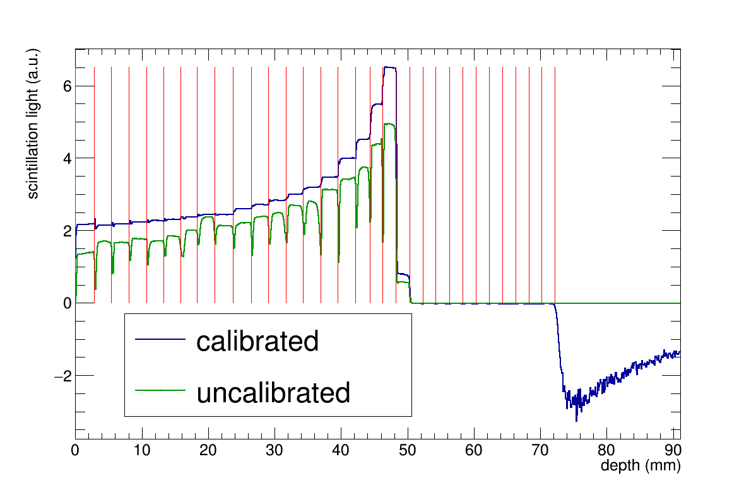
Calibration

