Slide 1
Design of a Detector for Fast Treatment Plan Verification in Proton Radiotherapy
Saad Shaikh
Supervised by Dr Simon Jolly & Prof Ruben Saakyan

Slide 2
Cancer
Cancer was responsible for 163,444 deaths in 2016 & costs the NHS £5 billion per year.
1 in 2 people will be diagnosed with some form of cancer in their lifetime.
Three main curative treatment methods:
  Surgery (45%)
  Chemotherapy (27%)
  Radiotherapy (28%)
Notes:
Immunotherapy is also used as a curative treatment (but much less than listed methods).

Slide 3
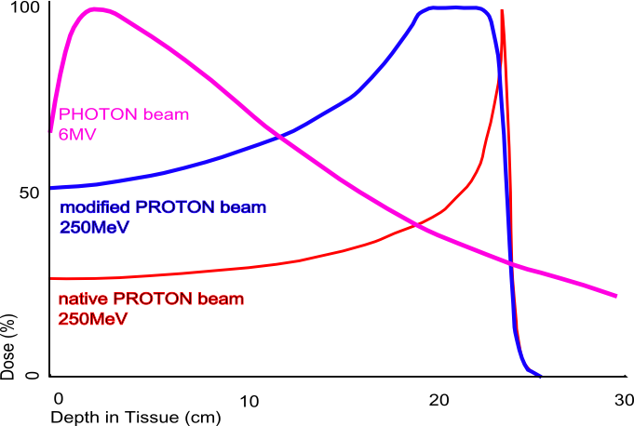
Radiotherapy
Deliver sufficient dose of ionising radiation to tumour to cause cell death, whilst minimising dose delivered to healthy tissue.
X-Rays have an exponential decay of dose with depth due to probabilistic interactions.
Protons primarily interact electrostatically which results in a Bragg Peak.
Notes:
Primarily have free radicals attacking DNA of cancerous cells. We essentially break the DNA using energetic particles.

Slide 4
Proton Therapy (PT) vs. X-Ray Radiotherapy
Advantages of PT | Disadvantages of PT
Can deliver highly localised dose, sparing healthy tissue. | Must ensure treatment is delivered accurately: high precision gives little margin for error.
Useful for paediatric patients and tumours near sensitive organs. | Technology not as mature as in X-Ray radiotherapy –gives rise to uncertainties.

Slide 5
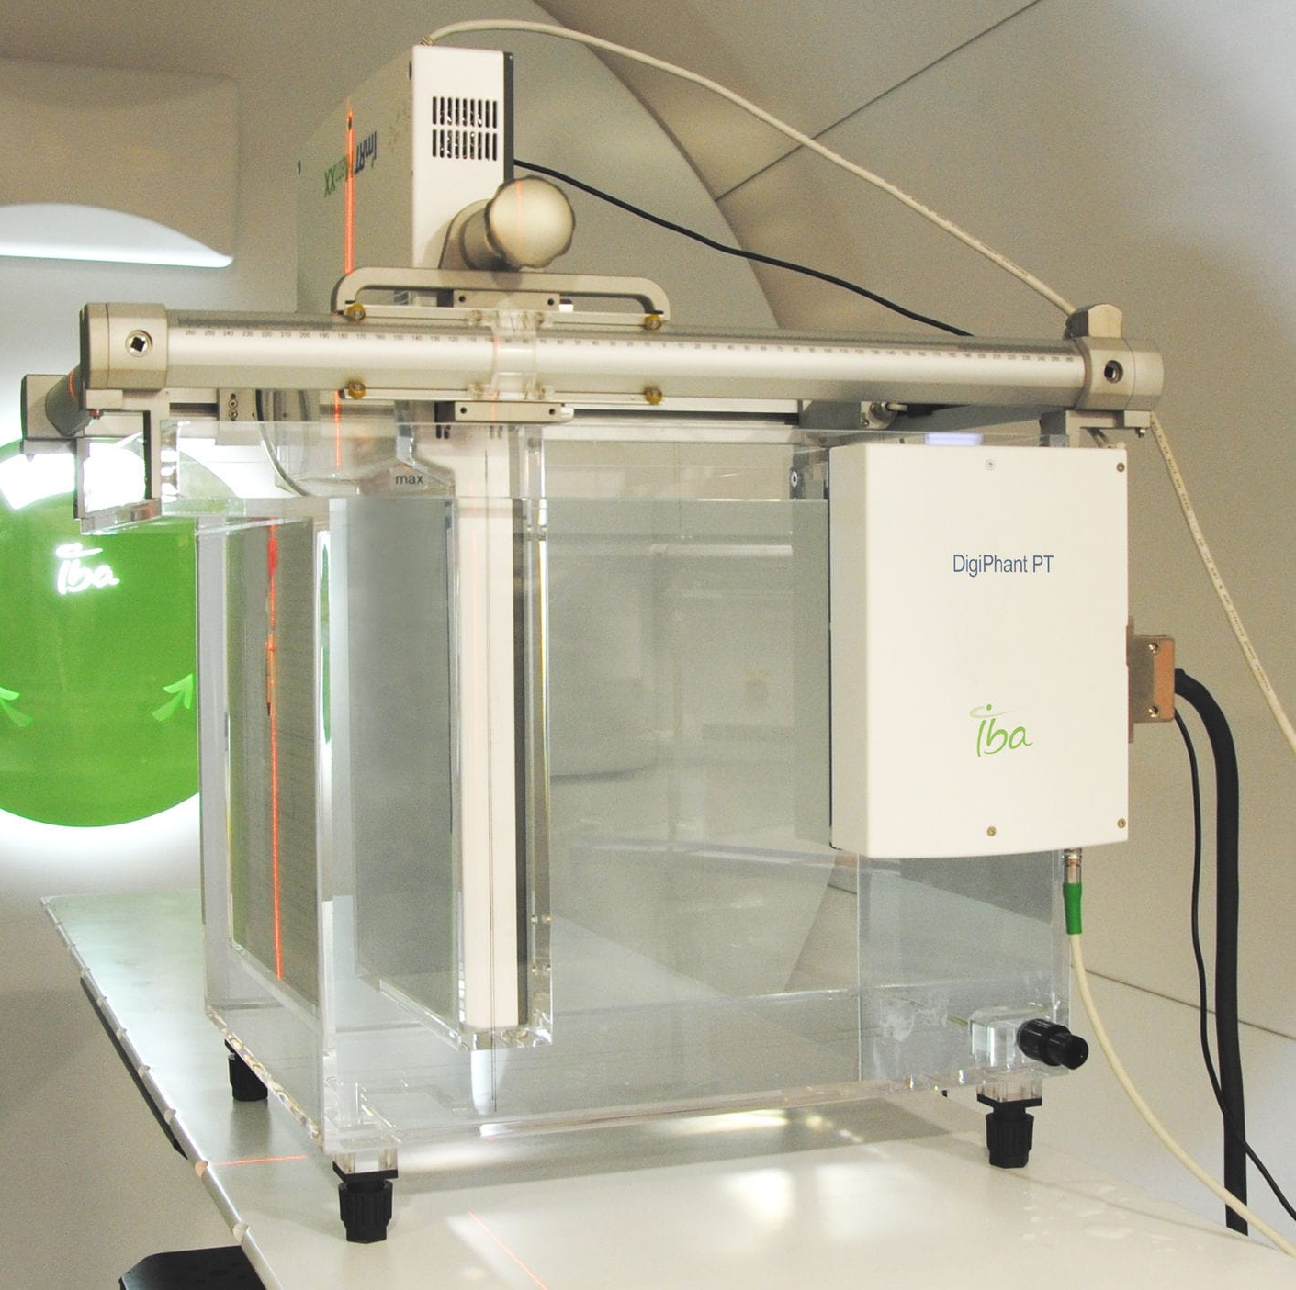
Treatment Plan Verification (TPV)
Must verify that dose will be delivered correctly before treatment.
Need 3D volumetric dose deposition (i.e. position and energy) of protons in water-equivalent material.
Current methods take a long time! Time could be better spent treating patients.
How can we make this faster?
Water Phantom TPV System
Notes:
The system shown is actually not very accurate. Typically use ionisation chambers for measurements. TPV takes a long time due to required movement of detector system upon rescanning.

Slide 6
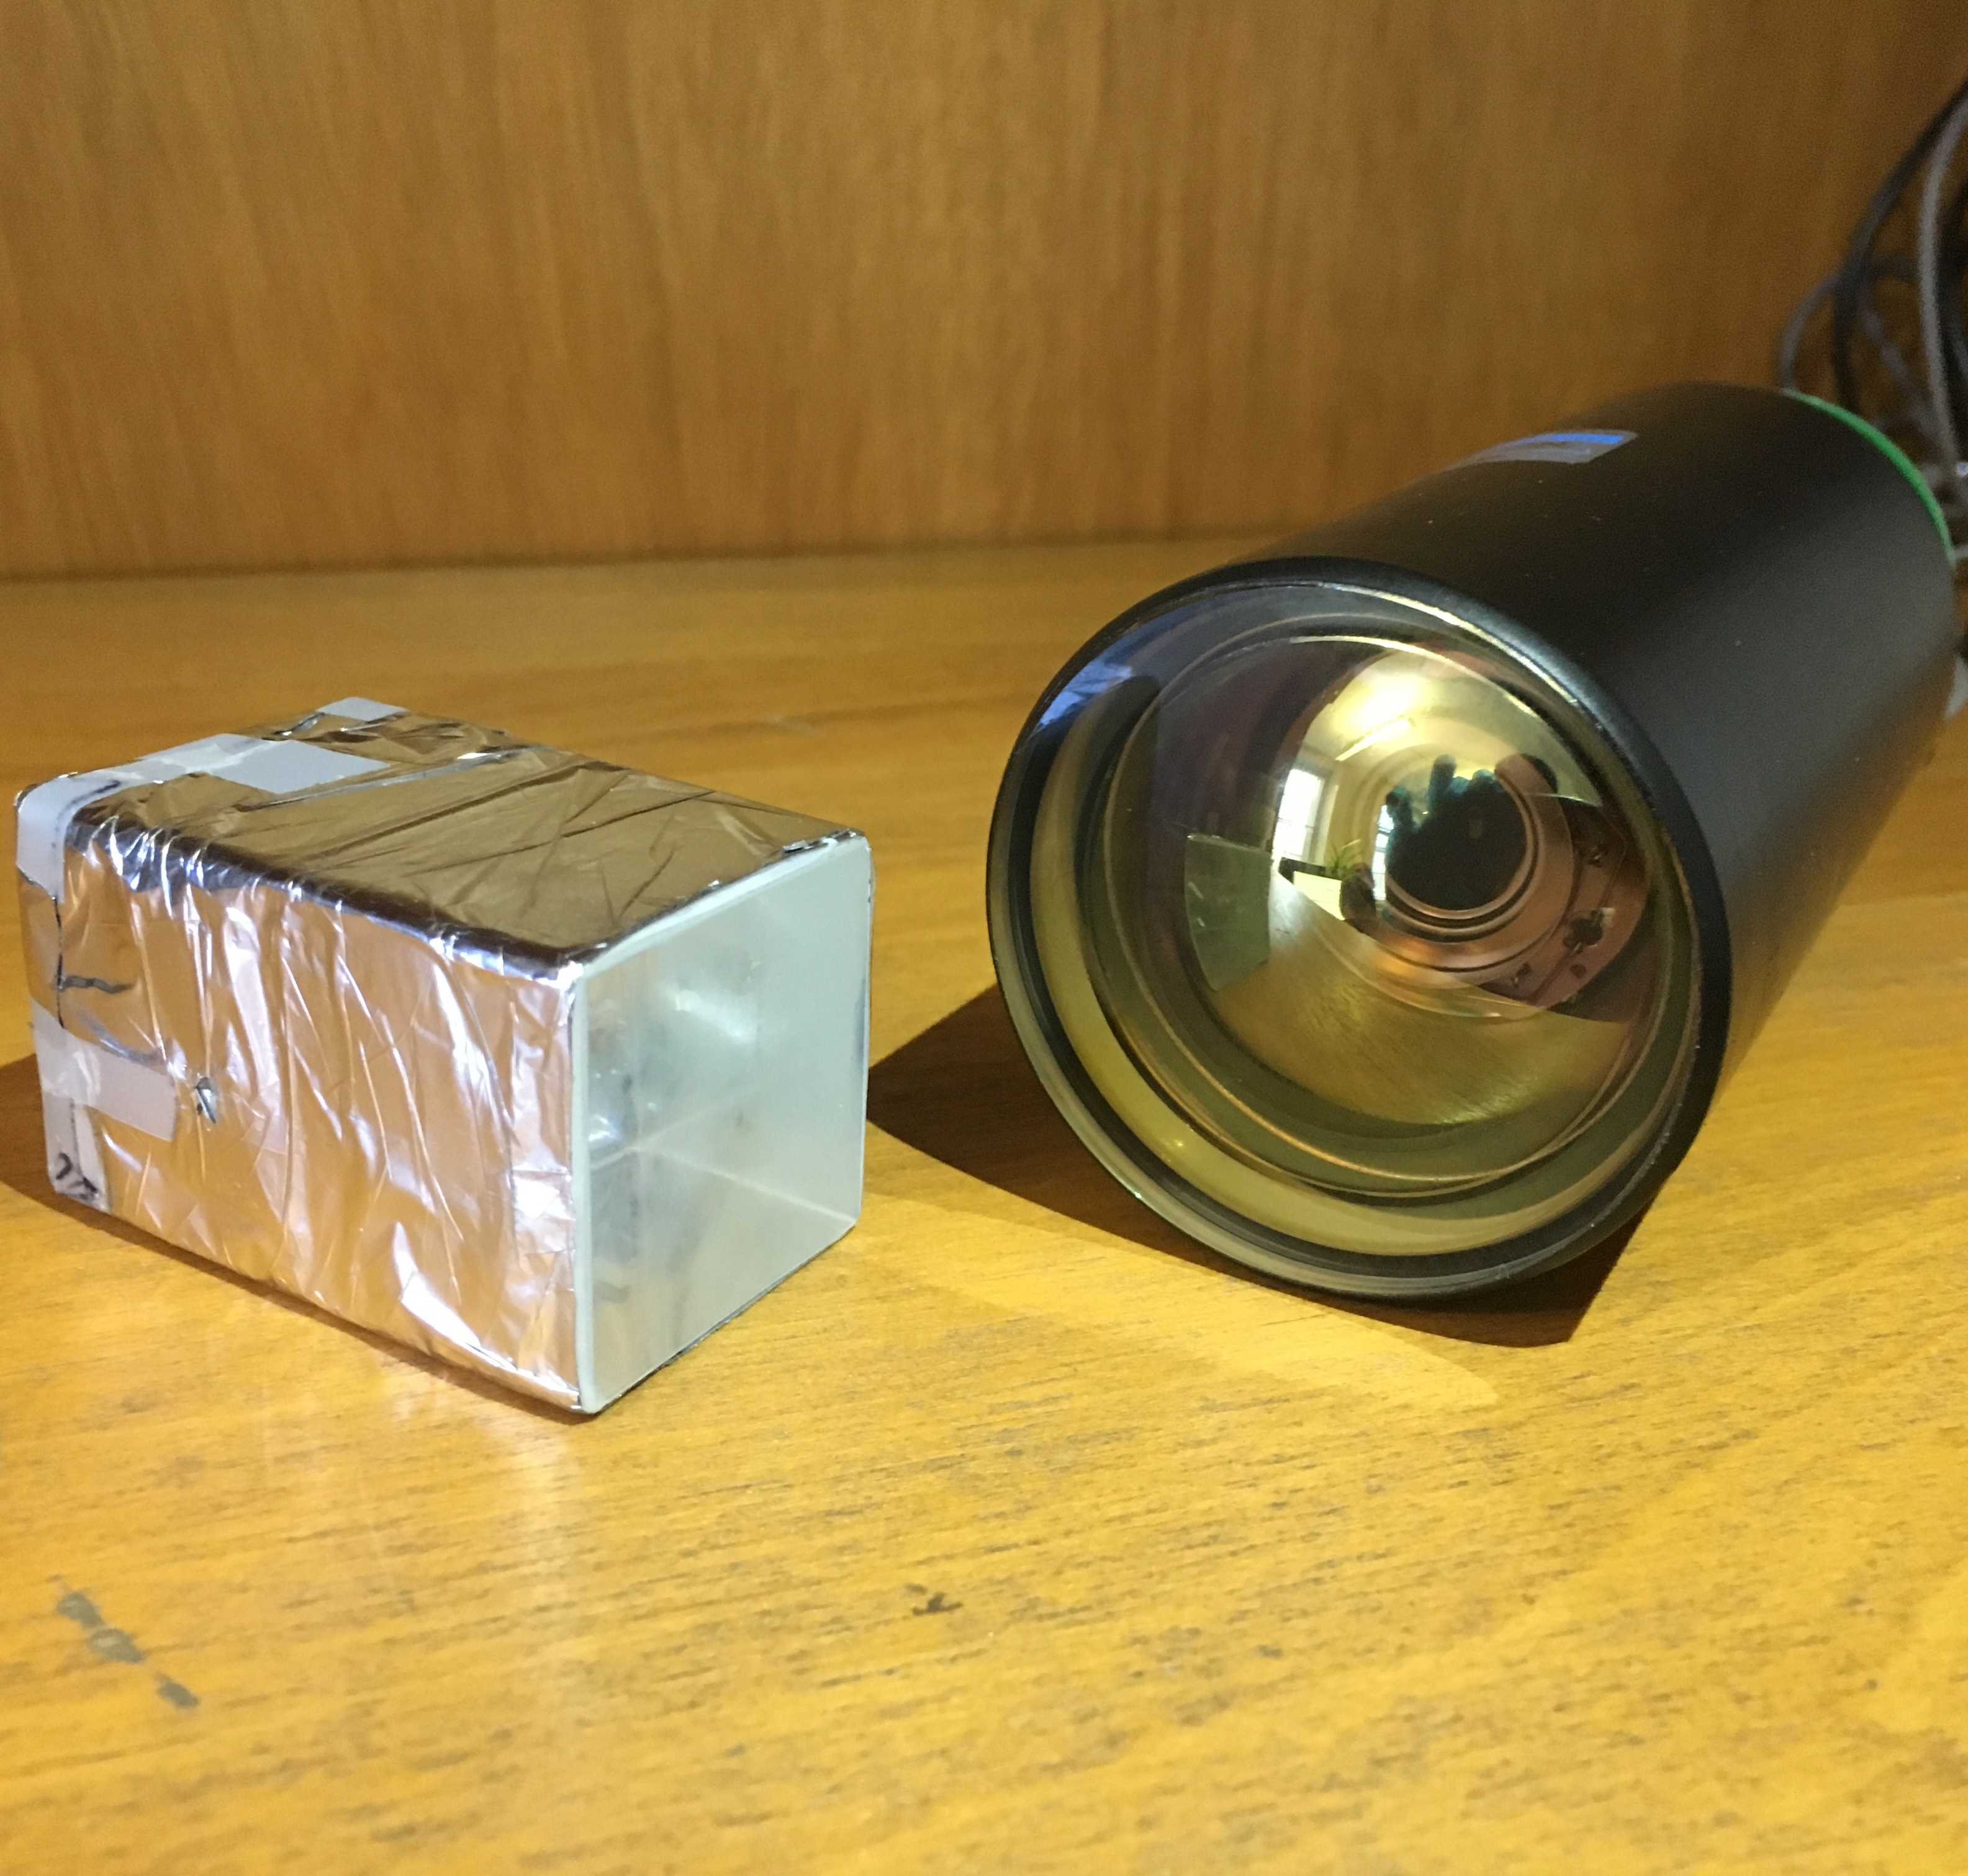
UCL Single-Module Calorimeter
Measures particle energy.
Scintillator light output proportional to deposited energy, converted to electric current in photomultiplier tube.
Polystyrene plastic scintillator block, which is water-equivalent.
Scintillator (left) and photomultiplier tube (right).

Slide 7
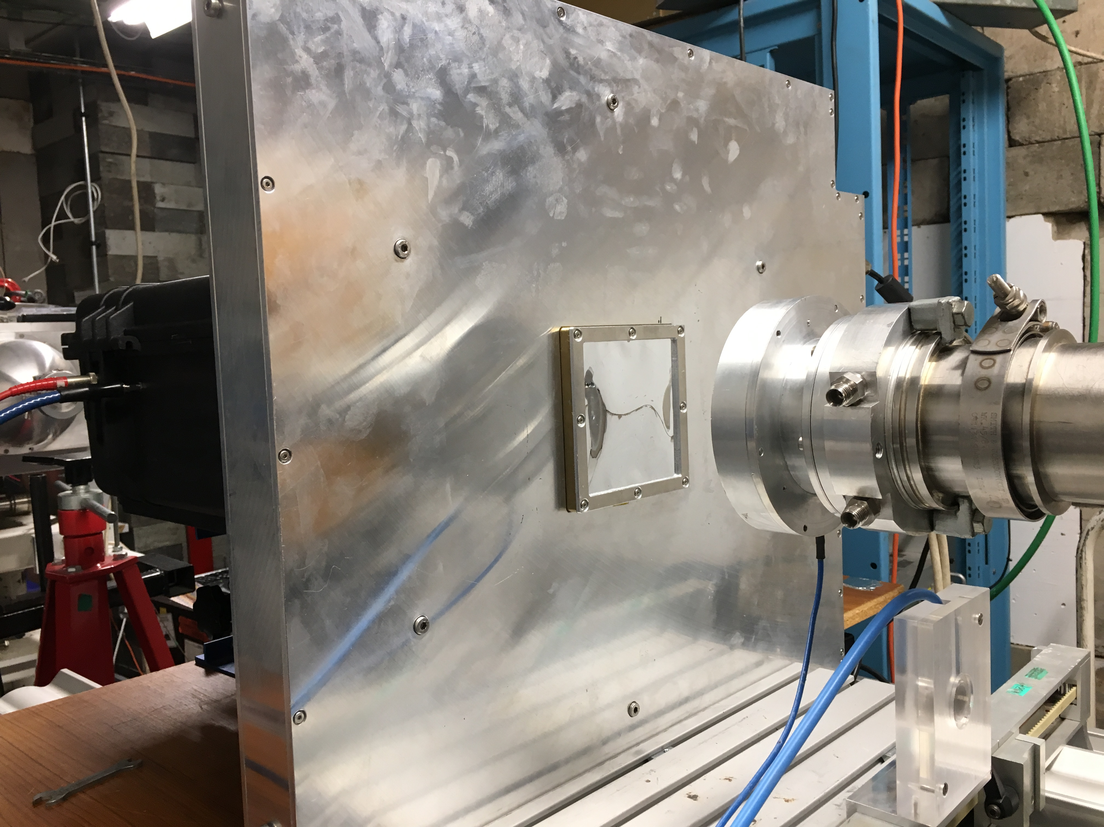
PRaVDA Silicon-Strip Tracker
Measures 2D particle position.
Intended for use in proton CT.
Consists of 3 silicon strip layers offset by 60° to allow 2D measurements.
Notes:
Mention where the tracker window is and where the beam enters from.
3 Silicon layers are used to reject noise. We triggered when 2/3 layers registered a hit.

Slide 8
Birmingham Beam Test
If we can correlate events made across detectors, we could reconstruct a 3D dose deposition.
Test simultaneous use of both detectors to measure proton energy and position using 36 MeV beam at Birmingham cyclotron.
Want to reconstruct 3D depositions for a variety of test configurations.

Slide 9
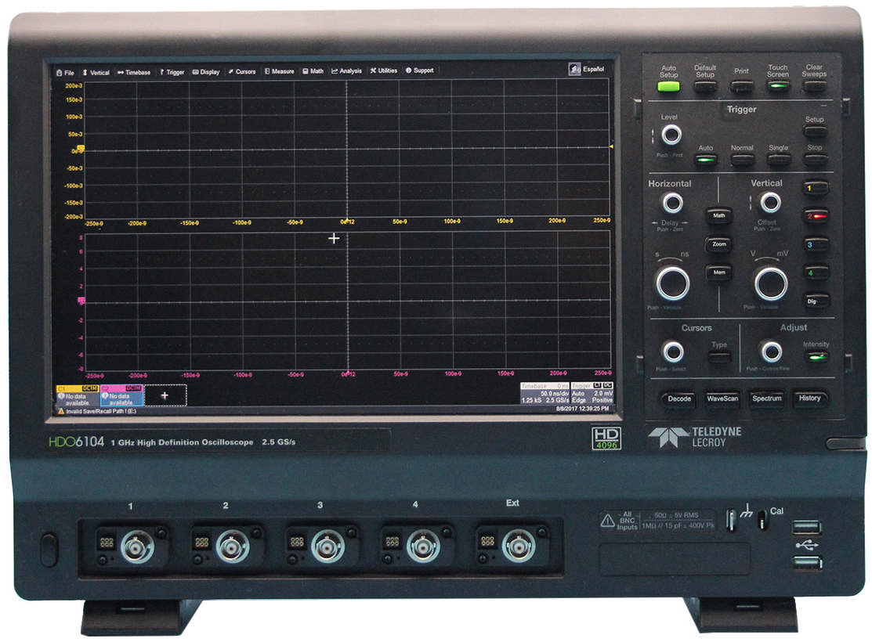
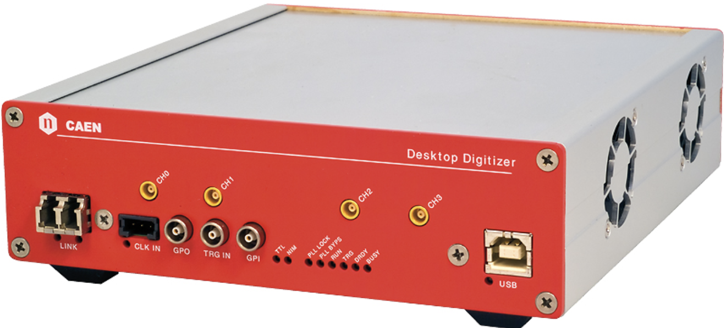
Single-Proton Counting Schematic
LeCroy Oscilloscope
Tracker
Aluminium Collimator
Trigger Pulse
Beam Degrader
36 MeV Proton Burst
Scintillator Block
Photomultiplier Tube
Calorimeter
Caen Digitiser
PMMA (1 mm increments)
(x, y) Position Measurement
Energy Measurement
Notes:
Mention beam degrader at the end, noting that PMMA is water-equivalent.

Slide 10
Calorimeter Read-out Devices
LeCroy Oscilloscope
Single-Proton Acquisition
Potential Difference (mV)
Time (ns)
Stores individual proton events: potential difference against time.
Integral of the pulse is proportional to proton energy.
Triggered by the tracker to record proton events.
Notes:
Stress that LeCroy was triggered by tracker!

Slide 11
Calorimeter Read-out Devices
Caen Digitiser
Proton Energy Spectrum – Histogram of Proton Energies
Frequency
ADC Counts
Able to automatically integrate and histogram proton pulses –> self-triggered.
Lacks resolution in storing individual proton events.
Used to compare energies calculated by LeCroy.

Slide 12
Overview of Analysis
Proton Energy Spectra Reconstruction
  Verify that LeCroy oscilloscope can provide reliable proton energies by comparing energy spectra against Caen digitiser

Slide 13
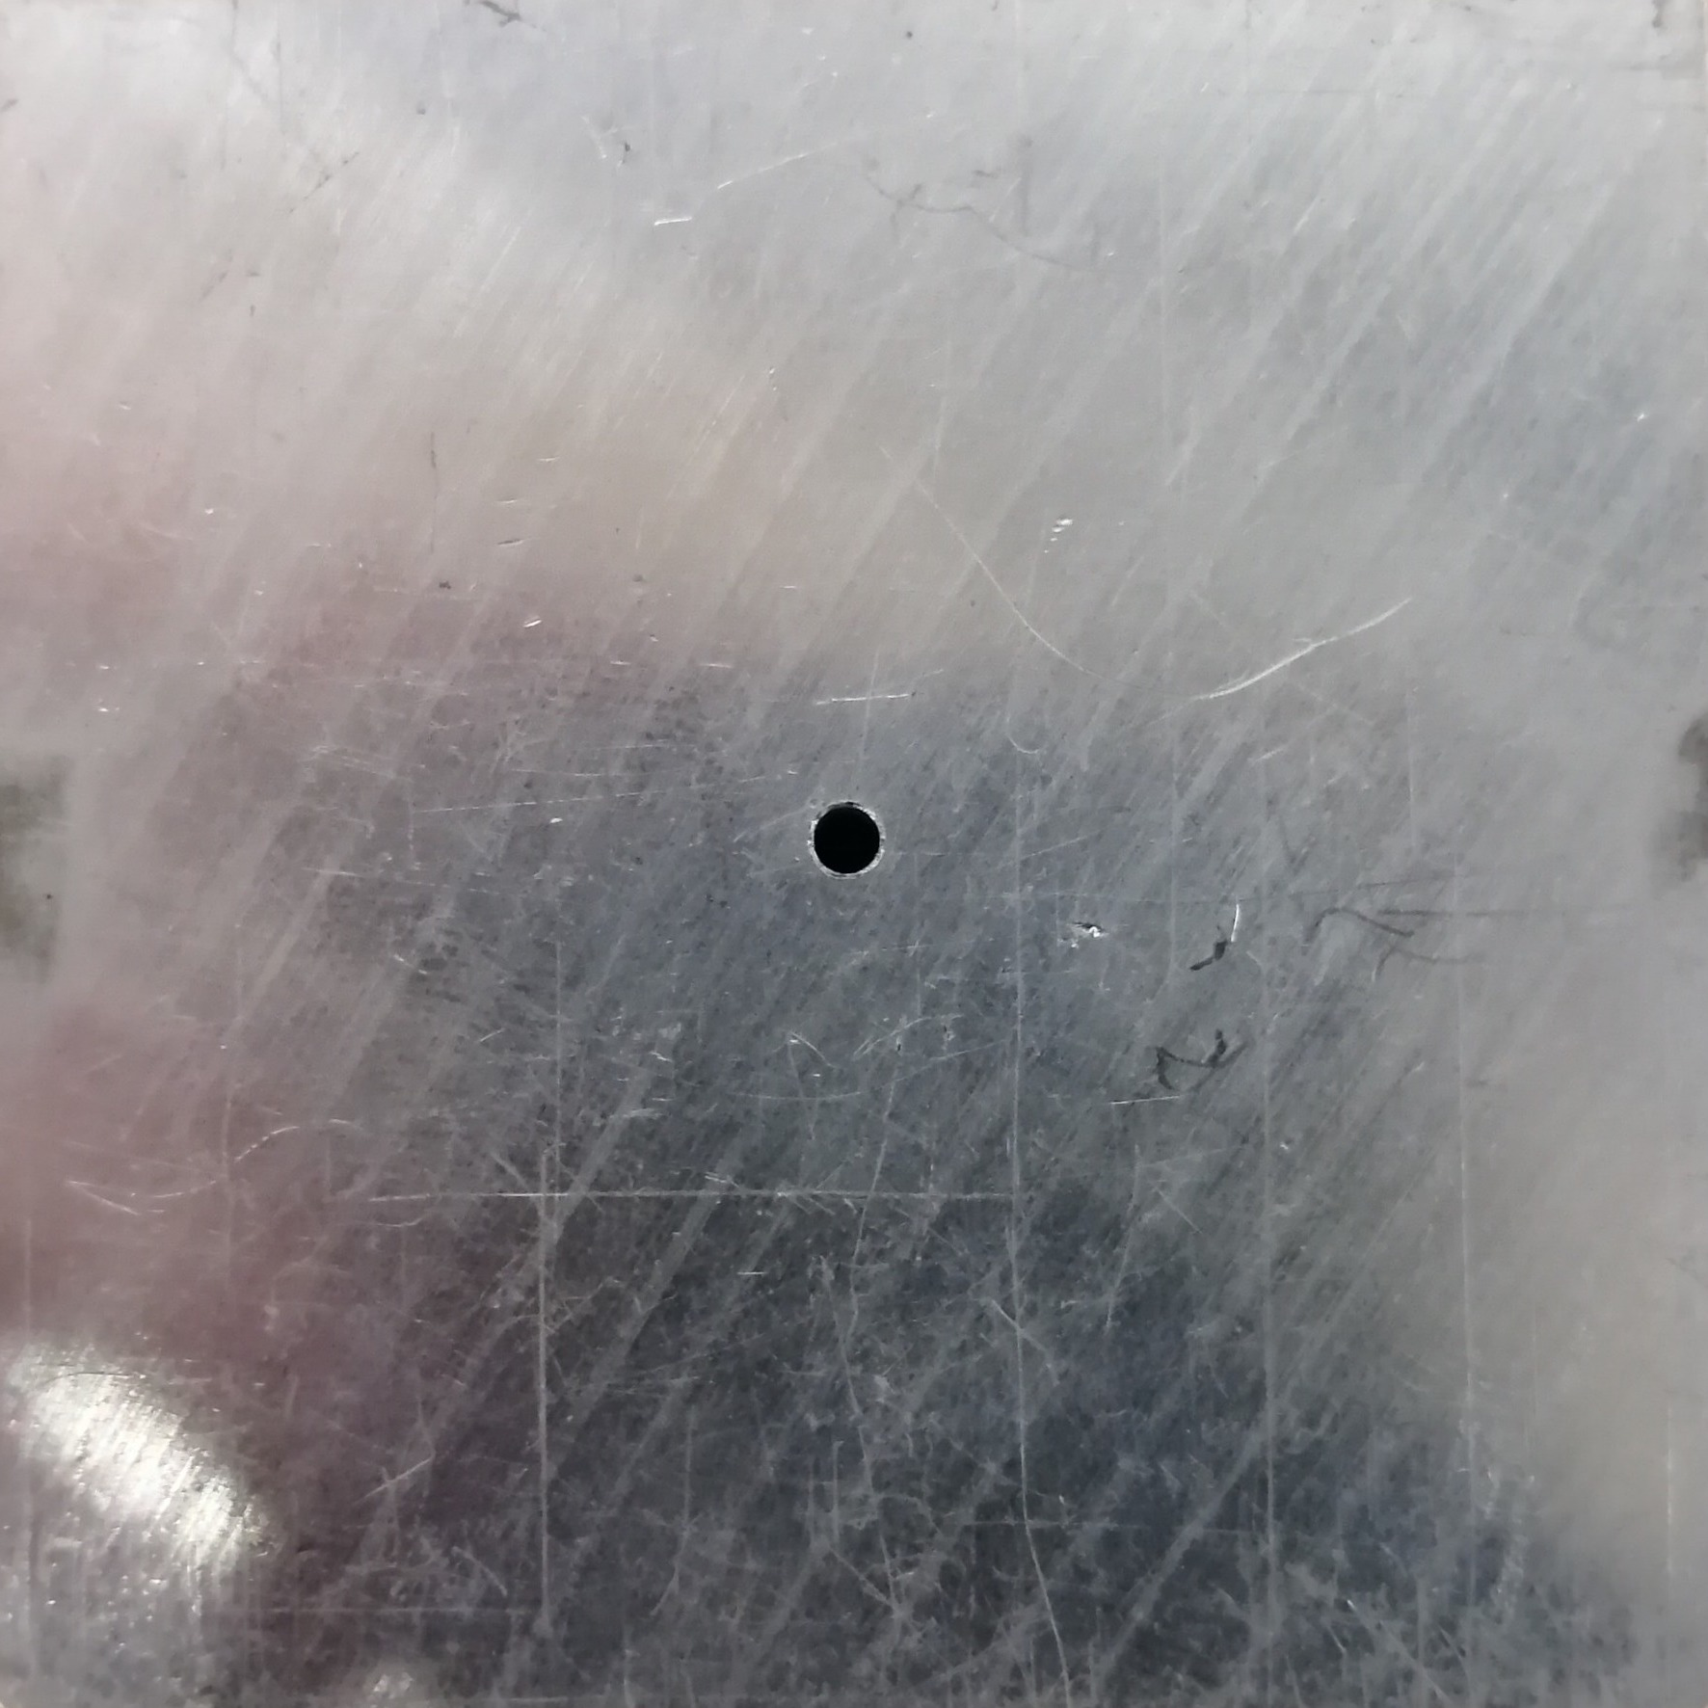
Proton Energy Spectrum Reconstruction
Use single collimator with increasing degrader thickness to check energy calculations.
Configuration produces a single beam, where peak proton energy decreases with degrader thickness.
2 mm centred collimator. Tested with 0 – 6 mm degrader in 1 mm increments.

Slide 14
Proton Energy Spectrum Reconstruction
Single Proton Acquisition
Histogram of Proton Energies (Spectrum)
Frequency
Potential Difference (mV)
Time (ns)
ADC Counts (mVns)
Approx. 10—20K acquisitions per run.
Filter poor acquisitions, remove noise and then integrate to calculate proton energy.
Scale and plot LeCroy spectrum alongside equivalent Caen digitiser spectrum.

Slide 15
Proton Energy Spectrum Reconstruction
Frequency
Frequency
ADC Counts (mVns)
ADC Counts (mVns)
1 mm Degrader
6 mm Degrader
Energy of the peak decreases with more degrader!
Notes:
Different low-energy tails due to different threshold energies of devices.

Slide 16
Overview of Analysis
Proton Energy Spectra Reconstruction
  Verify that LeCroy oscilloscope can provide reliable proton energies by comparing energy spectra against Caen digitiser
Tracker–Calorimeter Event Correlation
  Convert LeCroy energies to ranges and correlate with tracker events. Energy provides 3rd dimension!

Slide 17
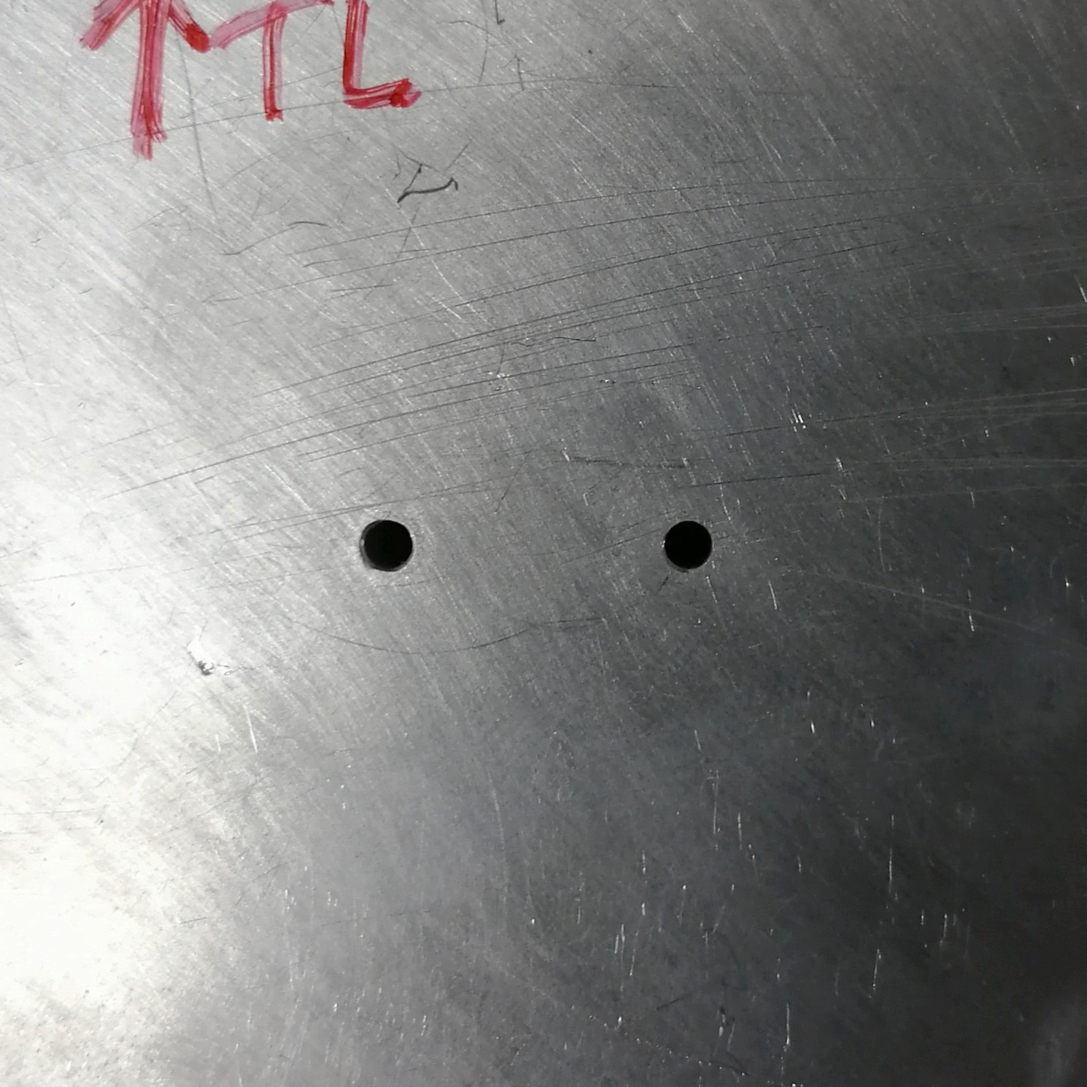
Tracker–Calorimeter Event Matching
Consider test configuration with 2 collimator holes – expect to see two peaks in 3D space.
Test 0 & 6 mm degrader in front of both holes and 4 mm in front of only one hole.
Convert energy to range using power law.
Find appropriate criterion to correlate LeCroy events with tracker events.
2 mm collimator pair with centres apart 12 mm in the x-direction.

Slide 18
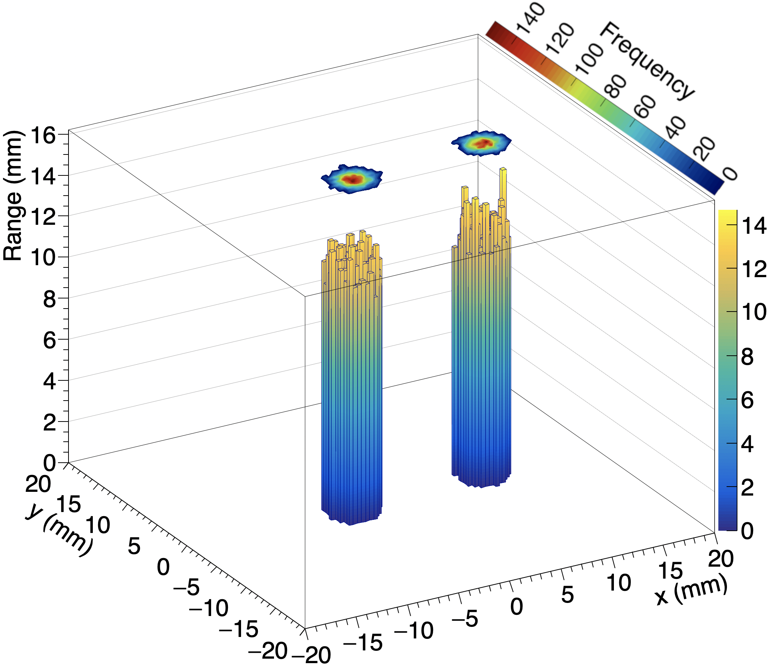
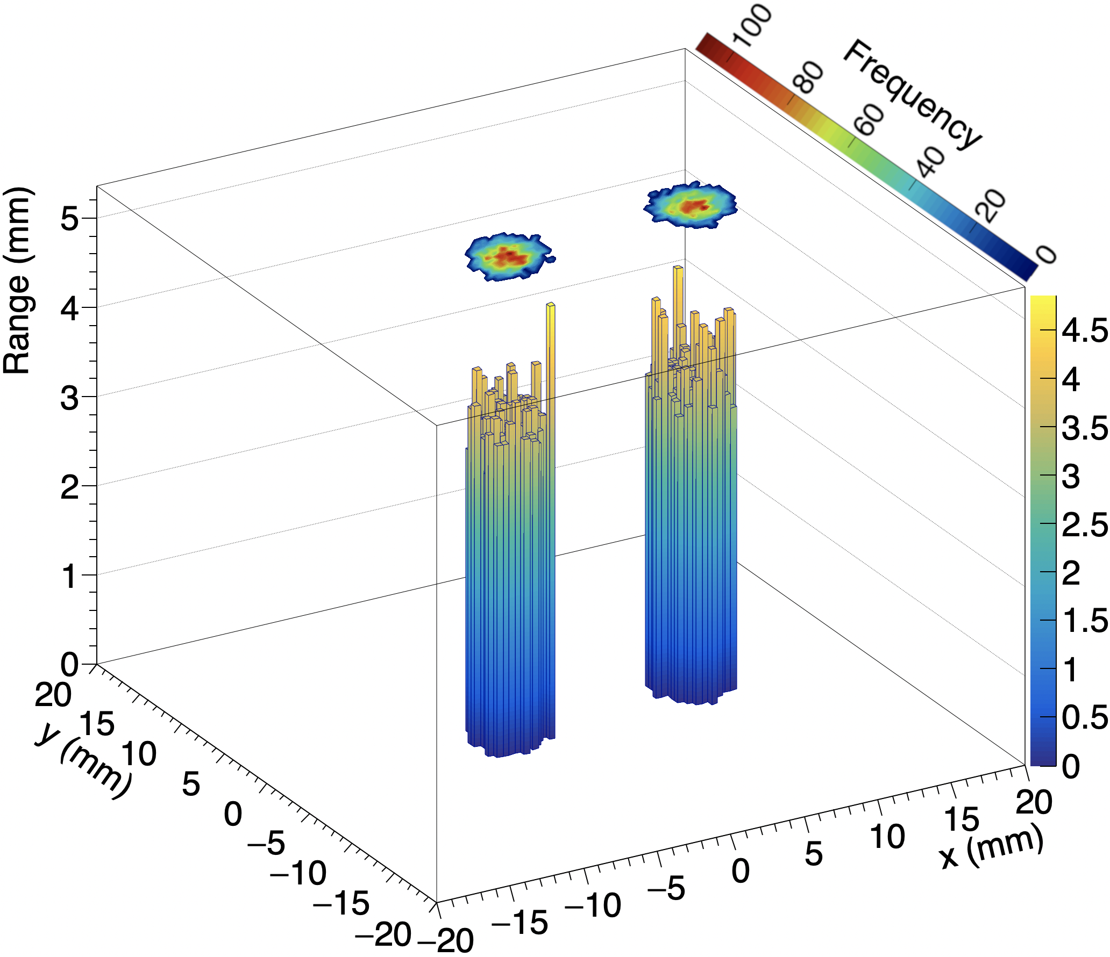
3D Dose Depositions – Collimator Pair
0 mm degrader
6 mm degrader on BOTH collimators

Slide 19
3D Dose Depositions – Collimator Pair
Covered collimator shows reduction in average range and intensity as expected.
Resolved both position and energy!
Frequency
4 mm degrader on ONE collimator
ADC Counts (mVns)

Slide 20
Summary
Measured proton energy and position using 36 MeV proton beam.
Calculated proton energies and correlated with position measurements.
Reconstructed 3D dose-depositions for variety of collimator configurations.
Provided proof-of-principle for simultaneous use of the tracker and the calorimeter.
Further work: Similar experiments using larger currents.
Notes:
If you have time, talk about how current set up would not work in a clinical scenario.

Slide 21
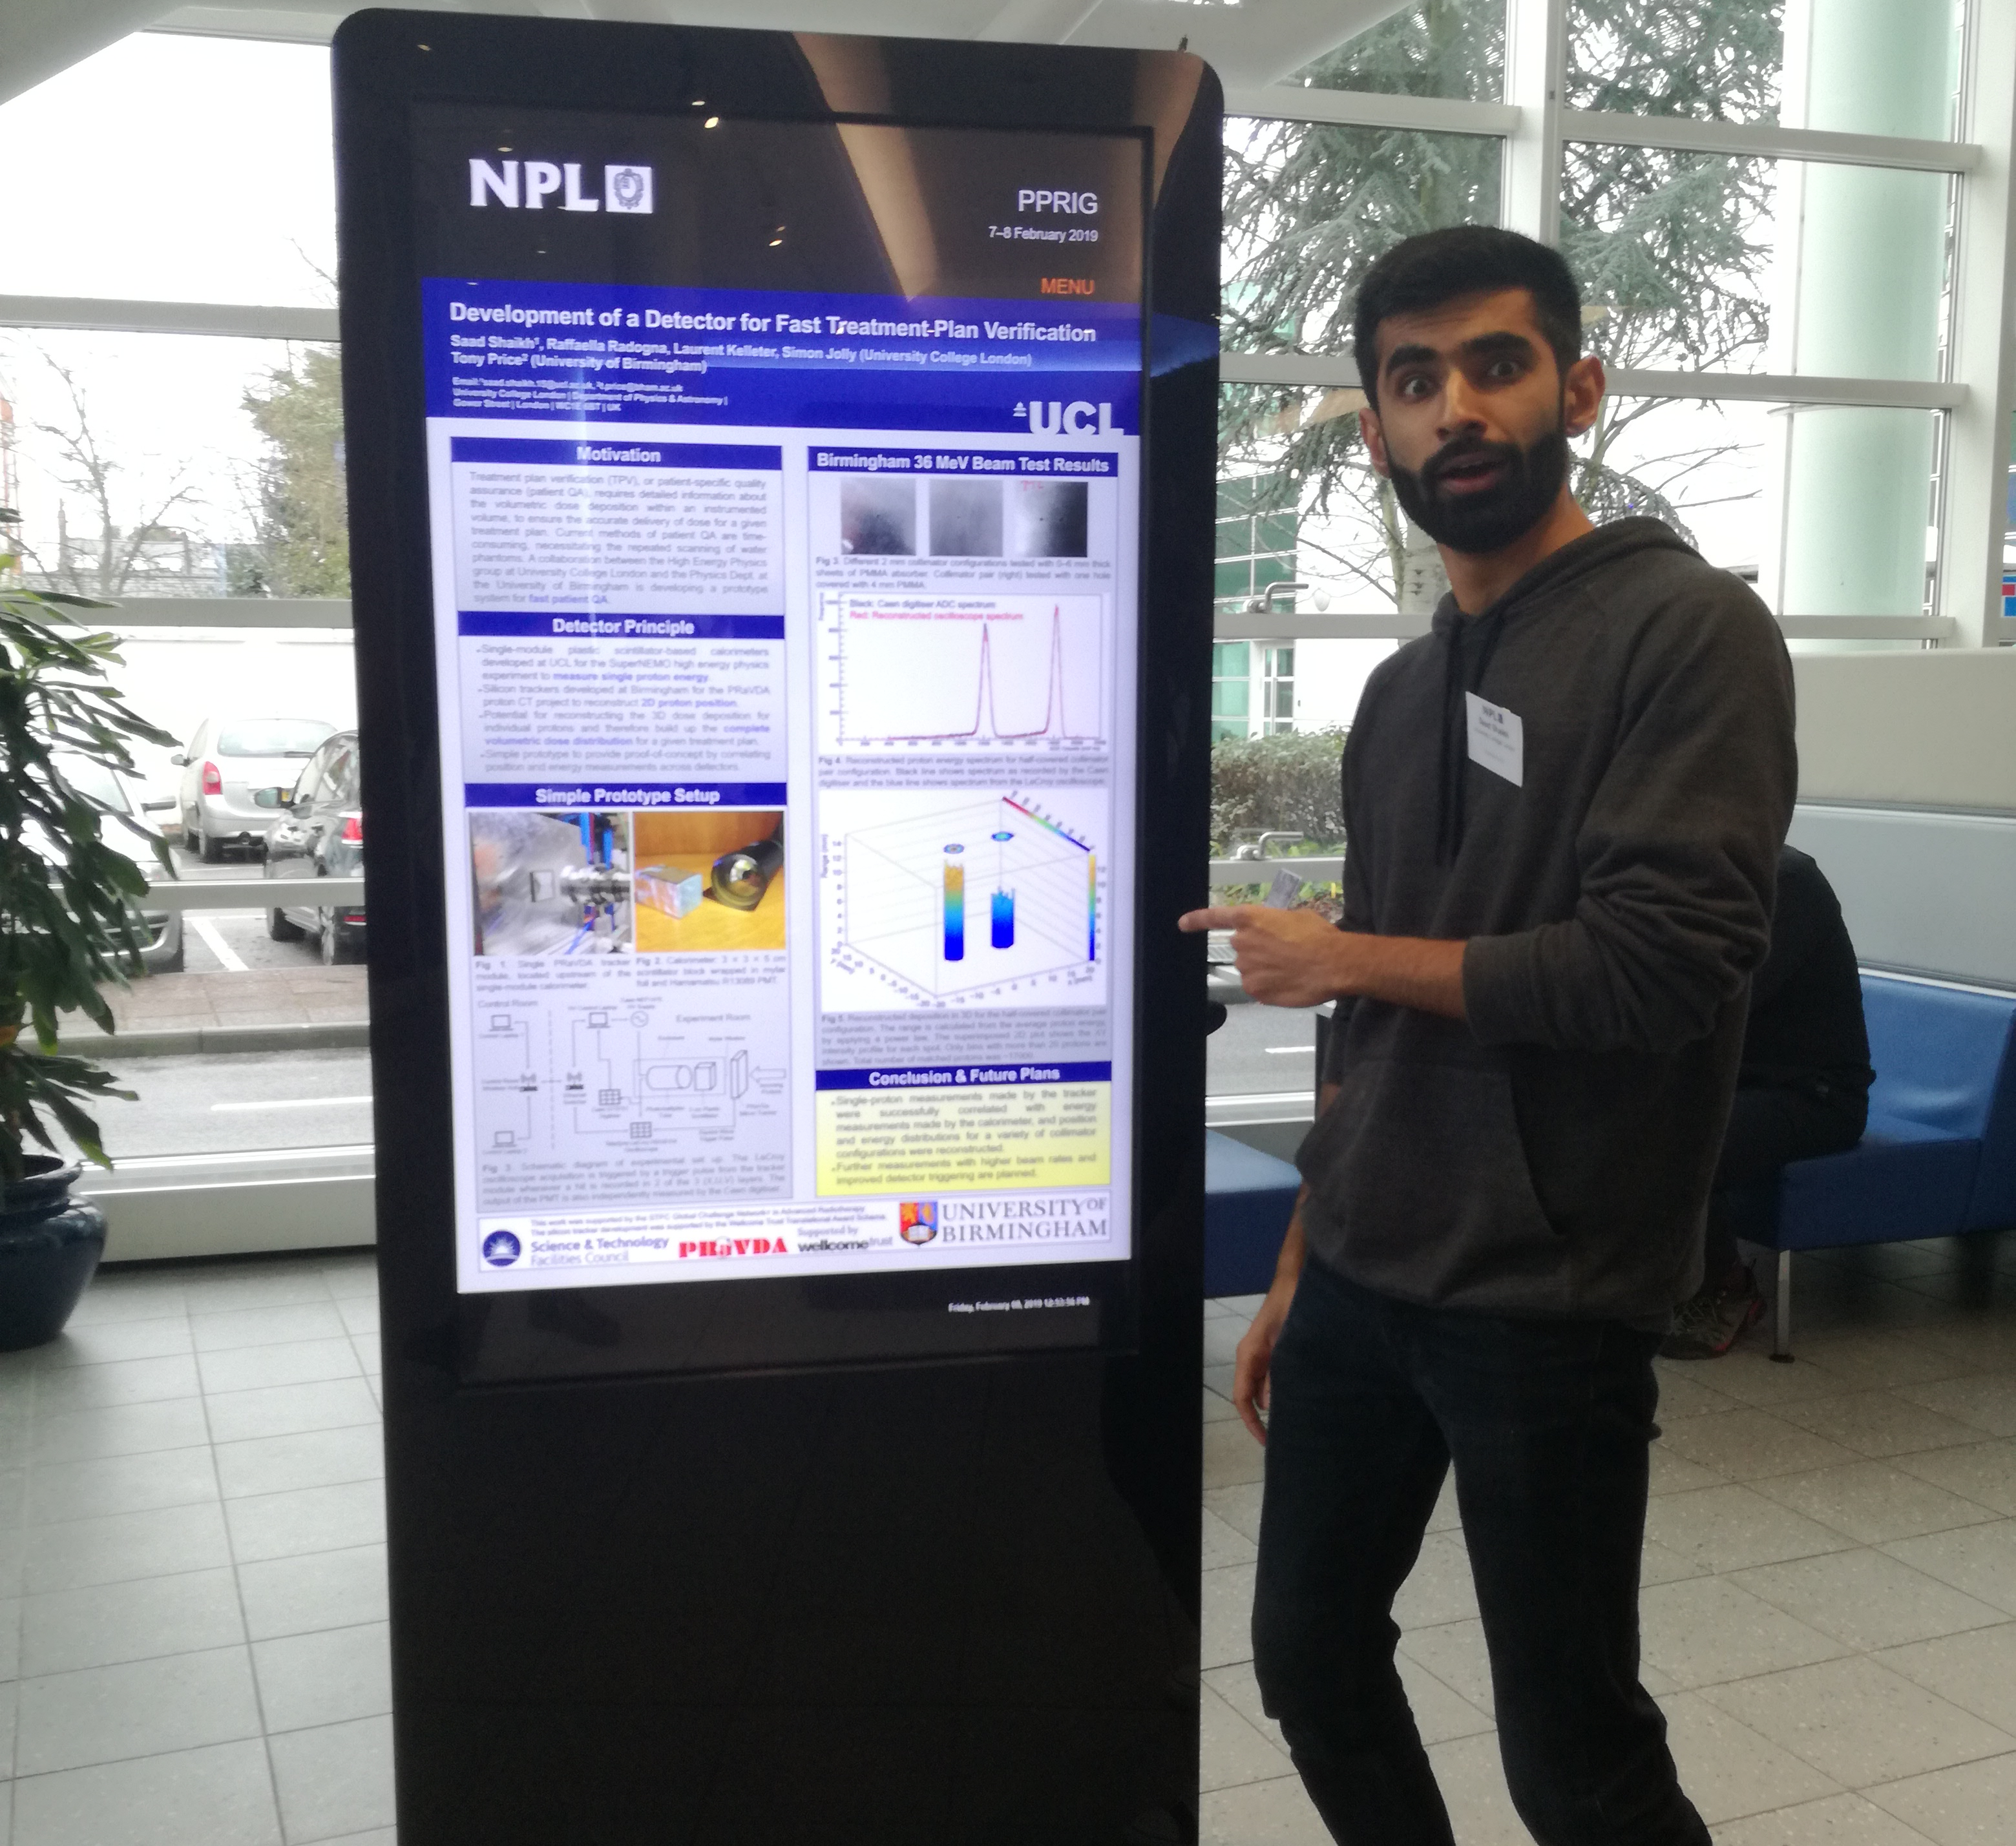
Questions?
Presenting a poster at the National Physics Laboratory

Slide 22
Extra Slides

Slide 23
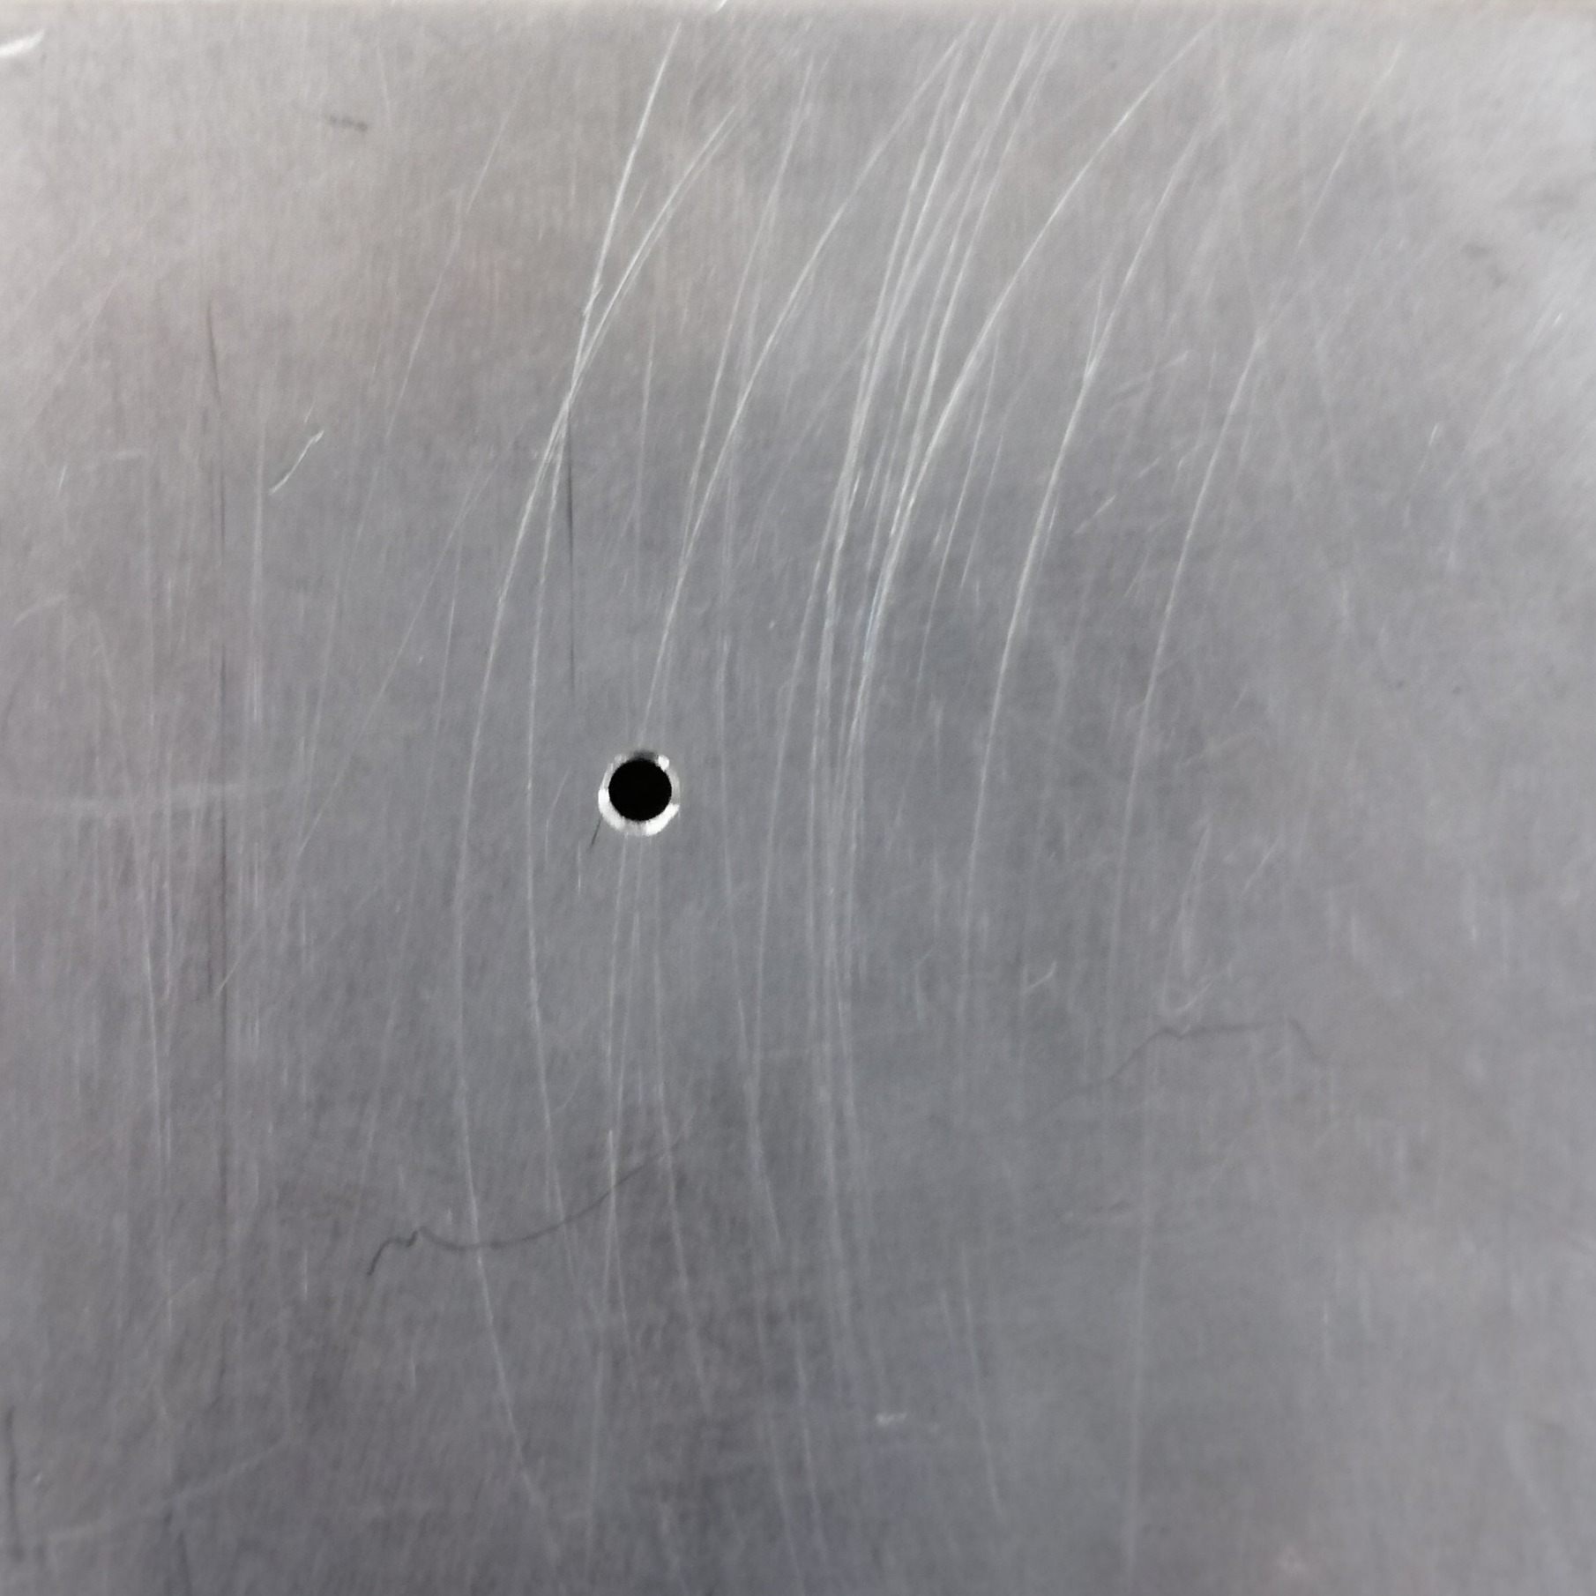
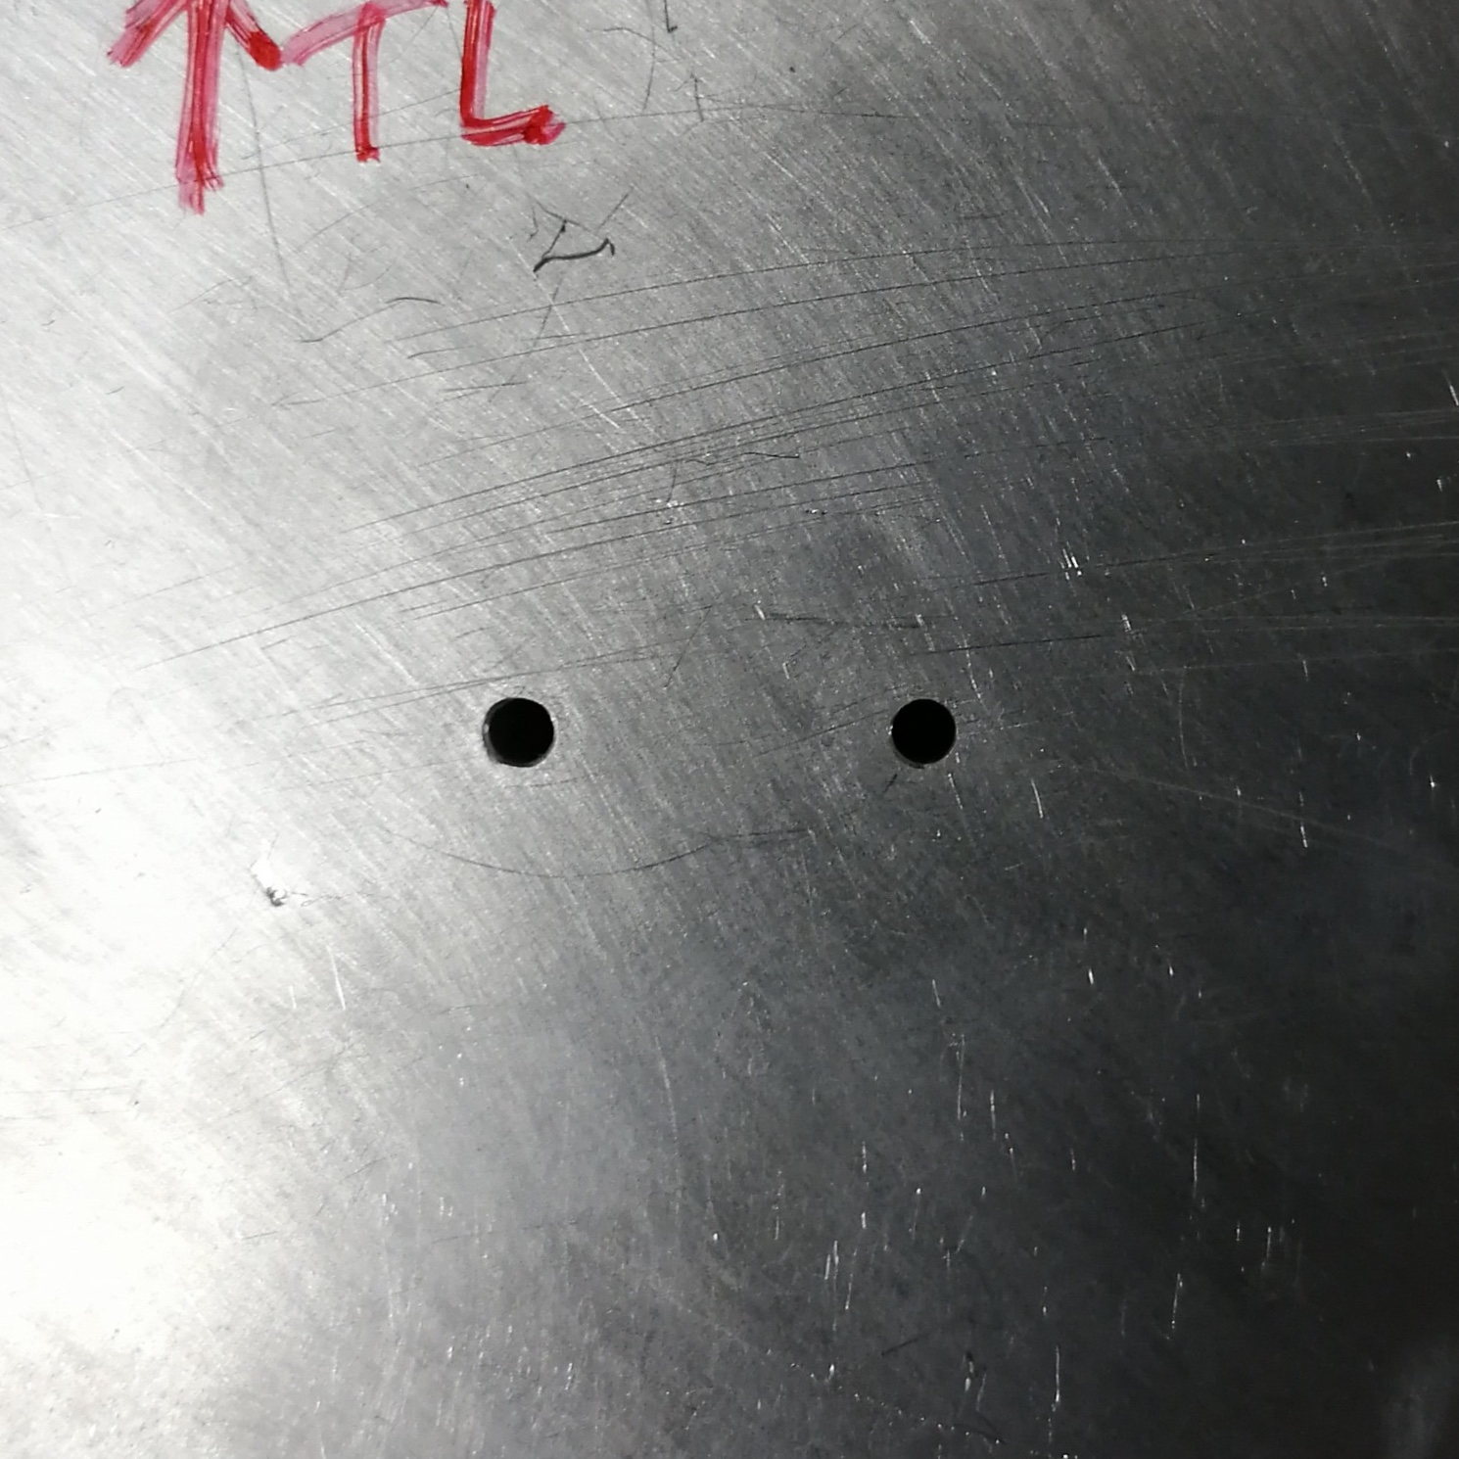
Collimator Configurations
2 mm centred collimator. Tested with 0 – 6 mm PMMA in approx. 1 mm increments.
2 mm collimator off-centre by 6 mm in the x-direction. Tested with 0 & 6 mm PMMA.
2 mm collimator pair with centres apart 12 mm in the x-direction. Tested with 0 & 6 mm PMMA in front of both holes, and 4 mm in front of only one hole.

Slide 24
Experiment Specifications
Beam Energy | 36 MeV
Beam Current | ~100 pA or ~10 kHz
PMT Voltage | -900 V
Scope Trigger Threshold | 70 mV
Scope Timebase | 100 ns/div
Scope Vertical Scale | 50 mV/div
Scintillator Density | 1.06 g/cm³
Scintillator Decay Time | 2.5 ns
Silicon Strip Thickness | 150 μm
Silicon Strip Active Area | 93 × 96 mm²
Silicon Strip Pitch | 90.8 μm

Slide 25
Proton Energy Spectra Reconstruction
How do we measure proton energy?
Oscilloscope measures potential difference output of PMT
Scintillation light is converted to a current hence we see a pulse.
We record lots of these “acquisitions”
  Most are good –> one proton only
  Some are bad –> more than one proton (pile-up) or no proton (false-trigger)
Integrating over this pulse gives a value representative of energy.

Slide 26
Proton Energy Spectra Reconstruction
How do we process an acquisition?
Subtract dark current background noise
  Baseline subtraction
Filter pile-up
  Baseline testing
Calculate energy
  Locate and integrate over pulse
  Already had integration method.

Slide 27
Proton Energy Spectra Reconstruction
Baseline Test
Pre-trigger Region
Post-trigger Region
Pulses could be anywhere in acquisition due to timing jitter from tracker trigger – but most pulses start at about -120 ns.
Choose two regions to test – pre-trigger and post-trigger.
Calculate average potential difference in pre-trigger region to determine background noise.
Don’t assume too heavily that pulse is around -120 ns – we check for pulses in both pre-trigger and post-trigger region, filtering an acquisition if both regions show a pulse.

Slide 28
Proton Energy Spectra Reconstruction
Negative Potential Difference Check
Check for a negative potential difference value to verify that there is a pulse at all!
After baseline tests, use position of most negative potential difference to assign an integration window of 150 ns.
Method of integration already written and tested in previous work – employs a Newton-Cotes formula.

Slide 29
Proton Energy Spectra Reconstruction
Recover the correct shape
True test would be to plot both spectra on single graph
  Caen digitiser took a lot more data -> Need to normalise y-scale (frequency)
  Energy scale is also slightly different –> Find a x-scale (energy) conversion factor from LeCroy to Caen

Slide 30
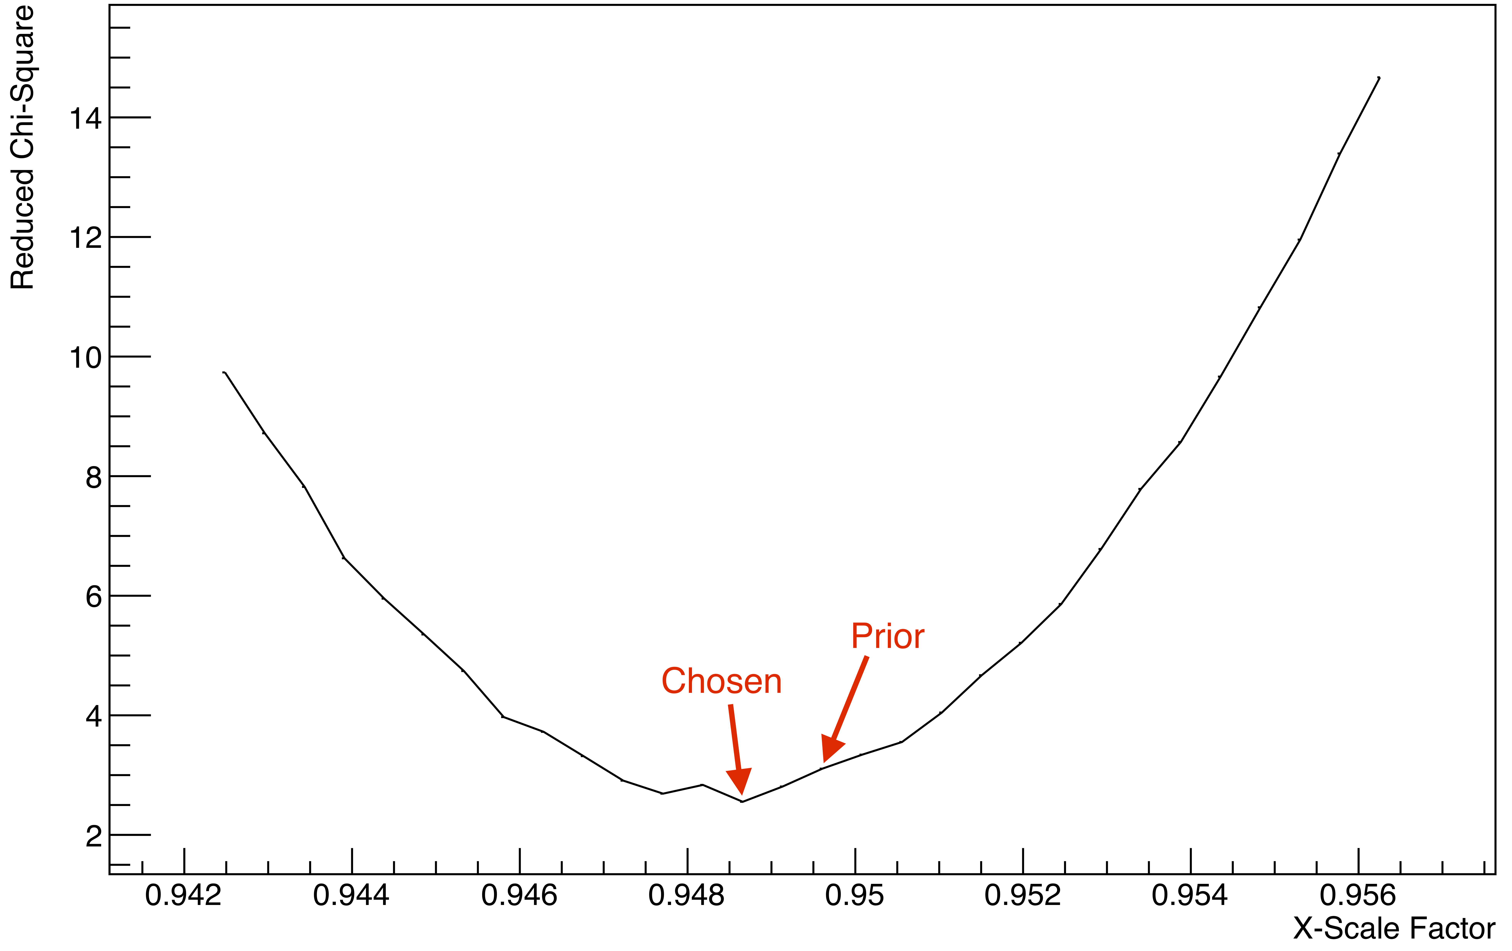
𝜒² Minimisation
Need to plot energy spectra from digitiser with spectra from LeCroy.
Find approximate x-scale factor by comparing positions of peak.
Construct histograms from a set of candidate x-scale factors.
Choose x-scale factor with lowest chi-square when compared to Caen digitiser spectrum.

Slide 31
Energy to Range
Energy forms the z-axis in our 3D reconstruction.
How do we convert an energy in units mVns to a range in mm?
Run simulations in GEANT4 of pencil-beam range in water.
Recover power law relation.
Set 36 MeV range as range of peak energy in spectrum without PMMA.

Slide 32
Tracker–Calorimeter Event Matching
Tracker was able to take in data much more quickly than LeCroy.
LeCroy limited by the length of an acquisition (1000 ns).
Tracker was not operating on exactly at 26 MHz – clocks drift further apart.
Plot of timestamp difference between closest LeCroy and tracker events reveals criterion to increase matching window appropriately.

Slide 33
Peak Energy vs. PMMA Thickness

