Slide 1
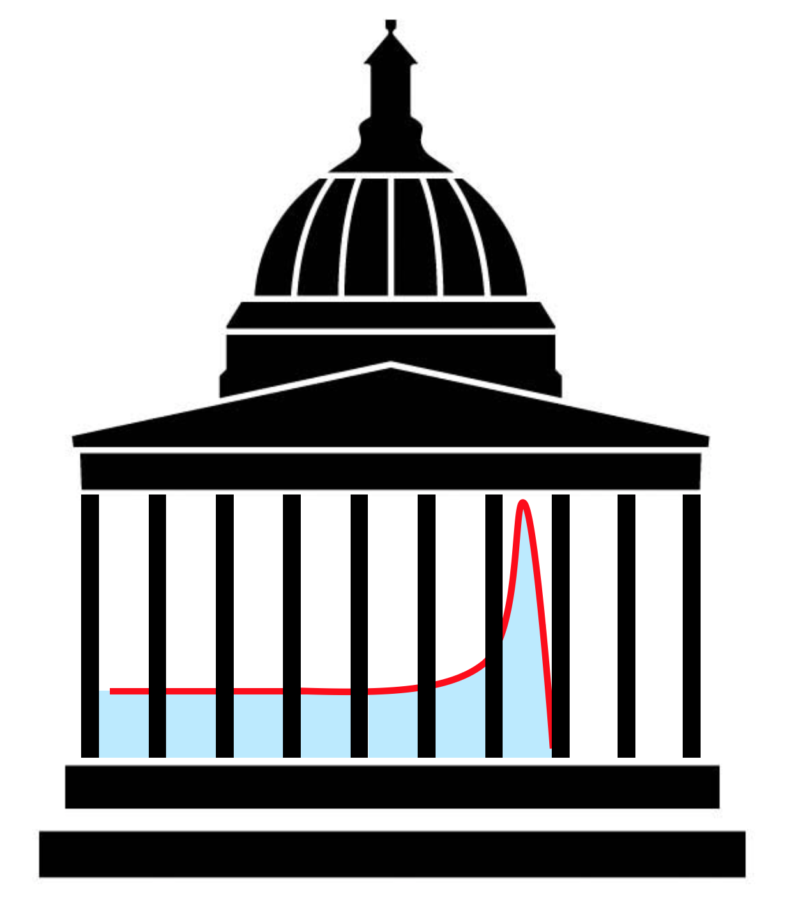
Light calibration of depth-light curves in QuARC
Laurent Kelleter

Slide 2
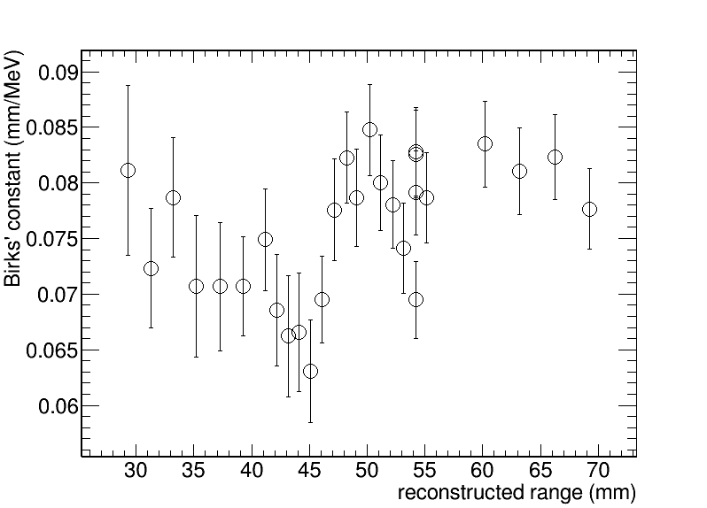
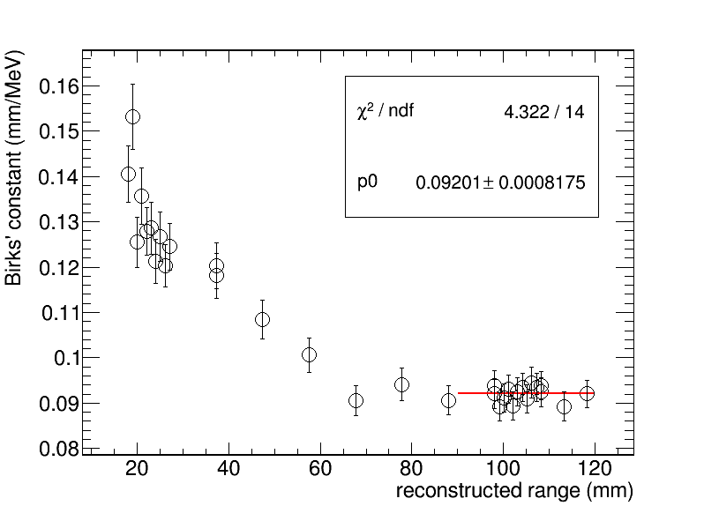
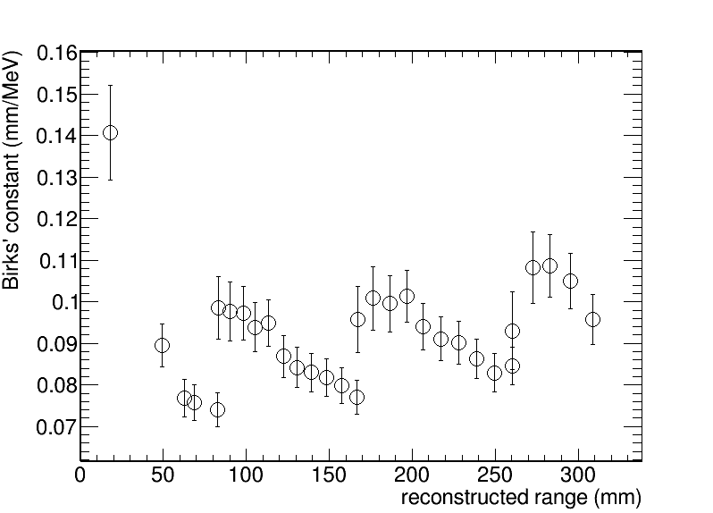
Birks constant measurement
MedAustron
HIT Nov18
HIT Apr19
Different values for each beam test! A calibration problem?

Slide 3
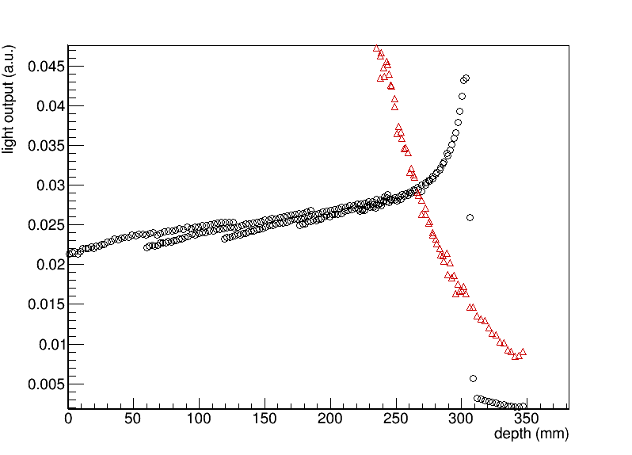
Helium long beam range
Another hint something is wrong with the calibration
??

Slide 4
Calibration: how it works
April 2019: Add shoot-throughs (ST) (front + back) / 2 and divide PDLs by it. The result should be flat and encode the sheet coupling.
Nov18 data: no back-side ST available, just use one-sided ST
March 18: no back-side ST available, just use one-sided ST
For the latter two: use a simulation of the ST to correct for the remaining slope in the plateau of the ST Bragg curve

Slide 5
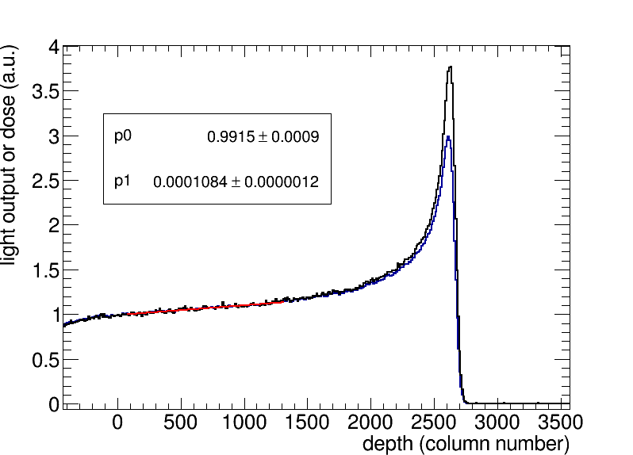
Simulation of ST
Protons, E=222.7MeV

Slide 6
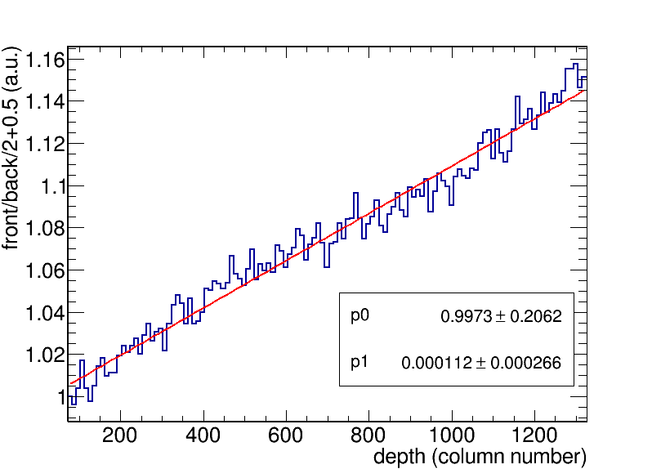
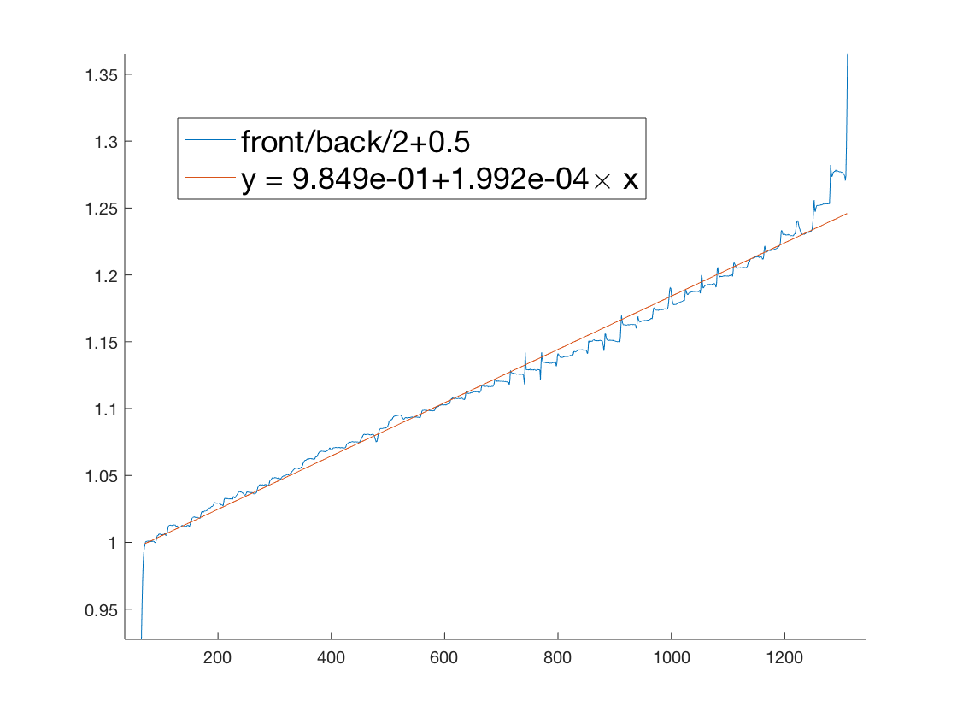
Comparison data & sim
y = front/back /2 +0.5
sim
Exp (data)
Slopes do not agree!

Slide 7
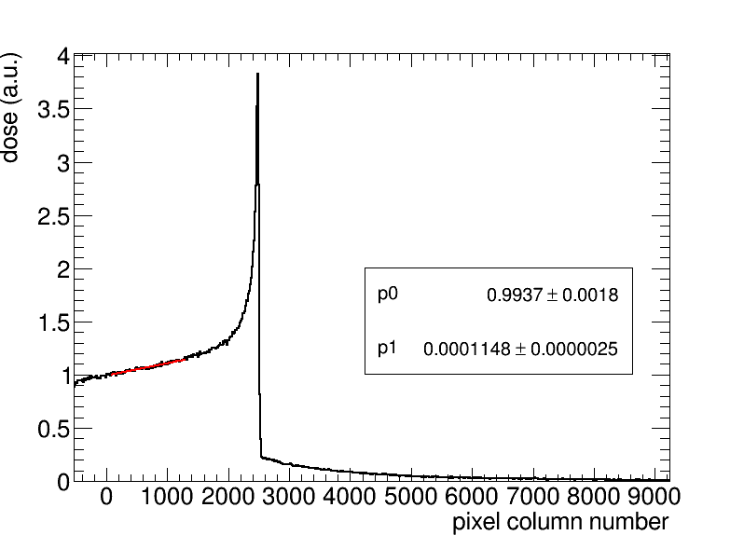
Comp sim & data for He

Slide 8
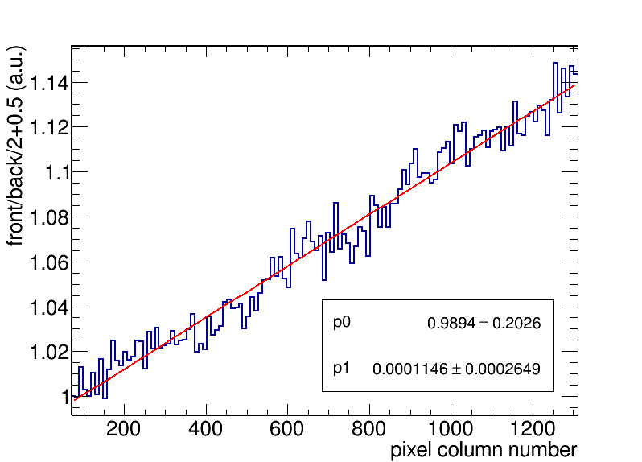
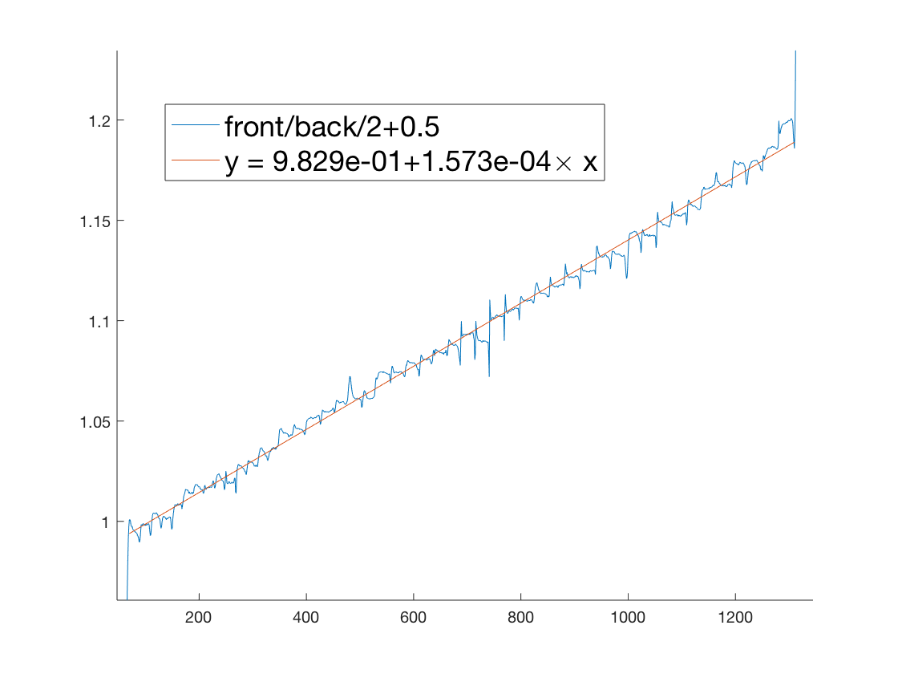
Comp sim & data for He
sim
exp

Slide 9
Potential explanation: misalignment
CMOS
light
Proton beam
scintillator

Slide 10
Discussion
How to utilise this information for a correction?
Would it be better to use Birks const as a fit parameter? (if there is a depth-dependent unknown correction, kB would be depth-dependent, too)

