Slide 1
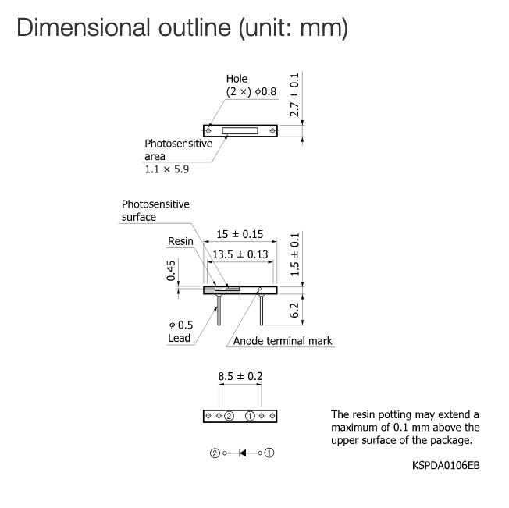
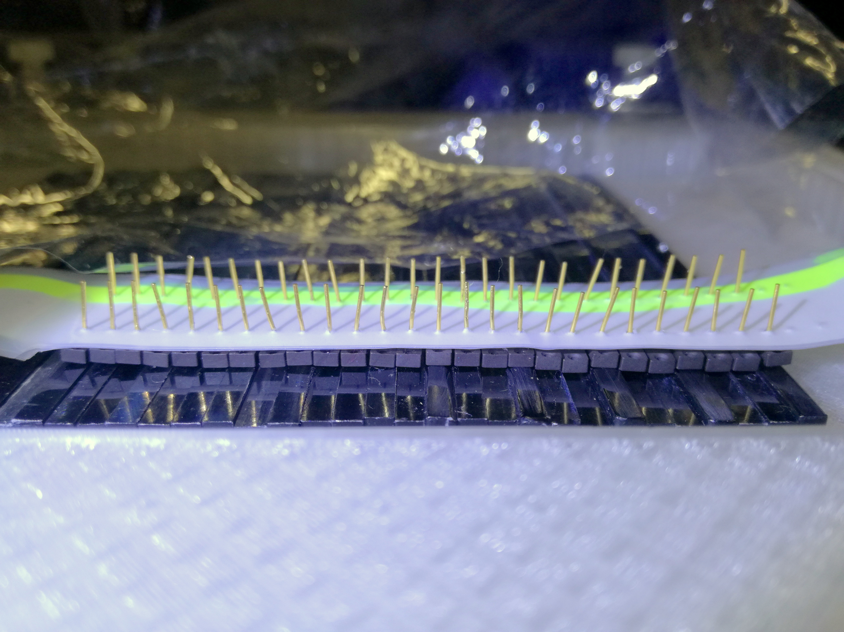
Current photodiodes array

Slide 2
Customized circuit board: updated dimensions
It would be great if we could align the board edge with the first PD.
15 - 20mm from the edge of the last PD
2.86 mm (hole pitch)
Common ground
8.5 mm PD pins
15 mm PD length
25 -30 mm
GND
1
2
3
26

Slide 3
Customized circuit board: updated dimensions
It would be great if we could align the board edges with the first and last PD.
2.86 mm (hole pitch)
8.5 mm PD pins
15 mm PD length
25 -30 mm
1
2
3
GND
Common ground

