Slide 1
Test of the detector prototype using photodiodes.
Preliminary results.
18 Nov 2020
Raffy, Saad.

Slide 2
EXPERIMENTAL SETUP n.1
Sensor
Optical fiber injecting UV light opposite to the PDs array and 90deg to the CMOS sensor
Very weak signal from photodiodes

Slide 3
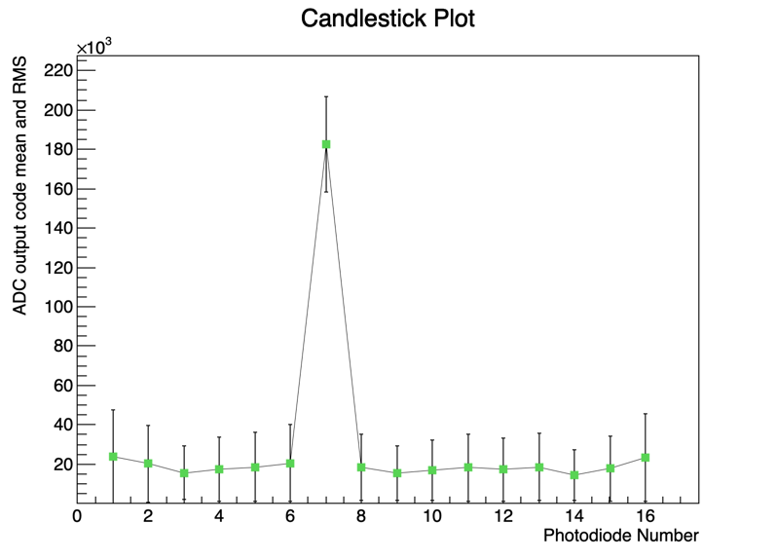
EXPERIMENTAL SETUP n.2
Area of the sensor covered by PDs in this setup.
Optical fiber injecting UV light 90deg to the PDs array. Sensor removed.

Slide 4
ELECTRONIC CONFIGURATION
Array of 16 photodiodes tested using a 32-channel current-input ADC. No reverse voltage applied.
2 different PD arrays tested using Hamamatsu S1337-16BR and S12915-16R
Different integration times and ADC Full Scale ranges
The signal from each PD is split in two ADC input channels:
  ADC channel 11 + channel 12 correspond to photodiode 7
  ADC channel 13 + channel 14 correspond to photodiode 4
- For each Run, int. time, full scale, and photodiode array are fixed
- About 20M bytes collected per run
- The signal for each photodiode is estimated as the sum of the signal recorded by the two associated channels, sample by sample.
32-ch. ADC

Slide 5
In this presentation:
ADC in diagnostic TEST mode ON
  when Test mode is used, the inputs are disconnected from the DDC232 integrators to enable the user to measure a zero input signal regardless of the current supplied to the inputs
ADC with TEST mode OFF and photodiodes unplugged
ADC with TEST mode OFF, photodiodes plugged and measuring DARK
ADC with TEST mode OFF, photodiodes plugged and measuring scintillation light

Slide 6
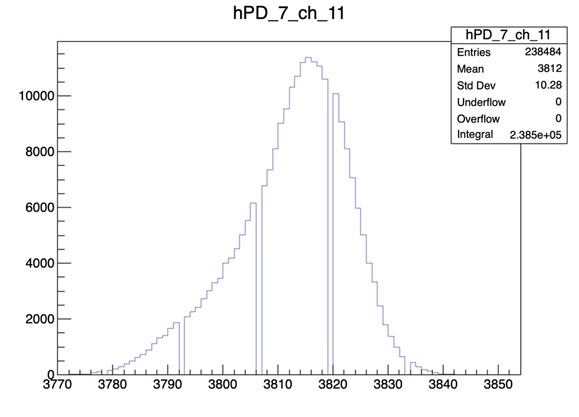
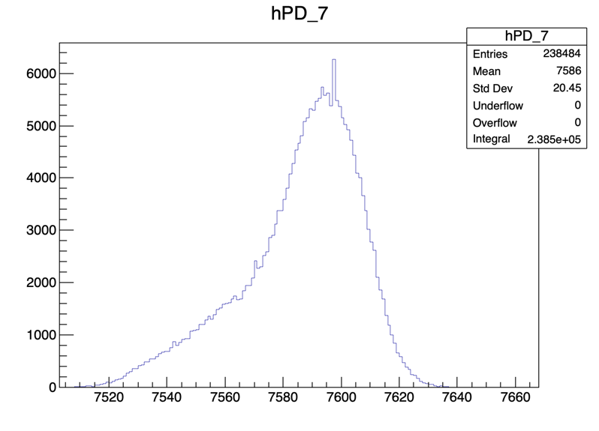
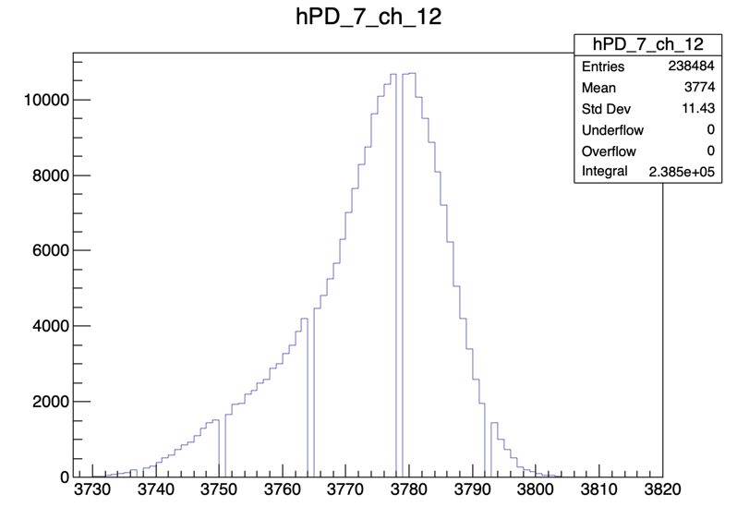
DDC in TEST mode. Int time 170us; Full Scale 350pC. Measured from Saad’s home.
Histograms of measured values. Each entry correspond to one sample.
Left: distribution of measured values for channels 11 and 12
Right: distribution of measured values for photodiode 7. Each entry is the sum of the associated values from ch 11 and 12.

Slide 7
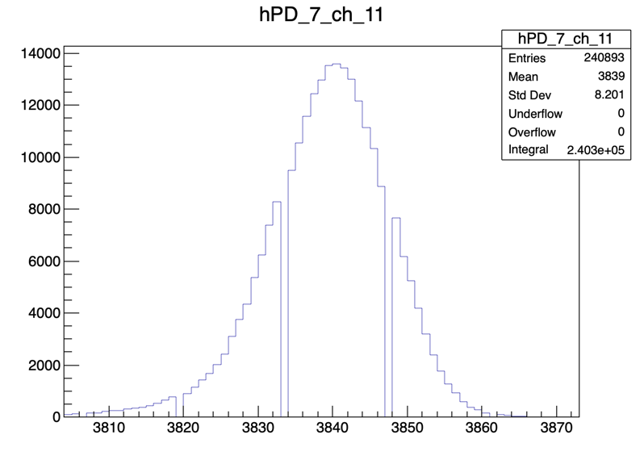
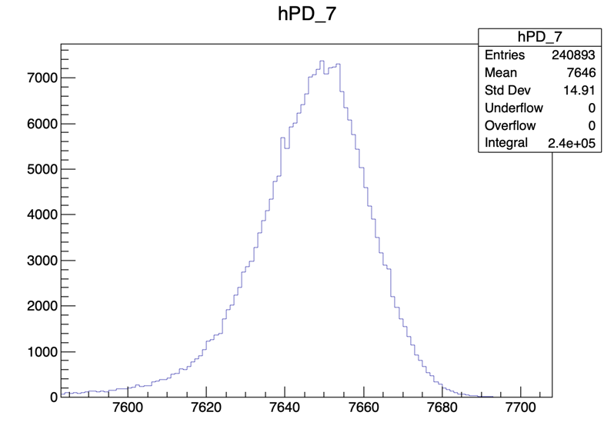
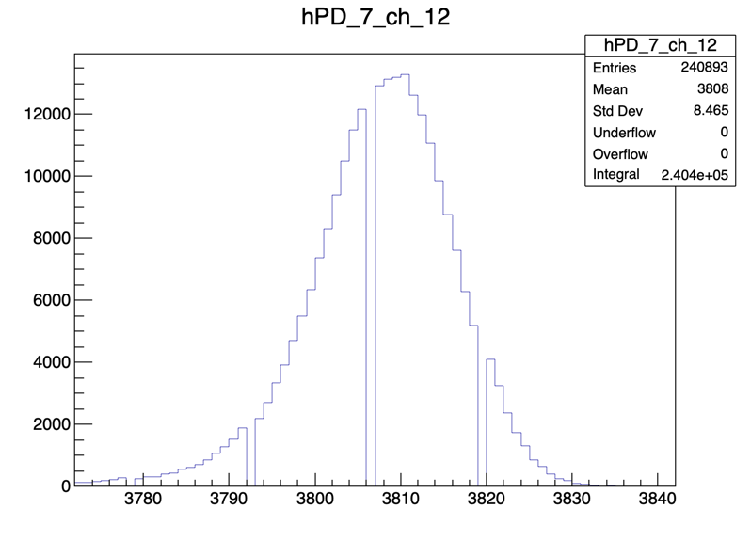
DDC in TEST mode. Int time 170us; Full Scale 350pC. Measured from D27 at UCL.
Histograms of measured values. Each entry correspond to one sample.
Left: distribution of measured values for channels 11 and 12
Right: distribution of measured values for photodiode 7. Each entry is the sum of the associated values from ch 11 and 12.

Slide 8
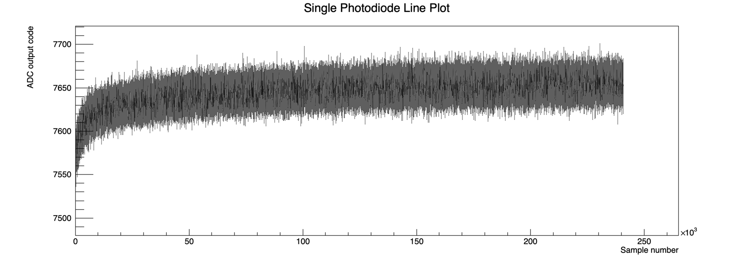
DDC in TEST mode. Int time 170us; Full Scale 350pC. Measured from D27 at UCL.
PD 7
Evolution of measured values over time/sample for photodiode 7.
Same rump-up observed in the Evolution plot from channels 11 and 12 separately.

Slide 9
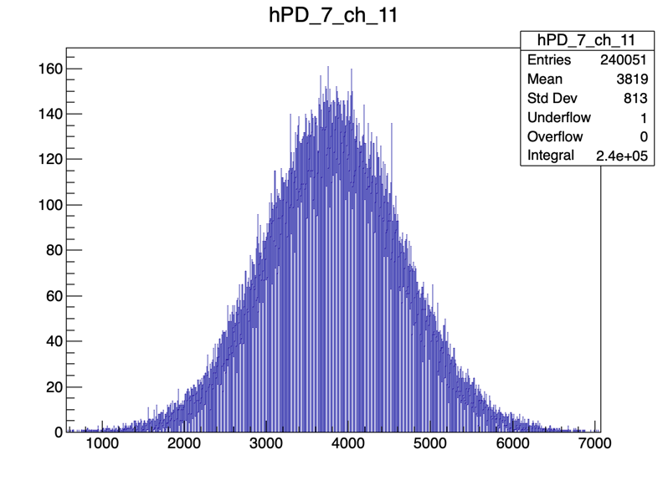
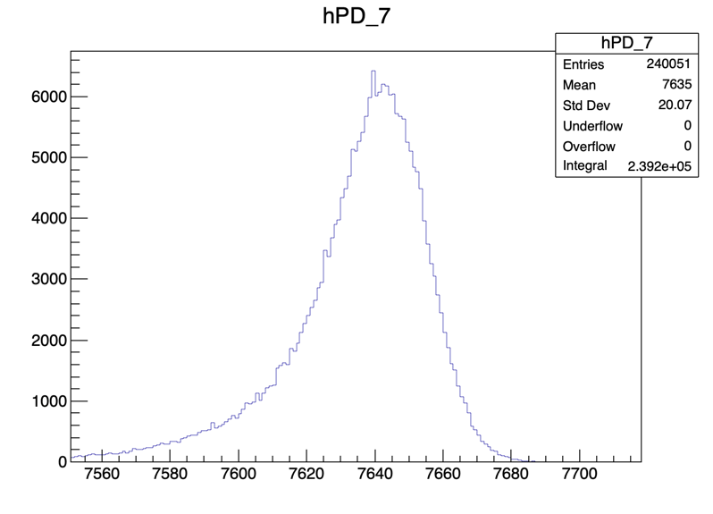
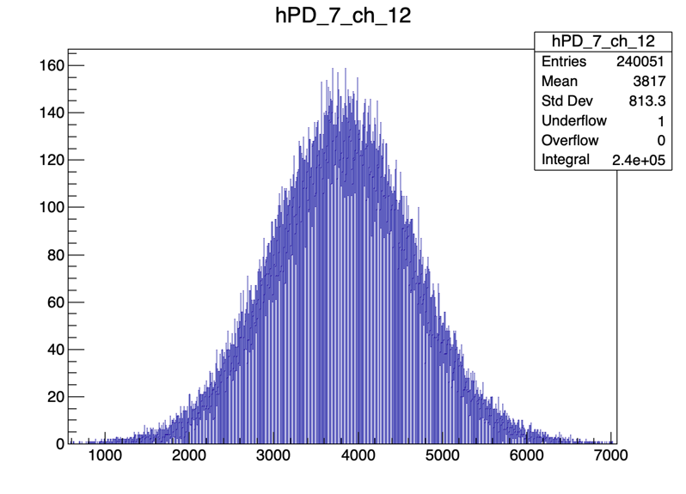
Unplugged Photodiodes. Int time 170us; Full Scale 350pC. Measured from Saad’s home.
Histograms of measured values. Each entry correspond to one sample.
Left: distribution of measured values for channels 11 and 12
Right: distribution of measured values for photodiode 7. Each entry is the sum of the associated values from ch 11 and 12.

Slide 10
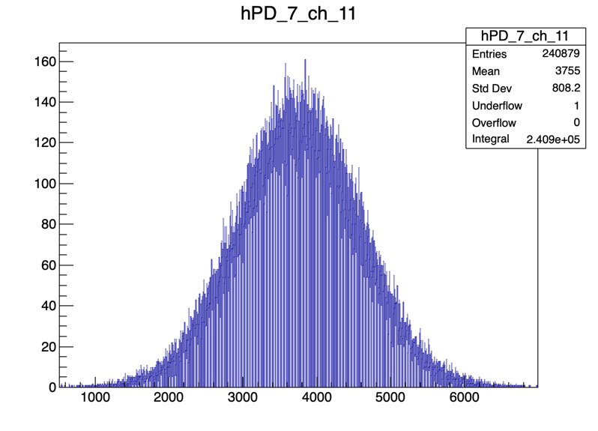
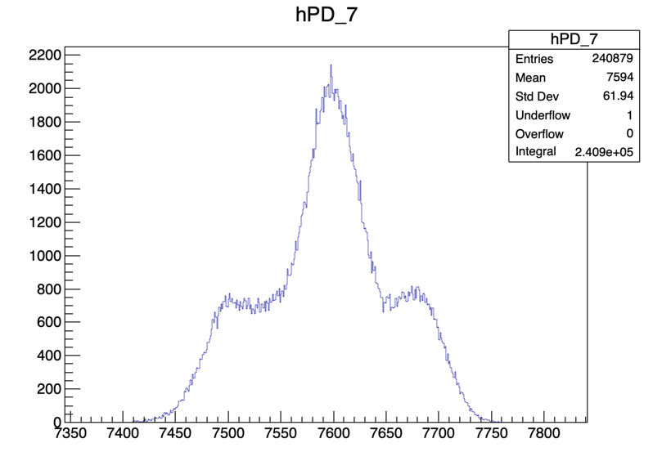
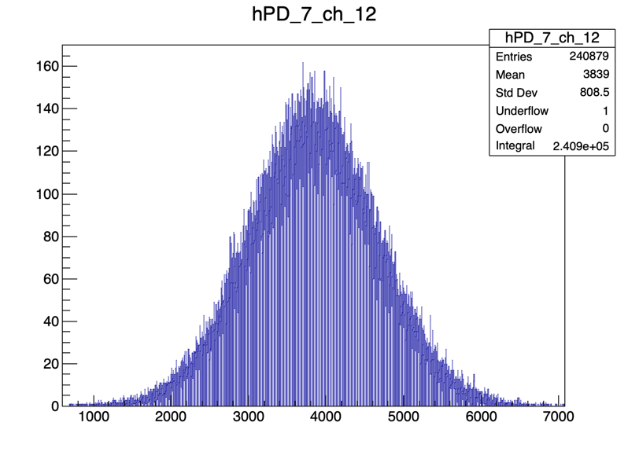
Unplugged Photodiodes. Int time 170us; Full Scale 350pC. Measured from D27 at UCL.
At UCL we start observing some spikes in the PD distribution, not reflecting the shape of the single channel distributions.

Slide 11
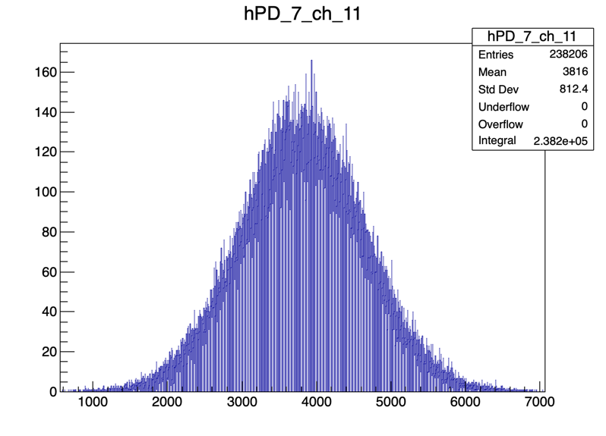
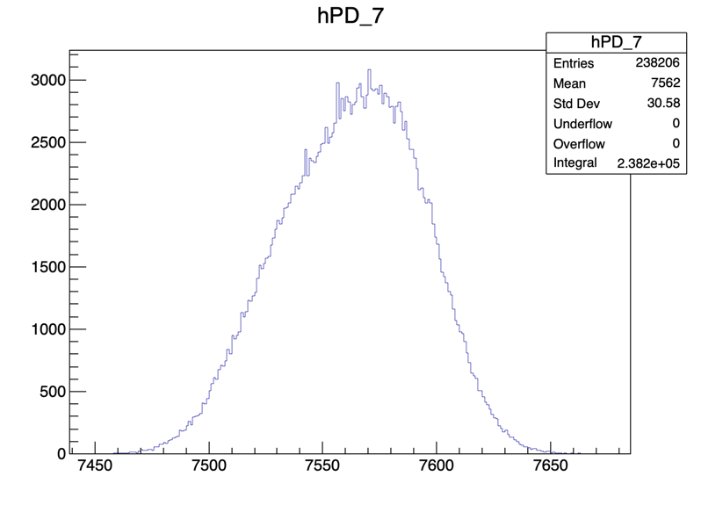
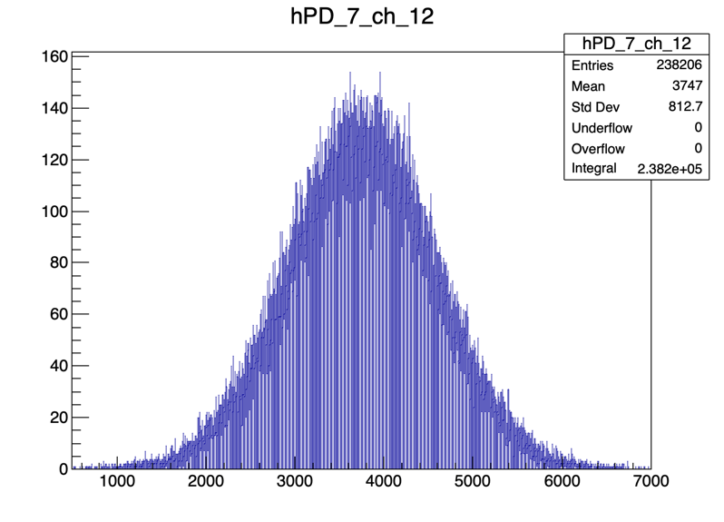
Dark measurements. Int time 170us; Full Scale 350pC. Measured from Saad’s home.
Histograms of measured values. Each entry correspond to one sample.
Left: distribution of measured values for channels 11 and 12
Right: distribution of measured values for photodiode 7. Each entry is the sum of the associated values from ch 11 and 12.

Slide 12
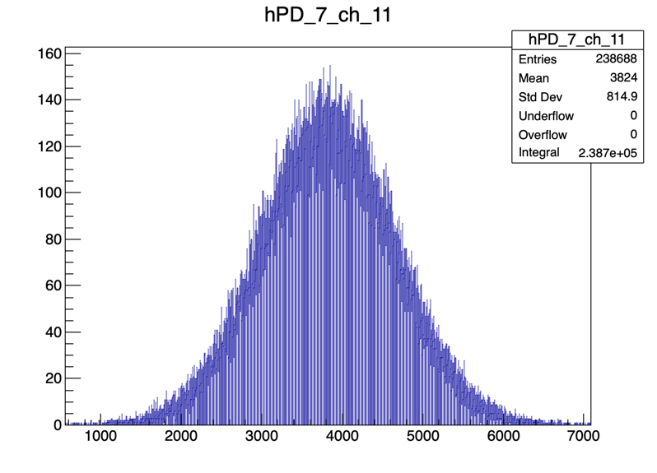
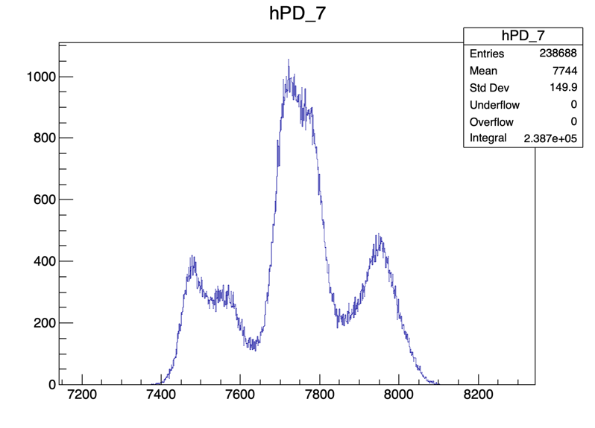
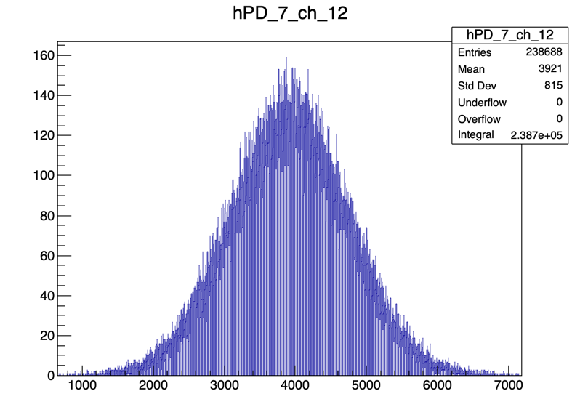
Dark measurements. Int time 170us; Full Scale 350pC. Measured from D27 at UCL.
At UCL we start observing some spikes in the PD distribution, not reflecting the shape of the single channel distributions.

Slide 13
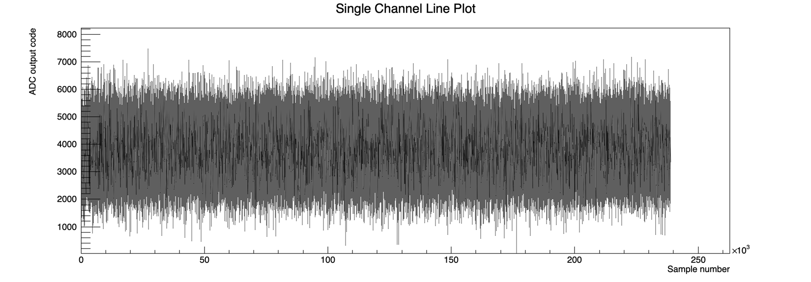
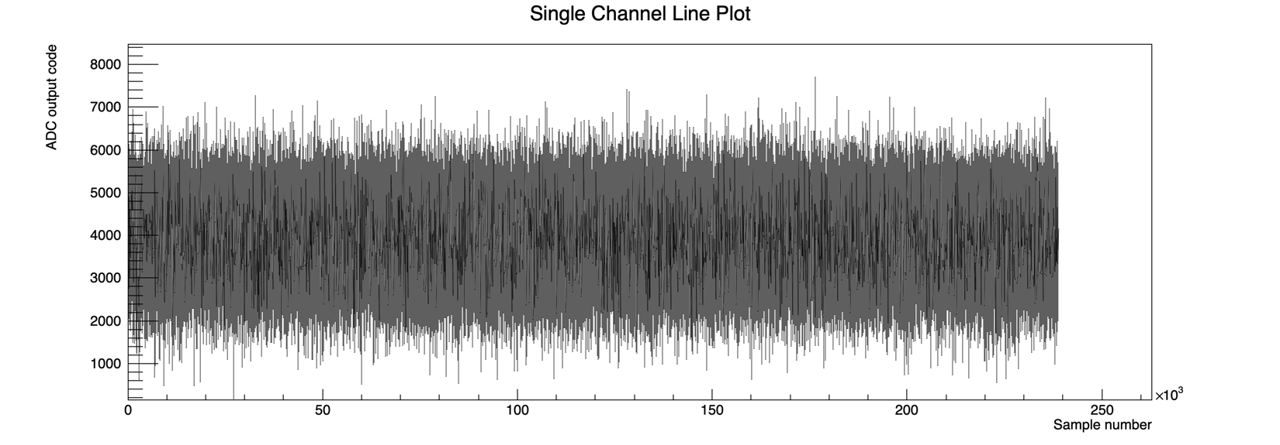
Dark measurements. Int time 170us; Full Scale 350pC. Measured from D27 at UCL.
Ch 11
Evolution of measured values over time/sample for channels 11 and 12.
Ch 12

Slide 14
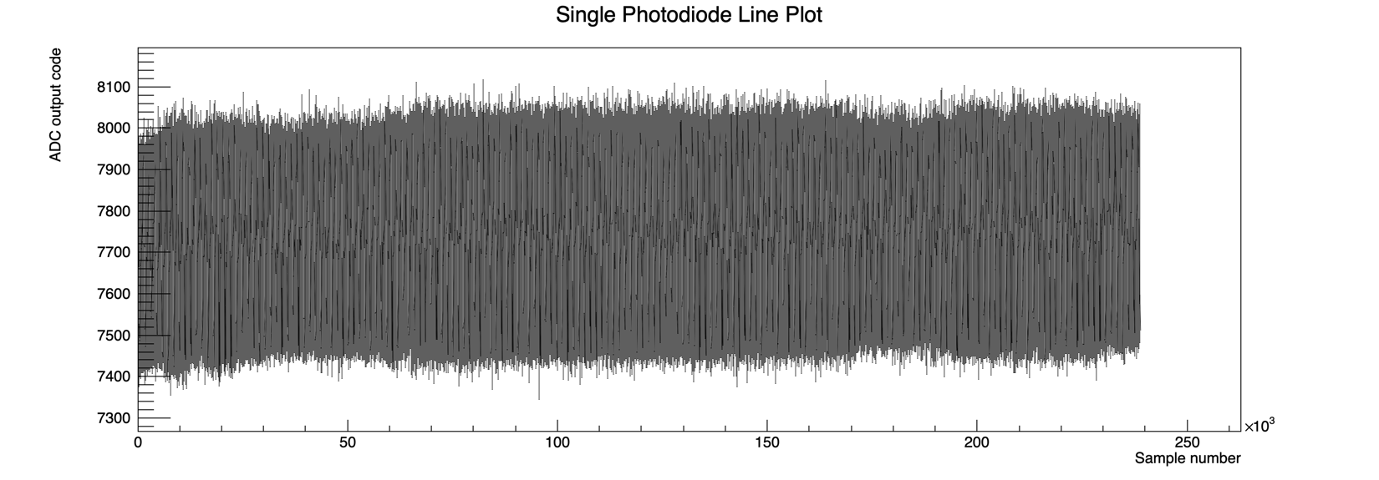
Dark measurements. Int time 170us; Full Scale 350pC. Measured from D27 at UCL.
PD 7
Evolution of measured values over time/sample for photodiode 7.

Slide 15
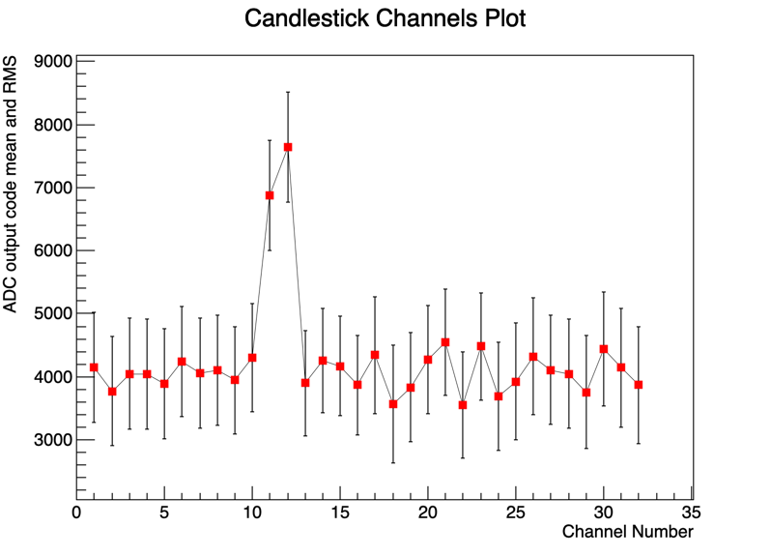
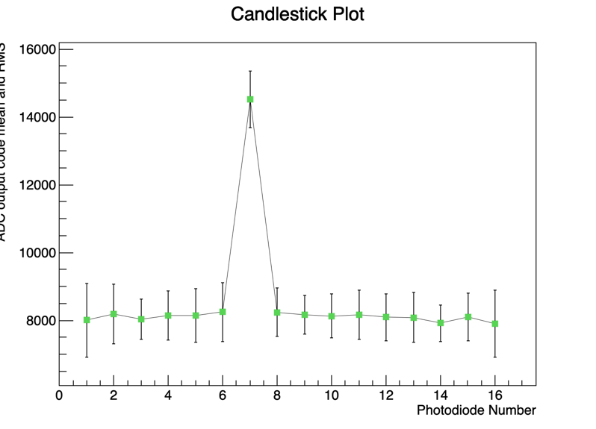
Measuring scintillation light in PD 7. Int time 170us; Full Scale 350pC
Mean measured value for each channel (left) and photodiode (right). The error bars correspond to the RMS of the distibutions.

Slide 16
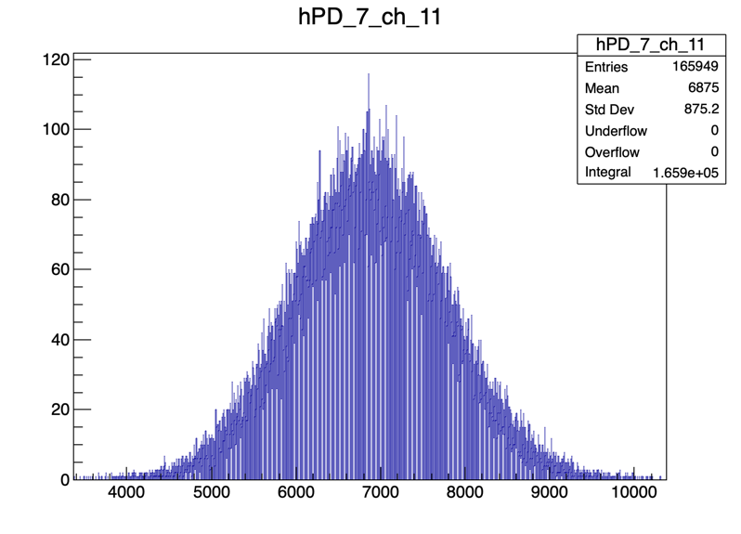
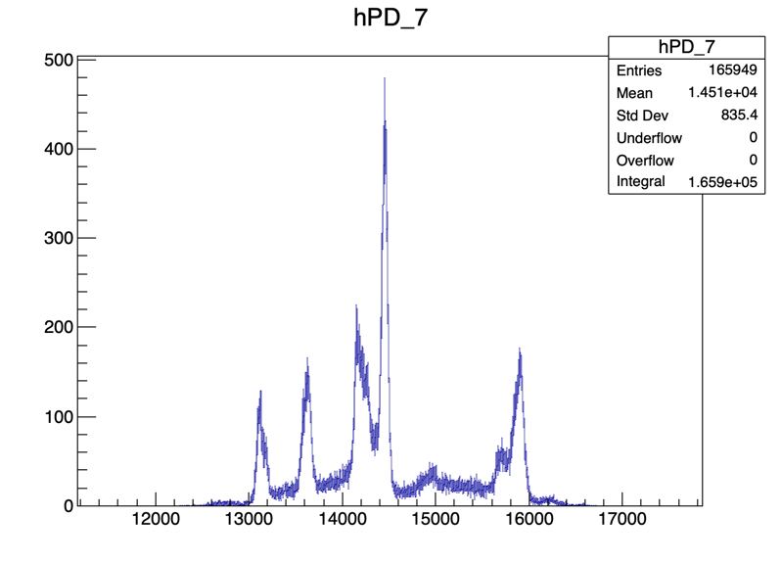
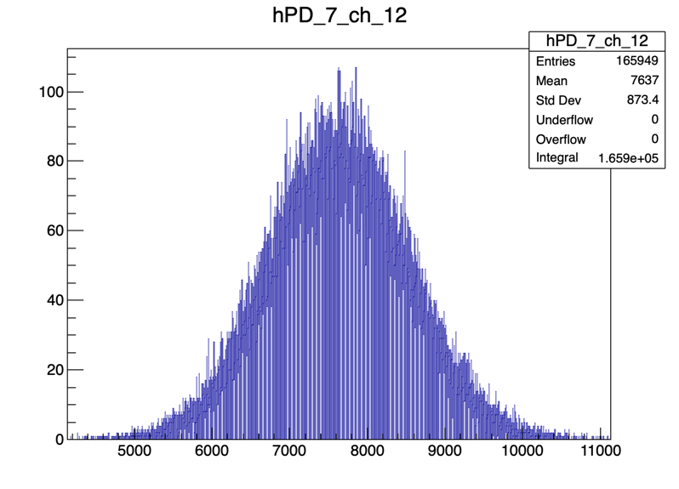
Measuring scintillation light in PD 7. Int time 170us; Full Scale 350pC
PD recording light
Histograms of measured values. Each entry correspond to one sample.
Left: distribution of measured values for channels 11 and 12
Right: distribution of measured values for photodiode 7. Each entry is the sum of the associated values from ch 11 and 12.
We don’t understand why we observe spikes in PD values.

Slide 17
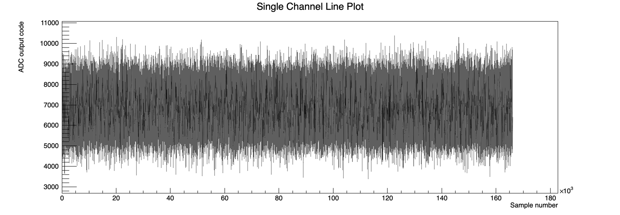
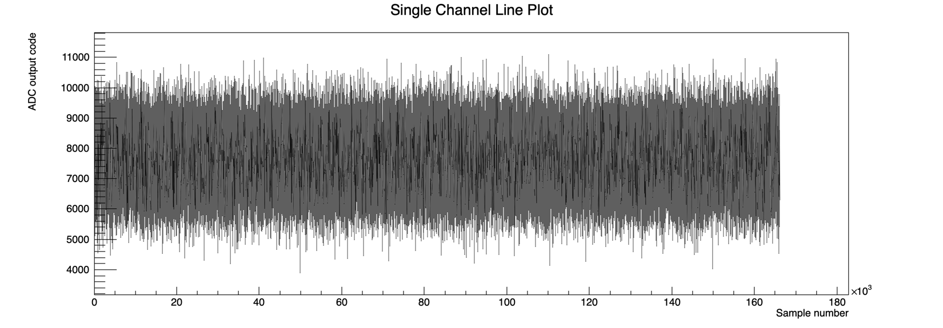
Measuring scintillation light in PD 7. Int time 170us; Full Scale 350pC
Ch 11
PD recording light
Evolution of measured values over time/sample for channels 11 and 12.
Ch 12

Slide 18
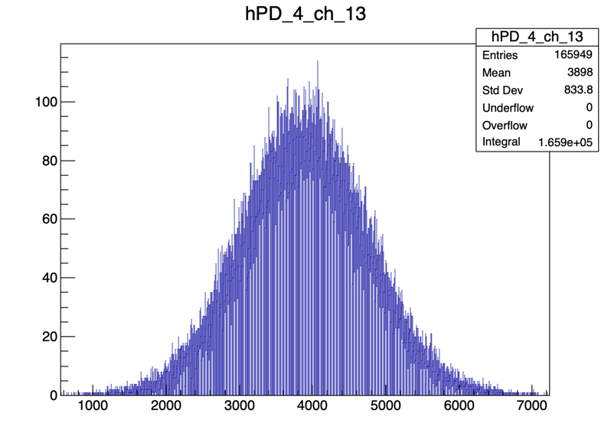
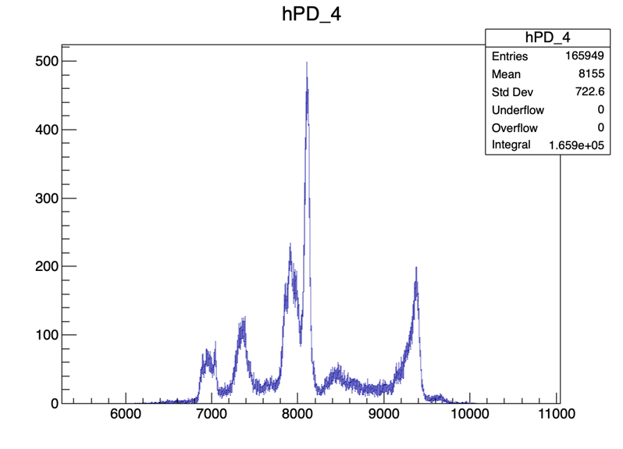
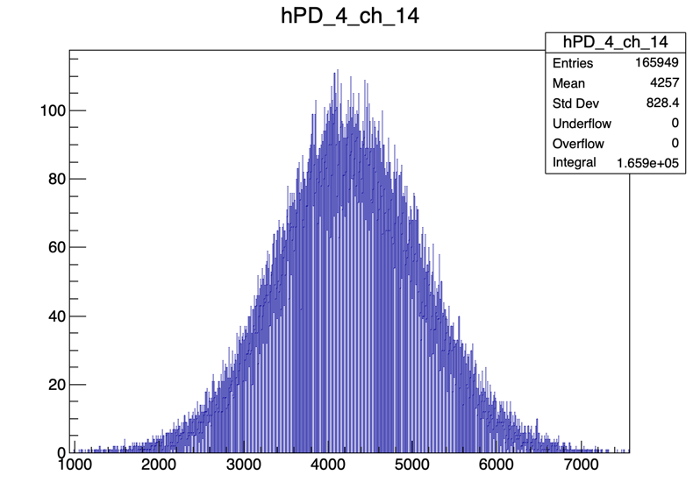
Measuring scintillation light in PD 7. Int time 170us; Full Scale 350pC
PD 4 recording dark
Histograms of measured values. Each entry correspond to one sample.
Left: distribution of measured values for channels 13 and 14
Right: distribution of measured values for photodiode 4. Each entry is the sum of the associated values from ch 13 and 14.
The value 4096 correspond to null charge collected by the ADC. Smaller values correspond to negative current fluctuations.

Slide 19
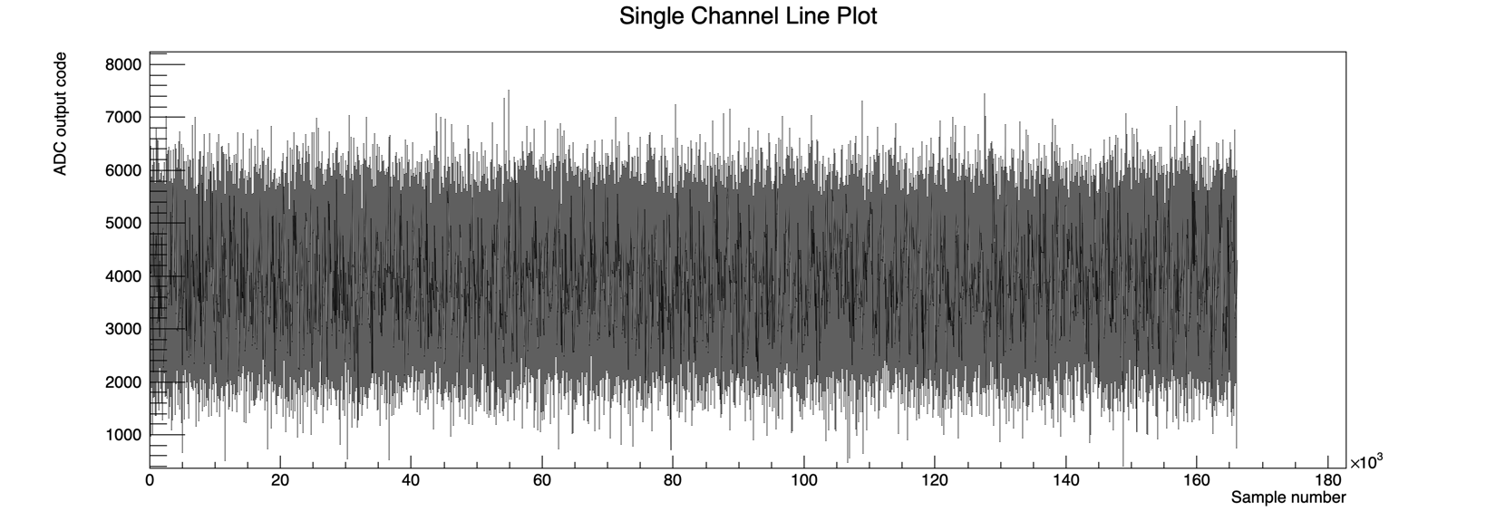
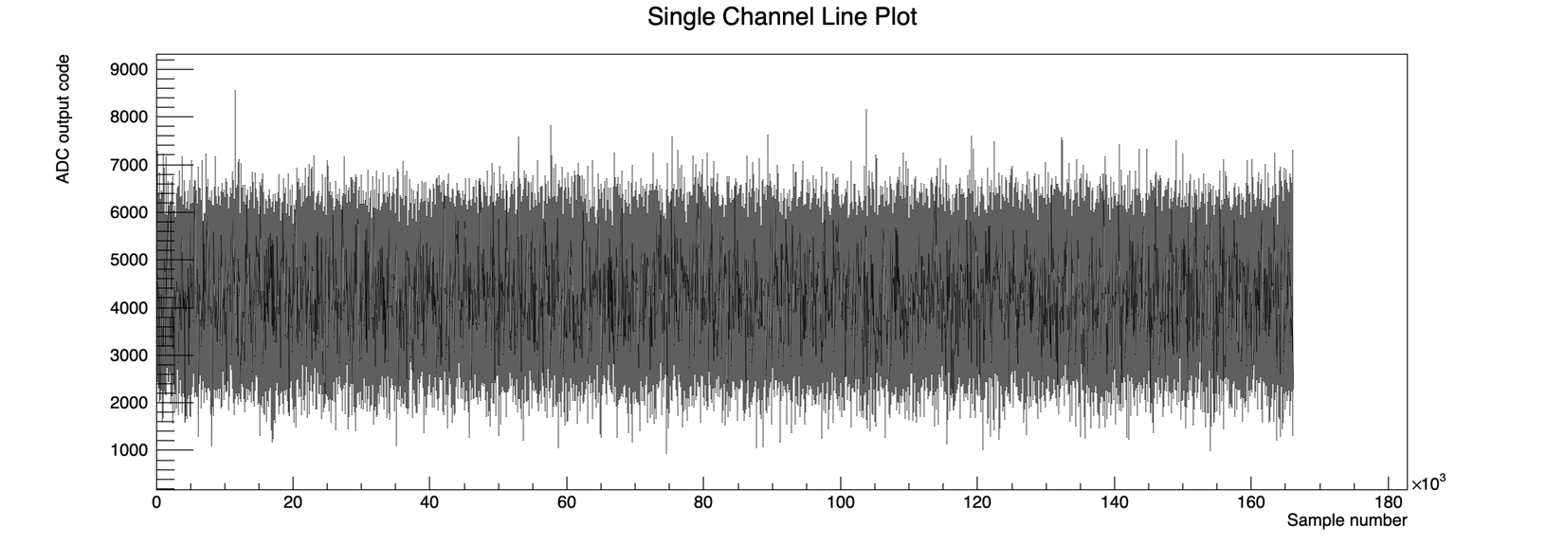
Measuring scintillation light in PD 7. Int time 170us; Full Scale 350pC
Ch 13
PD 4 recording dark
Evolution of measured values over time/sample for channels 13 and 14.
This values, translated to charge values say that we observe a fluctuation between 0 pC (raw value 4096).
Ch 14

Slide 20
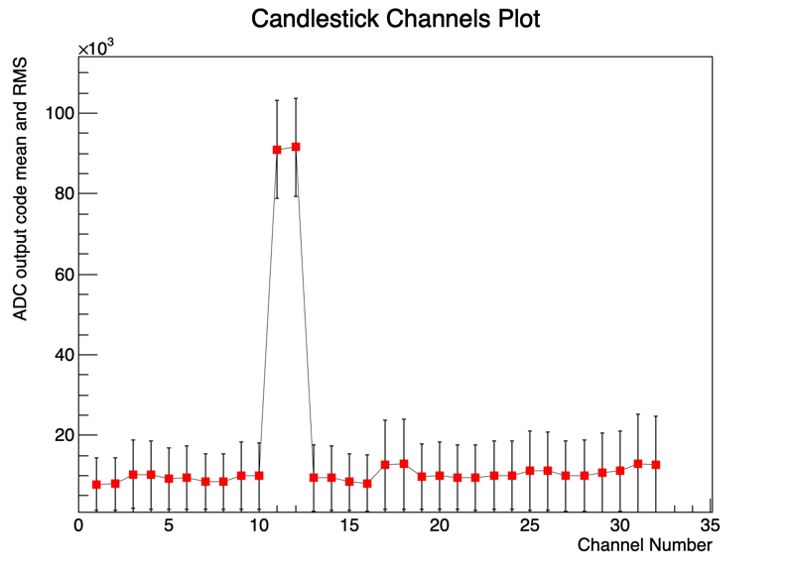
Measuring scintillation light in PD 7. Int time 170us; Full Scale 12.5pC
Mean measured value for each channel (left) and photodiode (right). The error bars correspond to the RMS of the distibutions.

Slide 21
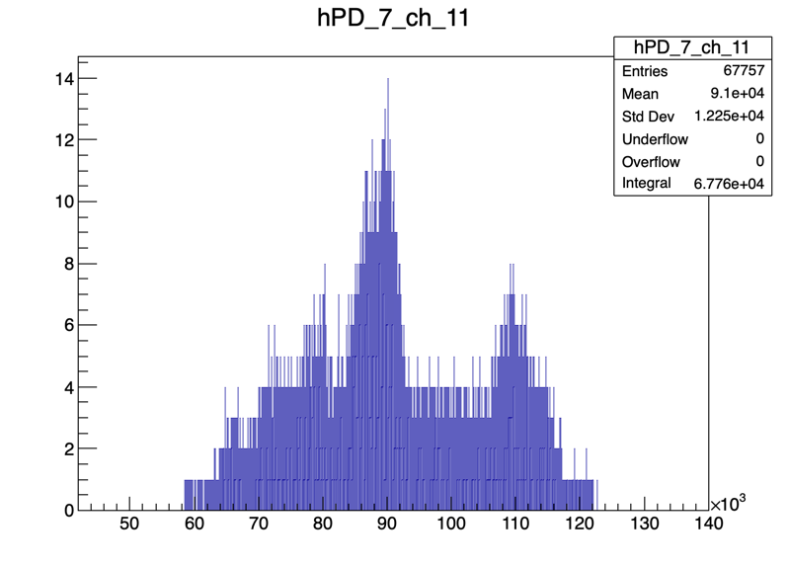
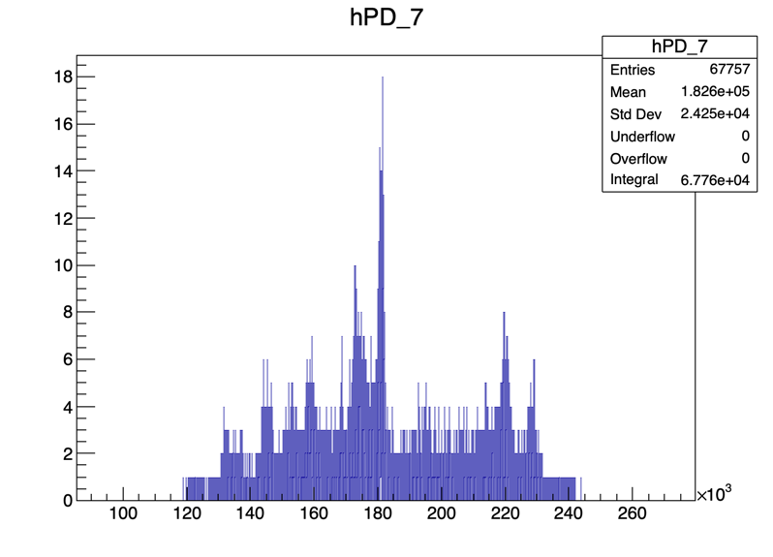
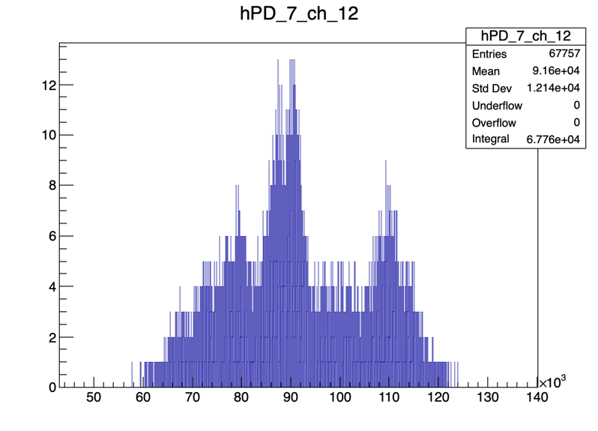
Measuring scintillation light in PD 7. Int time 170us; Full Scale 12.5pC
PD recording light
Histograms of measured values. Each entry correspond to one sample.
Left: distribution of measured values for channels 11 and 12
Right: distribution of measured values for photodiode 7. Each entry is the sum of the associated values from ch 11 and 12.
We don’t understand the shape of the distributions.

Slide 22
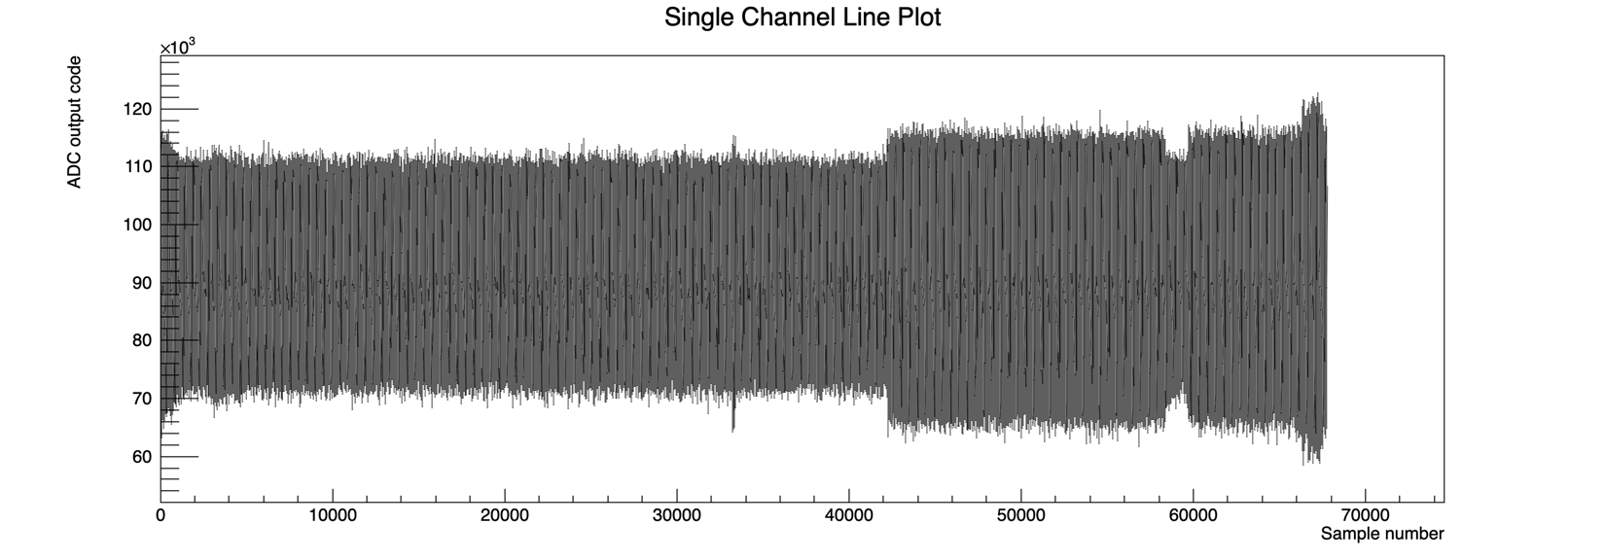
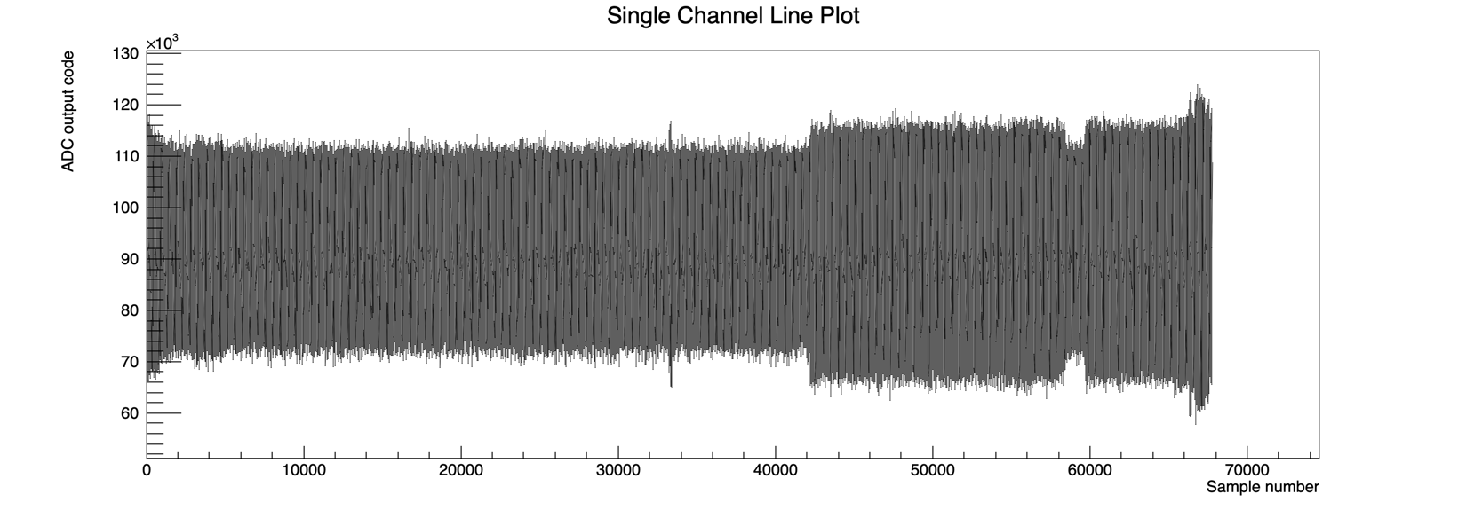
Measuring scintillation light in PD 7. Int time 170us; Full Scale 12.5pC
Ch 11
PD recording light
Evolution of measured values over time/sample for channels 11 and 12.
Ch 12

Slide 23
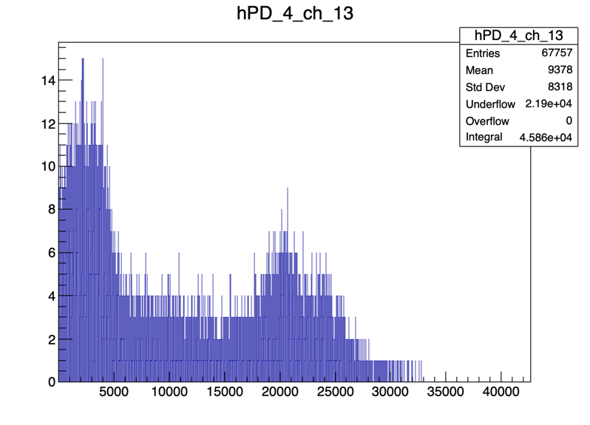
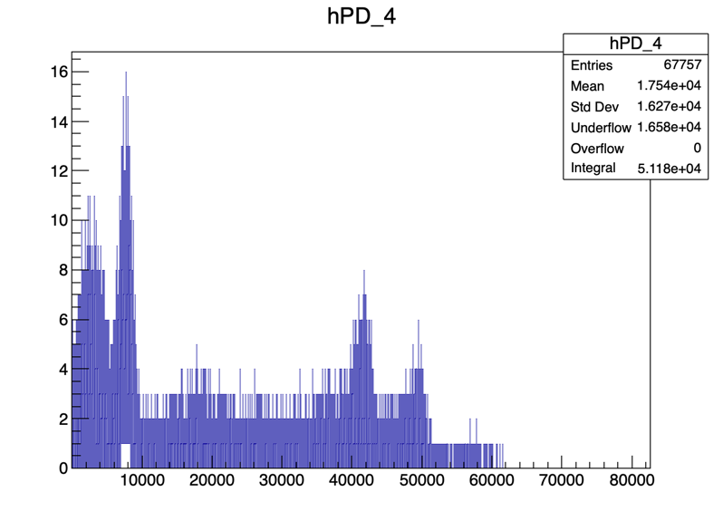
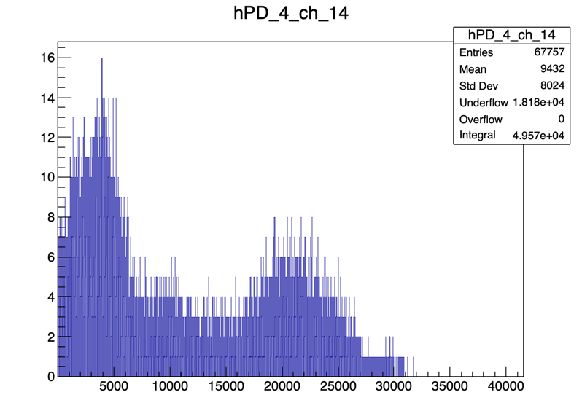
Measuring scintillation light in PD 7. Int time 170us; Full Scale 12.5pC
PD 4 recording dark
Histograms of measured values. Each entry correspond to one sample.
Left: distribution of measured values for channels 13 and 14
Right: distribution of measured values for photodiode 4. Each entry is the sum of the associated values from ch 13 and 14.
We observe many samples with raw value = 0 (underflow) coming from the ADC for dark channels.

Slide 24
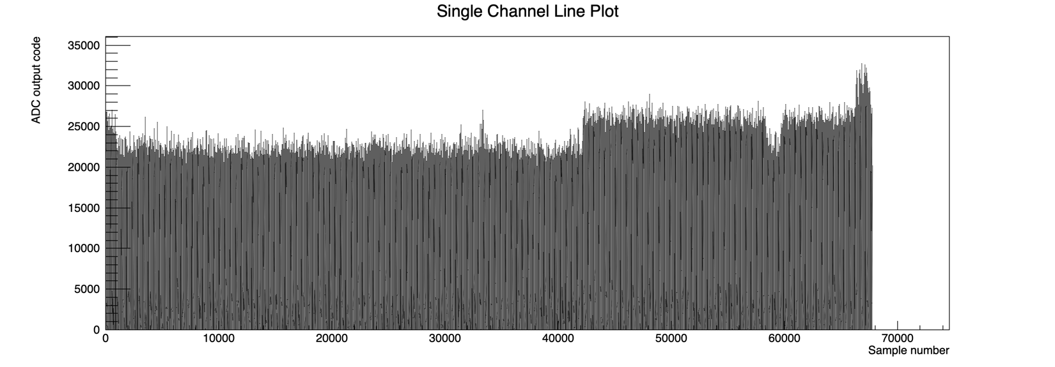
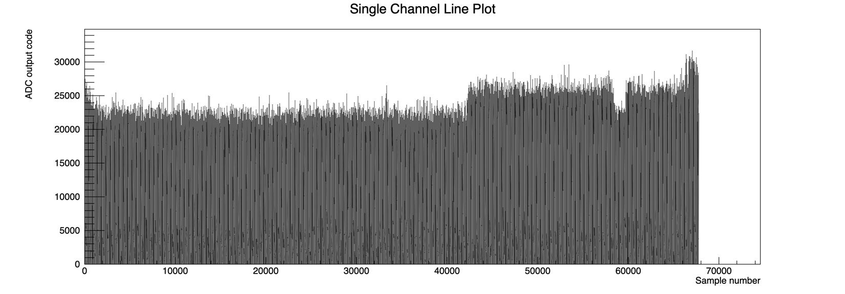
Measuring scintillation light in PD 7. Int time 170us; Full Scale 12.5pC
Ch 13
PD 4 recording dark
Evolution of measured values over time/sample for channels 13 and 14.
The events with raw value = 0 are recorded during the entire acquisition.
Ch 14

Slide 25
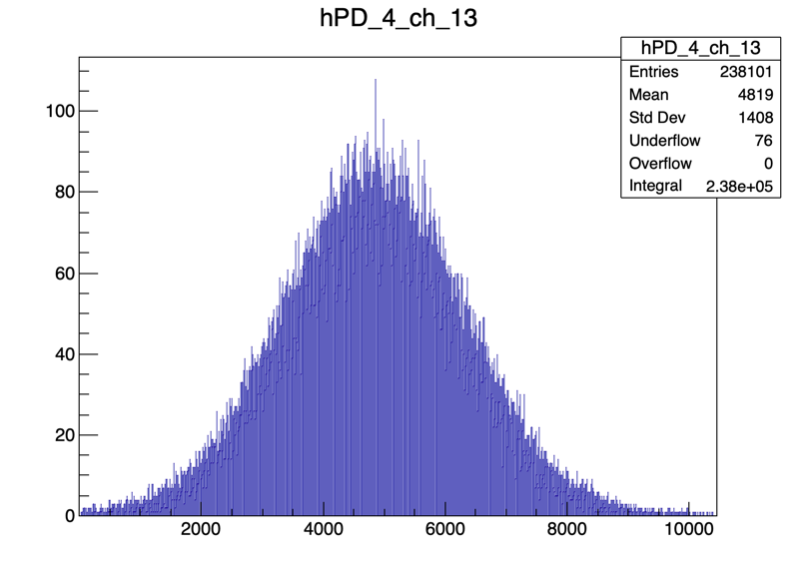
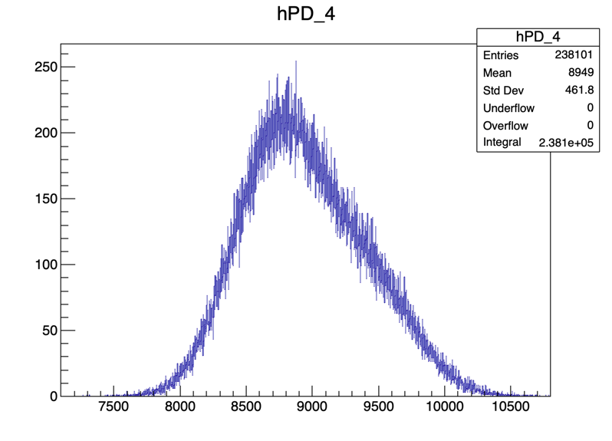
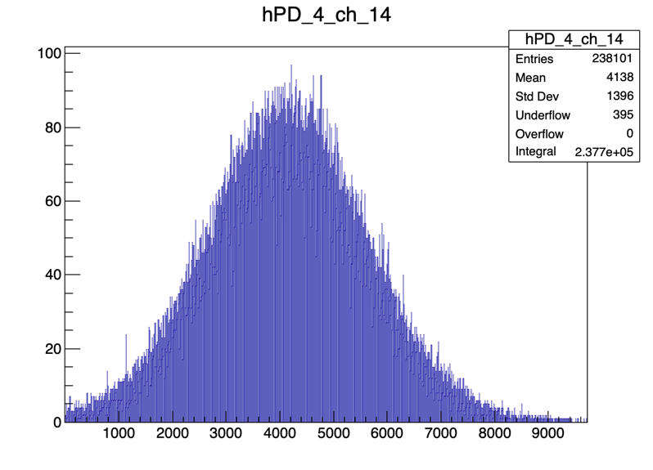
Equivalent measurement from Saad’s home. Int time 170us; Full Scale 12.5pC
PD 4 recording dark
Histograms of measured values. Each entry correspond to one sample.
Left: distribution of measured values for channels 13 and 14
Right: distribution of measured values for photodiode 4. Each entry is the sum of the associated values from ch 13 and 14.
We observe Gaussian distributions with underflow in channel plots but not when combined.

Slide 26
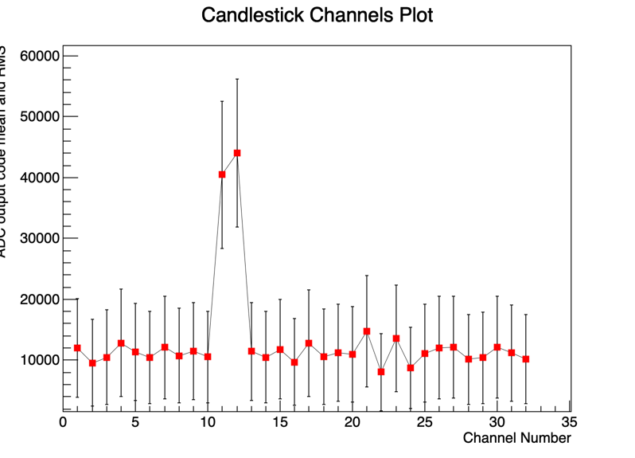

Measuring scintillation light in PD 7. Int time 2000us; Full Scale 350pC
Mean measured value for each channel (left) and photodiode (right). The error bars correspond to the RMS of the distibutions.

Slide 27



Measuring scintillation light in PD 7. Int time 2000us; Full Scale 350pC
PD recording light
Histograms of measured values. Each entry correspond to one sample.
Left: distribution of measured values for channels 11 and 12
Right: distribution of measured values for photodiode 7. Each entry is the sum of the associated values from ch 11 and 12.
For long integration time we still see spikes in the PD distribution.

Slide 28



Measuring scintillation light in PD 7. Int time 2000us; Full Scale 350pC
Ch 11
PD recording light
Evolution of measured values over time/sample for channels 11 and 12.
Ch 12

Slide 29



Measuring scintillation light in PD 7. Int time 2000us; Full Scale 350pC
PD 4 recording dark
Histograms of measured values. Each entry correspond to one sample.
Left: distribution of measured values for channels 13 and 14
Right: distribution of measured values for photodiode 4. Each entry is the sum of the associated values from ch 13 and 14.
For long integration times and dark channels we observe many events with ADC raw value = 0 (see underflow.

Slide 30


Measuring scintillation light in PD 7. Int time 2000us; Full Scale 350pC
Ch 13
PD 4 recording dark
Evolution of measured values over time/sample for channels 13 and 14.
The events with raw value = 0 are recorded during the entire acquisition.
Ch 14

Slide 31



Equivalent measurement from Saad’s home. Int time 2000us; Full Scale 350pC
PD 4 recording dark
Histograms of measured values. Each entry correspond to one sample.
Left: distribution of measured values for channels 13 and 14
Right: distribution of measured values for photodiode 4. Each entry is the sum of the associated values from ch 13 and 14.
We see sharp Gaussian roughly where “0” should be with decaying upwards tail. No underflow in PD plot.

Slide 32
Conclusions
Differences in measurements taken at home vs. in lab strongly suggest we suffer from electronic noise in D27, resulting in spikes in photodiode histograms.
  Why are the single channel plots still Gaussian?
  Should test in an office to see if noise persists.
Decreasing the full-scale range or increasing the integration time worsens performance.
  Larger RMS even in Gaussian plots from measurements taken at home.
  Likely need to discuss with Texas Instruments why this is the case.
Decreasing the FS or increasing the integration time results in values equal to exactly 0 to be measured.
  This shouldn’t be possible, as 0 is defined to be around 4000 in raw counts.
  Lack of underflow when combining channels from measurements taken at home might suggest some quirk in the way charge is split from a photodiode into its two channels.
    Likely something to discuss with CosyLab.

Slide 33
Useful Links:
Photodiodes S1337-16BR https://www.hamamatsu.com/eu/en/product/type/S1337-16BR/index.html
Photodiodes S12915-16R https://www.hamamatsu.com/eu/en/product/type/S12915-16R/index.html
Texas Instrument DDC232 https://www.ti.com/lit/ds/symlink/ddc232.pdf?ts=1591718081453&ref_url=https://www.ti.com/product/DDC232
Experimental Runs http://www.hep.ucl.ac.uk/pbt/wiki/Proton_Calorimetry/Experimental_Runs/2020/Oct23

