Slide 1
Preliminary Tests of First DDC232 Board Prototype
26 Nov 2020
Raffaella Radogna
Saad Shaikh

Slide 2
In this presentation, the following results taken at home and in a lab are presented:
ADC in diagnostic TEST mode ON
In test mode, inputs are disconnected from the DDC232 integrators to enable the user to measure a zero-input signal regardless of the current supplied to the inputs.
ADC with TEST mode OFF and photodiodes unplugged
ADC with TEST mode OFF, photodiodes plugged and measuring DARK
ADC with TEST mode OFF, photodiodes plugged and measuring scintillation light
Current questions:
Could the passive photodiode charge splitting into two channels introduce internal noise or other quirks?
Could the charge splitting affect the board performance, explaining the drop in ADC-board performance with increasing integration time and decreasing full-scale range?
Shielding from external electronic noise
Could measurements be affected by external noise?

Slide 3
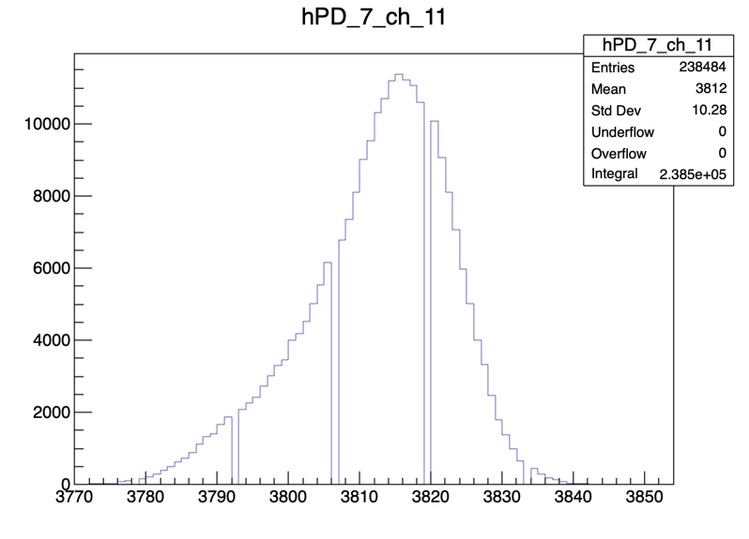
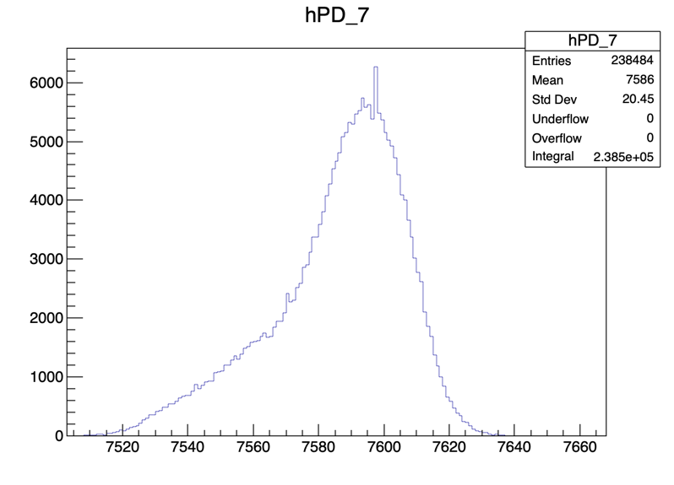
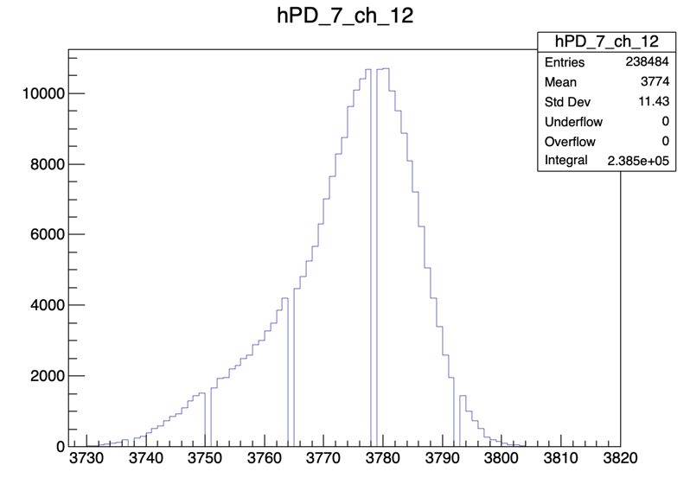
DDC in TEST mode. Int time 170us; Full Scale 350pC. Measured from Saad’s home.
Test mode behaves as expected, but appear to have “forbidden” values in channel plots?
Disappears in combined histogram.
Continue to observe this in later plots.
Histograms of measured values. Each entry correspond to one sample.
Left: distribution of measured values for channels 11 and 12
Right: distribution of measured values for photodiode 7. Associated values from channels 11 and 12 summed and then histogrammed.

Slide 4
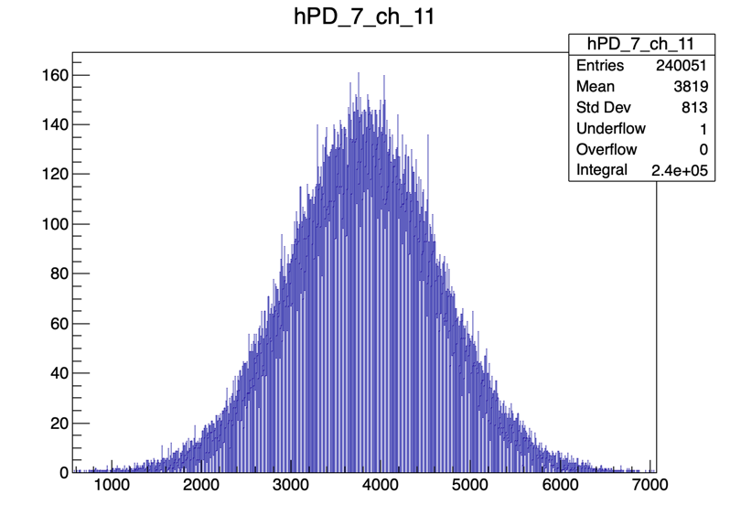
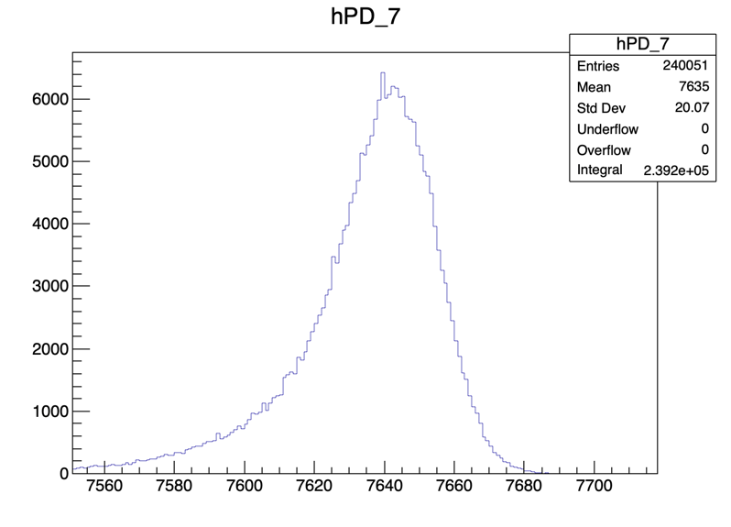
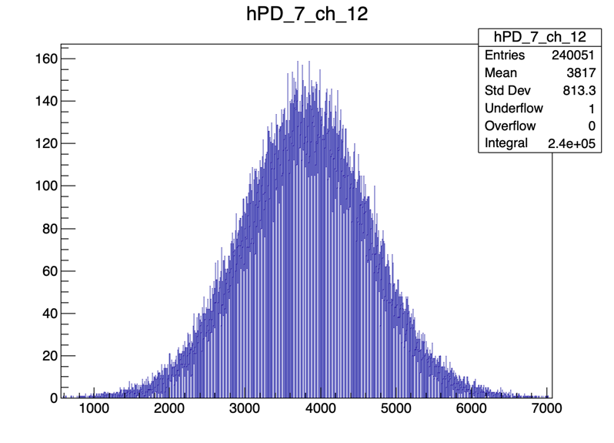
Unplugged Photodiodes. Int time 170us; Full Scale 350pC. Measured from Saad’s home.
Channels have much larger std. dev. than in test mode.
Same std. dev. from test mode recovered when combining channels.
White bars indicate the previous behaviour of “forbidden” values in channels.
The value 4096 corresponds to charge offset collected by the ADC.
Smaller values correspond to negative current fluctuations.

Slide 5
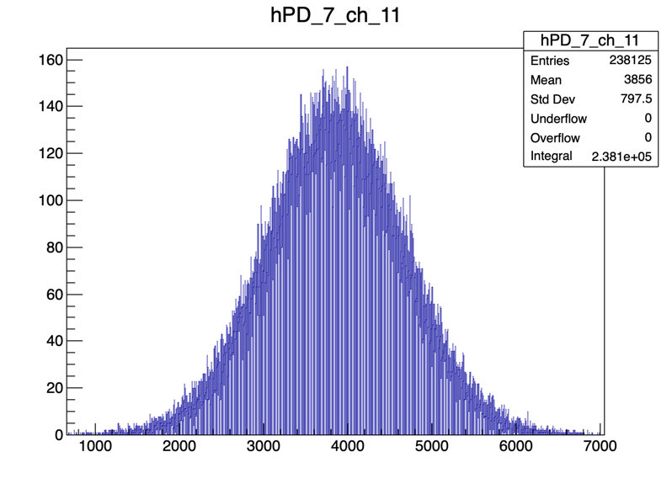
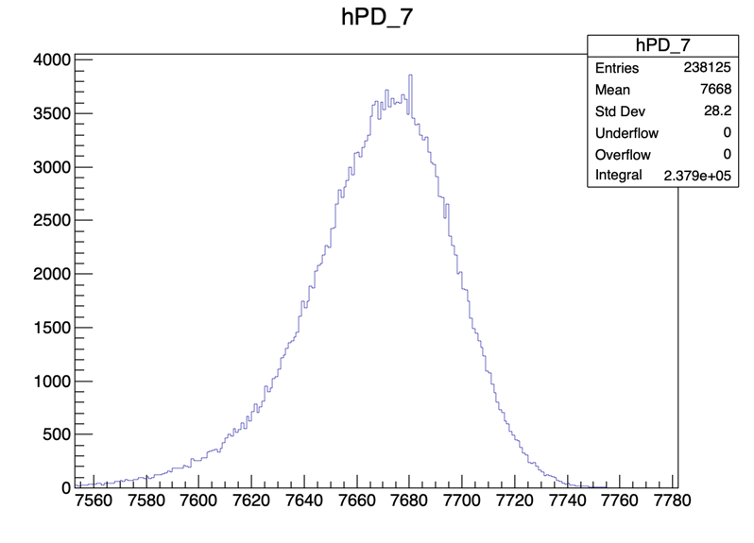
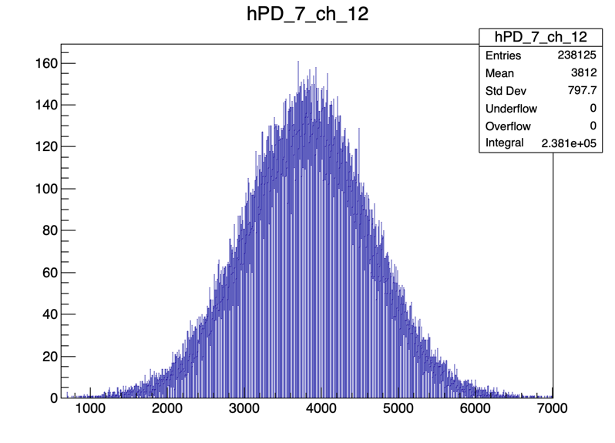
Dark measurements. Int time 170us; Full Scale 350pC. Measured from Saad’s home.
Adding photodiodes doesn’t change channel histograms, but combined histogram has increased std. dev. (as expected).

Slide 6
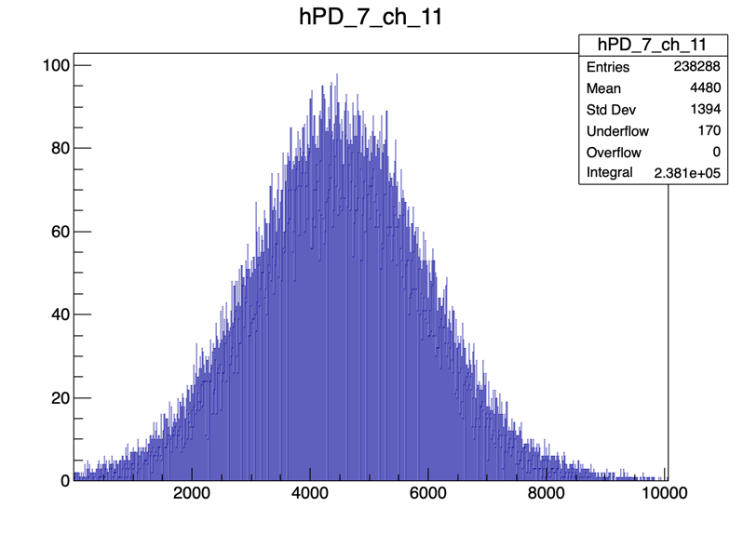
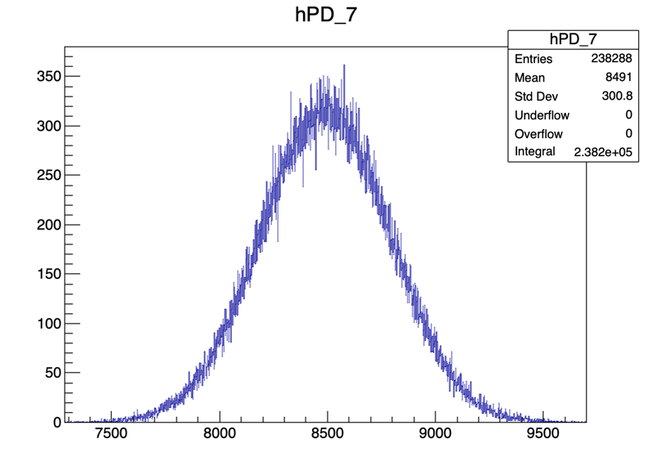

Dark measurements. Int time 170us; Full Scale 12.5pC. Measured from Saad’s home.
Underflow entries are where the DDC232 returns exactly 0 for a channel. This shouldn’t be possible!
“0” is defined as approx. 4096.
Performance worsens with reduction of full-scale range.
Std. dev. of all histograms increase relative to large full-scale.
Underflow increases in channel plots, which disappears in photodiode plot.

Slide 7
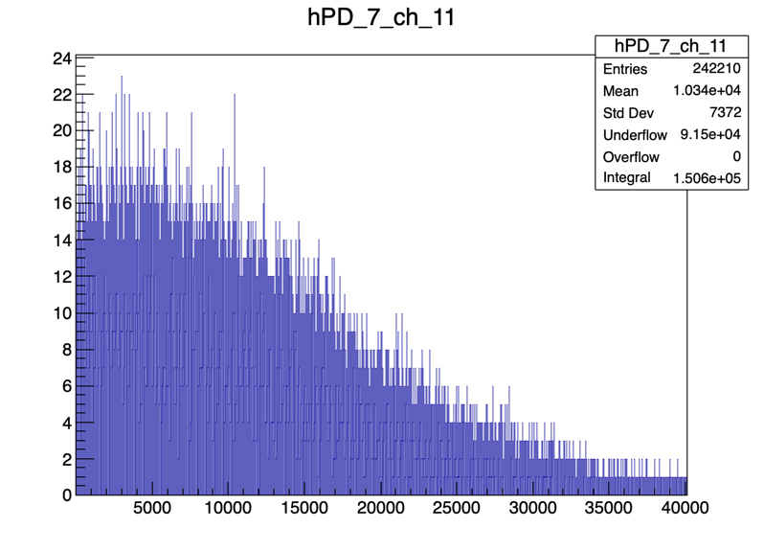
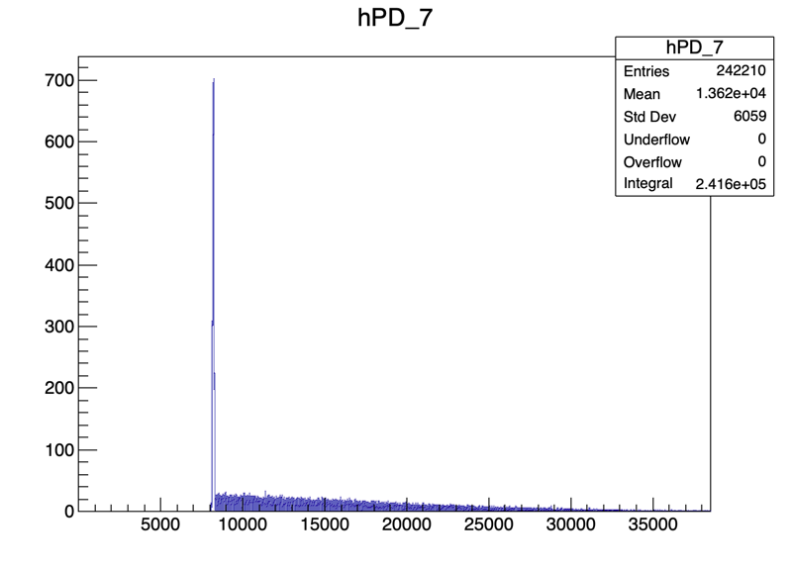

Dark measurements. Int time 2000us; Full Scale 350pC. Measured from Saad’s home.
Performance worsens with increase of integration time. We see a sharp Gaussian roughly where “0” should be with decaying upwards tail.
Large underflow in channel plots but no underflow in PD plot.

Slide 8
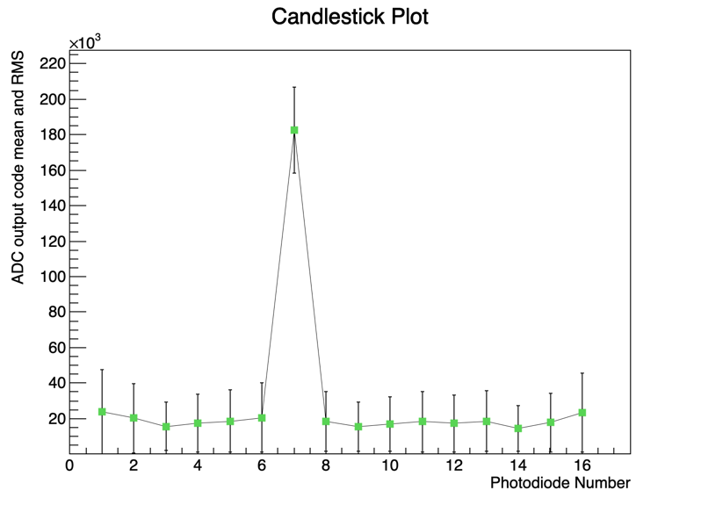
EXPERIMENTAL SETUP AT UCL
Optical fiber injecting UV light into scintillator sheet 90° to the PDs array.

Slide 9
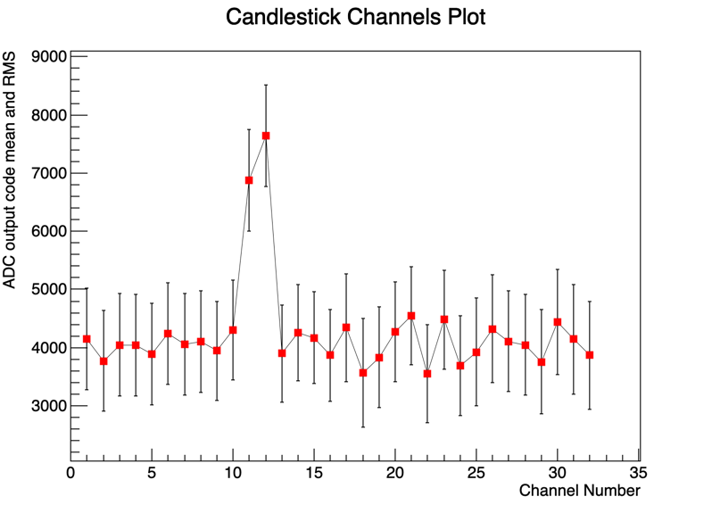
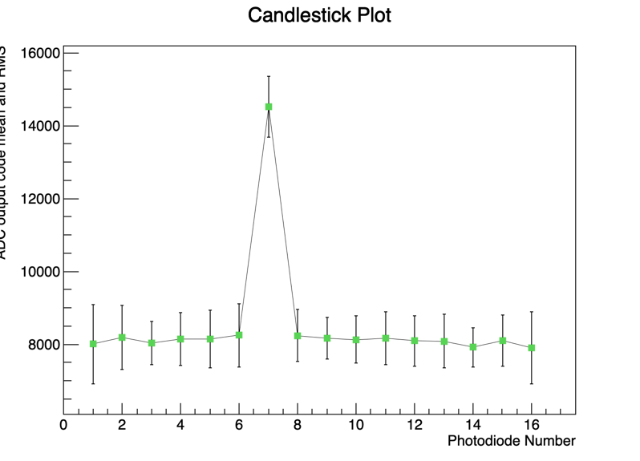
Measuring scintillation light in PD 7. Int time 170us; Full Scale 350pC
Mean measured value for each channel (left) and photodiode (right). The error bars correspond to the RMS of the distributions.

Slide 10
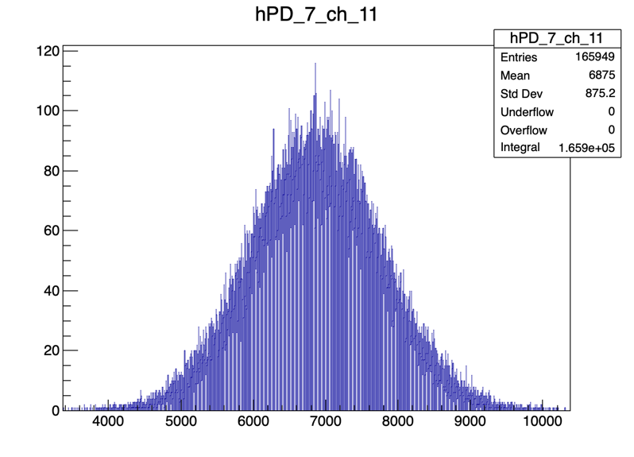
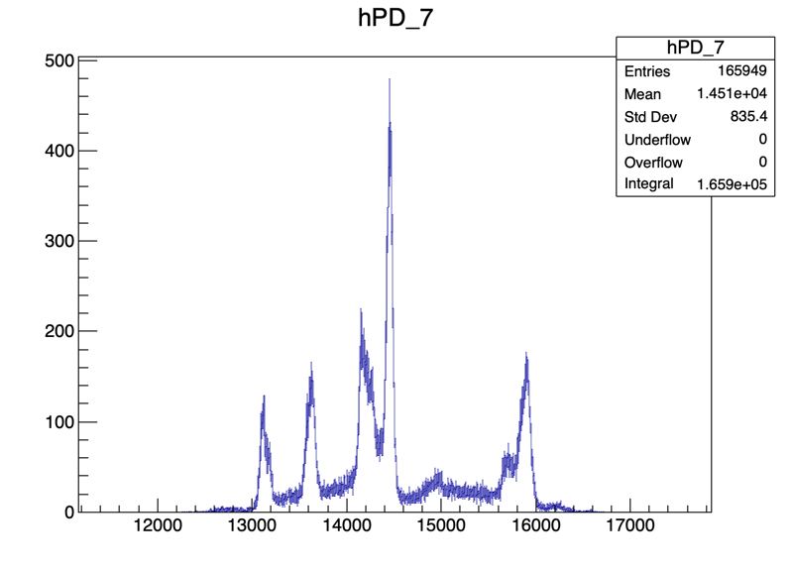
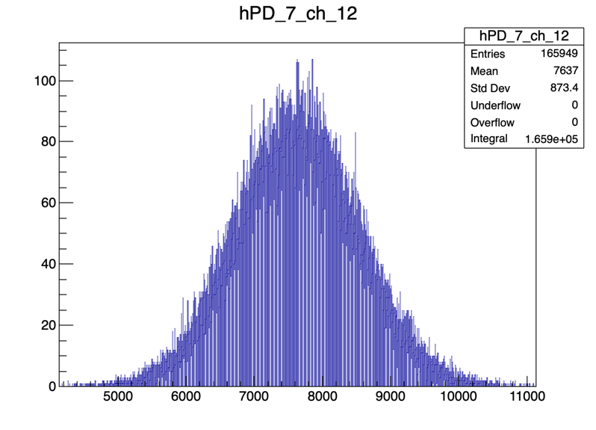
Measuring scintillation light in PD 7. Int time 170us; Full Scale 350pC
PD 7 recording light
Poor photodiode histogram likely due to electronic noise from test lab. Interestingly, we do not observe this shape in the channel histograms…

Slide 11
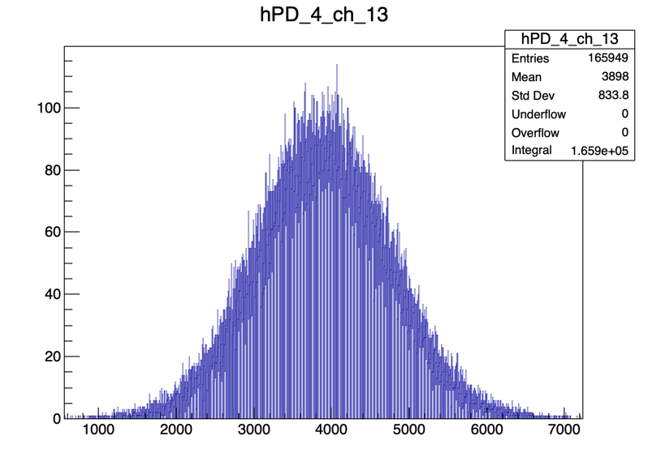
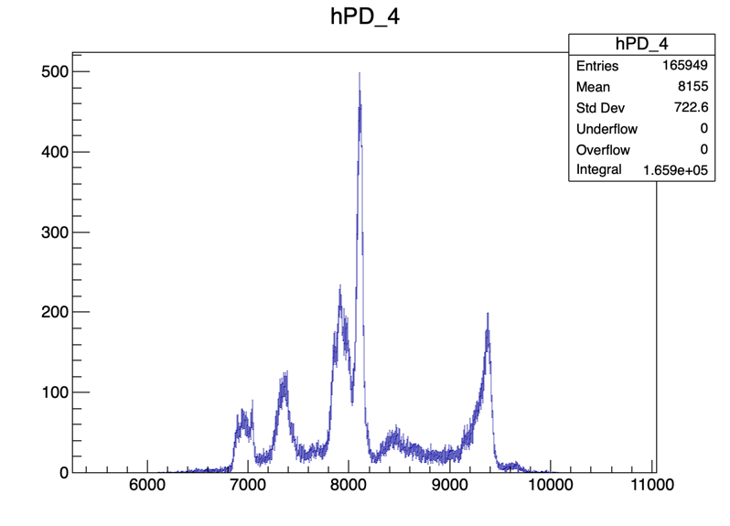
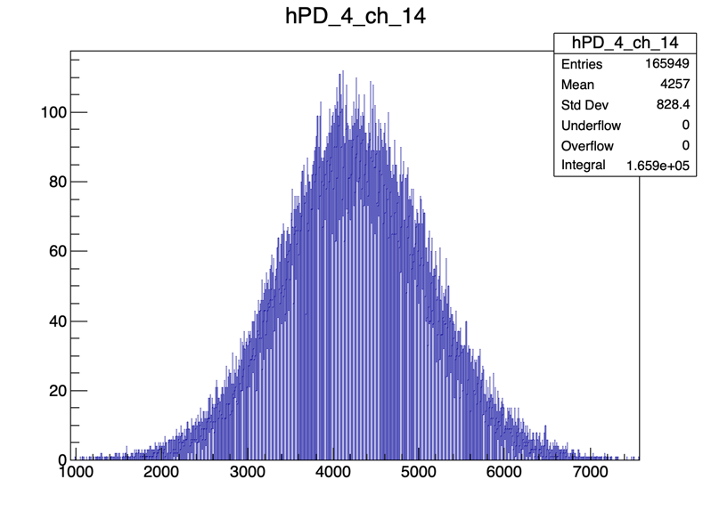
Measuring scintillation light in PD 7. Int time 170us; Full Scale 350pC
PD 4 recording dark
Observe the same shape as with the signal channel but shifted in the y-axis. Indicative of external noise rather than structure/coupling of scintillator light.

Slide 12
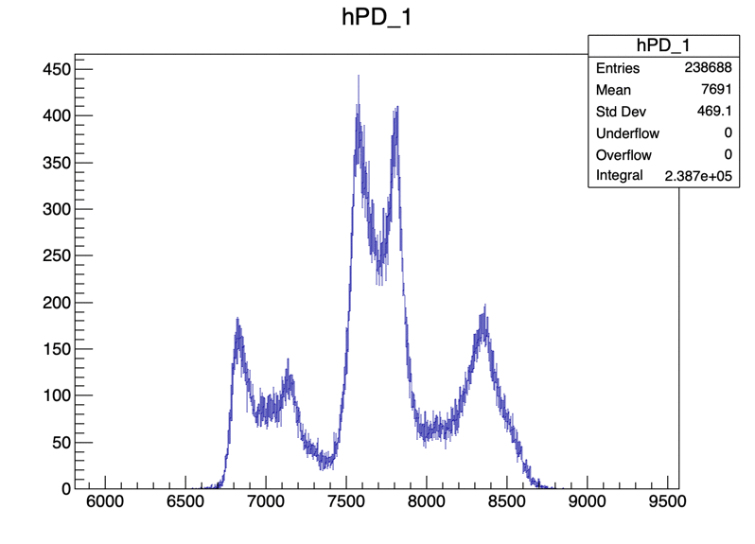
Variation in Noise with Photodiode Number. Int time 170us; Full Scale 350pC
All PDs recording dark
Noise appears to worsen with photodiodes on far right- and left-hand sides of DDC232 circuit board.

Slide 13
Conclusions
Differences in measurements taken at home vs. in lab strongly suggest we suffer from electronic noise in lab, resulting in random spikes in photodiode histograms.
Why are the single channel plots still Gaussian?
How can we shield the DDC232 board from external noise?
Likely need to understand the effects of current passive splitting of photodiode charge in two channels:
Test-mode histogram is much less noisy than real measurements.
Introducing the ADC inputs from the electronics (i.e. dark noise, photodiodes unplugged), we observe a dramatic increase of the RMS for the single channel. Is this expected?
Underflow disappears when combining channels: this means “0” measurements in one channel are paired with “real” measurements in the other. Could suggest charge is not being split properly.
Could the charge splitting explain the worse performance with small full-scale ranges and large integration times?

Slide 14
Useful Links:
Photodiodes S1337-16BR: https://www.hamamatsu.com/eu/en/product/type/S1337-16BR/index.html
Photodiodes S12915-16R: https://www.hamamatsu.com/eu/en/product/type/S12915-16R/index.html
Texas Instruments DDC232: https://www.ti.com/lit/ds/symlink/ddc232.pdf?ts=1591718081453&ref_url=https://www.ti.com/product/DDC232
Experimental Runs: http://www.hep.ucl.ac.uk/pbt/wiki/Proton_Calorimetry/Experimental_Runs/2020/Oct23

