Slide 1
Simulation of DDC232 Code
PBT Meeting 08/07/20

Slide 2
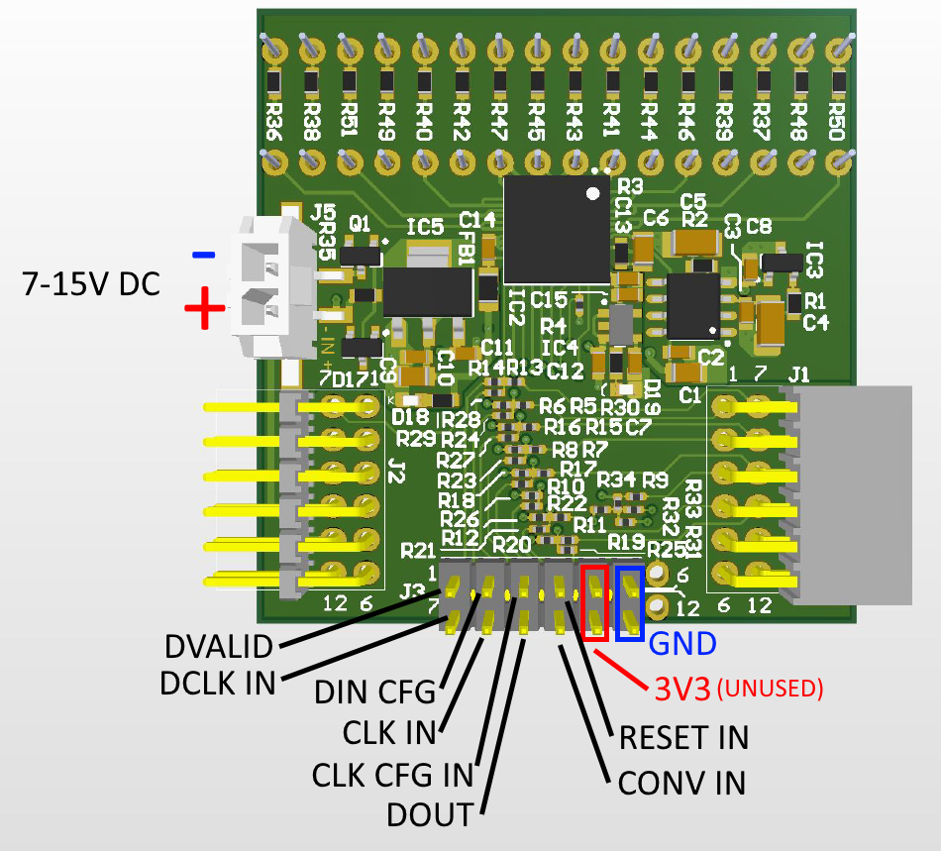
Reminder – I/O Signals
System (master) clock: CLK
Configuration register clock: CLK_CFG
Configuration register input: DIN_CFG
Serial data clock: DCLK
Serial data output: DOUT
Conversion control input: CONV
Data valid output: $\overline{DVALID}$
Digital reset: $\overline{RESET}$

Slide 3
DDC232 Operation Stages
Datasheet for DDC232 provides guidelines for signals and timing for of these stages.
Task here is to demonstrate in simulation that design can meet requirements.
Power Up
Configuration
Write
Read
And then alternating between:
Measurement (i.e. waiting for data)
Reading data

Slide 4
What is Simulation?
Test behaviour of a hardware design entirely within software.
Does not tell you anything about behaviour of hardware itself – just how your design behaves under certain stimuli.
An essential tool for debugging designs before testing on hardware.
User is able to provide input signals at any point in timeline to mimic hardware.
Result of simulation is a waveform chart, showing how signals progress with time.

Slide 5
Structure of Design
Xilinx Clocking Wizard
Module that takes 125 MHz Zybo clock and transforms to 120 MHz clock, which is a more useful frequency
Signals: Clock In (Clk_125MHz), Clock Out (MCLK), Clock ‘Good’ Status (LOCKED), Reset (MCLK_RST)
DDC232 Code
Handles communication and data transfer between FPGA and DDC232.
Signals: See slide 2. CLK, CONV, CLK_CFG, DCLK all generated from MCLK and only once LOCKED is high. $\overline{RESET}$ generated from MRST, which is a button on Zybo board.
UART Transmitter (coming soon…)
Takes data from DDC232 and outputs to computer

Slide 6
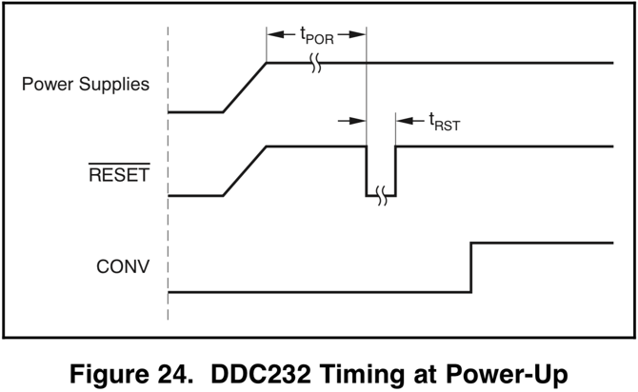
1) Power-up
Before powering up, all digital and analog inputs must be held low until power supplies have stabilised. Master clock can then be supplied to CLK.
After time t_{POR} = 250ms, configuration can begin.

Slide 7
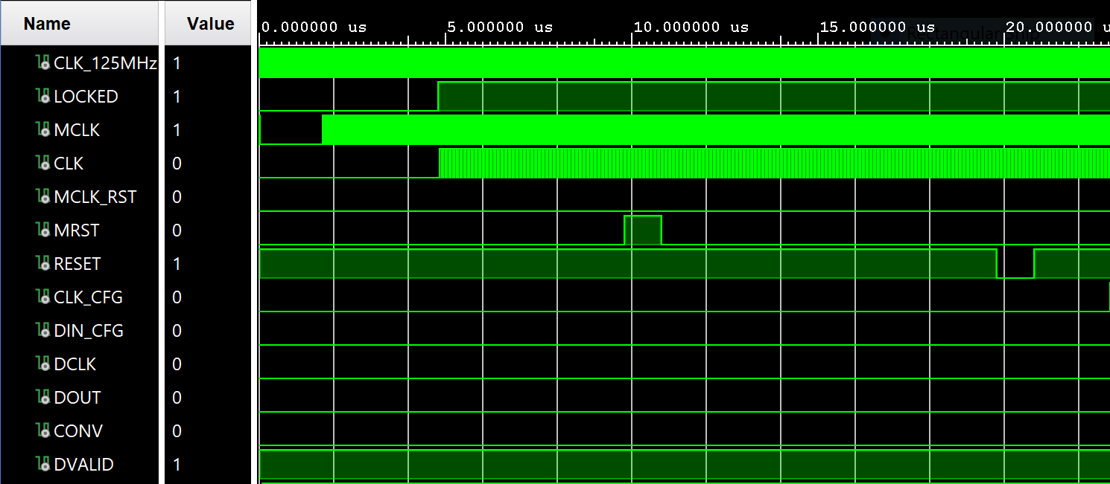
Results – Power Up
Takes 4.81 us for Clocking Wizard to generate a stable clock. MCLK actually starts before LOCKED goes high, but CLK (fed to DDC232 and generated from MCLK) only generated after LOCKED is high.
User presses MRST to start operation and after t_{POR}, $\overline{RESET}$ goes low.
Ensures power supplies have stabilized before operation.
Simulation timescale much smaller than real life, due to computation time, therefore t_{POR}= 10 us was chosen and found to be so in simulation.

Slide 8
2) Configuration

Slide 9
Results – Configuration Write
Measured t­­_{WTRST} = 2.025μs
Generally better for wait times to be on the longer side, i.e. 2μs is the minimum wait.
Successfully wrote configuration register [111110000001] on falling edges of CLK_CFG.
Important for activity in clocks to stop after process is completed (MCLK and CLK free-running).

Slide 10
Results – Configuration Read
Measured t­­_{WTWR} = 2.033μs
Successfully read a fake 640-bit readback pattern in DOUT on rising edges of DCLK, where first and last bits are 1.
CONV successfully strobed (high for one CLK cycle) after readback is completed.

Slide 11
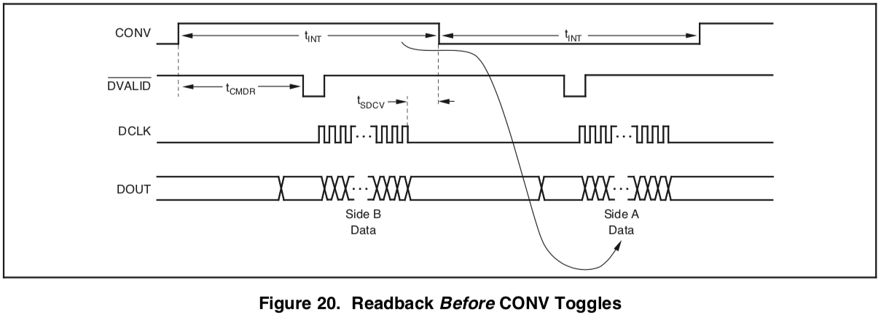
Continuous Mode – Data Retrieval Timing
It is easiest to retrieve data after falling edge of $\overline{DVALID}$ and before a CONV toggle.
Activity in DCLK must be stopped outside t_{SDCV} = ±10μs of changes in CONV.

Slide 12
Results – Measurement and Reading
CONV low-side measurement begins immediately after CONV strobe. Chose t­­_{INT} = 200μs.
After t­­_{CMDR} = 1382 CLK cycles, fake DVALID provided to trigger read.
Successfully read fake 640-bit data in DOUT on falling edges of DCLK, where first and last bits are 1.
Activity in DCLK stops 30μs before next CONV toggle, minimum time is t­­_{SDCV} = 10μs.
Fastest t­­_{INT} with this readout method confirmed to be 180μs.

Slide 13
Results – Measurement and Reading
CONV high-side measurement begins after CONV low-side measurement.
Same values found as previously.
This measurement/read cycle continues until system is powered off.

Slide 14
Conclusion
In simulation, code meets all design requirements stated in DDC232 datasheet.
Now need to figure out how to send measured data through UART transmitter module to PC so that we can test on hardware.
How long to acquire data?
Measurement every 200us, therefore 1kHz operation achieved by averaging 5 sequential measurements.
Can reduce strain on UART interface if averaged on FPGA before transmission.
Still will be flooded with data – maybe use a button press trigger to output 1 (averaged) measurement?

