Slide 1
Operation of TI DDC232CK
Summary of I/O and Timing
PBT Meeting 10/06/20

Slide 2
Key Specifications
32 channels at 10mW power per channel, dual-integrated
6kSPS maximum data rate
350pC full-scale range (FSR, range 7)
Integration time (t_{INT}) from 160μs to 1s (in continuous mode)
Analog power-supply voltage (AVDD): +5.0V
Digital power-supply voltage (DVDD): +3.0V
Reference voltage (VREF): +4.096V

Slide 3
Reference – Accuracy
±0.025% of reading ±1.0ppm FSR integral linearity
5.3ppm of FSR noise level (increases with capacitance)
±0.1ppm range error matching (matching between dual integrators)
±200ppm of FSR offset error(?)
  ±100ppm of FSR offset error match(?)
±0.1mV DC bias voltage(?)
±100ppm of FSR/V power-supply rejection ratio(?)
Quoted at typical operating conditions: T­­_{A} = 25°C, AVDD = +5V, DVDD = +3.0V, VREF = +4.096V, input current = 650μA, t_{INT} = 166.5μs, range 7 (FSR), continuous mode.

Slide 4
Reference – Performance with Temperature
±0.5ppm of FSR/°C offset drift(?)
±0.2ppm of FSR/minute offset drift stability(?)
±3μV/°C DC bias voltage drift(?)
0.01pA/°C input bias current drift(?)
25ppm/°C range drift
±5ppm/°C range drift match
Quoted at typical operating conditions: T­­_{A} = 25°C, AVDD = +5V, DVDD = +3.0V, VREF = +4.096V, input current = 650μA, t_{INT} = 166.5μs, range 7 (FSR), continuous mode.

Slide 5
I/O Signals

Slide 6
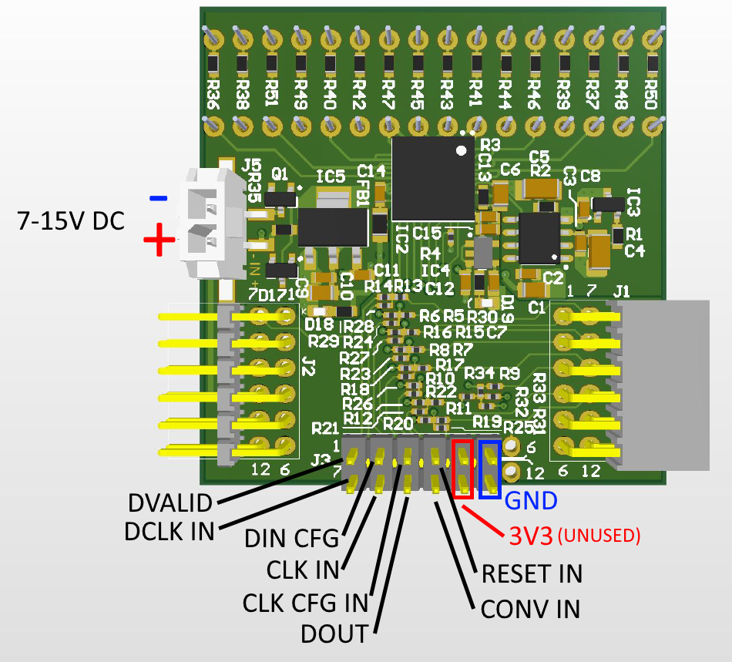

I/O Signals
System (master) clock: CLK
Configuration register clock: CLK_CFG
Configuration register input: DIN_CFG
Serial data clock: DCLK
Serial data input: DIN
Serial data output: DOUT
Conversion control input: CONV
Data valid output: $\overline{DVALID}$
Digital reset: $\overline{RESET}$

Slide 7
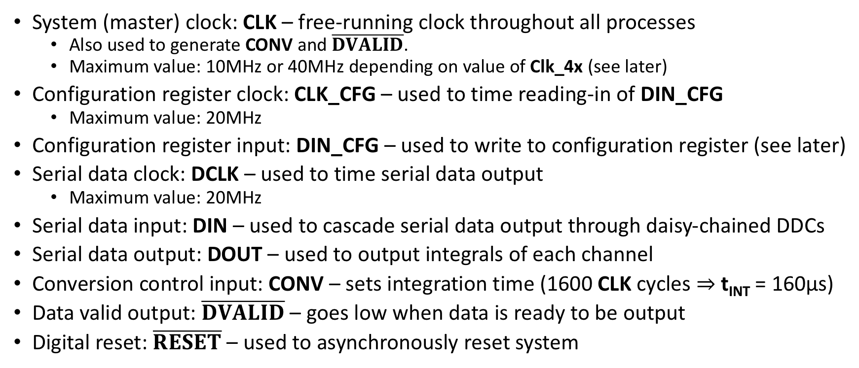
I/O Signals
System (master) clock: CLK – free-running clock throughout all processes
  Also used to generate CONV and $\overline{DVALID}$.
  Maximum value: 10MHz or 40MHz depending on value of Clk_4x (see later)
Configuration register clock: CLK_CFG – used to time reading-in of DIN_CFG
  Maximum value: 20MHz
Configuration register input: DIN_CFG – used to write to configuration register (see later)
Serial data clock: DCLK – used to time serial data output
  Maximum value: 20MHz
Serial data input: DIN – used to cascade serial data output through daisy-chained DDCs
Serial data output: DOUT – used to output integrals of each channel
Conversion control input: CONV – sets integration time (1600 CLK cycles ⇒ t_{INT} = 160μs)
Data valid output: $\overline{DVALID}$ – goes low when data is ready to be output
Digital reset: $\overline{RESET}$ – used to asynchronously reset system

Slide 8
Operation and Timing

Slide 9
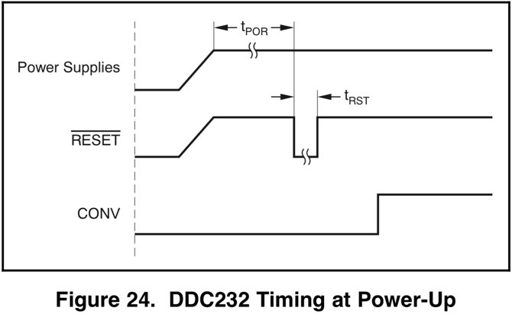
1) Power-up Sequencing
Before powering up, all digital and analog inputs must be held low until power supplies have stabilised. Master clock can then be supplied to CLK.
After time t_{POR} = 250ms, configuration can begin.

Slide 10
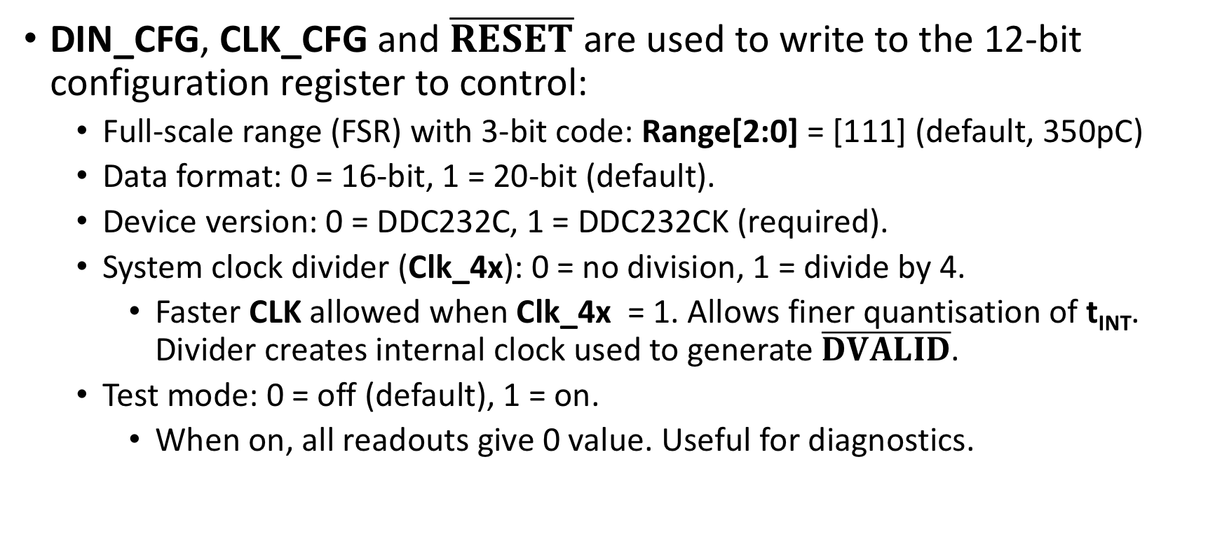
2) Configuration
DIN_CFG, CLK_CFG and $\overline{RESET}$ are used to write to the 12-bit configuration register to control:
  Full-scale range (FSR) with 3-bit code: Range[2:0] = [111] (default, 350pC)
  Data format: 0 = 16-bit, 1 = 20-bit (default).
  Device version: 0 = DDC232C, 1 = DDC232CK (required).
  System clock divider (Clk_4x): 0 = no division, 1 = divide by 4.
    Faster CLK allowed when Clk_4x = 1. Allows finer quantisation of t_{INT}. Divider creates internal clock used to generate $\overline{DVALID}$.
  Test mode: 0 = off (default), 1 = on.
    When on, all readouts give 0 value. Useful for diagnostics.

Slide 11
2) Configuration
Our DIN_CFG = [111100000000], which contains (left-to-right):
  3 bits for FSR, Range[2:0] = [111] (range 7, 350pC)
  Bit for data format = 1 (20-bit mode)
  Bit for device number = 1 (DDC232CK)
  Bit for CLK divider, Clk_4x = 0
    Shortest t_{INT} (160μs) can be divided from either 10MHz or 40MHz and a faster CLK doesn’t seem to have any other benefits.
  5 empty bits.
  Bit for test mode = 0 for beam tests (off), = 1 for development (on)
Beam test mode is the default setting
  Still need to write in order to engage test mode ;)

Slide 12
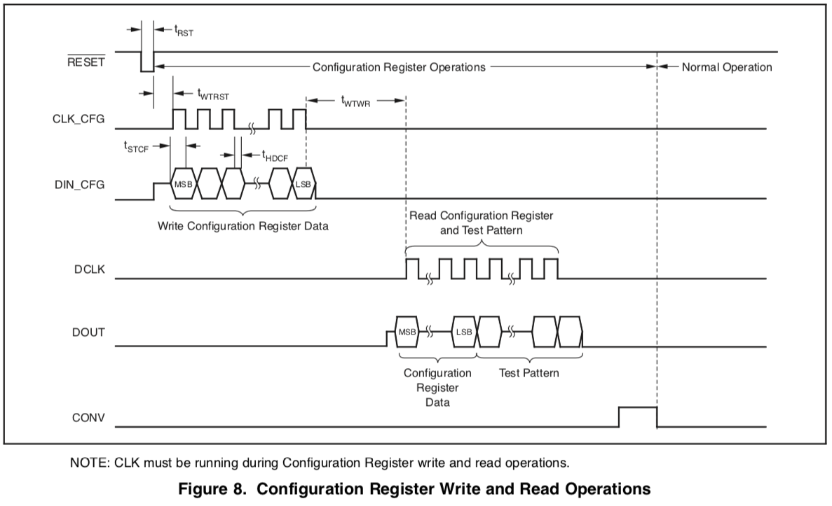
2) Configuration – Timing

Slide 13
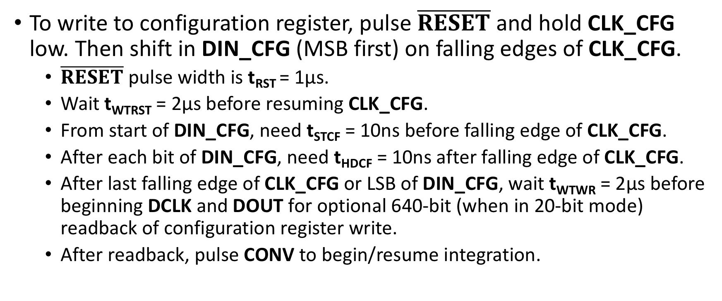
Configuration – Timing
To write to configuration register, pulse $\overline{RESET}$ and hold CLK_CFG low. Then shift in DIN_CFG (MSB first) on falling edges of CLK_CFG.
  $\overline{RESET}$ pulse width is t_{RST} = 1μs.
  Wait t­­_{WTRST} = 2μs before resuming CLK_CFG.
  From start of DIN_CFG, need t­­_{STCF} = 10ns before falling edge of CLK_CFG.
  After each bit of DIN_CFG, need t­­_{HDCF} = 10ns after falling edge of CLK_CFG.
  After last falling edge of CLK_CFG or LSB of DIN_CFG, wait t­­_{WTWR} = 2μs before beginning DCLK and DOUT for optional 640-bit (when in 20-bit mode) readback of configuration register write.
  After readback, pulse CONV to begin/resume integration.

Slide 14
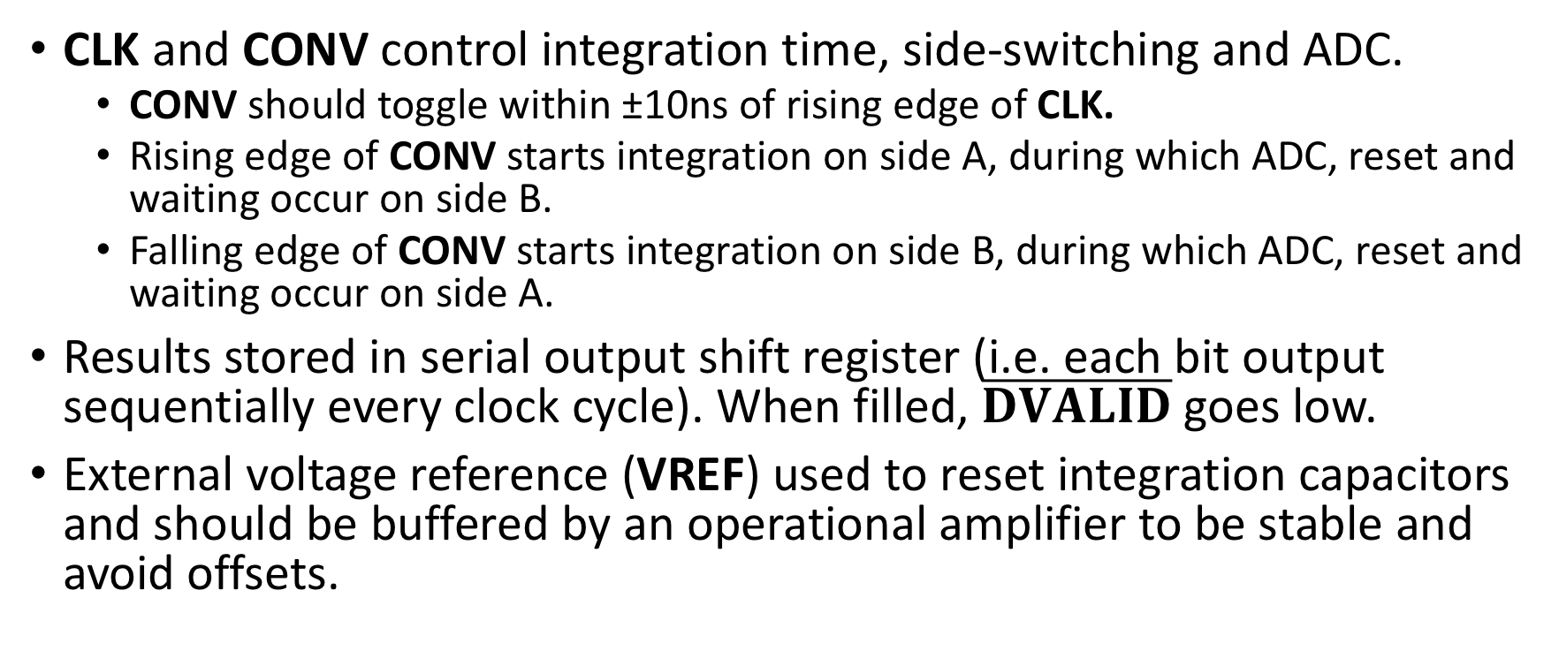
3) Integration
CLK and CONV control integration time, side-switching and ADC.
  CONV should toggle within ±10ns of rising edge of CLK.
  Rising edge of CONV starts integration on side A, during which ADC, reset and waiting occur on side B.
  Falling edge of CONV starts integration on side B, during which ADC, reset and waiting occur on side A.
Results stored in serial output shift register (i.e. each bit output sequentially every clock cycle). When filled, $\overline{DVALID}$ goes low.
External voltage reference (VREF) used to reset integration capacitors and should be buffered by an operational amplifier to be stable and avoid offsets.

Slide 15
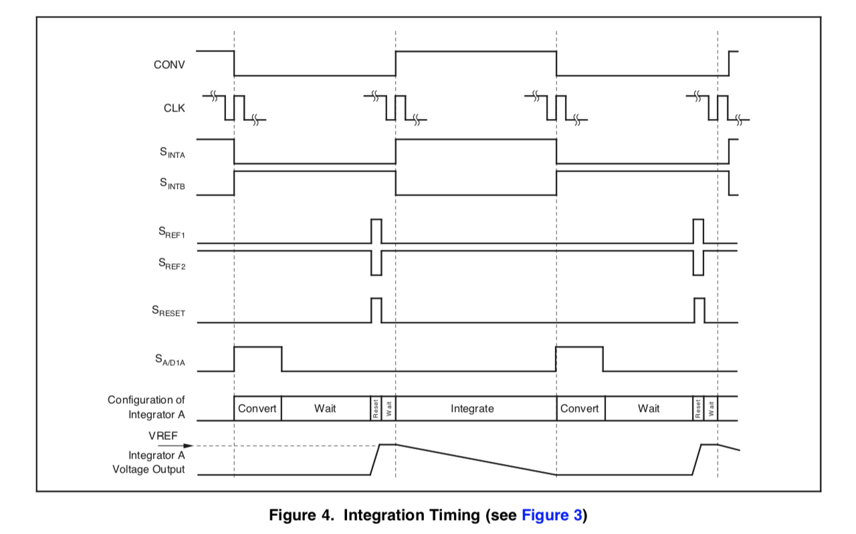
3) Integration – Timing
Internal Switches

Slide 16
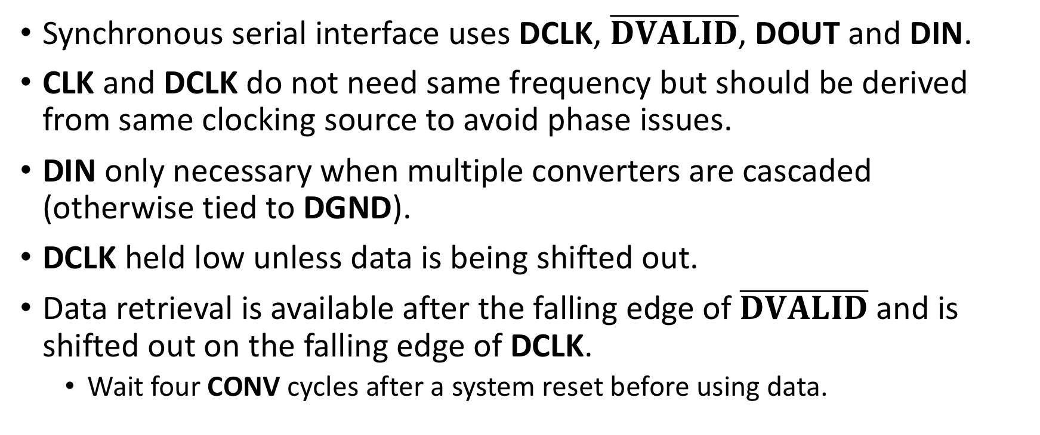
4) Digital Interface
Synchronous serial interface uses DCLK, $\overline{DVALID}$, DOUT and DIN.
CLK and DCLK do not need same frequency but should be derived from same clocking source to avoid phase issues.
DIN only necessary when multiple converters are cascaded (otherwise tied to DGND).
DCLK held low unless data is being shifted out.
Data retrieval is available after the falling edge of $\overline{DVALID}$ and is shifted out on the falling edge of DCLK.
  Wait four CONV cycles after a system reset before using data.

Slide 17
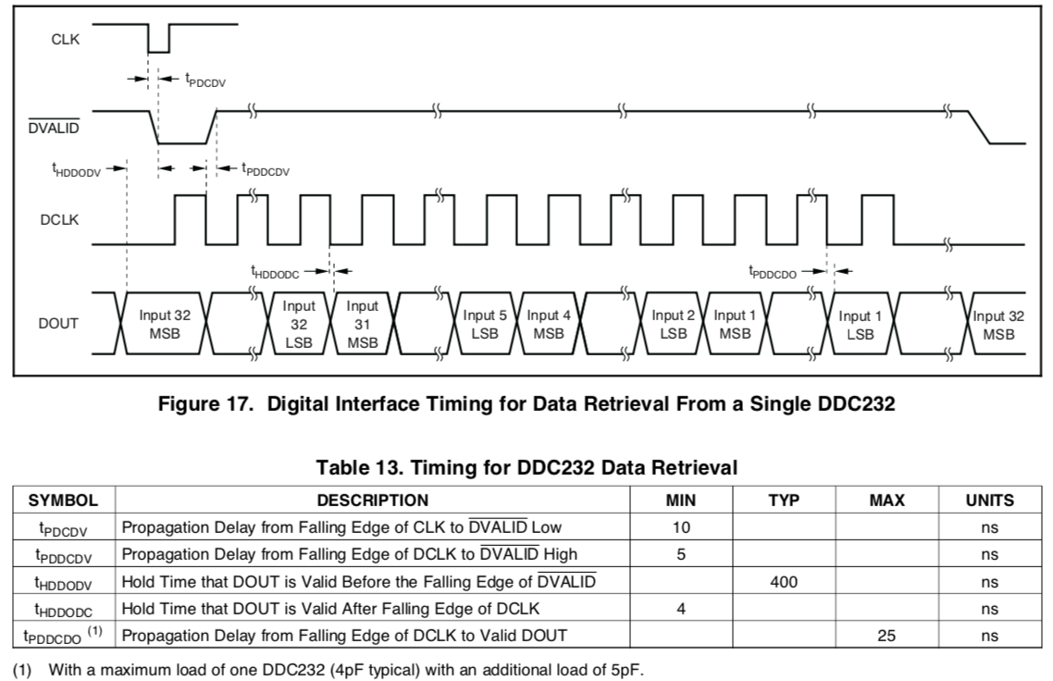
4) Digital Interface – Timing

Slide 18
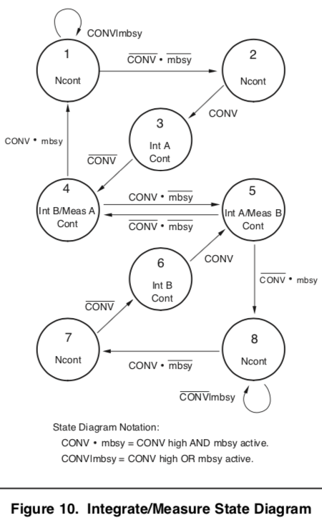
Putting It All Together
After powering-up and configuration, we enter normal operation. We want to operate in continuous mode.
This means that A/D conversion and digital readout must be faster than the integration time… and we want the shortest integration time possible to not saturate!
During normal continuous mode operation, system alternates between states 4 and 5.
System starts in either state 1 or 8 depending on if CONV is held high or low. Does not really matter which.

Slide 19
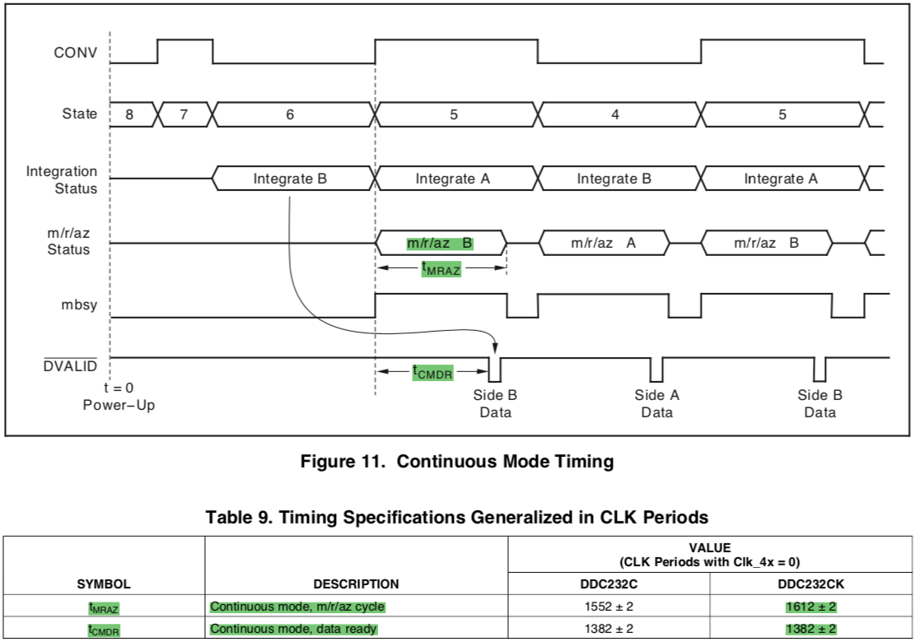
Continuous Mode – Timing

Slide 20
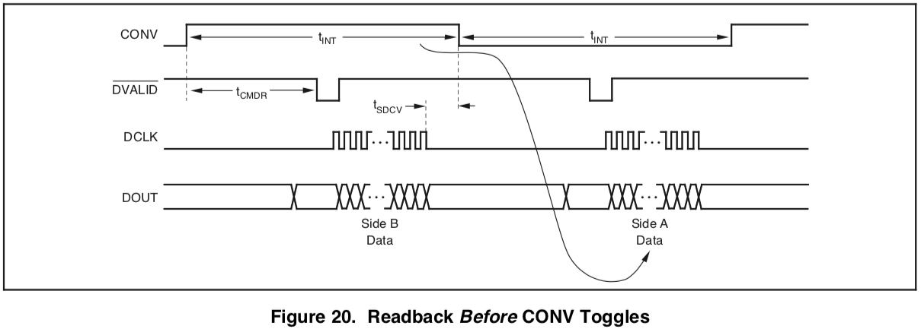

Continuous Mode – Data Retrieval Timing
It is easiest to retrieve data after falling edge of $\overline{DVALID}$ and before a CONV toggle.
  Activity in DCLK must be stopped outside t_{SDCV} = ±10μs of changes in CONV.

Slide 21
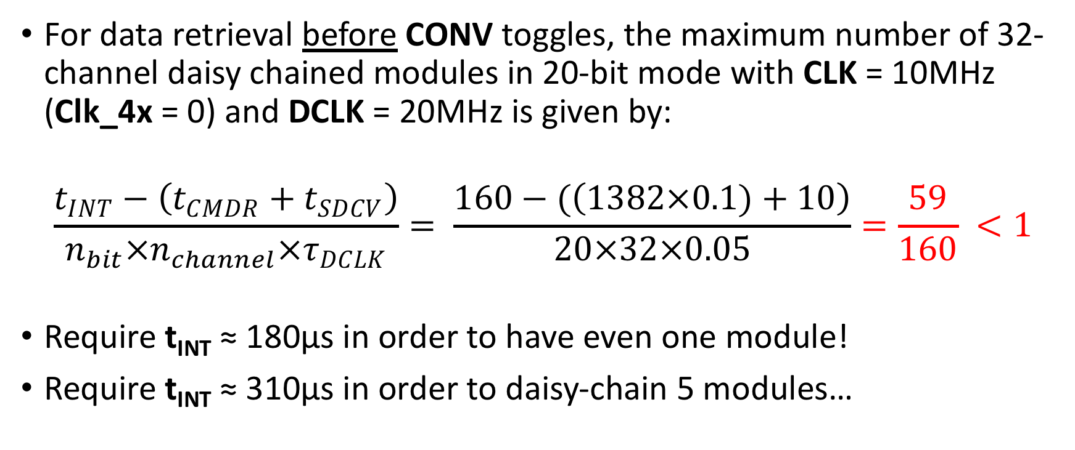
Data Retrieval Before CONV
For data retrieval before CONV toggles, the maximum number of 32-channel daisy chained modules in 20-bit mode with CLK = 10MHz (Clk_4x = 0) and DCLK = 20MHz is given by:
$$\frac{t_{INT}−\left(t_{CMDR}+t_{SDCV}\right)}{n_{bit}×n_{channel}×τ_{DCLK}}= \frac{160−(\left(1382×0.1)+10\right)}{20×32×0.05}=\frac{59}{160} <1$$
Require t_{INT} ≈ 180μs in order to have even one module!
Require t_{INT} ≈ 310μs in order to daisy-chain 5 modules…

Slide 22
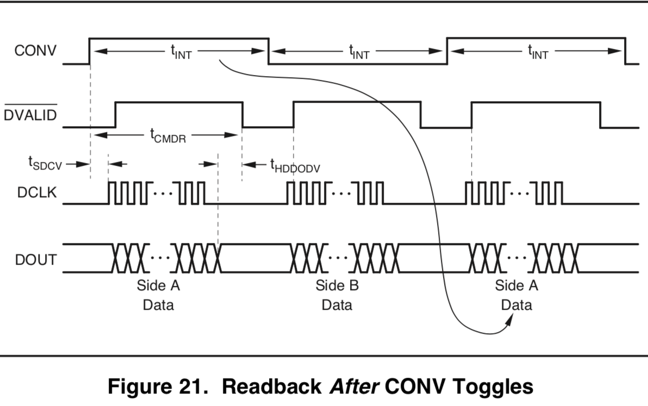
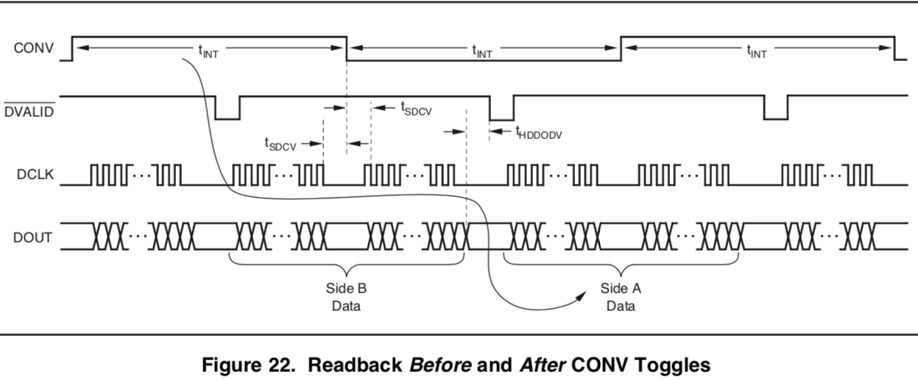
Continuous Mode – Other Data Retrieval Methods
The two other (more complicated) methods of data-retrieval can offer faster readout:
  Data retrieval after CONV toggles
  Data retrieval before AND after CONV toggles

Slide 23
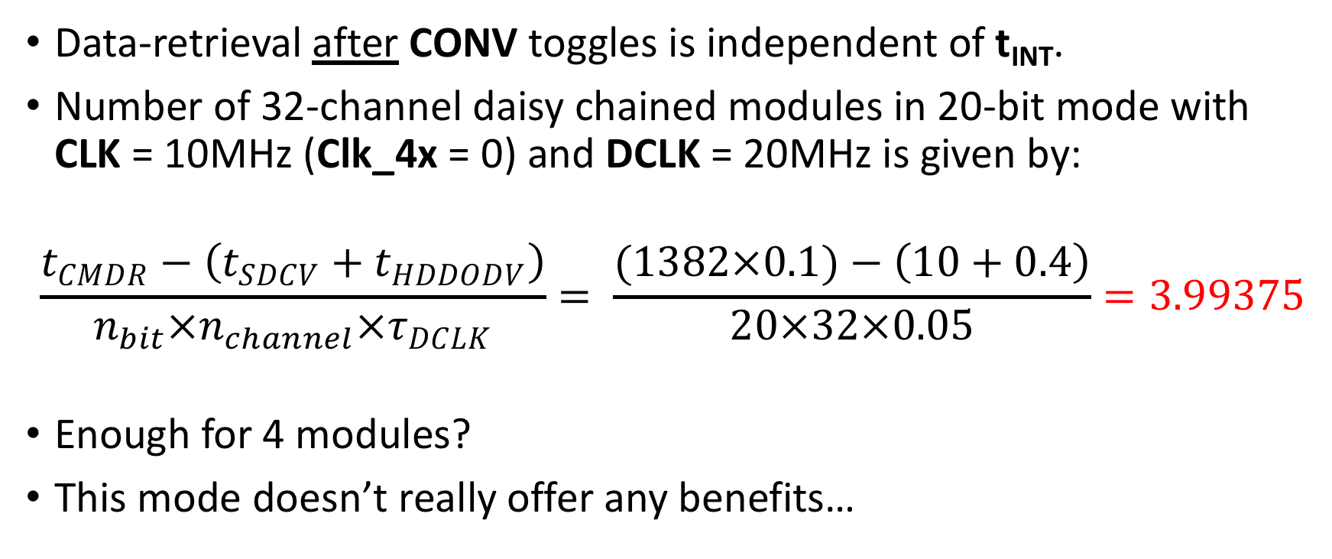
Data Retrieval After CONV
Data-retrieval after CONV toggles is independent of t_{INT}.
Number of 32-channel daisy chained modules in 20-bit mode with CLK = 10MHz (Clk_4x = 0) and DCLK = 20MHz is given by:
$$\frac{t_{CMDR}−\left(t_{SDCV}+t_{HDDODV}\right)}{n_{bit}×n_{channel}×τ_{DCLK}}= \frac{(1382×0.1)−\left(10+0.4\right)}{20×32×0.05}=3.99375$$
Enough for 4 modules?
This mode doesn’t really offer any benefits…

Slide 24
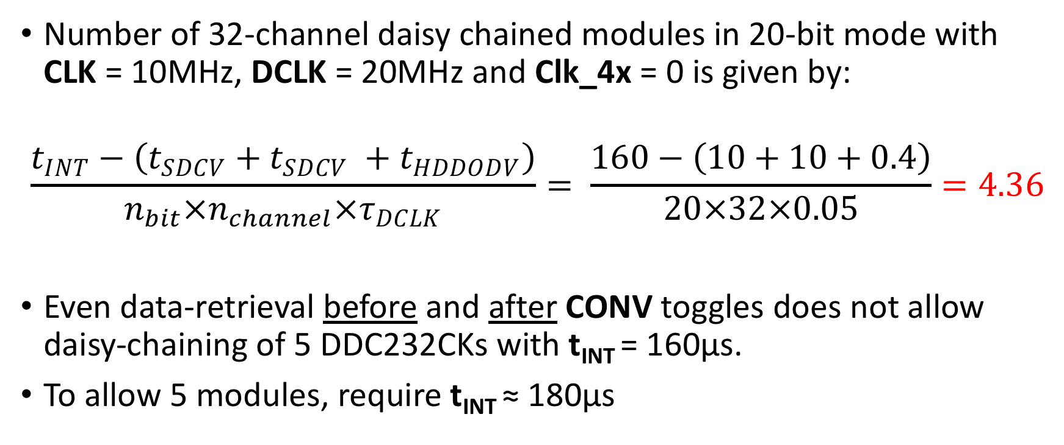
Data Retrieval Before AND After CONV
Number of 32-channel daisy chained modules in 20-bit mode with CLK = 10MHz, DCLK = 20MHz and Clk_4x = 0 is given by:
$$\frac{t_{INT}−\left(t_{SDCV}+t_{SDCV} +t_{HDDODV}\right)}{n_{bit}×n_{channel}×τ_{DCLK}}= \frac{160−\left(10+10+0.4\right)}{20×32×0.05}=4.36$$
Even data-retrieval before and after CONV toggles does not allow daisy-chaining of 5 DDC232CKs with t_{INT} = 160μs.
To allow 5 modules, require t_{INT} ≈ 180μs

Slide 25
Conclusion
Will first develop to retrieve data before CONV toggles (simplest method) with t_{INT} = 180μs.
  If we avoid saturation with t_{INT} = 320μs, then this readout method can be appropriate for daisy-chained modules.
Potential problem with splitting photodiodes across two inputs?
  For final detector, need 160 × 3mm photodiodes
  Doubling the number of readout channels requires longer integration times!
  Also requires more modules…
Test if photodiode input is above 50% of FSR with t_{INT} = 320μs
Now just need to implement this on an FPGA… ☺

Slide 26
Glossary of Values and Constants
CLK: system clock = 10MHz
CLK_CFG: configuration clock = 20MHz
DCLK: digital interface clock = 20MHz
CONV: integration time, t_{INT} = 160-320μs
Clk_4x: system clock divider = 0
Range[2:0]: full-scale range = [111] (350pC, range 7)
Data format: bit-resolution of data = 1 (20-bit)
Device number: device used = 1 (DDC232CK)
t_{POR}: Wait After Power-Up Until Reset = 250ms
t_{RST}: Reset Low Width = 1μs
t­­_{WTRST}: Wait Required from Reset High to First Rising Edge of CLK_CFG = 2μs
t­­_{STCF}: Set-Up Time from DIN_CFG to Falling Edge of CLK_CFG = 10ns
t­­_{HDCF}: Hold Time for DIN_CFG After Falling Edge of CLK_CFG = 10ns
t­­_{WTWR}: Wait Required from Last CLK-CFG of Write Operation to First CLK_CFG of Read Operation = 2μs
t_{PDCDV}: Propagation Delay from Falling Edge of CLK to DVALID Low = 10ns
t_{PDDCDV}: Propagation Delay from Falling Edge of DCLK to DVALID High = 5ns
t_{HDDODV}: Hold Time that DOUT is Valid Before the Falling Edge of DVALID = 400ns
t_{HDDODC}: Hold Time that DOUT is Valid After Falling Edge of DCLK = 4ns
t_{PDDCDO}: Propagation Delay from Falling Edge of DCLK to Valid DOUT = 25ns
t_{MRAZ}: Continuous mode, m/r/az cycle = 1612 ± 2 CLK periods (Clk_4x = 0)
t_{CMDR}: Continuous mode, data ready = 1382 ± 2 CLK periods (Clk_4x = 0)
t_{SDCV}: Data Retrieval Shutdown Before or After Edge of CONV = 10μs

