Slide 1
UART Interface of DDC232
Simulation of data transfer from DDC232
PBT Meeting 15/07/20

Slide 2
Data transfer from FPGA to PC
FPGA receives a 640-bit long data stream after every integration.
  640-bit configuration readback sequence before first integration.
640-bit data vector overwritten every time new data is received.
Need to transfer data before next measurement arrives.
  High-speed real-time readout could be possible! More on that later…
Simplest readout interface is a UART interface.

Slide 3
UART Interface
Universal Asynchronous Receiver Transmitter
  Data arrives without a clock, hence asynchronous.
Speeds up to 921600 bits per second (just under 1 Mb/s).
Sends 8-bits of data at a time.
Handshake protocol is a start bit (0) before 8-bit data packet and a stop bit (1) after.
  Unfortunately, the 921600 bits per second includes the start and stop bits…

Slide 4
UART Transmitter Code
Interfaced DDC232 code with a UART transmitter (UART TX).
Signals used:
  TX_DV – data valid, sent to UART TX when a byte is ready to send.
  TX_Byte – byte sent to UART TX.
  TX_Serial – individual bits sent to PC, high when inactive.
  TX_Done – sent from UART TX when a byte has been sent.
  TX_Active – high when UART TX is working on sending a byte.
Set up to send 80 8-bit packets while waiting for new data.
Requires sufficient integration time.

Slide 5
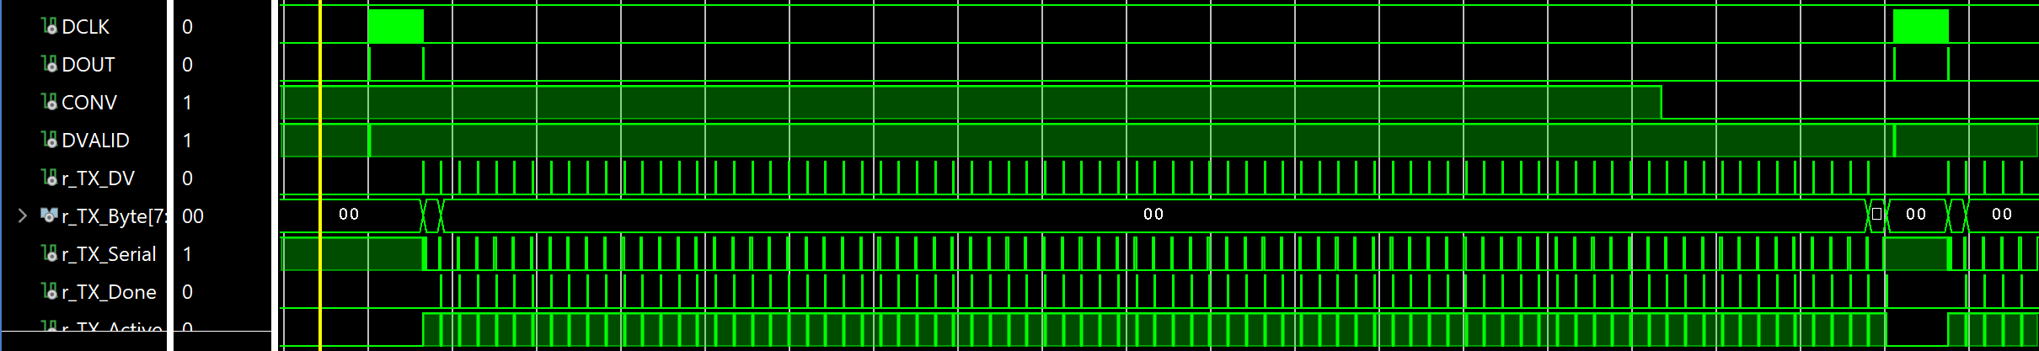
UART Transmitter Simulation
As soon as data is read from DDC232, begin sending data through UART TX.
Needs to finish before DDC232 DVALID pulse.
Recall that test data only has first and last bits = 1.

Slide 6
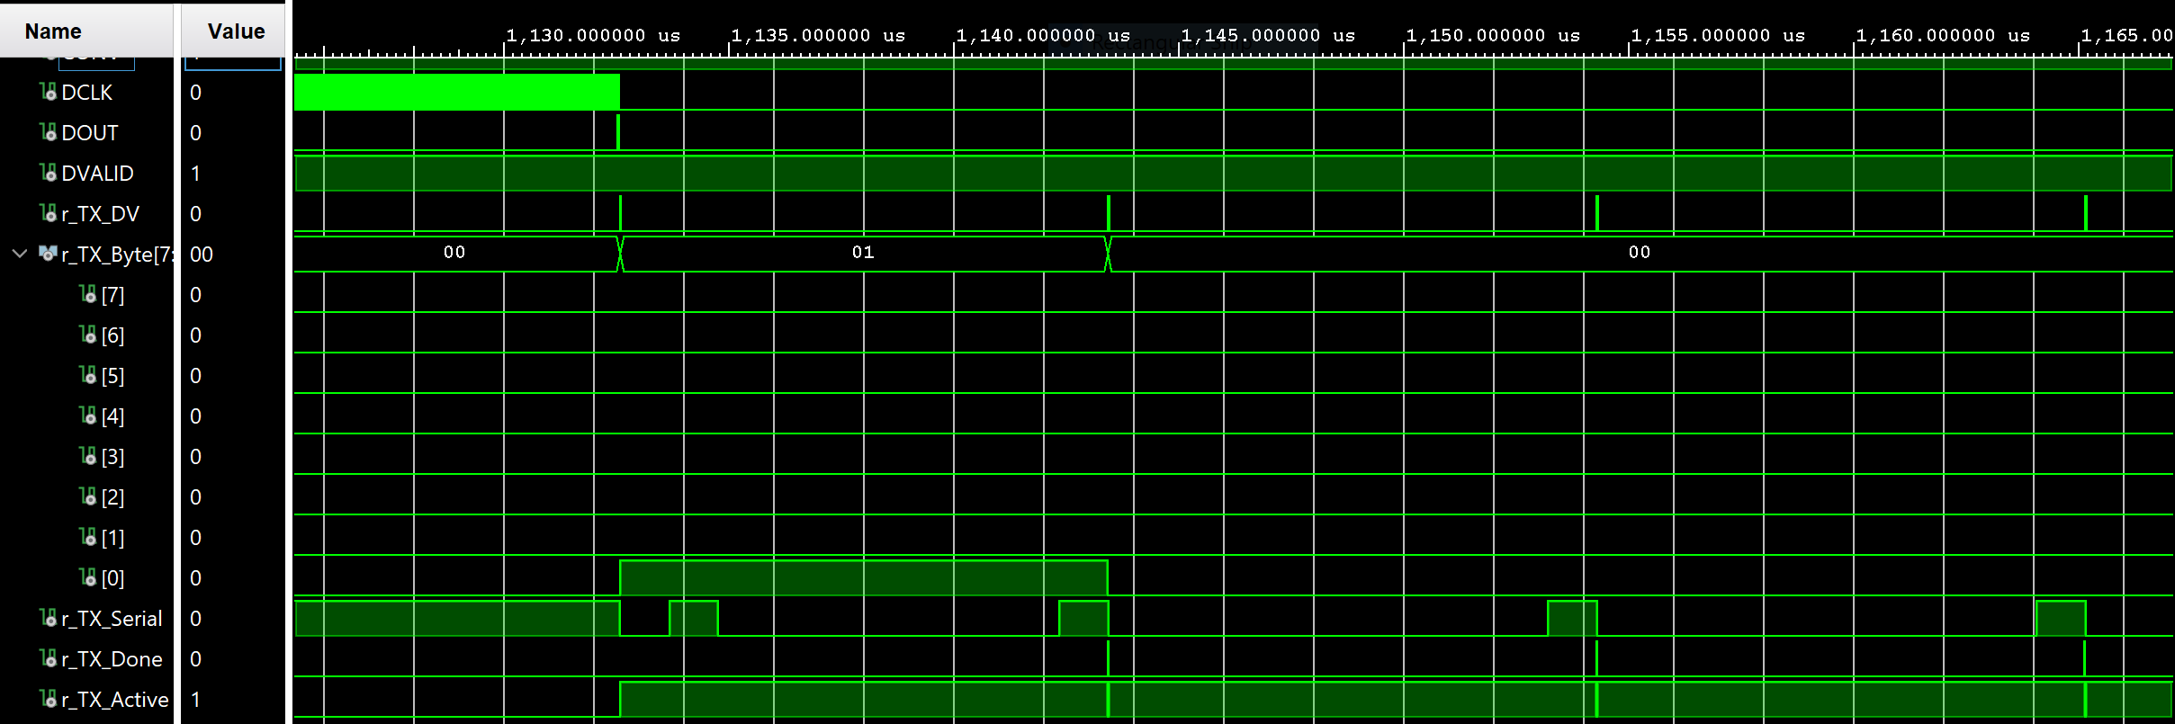
UART Transmitter Simulation

Slide 7
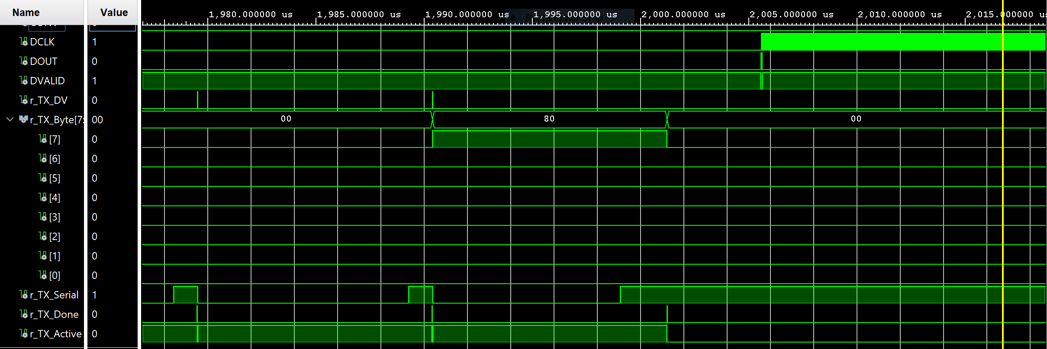
UART Transmitter Simulation

Slide 8
Conclusion
UART is slow!
  For real-time readout, pushes integration time up to 900 us (∼1.1 kHz) for 1 module and 4500 us (0.22 kHz) for 5 modules…
  Could use a First-in First-out (FIFO) register to hold data.
USB 2.0 seems more exciting?
  Data rate of up to 480 Mb/s – enough to make integration time independent of readout.
  Potentially readout with integration time of 180 us (5.6 kHz) for 1 module and 310 us (3.22 kHz) => see last few slides from presentation on 09/06/20.
  GUI on Raspberry Pi that displays real-time photodiode levels?
All dependent on integration time photodiodes need to provide good readings without saturation.

Slide 9
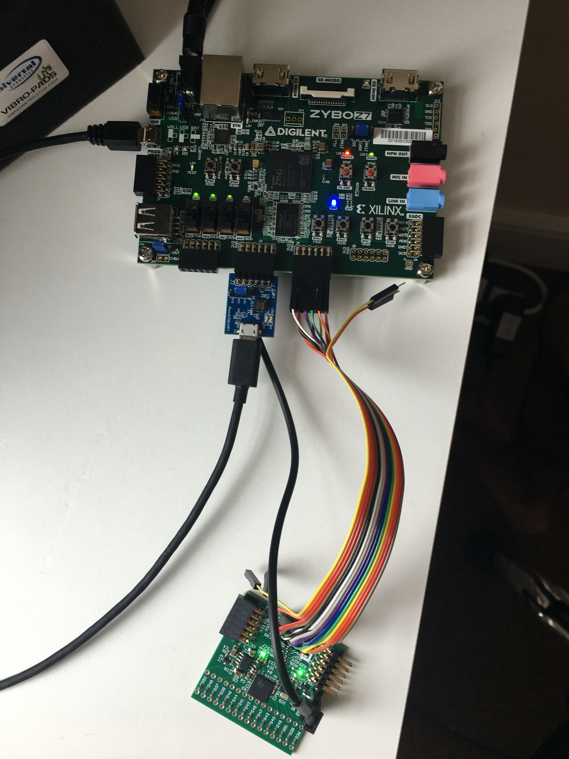
Next Steps…
Design behaves as intended in simulation.
Also works in hardware! ☺
  Need to verify output is correct.
Using longest integration time (1 s) to not flood terminal emulator (TeraTerm or RealTerm) with data.
  RealTerm allows data to be shown in binary format. TeraTerm only shows hexadecimal.
Next step is to figure out how to automate saving data to a txt file.

