Slide 1
Preliminary Analysis of 2nd Order Corrections to Birks’ Law
20/05/20

Slide 2
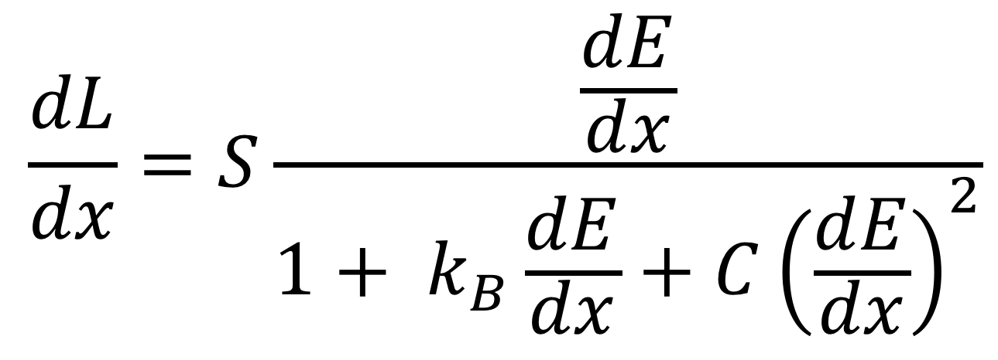
Birks’ Law to 2nd Order
$$\frac{dL}{dx}=S\frac{\frac{dE}{dx}}{1+ k_{B}\frac{dE}{dx}+C{\left(\frac{dE}{dx}\right)}^{2}}$$

Slide 3
Testing Corrected Law
Can’t use simulated data from Geant4 as it only uses Birks’ law to 1st order to produce scintillation photons.
Our quenched Bragg model is sensitive to starting estimates, so need high-resolution PDL to get rough estimates of what k_{B} and C are.
Laurent suggested data from Adam Gibson’s PhD student Mansour Almurayshid’s thesis.
  60 MeV proton beam at Clatterbridge in PVT scintillator, measured with a camera.
  They measured kB = 0.154 for their scintillator.

Slide 4
Birks = 0.154, C == 0
Birks == 0.154, C == 0
Birks == 0.154, C = 0.01
Birks = 0.154, C = 0.01

Slide 5
Comments
Not sure if their x-axis is depth in scintillator or water…
  Thesis mentions a basic correction but is not explicit about this data. I assume it’s H2O.
2nd order correction seems to perform better when both parameters are free – reference range at Clatterbridge is 31.2mm in water.

Slide 6
Testing on HIT Data
Leverington 2018 paper has some measured Birks constants at HIT
kB = 0.0178 as apposed to our proton value of approx. kB = 0.07
Try fitting with both of these values as starting values.
Ideally we want to not have to fix any parameters or provide parameter limits!

Slide 7
Birks = 0.07, C == 0

Slide 8
Birks = 0.07, C = 0.01

Slide 9
Birks = 0.07, C == 0.01

Slide 10
Birks = 0.0178, C = 0.01

Slide 11
Comments
Using k_{B} quoted by Leverington 2018, able to fit without having to fix k_{B} or C.
Small increase in reconstructed range pushes our reconstructed Bragg peak to overlap with FLUKA benchmark.
So far haven’t had much success with ion fits – lack of FLUKA reference curves makes it hard to compare goodness-of-fits.

