Slide 1
DDC232 First Tests
PBT Meeting 22/07/20

Slide 2
Current Status of Development
It works! ☺☺☺
A few design notes:
  LEDs reflect current state (e.g. power-up, configure, measure).
  One button resets both Clocking Wizard and DDC232 simultaneously and another button stops operation.
    Operation resumed by pressing reset button.
  After reset, DDC232 is reconfigured (required).
  Confirmed integration begins immediately after post-configuration readback CONV strobe, but ignore first 4 sets of data (required).
Used Xilinx Integrated Logic Analyser to monitor real signals on FPGA.
Monitoring binary output to PC with RealTerm.

Slide 3
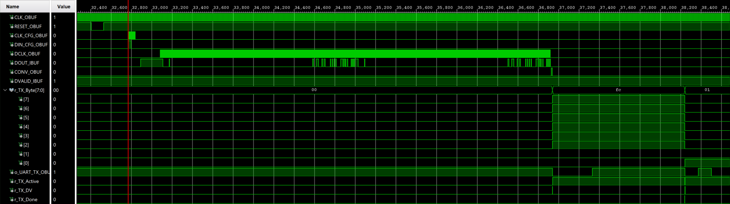
Integrated Logic Analyser
  Samples real signals in waveform diagram like in Simulation on a user-defined trigger.
  Only verified that configuration read/write look correct.
  Requires allocation of on-board RAM, so not free.

Slide 4
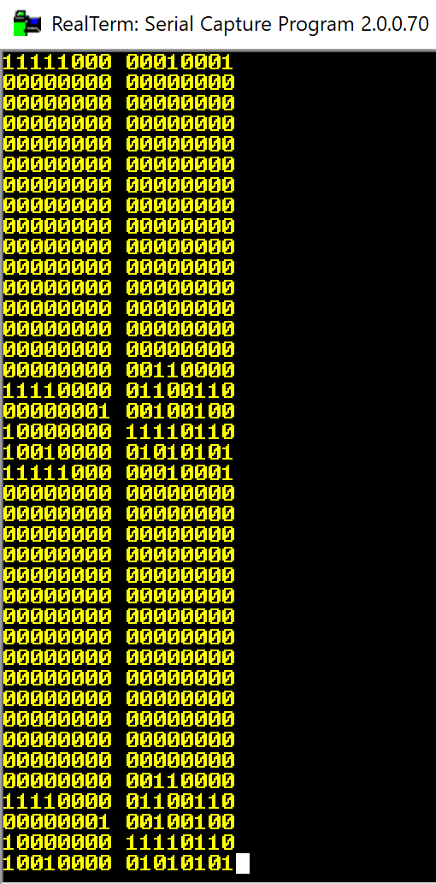
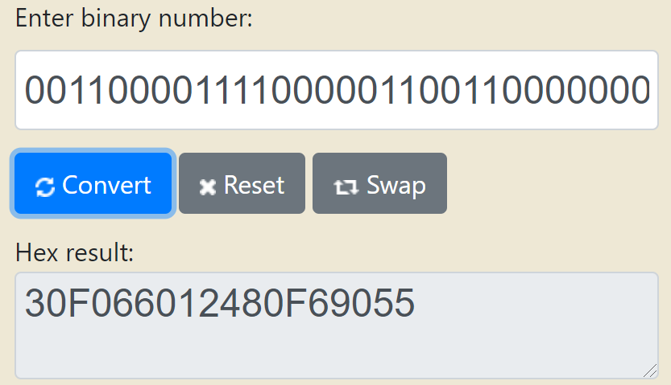
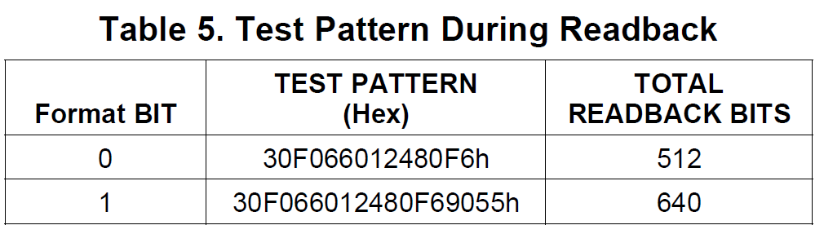
Configuration Readback
After configuration write, DDC232 outputs for verification:
  12-bit Configuration register (i.e. what it thinks you sent)
  4-bit Revision ID
  304-bit readback pattern (only last 72-bits are non-zero)
  This is then repeated (640 bits sent in total).
Output is correct!

Slide 5
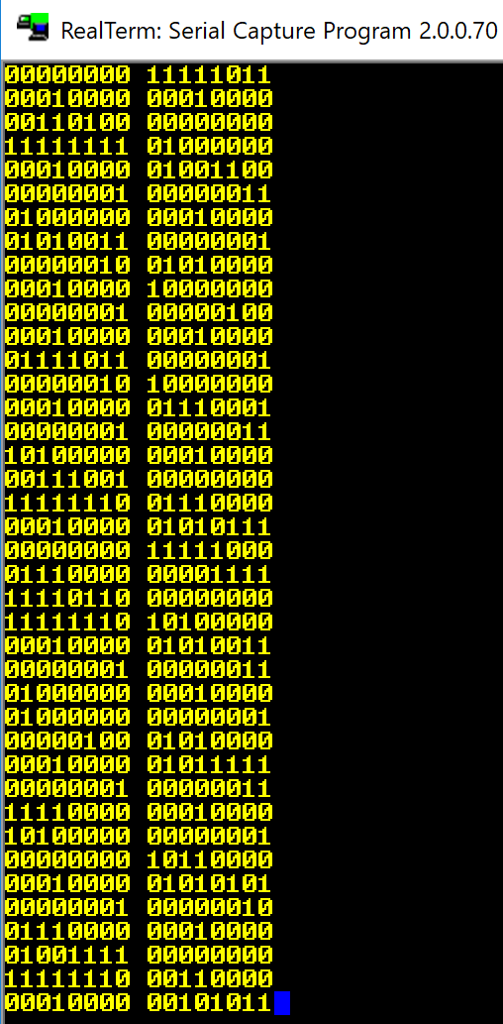
Test-Mode Data Output
Datasheet states that all inputs should give zero signal when device is in test mode.
Convert binary to decimal with unit pC in range 0-350 pC and also subtract 0.4% negative full-scale range.

Slide 6
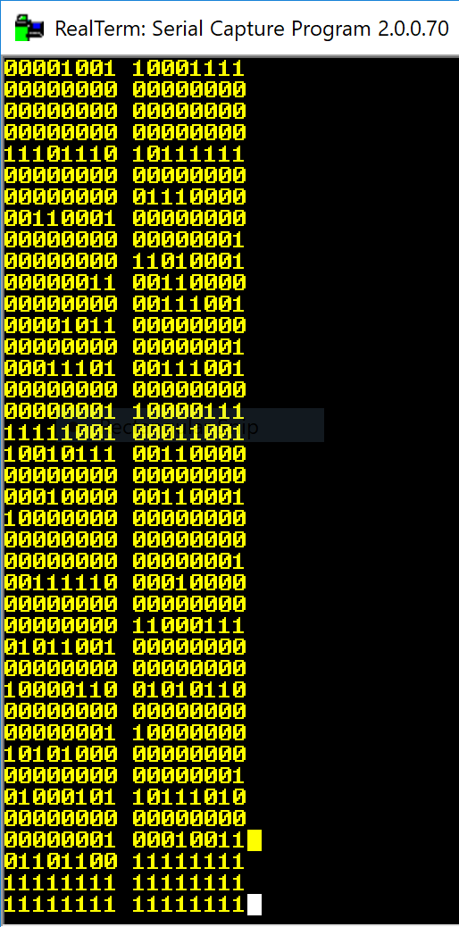
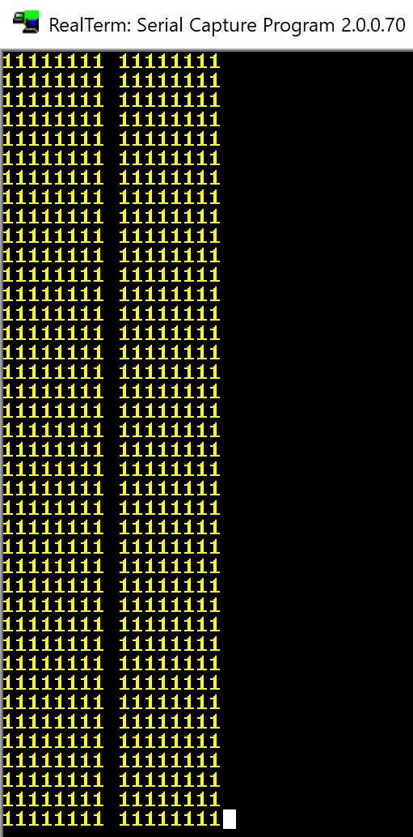
Photodiode Data Output
Quick test with 1 (left) and 16 (right) photodiodes.
Using longest integration time (1s) so photodiodes saturate even with ambient light.
Will conduct further tests with shorter integration times.

Slide 7
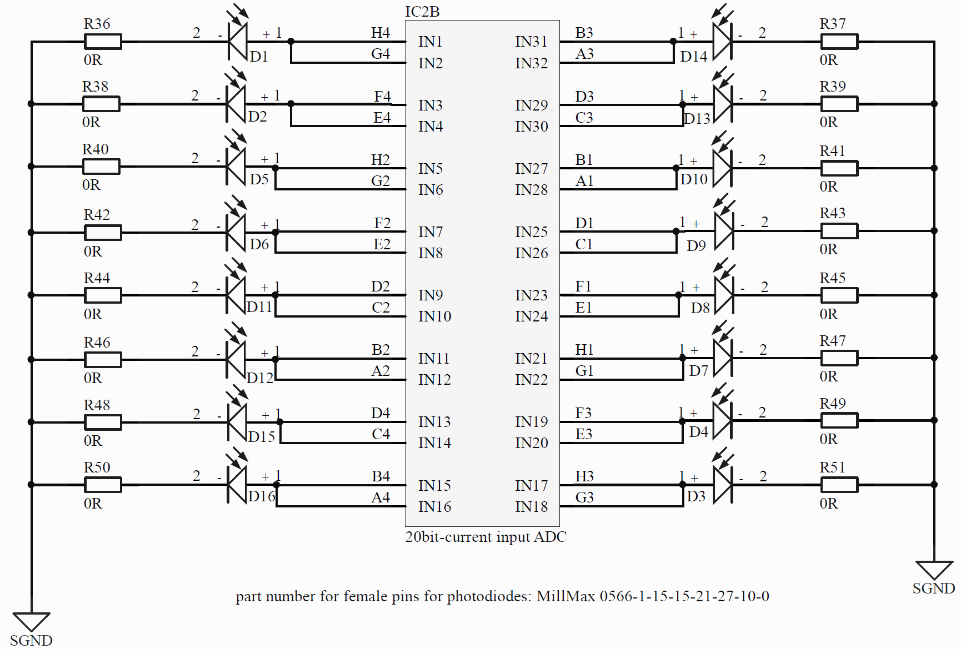
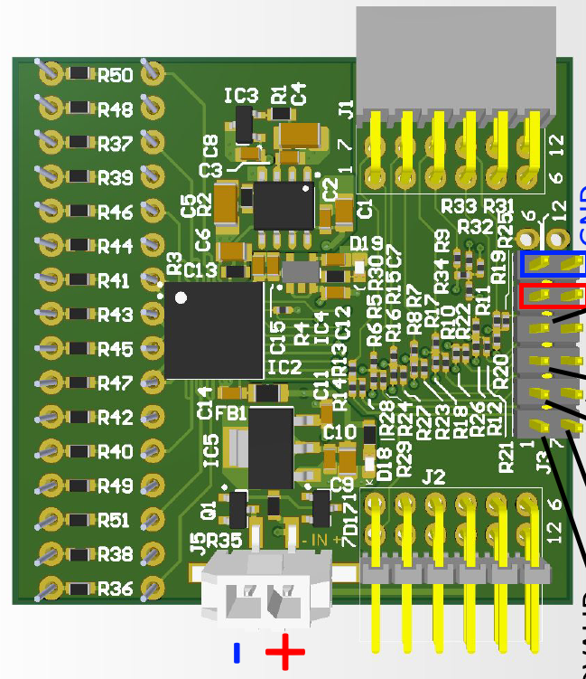
Next Steps
Need to streamline data acquisition:
  Organise 8-bits data packets into 20-bit measurements.
  Save data to text file on some trigger.
  Conversion from binary to decimal format.
  Resistor-input map does not reflect physical ordering of photodiodes!
    Can this be fixed in future chips?
Determine suitable integration times.
  Household light-source approximation of detector light levels?

