Slide 1
DDC232 Demo
PBT Meeting 29/07/20

Slide 2
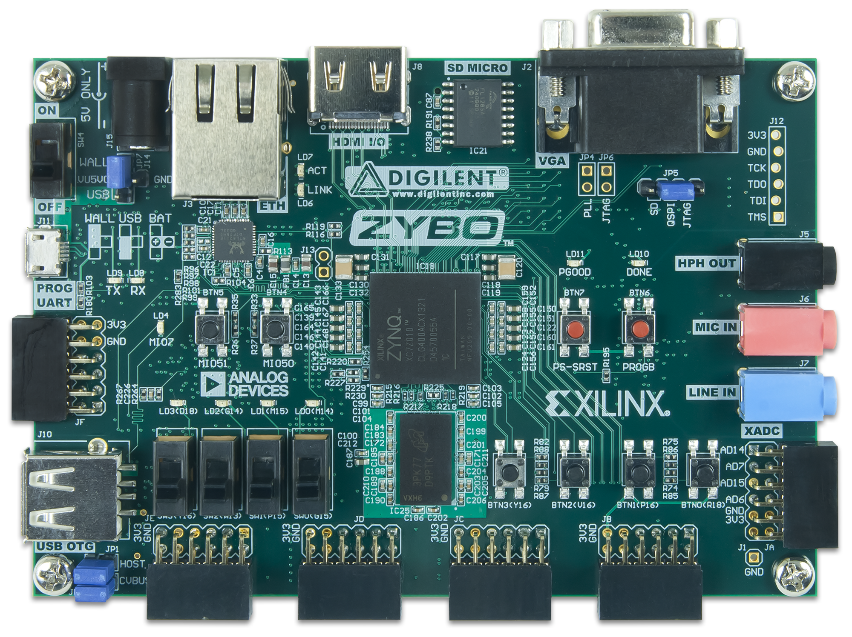
Features of Design
Note: triggered acquisition mode allows for shortest integration times!
Trigger Acquisition
Clocking Wizard Status LED
State LED 1
Pause Operation
State LED 2
Error LED
Global Reset
Acquisition Mode (Continuous or Triggered)
Note: button operations can also be done from PC.
Toggle Test Mode

Slide 3
Demonstration
What could possibly go wrong…?

Slide 4
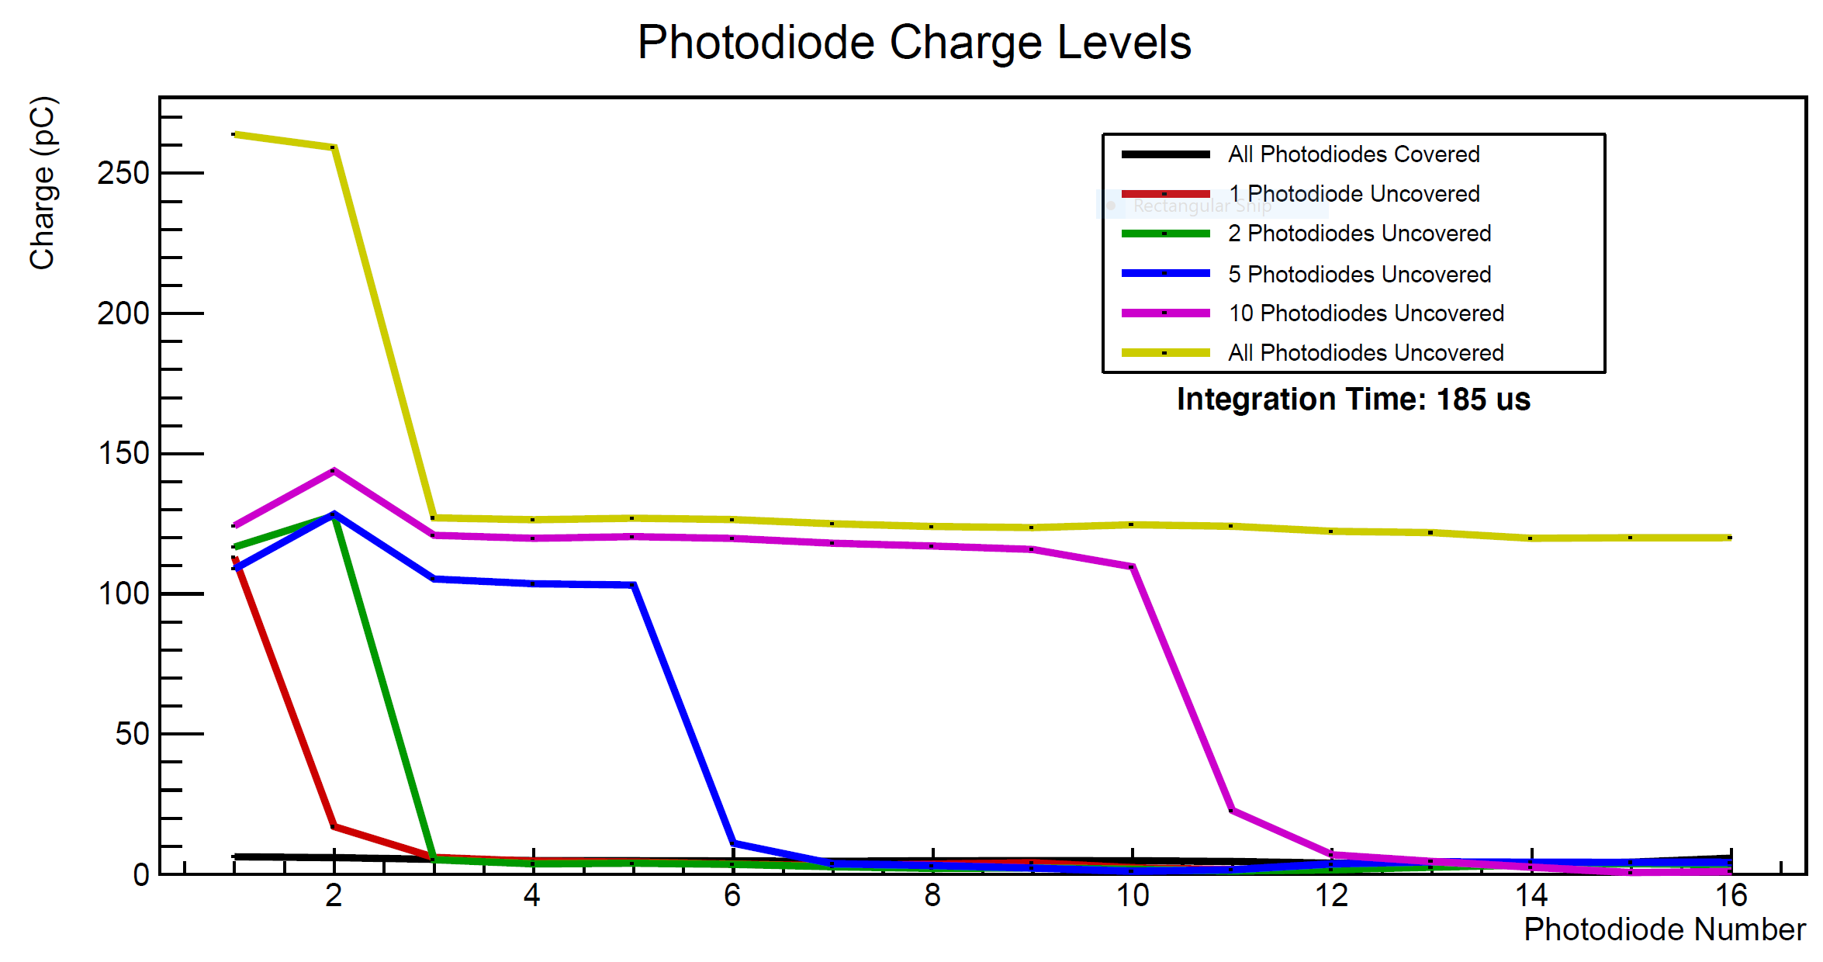
Photodiode Test

Slide 5
Next Steps
Refine what constitutes an acquisition:
  Appropriate integration time for photodiodes.
  Number of measurements to average.
Upgrade UART to USB or Ethernet
  Requires use of the Zybo processor.
    Need to figure out how to instantiate the processor and transfer data to it.
Build GUI on Zybo?
  Look into ‘Petalinux’ and evaluate capabilities for SSH/Remote Desktop.
  Unsure if processor is powerful enough, but might be worth trying anyway…
Already have enough to do an experiment?

