Slide 1
A Quality Assurance Range Calorimeter for Proton Beam Therapy
Saad Shaikh
Transfer Talk

Slide 2

You know, I’m something of a scientist myself

Slide 3
Proton Beam Therapy (PBT)
PBT is a type of radiotherapy.
Ionising radiation damages DNA of tumour cells, causing cell death.
Offers better dose localisation than X-rays.
Requires daily quality assurance (QA) to ensure correct delivery.
Proton range is a key parameter.

Slide 4
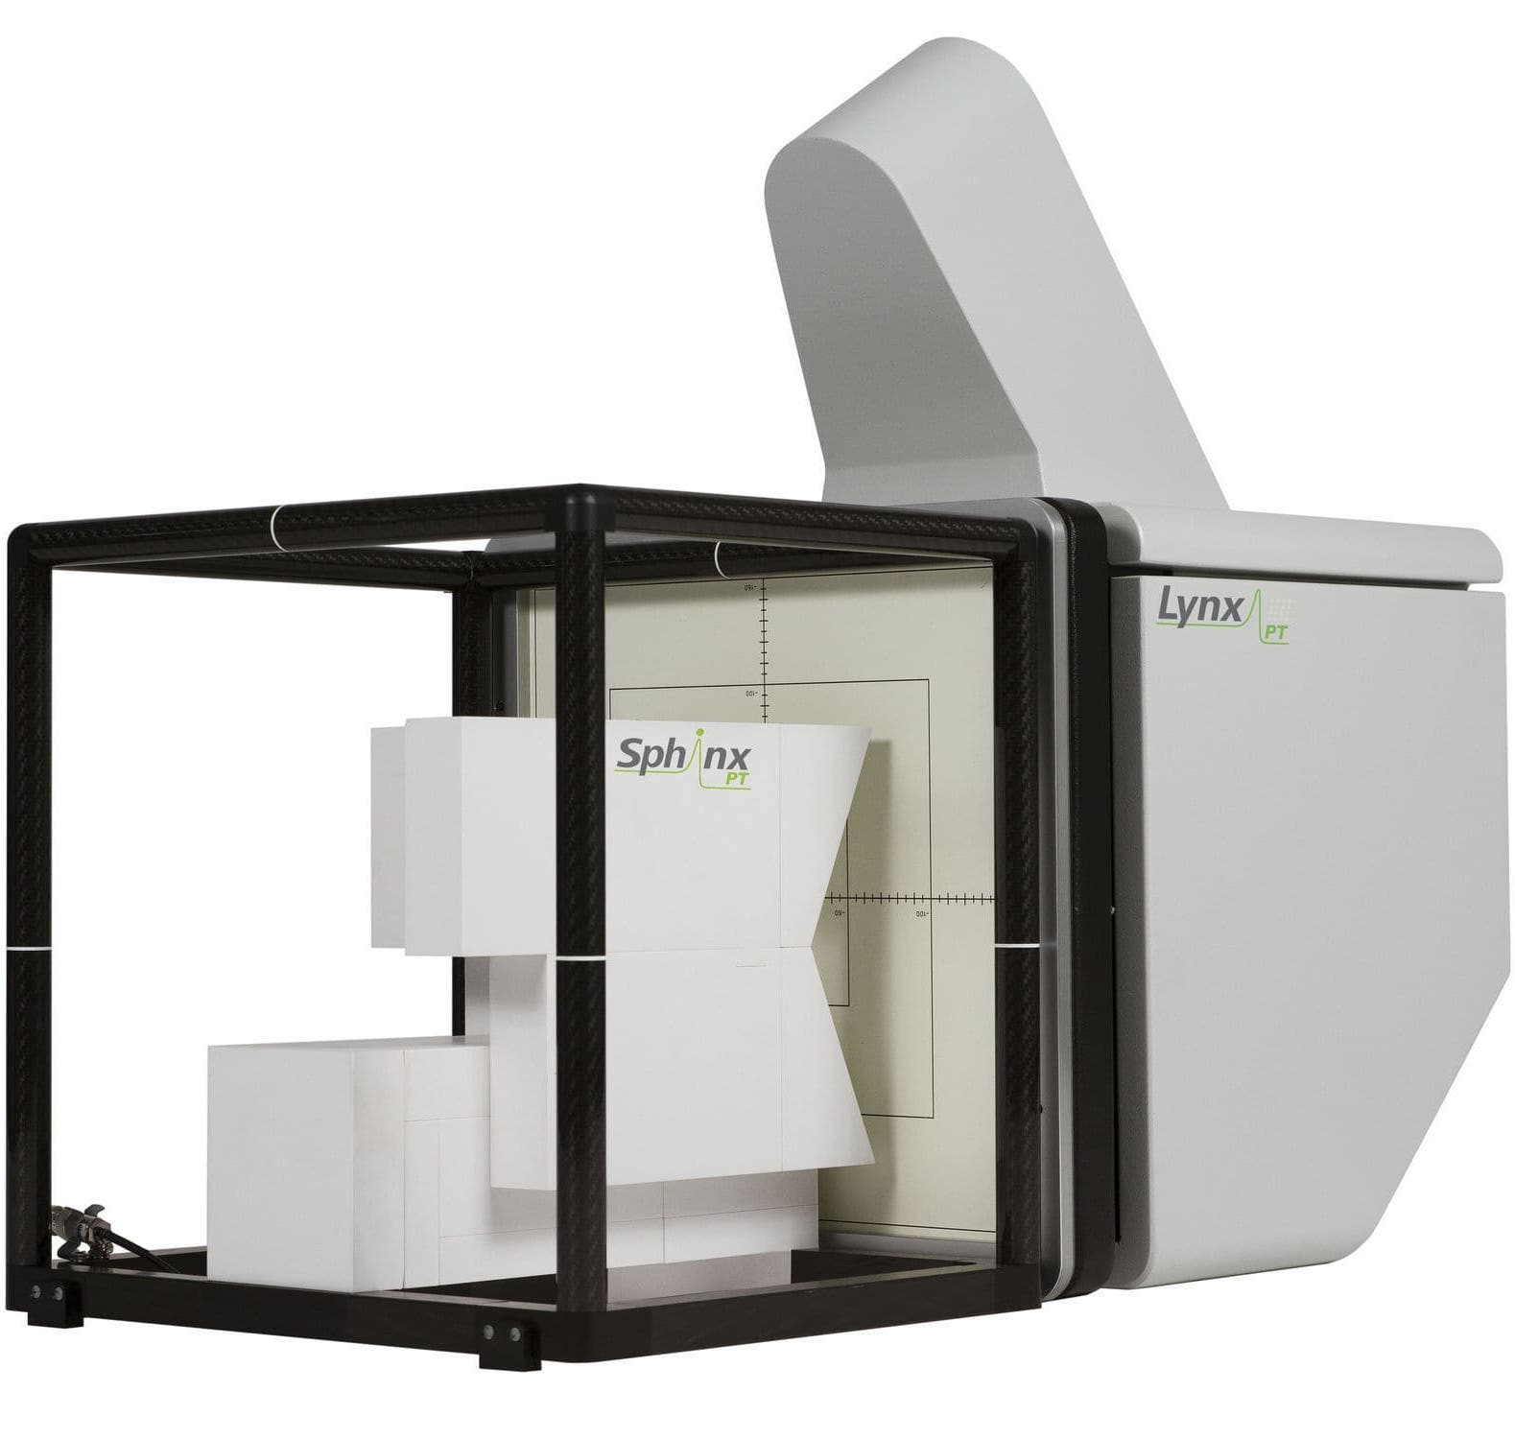
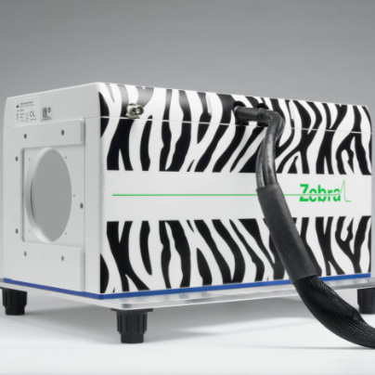
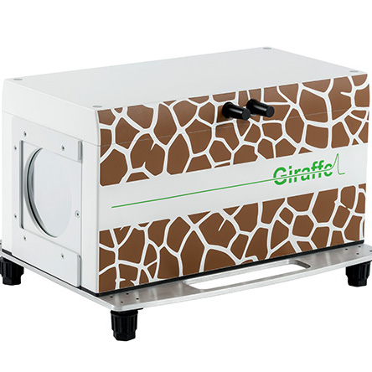
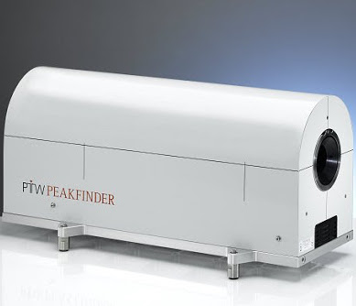
Daily QA
Measure proton range in water-equivalent material for a selection of beam energies.
Current methods often slow and difficult to setup.
  Takes time away from patient treatment.
  Expensive and not directly water-equivalent.
Develop a detector to make fast and accurate measurements of proton range.

Slide 5
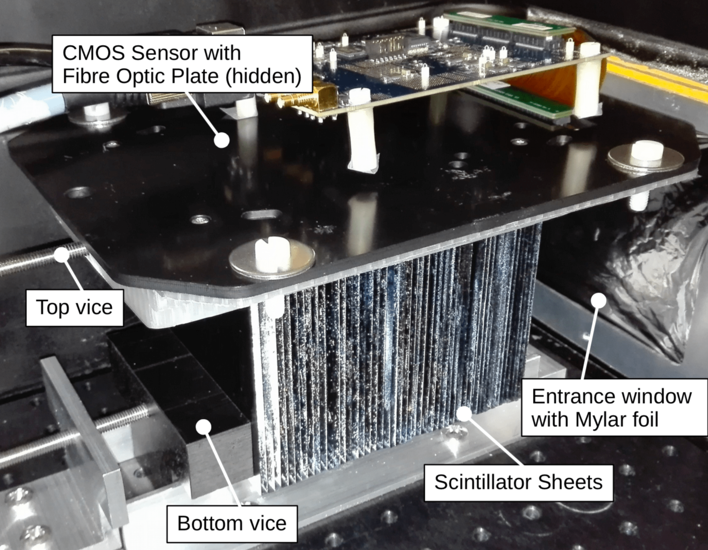
The Quality Assurance Range Calorimeter (QuARC)
Current working prototype is a series of polystyrene scintillator sheets read by a CMOS sensor.
Sheets are inexpensive and water-equivalent.
Measure light in each sheet to reconstruct Bragg curve and recover proton range.
Easy setup and range recovered with only single beam delivery.
Worked with prototype at test beam in Heidelberg April 2019.

Slide 6
Depth-light Model
Proton Fit
SOBP Fit
Helium Fit
Carbon Fit

Slide 7
Detector Upgrade
CMOS sensor is slow and delicate to handle.
Number of sheets is limited by size of sensor – not modular.
  Full-size detector would need ∼160 sheets.
  Different facilities have different requirements.
CMOS sensor requires involved image analysis to recover light output in each sheet.
Decided to upgrade CMOS sensor to photodiode-based system.
  Direct measurement of light in each sheet.
  Much faster readout.
  Number of sheets can be made-to-order.

Slide 8
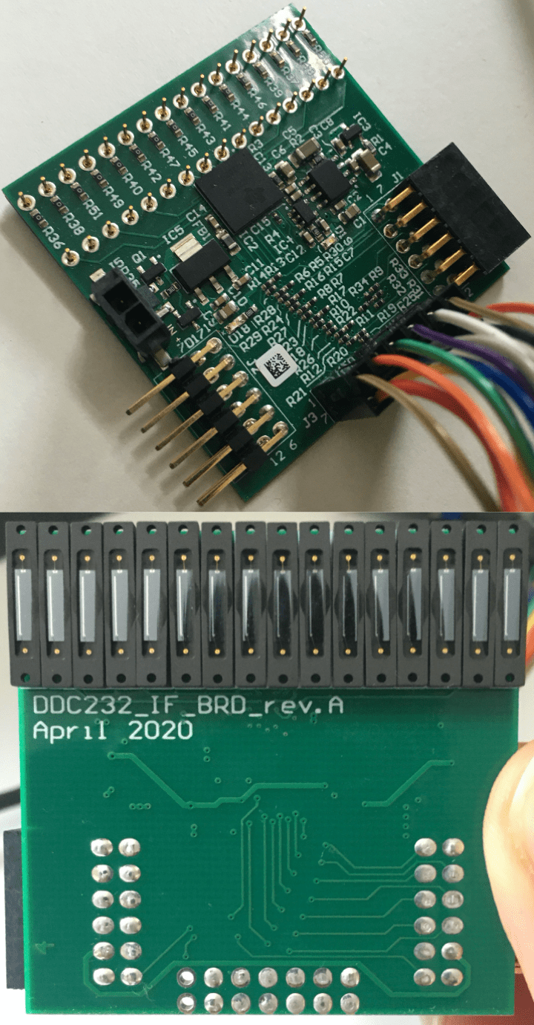
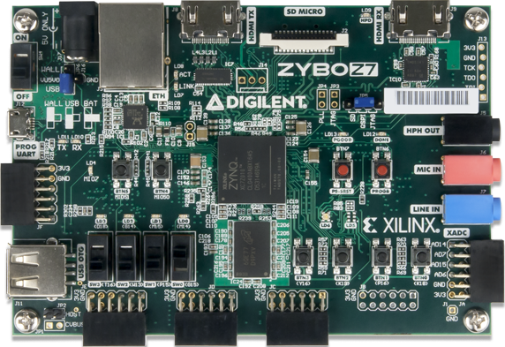

Photodiode Readout System
32-channel ADC housed on custom circuit board.
  Houses 16 photodiodes (each is split across 2 inputs).
Photodiodes coupled directly to sheets.
Configured and read by FPGA on Zybo Z7-10.
Time to learn VHDL…

Slide 9
Overview of Operation
ADC configured: FPGA sends bits to set dynamic range, precision etc.
ADC sends read-back pattern – used to check everything is OK.
Integration begins: each cycle gives a photodiode measurement.
If data transfer is not busy, measurement sent to FIFO in bytes.
FIFO sends measurement to PC over UART protocol.
PC saves incoming hexadecimal data and converts to charge.
  PC can also send commands to FPGA over UART.
Display data in real-time…
Notes:
Refer to t_INT as “integration time”.

Slide 10
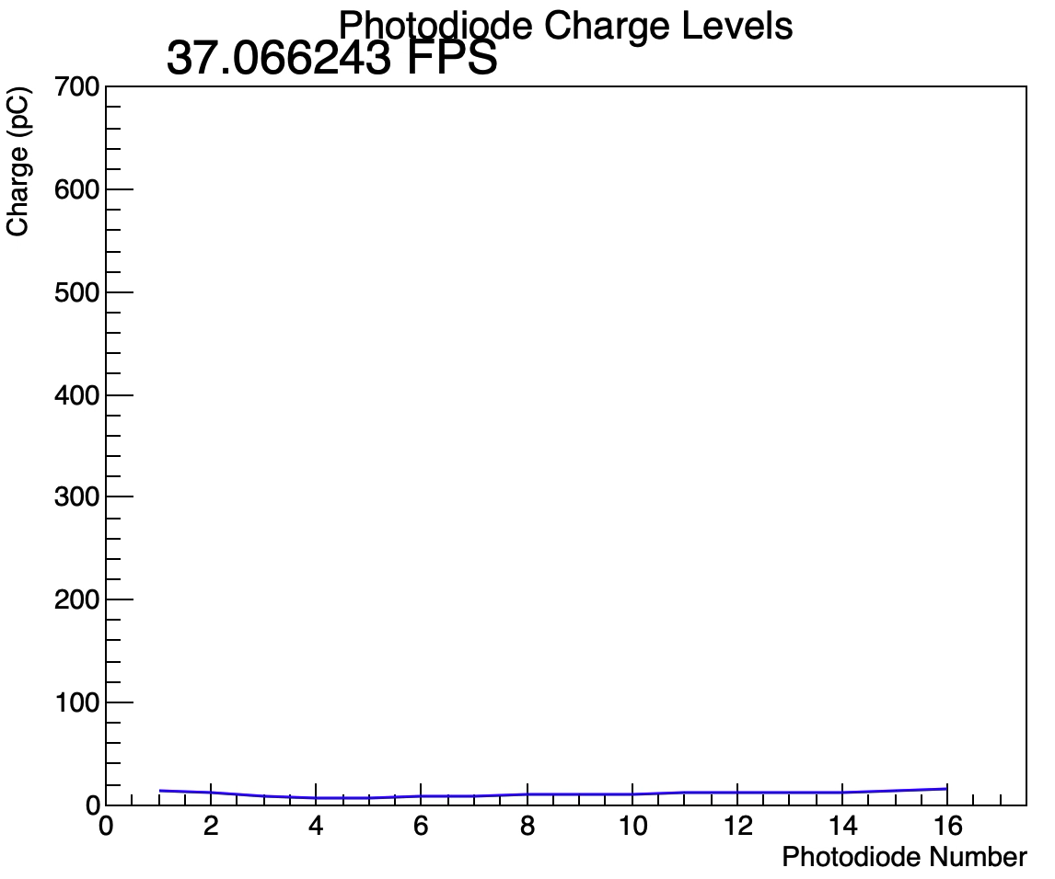
Data Acquisition
Plot real-time photodiode measurements!
  Data output at 1kHz but integration rate is 6kHz.
    Limited by slow UART.
  Use of ROOT limits frame rate.
Developing live web-based plot:
  Upload data to HEP server to update webpage display at 50Hz.
  Currently functional – need to improve aesthetics.
  Allow user-control on any handheld device.
  Eventually replace PC with Raspberry Pi.
Notes:
http://www.hep.ucl.ac.uk/pbt/PDdisplay/html5-canvas-bar-graph.html

Slide 11
FPGA Design: Next Steps
Custom circuit boards can be daisy-chained to allow any multiple of 16 photodiodes.
  Full-size detector would need 10 sets of 16 photodiodes.
  Test daisy-chain to finalise future ADC circuit board design.
More photodiodes reduce data transfer speed (more bits to shift).
  Minimum integration time is ∼340us with 160 photodiodes but data transfer rate would only be ∼0.7kHz using UART.
  Upgrade UART interface to USB 2.0 to keep up with ∼3kHz data rate.

Slide 12

Long-term Goals
Develop depth-light model for reliable fits of helium and carbon data.
  Fully test performance of current analytical model with heavy ions.
  Move to tried-and-true numerical depth-dose model and apply quenching.
Further detector simulation in GEANT4.
  Learn GEANT4.
  Implement latest geometry and fix bugs.
  Improve optical properties.
Experiments with new detector prototype.
  Evaluate performance of photodiodes.
Get the detector ready for the clinics!

Slide 13
Questions?
Thank you for listening!

