Slide 1

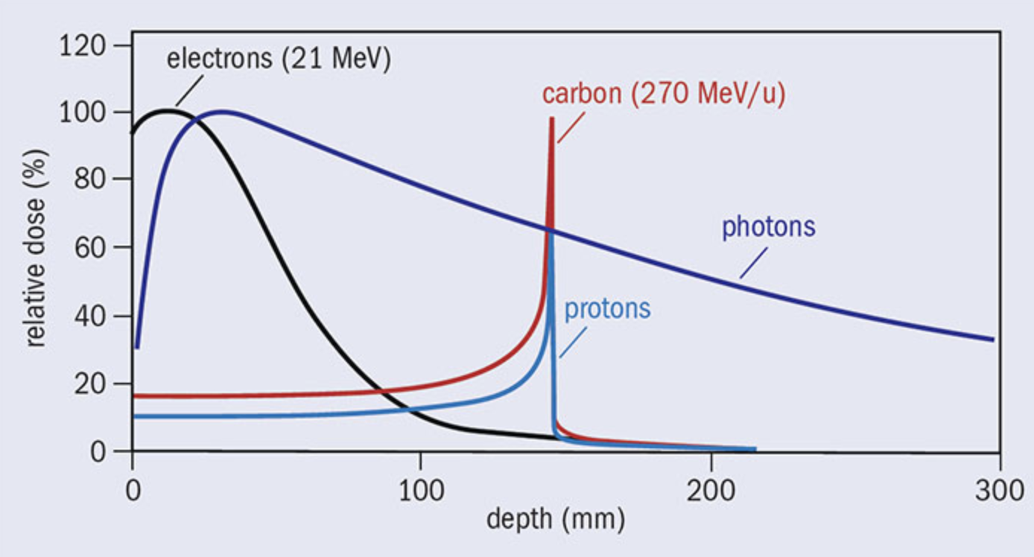
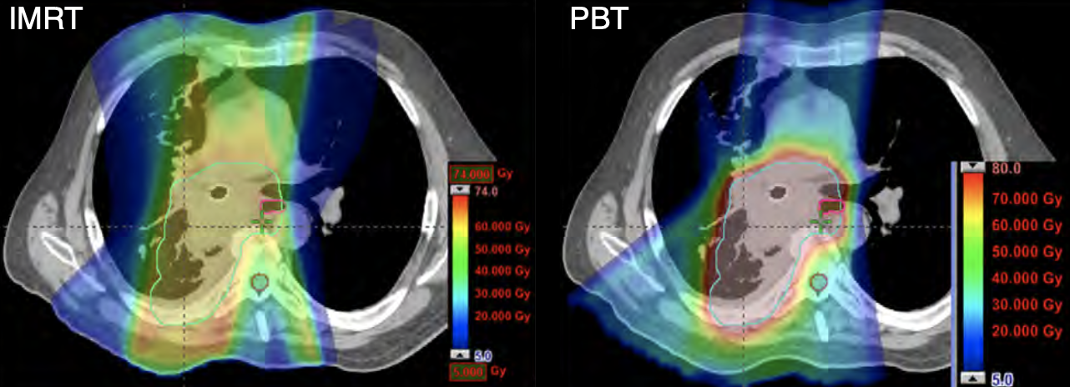

Proton Beam Therapy
Advanced Radiotherapy: Proton Beam Therapy
Every two minutes, someone in the United Kingdom receives a cancer diagnosis.
Conventional X-ray radiotherapy plays an important role in treating cancer but is notorious for its side effects, most notably damage to surrounding healthy tissues and organs.
Proton beam therapy (PBT) provides an alternative specialised treatment for specific cancer cases – beneficial in situations where the tumor is located close to vital organs and structures.
A proton deposits most of its energy at the end of its path (the Bragg peak), ensuring localised radiation dose.
Controlling the proton beam energy and position allows irradiation of entire tumor volumes and adequately spares healthy tissue.
Proton beam range defines the point of maximum dose deposition and is therefore the most significant parameter in PBT.
Technology must be able to quickly and accurately verify range for efficient operation of PBT treatment centers.
Why the Field of Research is Important
Fern Pannell
Dr Simon Jolly
Prof. Ruben Saakyan
PHAS0097
Dose-depth curves for various radiotherapy modalities [1].
Comparison of dose deposition photons and protons for lung cancer [2].
[1] - https://physicsworld.com/a/the-changing-landscape-of-cancer-therapy/ [2] - Zhang X, Li Y, Pan X, et al. Int J Radiation Oncology Biological Physics. 2009;77(2):357-366

Slide 2
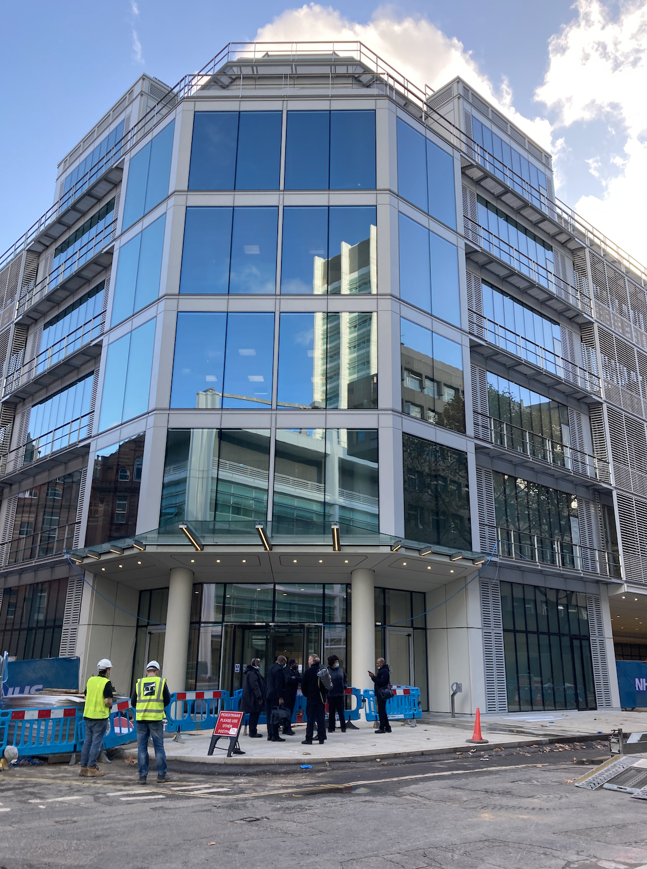

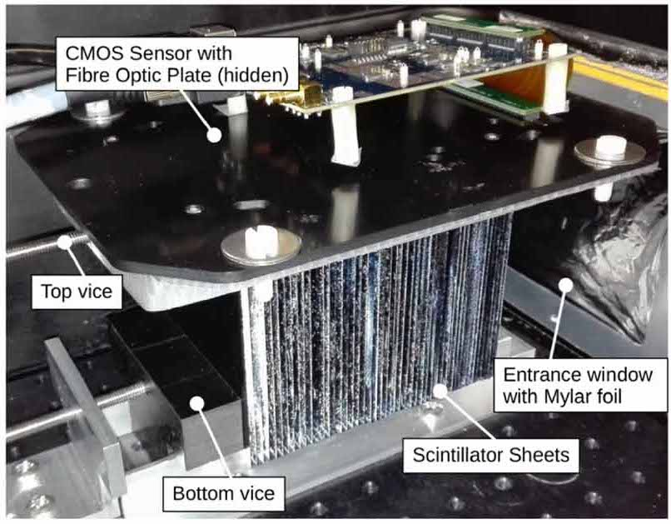
Proton Beam Therapy
Design of a New Range Calorimeter for Improved Quality Assurance in Proton Beam Therapy
Proton range quality assurance (QA) is vital to ensure the safe treatment of proton therapy patients.
Existing, market-dominating QA solutions, such as the IBA Multi-Layer Ionisation Chambers and the PTW Dosimeter, are expensive (+150k) with slow set-up and measurement times.
UCL HEP Proton Therapy focus: Develop a prototype detector able to make fast, sub-millimeter verifications of proton range in tissue for improved clinical QA.
What Part of the Field this Project Pertains to
Introducing…
The Quality Assurance Range Calorimeter (QuARC)
Estimated cost below £20k
Range can be measured to within 100 microns
Plastic scintillator for easy water-equivalent measurements
Versatile: Suitable for He, C and O ions
Capable of FLASH QA
Fern Pannell
Dr Simon Jolly
Prof. Ruben Saakyan
PHAS0097
Proton range calorimeter prototype [3].
UCLH Proton Therapy Centre
[3] - L. Kelleter, R. Radogna, L. Volz, D. Attree, A. Basharina-Freshville, J. Seco, R. Saakyan, and S. Jolly, “A scintillator-based range telescope for particle therapy,” Physics in Medicine & Biology, 2020.

Slide 3

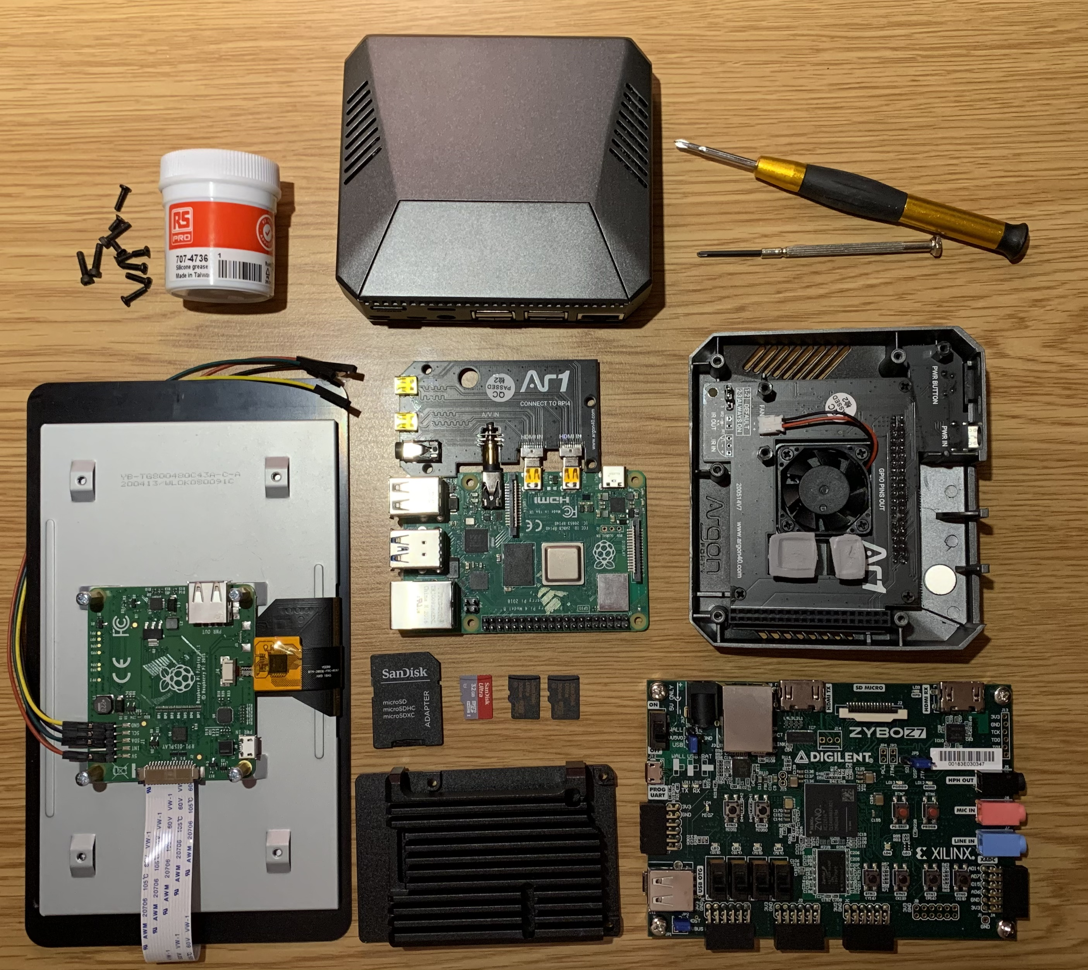
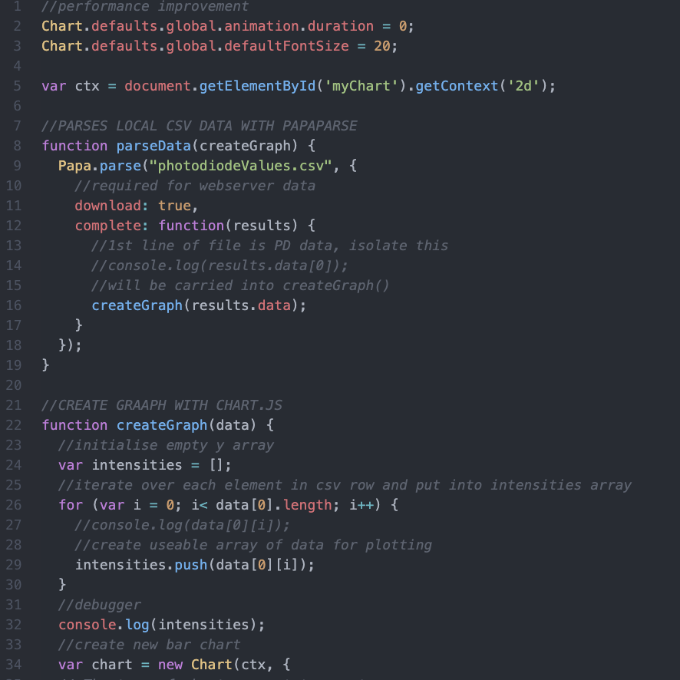
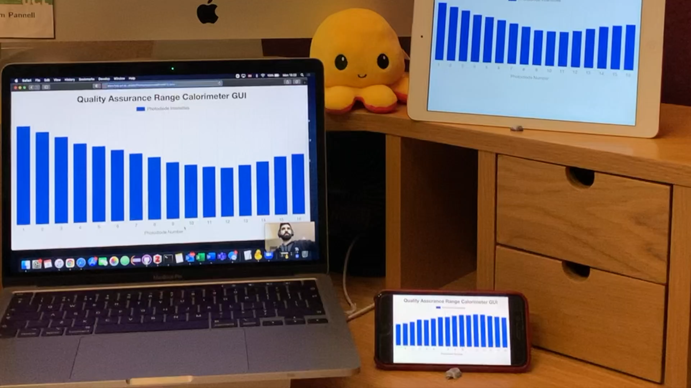
Proton Beam Therapy
Development of a Web-based Graphical User Interface (GUI) for Clinical Quality Assurance
Hardware
Software
Testing & Development
Set up 3 Raspberry Pi4s to run as web servers – configured for touchscreen use
Installed Argon ONE heat sink for 2 Pis
VHDL tutorial completed to aid understanding of FPGA back-end data processing
LabView for initial graphical programming
Transitioned to text-based programming – JavaScript
GUI development and debugging with updating dummy data on HEP server
JavaScript canvas scaling for use of GUI on various device sizes
Tested various heat sinks on Pi4 devices to prevent thermal throttling of CPU under heavy workload
Successful run of the GUI across multiple screen widths with the photodiodes experiencing varied light exposure
Next Steps:
  Proton Bragg curve fit displaying over photodiode bars
  Investigate possibility of analysing individual photodiodes via GUI
  Saving experimental runs for clinical analysis
What I am Specifically Working on in this Project
Fern Pannell
Dr Simon Jolly
Prof. Ruben Saakyan
PHAS0097
Monitor, FPGA board, Pi, Heat sinks
GUI JavaScript code sample
Live test of current GUI with photodiodes

