Slide 1
DDC232 Board Test
Tests of 2nd Prototype

Slide 2
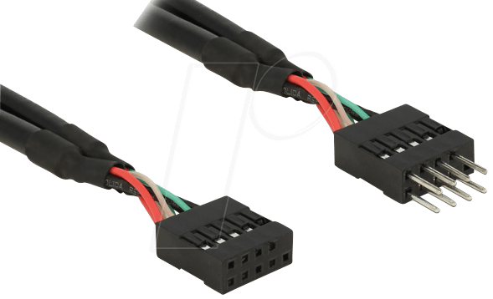
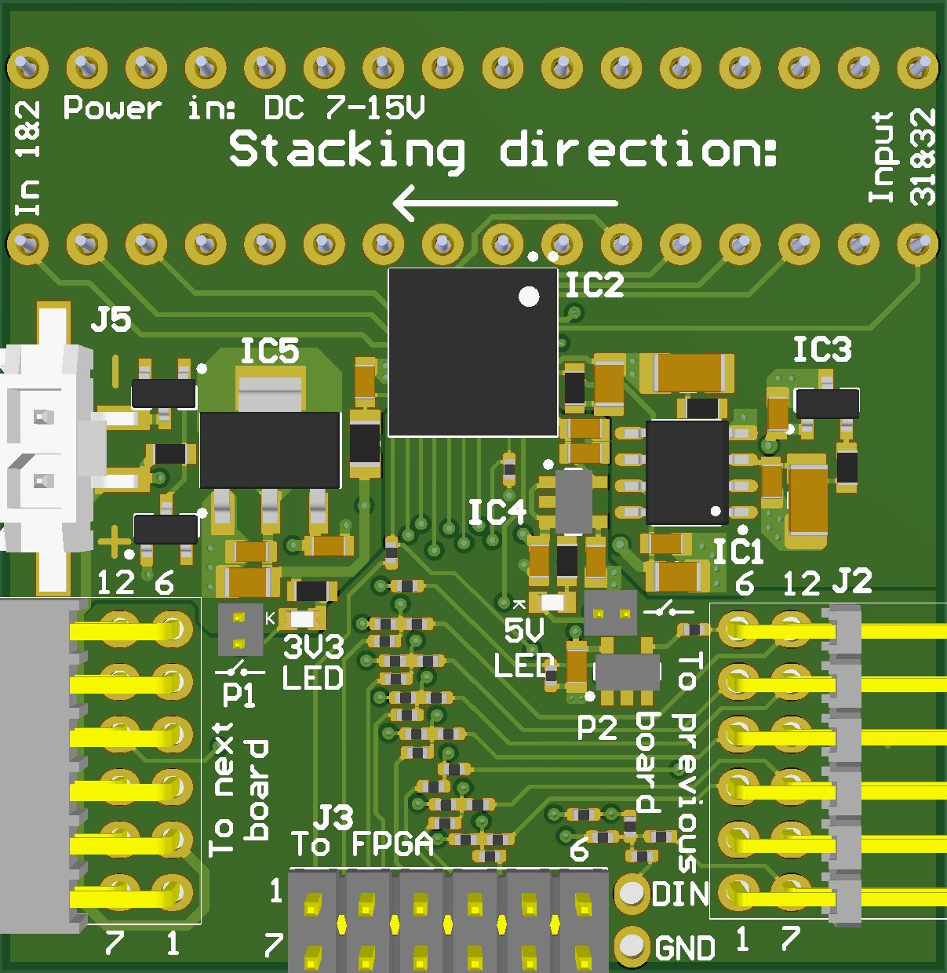
Improvements from First Prototype (Recap)
Swapped 3V3 and GND pins on J3 – allows for direct 1:1 mapping with FPGA board socket.
  Easier setup with fixed 10-pin cable.
Jumpers to disable on-board LEDs.
Logical mapping of photodiode channels to DDC232 inputs.
  Data should arrive in order from right to left.
OR gates to propagate DVALID signal across boards in daisy-chain.
  Last board in chain has DVALID output grounded.
  Should make daisy-chaining possible…

Slide 3
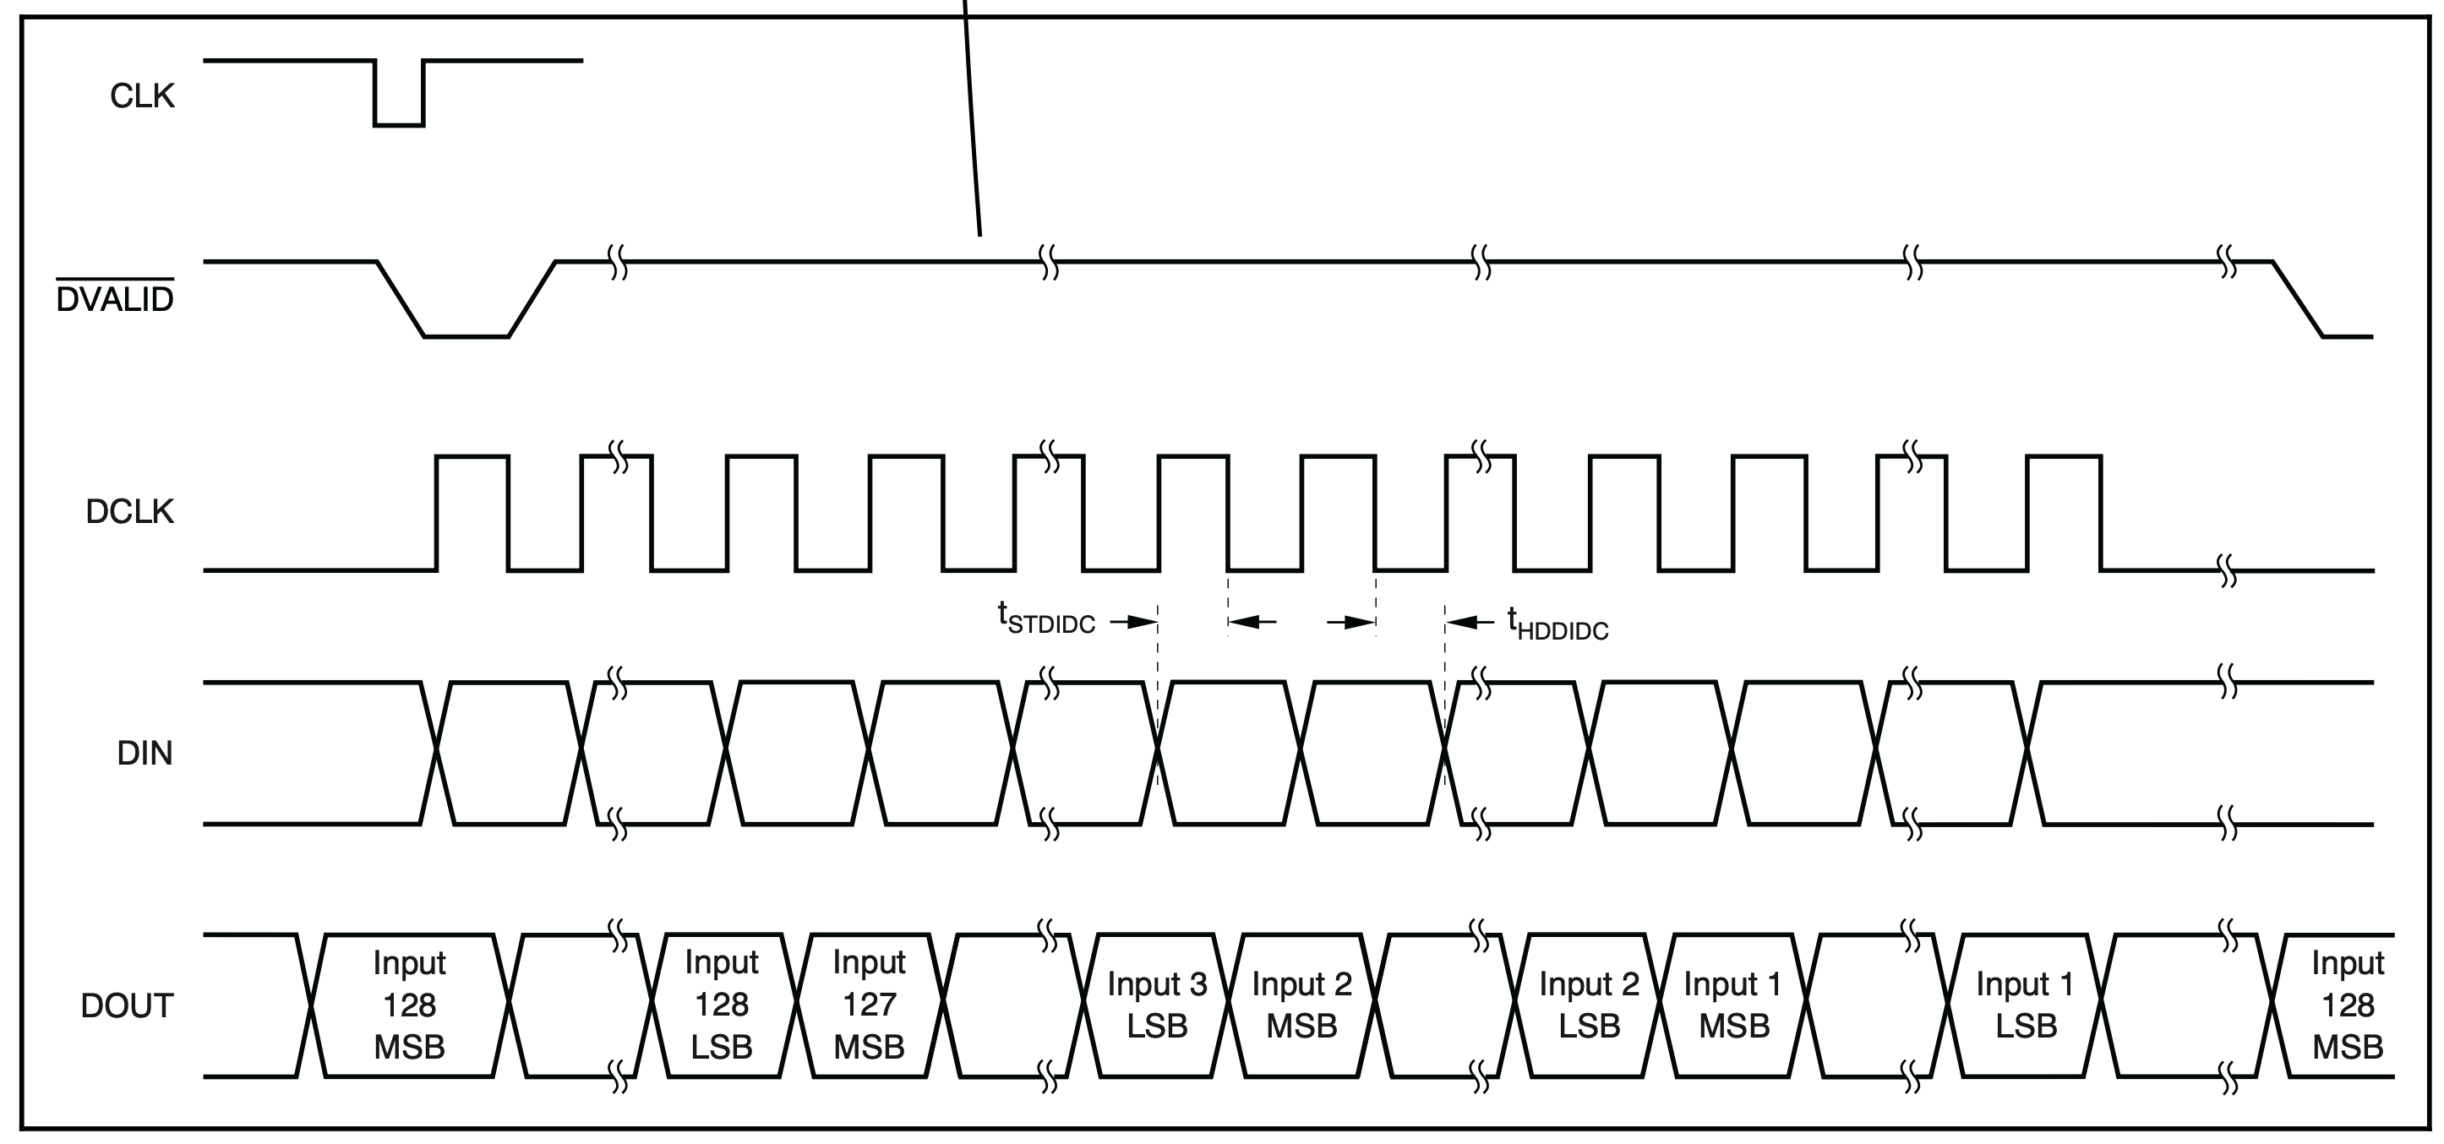
Daisy-Chain Principle

Slide 4
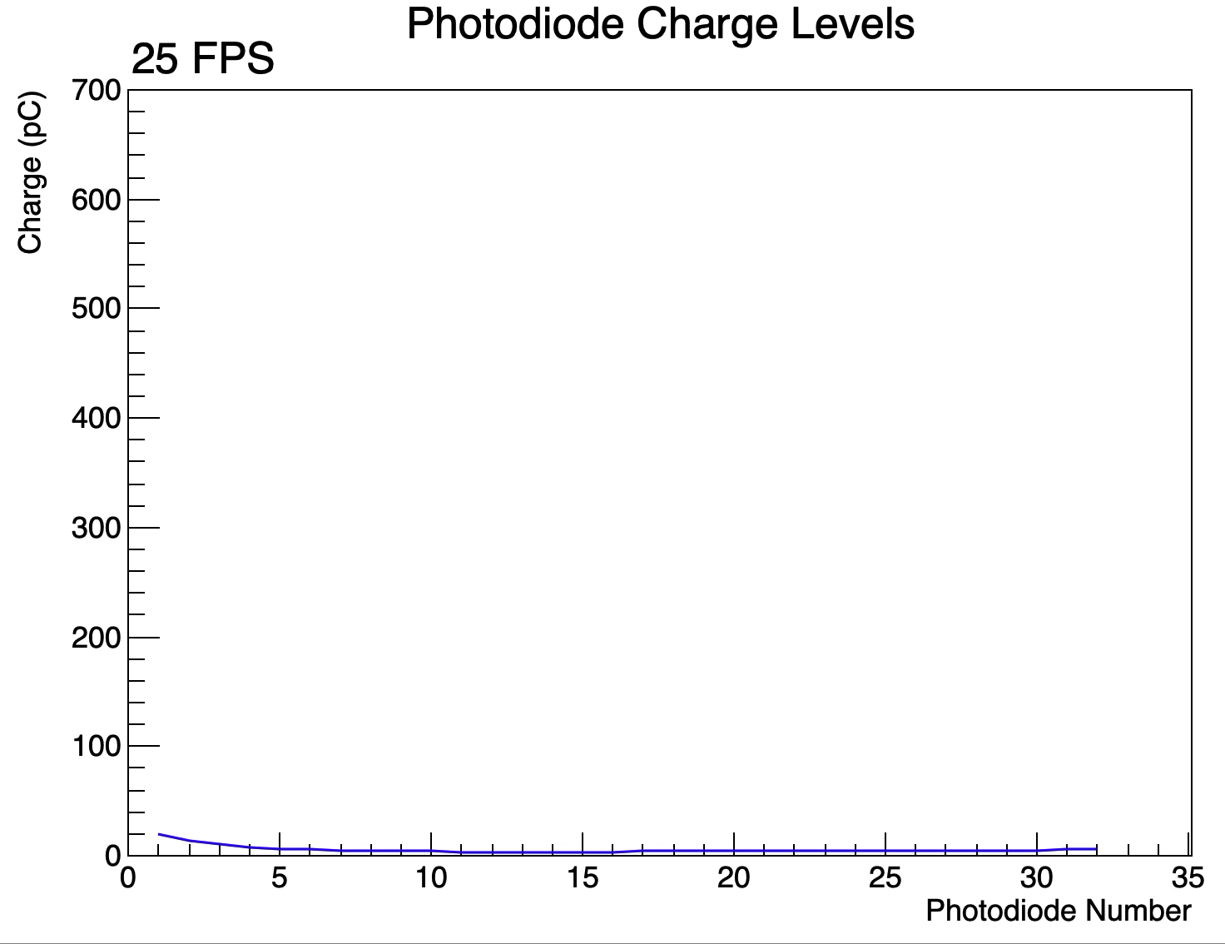
Daisy-Chain Test (2 DDCs)
First verified that all 4 new boards function properly on their own.
  Note: each board has a different type of photodiode.
Configuration readback pattern is repeated for each DDC in the chain and each board sends a pattern twice.
  F8 01 00 00 00 00 00 00 00 00 00 00 00 00 00 00 00 00 00 00 00 00 00 00 00 00 00 00 00 00 00 30 F0 66 01 24 80 F6 90 55
  Received 4 times as expected ✅
Live feed also looks good!

Slide 5
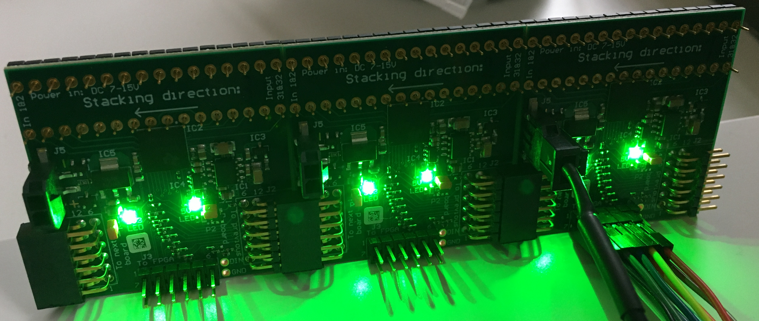
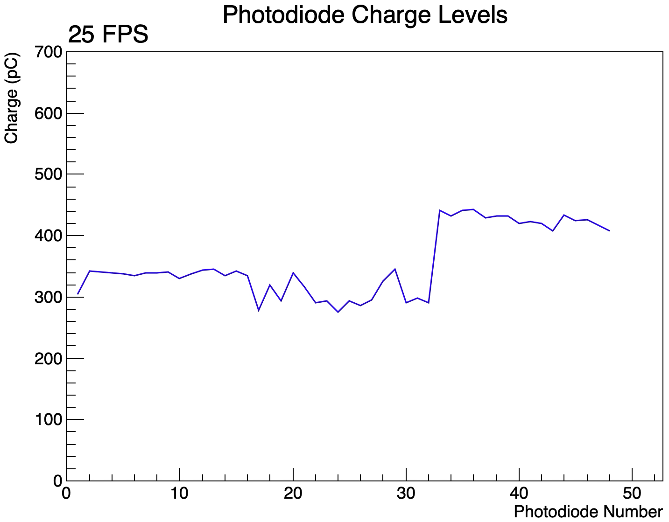
Daisy-Chain Test (3 DDCs)
Correct configuration readback received (i.e. same pattern 6 times).
However, live feed appears to show that data is not being shifted across boards properly.
Daisy-chained boards also appear to be noisier than board connected to FPGA.
Board connected to FPGA behaves normally!

Slide 6
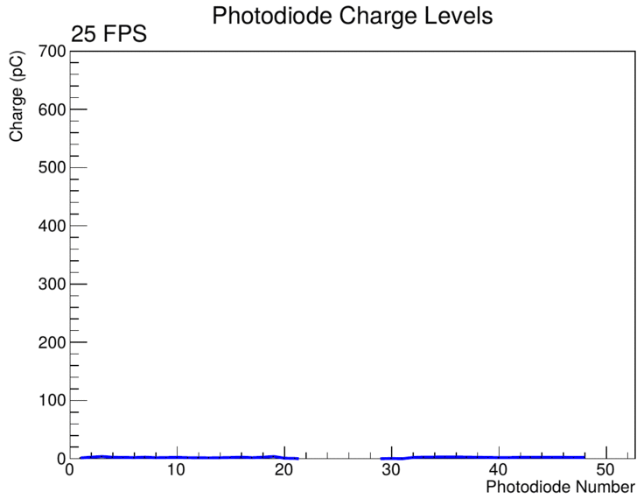
Daisy-Chain Test (3 DDCs)
Test saturating photodiodes 1-16 one-by-one.
  Final image remains the same until photodiode 32 is exposed (see next slide).
Verified that error was in dataset and not in plotting routine.
  e.g. with three left-most photodiodes exposed (boards listed right to left):
01 B1 F0 1B B0 02 2D 80 19 94 01 F6 40 1F AE 01 D0 A0 21 94 02 32 B0 1C 9C 02 52 30 19 C8 01 E2 C0 1E 2A 01 72 C0 21 35 01 A5 D0 1D 36 01 CE E0 1D 91 01 D8 50 1E D7 02 39 C0 1B F4 01 E6 C0 22 E0 02 2F 40 1B F6 01 8E 30 23 2B 01 CF 60 1F 07
01 FC 70 18 07 01 D7 E0 1E 1F 01 F9 F0 19 06 01 F1 00 1B C6 00 3E 20 1C 7F 00 40 80 1F E9 01 FC C0 04 4D 00 77 D0 1C E6 00 37 80 1F A4 00 1C B0 07 C0 02 78 00 06 03 03 83 80 33 F9 02 5C 00 21 C4 03 FF FF FF FF FF FF FF FF FF FF FF FF FF FF
01 FC 30 1E 07 00 3B 20 1F 1F 01 F9 F0 19 06 01 F1 00 1D C0 01 3F 00 1C FF 01 C0 80 1F F7 01 FC C0 1C 05 01 F7 D0 1C E6 01 D7 80 1F A4 01 FF B0 1F C6 02 7C 70 06 70 03 83 90 31 E0 02 3C 00 21 C4 03 FF FF FF FF FF FF FF FF FF FF FF FF FF FF
Data “copied” in middle board
First 3 Photodiodes

Slide 7
Daisy-Chain Test (3 DDCs)
Covering photodiodes 1-31 and exposing photodiodes 32-48 shows board connected to FPGA (photodiodes 33-48) behaves as expected.
Compare saturation of photodiodes 1-32 (left) vs. 32-48 (right):

Slide 8
Daisy-Chain Test (3 DDCs)
Used ILA to verify that error was in actual data being sent by DDC232
  e.g. with three left-most photodiodes exposed (boards listed right to left):
01 B1 F0 1B B0 02 2D 80 19 94 01 F6 40 1F AE 01 D0 A0 21 94 02 32 B0 1C 9C 02 52 30 19 C8 01 E2 C0 1E 2A 01 72 C0 21 35 01 A5 D0 1D 36 01 CE E0 1D 91 01 D8 50 1E D7 02 39 C0 1B F4 01 E6 C0 22 E0 02 2F 40 1B F6 01 8E 30 23 2B 01 CF 60 1F 07
01 FC 70 18 07 01 D7 E0 1E 1F 01 F9 F0 19 06 01 F1 00 1B C6 00 3E 20 1C 7F 00 40 80 1F E9 01 FC C0 04 4D 00 77 D0 1C E6 00 37 80 1F A4 00 1C B0 07 C0 02 78 00 06 03 03 83 80 33 F9 02 5C 00 21 C4 03 FF FF FF FF FF FF FF FF FF FF FF FF FF FF
01 FC 30 1E 07 00 3B 20 1F 1F 01 F9 F0 19 06 01 F1 00 1D C0 01 3F 00 1C FF 01 C0 80 1F F7 01 FC C0 1C 05 01 F7 D0 1C E6 01 D7 80 1F A4 01 FF B0 1F C6 02 7C 70 06 70 03 83 90 31 E0 02 3C 00 21 C4 03 FF FF FF FF FF FF FF FF FF FF FF FF FF FF
Data “copied” in middle board
First 3 Photodiodes

Slide 9
Daisy-Chain Test (4 DDCs)
Fails to send correct configuration readback pattern…
  FC01800000000000000000000000000000000000000000000000000000000030F8660124C0FFD05F
  FC01800000000000000000000000000000000000000000000000000000000030F066012480F69055
  F801000000000000000000000000000000000000000000000000000000000030F066012480F69055
  F801000000000000000000000000000000000000000000000000000000000030F066012480F69055
  F801000000000000000000000000000000000000000000000000000000000030F066013480F69055
  F801000000000000000000000000000000000000000000000000000000000030F066012480F69055
  F801000000000000000000000000000000000000000000000000000000000030F87701B480F69055
  F801000000000000000000000000000000000000000000000000000000000038F87701B680FFD07D
Correct pattern should be (8 times):
  F801000000000000000000000000000000000000000000000000000000000030F066012480F69055

Slide 10
Conclusions
Daisy-chain with 2 DDCs appears to behave properly… breaks down with 3 and 4 boards.
With 3 boards, observe some strange ordering of data.
To daisy-chain, FPGA just runs DCLK for longer – no reason for disordering as it transfers bits of data sequentially.
  Board connected to FPGA behaves normally.
Suspect that there are some timing issues or circuit issues in shifting data on the DDC232 boards.

Slide 11
Further Investigation
Test mode has no effect on problem.
Slowing down DCLK from 20MHz to 10MHz also doesn’t solve problem with three boards.
  Saturating photodiodes 1-16 (left) and photodiodes 17-32 (right).

Slide 12
Further Investigation
Slowing down DCLK does make configuration pattern correct with 4 DDC232 boards.
  However, this may not mean much…
  Slight exposure in first few photodiodes.
  Exact copying in boards 1-3?

