Slide 1
DDC232 Daisy-Chain
Saad Shaikh & Raffaella Radogna

Slide 2
Detector Introduction
Stack of plastic scintillator sheets.
The light produced in each sheet is detected by a Si photodiode.
Each photodiode is read independently using a current-input ADC.
Modular design: custom electronics designed to read-out 32 channels.
Several modules are daisy-chained to cover the full detector area.
Photodiode Array
32-ch. DDC232

Slide 3
Presentation Objectives
Introduce the main concepts of the DDC232 operation.
Show custom circuit board housing the DDC232 chip.
Describe issues faced with “daisy-chaining” several boards.
Useful documentation (both attached to email):
DDC232 datasheet
DDC232 custom circuit board schematic

Slide 4
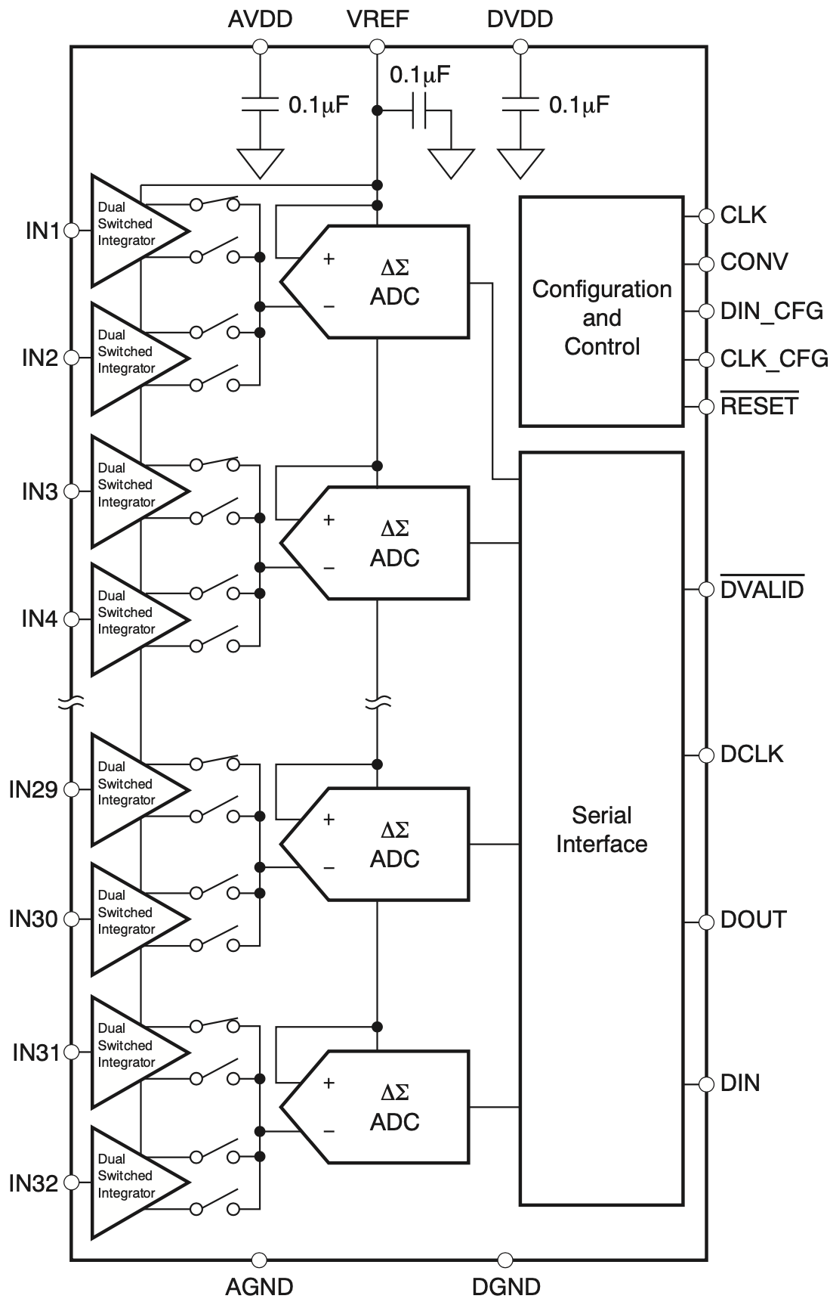
Texas Instruments DDC232
20-bit, 32-channel current-input analog-to-digital converter (ADC).
Integration times between 166.5us – 1s with 7 different dynamic ranges.
Each input has two integrators to allow continuous measurements.
Housed on custom circuit board housing 16 photodiodes, where each is split across 2 inputs.
Configured and read by FPGA (Artix-7 on Nexys Video), which sends data to PC.

Slide 5
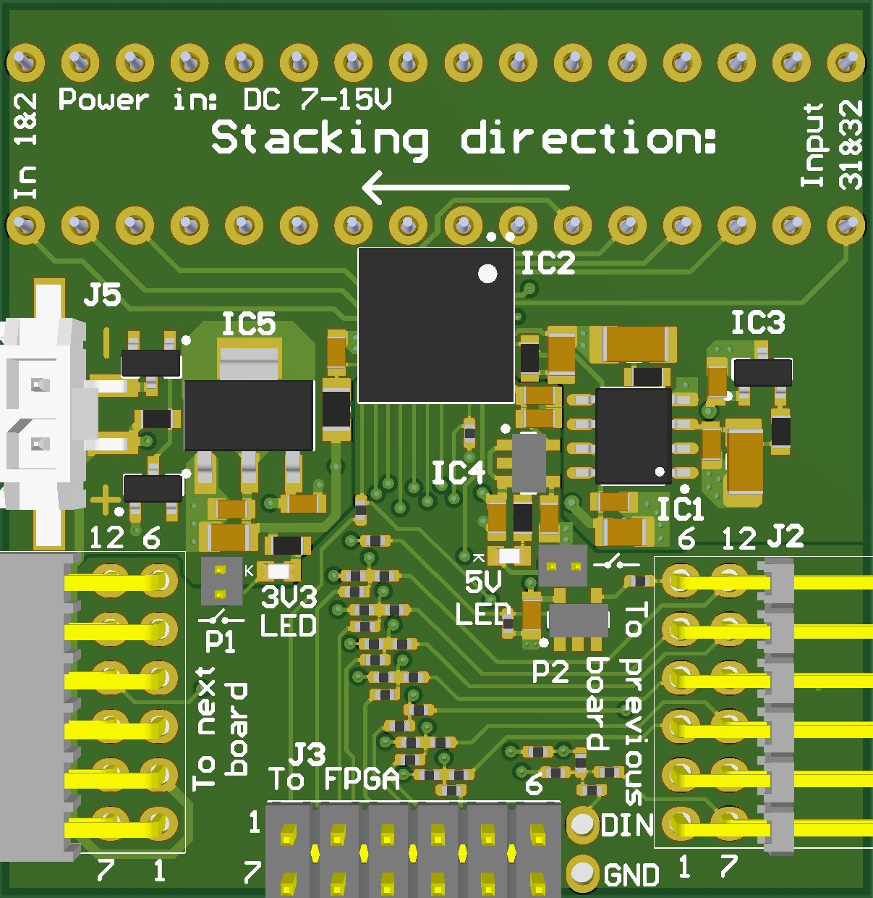
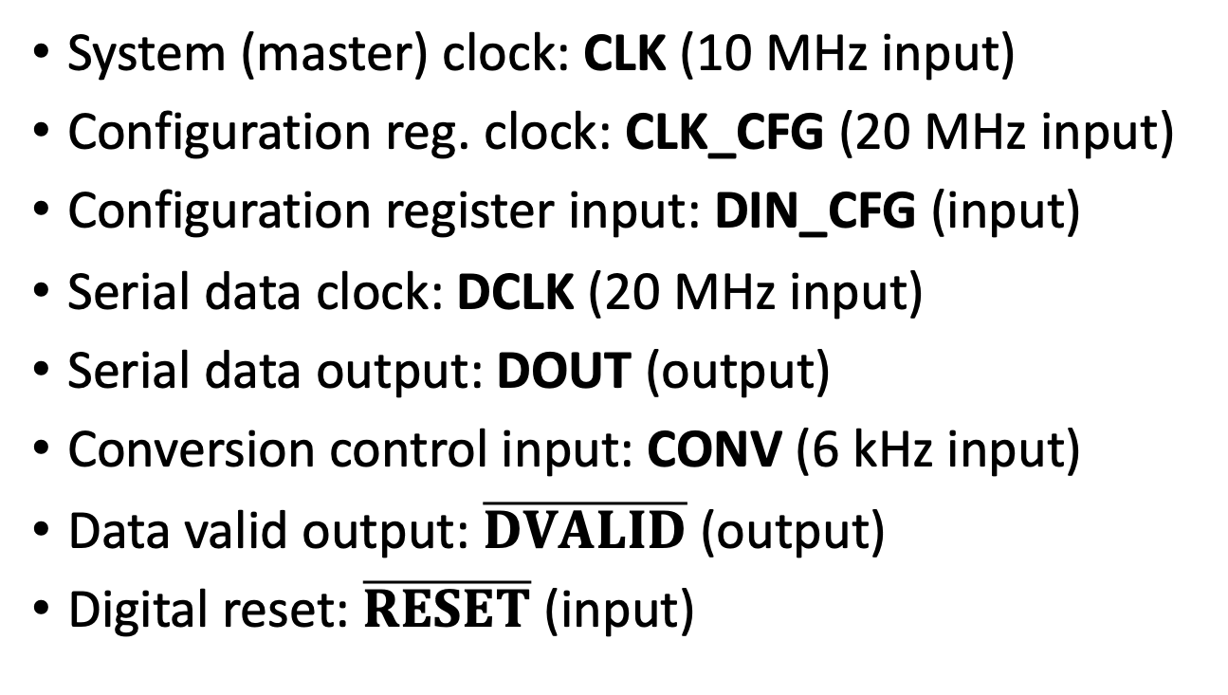
I/O Signals (FPGA-DDC232)
System (master) clock: CLK (10 MHz input)
Configuration reg. clock: CLK_CFG (20 MHz input)
Configuration register input: DIN_CFG (input)
Serial data clock: DCLK (20 MHz input)
Serial data output: DOUT (output)
Conversion control input: CONV (6 kHz input)
Data valid output: $\overline{DVALID}$ (output)
Digital reset: $\overline{RESET}$ (input)

Slide 6
Custom Circuit Board Schematic

Slide 7
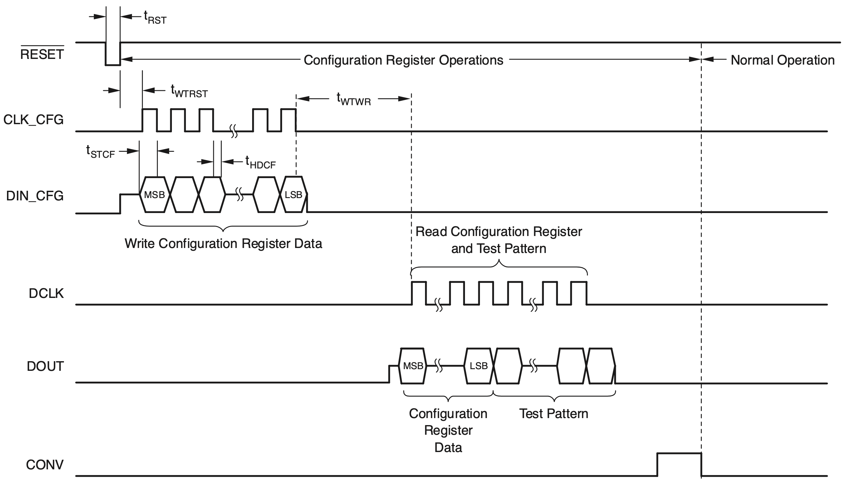
Overview of Operation – Configuration
12-bit pattern sent to DDC232 along DIN_CFG.
640-bit readback pattern sent from DDC232 along DOUT to confirm correct configuration and readout.

Slide 8
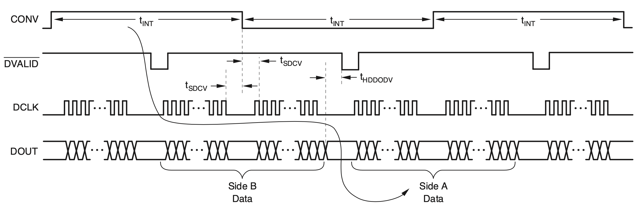
Overview of Operation – Integration
CONV toggles between dual-switched integrators to give a measurement every t_{INT}.
When DVALID is received, data is shifted out on DOUT using DCLK.
  Note: DCLK is paused around CONV toggles to minimise noise.
Must ensure all data is shifted out before next DVALID.
Duration of DCLK dependent on number of bits to shift out, i.e. number of DDC232s.

Slide 9
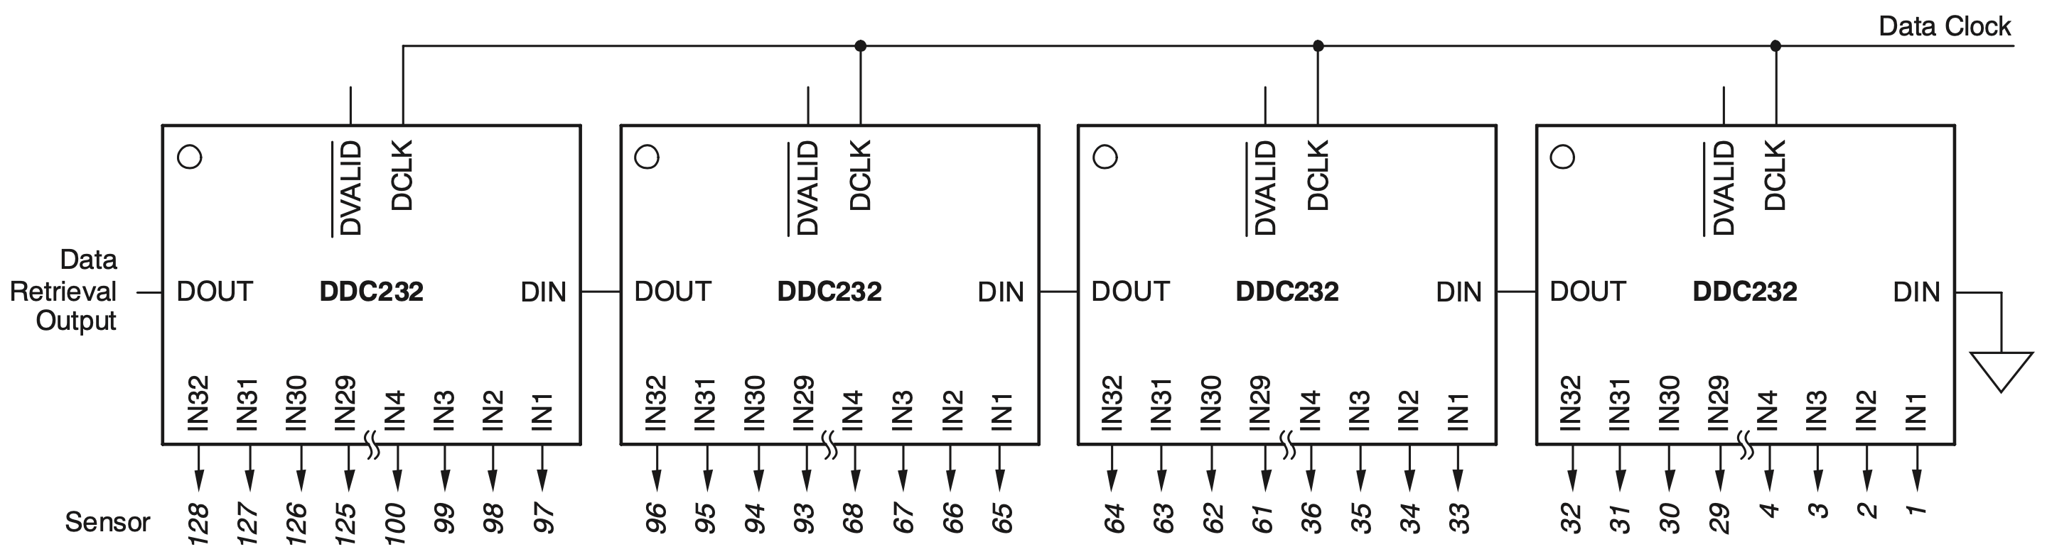
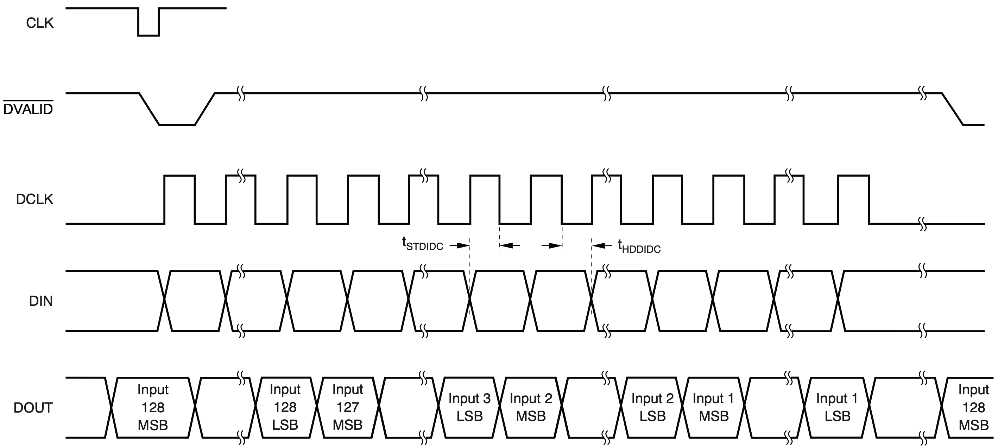
Daisy-Chaining DDC232s
DDC232 designed to minimise overhead to chain multiple chips together to allow for more inputs.
Uses DIN pin connected to DOUT of the next board in chain.
DCLK shifts data in both DIN and DOUT.
DVALID is propagated across boards using logic OR gates, ensures that all boards have data-ready when DVALID reaches FPGA.

Slide 10
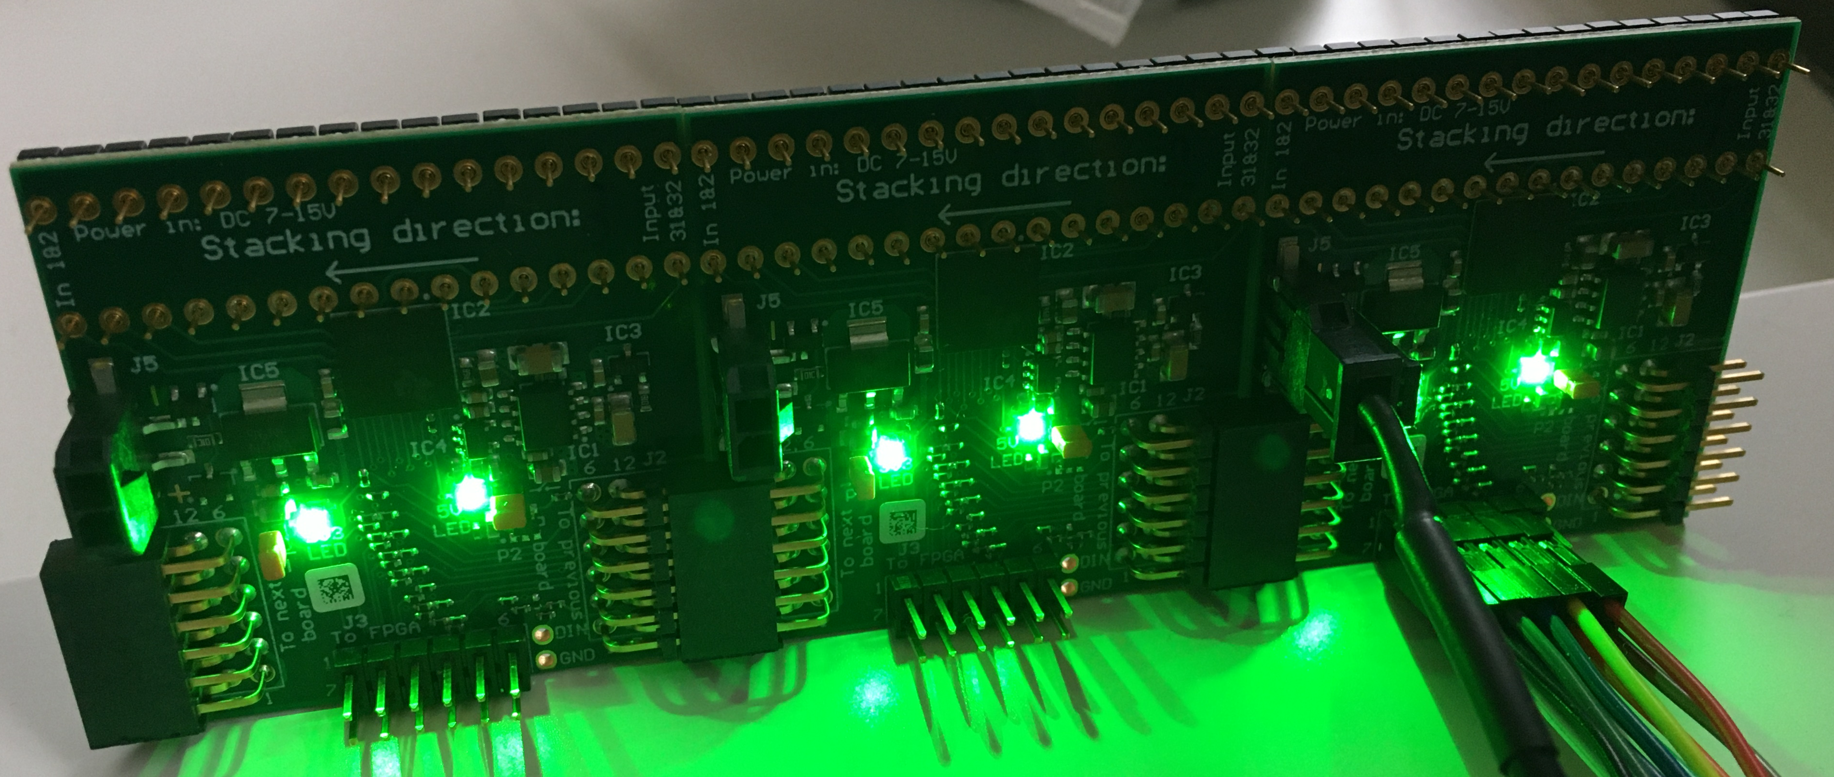
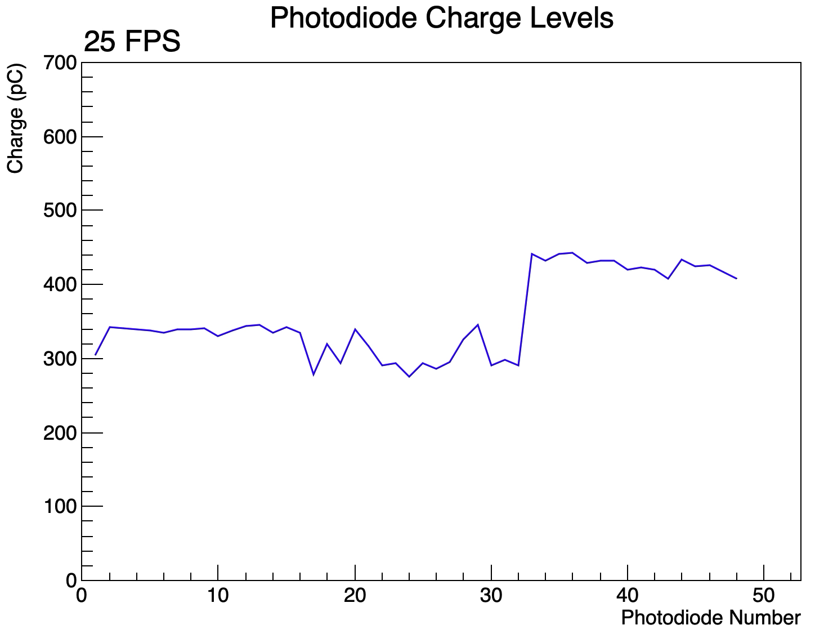
The Problem
Board 1 (to FPGA)
Board 3
Board 2
Boards work well individually and when paired, problems with 3 or more boards.
Correct configuration readback pattern received with 3 (or 4) boards.
However, appear to observe some sort of influence across boards:
  When 3 boards are daisy-chained, board 1 behaves normally, but there is “mirroring” in the same inputs of boards 2 and 3.
  Daisy-chained boards are also much noisier.
  Steps in output are due to each board having a different type of photodiode.
Board 3
Board 2
Board 1
All boards exposed to ambient light and a thin cover (4 photodiodes thick) is moved across boards to block light. Board 3 = photodiodes 1-16 etc.

Slide 11
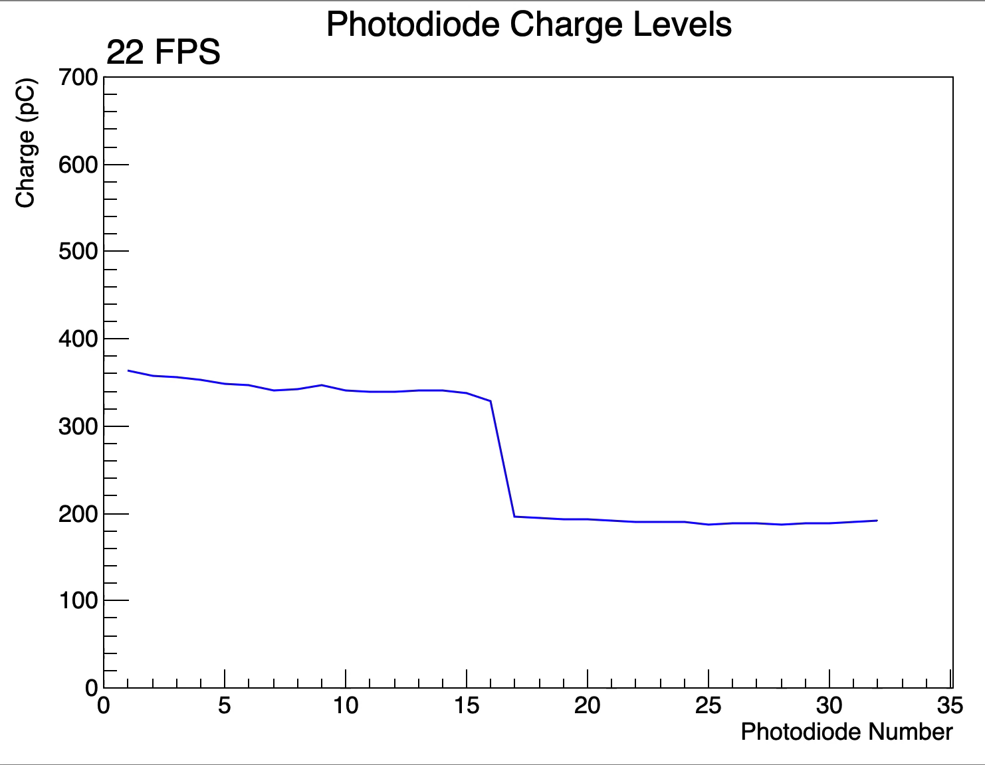
2 Boards vs. 3 Boards
Board 3
Board 2
Board 1
Board 2
Board 1
All boards exposed to ambient light and phone torch is moved across the boards.
Board 2 = photodiodes 1-16 etc.
All boards exposed to ambient light and a thin cover (4 photodiodes thick) is moved across boards to block light. Board 3 = photodiodes 1-16 etc.

Slide 12
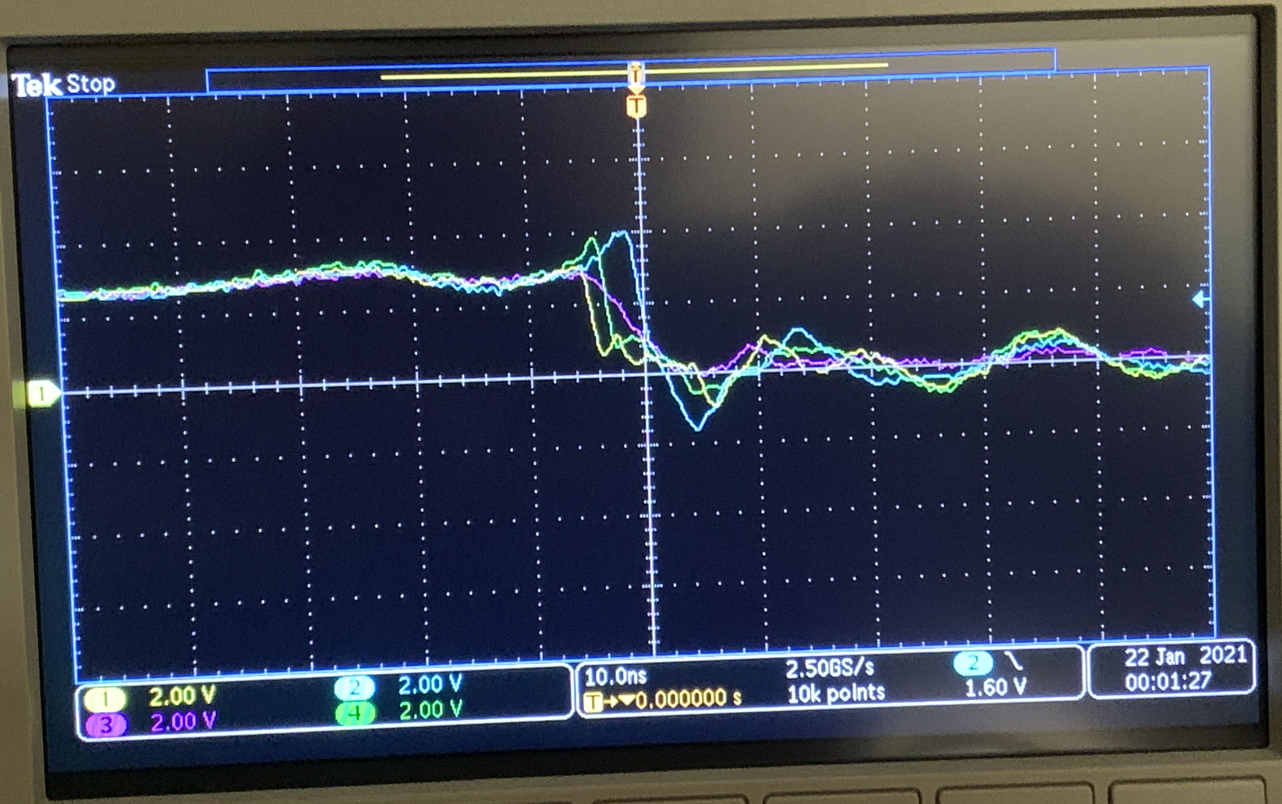
Steps Taken So Far
Shuffled board order and slowed down DCLK to 10 MHz and 5 MHz.
  Board connected to FPGA works fine, other boards have signal mirroring.
Verified that “mirroring” was present in actual data being sent to FPGA, confirming problem was in DDC232 and not in FPGA or PC.
  Used Vivado Integrated Logic Analyser to view DOUT signal.
Used oscilloscope to check propagation delay of CLK, DVALID and DCLK signals across boards.
  Delay on the order of 2-3ns, not enough to create problems with CLK and DCLK at 10MHz and 20MHz, respectively.
  Scope shows propagation of DVALID through OR gates across consecutive boards.

Slide 13
Assistance Requested
Summary: While daisy-chain works as expected with 2 boards, we have problems adding any further boards.
  For some reason changes in light in board 1 affect readings in board 2 and vice versa. The serial data line is getting disordered somehow.
  Suspect that there may be some problem with how DIN and DOUT are chained, causing issues with 3 or more boards.
Looking at the interface schematics provided, is there any electronic reason that there should be a problem with daisy-chaining?
Is there anything we should test ourselves to further diagnose the problem?
Thank you for your help!

