Slide 1
UCLH Analysis
15th April 2021 Experiment

Slide 2
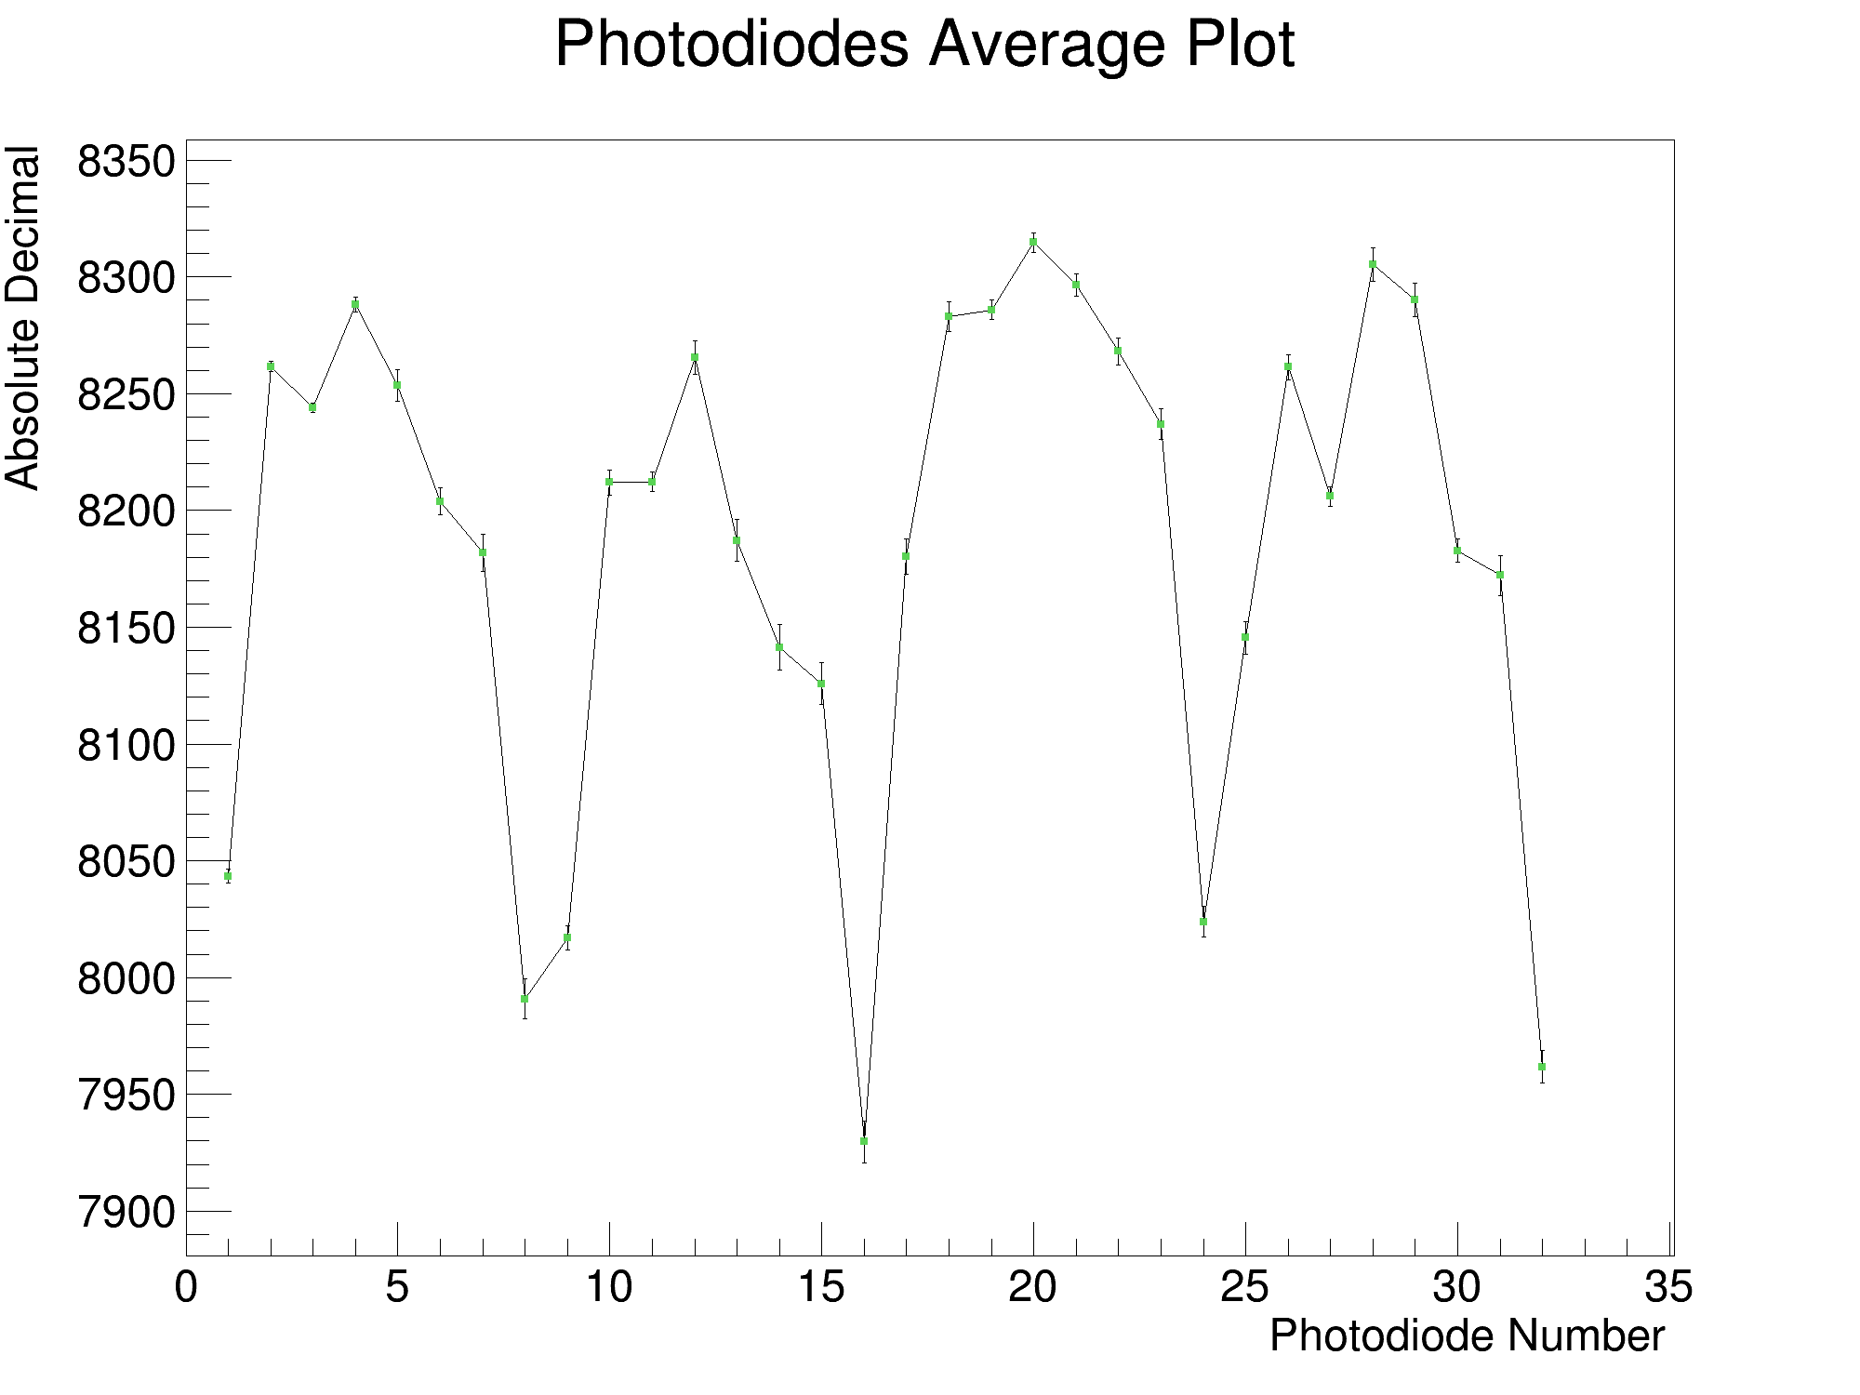
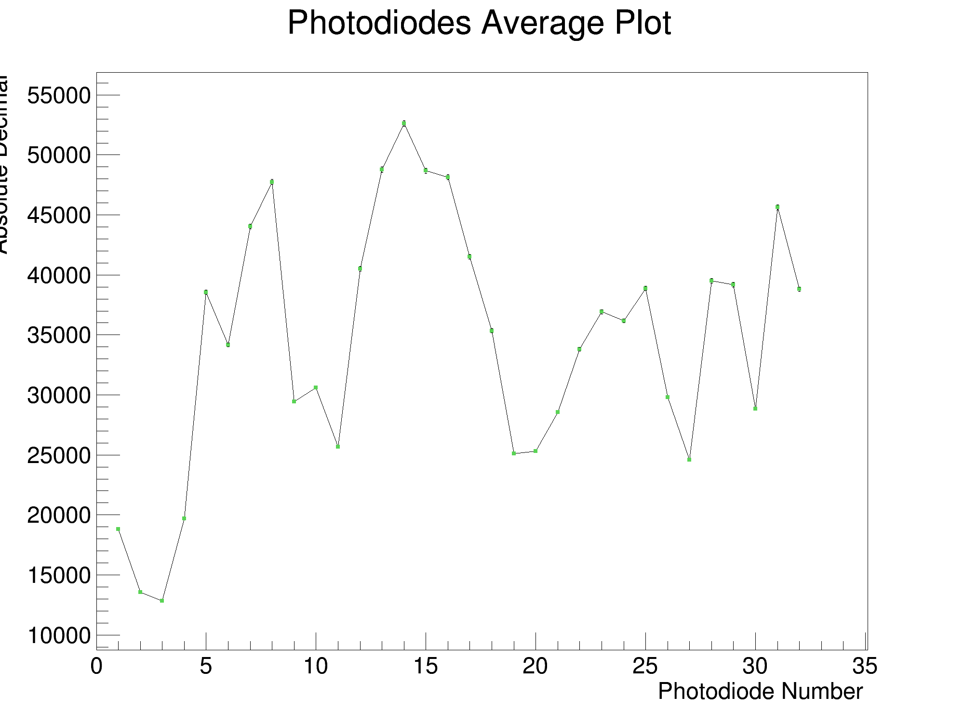
FSR: 12.5pC vs. 350pC (Background Measurement)
Run 0: 350pC
Run 1: 12.5pC

Slide 3
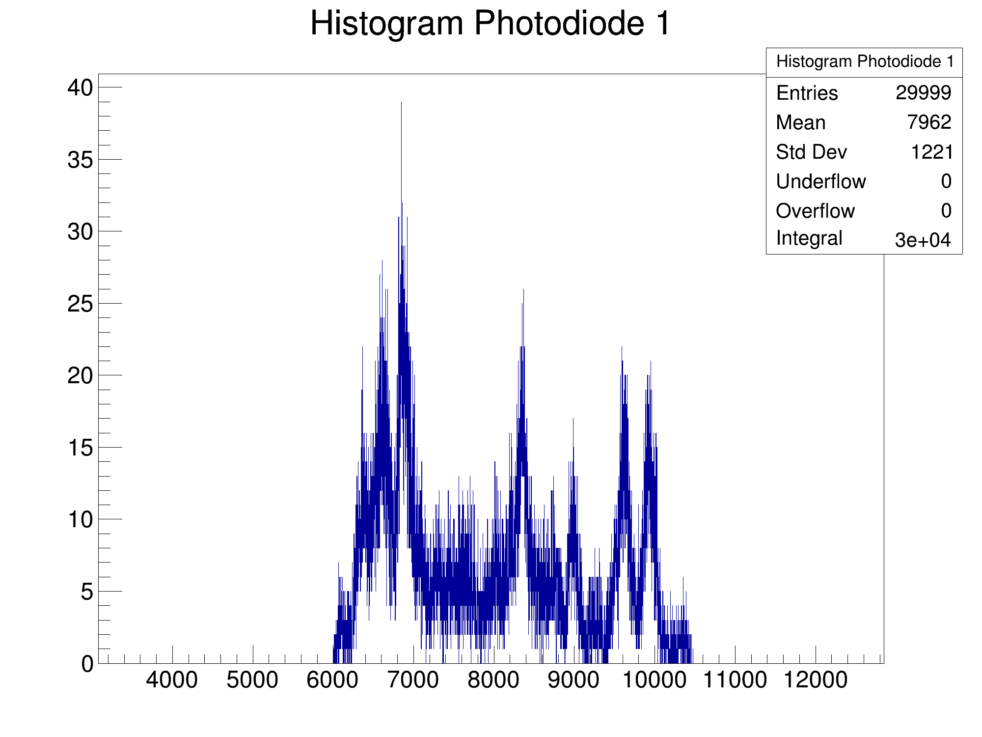
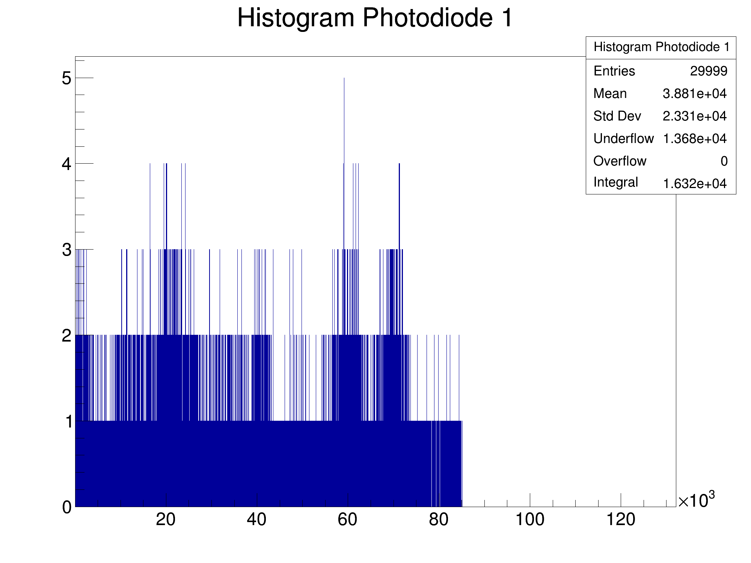
FSR: 12.5pC vs. 350pC (Background Measurement)
Run 0: 350pC
Run 1: 12.5pC

Slide 4
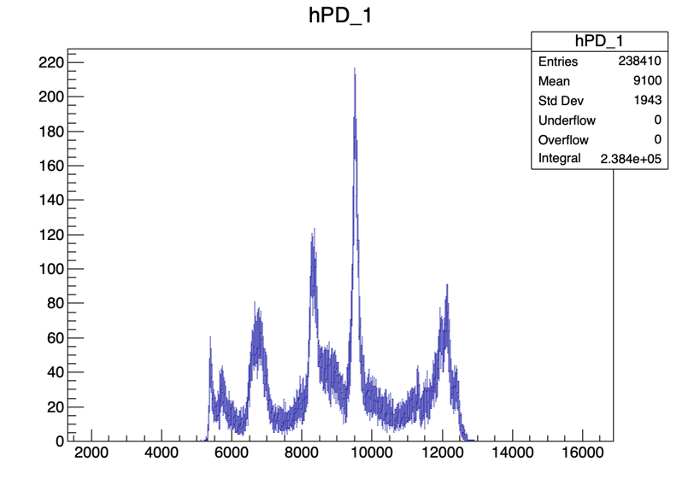
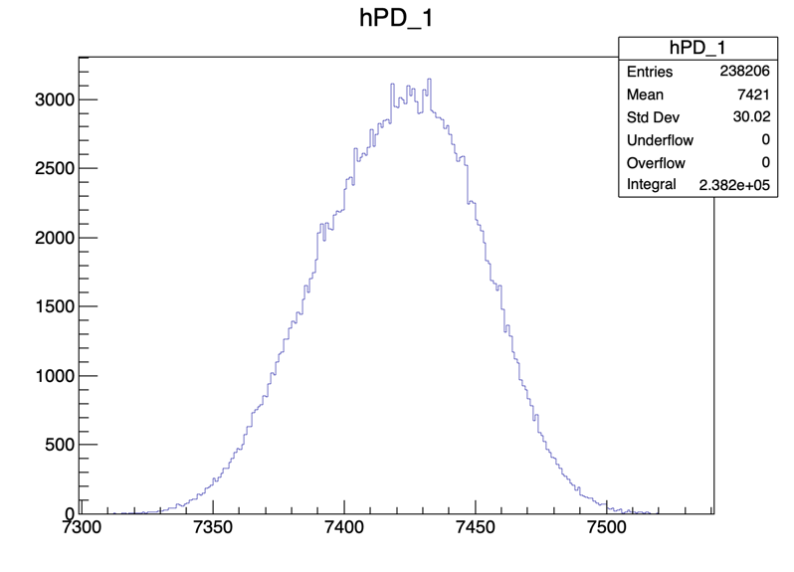
UCLH vs. Lab vs. Home (Dark Measurement)
UCLH 350pC
D27 350pC
Home 350pC

Slide 5
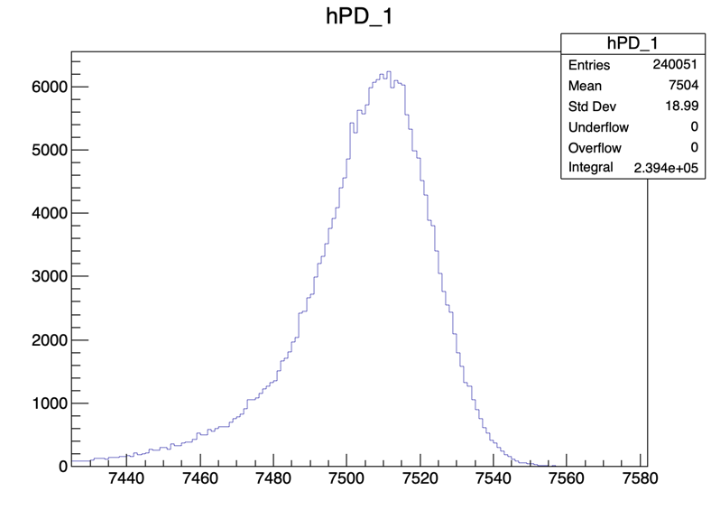
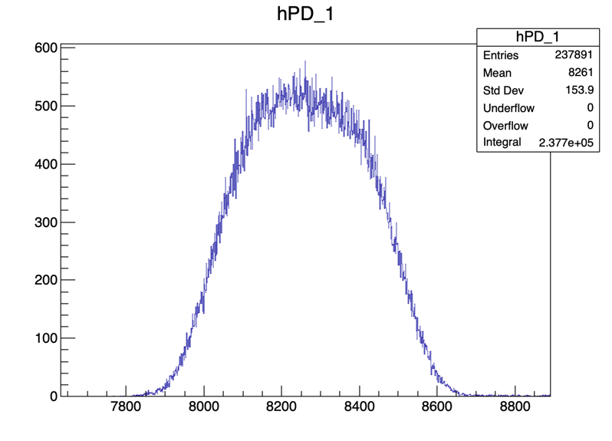
FSR: 12.5pC vs. 350pC (Home PD Unplugged)
350pC
12.5pC

Slide 6
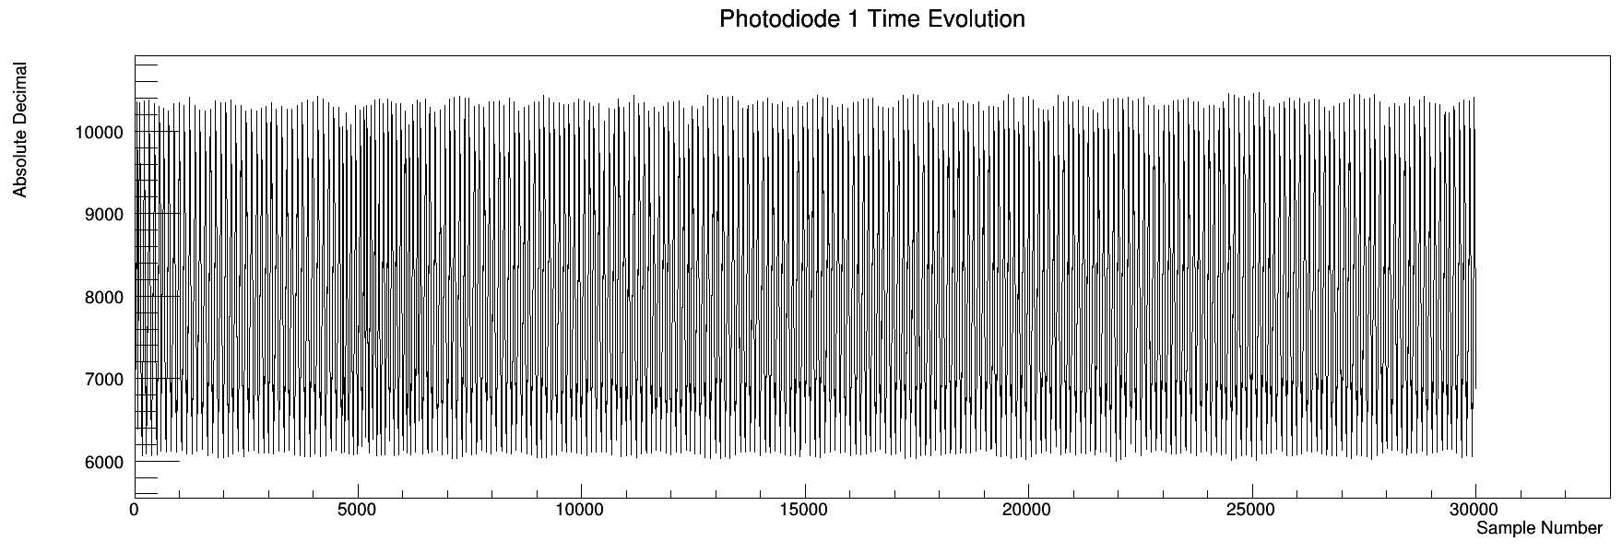
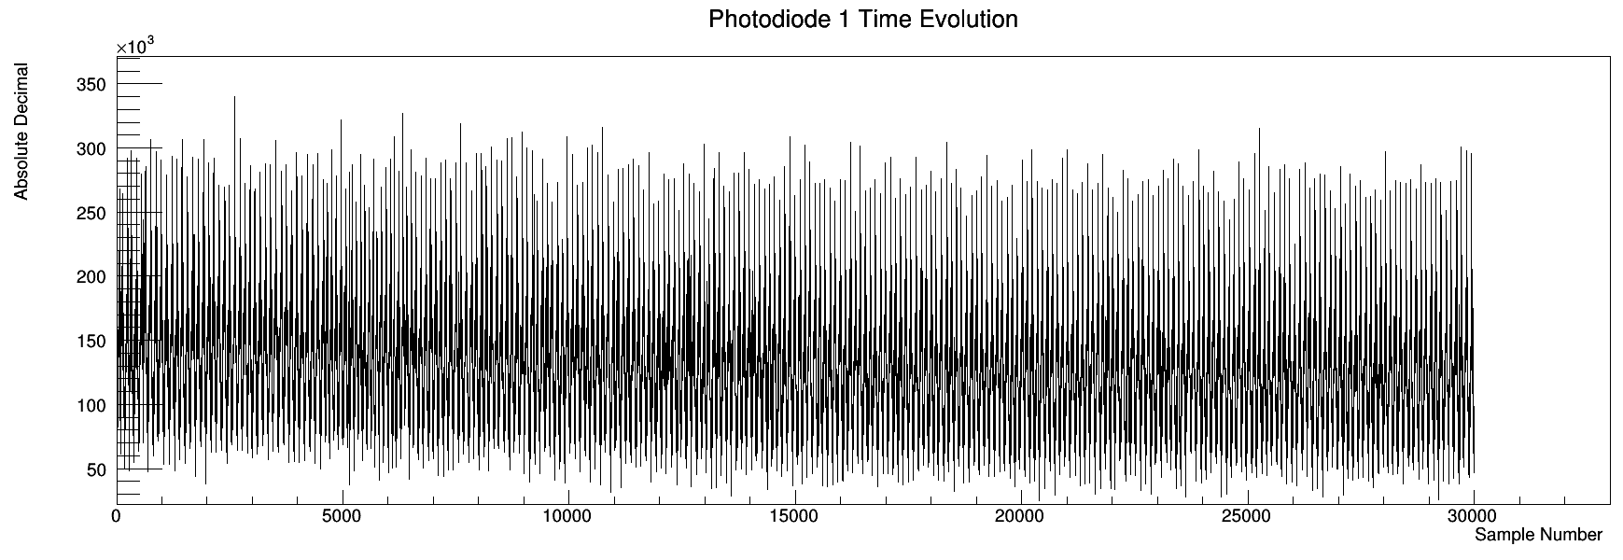
Pulsing
Run 0: 350pC
Run 3: 12.5pC

Slide 7
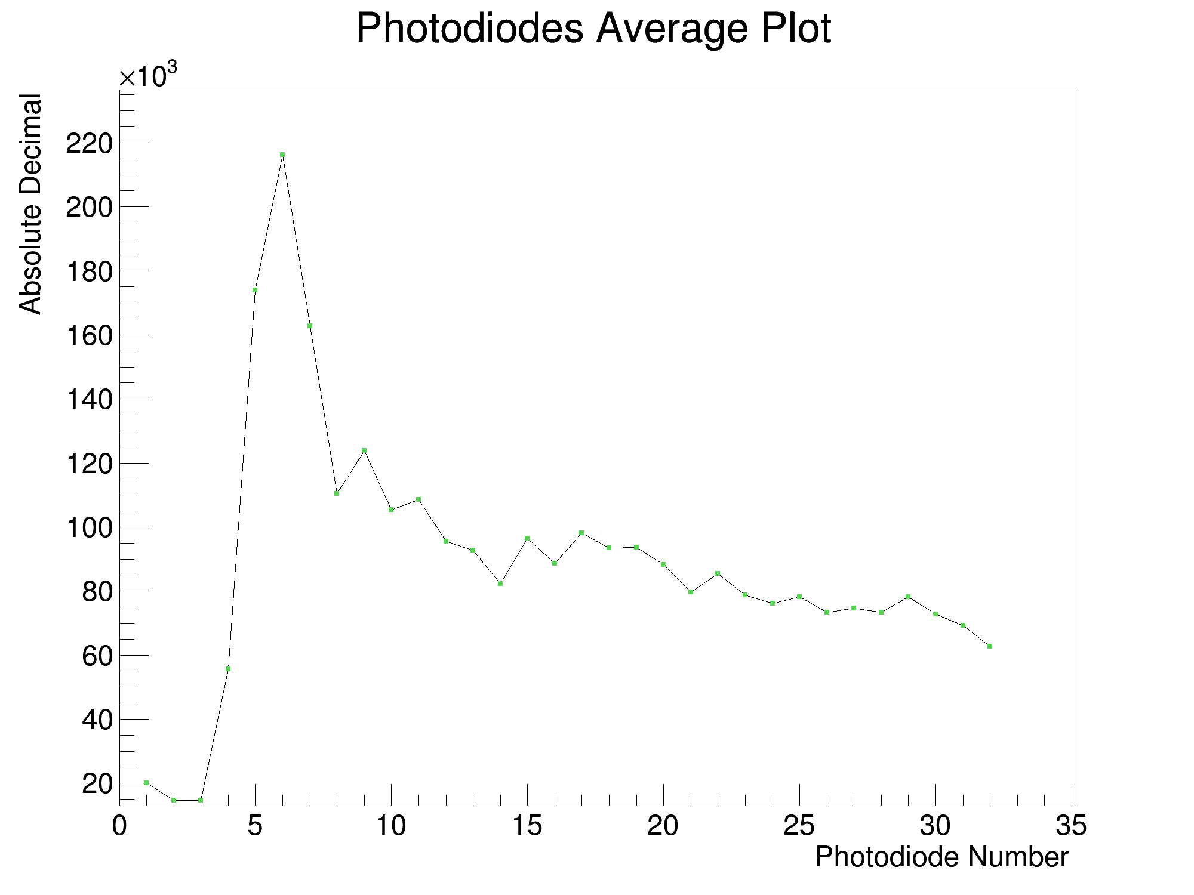
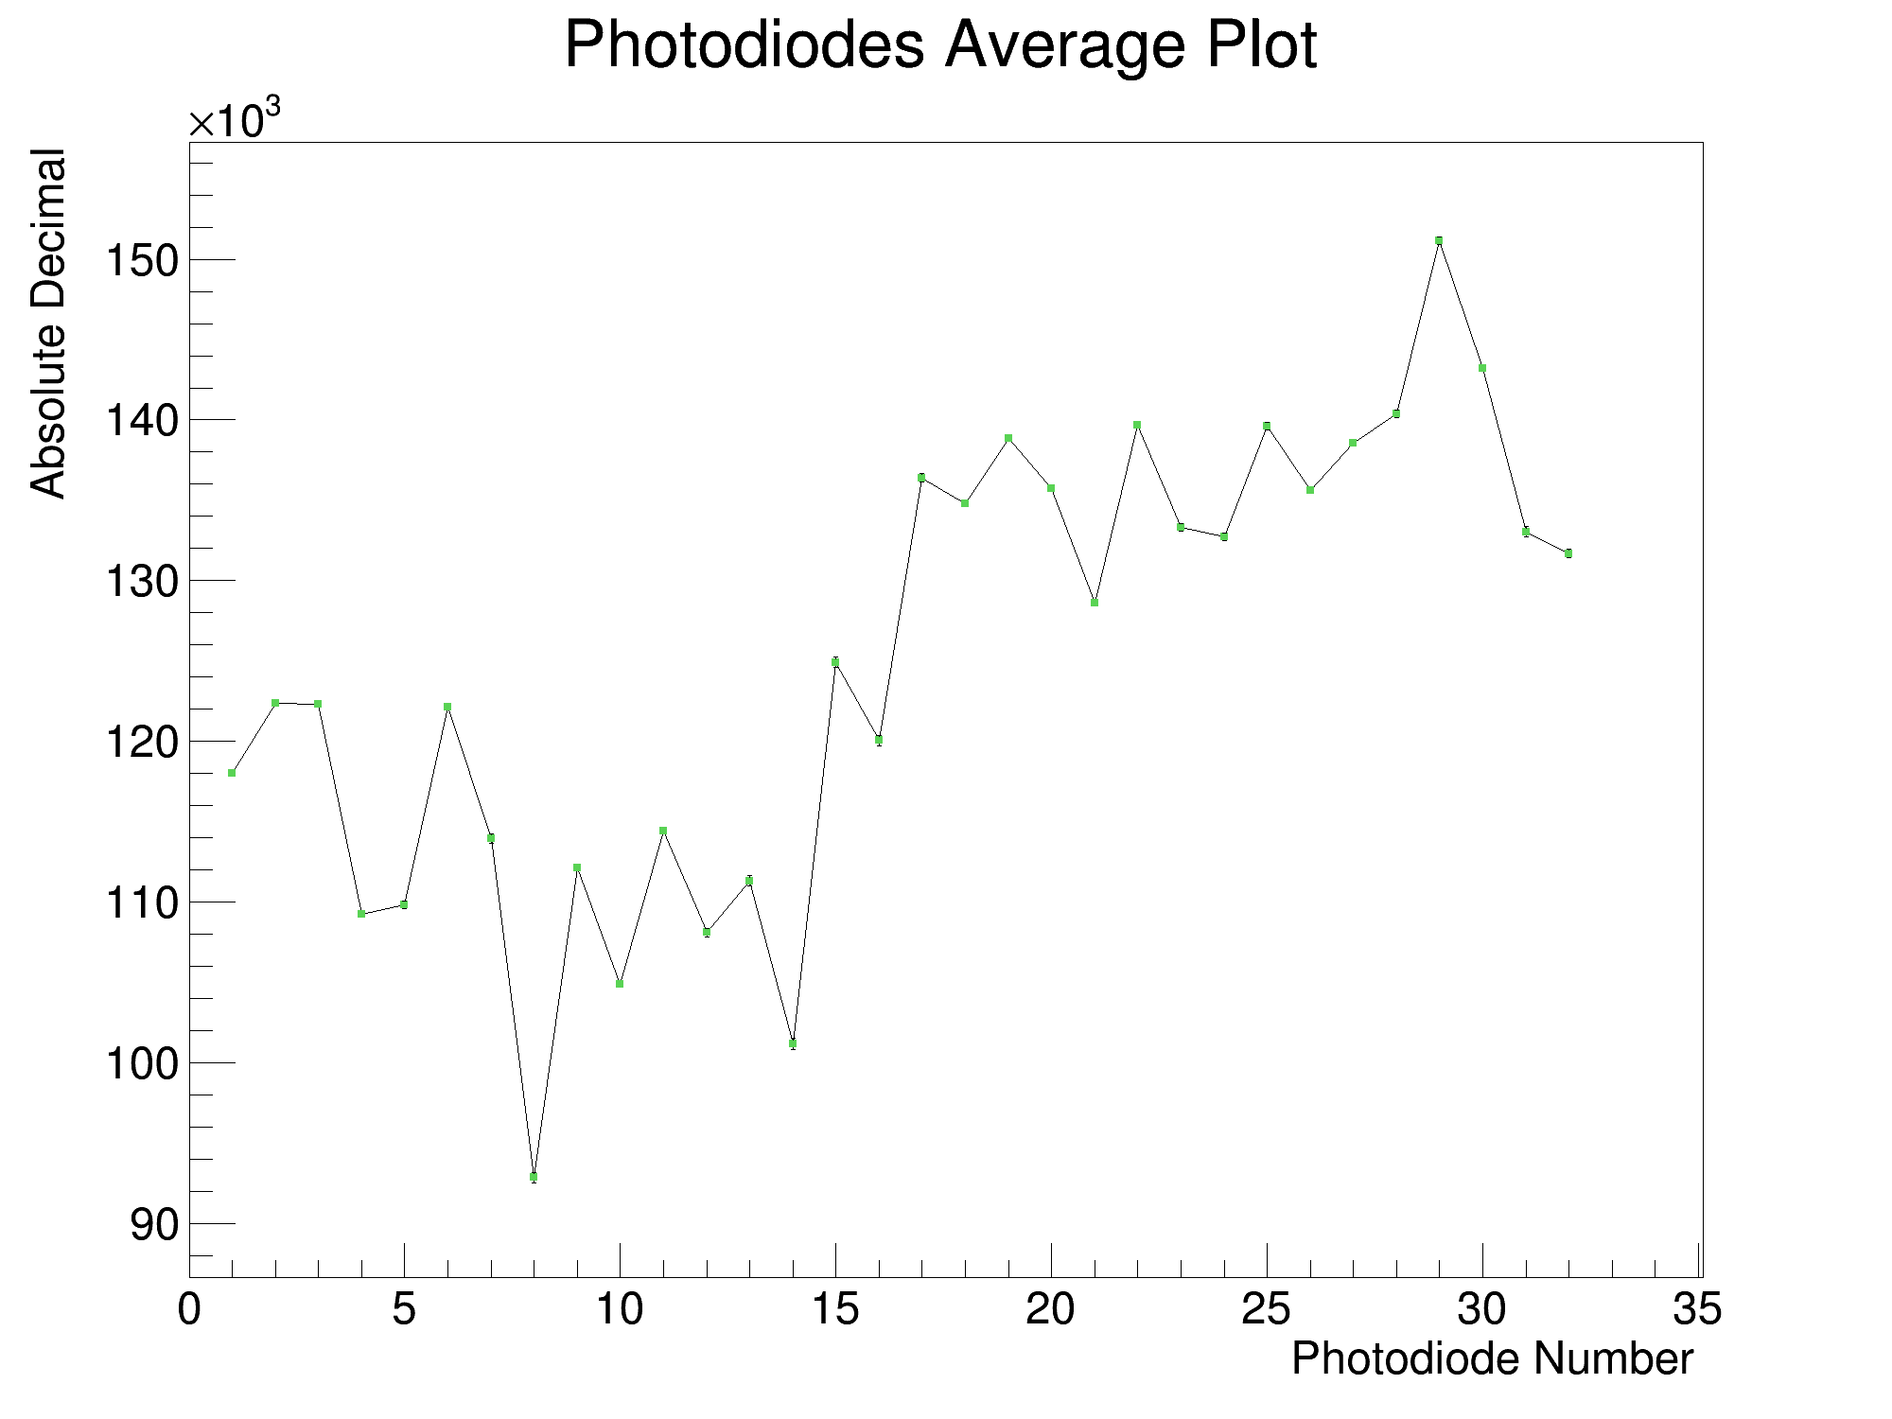

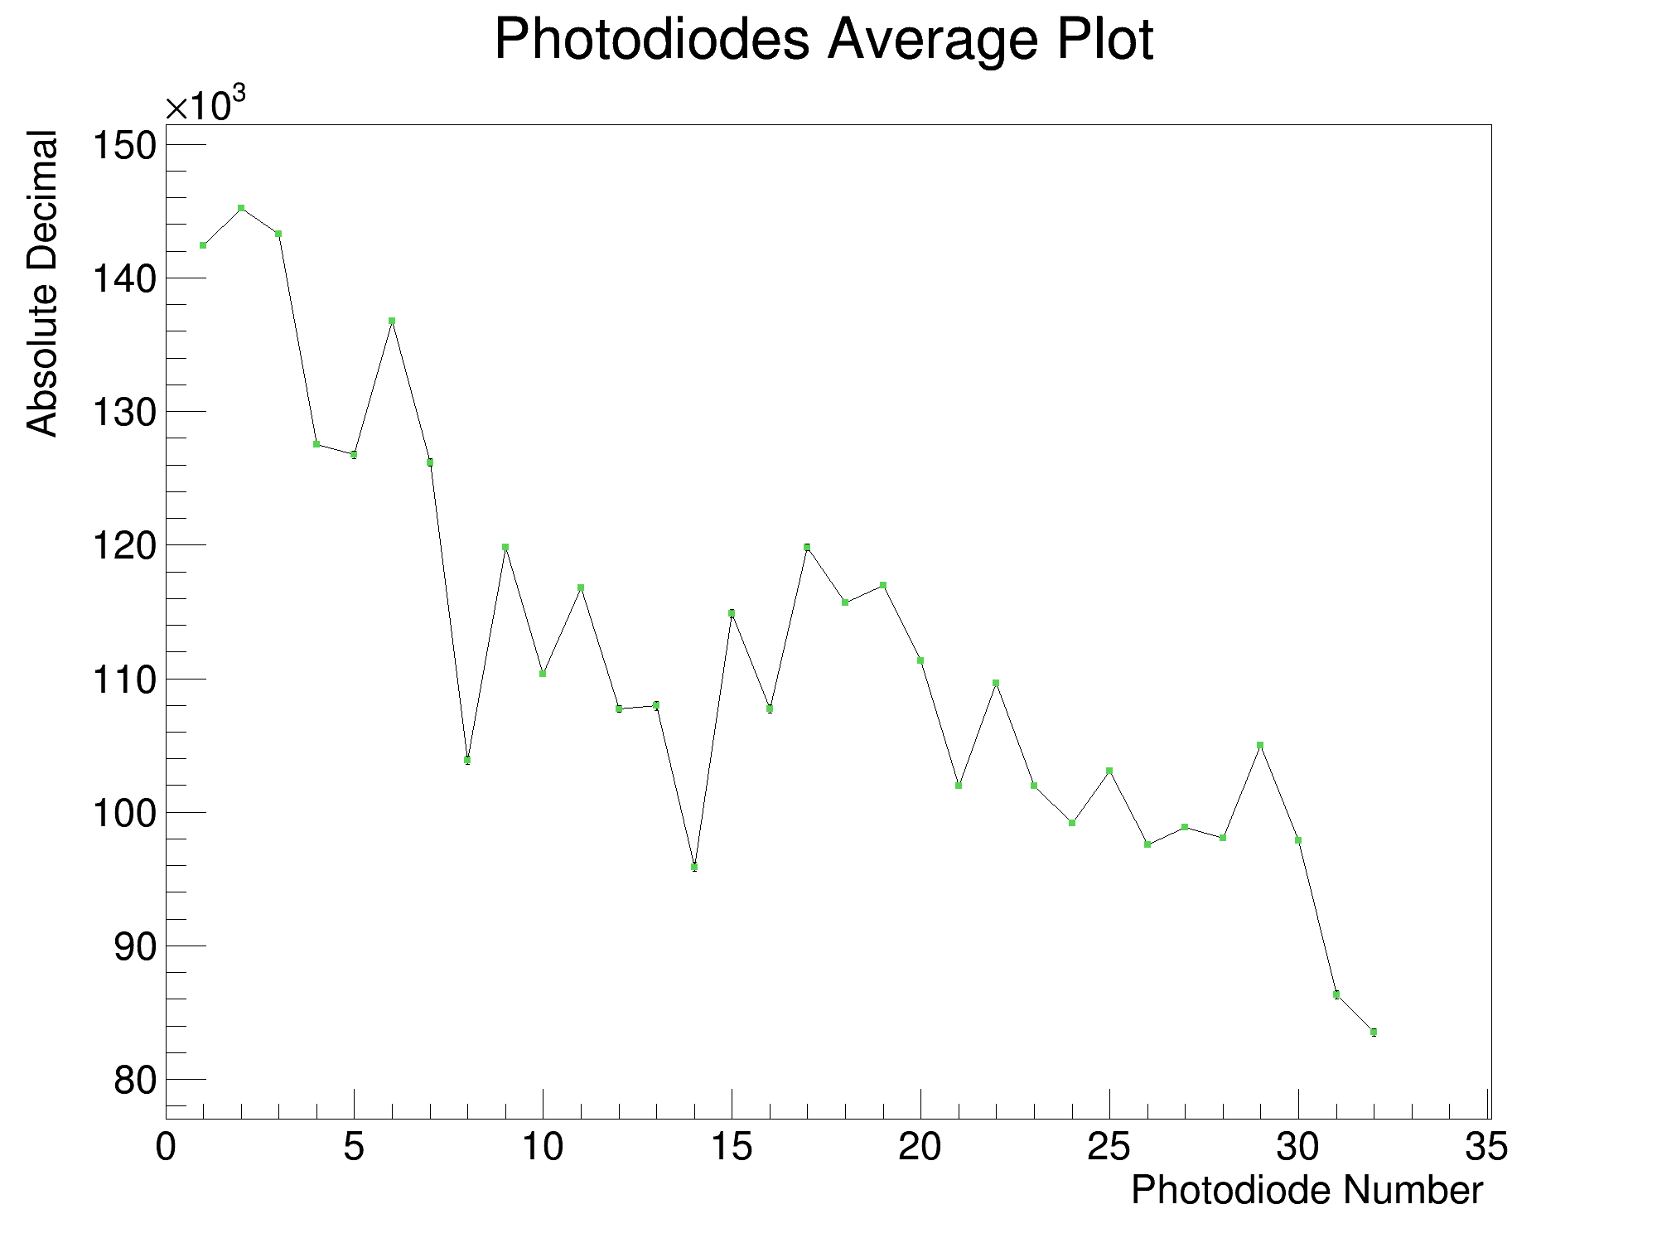
Analysis (Run 7, 105MeV, 300nA, 12.5pC, 170us)
Raw Average
Back ST
Background
Front ST

Slide 8
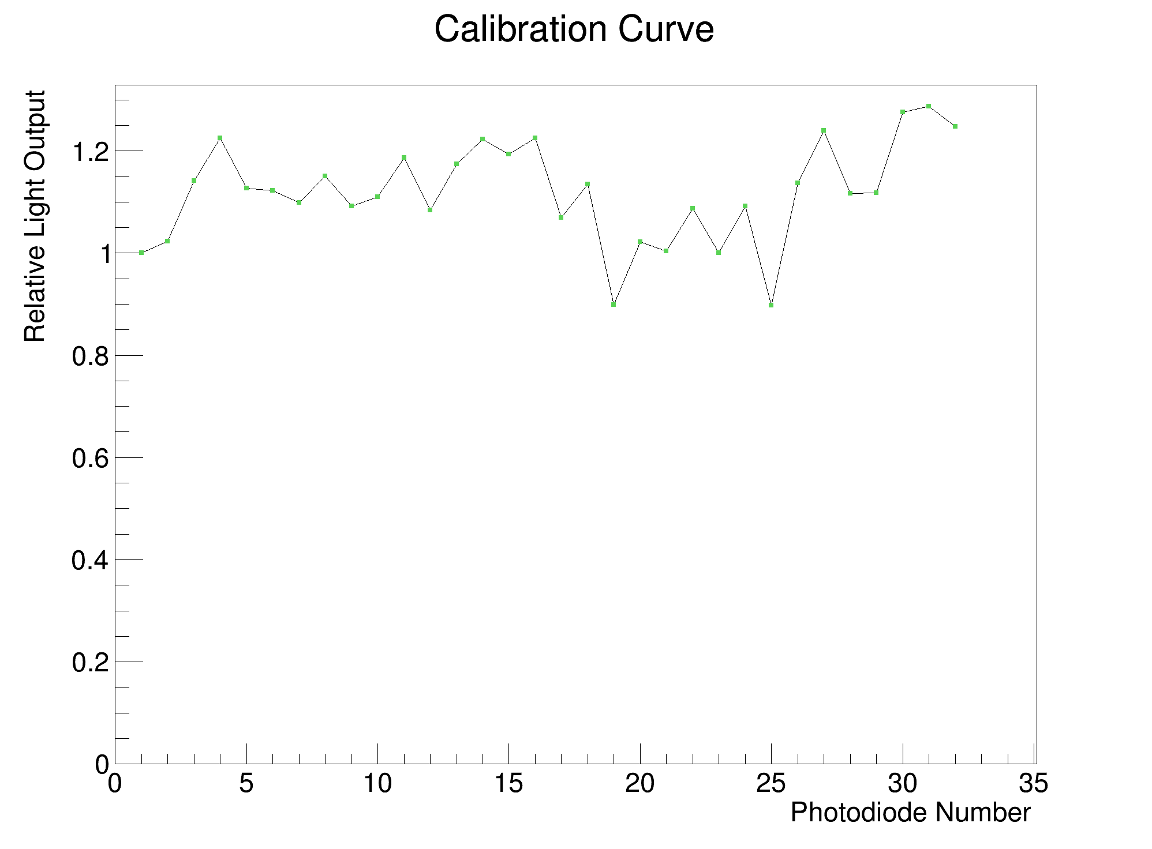
Analysis (Run 7, 105MeV, 300nA, 12.5pC, 170us)
Back ST
Front ST
Normalised + Averaged ST

Slide 9
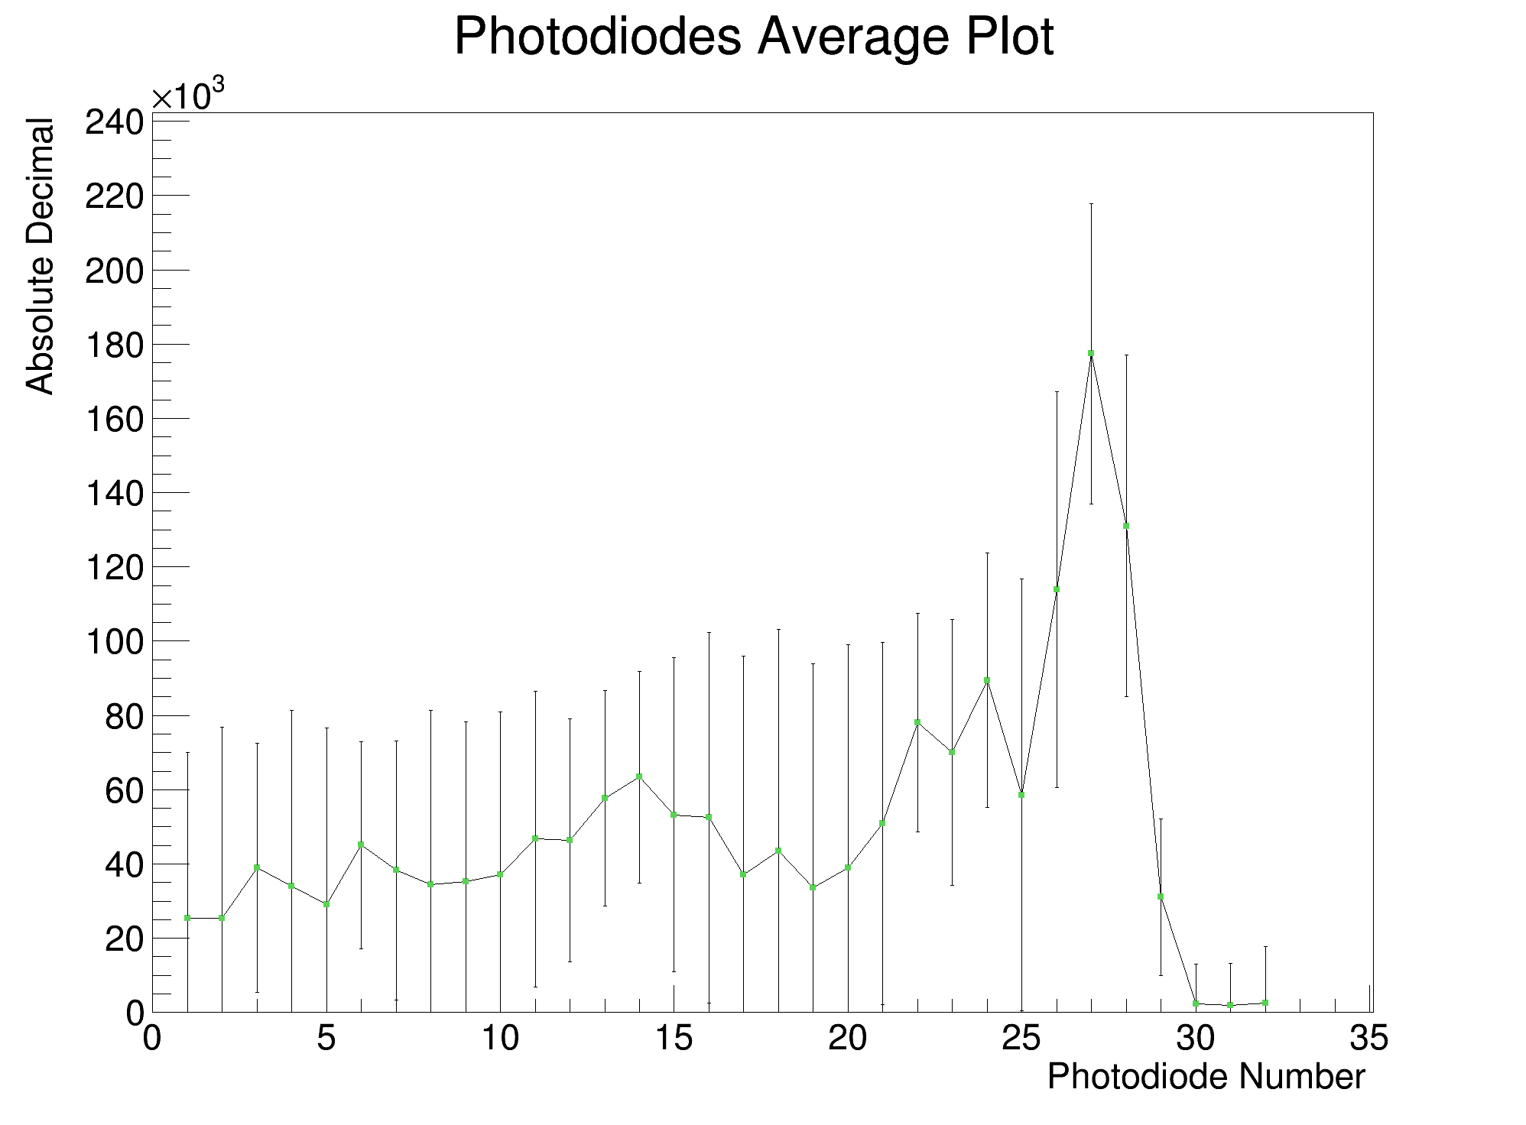
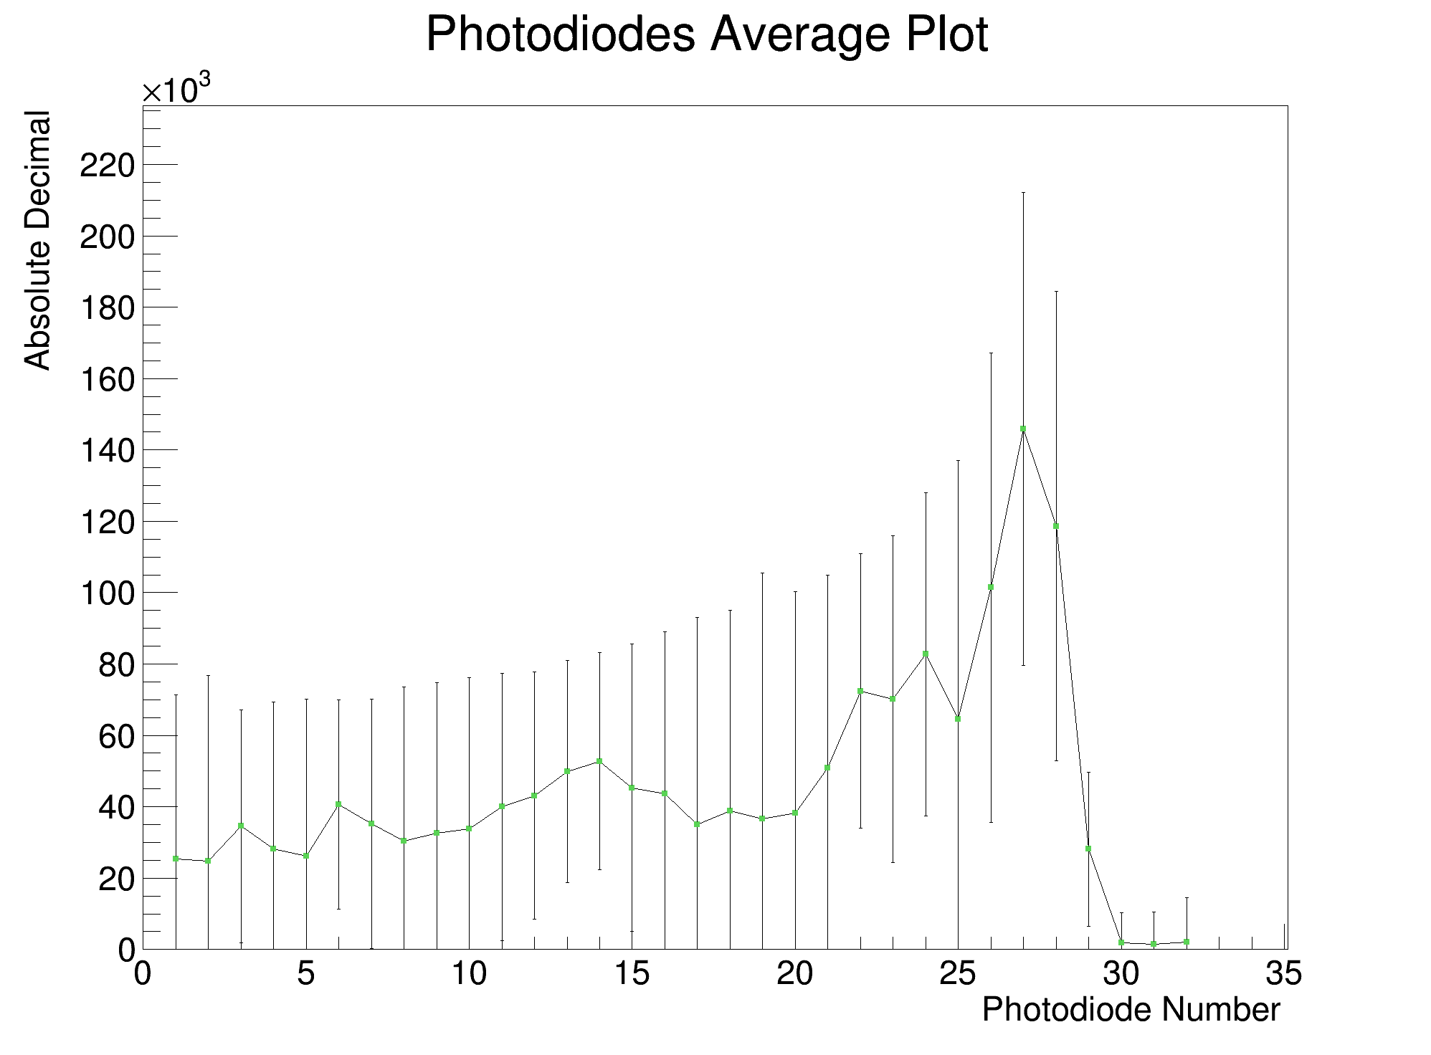
Analysis (Run 7, 105MeV, 300nA, 12.5pC, 170us)
Background Subtracted, Reversed, Calibrated
Raw Average
Background Subtracted, Reversed
(Ignore large error bars)

Slide 10
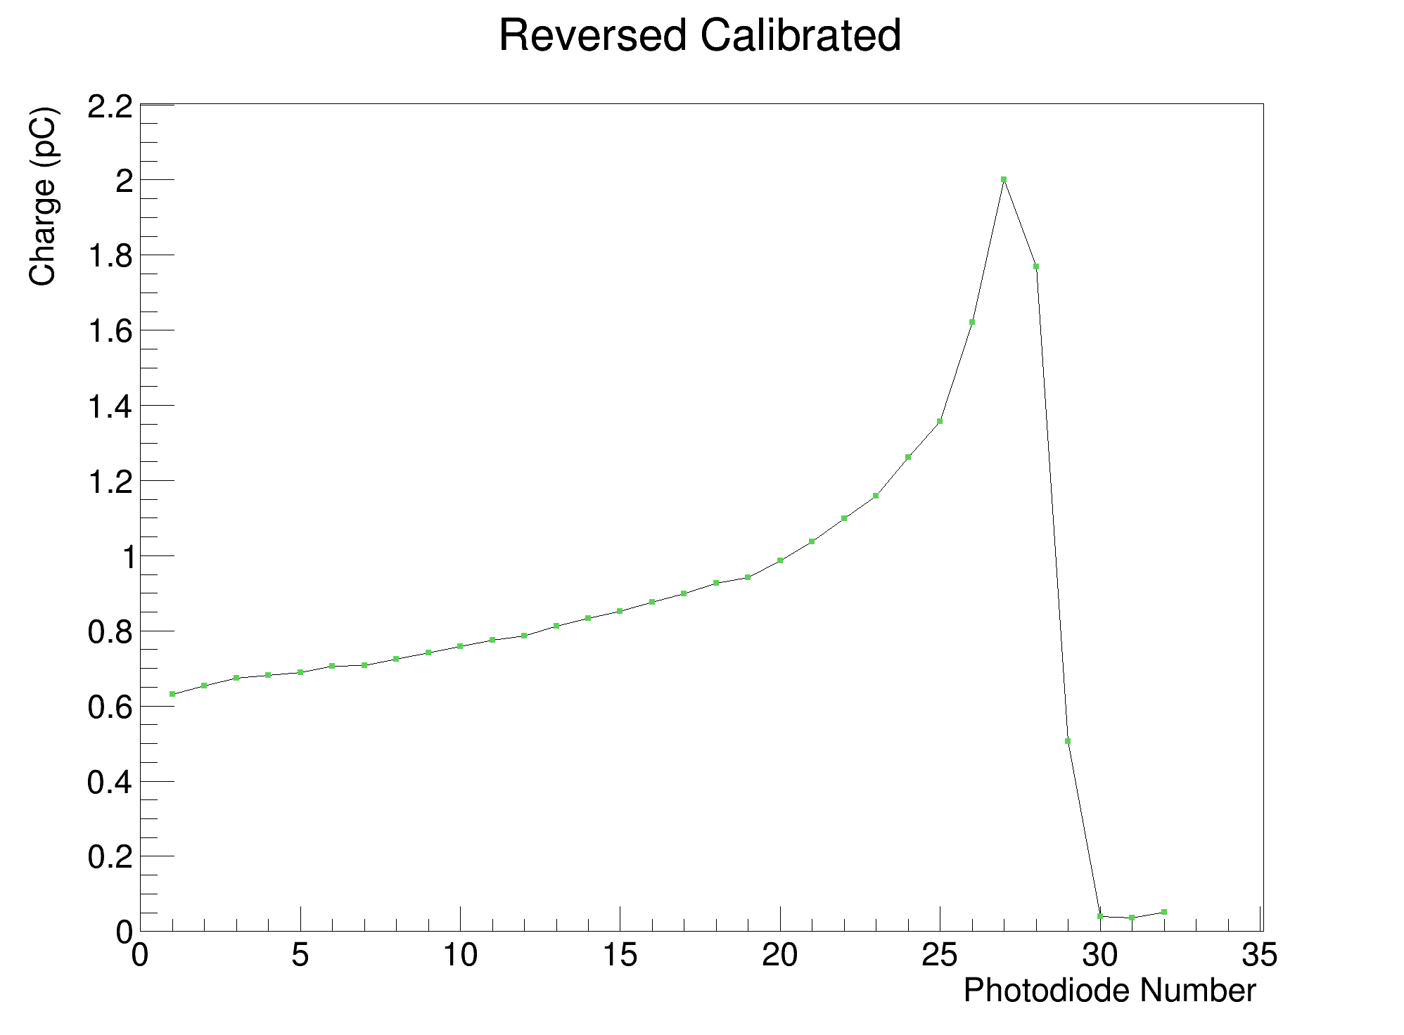
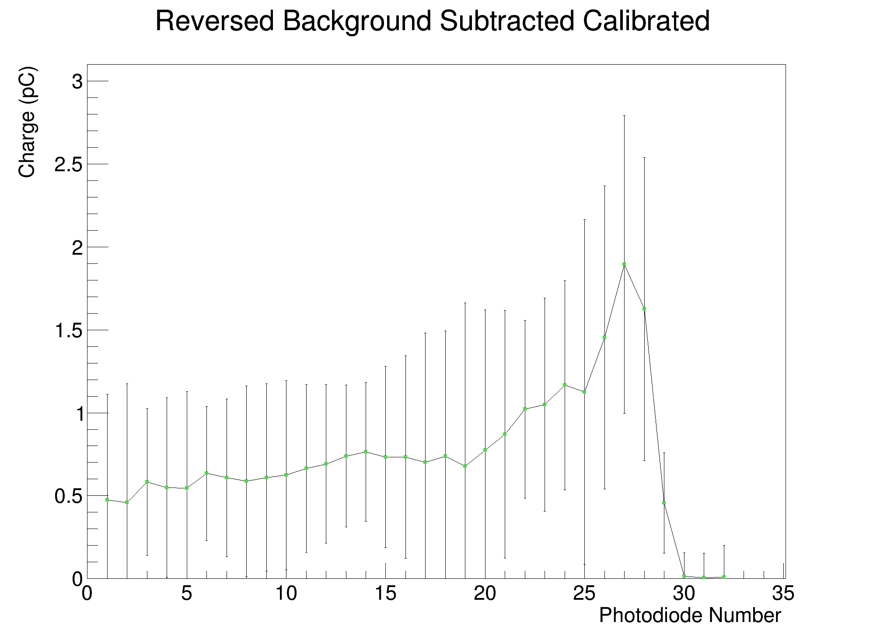
Analysis (Run 7, 105MeV, 300nA, 12.5pC, 170us)
Reversed, Background Subtracted, Calibrated
Reversed, Calibrated
(Ignore large error bars)

Slide 11
UCLH Reference Curves
When comparing to photodiode data, subtract WET of first sheet in stack, since this was not covered by photodiode (sheet 25).

Slide 12
Analysis (105 MeV, 12.5pC, 170us)
Reversed, Calibrated, 150nA (Run 8)
Reversed, Calibrated, 300nA (Run 7)

Slide 13
Calibrated PDL & Fit Comparisons
Photodiodes vs. CMOS Sensor (vs. UCLH Reference)
Note: Additional sheet in front of stack not covered by PDs – reference curve shifted back in x-direction by 2.63 mm

Slide 14
CMOS
75 MeV Pencil Beam Fit
Run 26, 600 nA
PD

Slide 15
CMOS
80 MeV Pencil Beam Fit
Run 25, 500 nA, 1000 us
PD

Slide 16
CMOS
85 MeV Pencil Beam Fit
Run 23, 500 nA
PD

Slide 17
CMOS
90 MeV Pencil Beam Fit
Run 12, 400 nA
PD

Slide 18
CMOS
95 MeV Pencil Beam Fit
Run 20, 400 nA
PD

Slide 19
CMOS
100 MeV Pencil Beam Fit
Run 18, 200 nA
PD

Slide 20
CMOS
105 MeV Pencil Beam Fit
Run 7, 300 nA
PD

Slide 21
CMOS Black Sheets
110 MeV Pencil Beam Fit
Run 16, 150 nA
PD Black Sheets

Slide 22
CMOS Fit Comparisons
Comparison of CMOS fit with CMOS photodiode approximation fit.
CMOS PD approx.: take 6 mm central stripe of image and average central 1 mm within each sheet.

Slide 23
70 MeV Pencil Beam Fit (Run 27)
Normal Fit
Photodiode Approx.

Slide 24
75 MeV Pencil Beam Fit (Run 26)
Normal Fit
Photodiode Approx.

Slide 25
80 MeV Pencil Beam Fit (Run 24)
Normal Fit
Photodiode Approx.

Slide 26
85 MeV Pencil Beam Fit (Run 23)
Normal Fit
Photodiode Approx.

Slide 27
90 MeV Pencil Beam Fit (Run 21)
Normal Fit
Photodiode Approx.

Slide 28
95 MeV Pencil Beam Fit (Run 20)
Image is saturated!
Normal Fit
Photodiode Approx.

Slide 29
100 MeV Pencil Beam Fit (Run 18)
Normal Fit
Photodiode Approx.

Slide 30
105 MeV Pencil Beam Fit (Run 8)
Normal Fit
Photodiode Approx.

Slide 31
110 MeV Pencil Beam Fit (Run 16)
Normal Fit
Photodiode Approx.

Slide 32
CMOS Range Difference vs. Energy

Slide 33
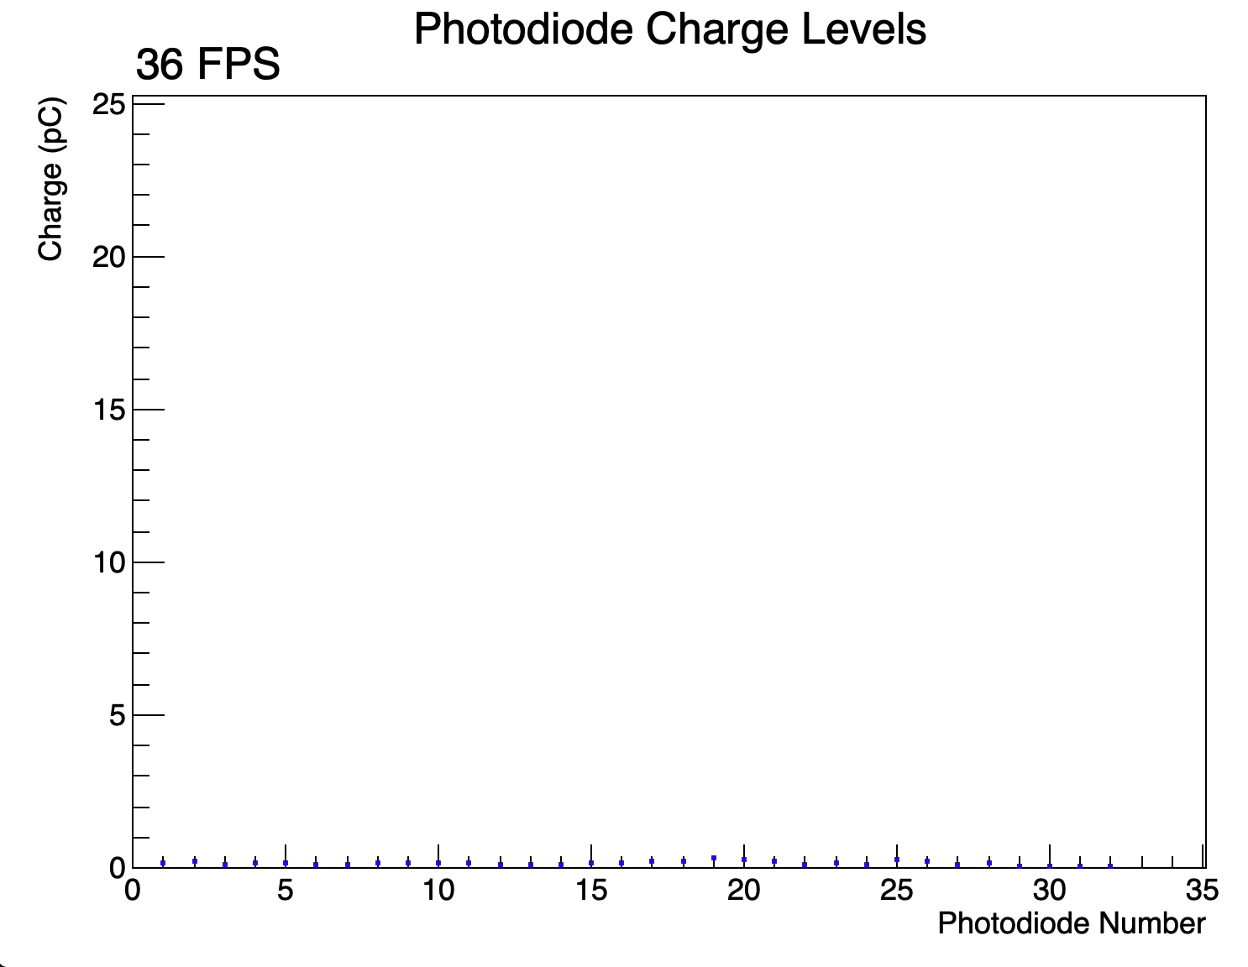
Box Field Treatment Plan
Observe strange ”shoulder” after Bragg peak. Unclear why this occurs.

Slide 34
Conclusions
Lower FSR has greater precision therefore larger std. dev.
Significant electronic noise present in photodiode data!
  Better to not perform background subtraction.
  Still able to get reasonable fit results.
Similar range reconstruction between low and high currents.
Good match between CMOS and PD PDLs.
CMOS sensor fits excellent across all energies – PD fits mixed: affected by electronic noise after Bragg peak.
Photodiode approximation does not impact fitting in CMOS images, provided there is no saturation.
Appear to have a systematic range offset of about -0.56mm.

