Slide 1
DEPARTMENT OF PHYSICS & ASTRONOMY
QuARC – A Quality Assurance Range Calorimeter
Update on New Developments
Saad Shaikh¹, Simon Jolly, Raffaella Radogna, Fern Pannell,
Spyros Manolopoulos
¹saad.shaikh.15@ucl.ac.uk

Slide 2
Proton Therapy
Offers superior dose conformity to conventional X-ray radiotherapy.
Range uncertainties remain one of the largest technical difficulties.
Prevents from taking full advantage of proton therapy benefits.
  Treatment planning
    Treatment angles, regions, etc.
  Daily Quality Assurance (QA)
    Time consuming, laborious

Slide 3
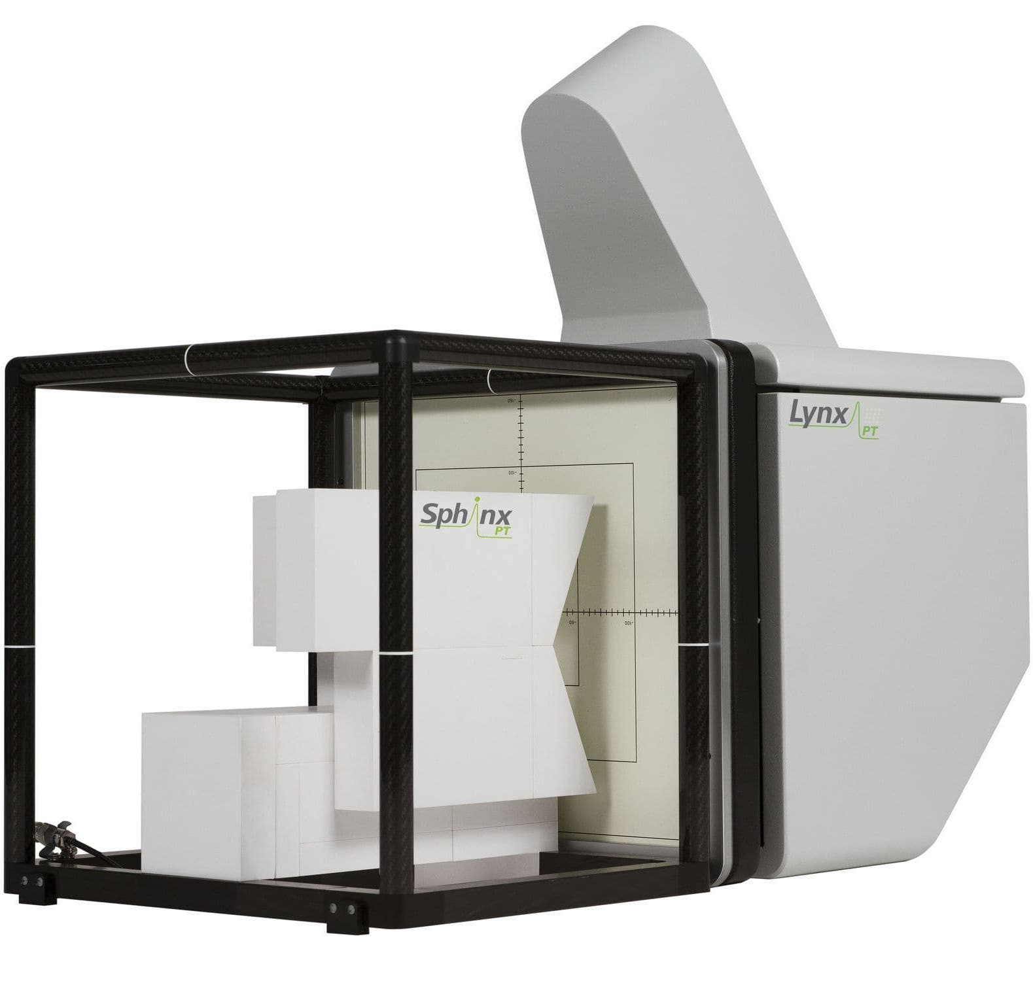
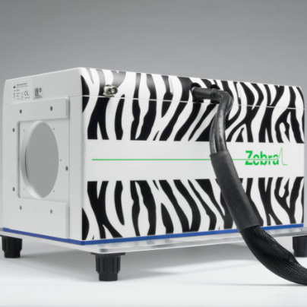
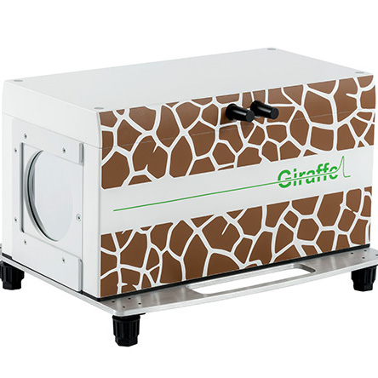
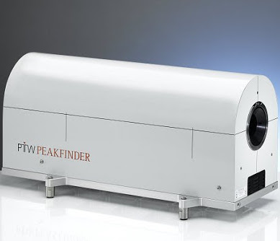
Current Methods of Daily QA
Detectors used:
  IBA Sphinx/Lynx
  IBA Giraffe
  IBA Zebra
  PTW Peakfinder
Do the job but are expensive and can be slow and difficult to set up.
Speed often tied with requirement of repeated beam delivery.
WET measurements not guaranteed.

Slide 4
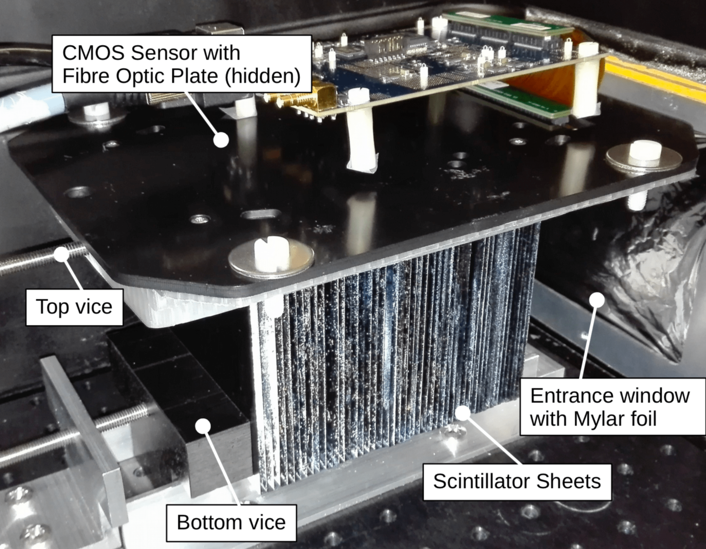
QuARC
Detector is a series of optically isolated polystyrene scintillator sheets of size: 10 cm × 10 cm × 2.8 cm.
Measure light output of each sheet and reconstruct Bragg curve to recover proton range.
  Fit data to analytical depth-light model.
Key benefits:
  Plastic scintillator is inexpensive and water-equivalent.
  Range can be reconstructed with single beam delivery.
  Detector is easy to setup.
First prototype used a large-area CMOS sensor to take images of the scintillator stack.

Slide 5
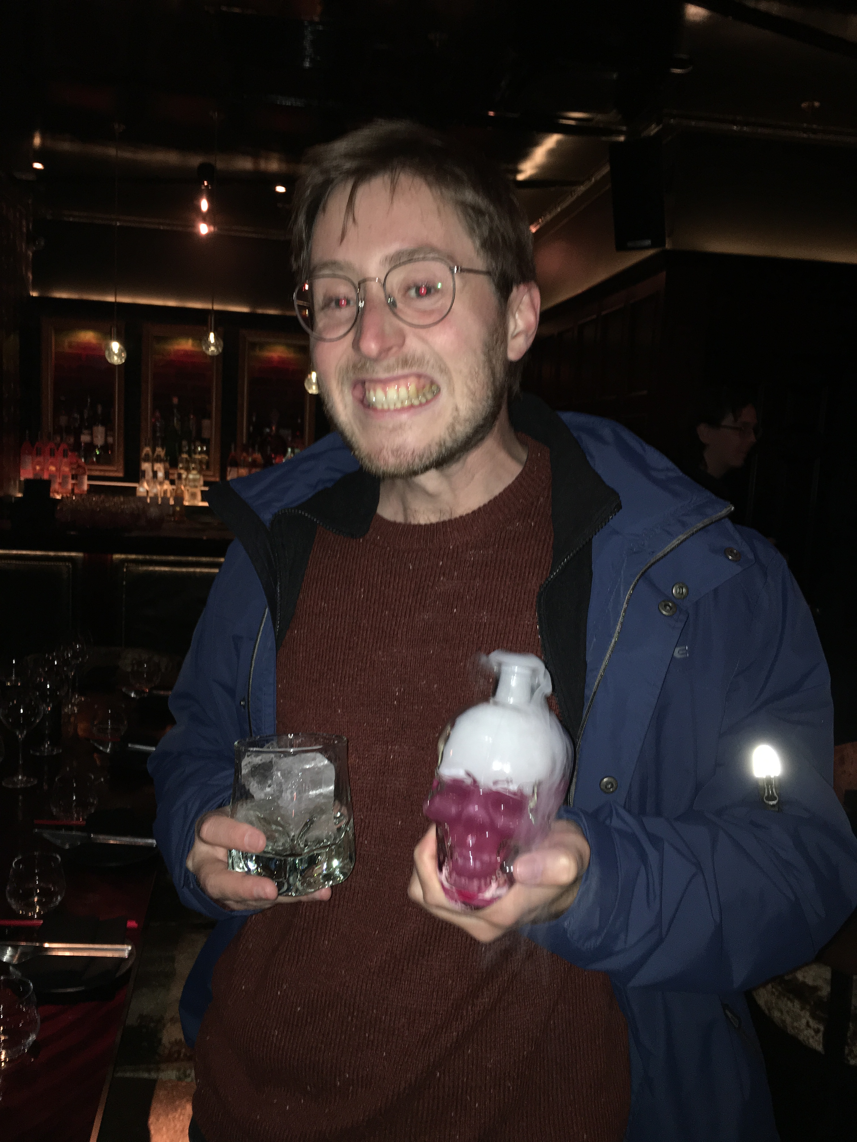
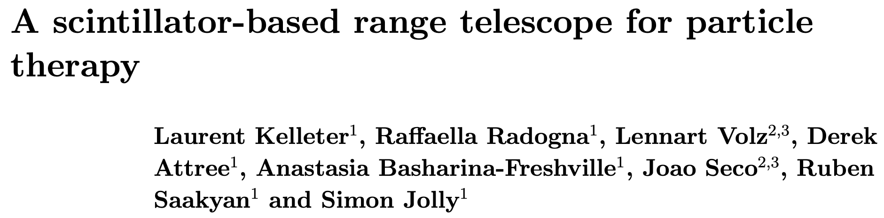
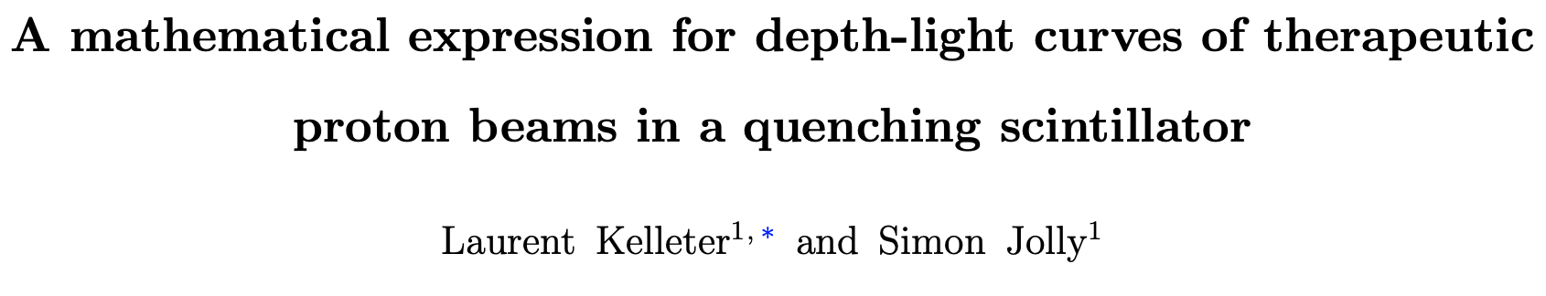
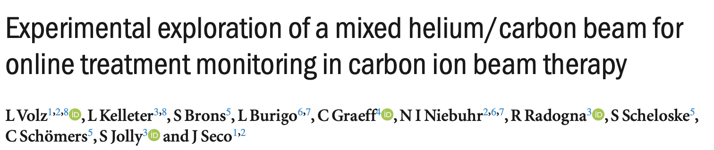
Achievements So Far…
Publication about first prototype:
  https://doi.org/10.1088/1361-6560/ab9415
Analytical model to fit depth-light data – Bortfeld Bragg model with scintillator quenching corrections:
  https://doi.org/10.1002/mp.14099
Applications in real-time treatment range verification using mixed He-C beams:
  https://doi.org/10.1088/1361-6560/ab6e52

Slide 6
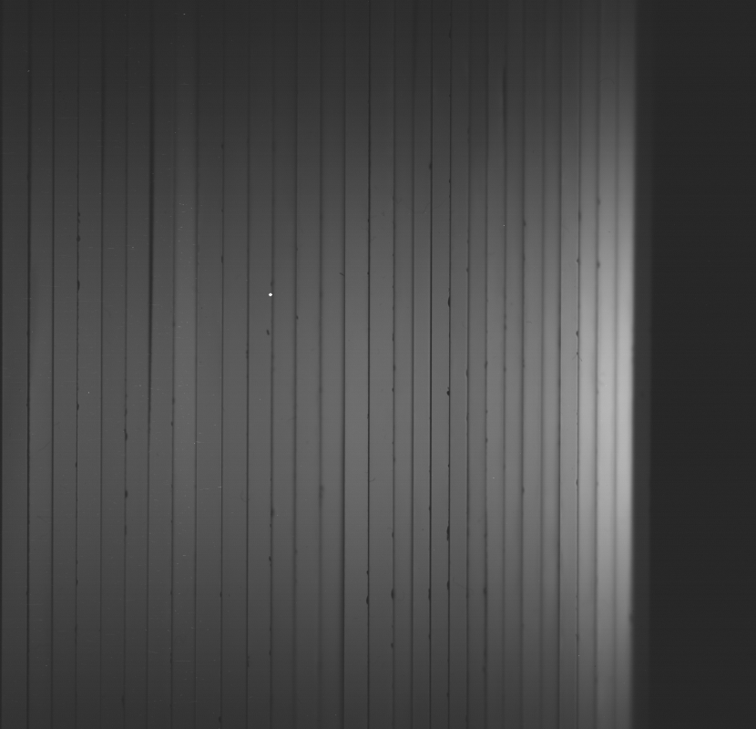
Achievements So Far…
In short… the detector works!
  Able to consistently and accurately reconstruct proton ranges across clinical energies.
Improvements to be made:
  CMOS sensor is delicate and expensive.
  Sheet number limited by size of sensor.
    Max 50 sheets – need 160 in total!
  Image analysis is slow and involved.

Slide 7
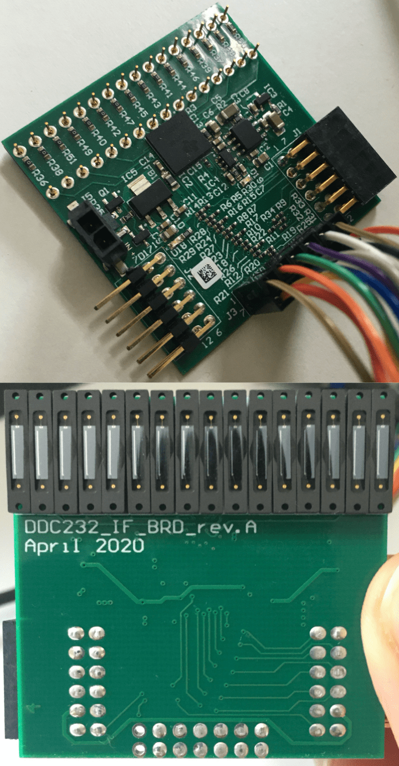
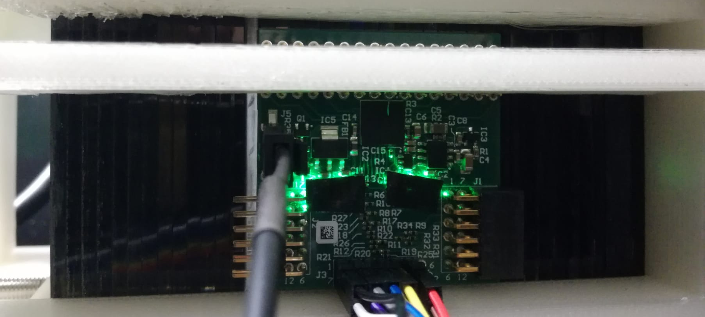
QuARC 2.0
Replace CMOS with photodiodes.
  Each sheet coupled to one photodiode.
  Custom modular circuit board designed by CosyLab housing Texas Instruments DDC232.
  32-channel ADC with zero-deadtime readout over 5kHz.
My tasks
  FPGA design to transfer digitised data to PC and control DDC232.
  C++ analysis with ROOT to process and display data live and perform fit.

Slide 8
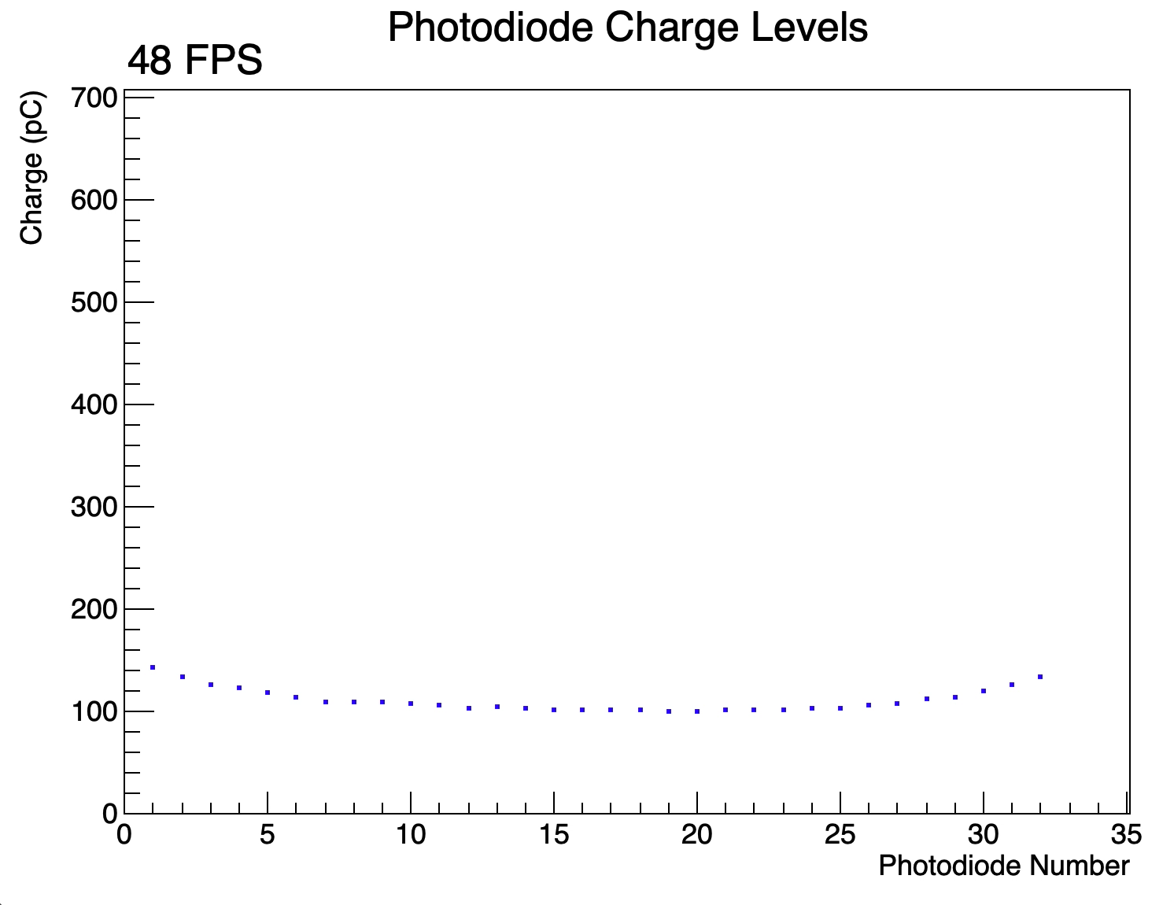
Photodiode Live Display

Slide 9
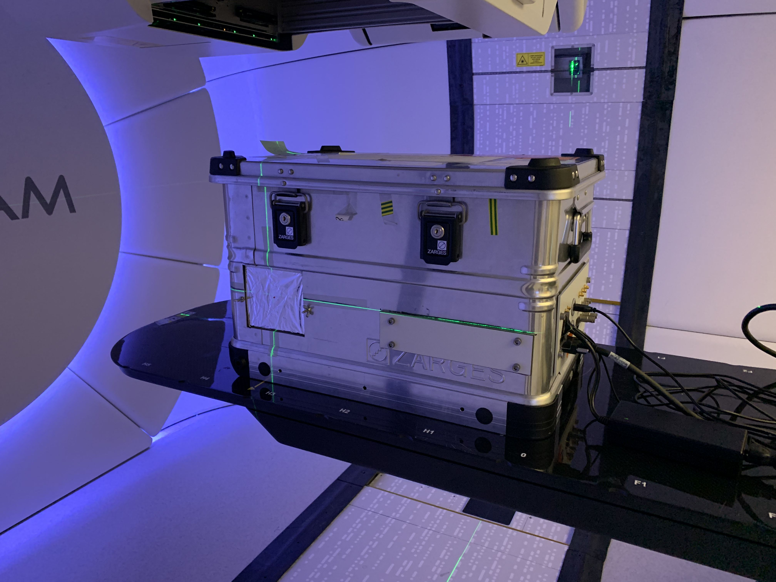
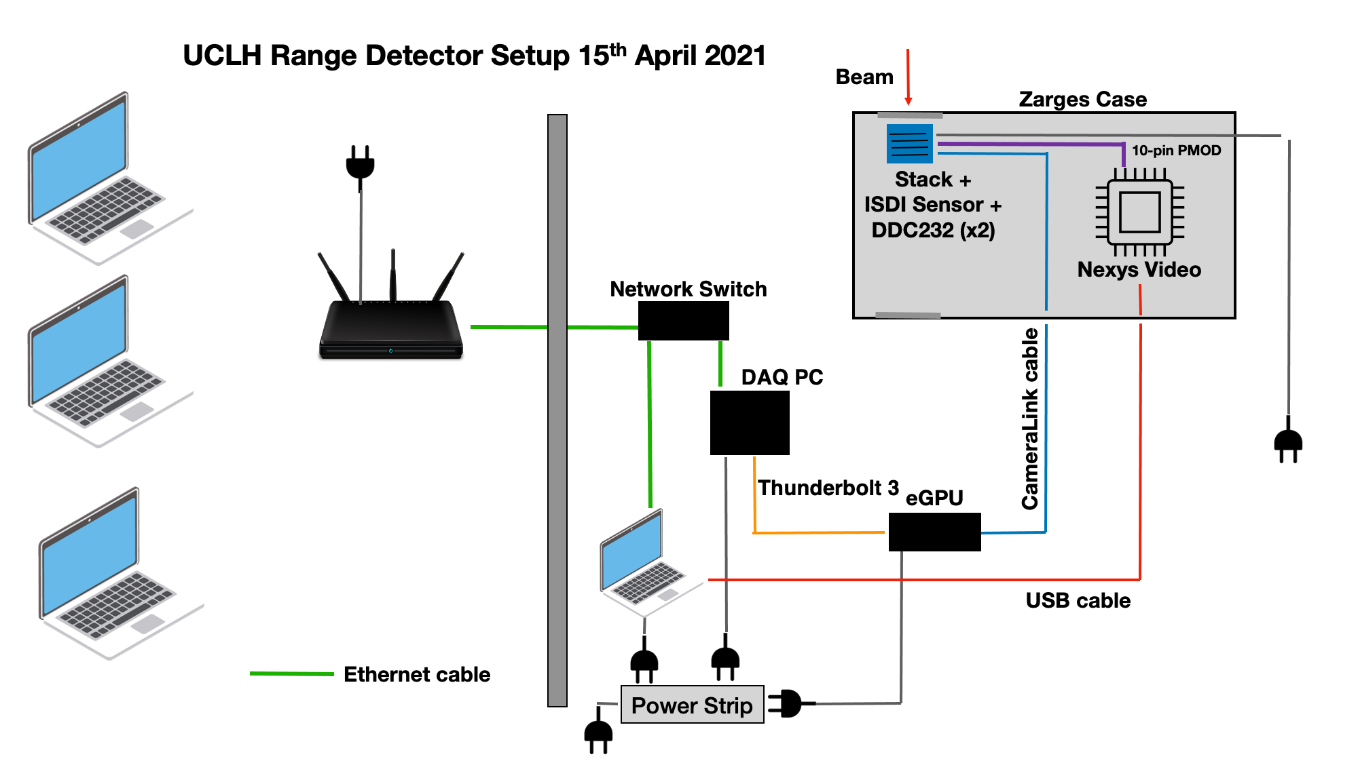
UCLH Beam Test
Short test at UCLH to evaluate performance of photodiodes vs. CMOS sensor.
Use 32 sheets (2 DDC232 boards) to test pencil beam energies between 70-110 MeV.
Deliver 3 cm × 3 cm × 3 cm treatment plan to test speed of photodiode DAQ.
Establish light levels for photodiodes.

Slide 10
Notes on Data Acquisition
Photodiode ADC has 7 dynamic ranges to choose from, varying between 12.5 – 350pC.
  20-bit resolution between 0pC and upper dynamic range limit.
  Chose 12.5pC due to low light levels.
Each photodiode is split across two ADC inputs and then summed during analysis.
Choose fastest integration time (170us) and target display frame-rate of 50Hz.
Take approximately 30000 measurements for pencil beams.
  Total exposure time around 5s.

Slide 11
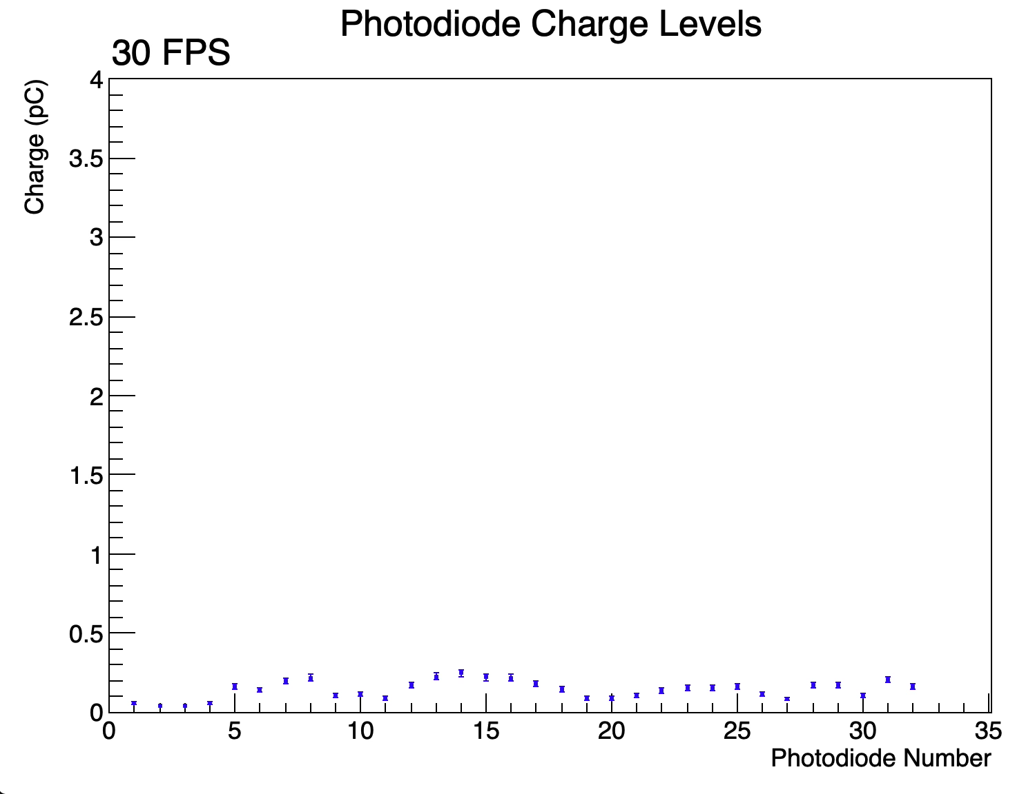
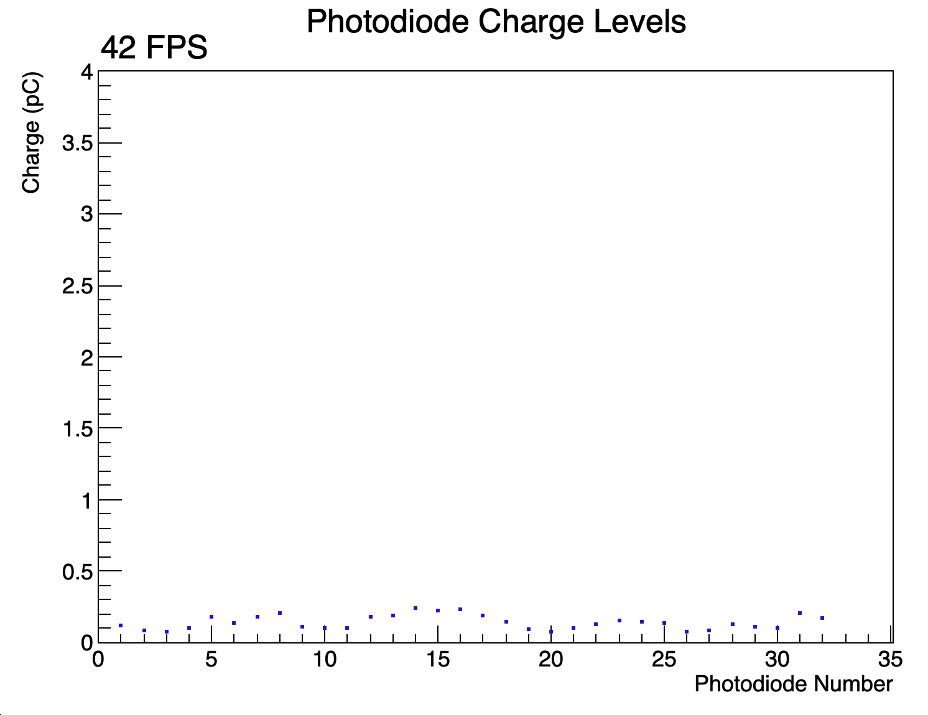
Results (Background)
Background (50Hz average)
Background (Step)
Very noisy!

Slide 12
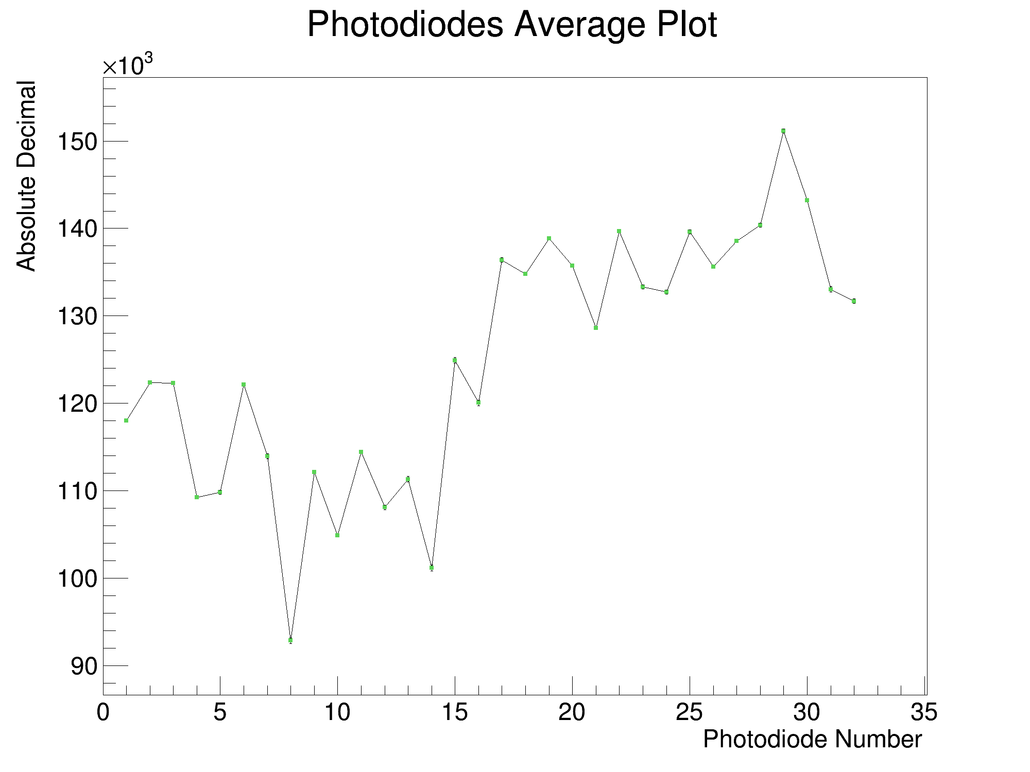
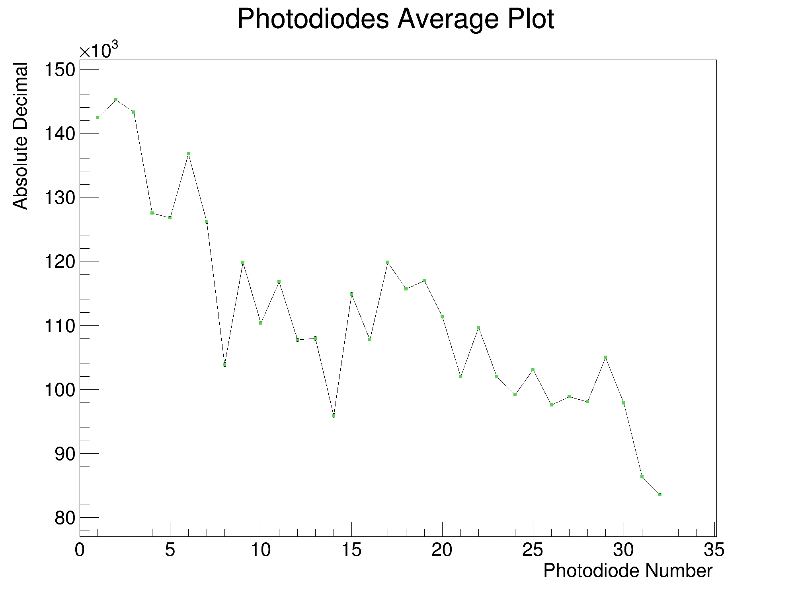
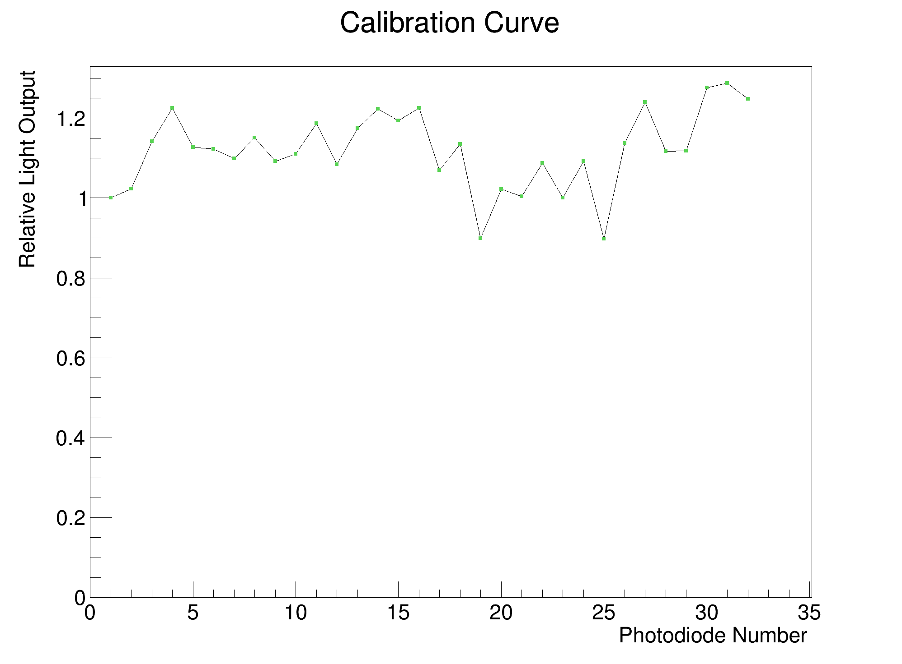
Results (245 MeV Shoot-through)
+
=
=
Back ST
Front ST
Normalised + Averaged ST

Slide 13
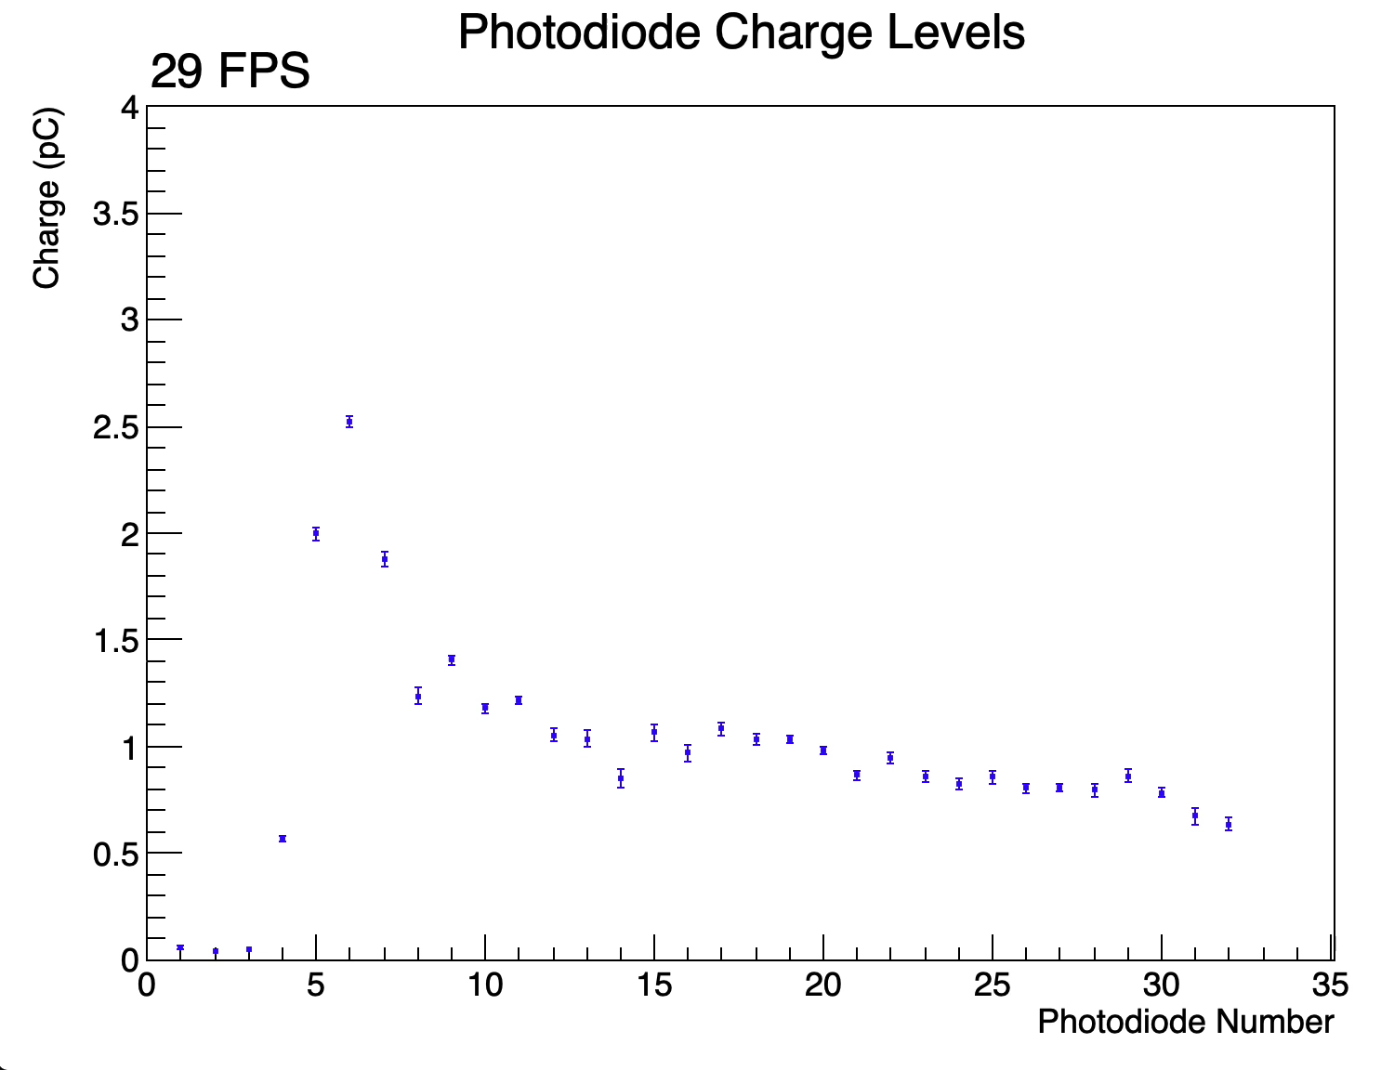
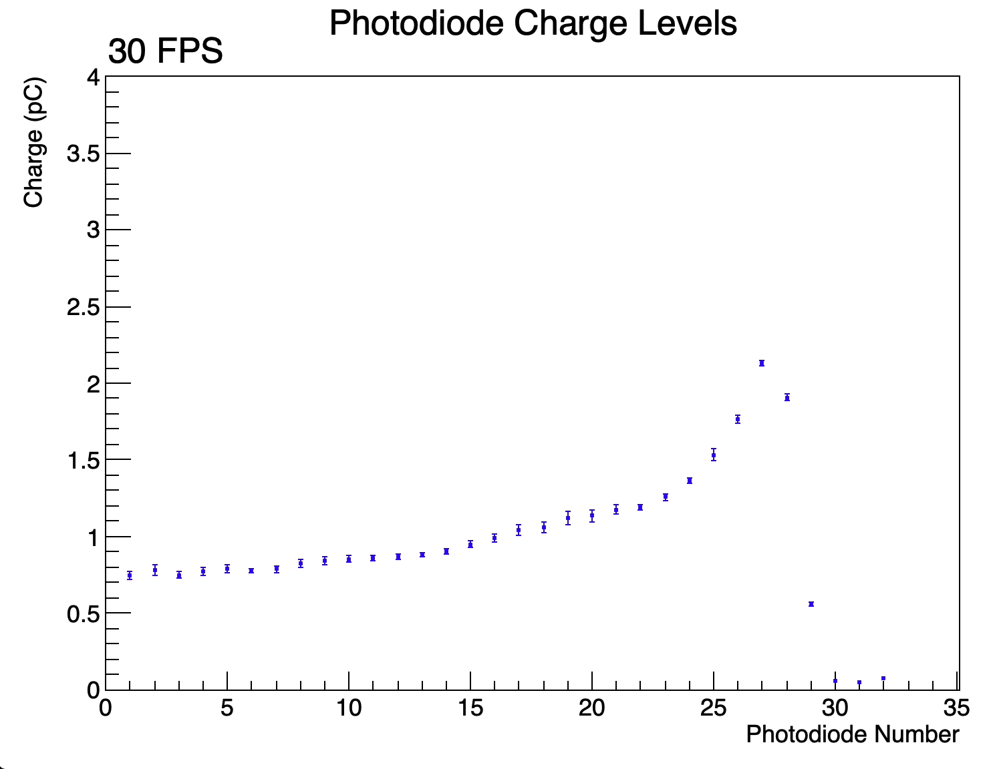
Results (105 MeV Pencil Beam)
Not even close to 350pC maximum
Jumpy due to background noise
Raw data
Shoot-through Calibrated (and reversed)

Slide 14
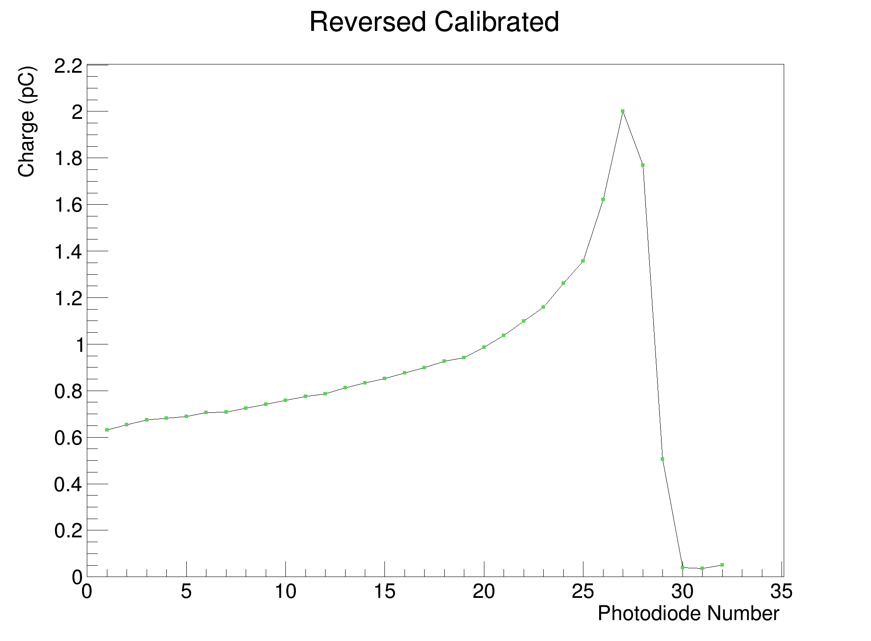
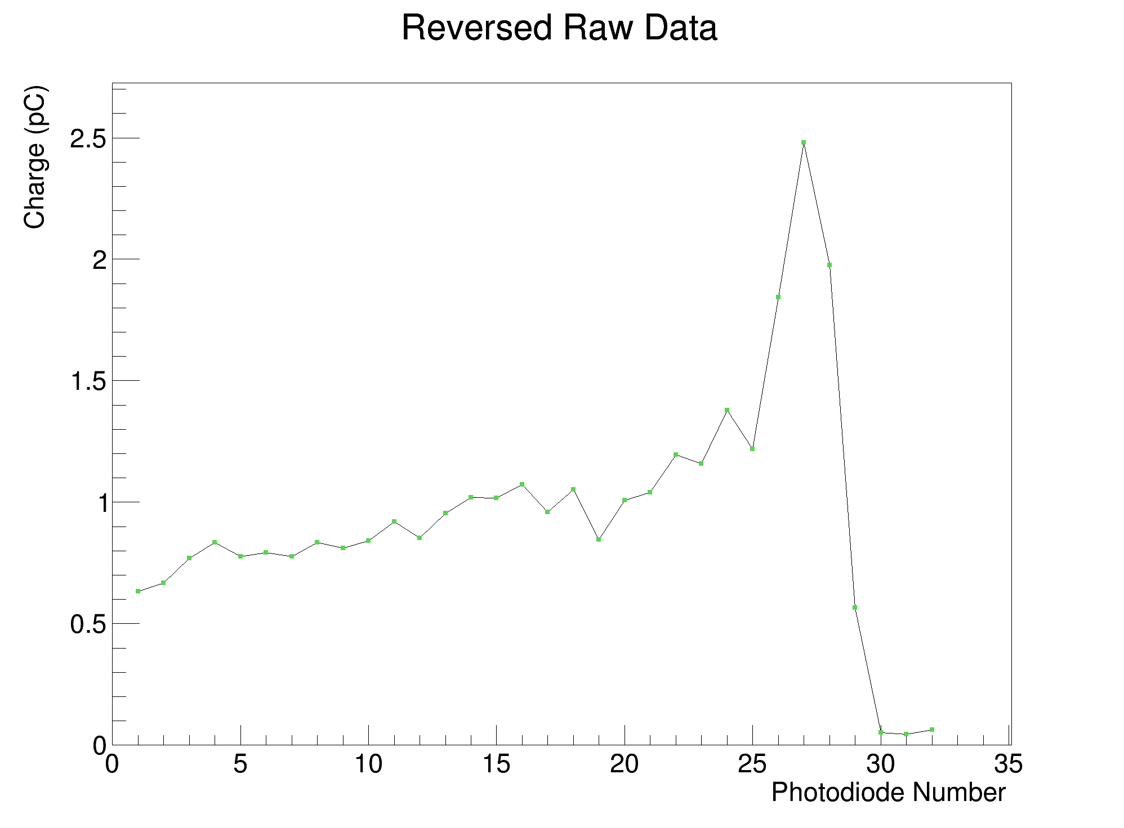
Results (105 MeV Pencil Beam)
Shape is worse with background subtraction
Reversed, Calibrated and Background Subtracted
Reversed, Calibrated

Slide 15
Results (105 MeV Pencil Beam)
Might be saturating slightly
Light output comparison (normalised to first PD)
CMOS image

Slide 16
Results (105 MeV Fit)

Slide 17
Results (70 MeV Fit)

Slide 18
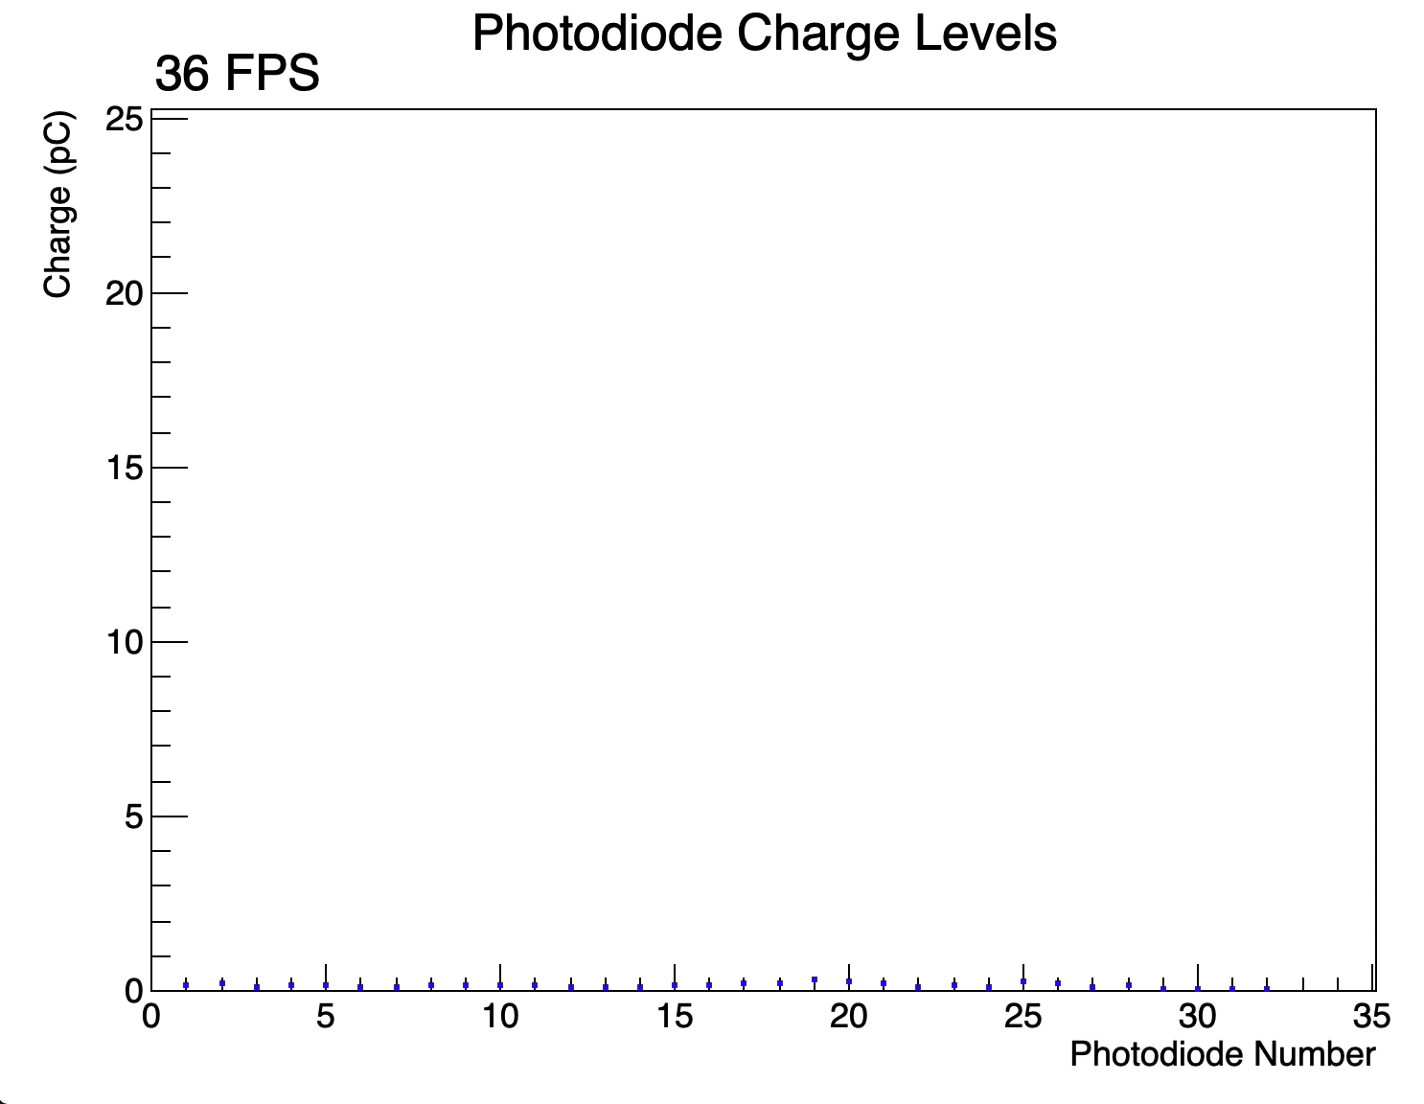
Treatment Plan
3cm × 3cm × 3cm box field, 6Gy.
Calibrated, reversed and played at half-speed.
Strange “shoulder” after Bragg Peak.
Suspected to be due to direct proton hits in photodiodes as beam is steered closer to edges.

Slide 19
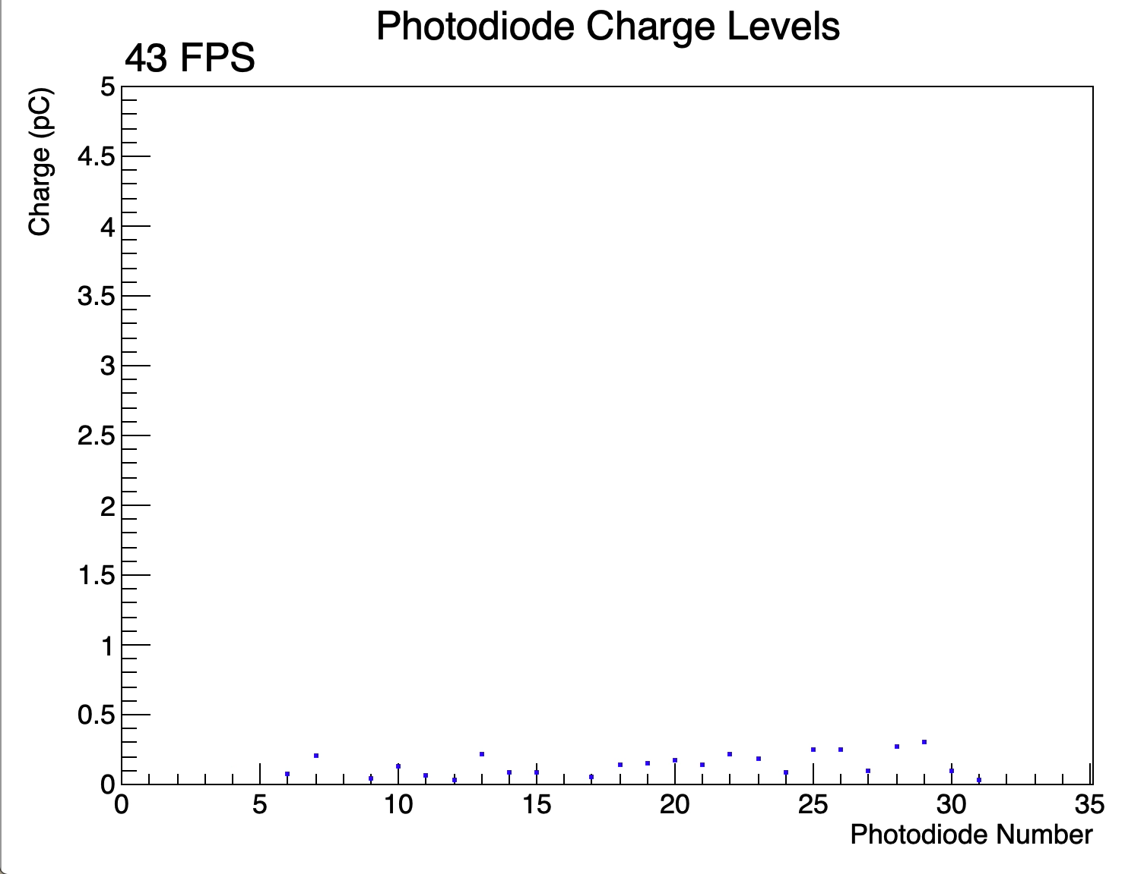
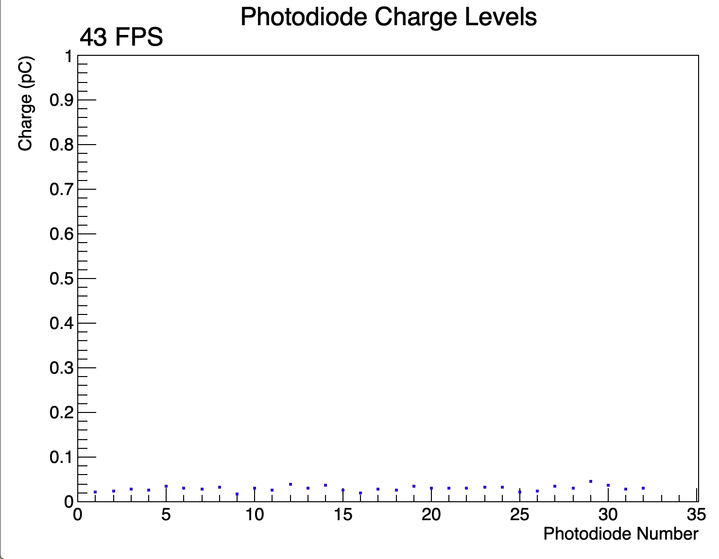
Diagnosing Background Noise
CMOS sensor on, no grounding
CMOS sensor off, detector enclosure grounded

Slide 20
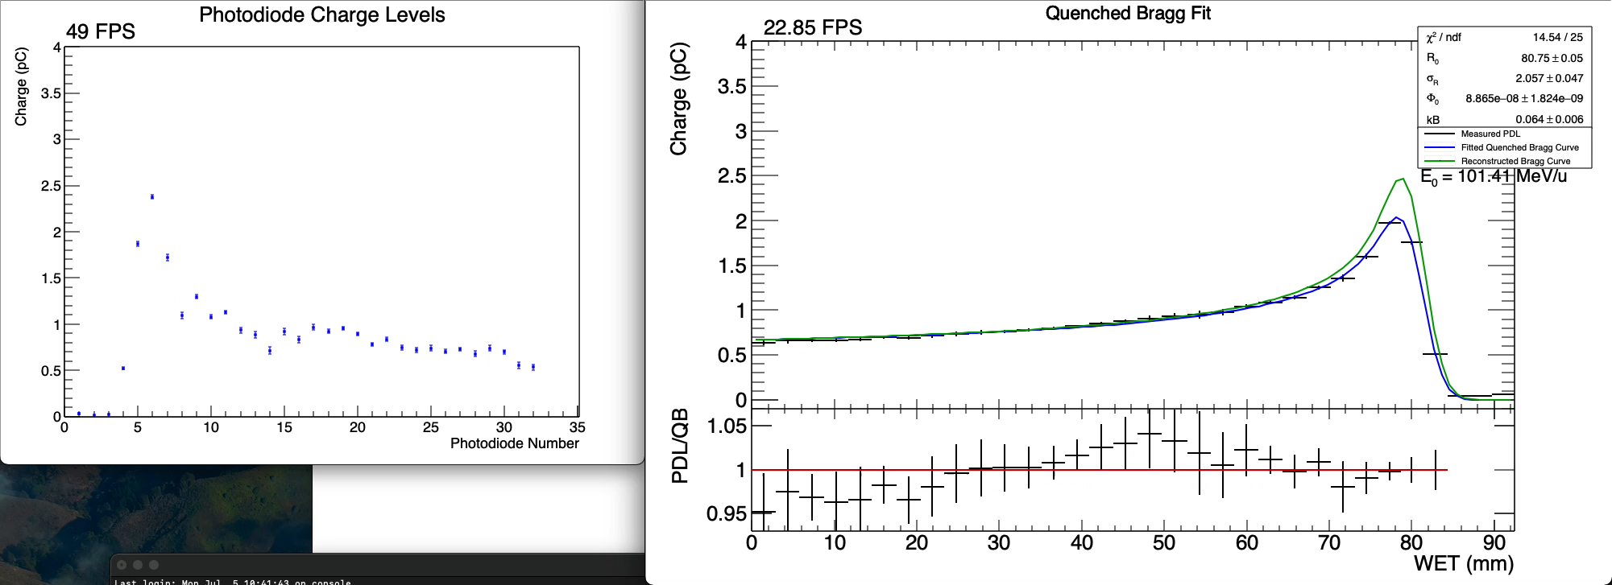
Live Fitting
Incoming data
Note: without ROOT GUI showing fit result, achieve fit rate of approx. 35Hz
Live Fit

Slide 21
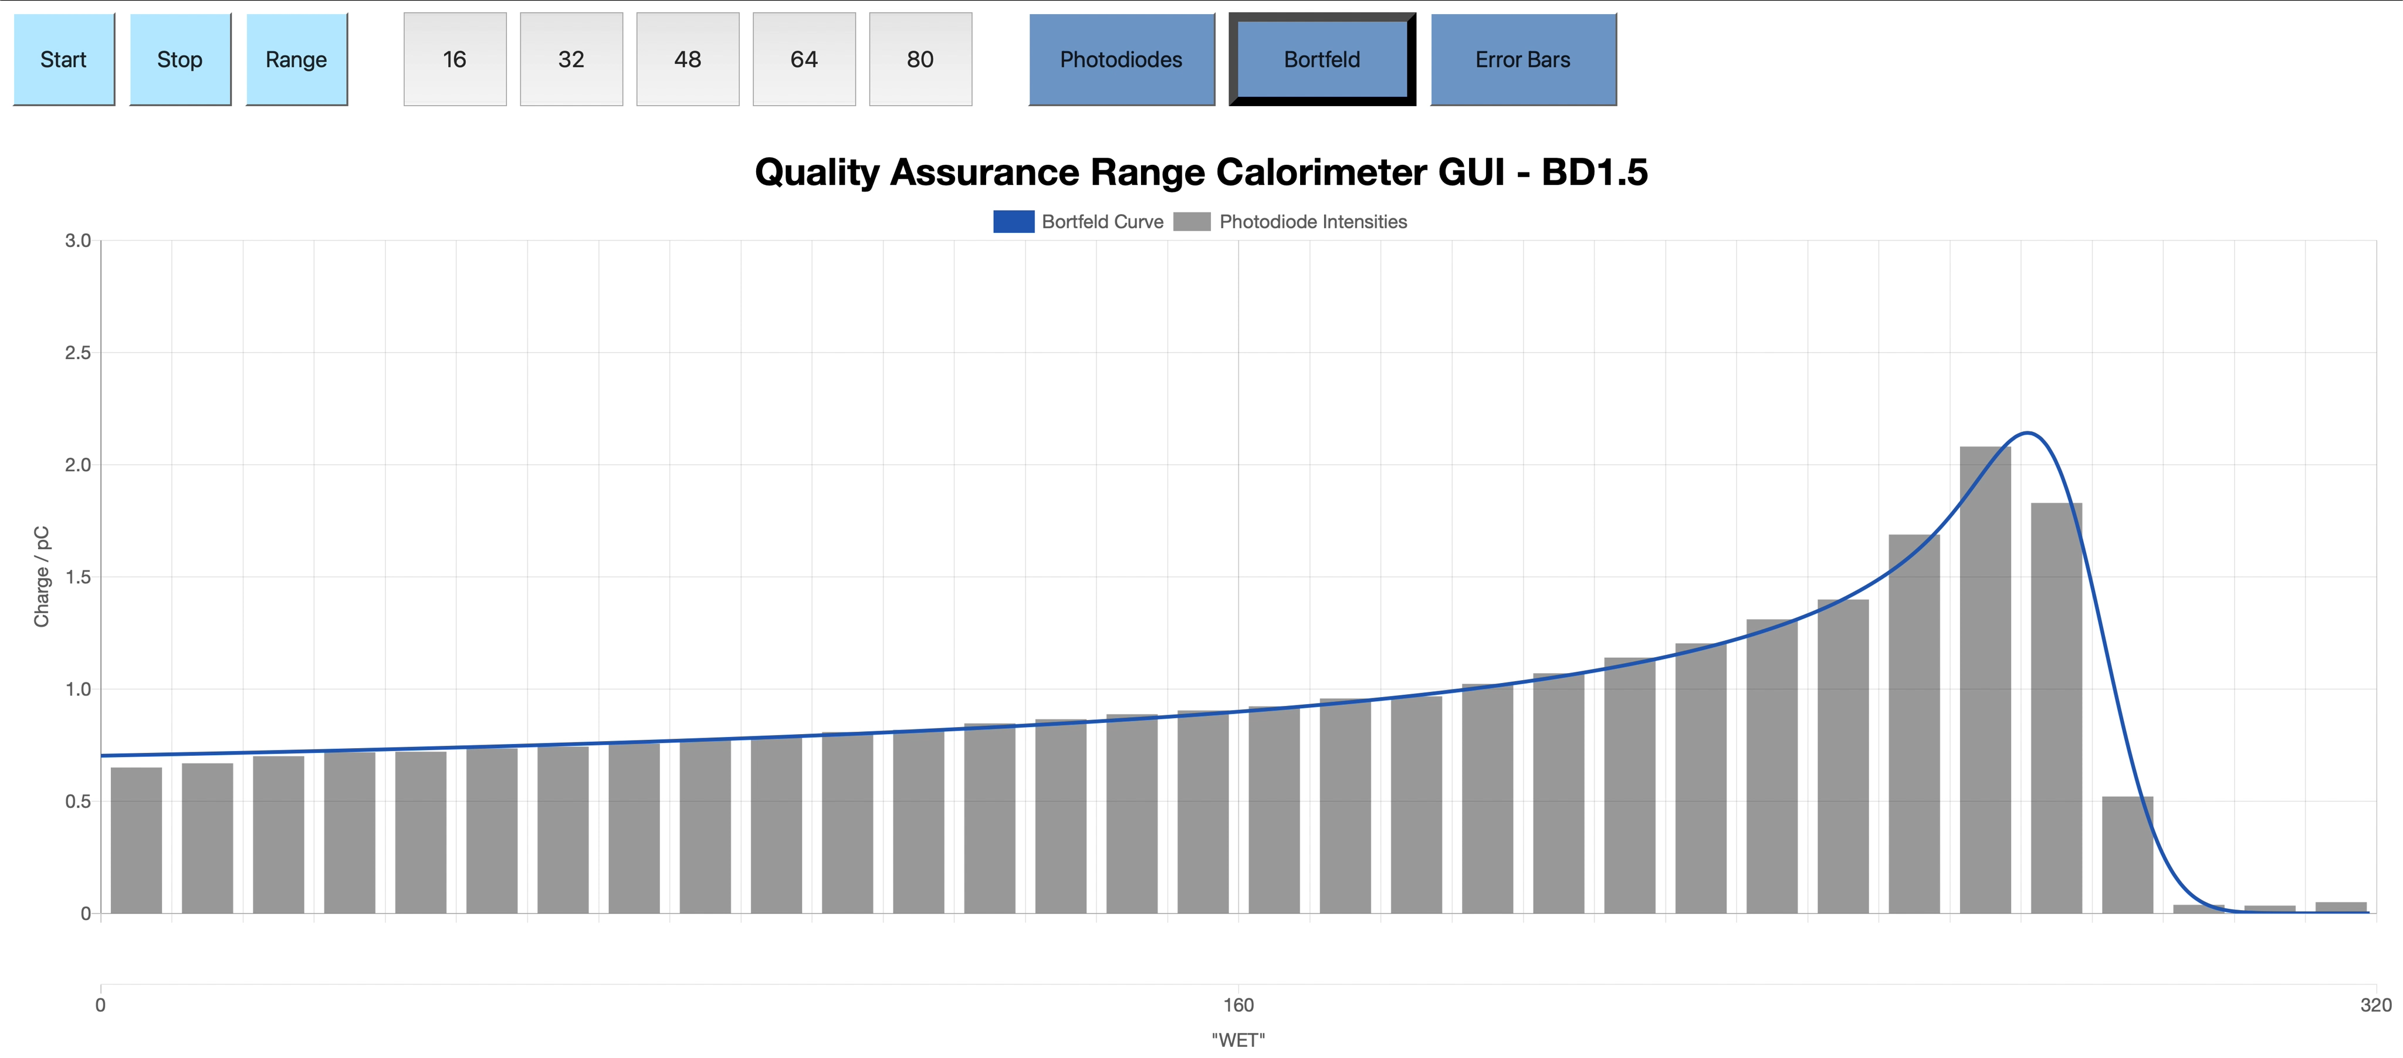
Web GUI
Developed in JavaScript by MSci student Fern Pannell.
DAQ device hosts web-page on LAN, to allow any device on network to access live display.
Plan to add facility to allow detector control.

Slide 22
Conclusions & Next Steps
Despite poor data quality, still able to reconstruct Bragg curve well.
Need to improve signal-to-noise ratio!
  Cut down electronic noise:
    Better electronic design of ADC boards (already being designed).
    Grounding of detector enclosure.
  Increase scintillator light output:
    Paint scintillator sheets white rather than black (potential 5-7x increase in light).
    More accurate scintillator sheet thickness.
    Optical gel between photodiodes and scintillator.
Investigate treatment plan “shoulder” after Bragg peak.

Slide 23
Thank you for listening!
Questions?

