Slide 1
UCLH Analysis
2nd November 2021 Experiment

Slide 2
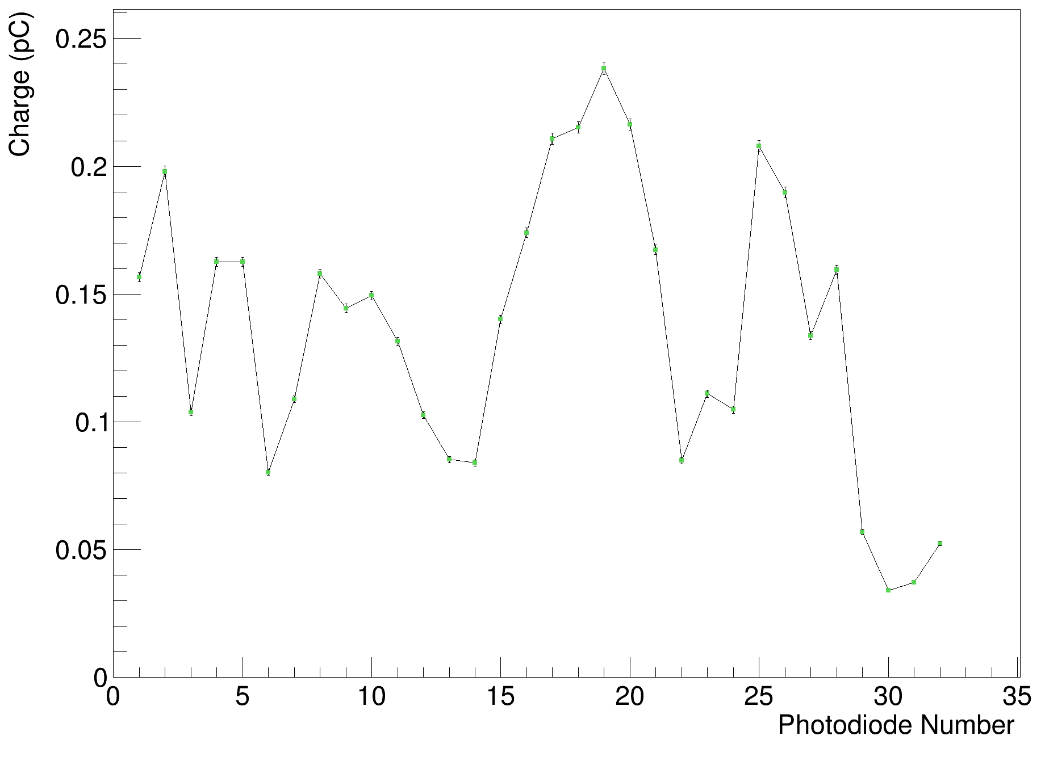
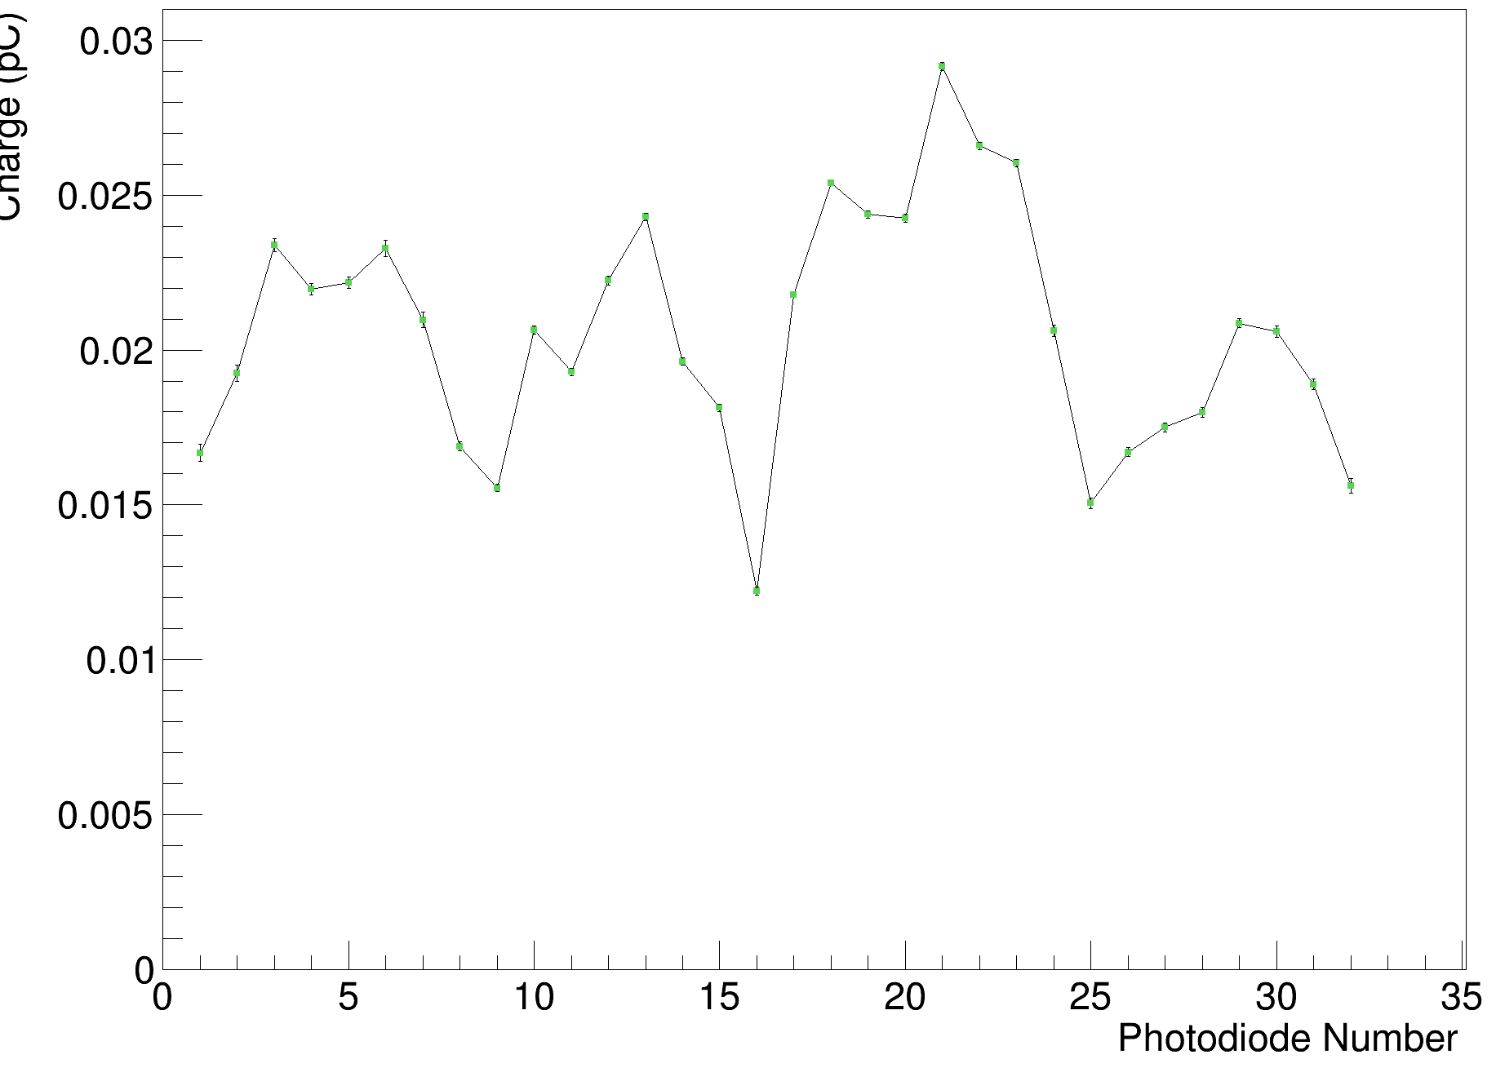
Background Comparison
15th April (CMOS sensor)
Approx. factor of 10 reduction in background noise!
2nd November (no CMOS sensor)

Slide 3
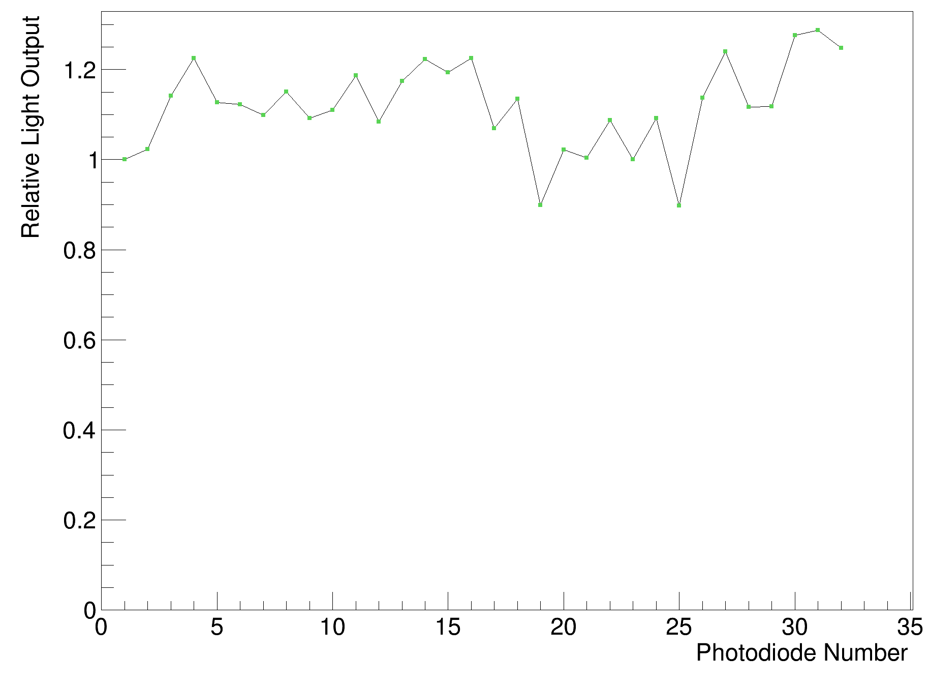
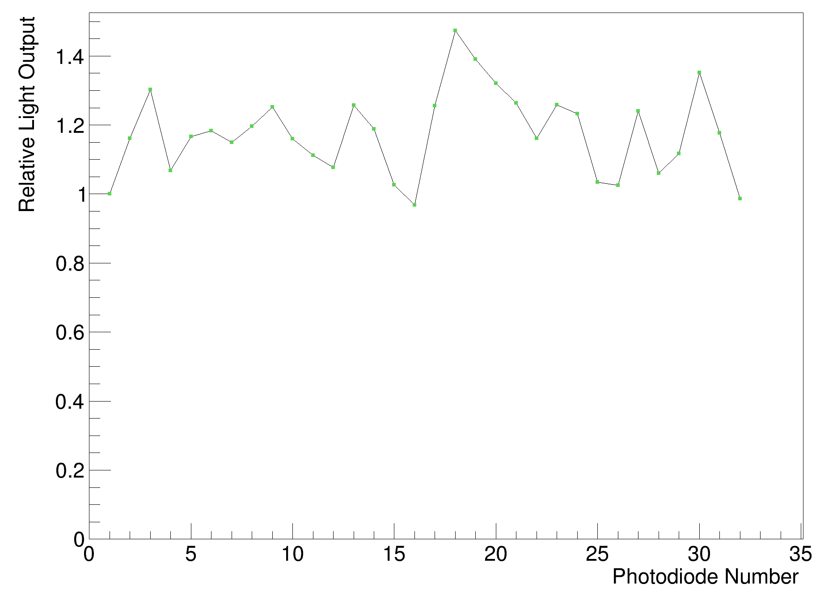
Calibration Comparison
15th April (CMOS sensor)
2nd November (no CMOS sensor)

Slide 4
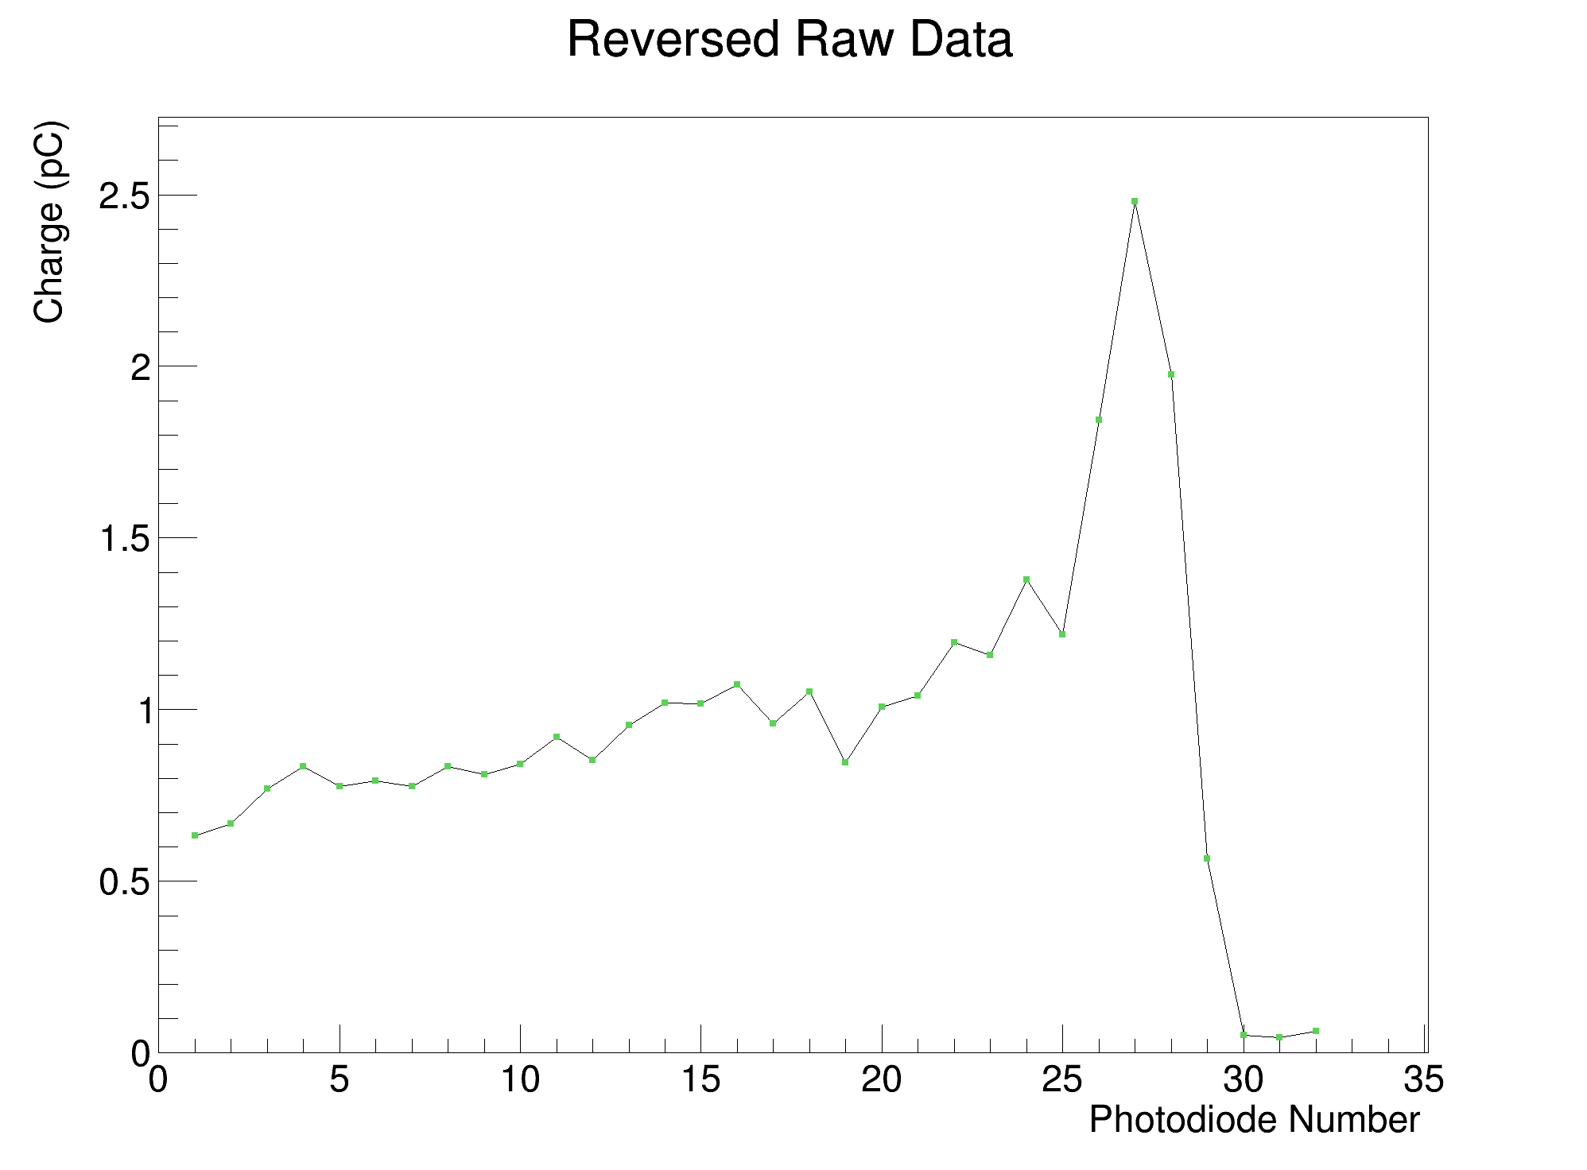
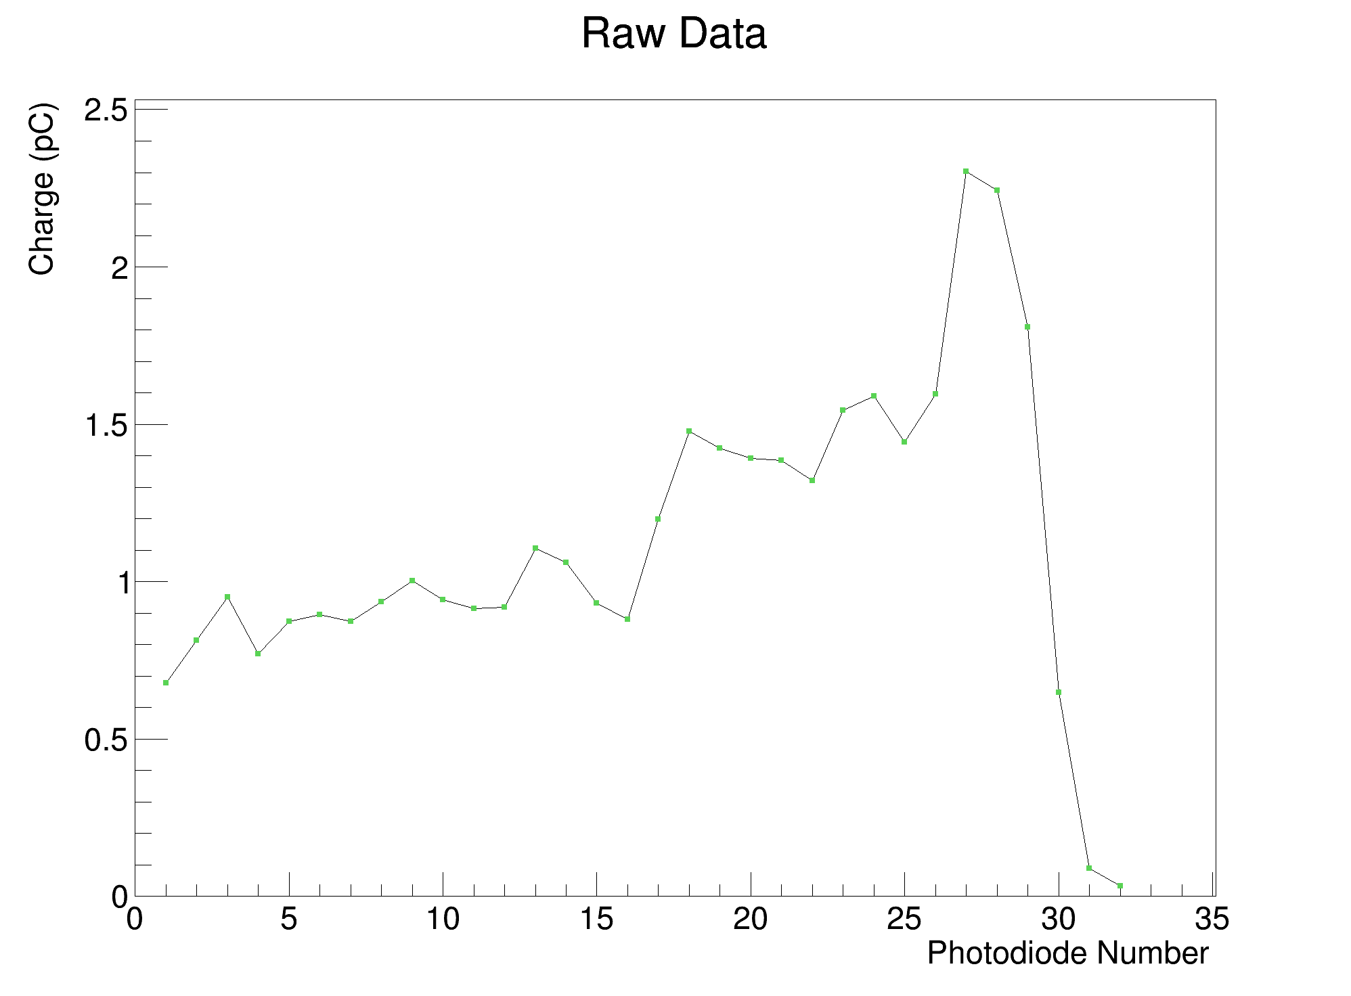
Absolute Light Output Comparison (105 MeV)
15th April (CMOS sensor)
2nd November (no CMOS sensor)
Slightly less light with white sheets (both runs 300 nA)

Slide 5
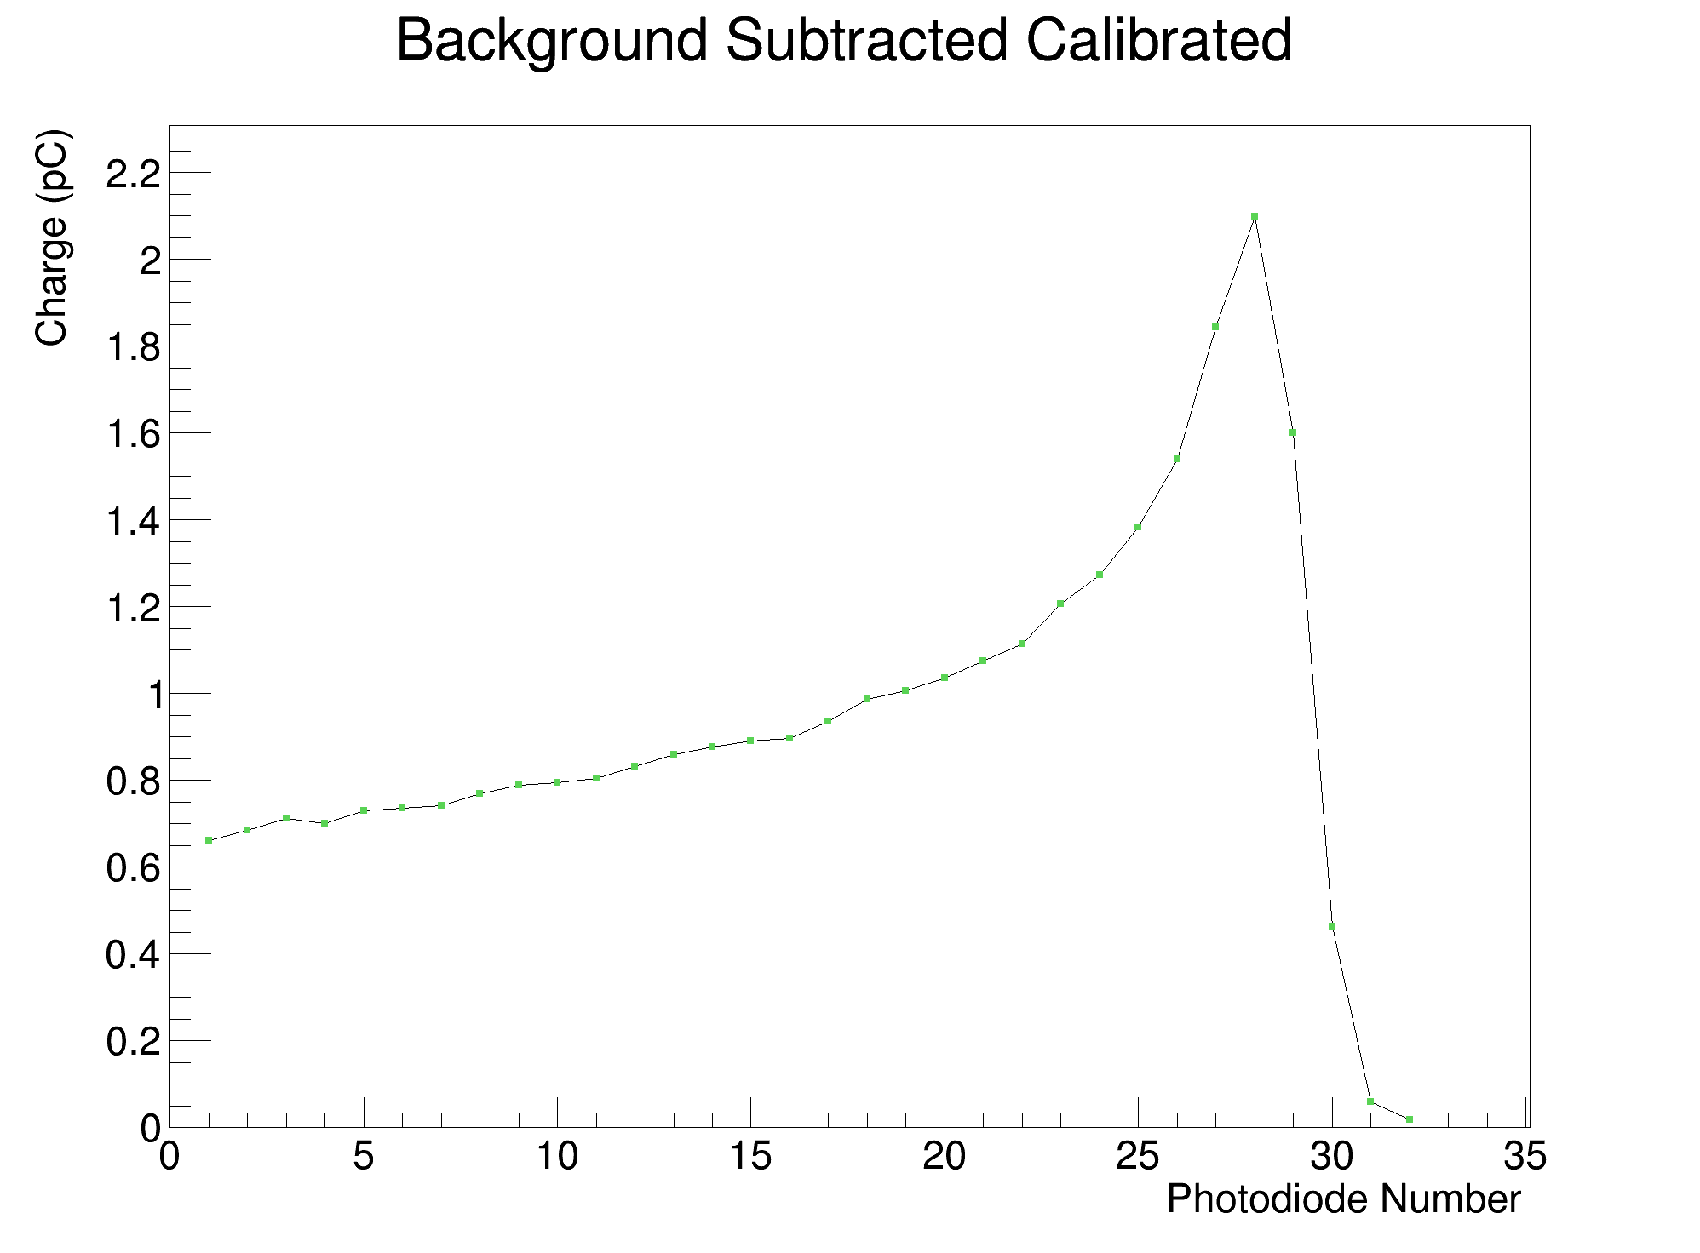
Raw Data vs. Calibrated (105 MeV)
2nd November (no CMOS sensor)

Slide 6
Calibrated PDL & Fit Comparisons
Black Sheets vs. White Sheets (vs. UCLH Reference)

Slide 7
Black Sheets (Run 26, 600 nA)
White Sheets (Run 17, 350 nA)

Slide 8
75 MeV Pencil Beam Fit
CMOS Black Sheets
Note: Additional sheet in front of stack not covered by PDs Black Sheets – reference curve shifted back in x-direction by 2.63 mm
PD White Sheets
PD Black Sheets

Slide 9
Black Sheets (Run 25, 500 nA, 1000 us)
White Sheets (Run 16, 350 nA)

Slide 10
80 MeV Pencil Beam Fit
CMOS Black Sheets
Note: Additional sheet in front of stack not covered by PDs Black Sheets – reference curve shifted back in x-direction by 2.63 mm
PD White Sheets
PD Black Sheets

Slide 11
Black Sheets (Run 23, 500 nA)
White Sheets (Run 15, 350 nA)

Slide 12
85 MeV Pencil Beam Fit
CMOS Black Sheets
Note: Additional sheet in front of stack not covered by PDs Black Sheets – reference curve shifted back in x-direction by 2.63 mm
PD White Sheets
PD Black Sheets

Slide 13
Black Sheets (Run 12, 400 nA)
White Sheets (Run 14, 350 nA)

Slide 14
90 MeV Pencil Beam Fit
CMOS Black Sheets
Note: Additional sheet in front of stack not covered by PDs Black Sheets – reference curve shifted back in x-direction by 2.63 mm
PD White Sheets
PD Black Sheets

Slide 15
Black Sheets (Run 20, 400 nA)
White Sheets (Run 13, 350 nA)

Slide 16
95 MeV Pencil Beam Fit
CMOS Black Sheets
Note: Additional sheet in front of stack not covered by PDs Black Sheets – reference curve shifted back in x-direction by 2.63 mm
PD White Sheets
PD Black Sheets

Slide 17
Black Sheets (Run 18, 200 nA)
White Sheets (Run 12, 350 nA)

Slide 18
100 MeV Pencil Beam Fit
CMOS Black Sheets
Note: Additional sheet in front of stack not covered by PDs Black Sheets – reference curve shifted back in x-direction by 2.63 mm
PD White Sheets
PD Black Sheets

Slide 19
Black Sheets (Run 7, 300 nA)
White Sheets (Run 12, 350 nA)

Slide 20
105 MeV Pencil Beam Fit
CMOS Black Sheets
Note: Additional sheet in front of stack not covered by PDs Black Sheets – reference curve shifted back in x-direction by 2.63 mm
PD Black Sheets
PD White Sheets

Slide 21
Black Sheets (Run 16, 150 nA)
White Sheets (Run 11, 350 nA)

Slide 22
110 MeV Pencil Beam Fit
CMOS Black Sheets
Note: Additional sheet in front of stack not covered by PDs Black Sheets – reference curve shifted back in x-direction by 2.63 mm
PD Black Sheets
PD White Sheets

Slide 23
Reconstructed-Reference Range Difference

Slide 24
Y-Shift
Influence on Range Reconstruction

Slide 25
+1 cm
+2 cm
+3 cm
+4 cm

Slide 26
Y-Shift Influence on Range

Slide 27
X-Shift
Influence on Range Reconstruction

Slide 28
-1 cm
-2 cm
-3 cm
-4 cm

Slide 29
+1 cm
+2 cm
+3 cm
+4 cm

Slide 30
X-Shift Influence on Range

Slide 31
Angular Rotation
Influence on Range Reconstruction

Slide 32
+0°
+2°
+5°
+10°

Slide 33
Angular Rotation Influence on Range

Slide 34
Live Fitting
Range-Step Treatment Plan

Slide 35
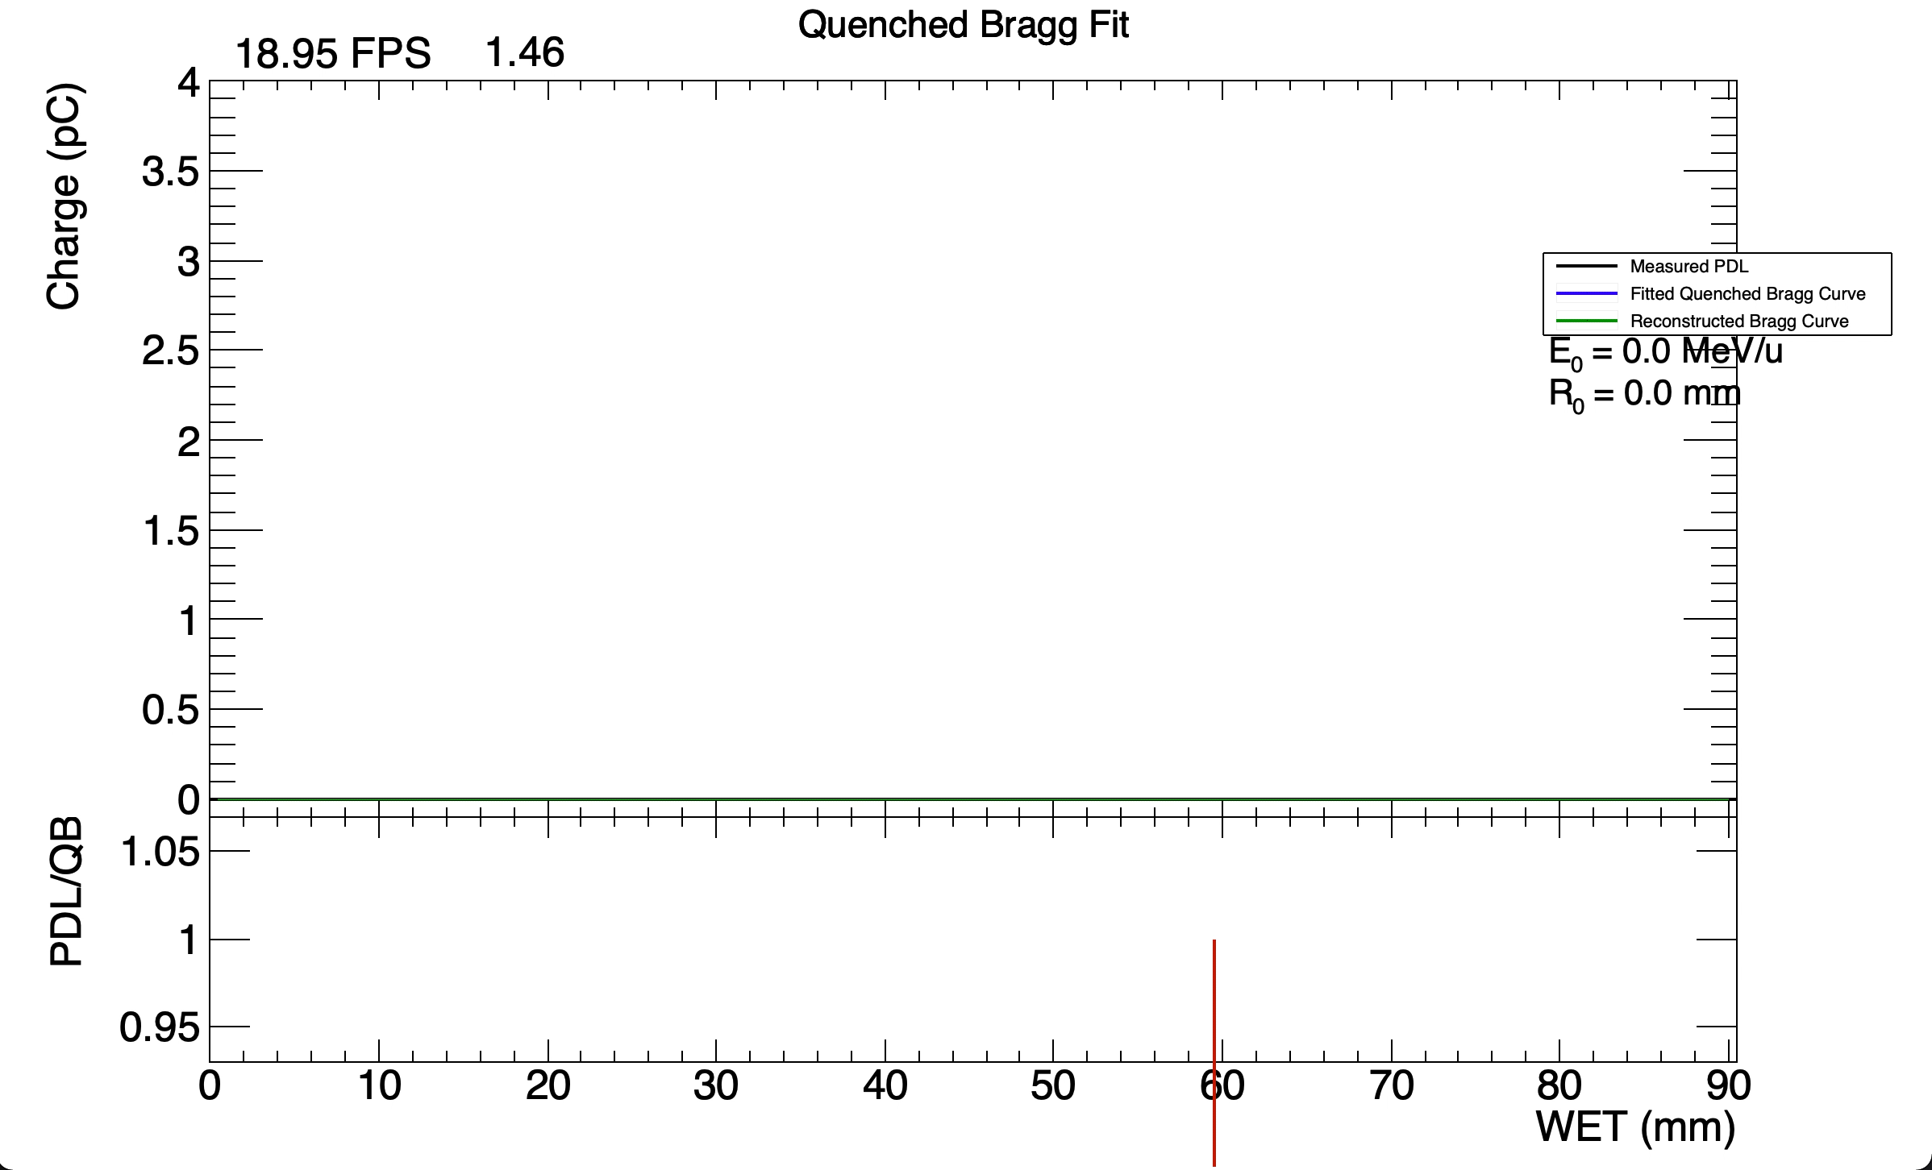
NON-BINNED FIT

Slide 36
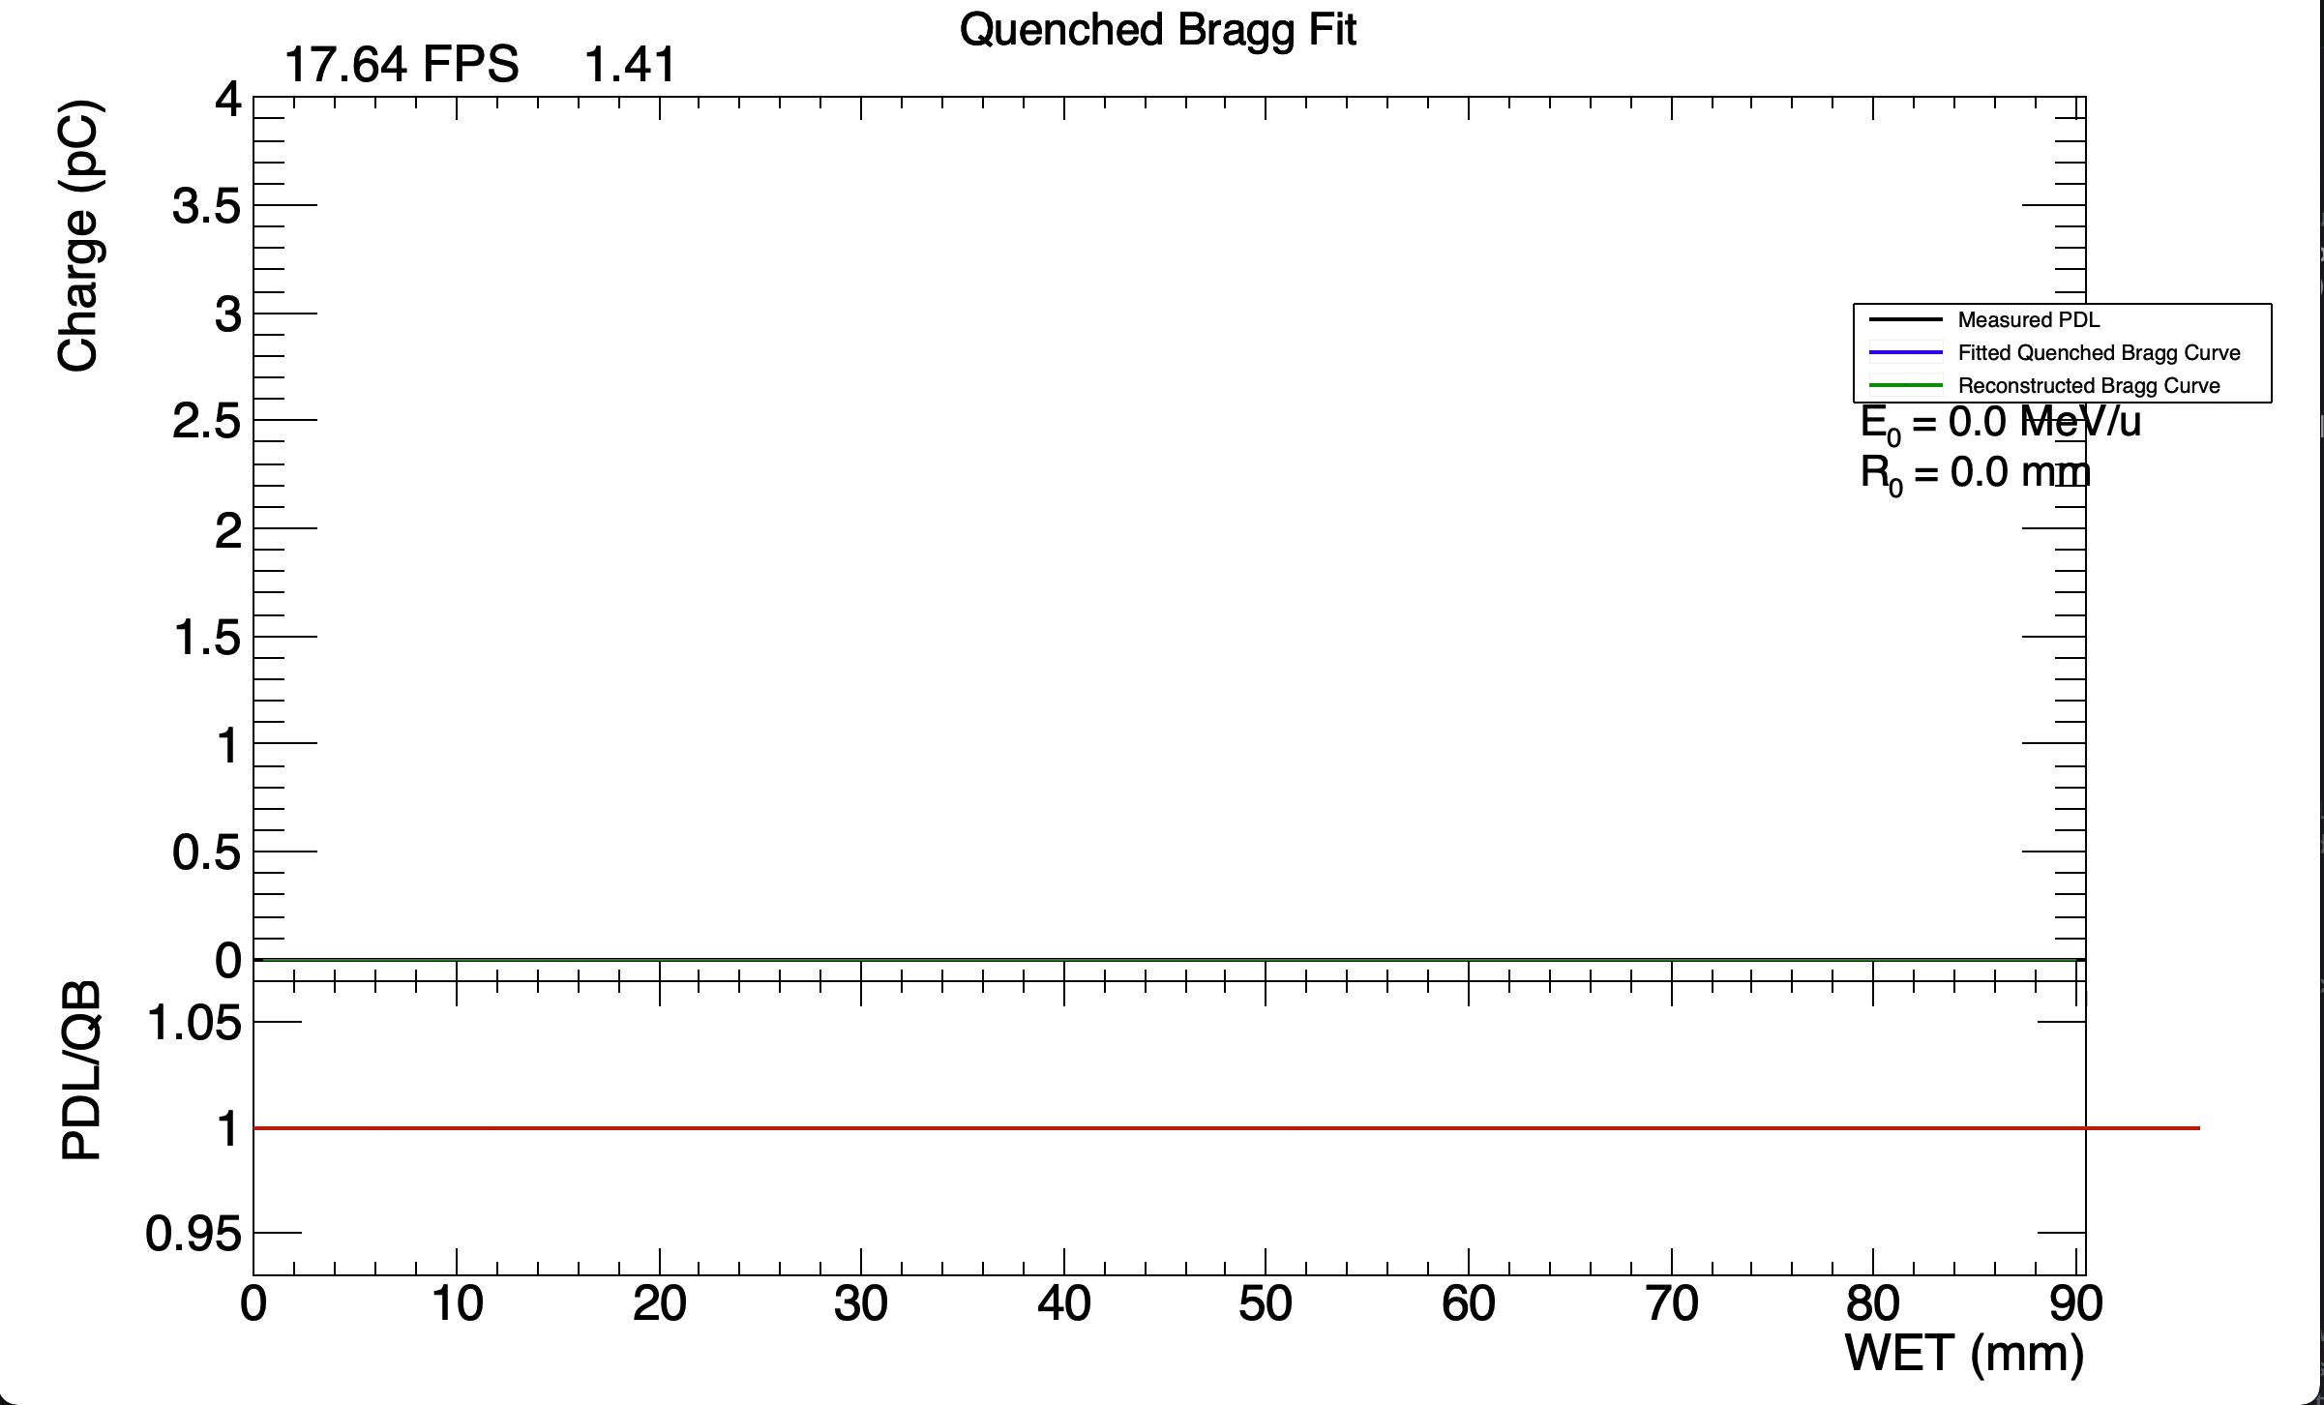
BINNED FIT

Slide 37
Conclusions
Slightly less absolute light output with white than black sheets.
  Background noise significantly reduced without CMOS sensor.
Generally worse fits with white sheets than with black sheets.
  Sigma consistently too large and range underestimated.
  Observe consistent discrepancy in PDLs.
Systematic offset of approx. 1mm compared to reference range.
  Tweaking starting value of R₀/sigma either gives no change or causes fit to fail.
Shifting beam in y-direction appears to not significantly affect range.
Strong range dependence on rotation and shifts in x-direction.
Live fitting much better with binned-fit, at the expense of frame-rate.
  Approx. 10x reduction in frame-rate (no ROOT GUI).

Slide 38
Fit to Peak
Fitting only around the Bragg Peak

Slide 41
Reference Fit
Using fixed “correct” values of sigma and range to fit kB and phi

Slide 42
75 MeV Pencil Beam Fit
Sigma = 1.0
R0 = 46.06
Sigma = 0.95
R0 = 46.06
15th April (CMOS sensor)
2nd November (Photodiodes)

Slide 43
80 MeV Pencil Beam Fit
Sigma = 1.1
R0 = 51.63
Sigma = 1.05
R0 = 51.63
15th April (CMOS sensor)
2nd November (Photodiodes)

Slide 44
85 MeV Pencil Beam Fit
Sigma = 1.25
R0 = 57.70
Sigma = 1.2
R0 = 57.70
15th April (CMOS sensor)
2nd November (Photodiodes)

Slide 45
90 MeV Pencil Beam Fit
Sigma = 1.4
R0 = 63.76
Sigma = 1.3
R0 = 63.76
15th April (CMOS sensor)
2nd November (Photodiodes)

Slide 46
95 MeV Pencil Beam Fit
Sigma = 1.55
R0 = 70.34
Sigma = 1.45
R0 = 70.34
15th April (CMOS sensor)
2nd November (Photodiodes)

Slide 47
100 MeV Pencil Beam Fit
Sigma = 1.7
R0 = 76.84
Sigma = 1.6
R0 = 76.84
15th April (CMOS sensor)
2nd November (Photodiodes)

Slide 48
105 MeV Pencil Beam Fit
Sigma = 1.7
R0 = 84.11
Sigma = 1.8
R0 = 84.11
15th April (CMOS sensor)
2nd November (Photodiodes)

Slide 49
110 MeV Pencil Beam Fit
Sigma = 1.9
R0 = 91.13
Sigma = 1.8
R0 = 91.13
15th April (CMOS sensor)
2nd November (no CMOS sensor)

