Slide 1
UCLH Analysis
2nd November 2021 Experiment
Nikon Images

Slide 2
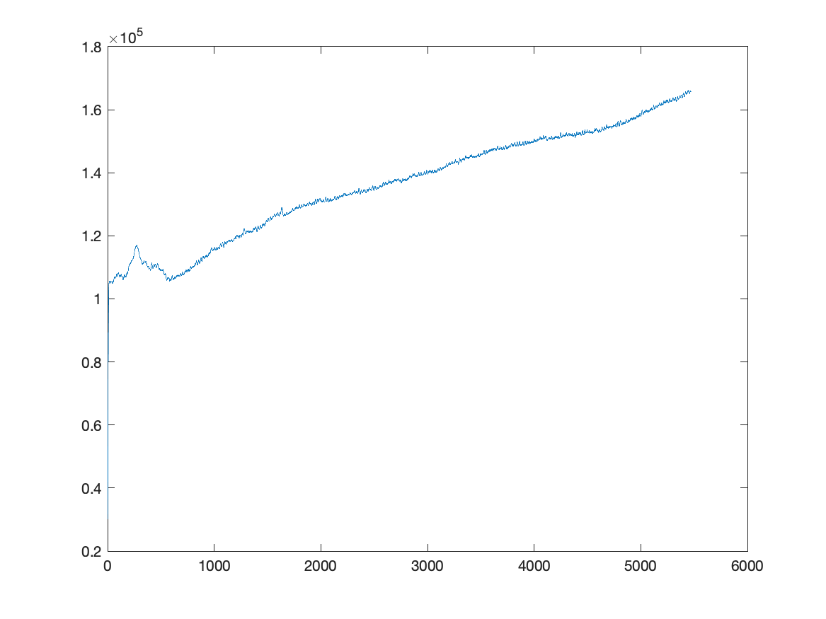
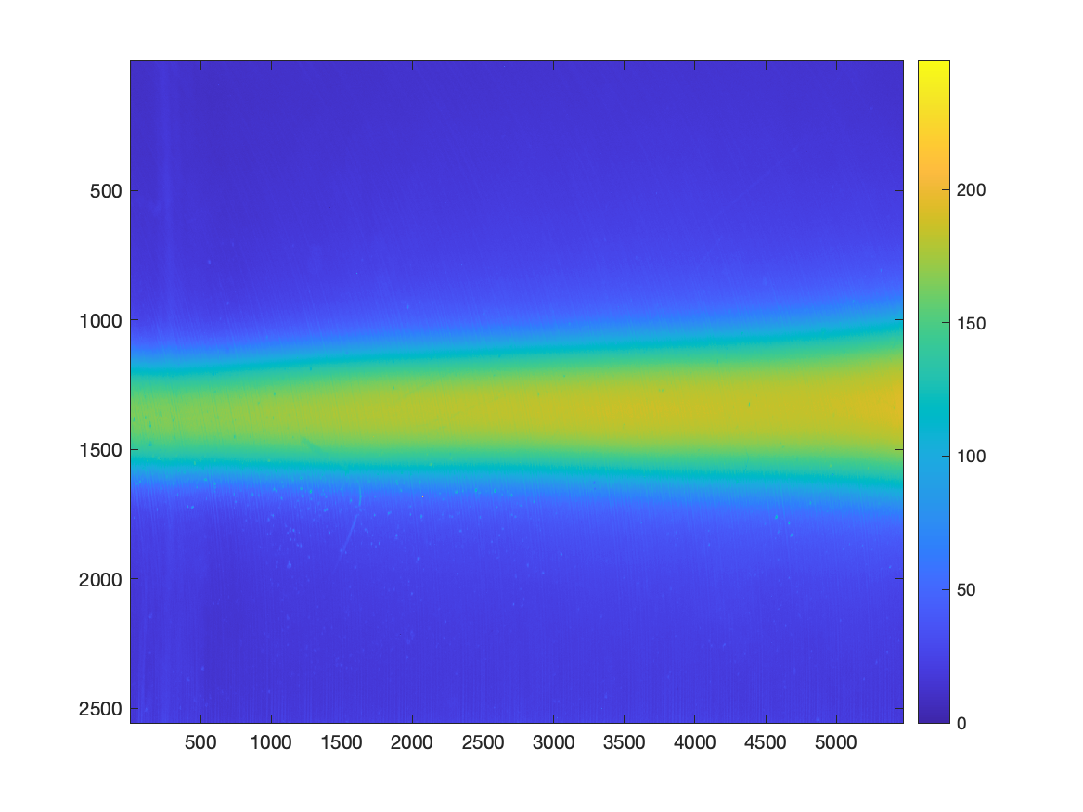
DSC_1628 (160 MeV, 125 nA, 1s)

Slide 3
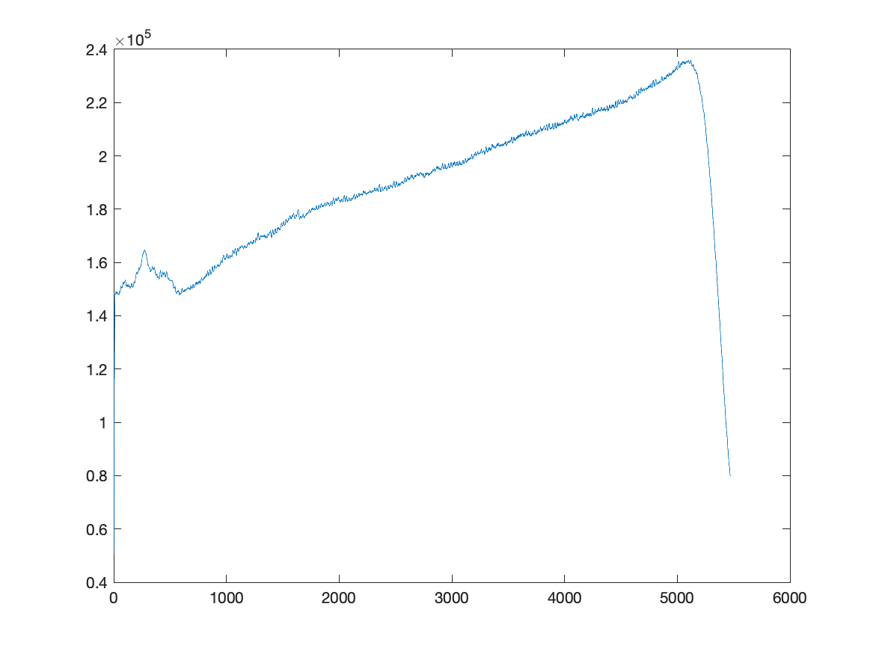
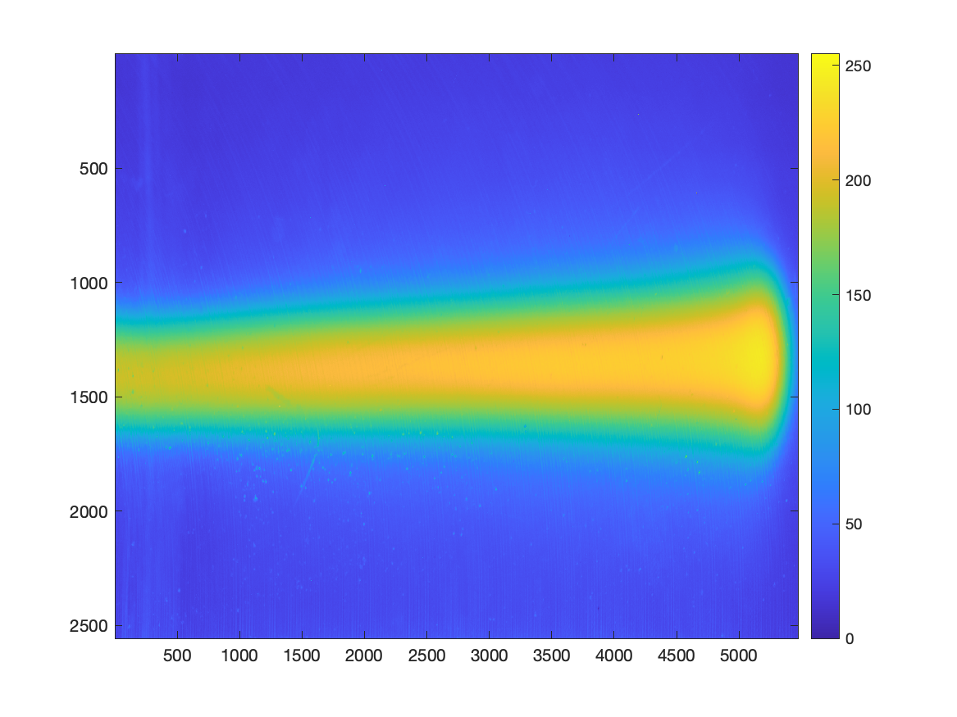
DSC_1629 (150 MeV, 125 nA, 2s)

Slide 4
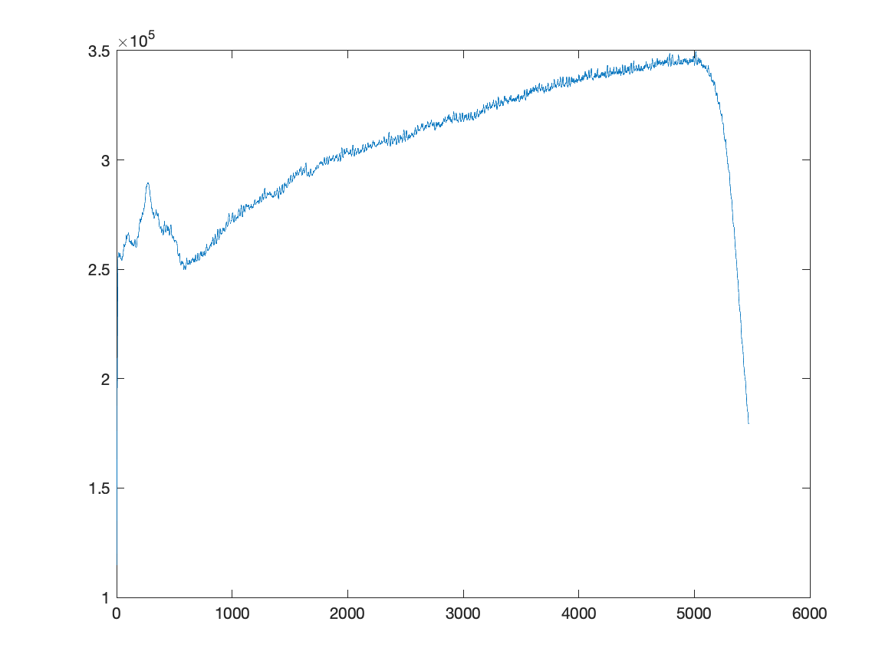
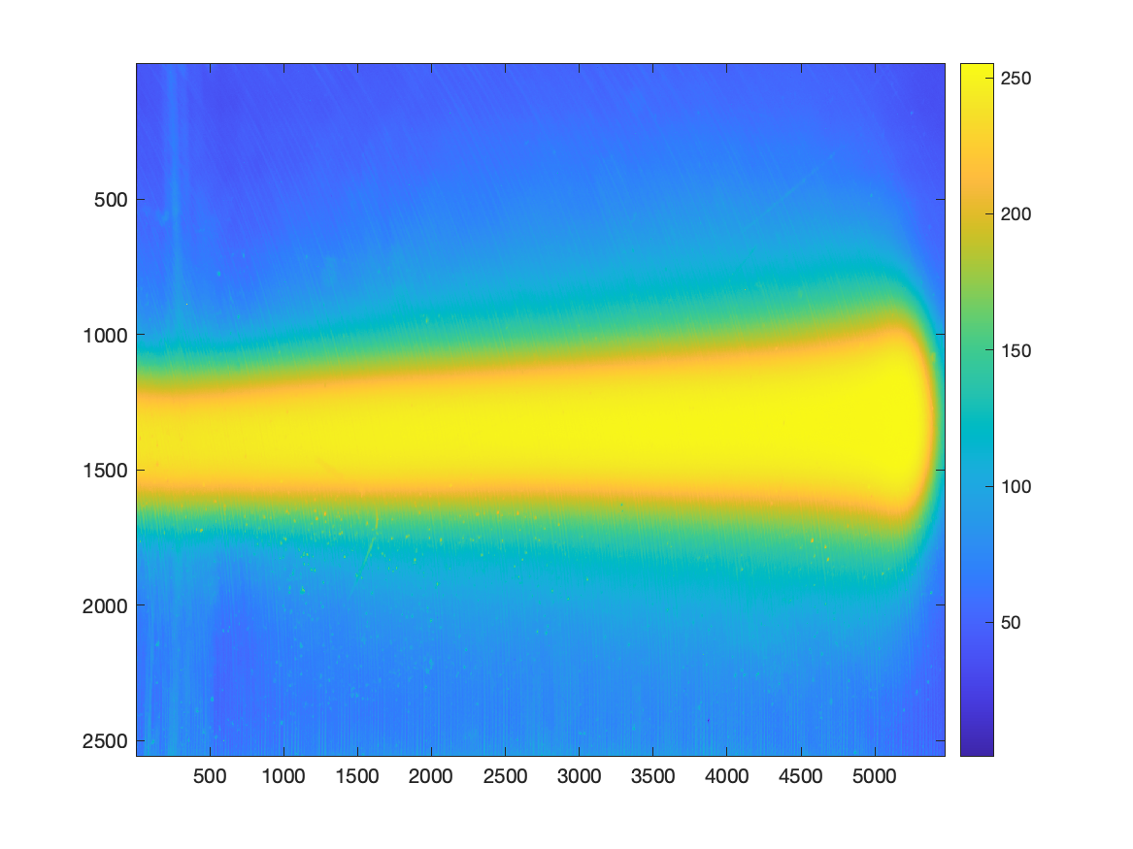
DSC_1630 (150 MeV, 125 nA, 5s)

Slide 5
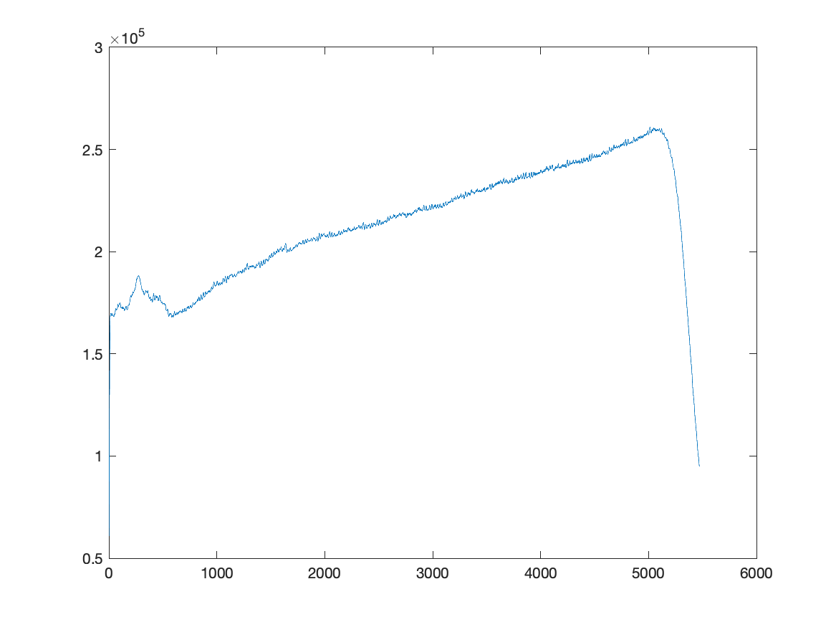
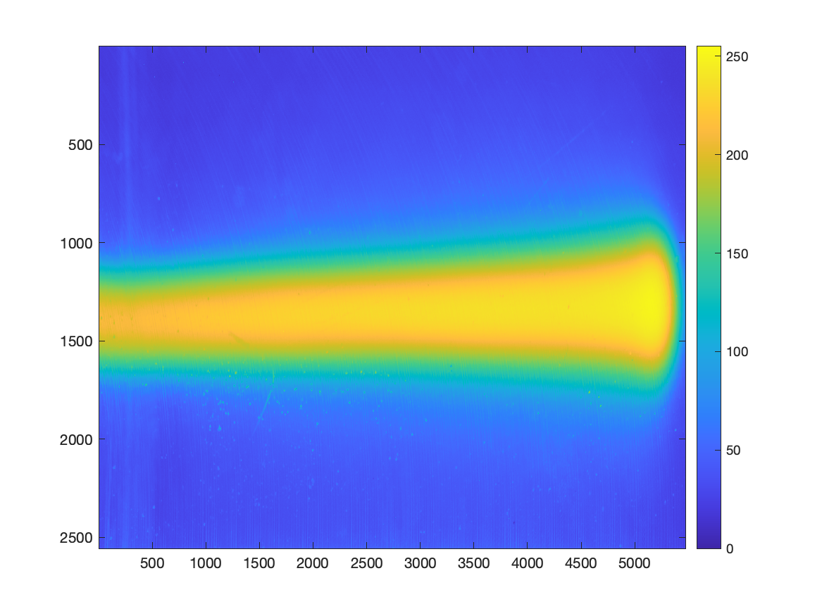
DSC_1631 (150 MeV, 125 nA, 2.5s)

Slide 6
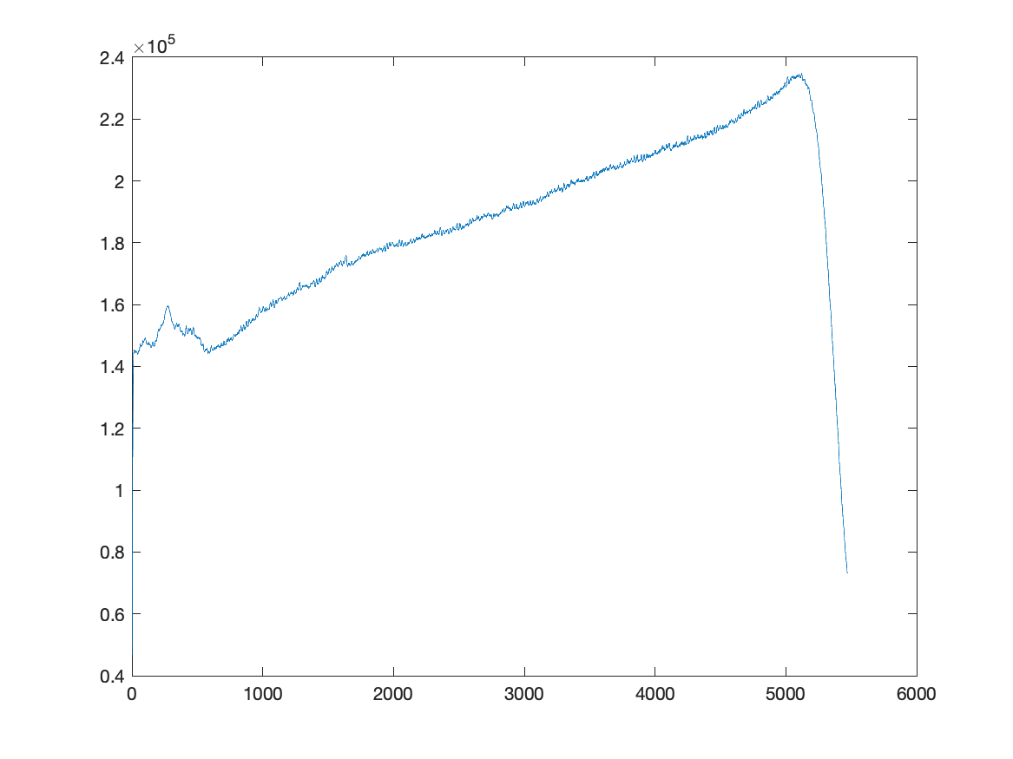
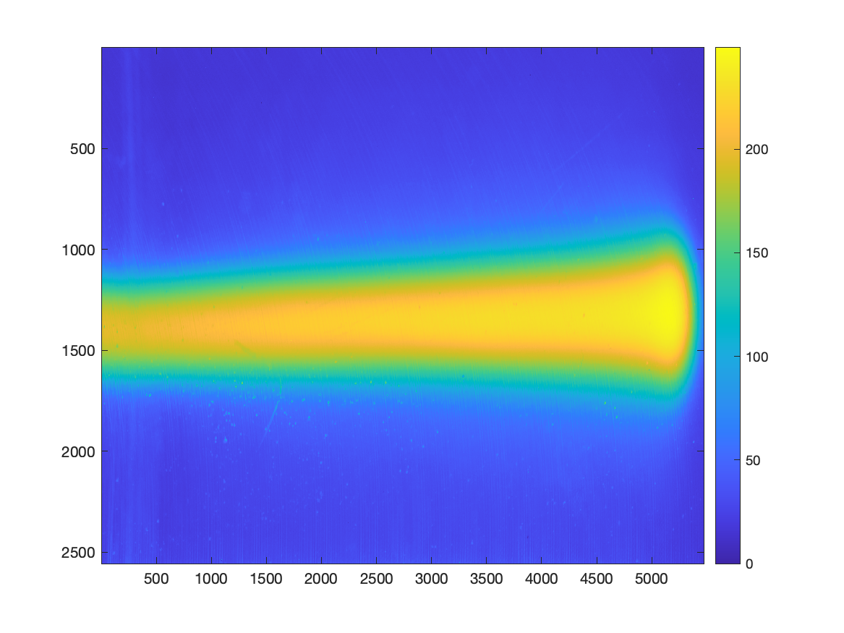
DSC_1632 (150 MeV, 125 nA, 2s)

Slide 7
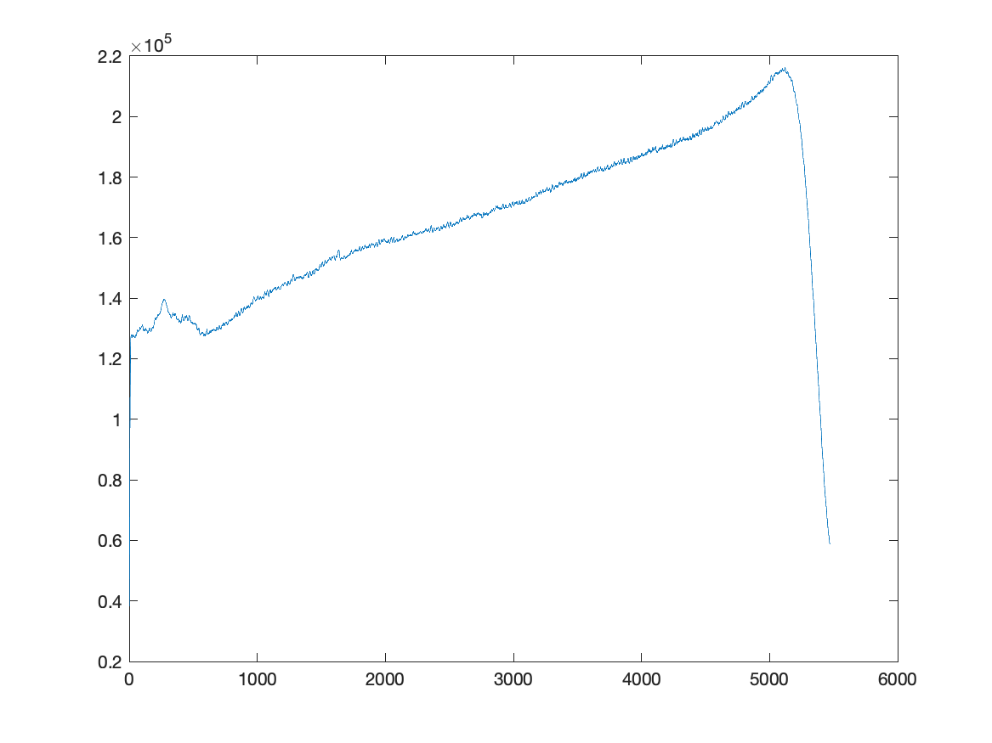
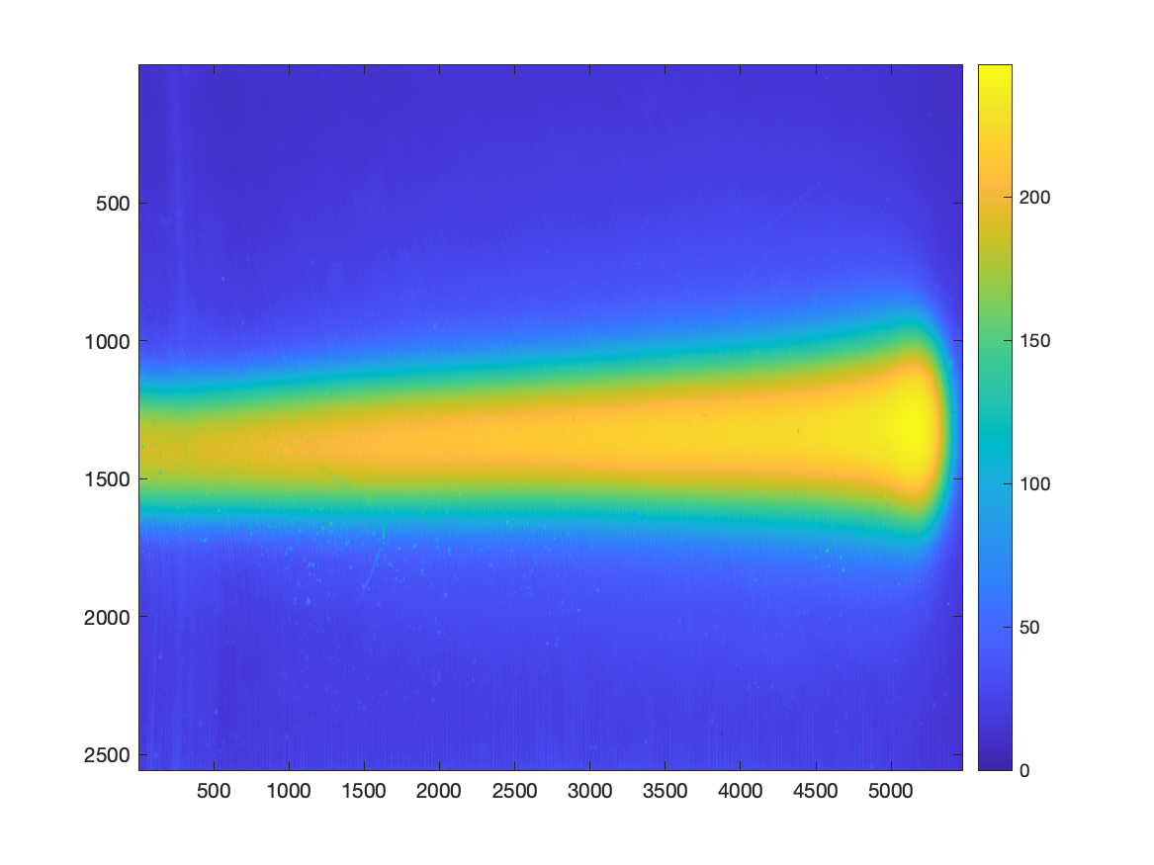
DSC_1633 (150 MeV, 125 nA, 1.6s)

Slide 8
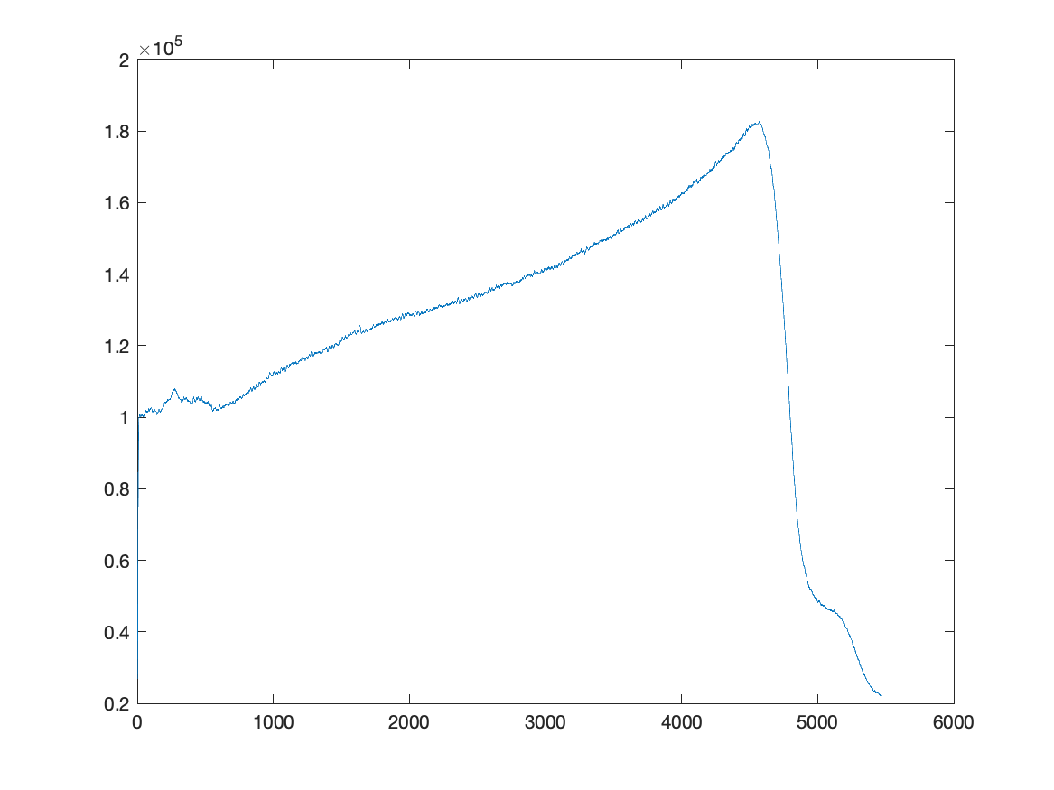
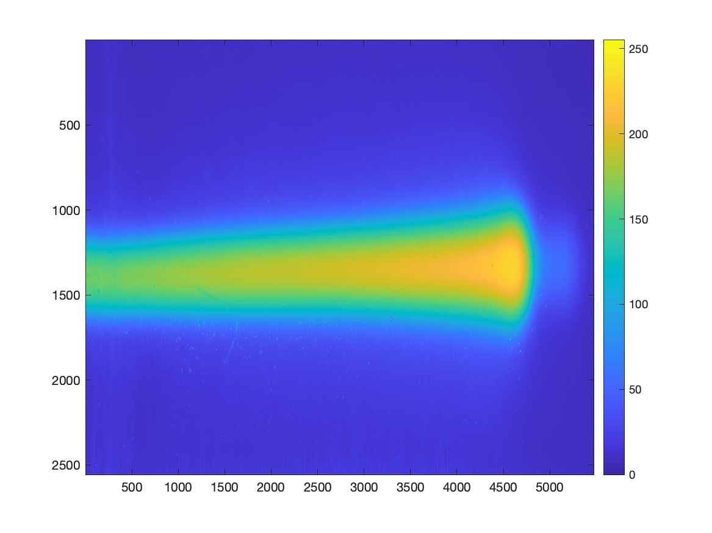
DSC_1634 (140 MeV, 165 nA, 1s)

Slide 9
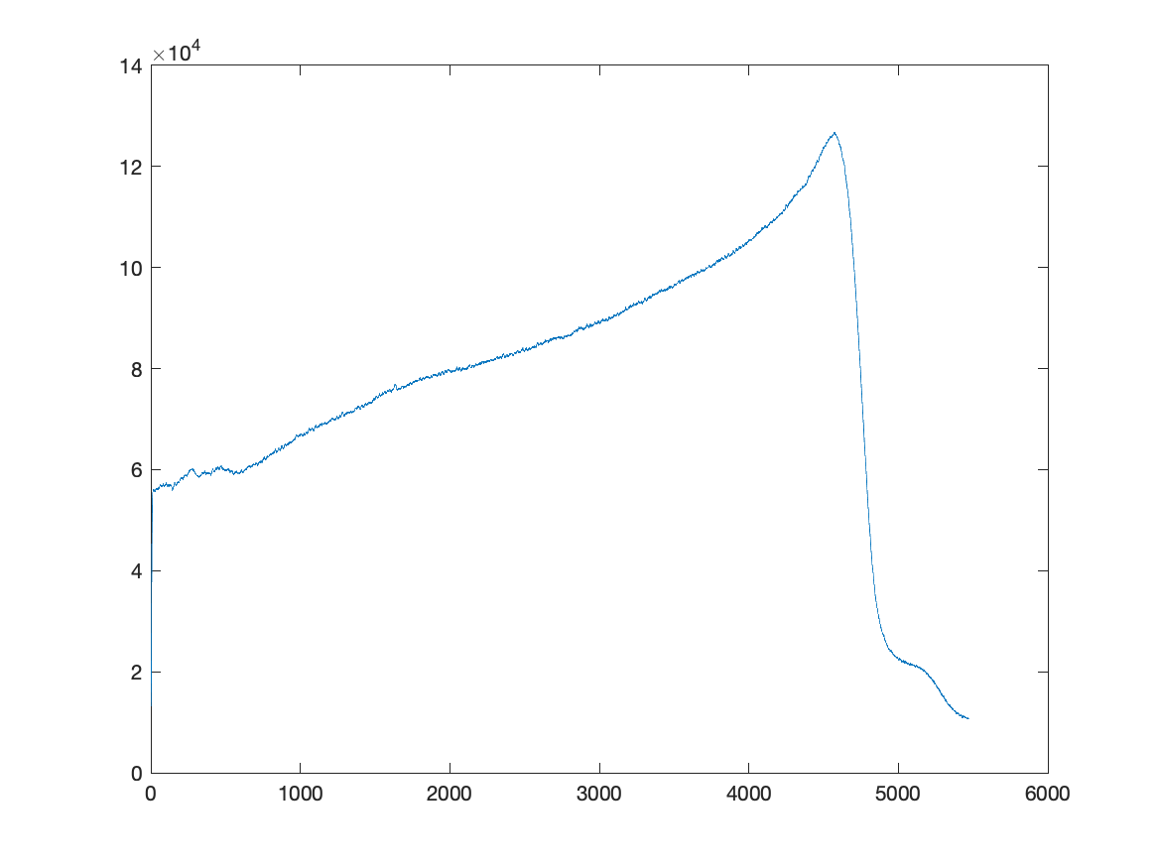
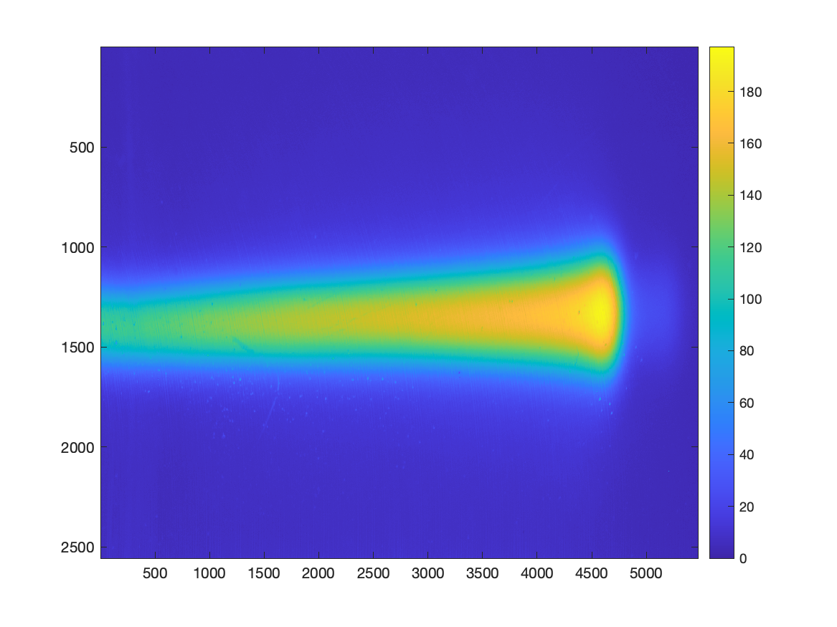
DSC_1635 (140 MeV, 165 nA, 0.5s)

Slide 10
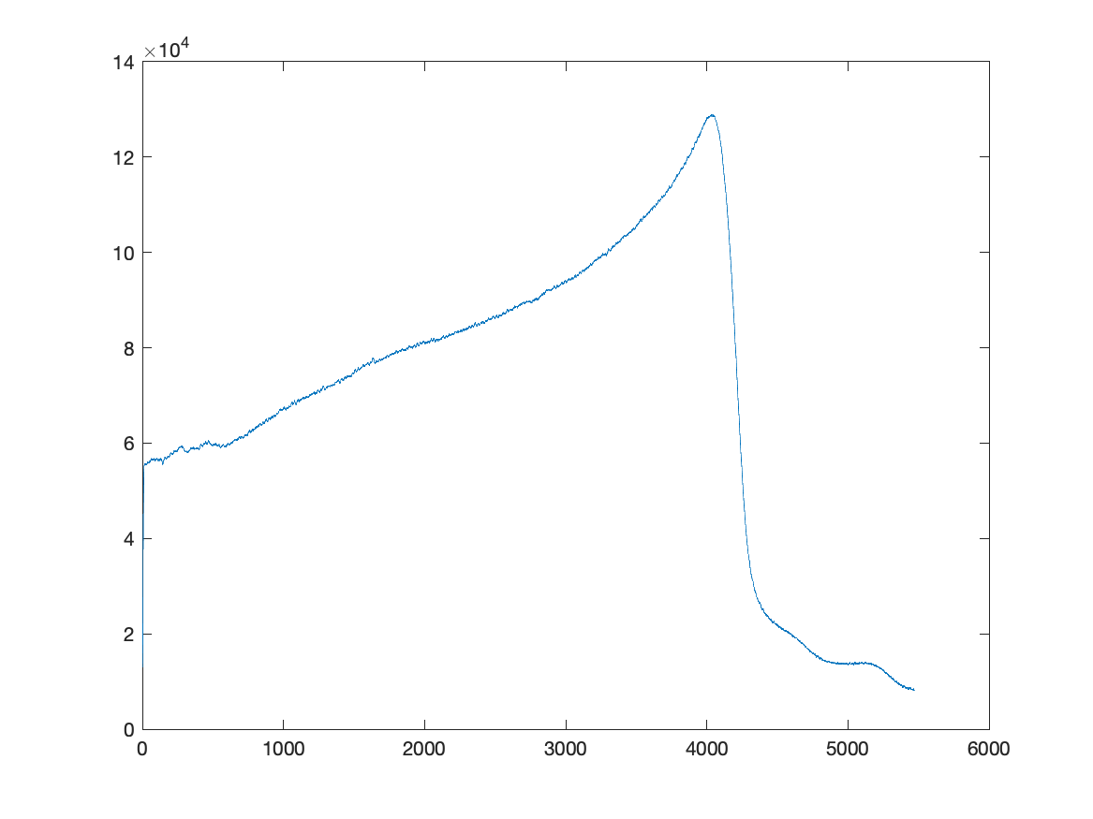
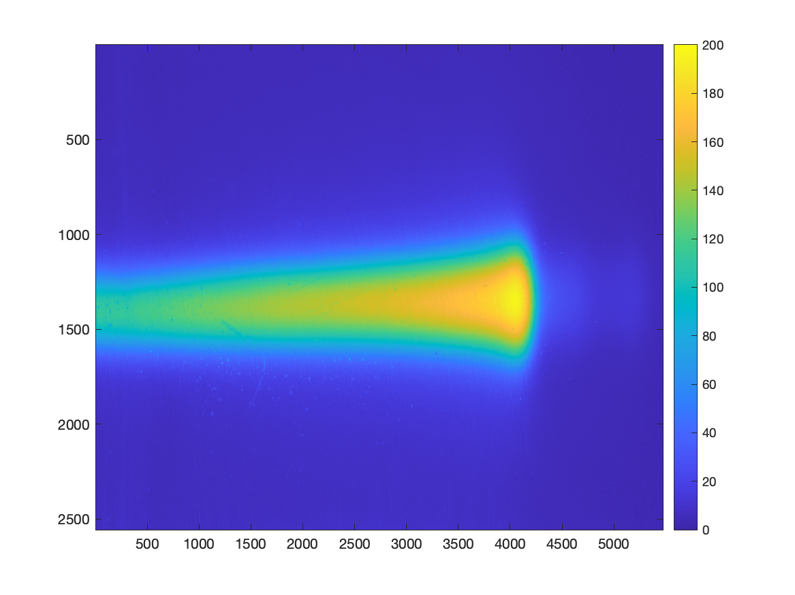
DSC_1636 (130 MeV, 200 nA, 0.5s)

Slide 11
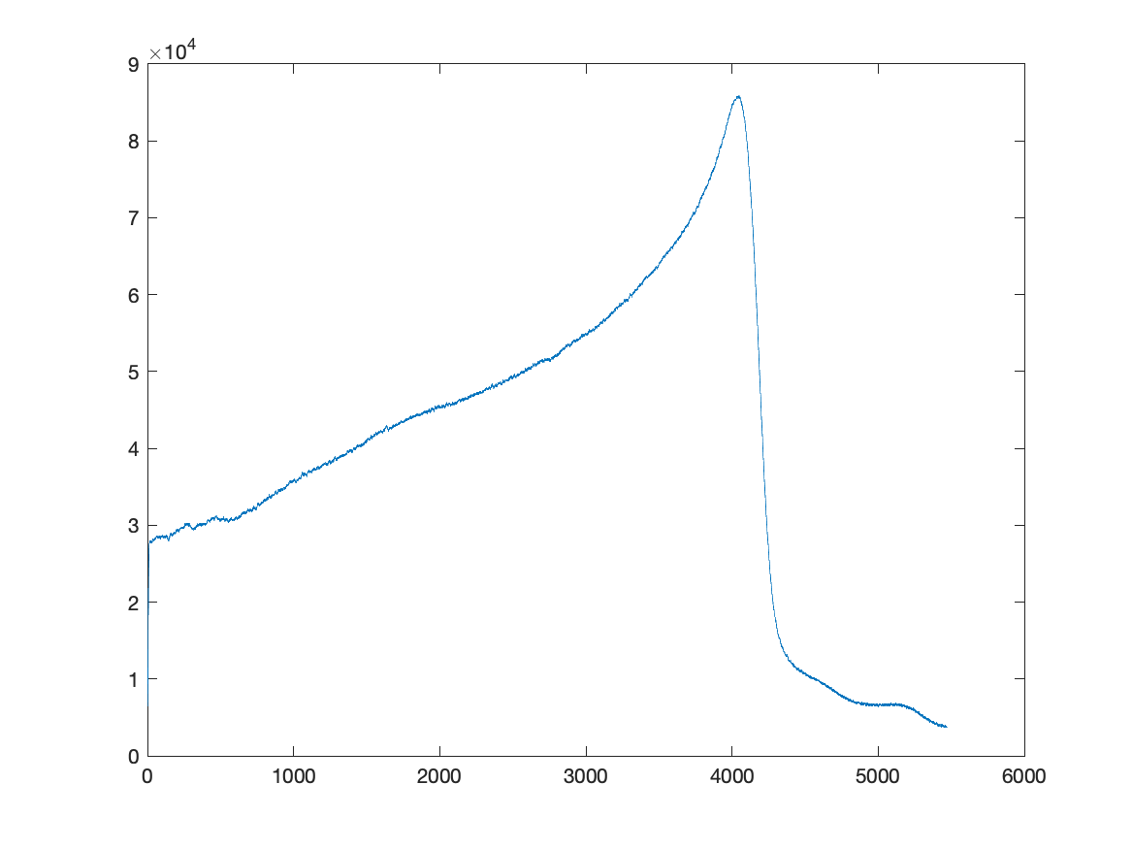
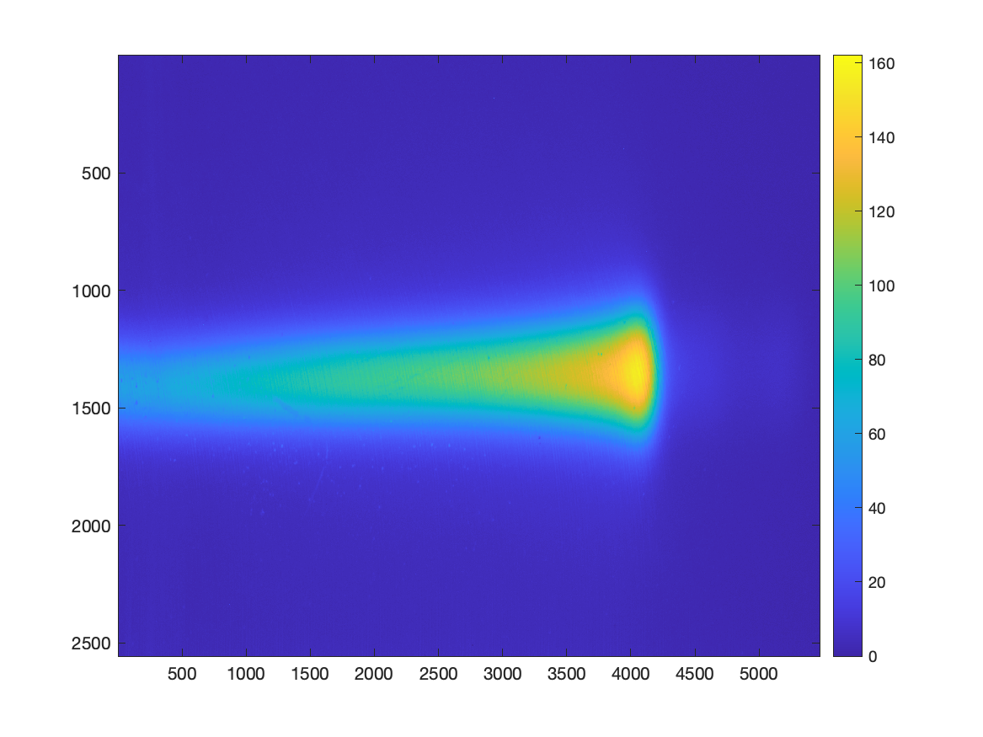
DSC_1637 (130 MeV, 200 nA, 0.25s)

Slide 12
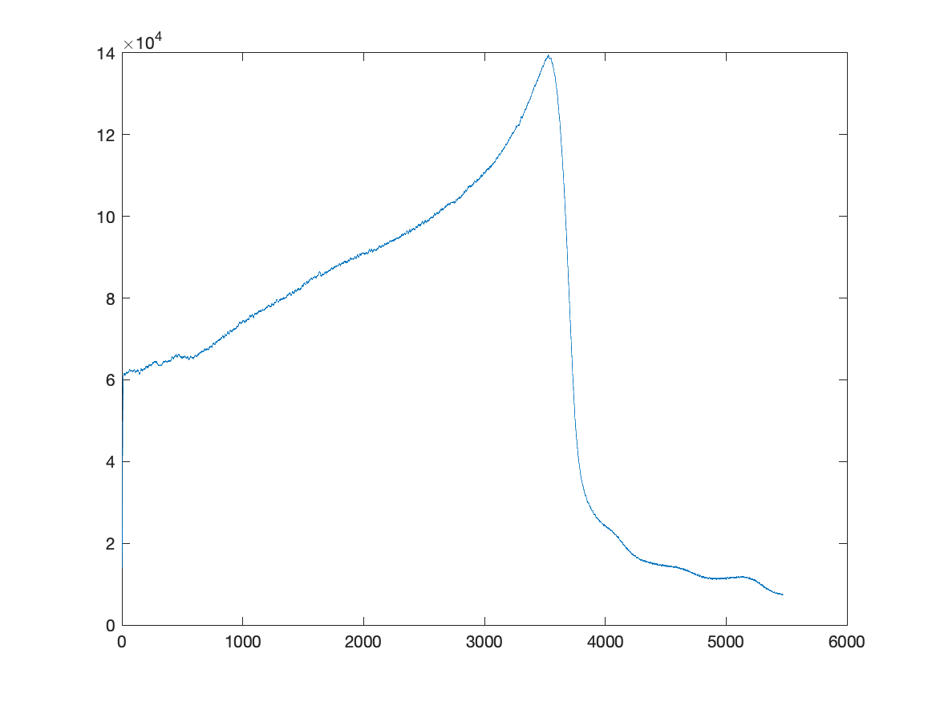
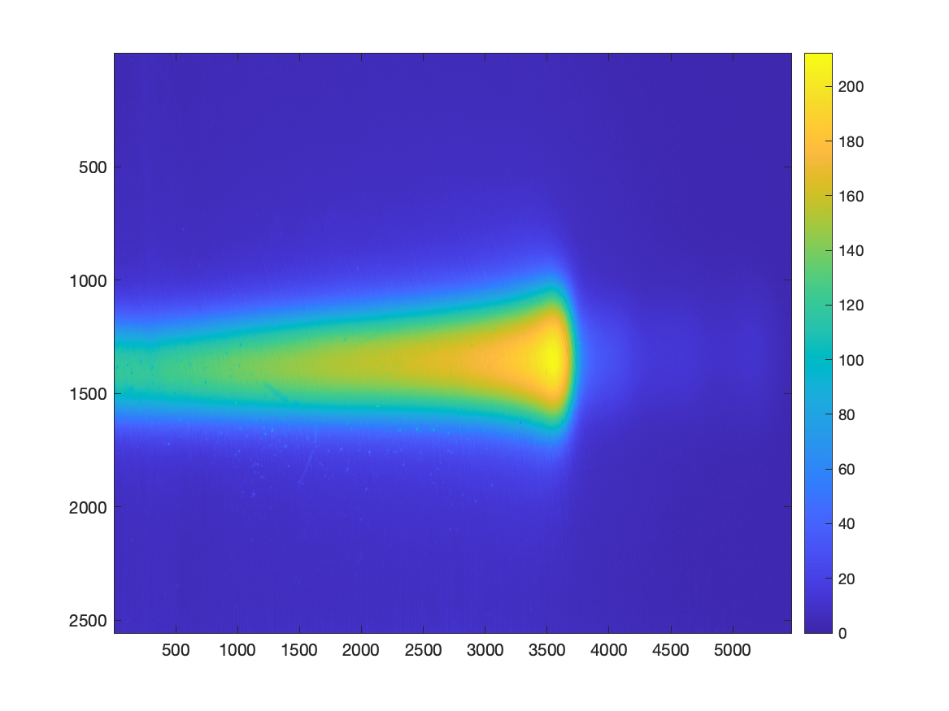
DSC_1638 (120 MeV, 270 nA, 0.5s)

Slide 13
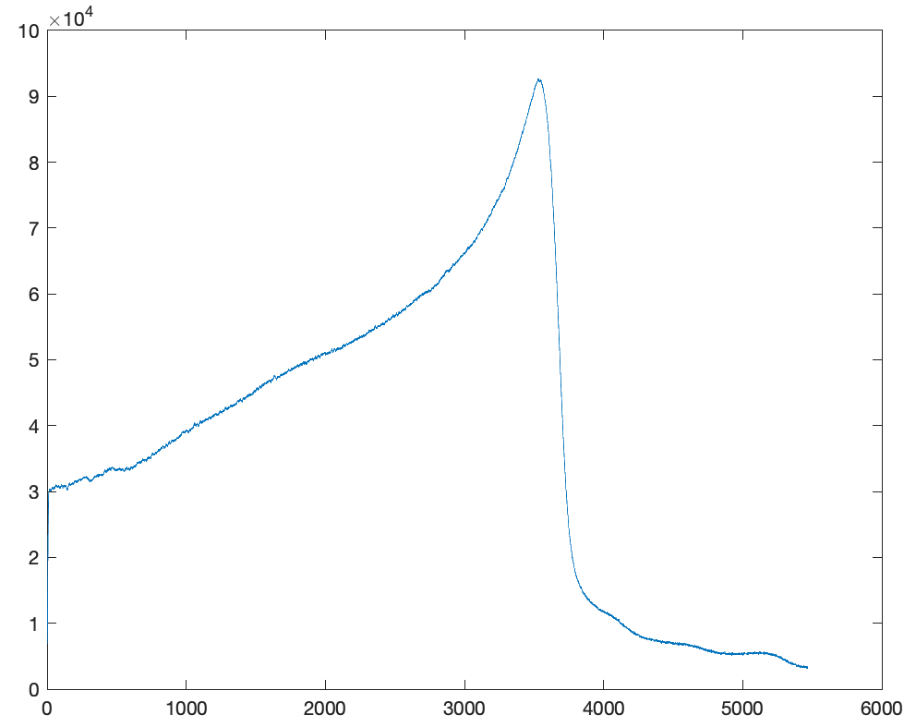
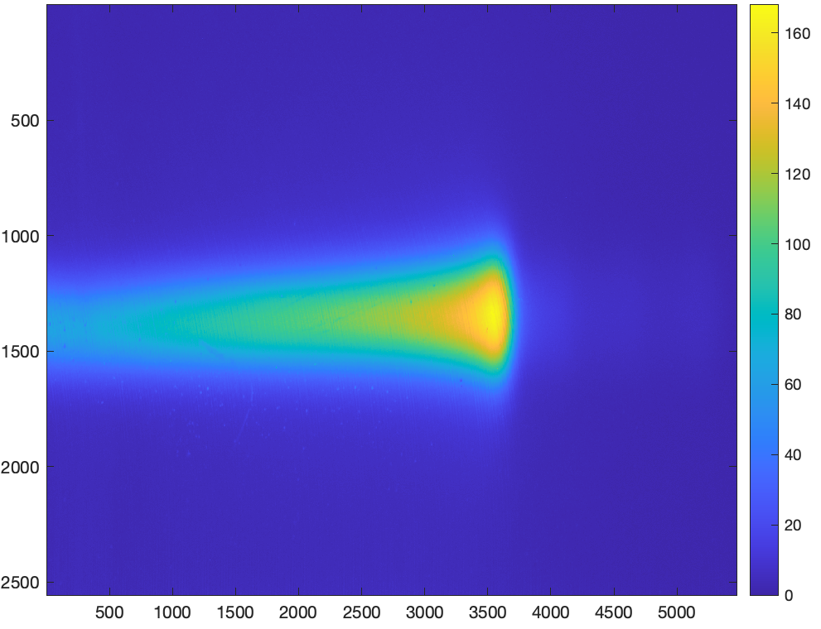
DSC_1639 (120 MeV, 270 nA, 0.25s)

Slide 14
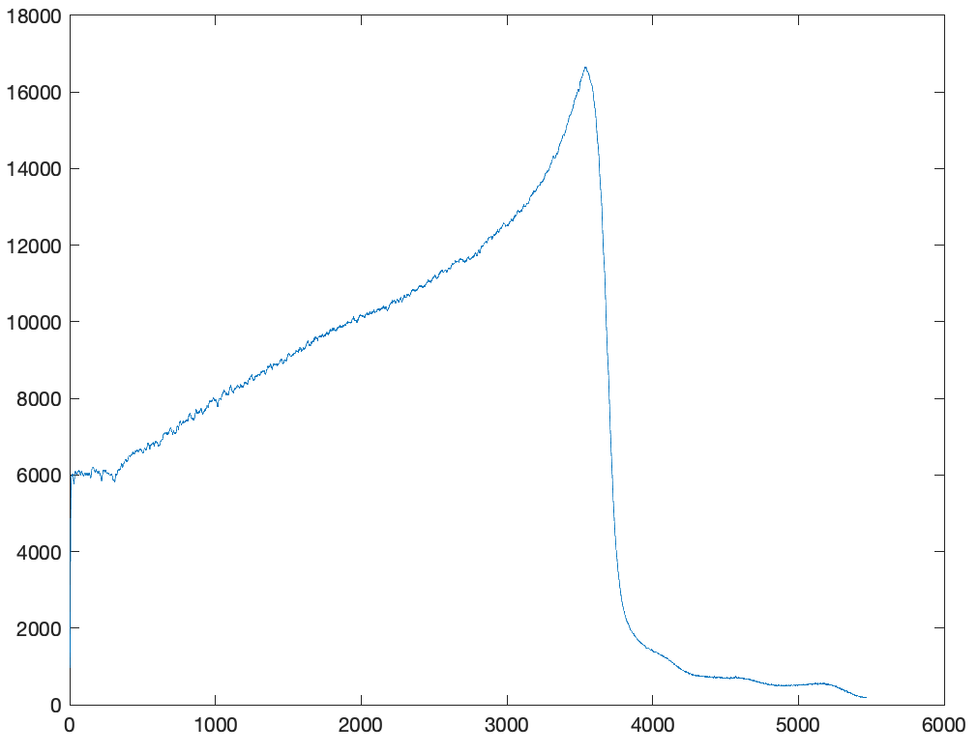
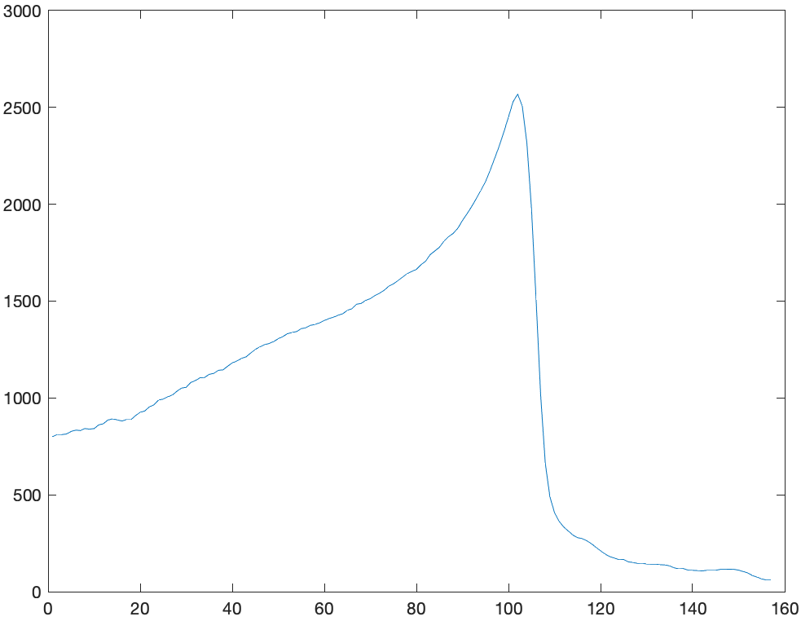
DSC_1639 (120 MeV, 270 nA, 0.25s)
JPG Full Image
JPG Centre Strip (100 pixels)
NEF Full Image

Slide 15
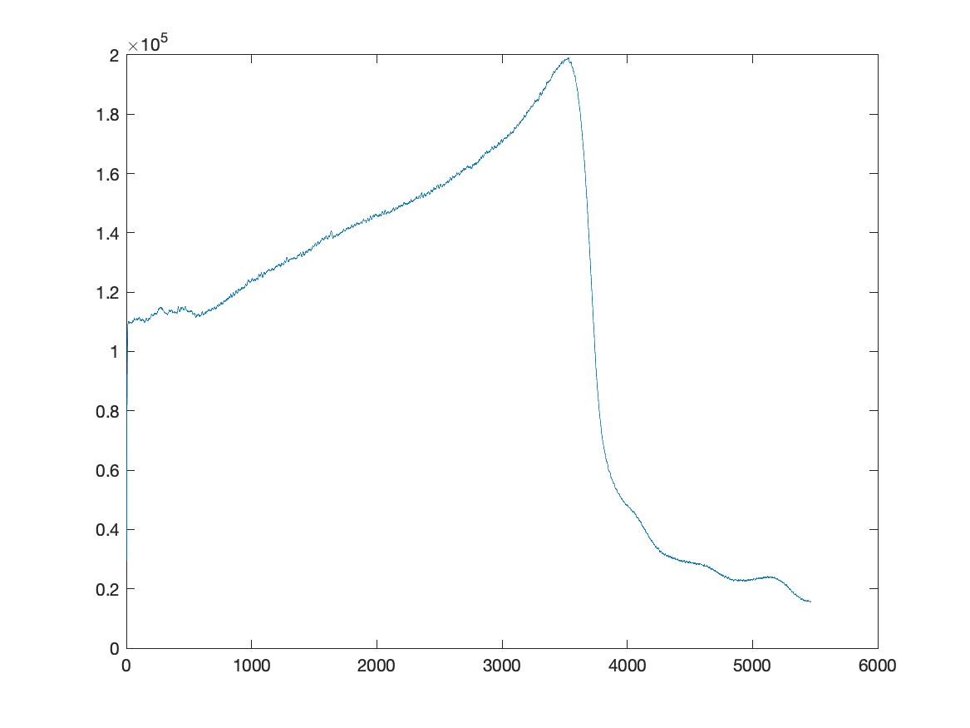
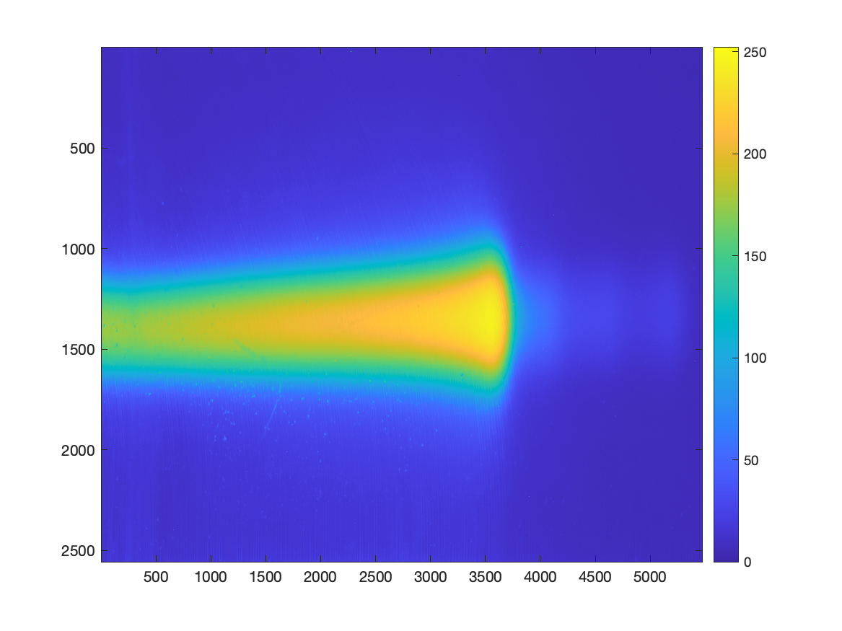
DSC_1640 (120 MeV, 270 nA, 1s)

Slide 16
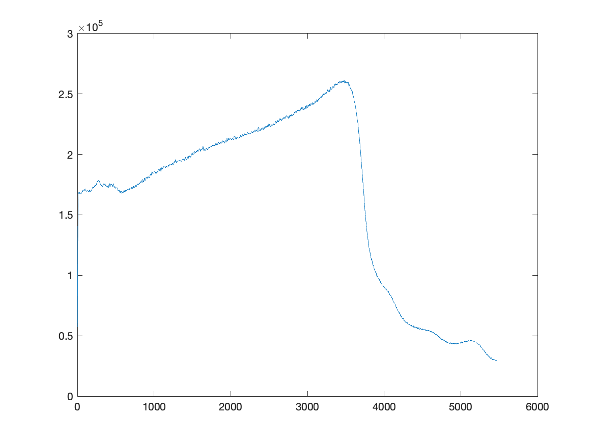
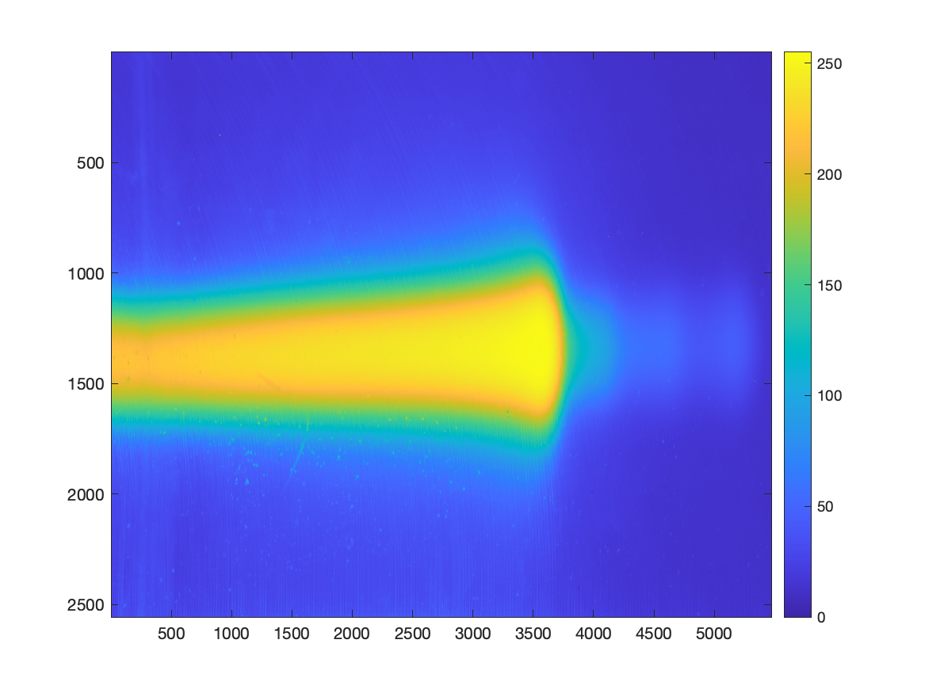
DSC_1641 (120 MeV, 270 nA, 2s)

Slide 17
Conclusions
Most images are saturated and therefore do not provide useful information from fitting.
In future, recommended to use shutter speed around 0.1s.
No significant difference from using full image vs. central stripe or from using JPG vs. NEF formats.

