Slide 1
LED Lab Tests
Optical Isolation Tests to Measure Light Levels and Cross-Talk

Slide 2
Setup
Testing optical isolation of stack of unpainted scintillator sheets using layers of material between sheets.
Mechanically easier than wrapping and do not risk damage to scintillator sheets from painting.
Materials used:
  White Paper (0.1 mm thick)
  Black Card (0.2 mm thick)
  Mylar Foil (0.006 mm thick)
Inject light with LED fibre: 500 kHz, 6 V amplitude, 300 ns width.
  Inject parallel and perpendicular to photodiode face.

Slide 3

Setup
LED FIBRE
LED FIBRE
MISC. SHEETS
MISC. SHEETS
PHOTODIODES
MATERIAL

Slide 4
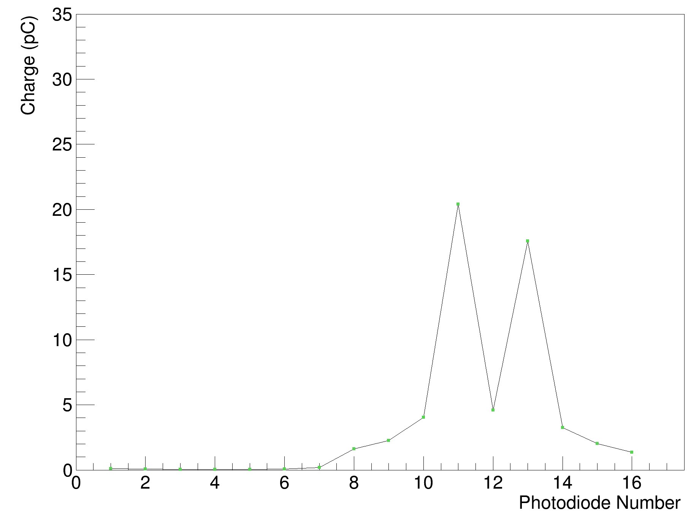

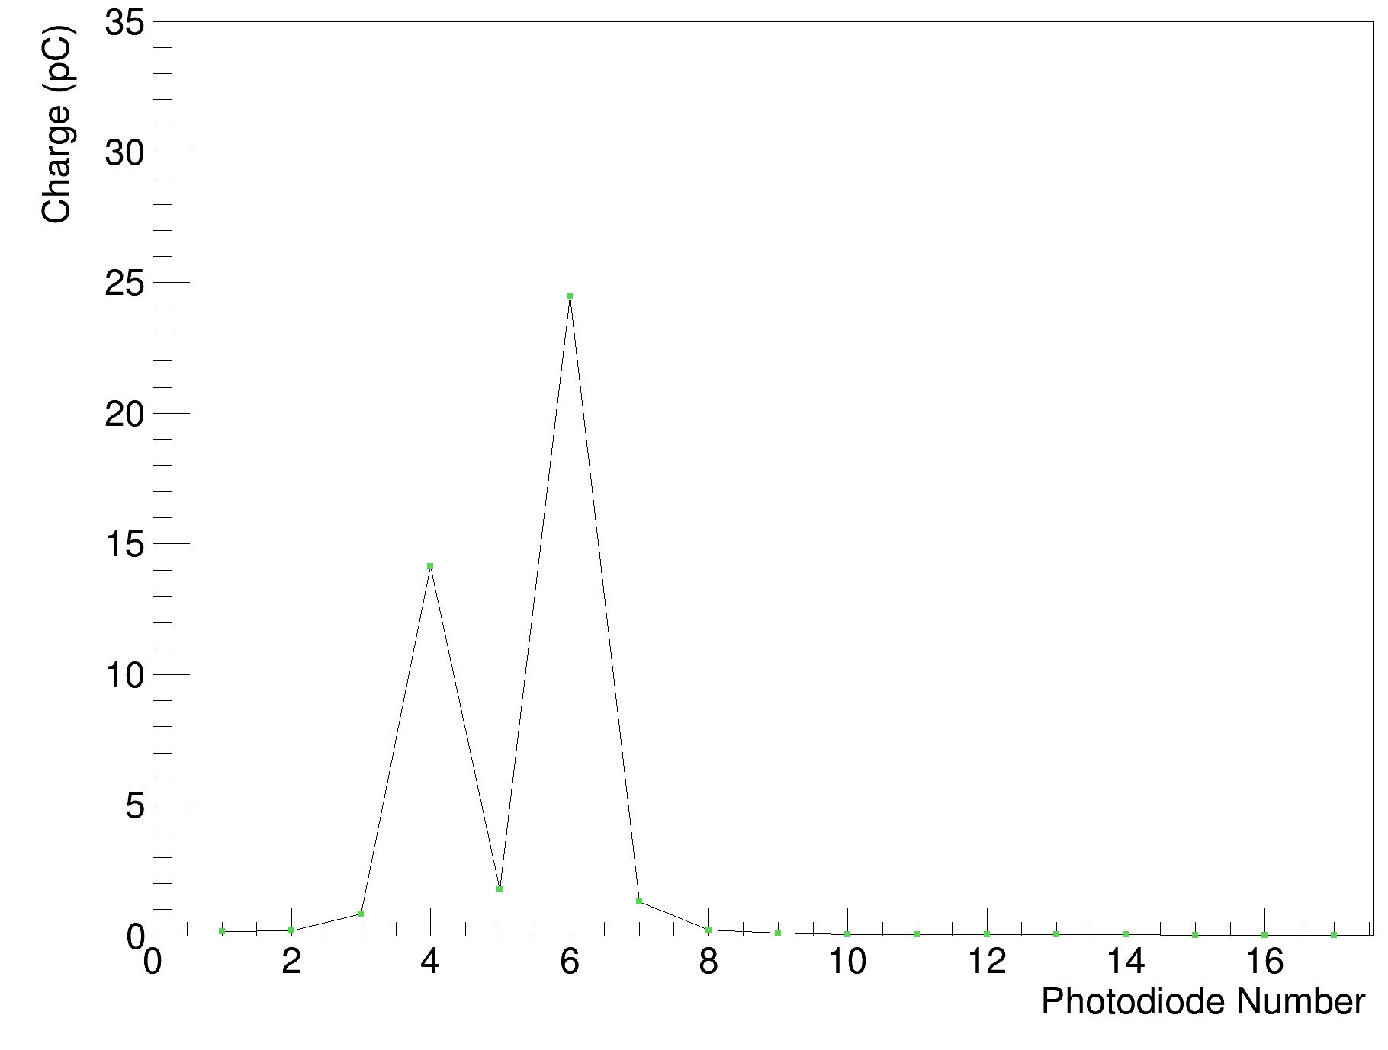

Cross-Talk
No Material
White Paper
  Mylar and Black card have similar cross-talk levels, but mylar has 10-20% more signal.
Black Card
Mylar Foil

Slide 5
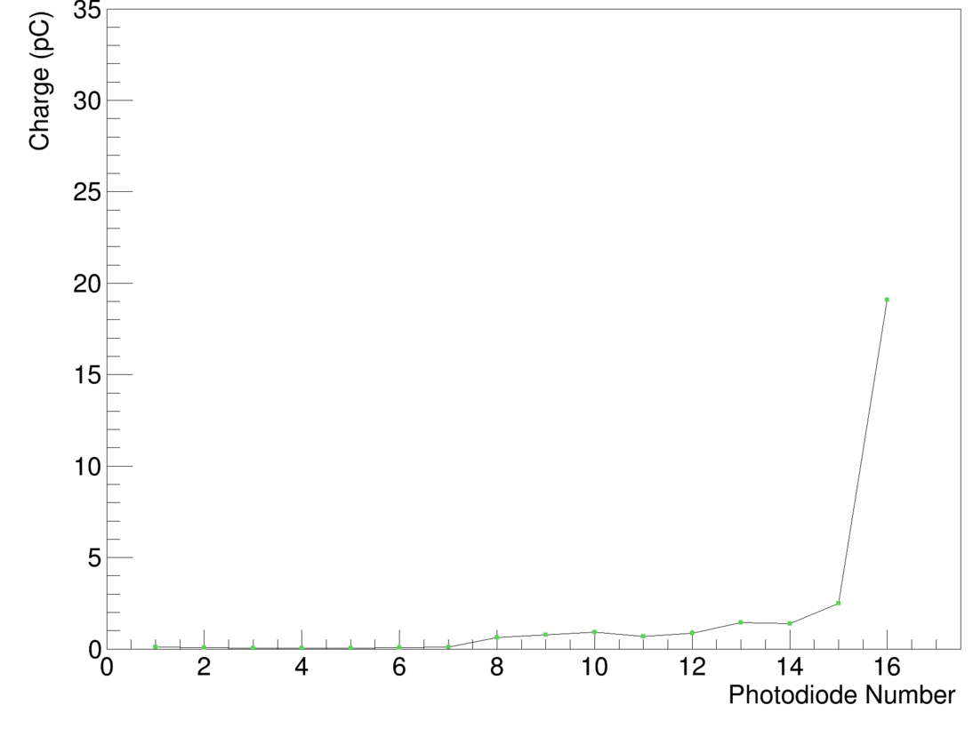
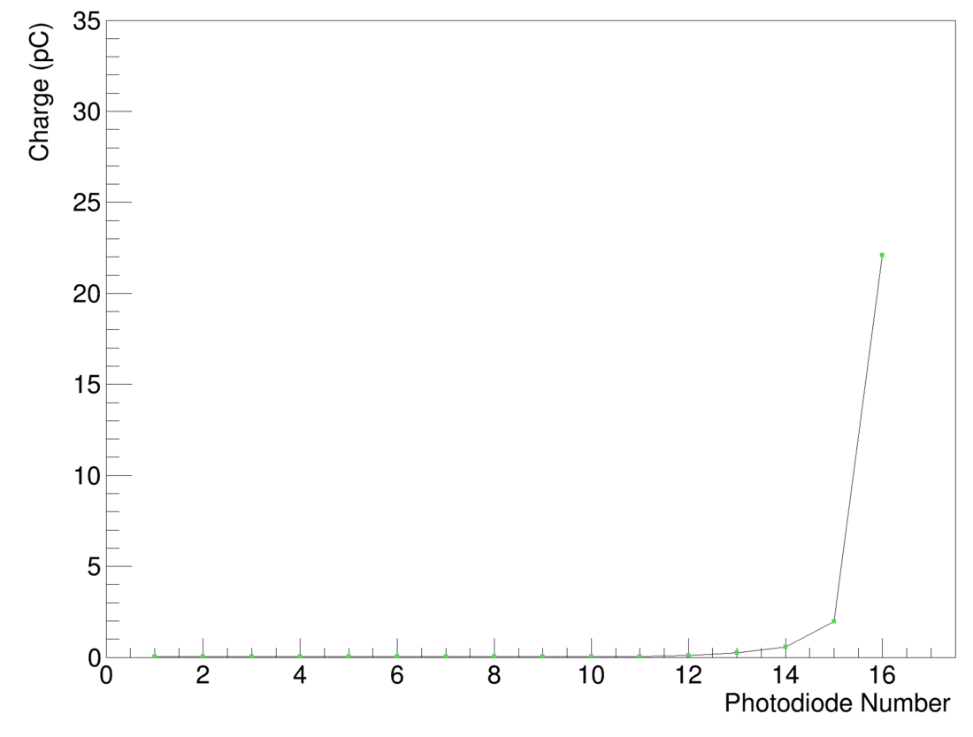


Light Levels
No Material
White Paper
  Mylar and Black card have similar cross-talk levels, but mylar has 10-20% more signal.
Black Card
Mylar Foil

Slide 6



Light Levels 90°
No Material
White Paper
  Lower signals levels than parallel injection, but similar cross-talk levels.
No black card 90° data due to Rev. C board issues
Mylar Foil
Mylar Foil
(Parallel)

Slide 7

Comparison with White Painted Sheets
White Paint
Mylar Foil

Slide 8

Mylar & Optical Gel (Single Photodiode)
Mylar Foil (Gel on PD 15)

Slide 9
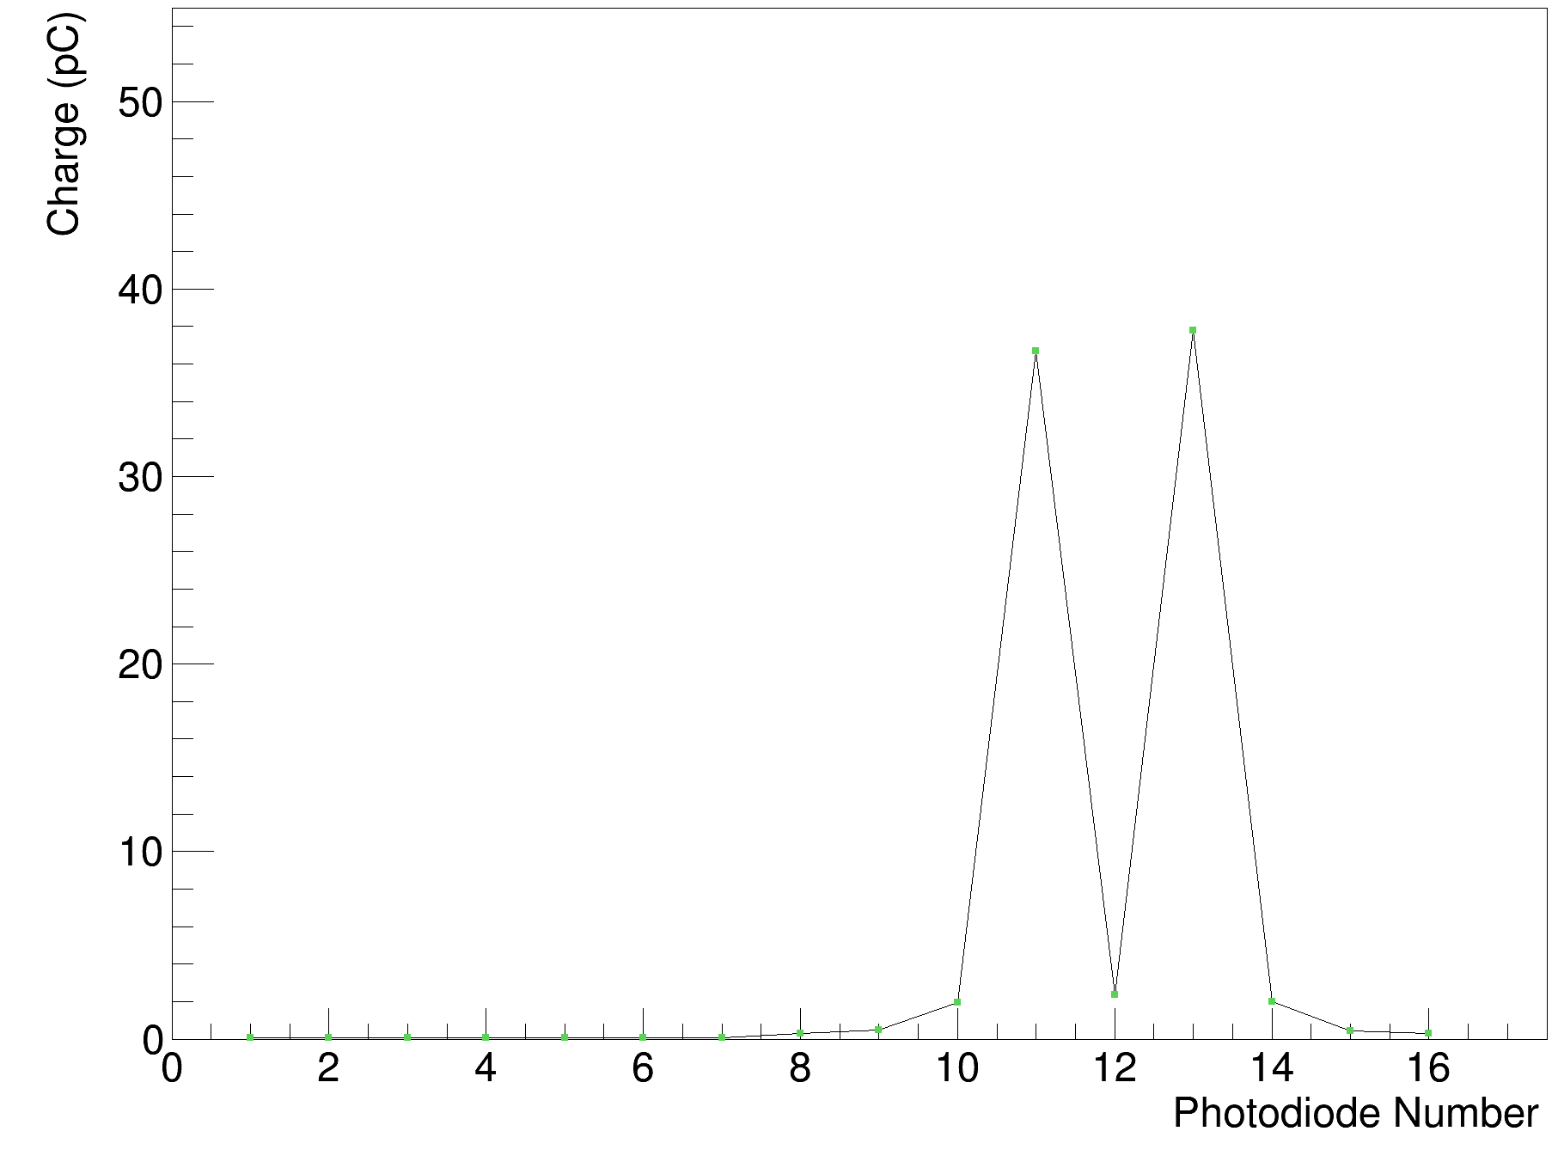
Mylar & Optical Gel Cross-Talk (Smear)
No Gel
Gel Smear

Slide 10

Mylar & Optical Gel Light Levels (Smear)
No Gel
Gel Smear

Slide 11
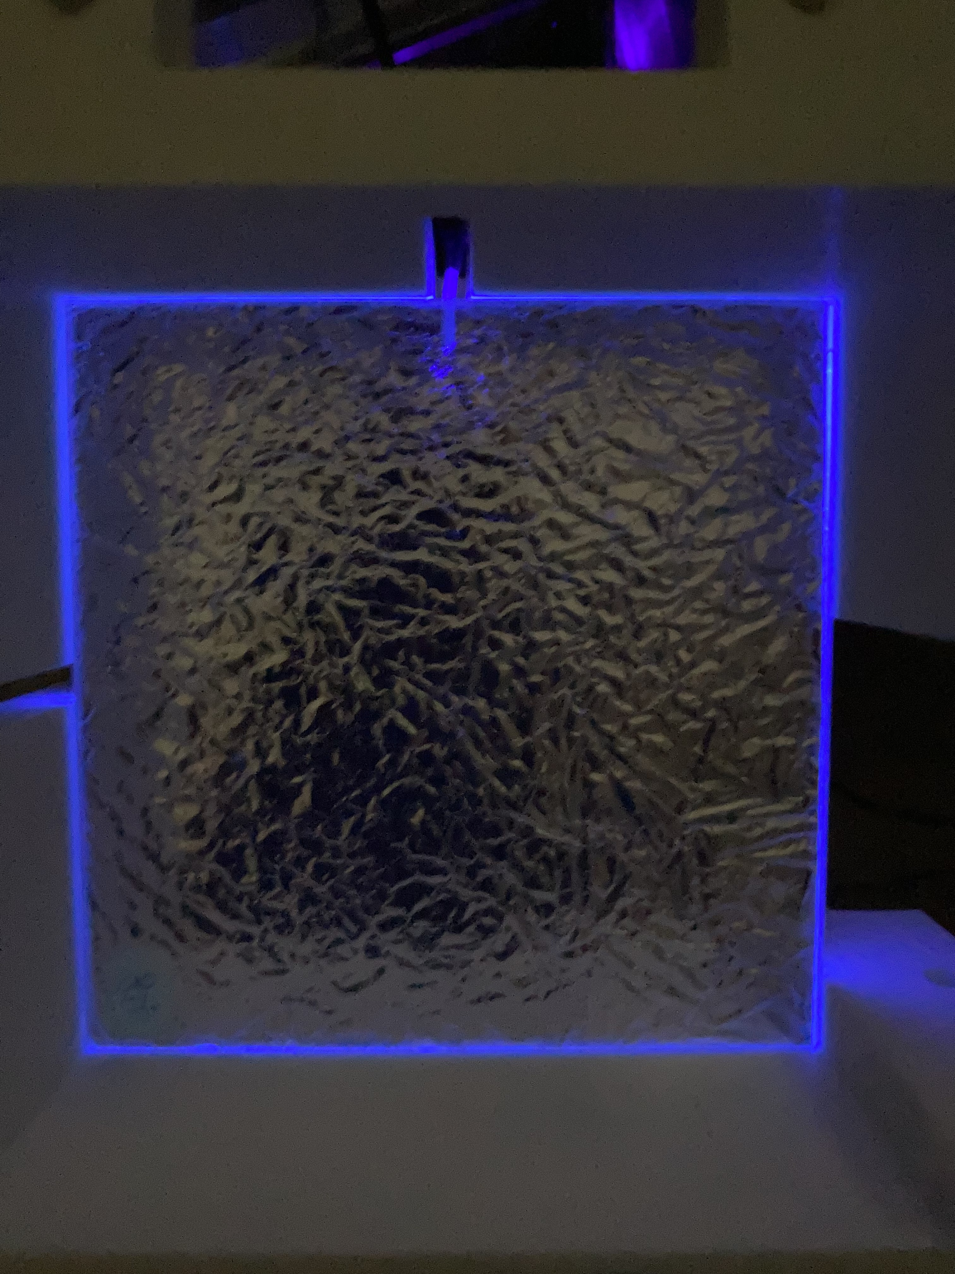
Conclusions
Unpainted sheets are 10-20 times brighter than white repainted sheets.
Optical isolation is necessary with photodiodes, but no method presented gives perfect results.
  Mylar foil gives best results in terms of signal/cross-talk ratio.
  Is not terrible to handle!
  Cross-talk likely due to light leaking around edges of sheet – black holder could help?
Optical gel provides 20-30% boost to signal level with little change to cross-talk.

