Slide 1
UCLH Analysis
16th June 2022 Experiment

Slide 2
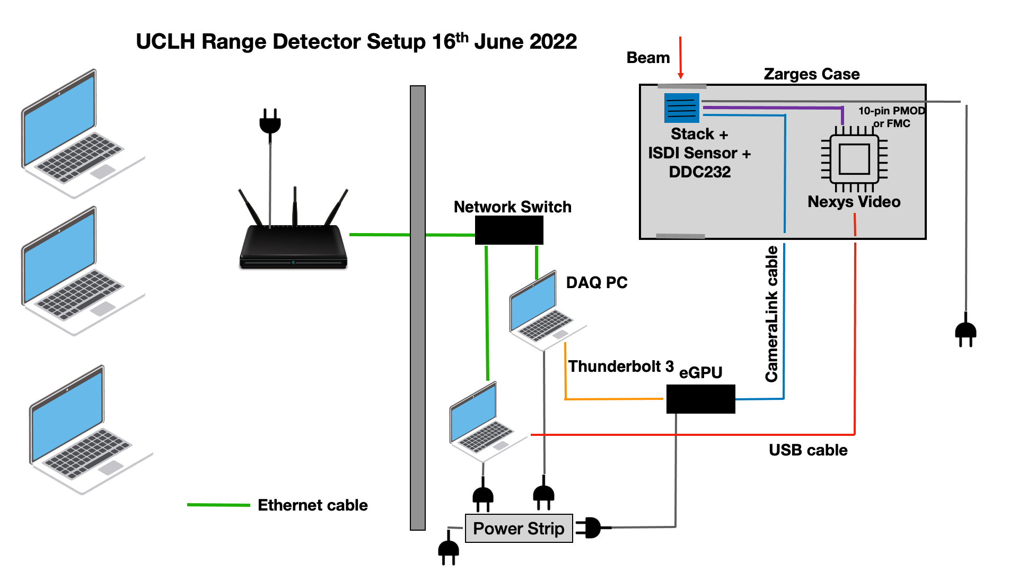

Slide 3
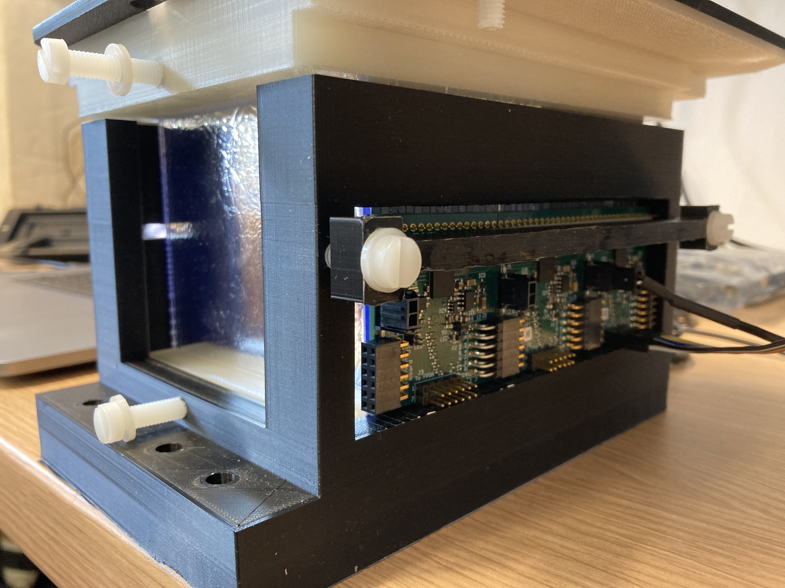
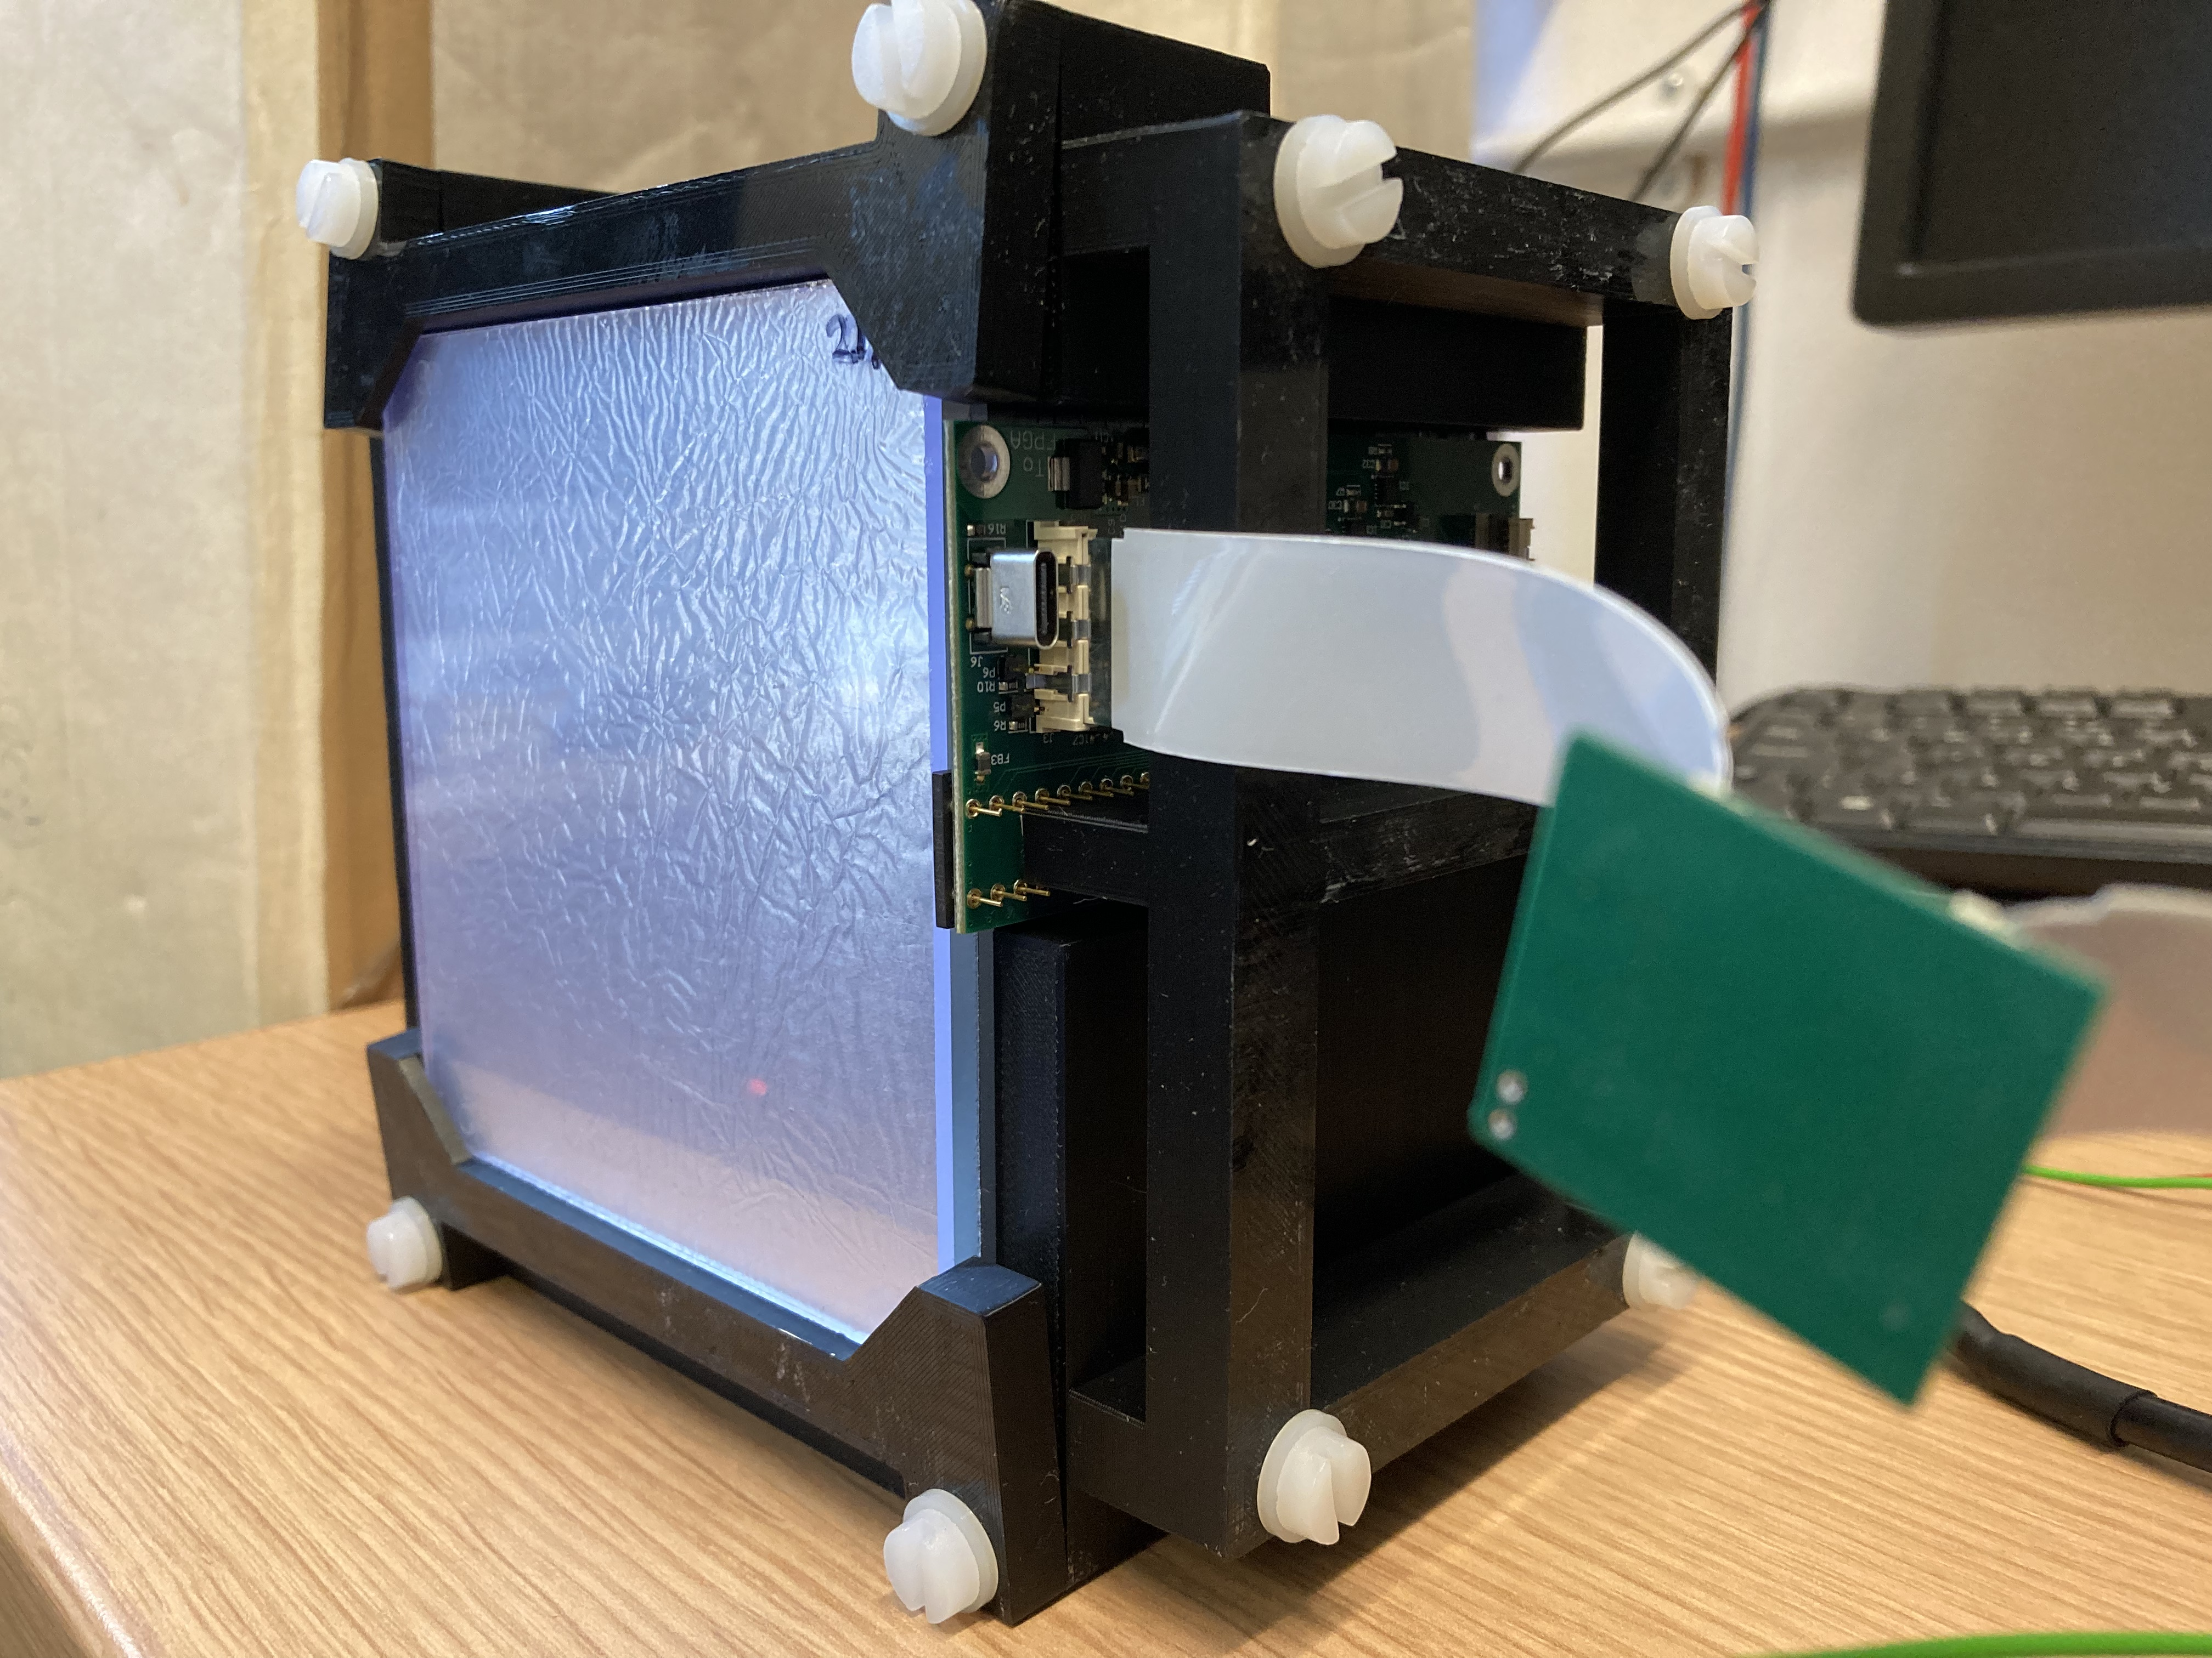
Prototypes for Testing
Rev. B Prototype: 25 clear sheets & 23 white sheets
Approx. 2.86 mm sheet thickness
Rev. C Prototype: 32 clear sheets
Approx. 3 mm sheet thickness
(3.4mm and 2mm sheets)

Slide 4
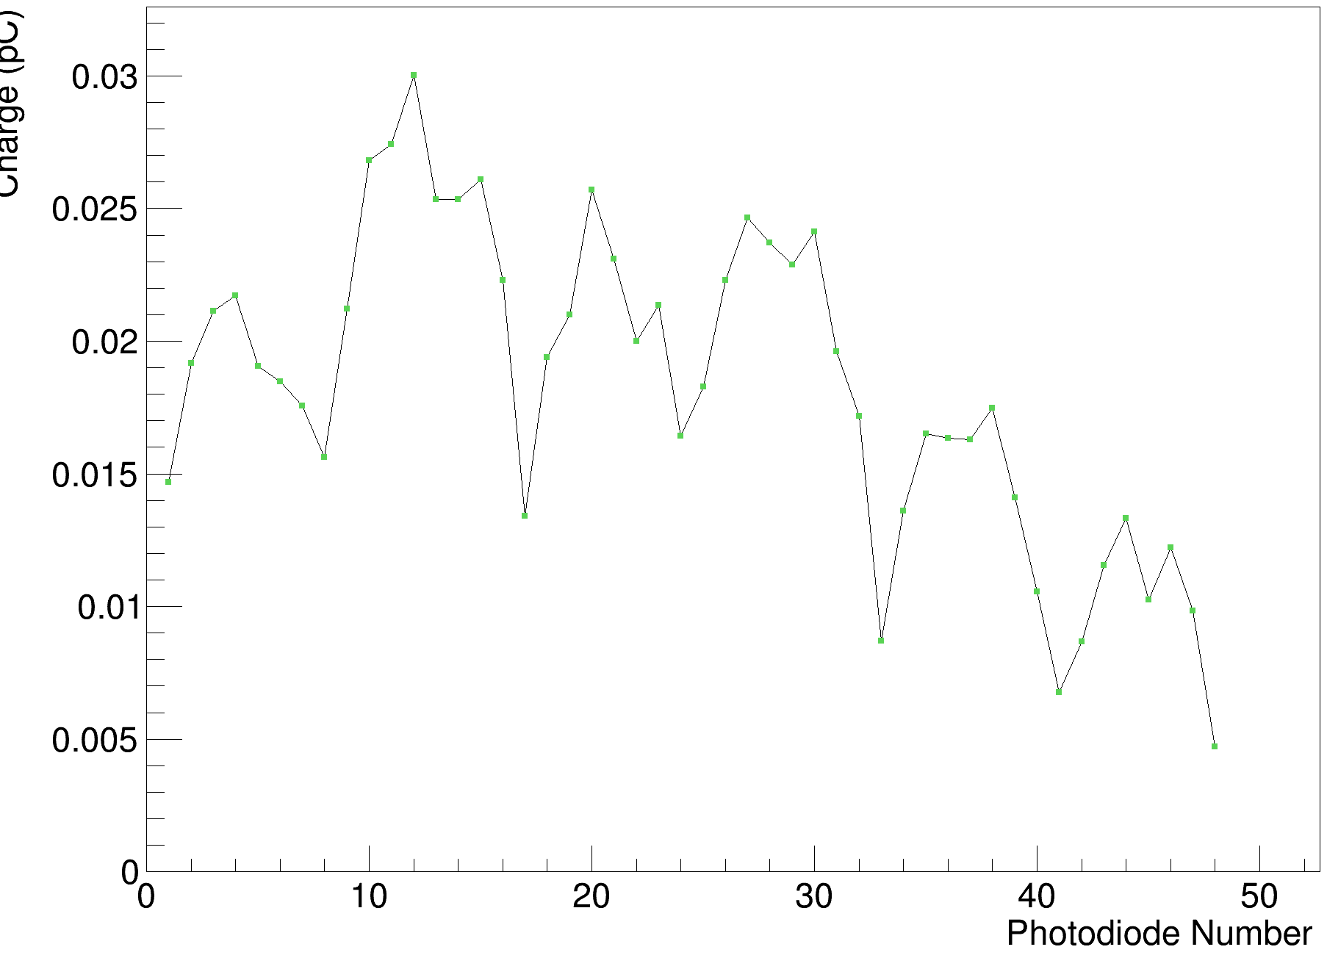
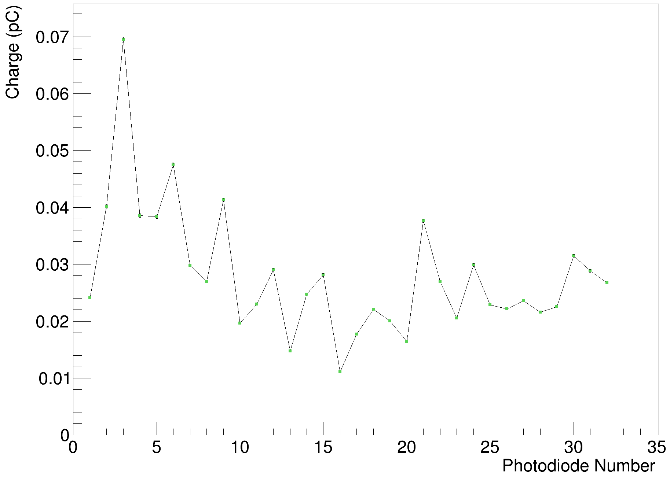
Background Comparison
Rev. B (w/ additional grounding)
Rev. C (no additional grounding)

Slide 5
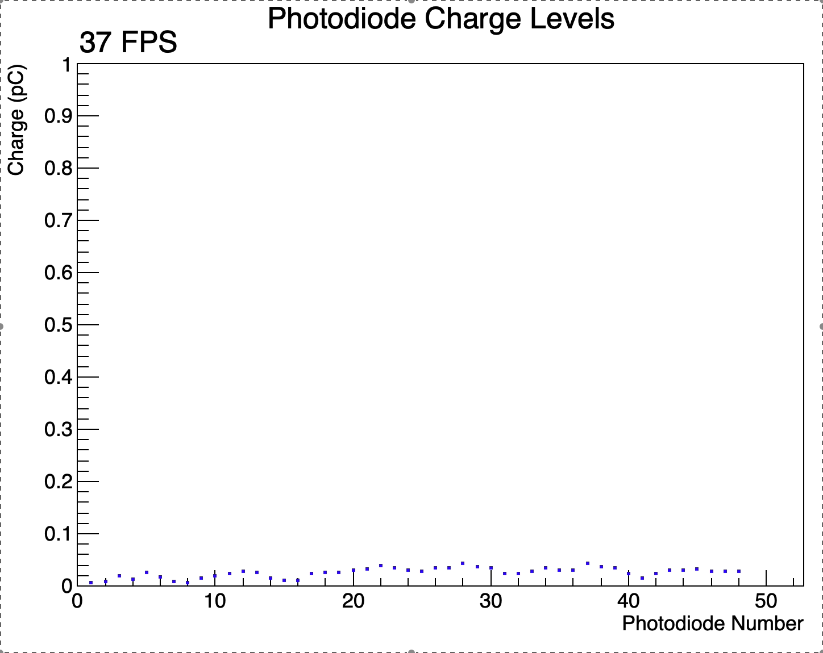
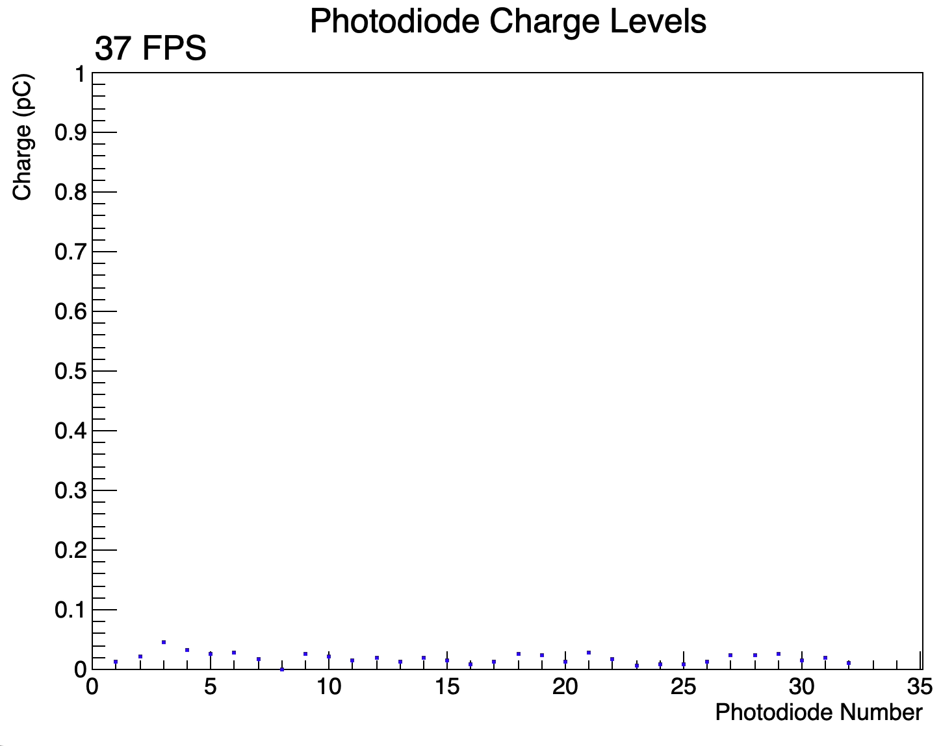
Background Comparison
Rev. B (w/ additional grounding)
Rev. C (no additional grounding)

Slide 6
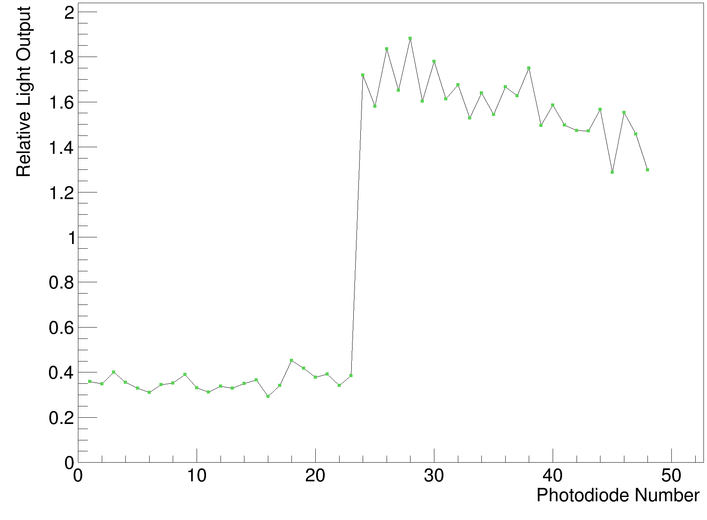
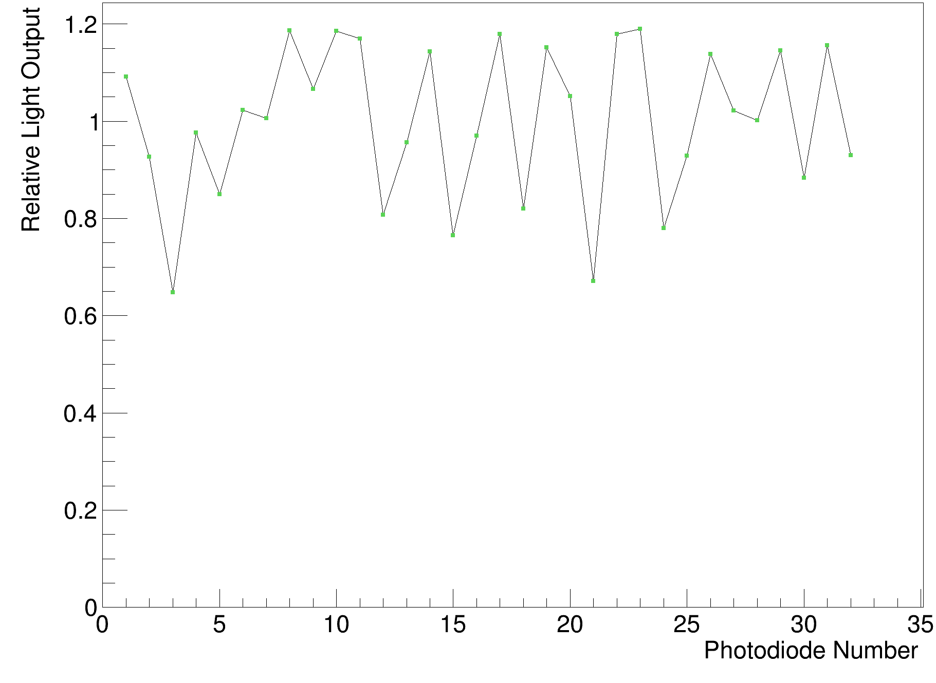
Calibration Comparison
Rev. B (clear and white sheets)
Rev. C (clear sheets only)

Slide 7
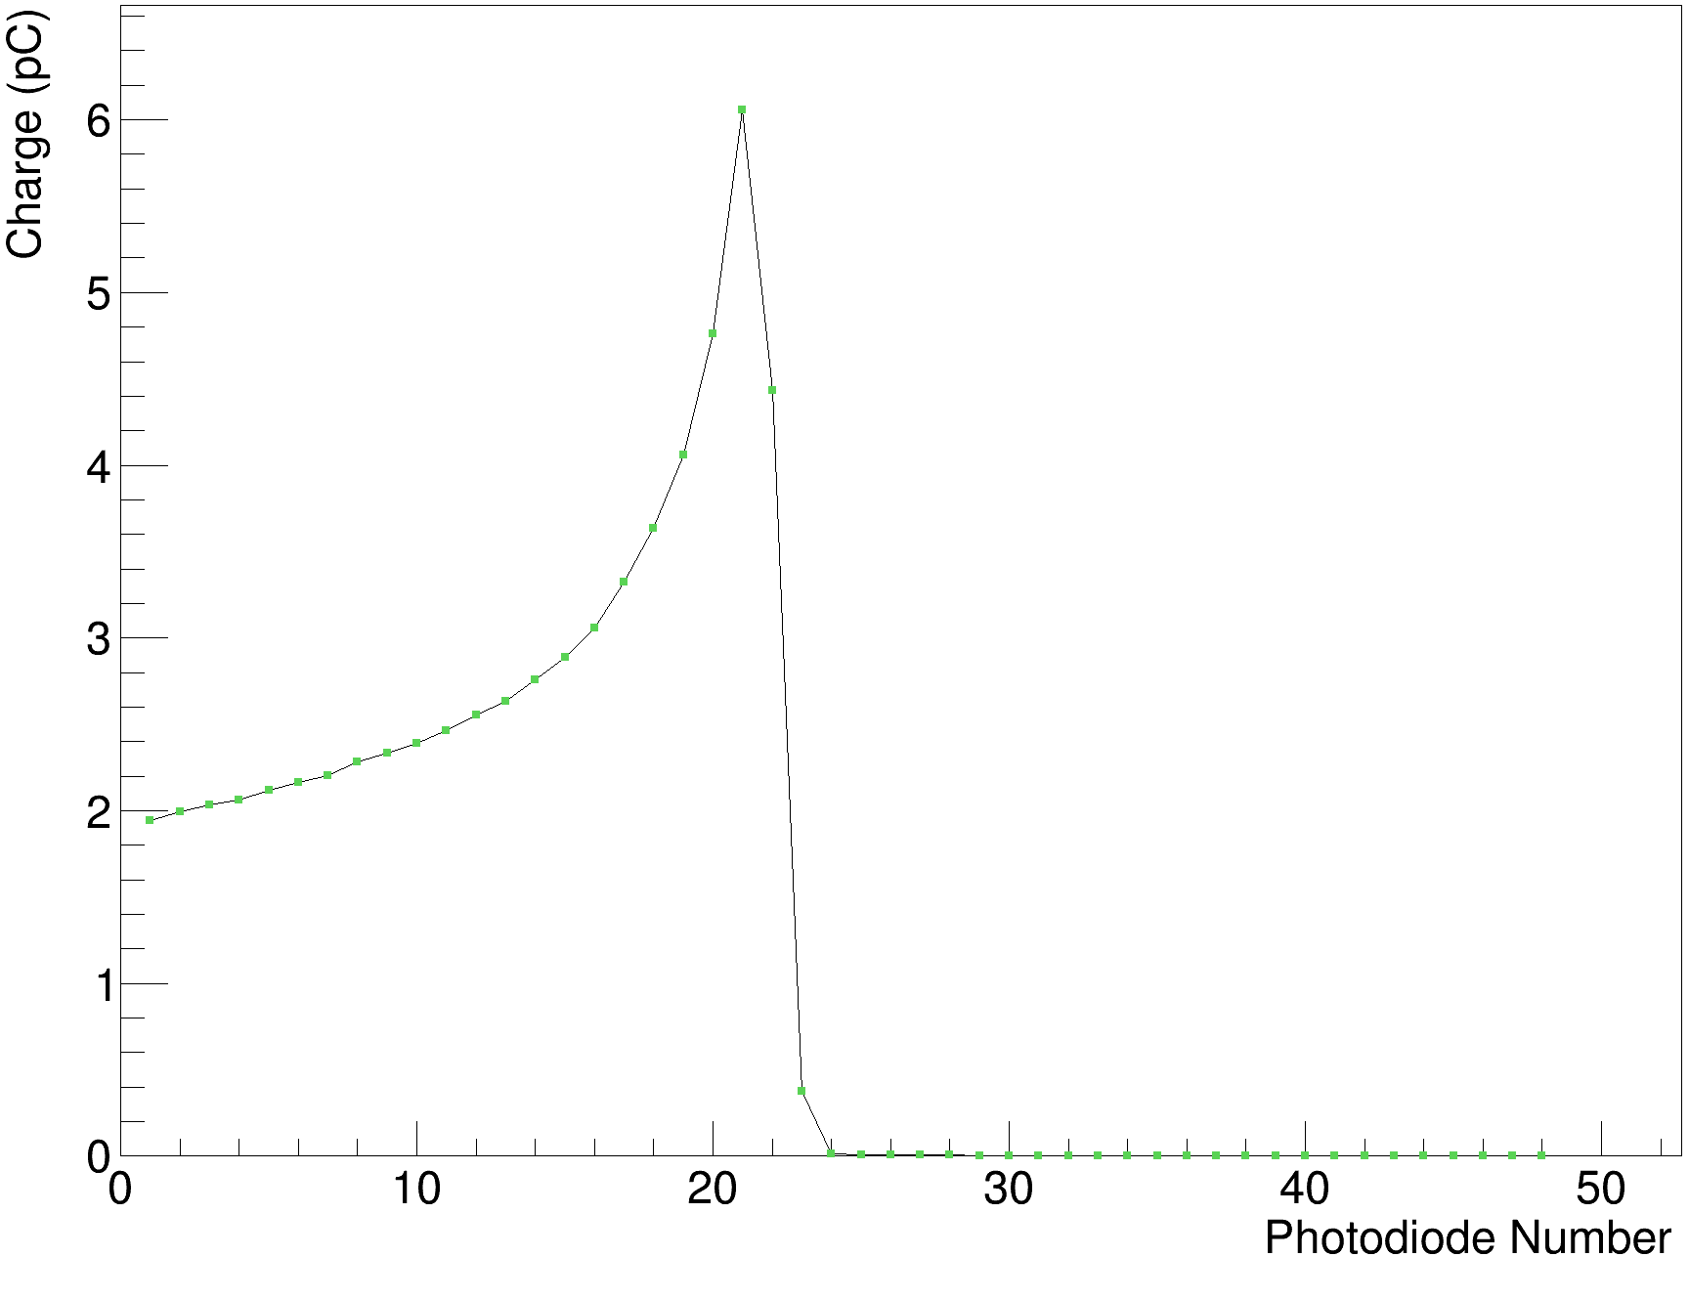
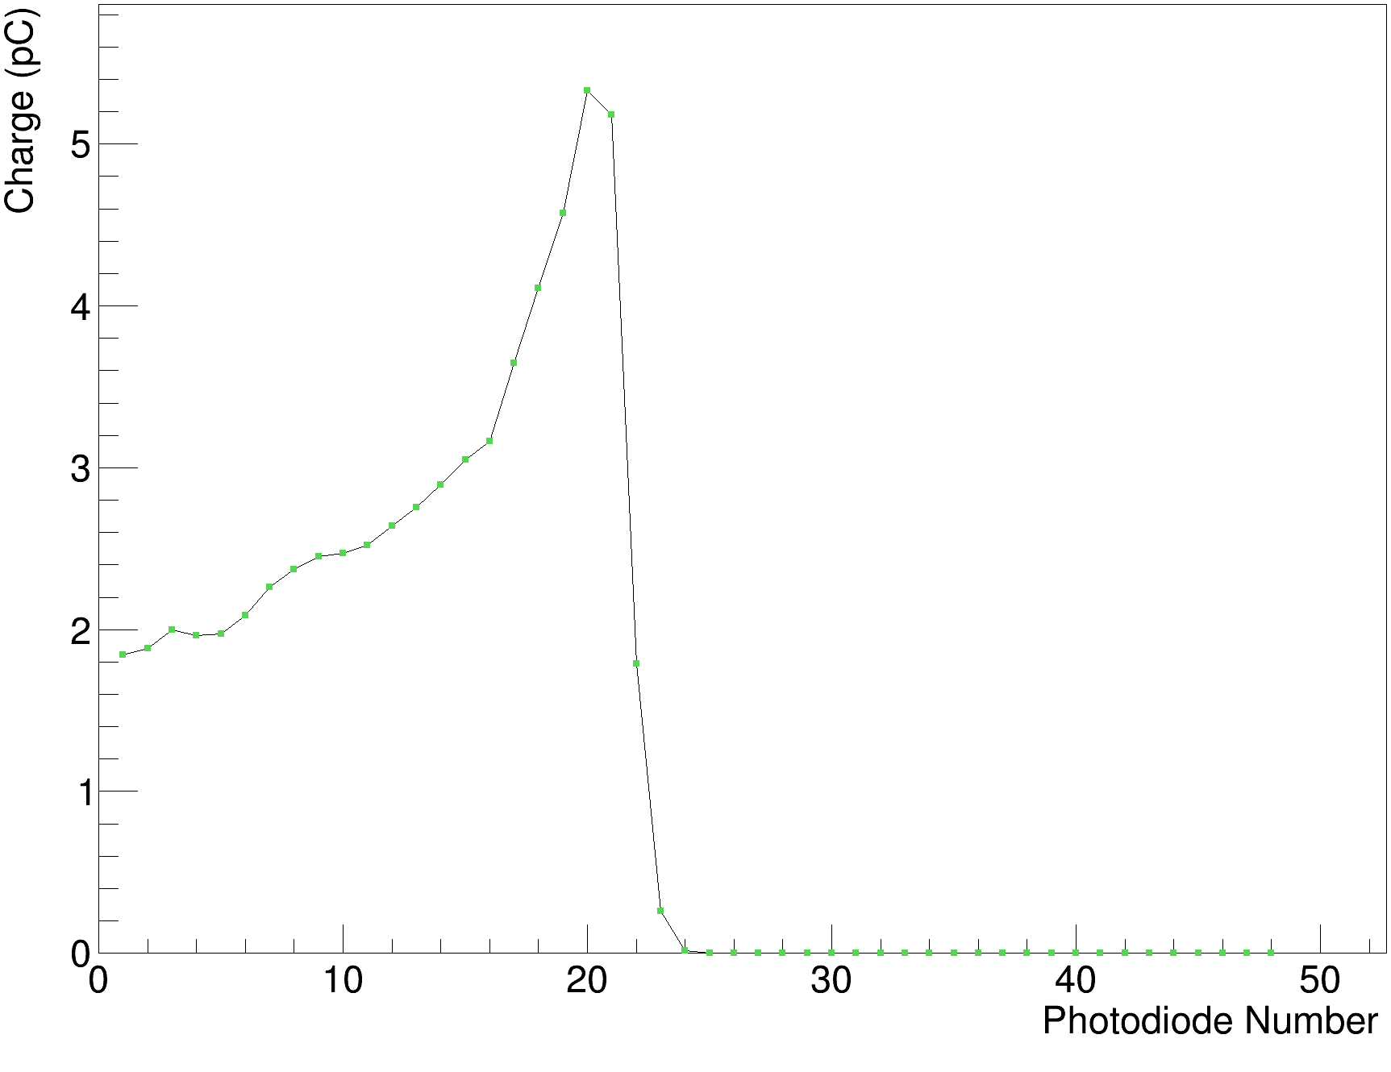
Rev. B White Sheets Calibrated Data
90 MeV (clear sheets)
90 MeV (white sheets)

Slide 8
Rev. B Fits in White Painted Sheets
CMOS Sensor
Rev. B
Note: 2.07 mm offset due to extra sheet not covered by diodes

Slide 9
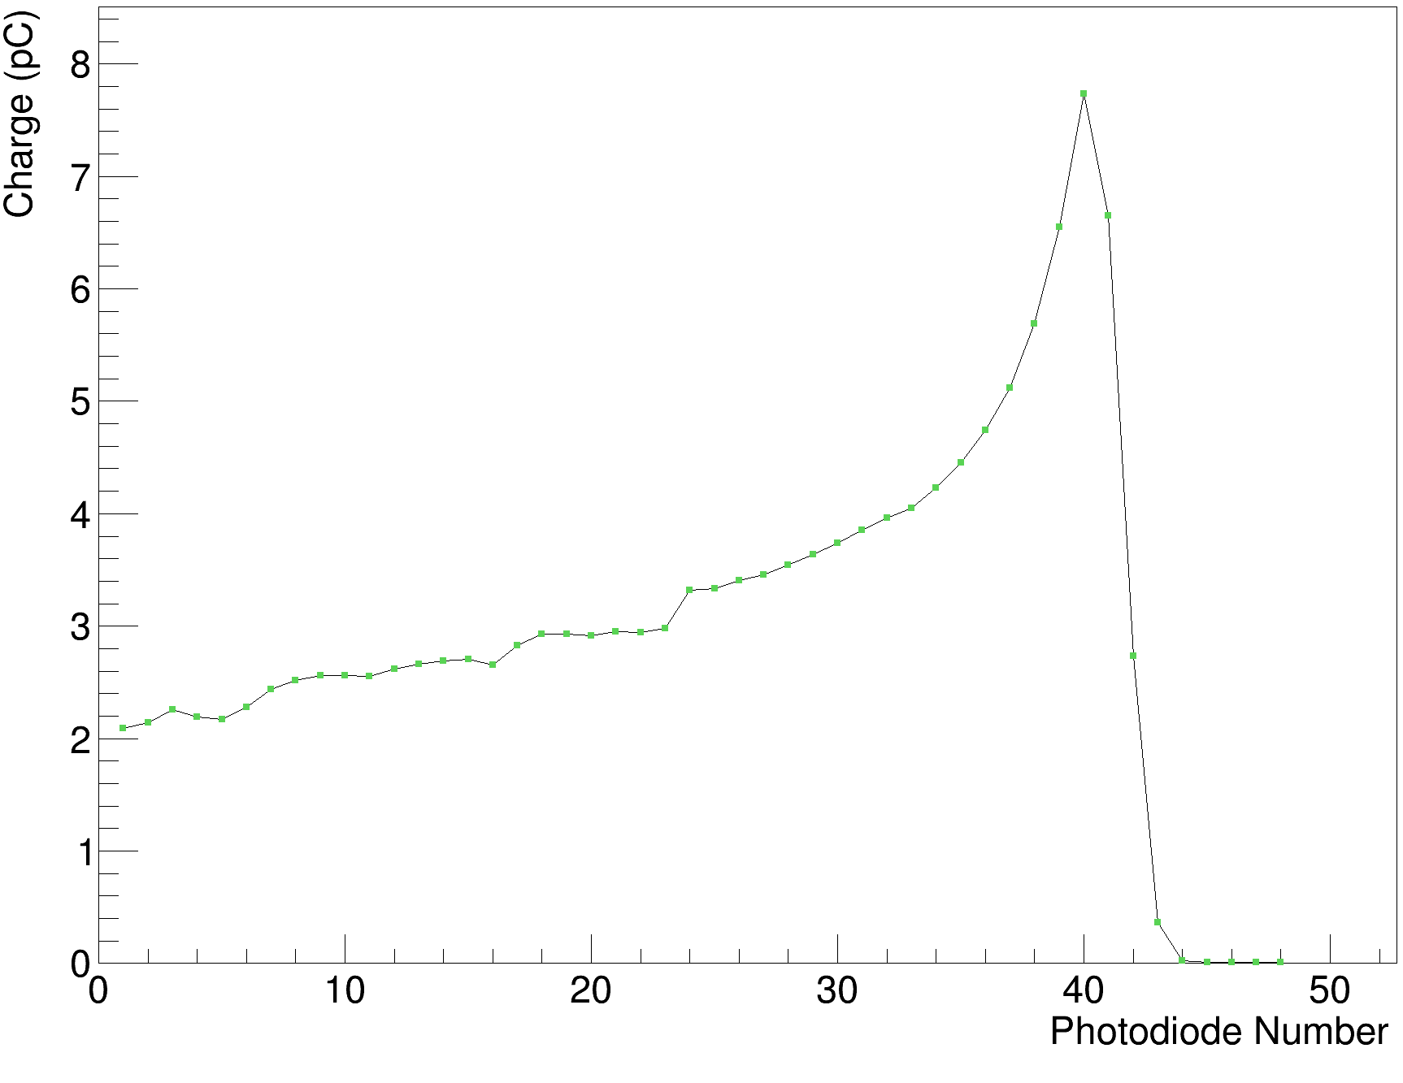
Rev. B Clear Sheets Calibrated Data
90 MeV (clear sheets only)
130 MeV (white & clear sheets)

Slide 10
Rev. B Fits in Clear Sheets
70 MeV (clear sheets only)
80 MeV (clear sheets only)

Slide 11
Rev. B Fits in Clear Sheets
90 MeV (clear sheets only)
110 MeV (white & clear sheets)
Note: 2.07 mm offset due to extra sheet not covered by diodes

Slide 12
Rev. B Fits in Clear Sheets
120 MeV (white & clear sheets)
130 MeV (white & clear sheets)
Note: 2.07 mm offset due to extra sheet not covered by diodes

Slide 13
Energy Dependence on Range

Slide 14
Rev. B Fits in Clear Sheets (X-axis adjust)
Add 0.086mm to each clear sheet
70 MeV (clear sheets only)
80 MeV (clear sheets only)

Slide 15
Rev. B Fits in Clear Sheets (X-axis adjust)
Add 0.086mm to each clear sheet
90 MeV (clear sheets only)
110 MeV (white & clear sheets)
Note: 2.07 mm offset due to extra sheet not covered by diodes

Slide 16
Rev. B Fits in Clear Sheets (X-axis adjust)
Add 0.086mm to each clear sheet
120 MeV (white & clear sheets)
130 MeV (white & clear sheets)
Note: 2.07 mm offset due to extra sheet not covered by diodes

Slide 17
Energy Dependence on Range (Adjusted)

Slide 18


Rev. C Clear Sheets Calibrated Data
70 MeV
105 MeV

Slide 19
Rev. C Fits in Clear Sheets (X-axis adjust)
70 MeV
105 MeV

Slide 20
Rev. C Fits in Clear Sheets (X-axis adjust)
80 MeV
95 MeV

Slide 21
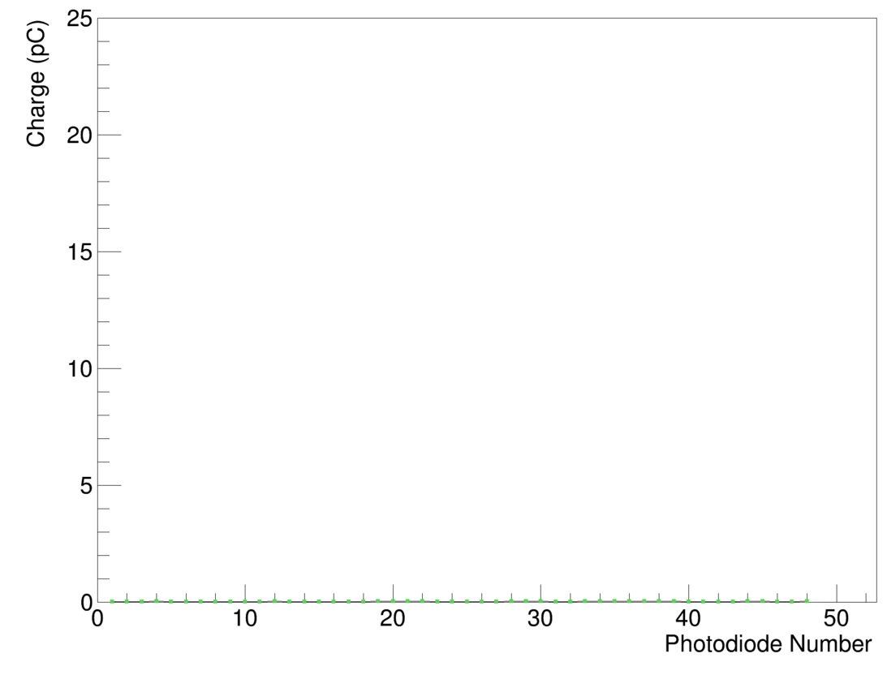
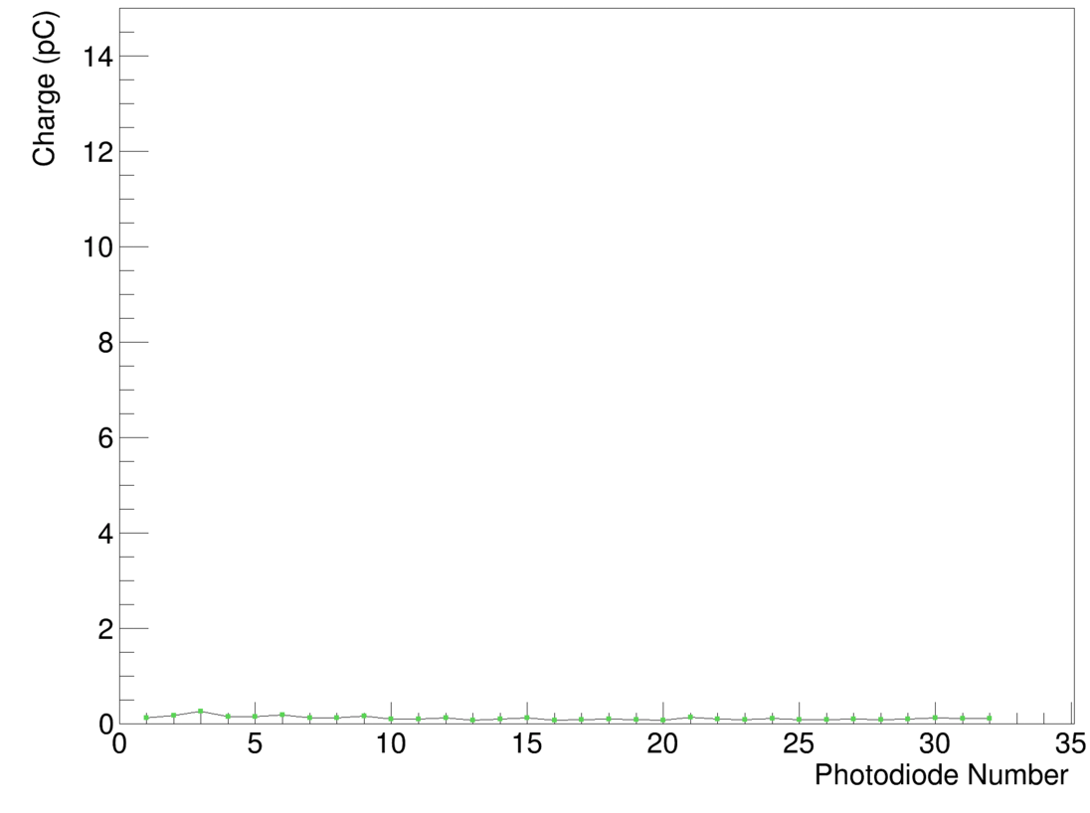
Crosstalk Measurements (Clear Sheets)
Rev. B Stack
Average: 0.78%
Rev. C Stack
Average: 5.11%

Slide 23
Conclusions
Rev. C (and rev. D?) could benefit from some additional grounding.
Clear sheets between 5-6 times brighter than white painted sheets.
CMOS sensor data corroborates photodiode data with fits in white painted sheets – see “fat” Bragg curves like in November 2021 data.
  White painted sheets pretty much only good for absorber…
Clear sheets produce good Bragg curves, but WET (for sheets with mylar) needs calibrating for good range accuracy.
  Adjustment shown adds 0.086mm WET to each clear sheet. Is this physical?
  Mylar foil is only 0.006mm thick – what is its RSP?
  Systematic effects present!
Rev. C fits inconsistent – 6.5 times more crosstalk observed than Rev. B.
Fibre-calibration not quite the same as beam shoot-through.

