Slide 1
UCLH Analysis
1st September 2022 Experiment

Slide 2
Experiment Plan
Using IBA Giraffe, measure the WET of the following:
  Stack of 25 clear sheets (100 x 100 x 2.86 mm) w/ mylar foil.
  Stack of 23 white painted sheets (100 x 100 x 2.86 mm).
  Clatterbridge Prototype A: 14 clear sheets (100 x 100 x 2.86 mm) w/ mylar.
  Clatterbridge Prototype B: 11 clear sheets w/ mylar and 3 white sheets.
  Rev. D Prototype: 32 clear sheets (105 x 105 x 3 mm) w/ mylar foil.
  Single Block Scintillator (100 x 100 x 200 mm)
DDC232 measurements:
  Clatterbridge Prototypes background and calibration shoot-throughs.
  Rev. D prototype background, calibration and Bragg peak measurements.
Quenching measurements:
  Bragg peak image measurements with single block.

Slide 3
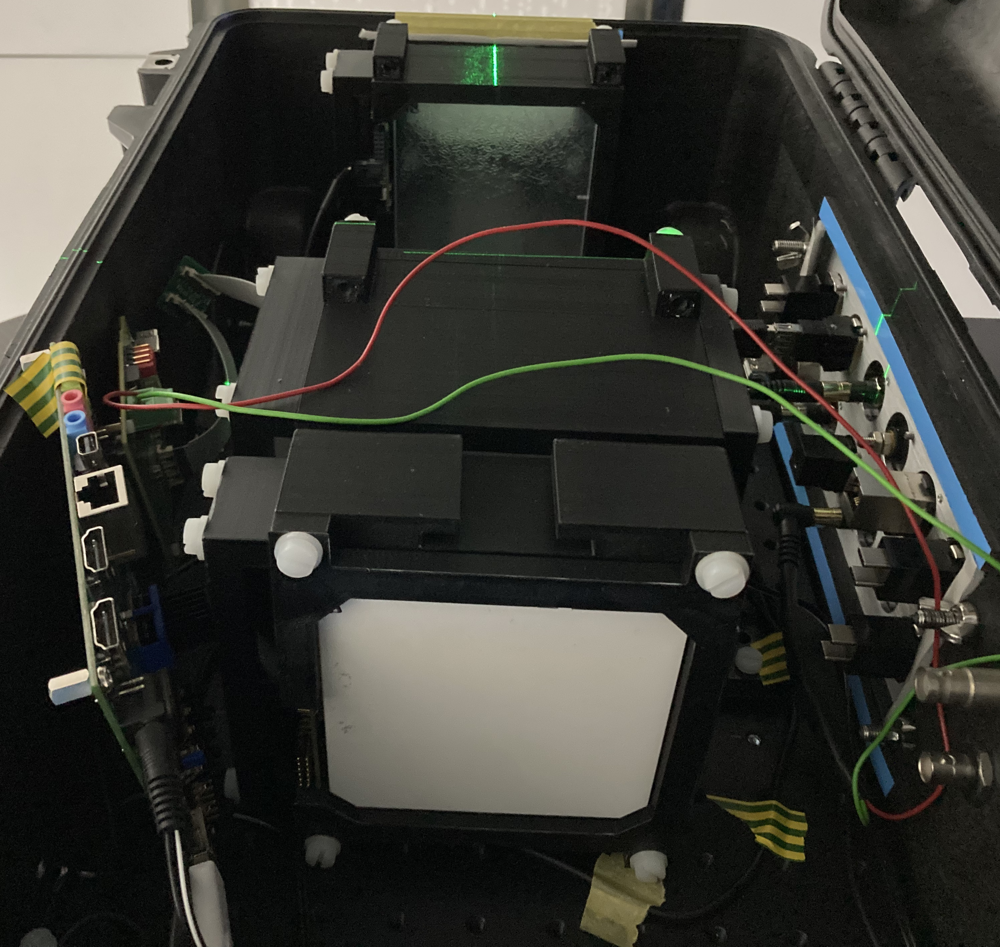
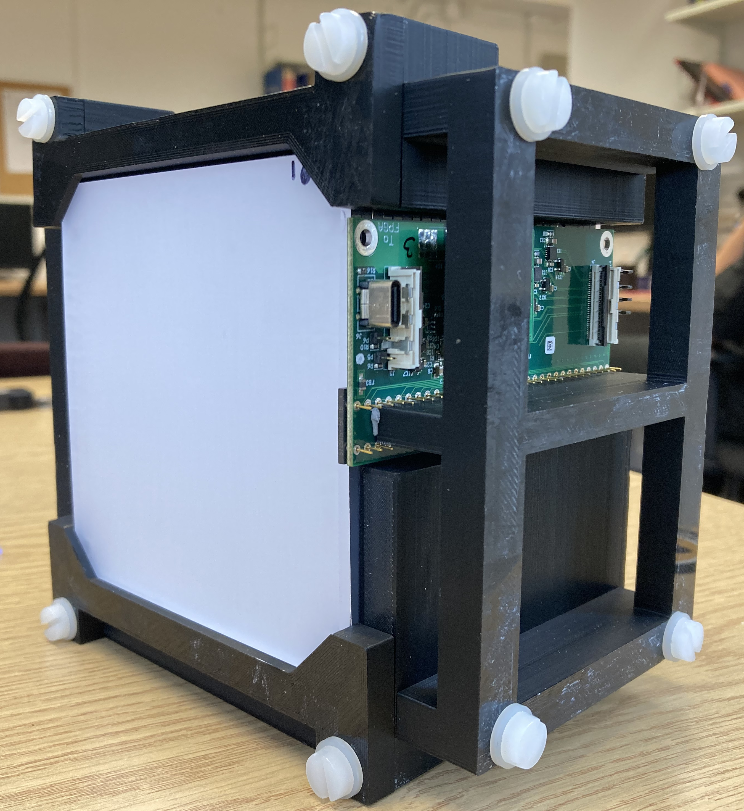
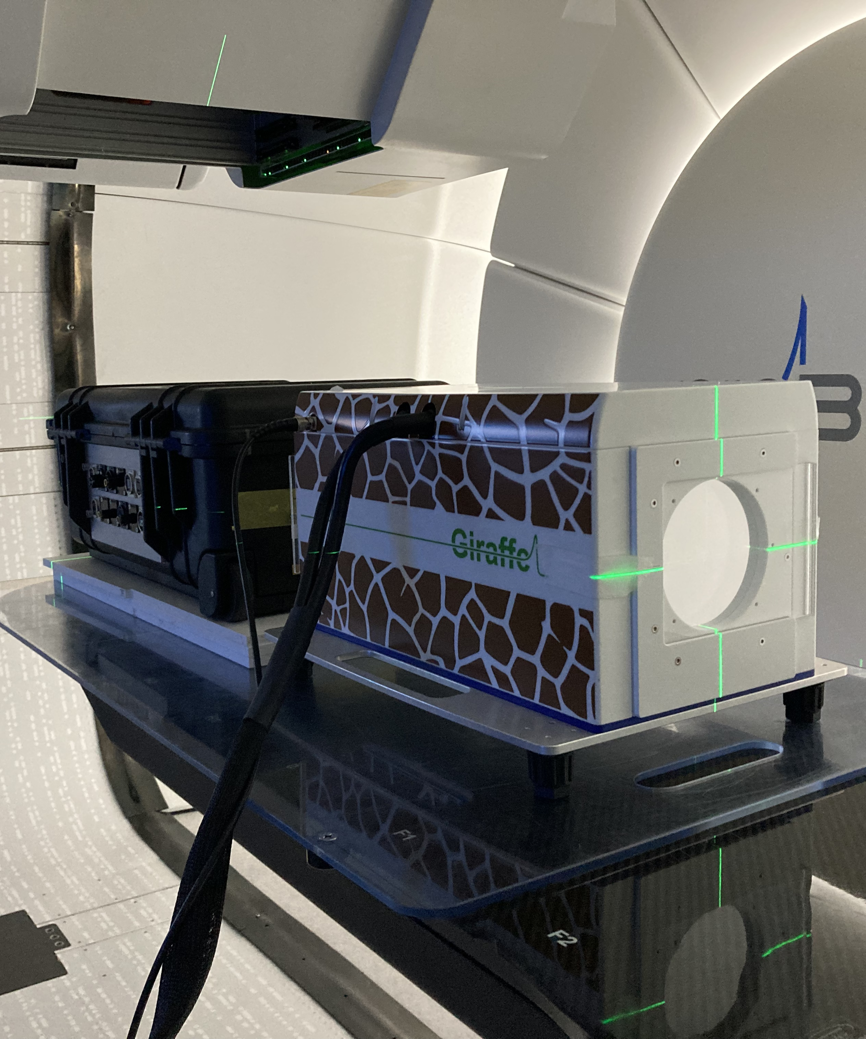
Experiment Equipment

Slide 4
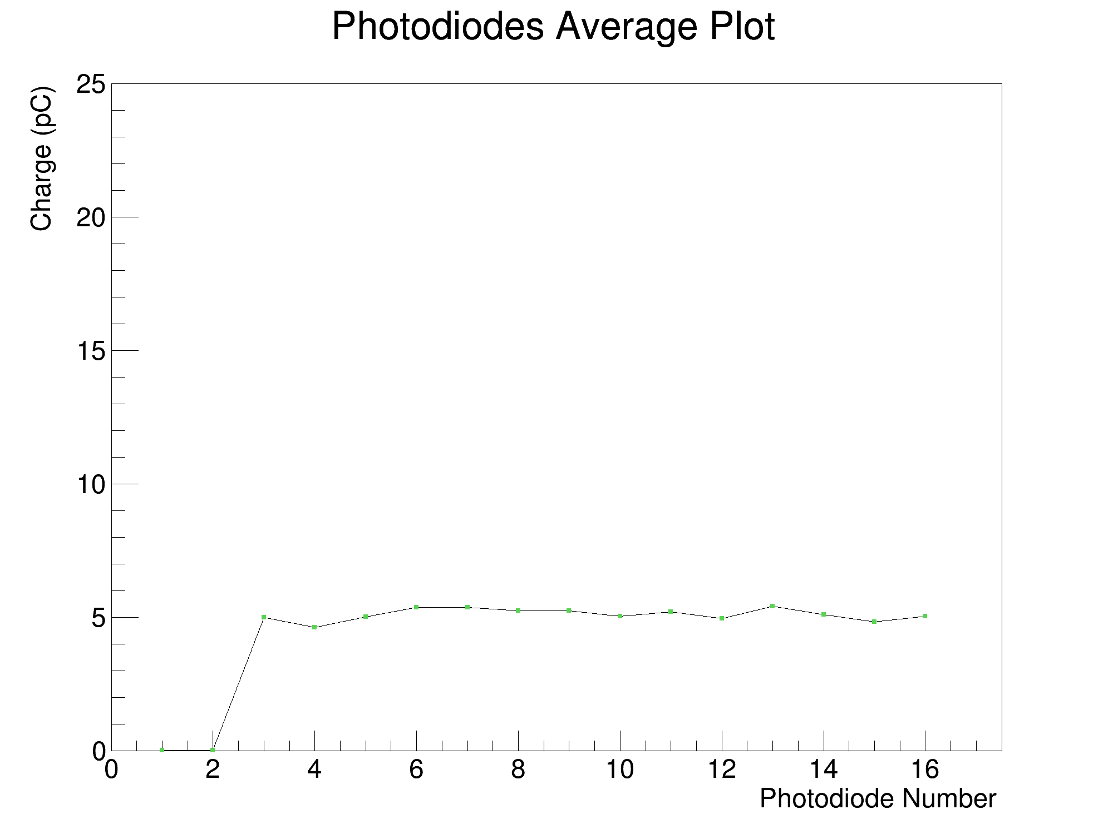
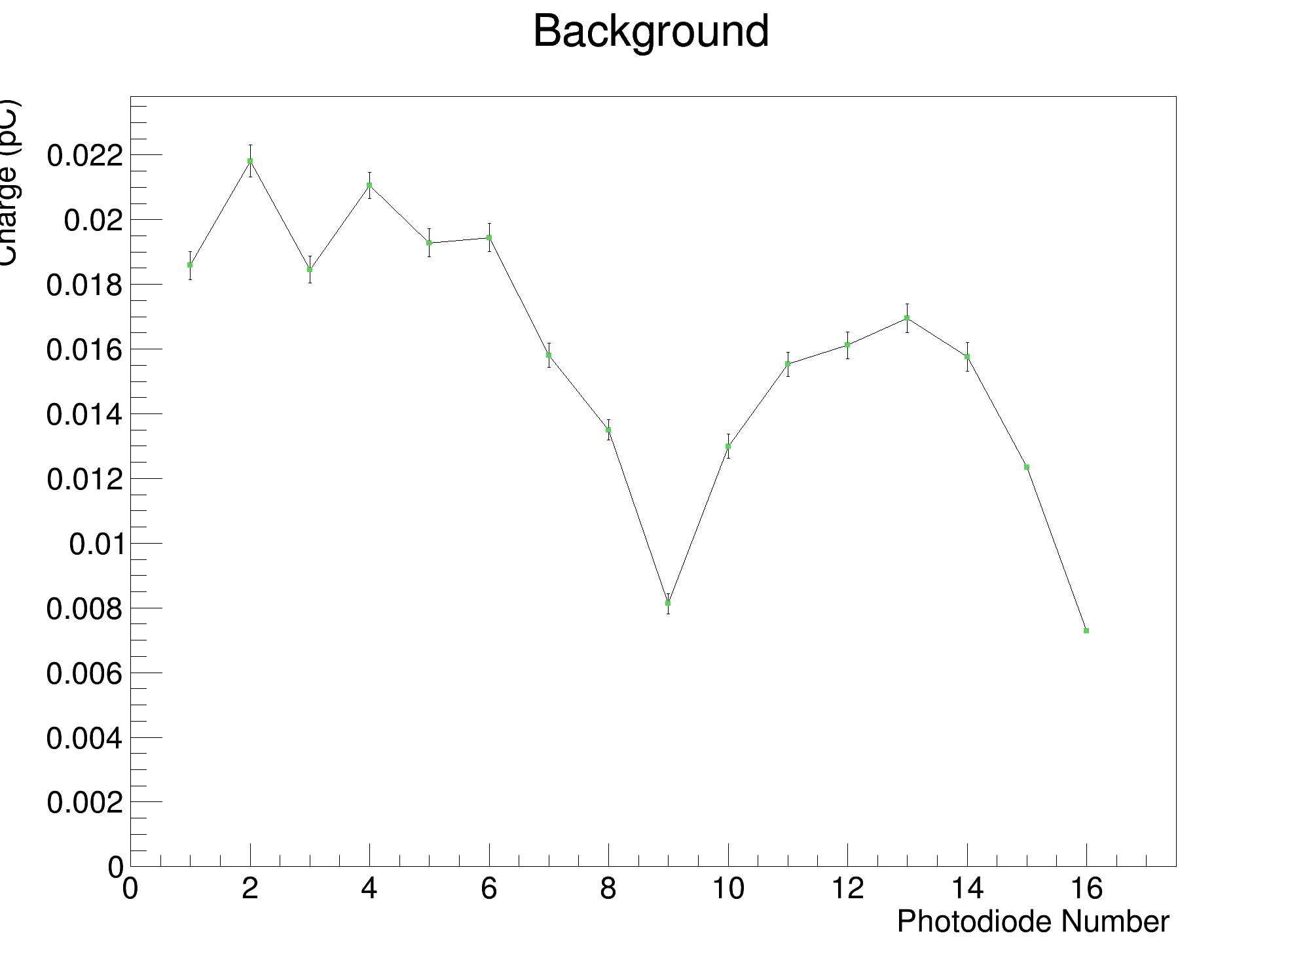
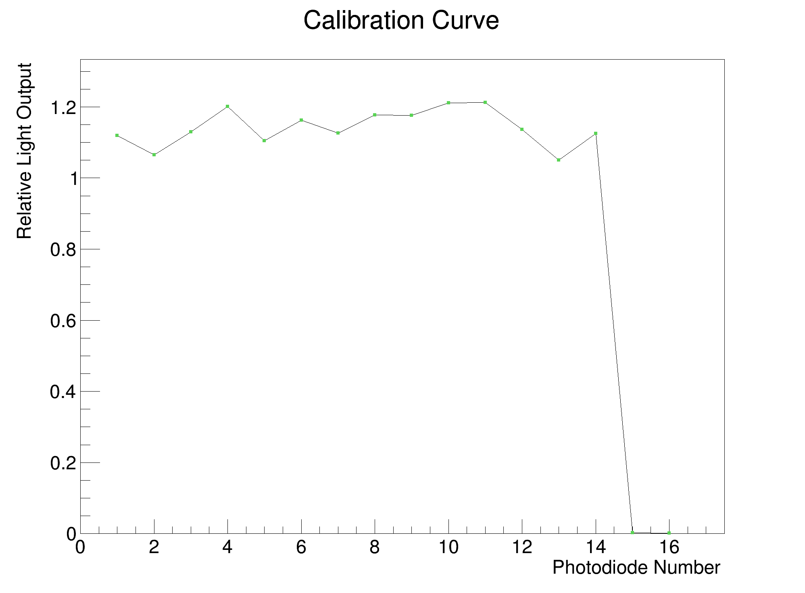

Clatt. A Results

Slide 5
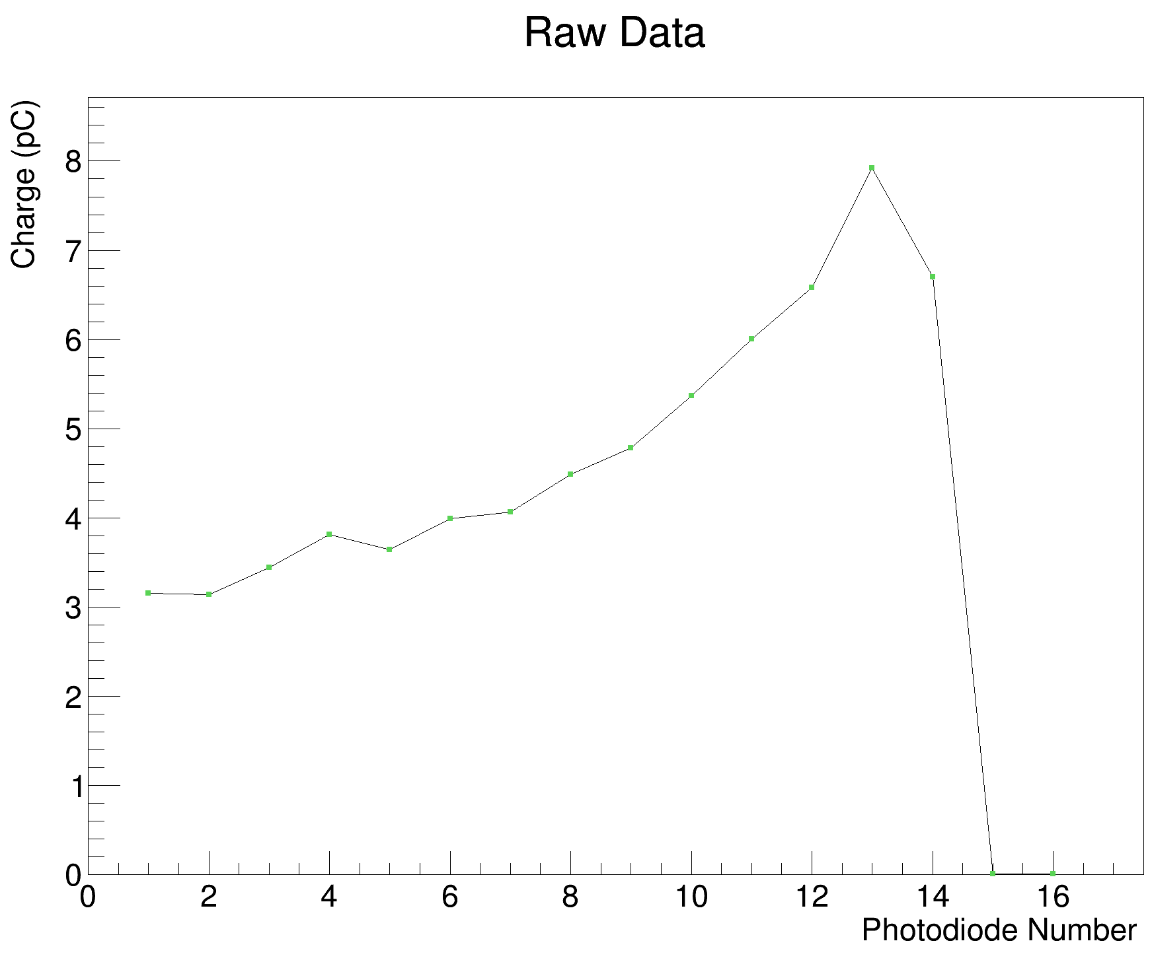
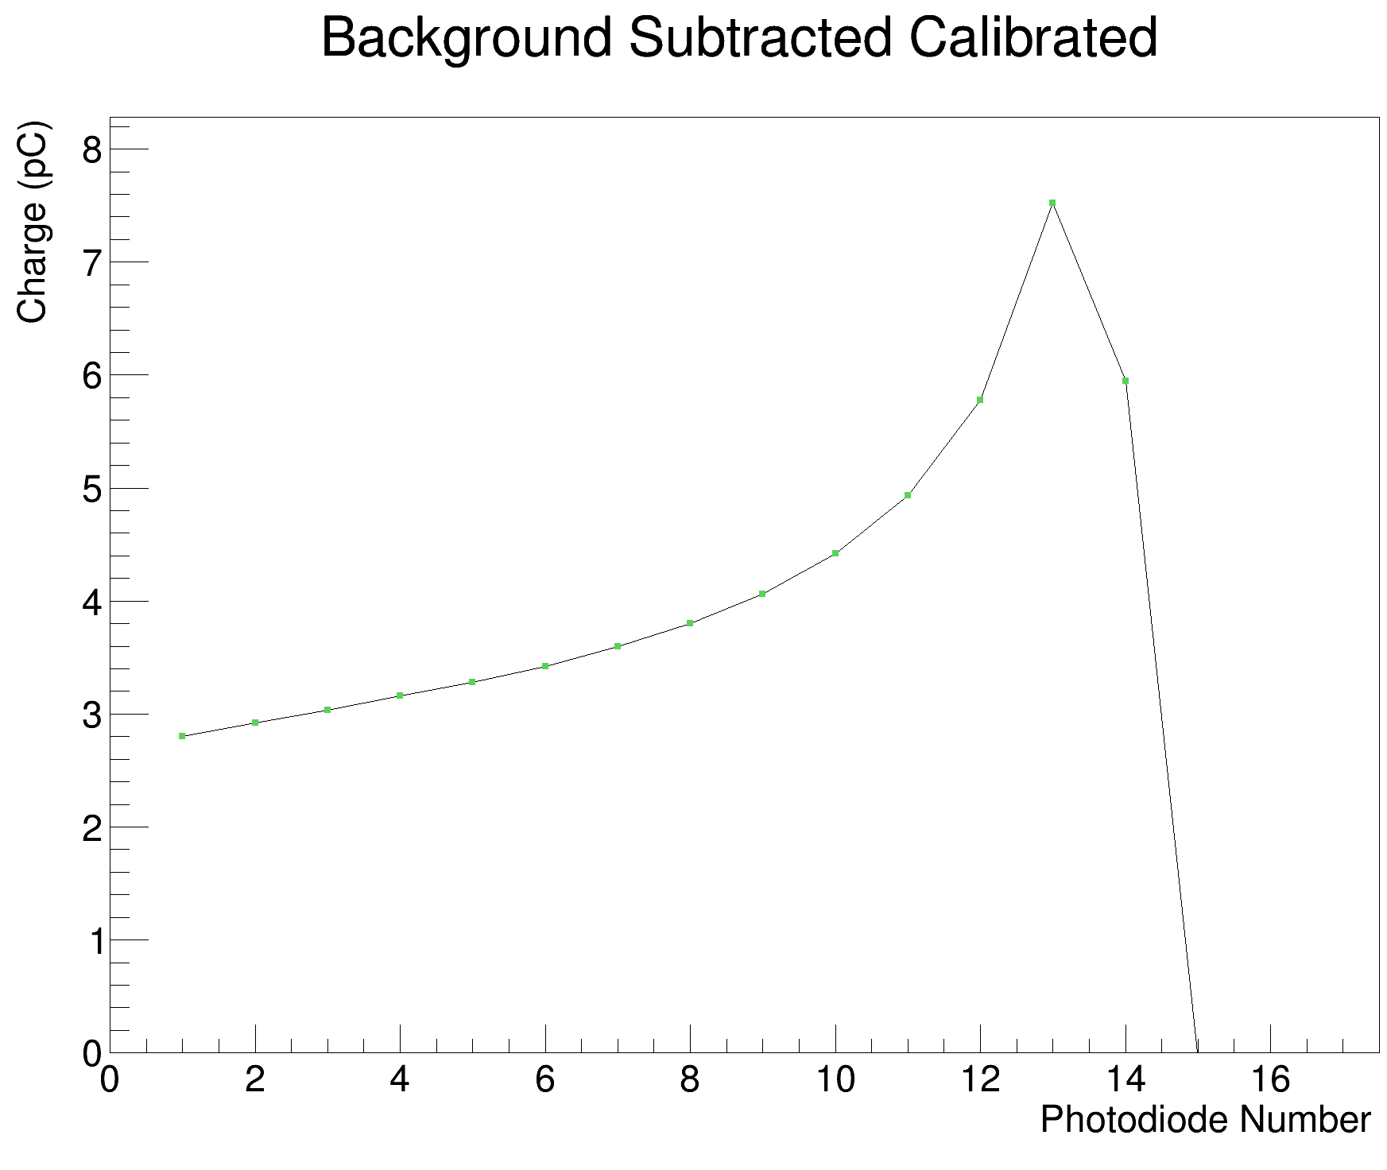
Clatt. A Results (cont.)

Slide 6


Clatt. B Results

Slide 7
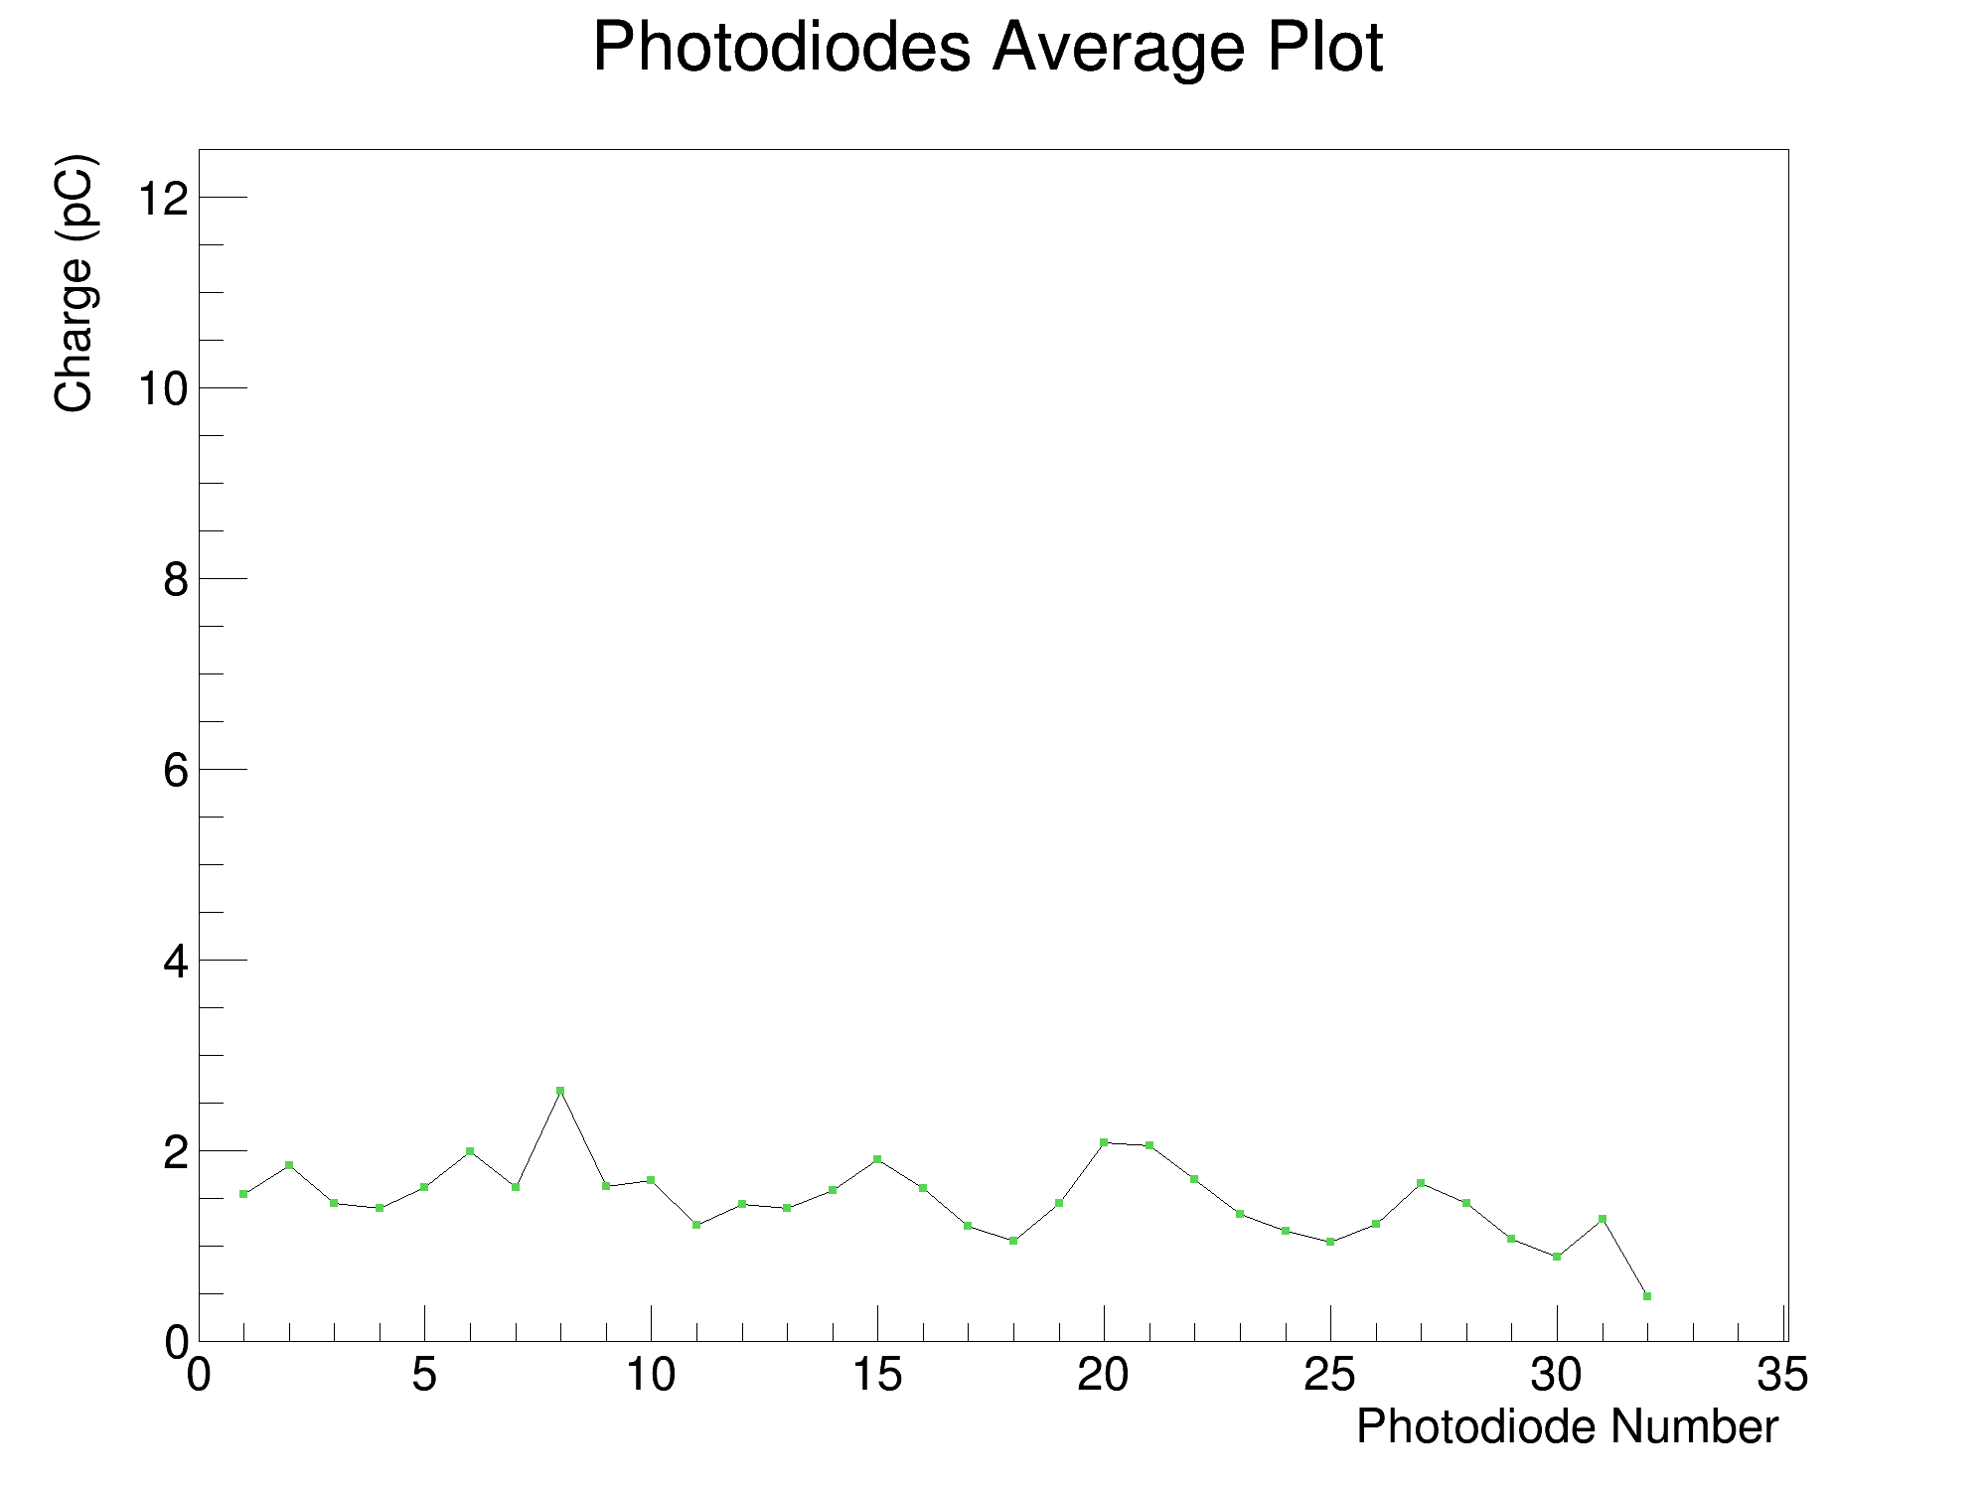
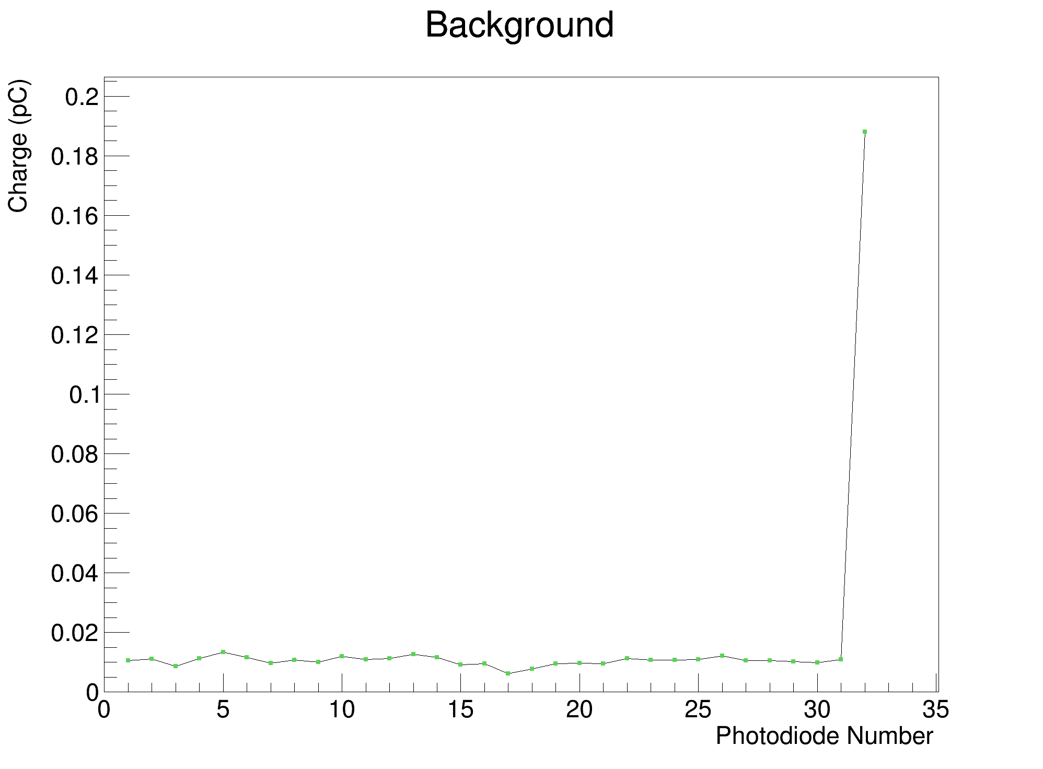
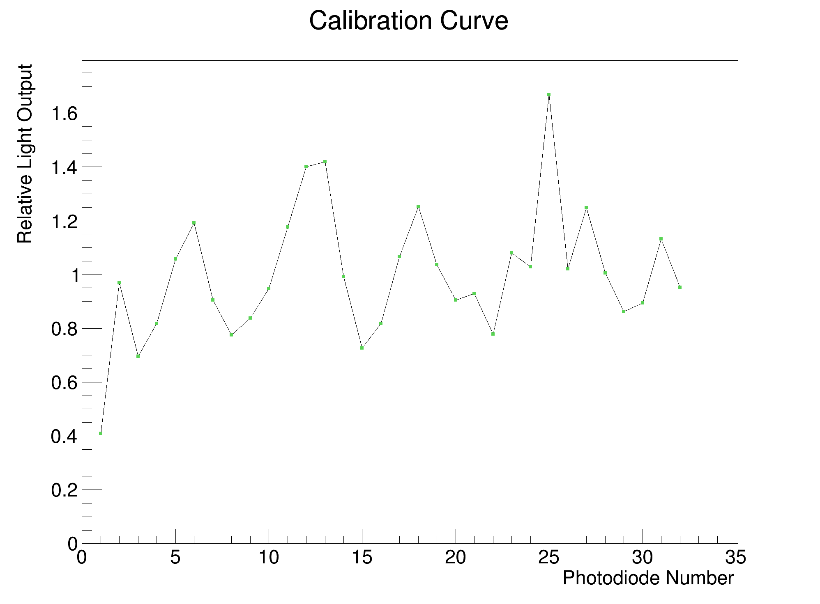
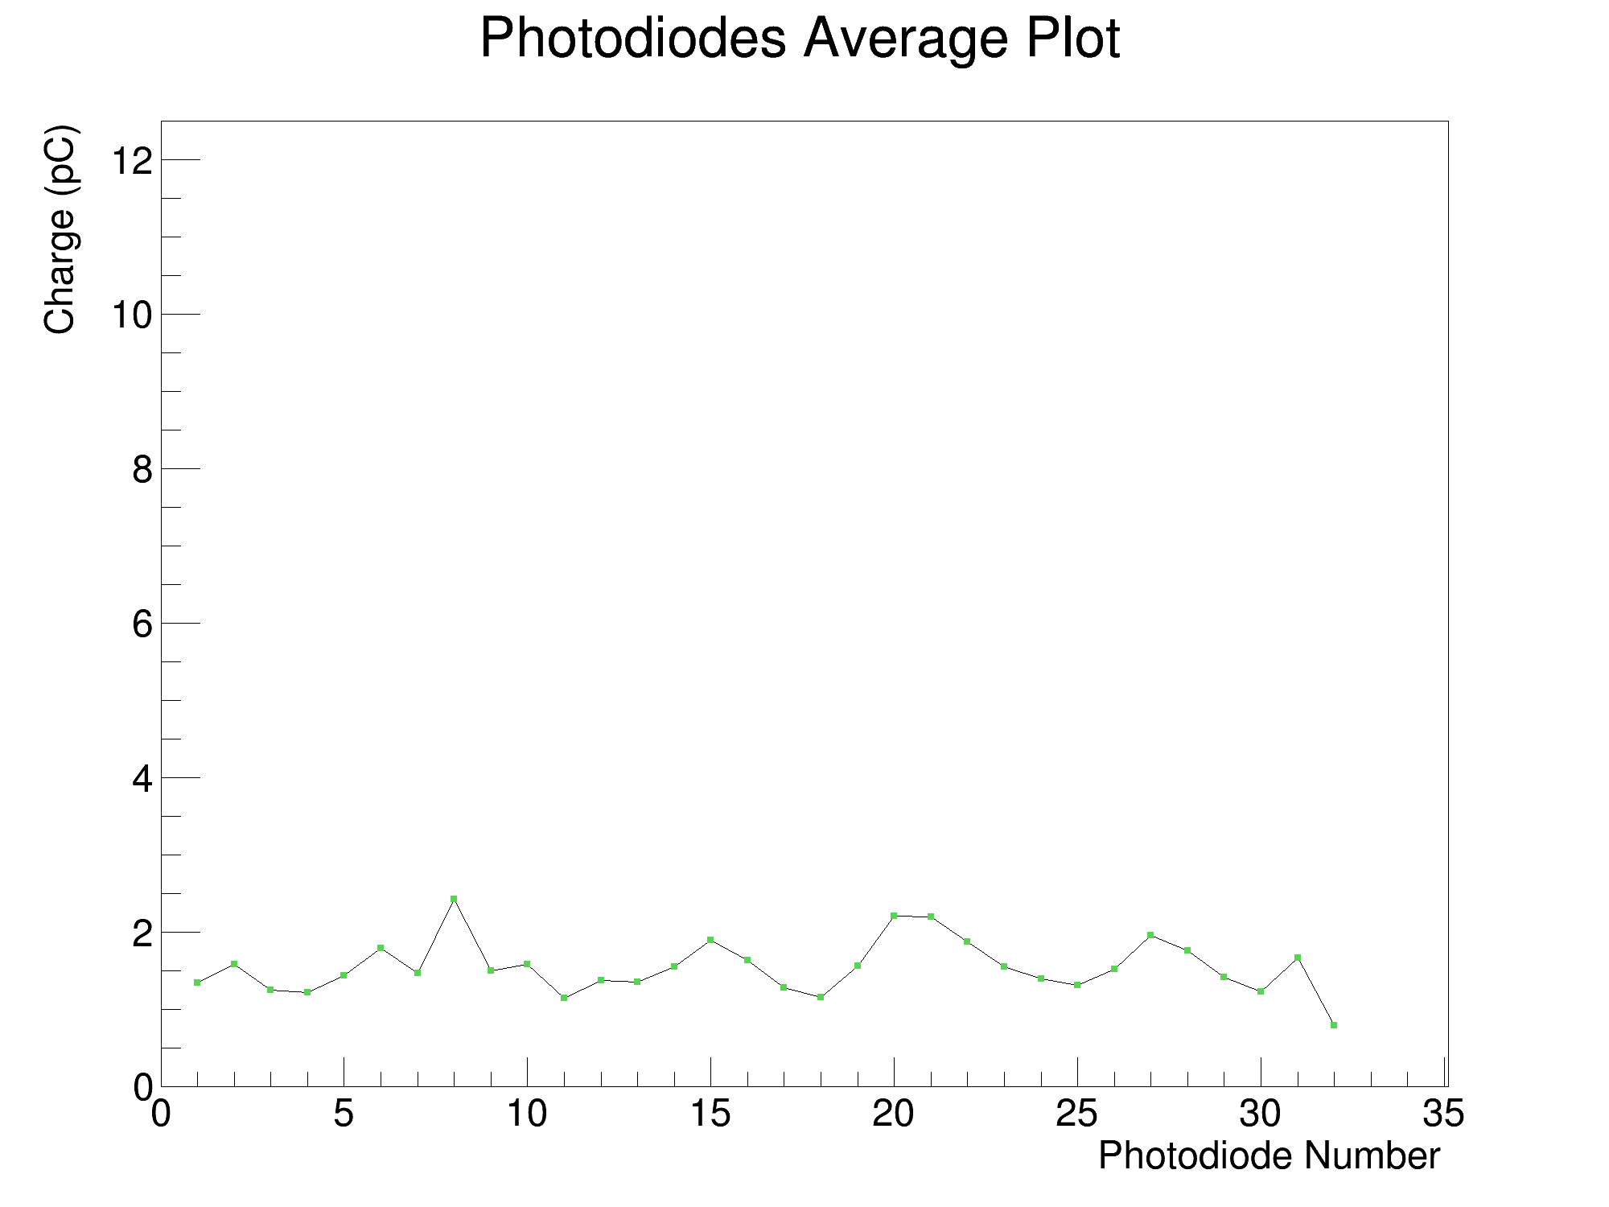
Rev. D Results

Slide 8
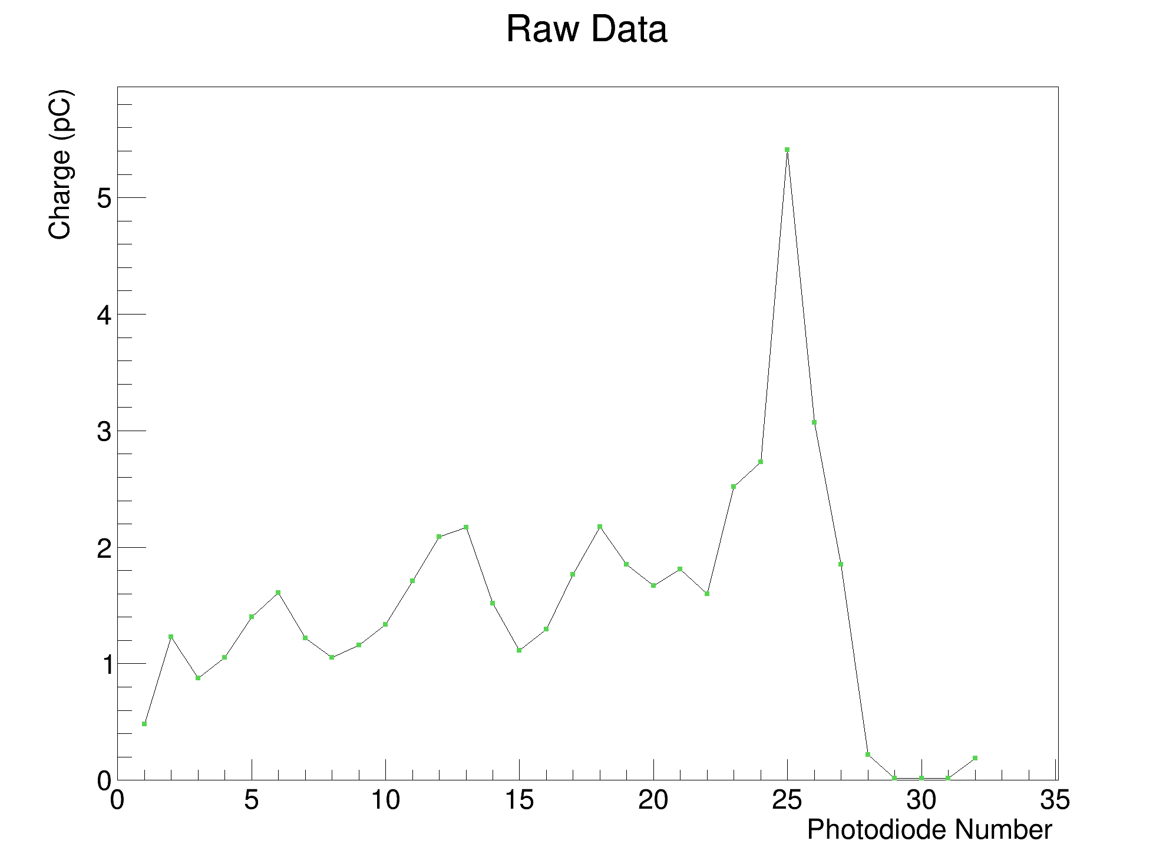
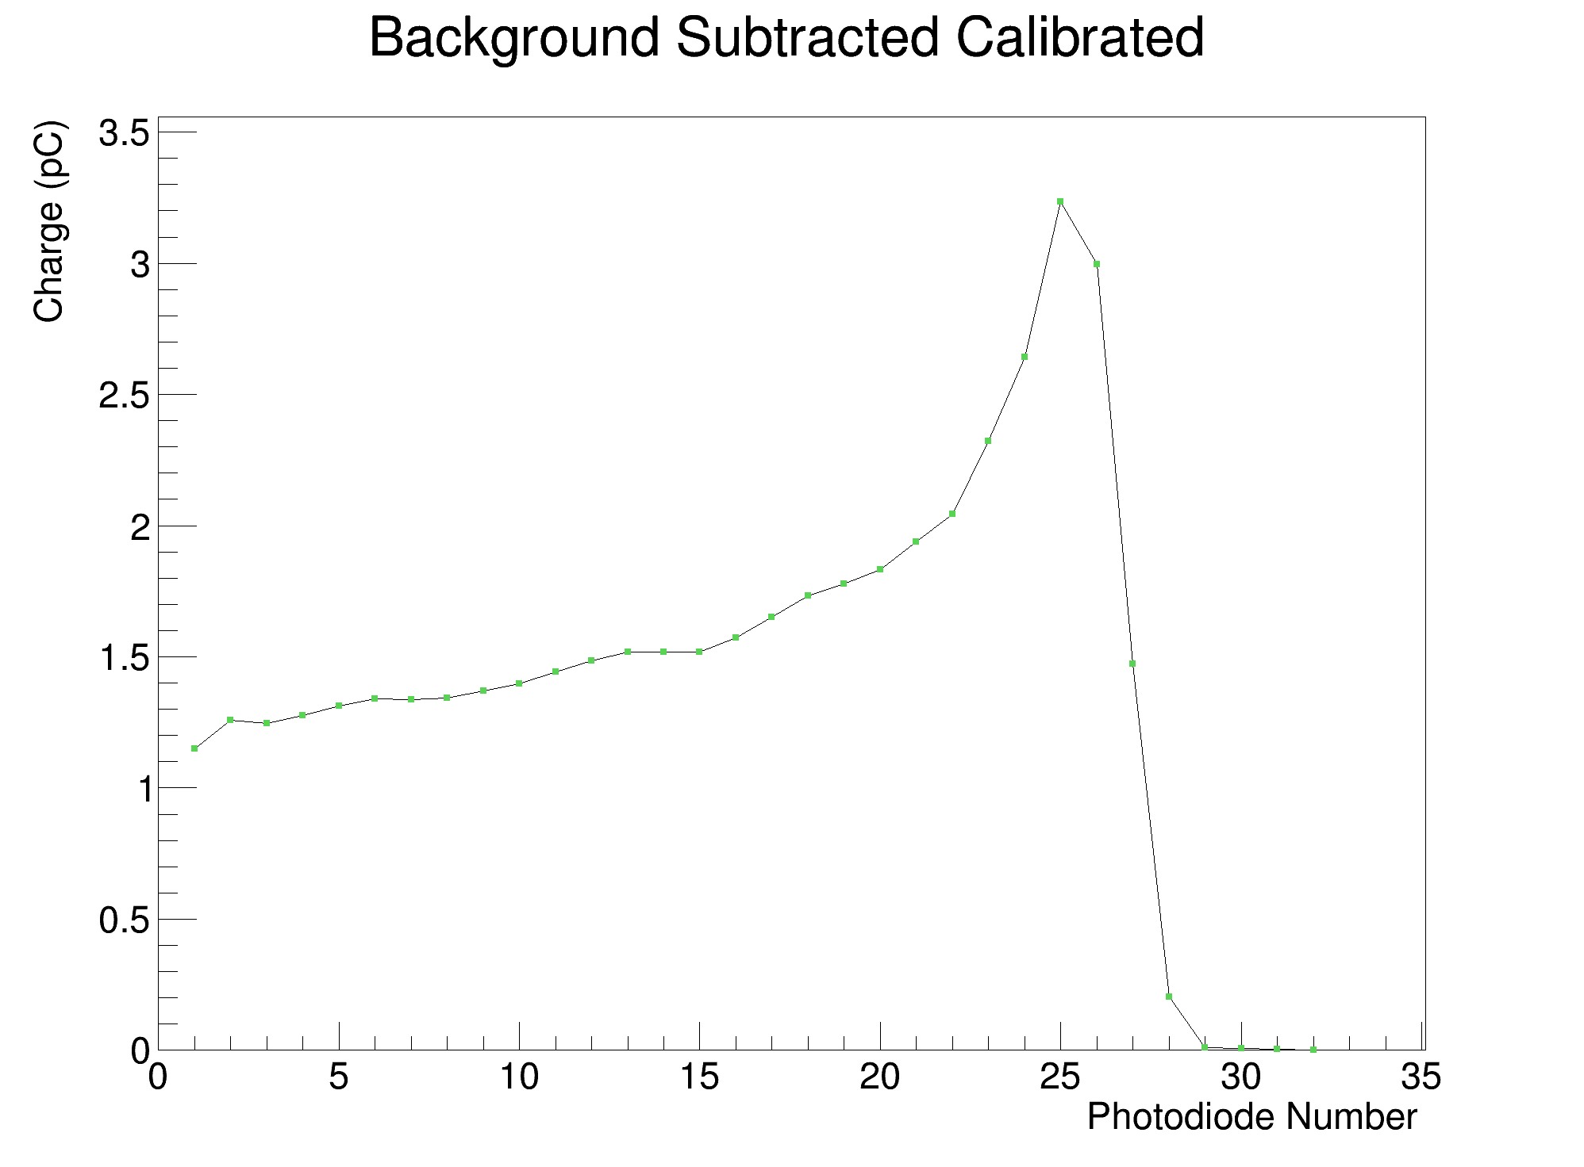
Rev. D Results (cont.)

Slide 9
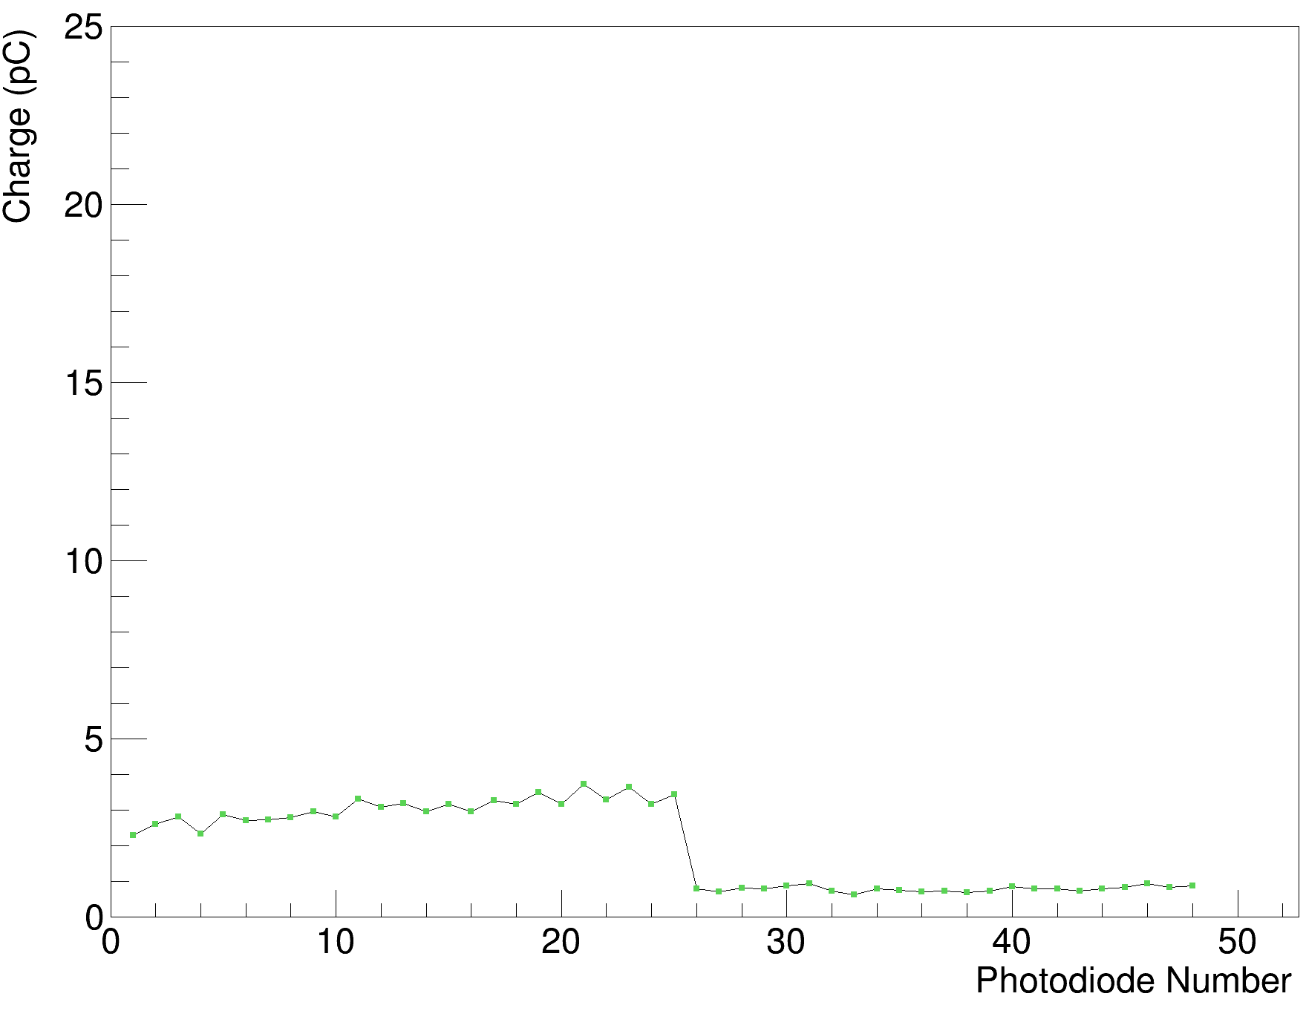
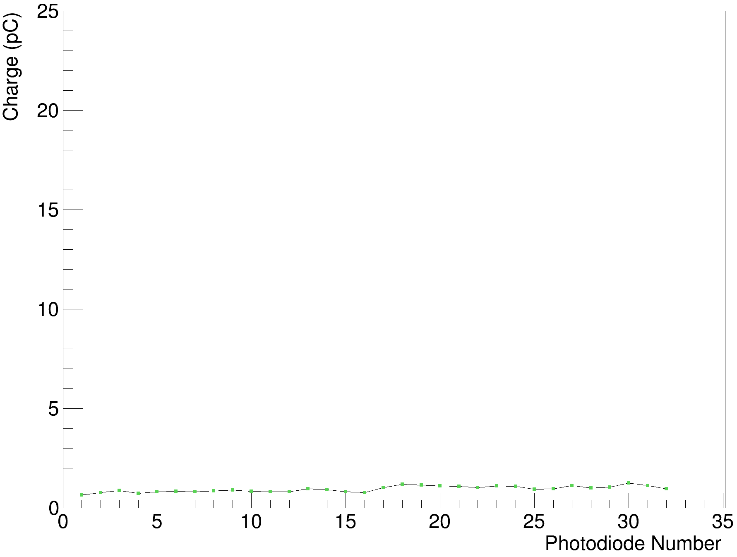
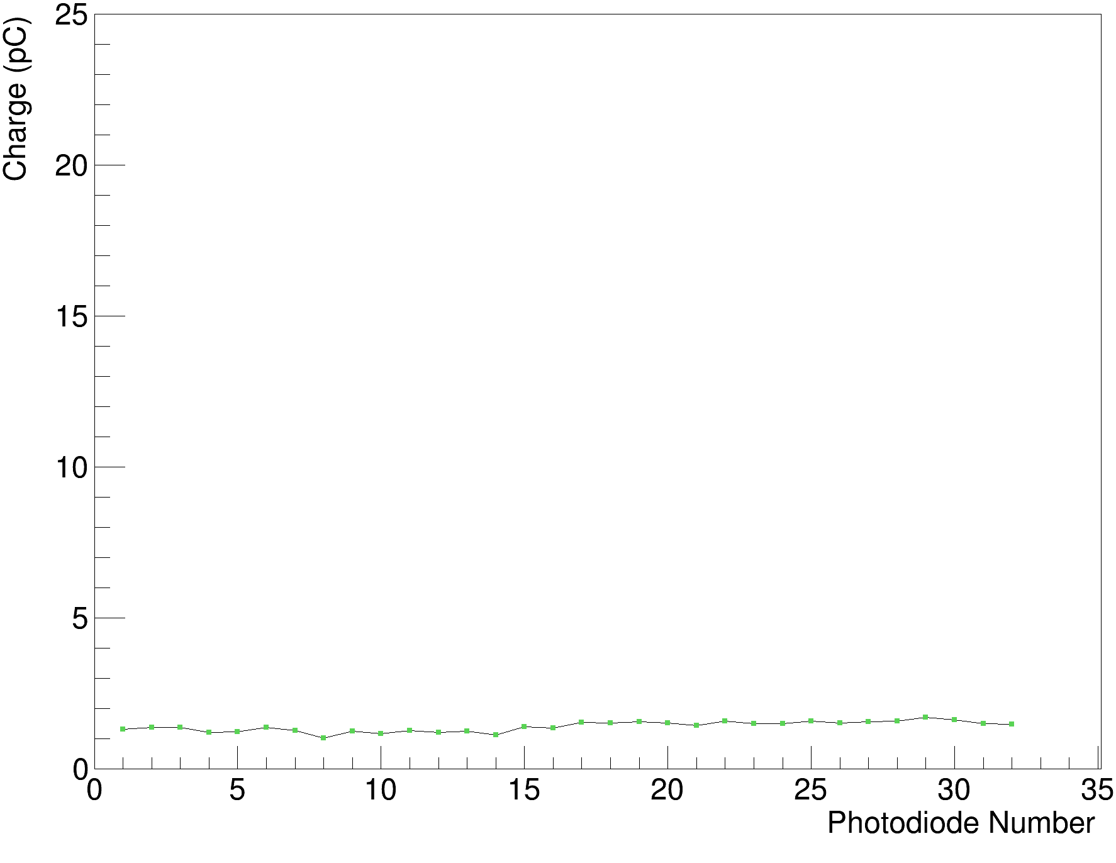
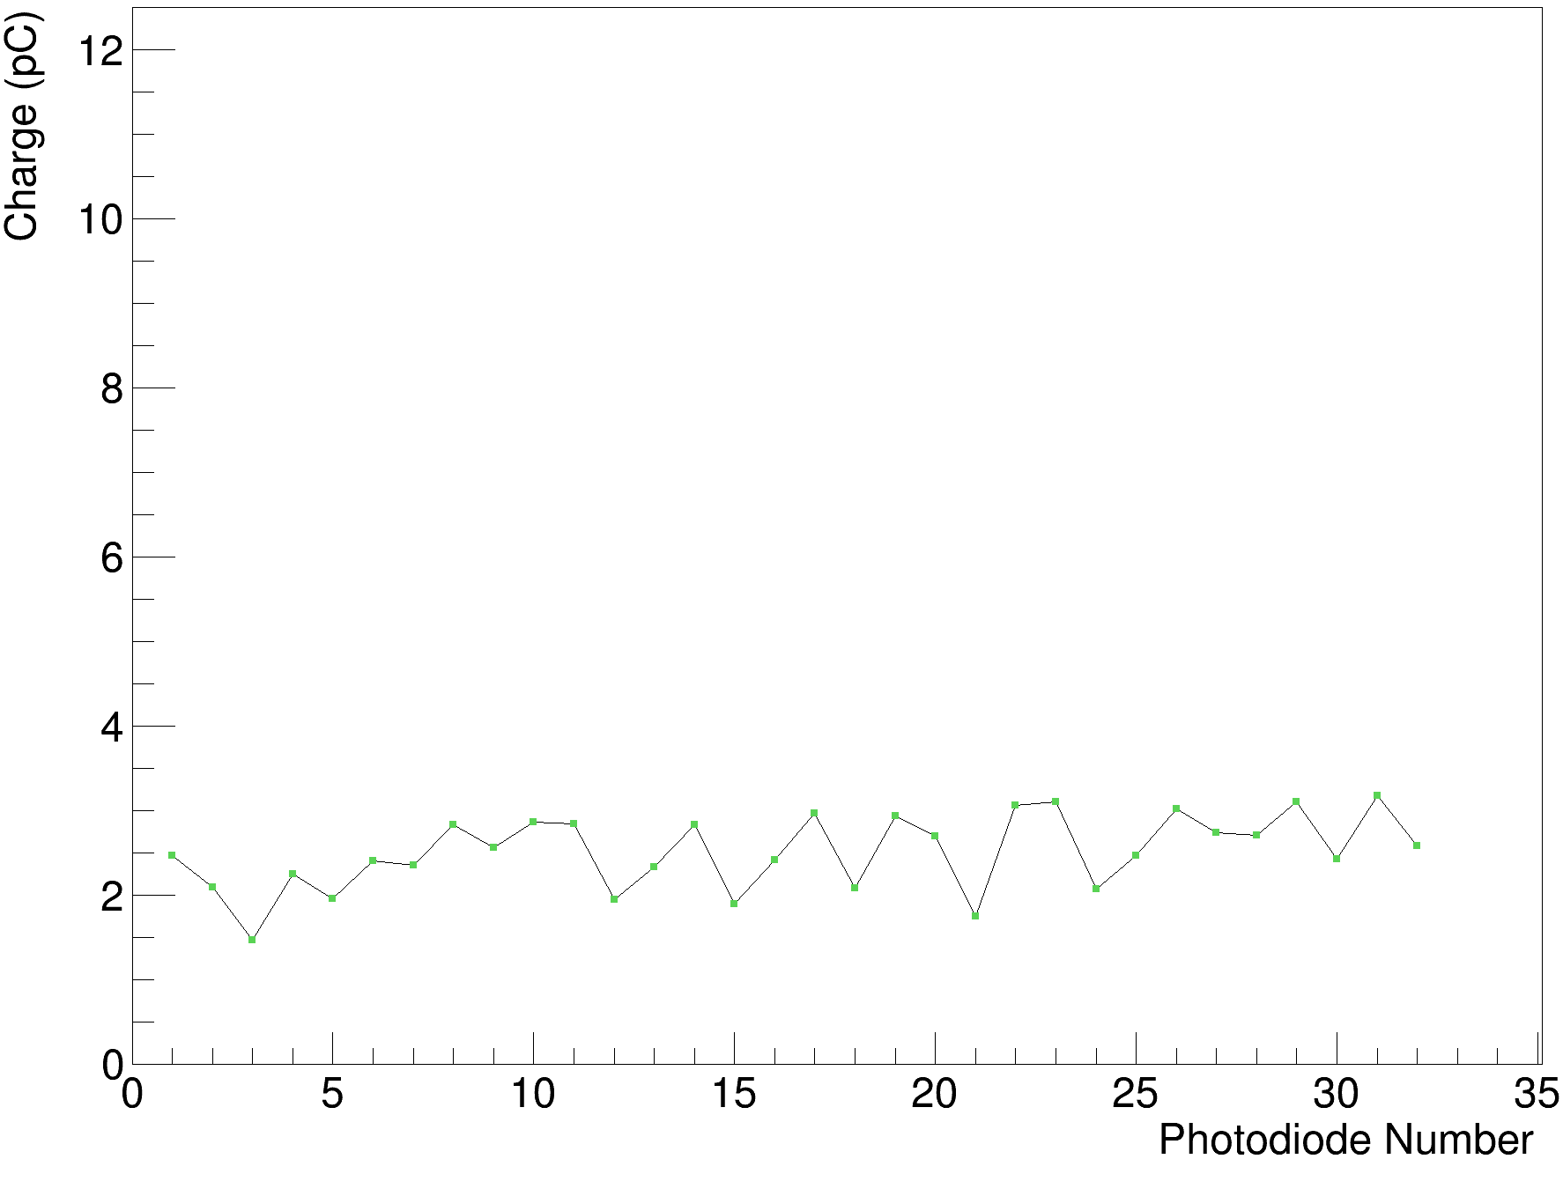
Shoot-Through Comparisons
Rev. B Clear Polished & White Painted
Rev. B White Painted
Rev. B Black Painted
Rev. B Clear Polished
Rev. C Clear Polished
(misaligned photodiodes)
Rev. D Clear Opaque

Slide 10
Giraffe WET Measurements
Configuration | Physical Thickness (mm) | WET = D₈₀^{Air}- D₈₀ (mm) | RSP
Air | 0 | 0 | 0
Empty Case | 0.012 | 0 | 0
Clear Stack | 71.00 | 73.4 | 1.034
White Stack | 65.50 | 67.7 | 1.034
Combined Clear + Stack | 135.50 (estimated) | 140.9 | 1.032
Clatterbridge A | 39.89 | 41.6 | 1.043
Clatterbridge B | 39.92 | 41.1 | 1.030
Rev. D | 95.78 | 98 | 1.023
Single Block | 178.57 | 185.8* | 1.040
*Giraffe depth-dose curve supposedly was not good for this measurement.

Slide 11
Calibrating X-Axis in WET
Overall RSP can be found using Giraffe measurement, but still need to determine the edges for each bin in fit: the sheet edges in WET.
Three multiplicative contributions:
  Physical sheet thickness (+ mylar foil)
  RSP
  Factor for difference between the total sum of individual sheet thicknesses (+ mylar) and the thickness of the stack in the holder
Which RSP to use?

Slide 12
Rev. D 130 MeV Fit
RSP: 1.034 (no adjustment)
RSP: 1.023 (+1.5% adjust)
RSP: 1.023 (no adjustment)
REFERENCE RANGE: 80.75 mm

Slide 13
UCLH 16th June Fits Revisited
RANGE DIFFERENCE: 1.34 mm
RSP: 1.034
RANGE DIFFERENCE: 0.53 mm

Slide 14
UCLH 16th June Fits Revisited
RSP: 1.024
(+3% adjust on clear sheets)
RSP: 1.024
RSP: 1.034
(+1.5% adjust on clear sheets)
RSP: 1.034

Slide 15
Conclusions
Giraffe results show previous assumption of RSP of 1.024 is not true – value appears to be closer to 1.034.
  Mylar foil seems to have little impact on overall RSP.
Rev. D sheets have about 40% of polished clear sheet light output.
  Also appear to have more variation post-calibration – curves are worse.
RSP of 1.034 helps but is not enough to correct June 16th fits.
  Still need to add mystery factor (though smaller now) of 1.5% to clear sheets to remove range energy dependence.
Experiment at Manchester should give more data with new prototype:
  Repeat WET measurement of Rev. D prototype(s) with PeakFinder.
  Bragg Peak measurements over larger energy range.

