Slide 1
Updates to Geant4 Simulation
PBT Meeting 15/03/2023

Slide 2
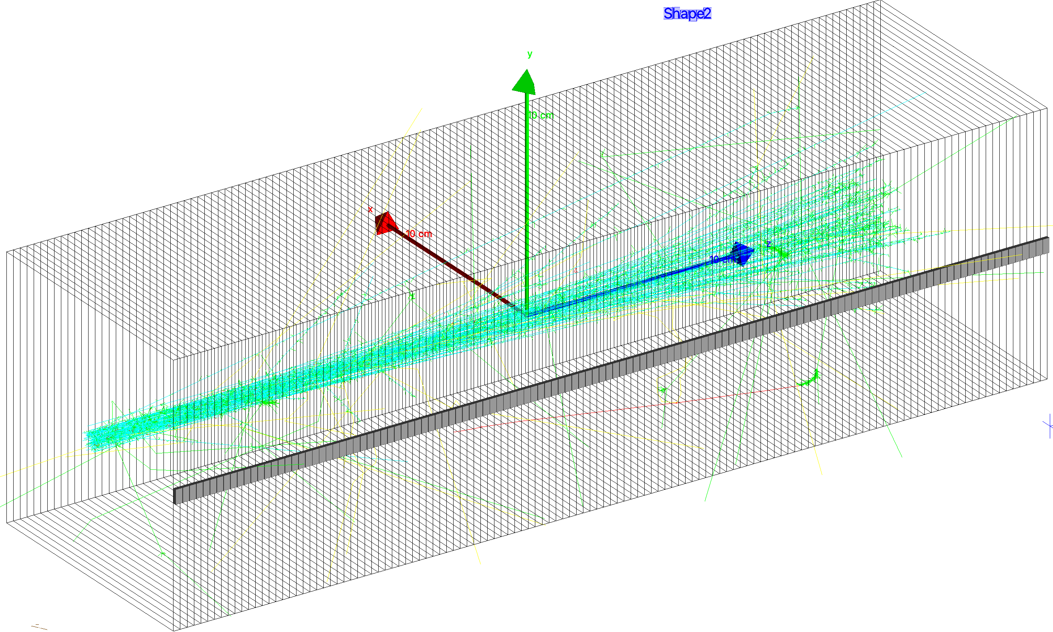
Recap
Simulation of a segmented polystyrene-based scintillator detector.
Quantities measured:
  Dose-depth (high-resolution & by-sheet)
  Light-depth (high-resolution & by-sheet)
All quantities measured and stored in .root files, accessed by plotting macro.
ROOT macro plots and fits data with Bortfeld and Kelleter (independent fits).

Slide 3
Optical Properties of Scintillator
Simple, basic properties:
  Density: 1.03 g/cm³
  Elemental composition: C₉H₁₀
  Mean ionisation excitation energy: 68.7 eV
  Fast and slow scintillation time constants: 0.9 ns and 2.1 ns.
  Birks’ constant: somewhere around 0.1 MeV/mm
Harder stuff (all energy-dependent):
  Emission spectrum (both fast and slow)
  Refractive index
  Bulk absorption spectrum
  Wavelength shifting components
    Absorption length and emission spectra
    Time constant (not energy-dependent)
  Reflectivity
Have usable data (old stuff from SuperNEMO), but not guaranteed to be representative of our scintillator
No usable data: but might not matter?

Slide 4
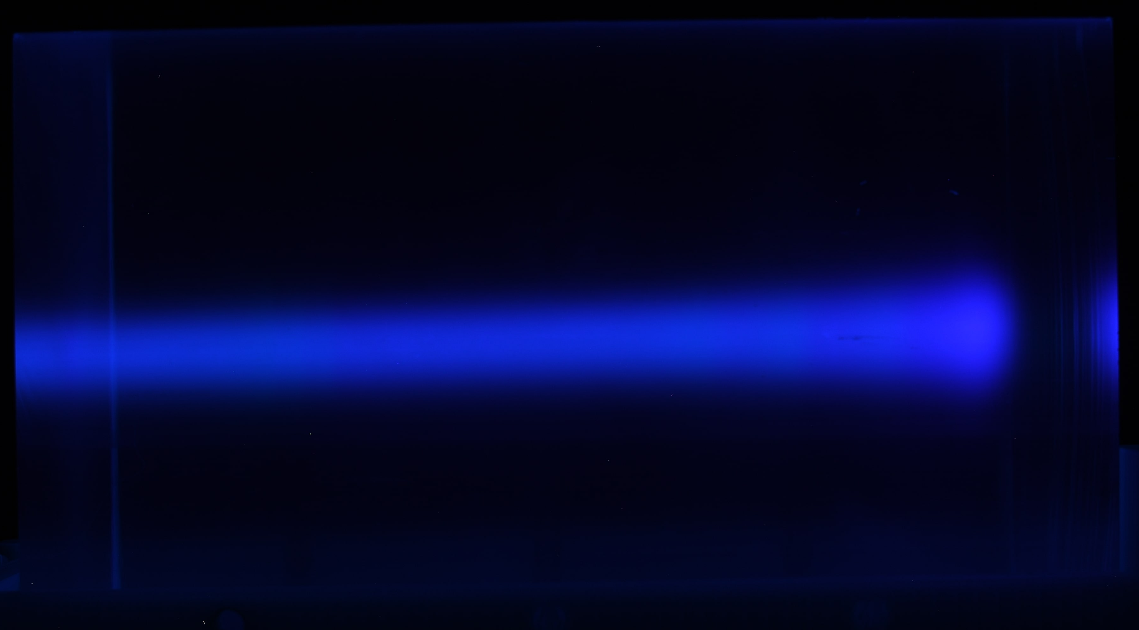
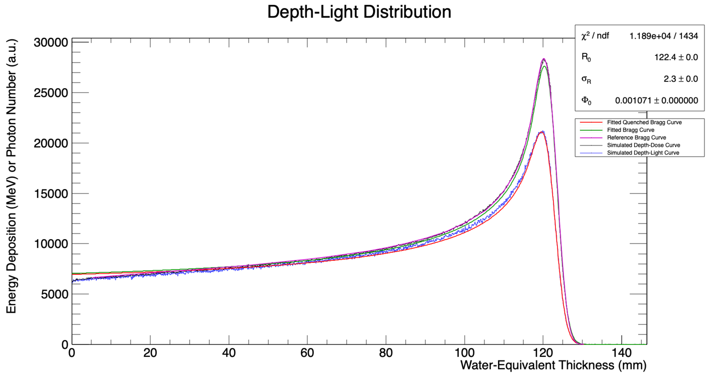
Determining Birks’ Constant
Model-dependent investigation of Birks’ constant using single-block depth-light curves measured with a camera at UCLH.
To measure Birks’ constant:
  Produce simulated depth-dose curve that matches UCLH reference depth-dose curve. This also creates a depth-light curve.
  Plot image data alongside simulated depth-light curve produced in step 1. Everything normalised to value at entry (little quenching).
  Re-run simulation with different kB values until simulated depth-light curve matches real data (using Kolmogorov-Smirnov test).
Note: fitted curves not actually needed at all!

Slide 5
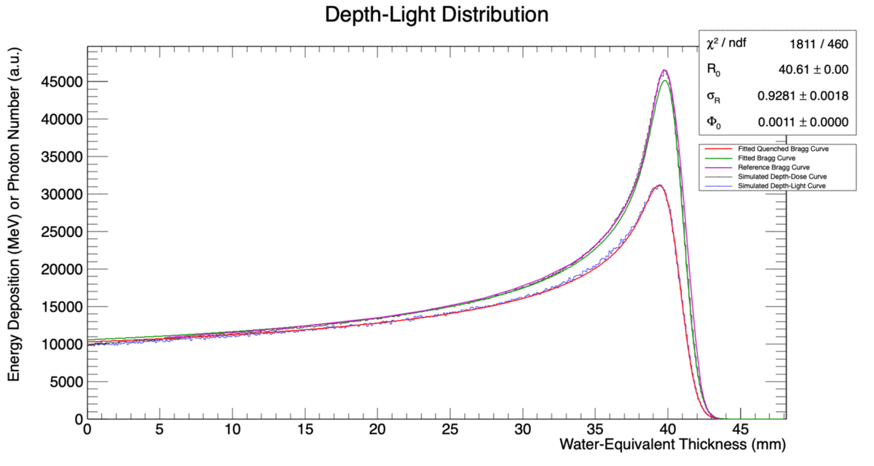

Slide 6
Range Reconstruction Accuracy
Using an RSP = scintillator density does not work for some reason!
RSP = 1.030 = Scintillator Density
RSP = 1.018

Slide 7
Conclusions and Next Steps
We have a list of values of Gaussian energy straggling to match UCLH depth-dose data: matched by hand/eye.
New functionality: implemented a detector messenger to allow Birks’ constant to be set at runtime.
  Could be developed to add further customisation e.g. sheet size, thickness, etc.
Verifying optical properties of scintillator with NUVIA is key.
Geometry has photodiodes implemented as sensitive detectors however light collection doesn’t seem to work.
  Tricky things like photon reflection and transmission.
  Diode material may not matter as just need to collect photons on surface.

