Slide 1
PARTREC Analysis
25/11/2022 Beam Test

Slide 2
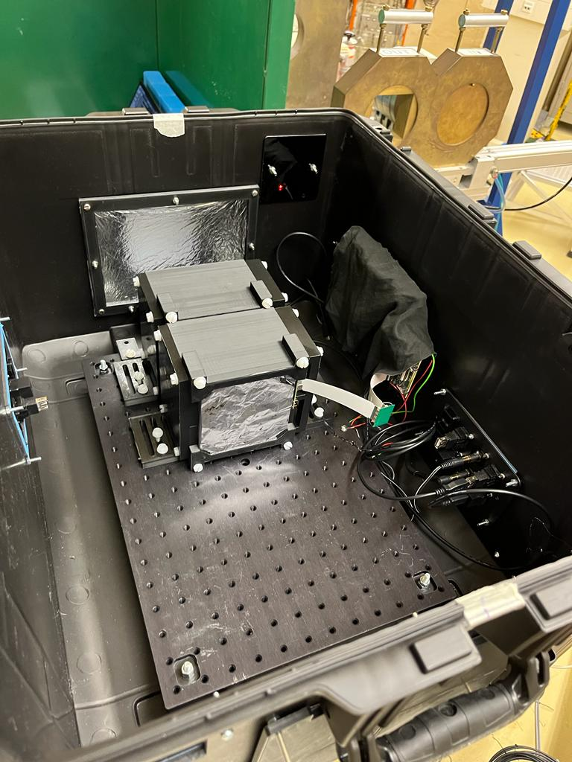
Experimental Setup
Used 2 32-sheet Rev. C modules to test range reconstruction between 60 – 150 MeV.
Test performance at FLASH currents
  Currents tested: 1, 2, 5.5, 10, 20, 30 and 47 nA.
Previously used prototypes at Manchester
  Stacks “1” and ”2”.
  Measured RSPs of 1.024 and 1.016.
    Latter was found to be better at 1.018.
Using Manchester calibration shoot-throughs.

Slide 3
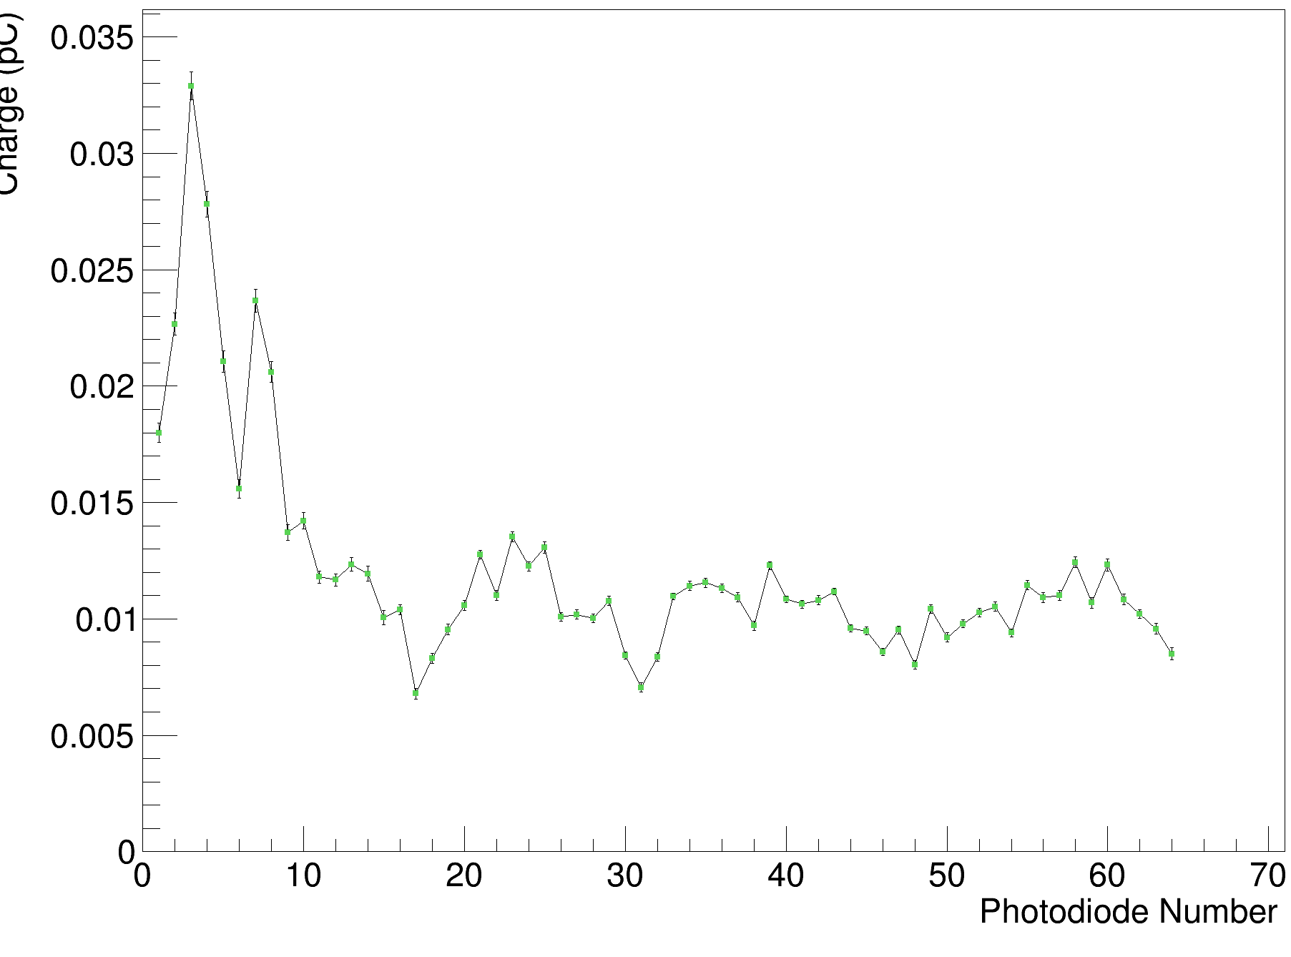
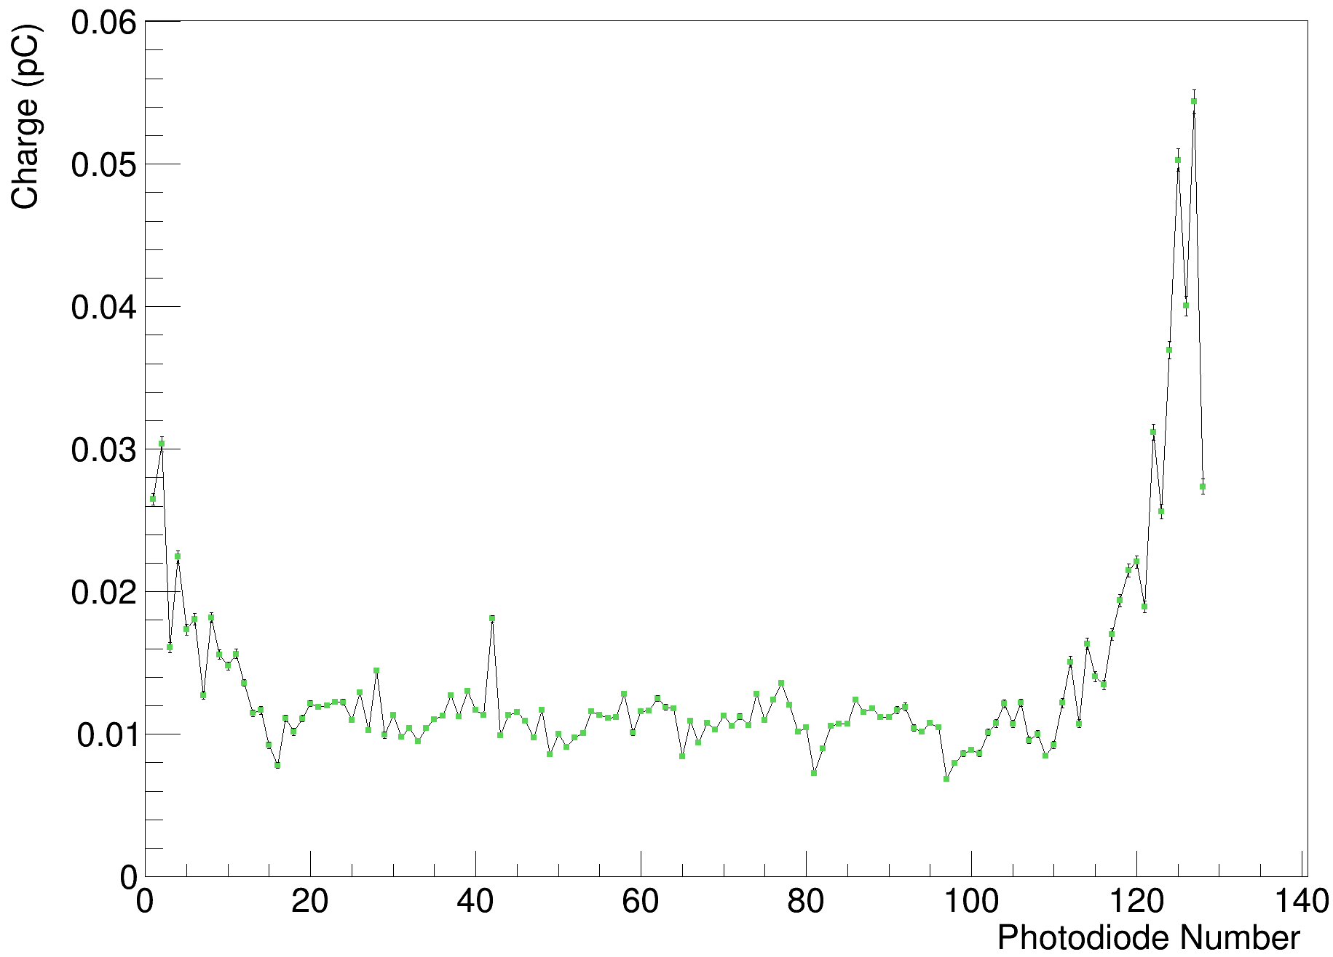
Background Comparison
PARTREC
The Christie

Slide 4
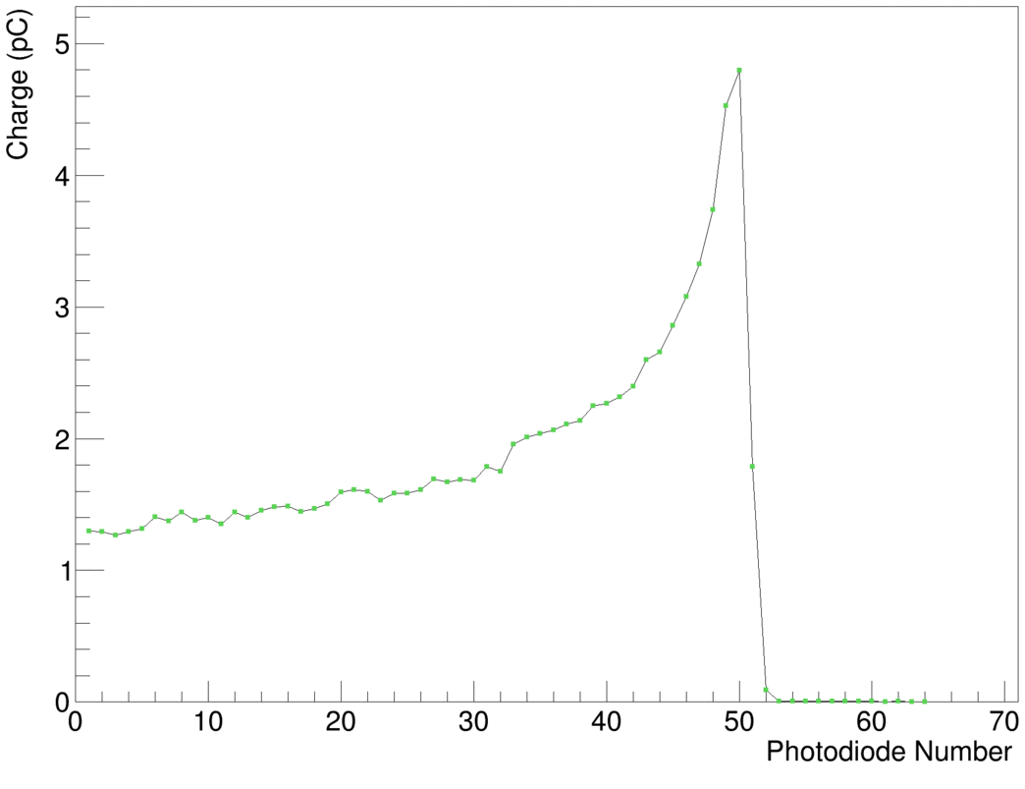
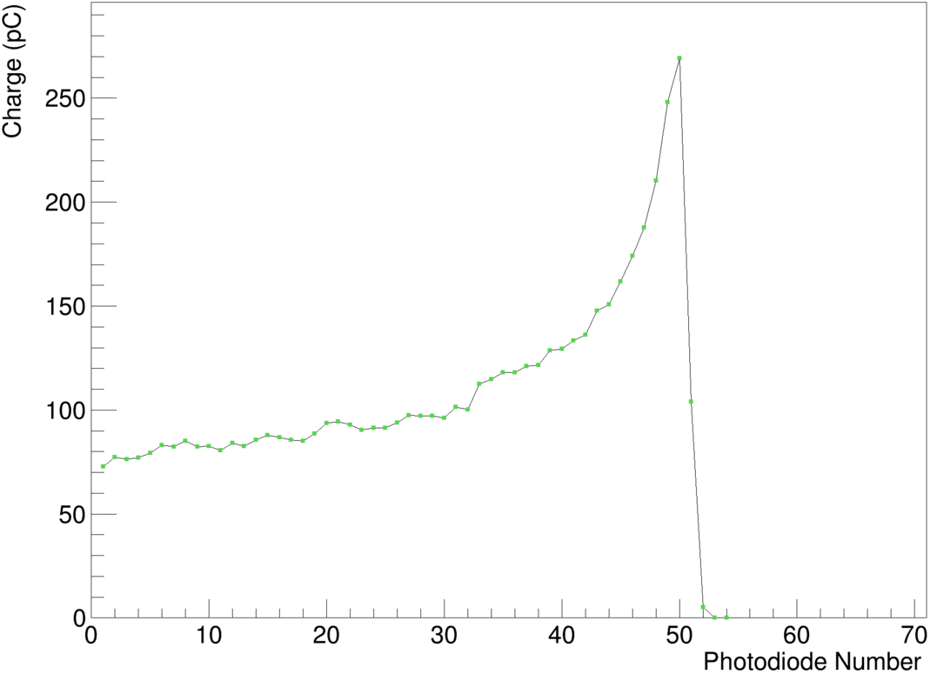
Calibrated PDL Comparison
1 nA
47 nA

Slide 5
Average Charge vs. Beam Current

Slide 6
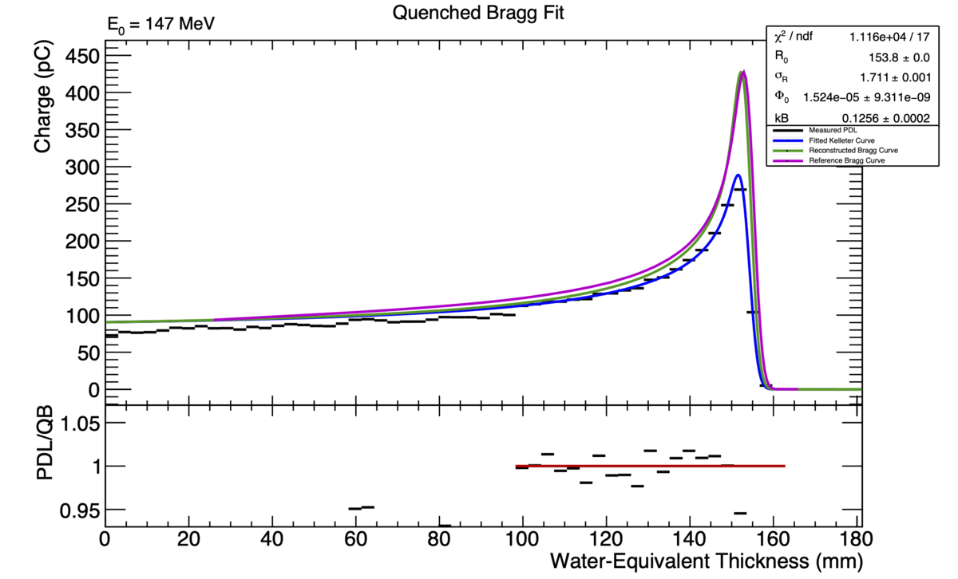
Fit Comparisons (1 nA vs. 47 nA)

Slide 7
Range vs. Beam Current

Slide 8
Birks’ Constant vs. Beam Current
Note: hierarchy inverted from last slide!

Slide 9
Range Accuracy vs. Beam Energy

Slide 10
Conclusions
Reconstructed PDLs show worsening of beam with lower energies.
  Could be due to aluminium beam degrader? Direct proton hits in diodes.
  Similar effects NOT seen in reference data – though this is likely measured in the middle of the beam.
Appear to have linear scaling of average charge with beam current.
Fit results NOT consistent across different beam currents:
  Appear to have a correlation with range and Birks’ constant: better, more consistent results at higher currents, though effect tapers off past 10 nA?
  Fit results generally worse at lower beam energies: see very small values of Birks’ constant. Lower energies shift range more with increasing beam current.
Range accuracy appears to be systematic value at around 0.8 mm but need more reference data to confirm this among outlier data points.

