Slide 1
MINOS+ Starts April 2013 for three years
April 2013-2016

Slide 2
MINOS+
Summary of Physics Goals
Search for non-standard 3x3 mixing behaviour
θ₂₃ and Δm²_{atm} (the new precision frontier)
Sterile Search
Non-Standard Interactions & Extra Dimensions
Atmospherics

Slide 3
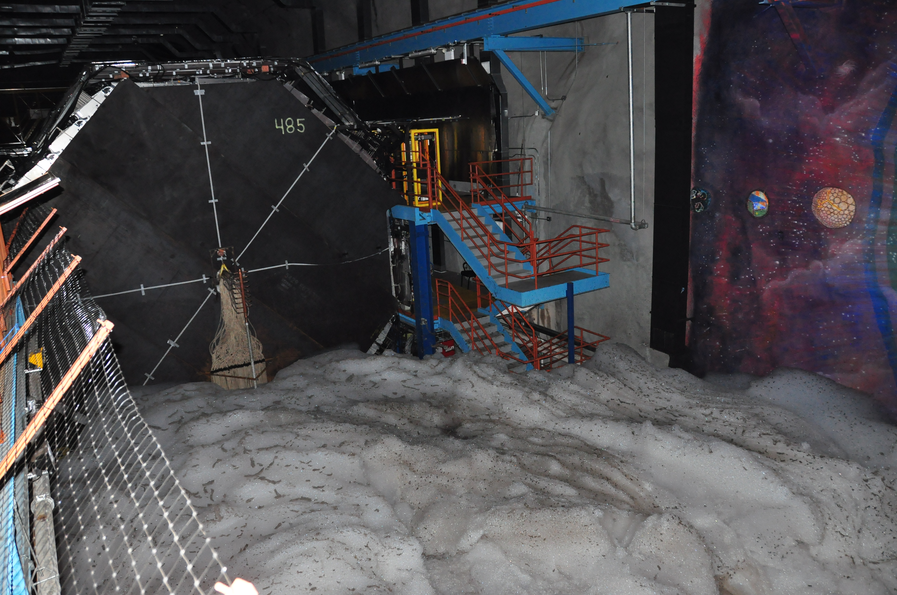
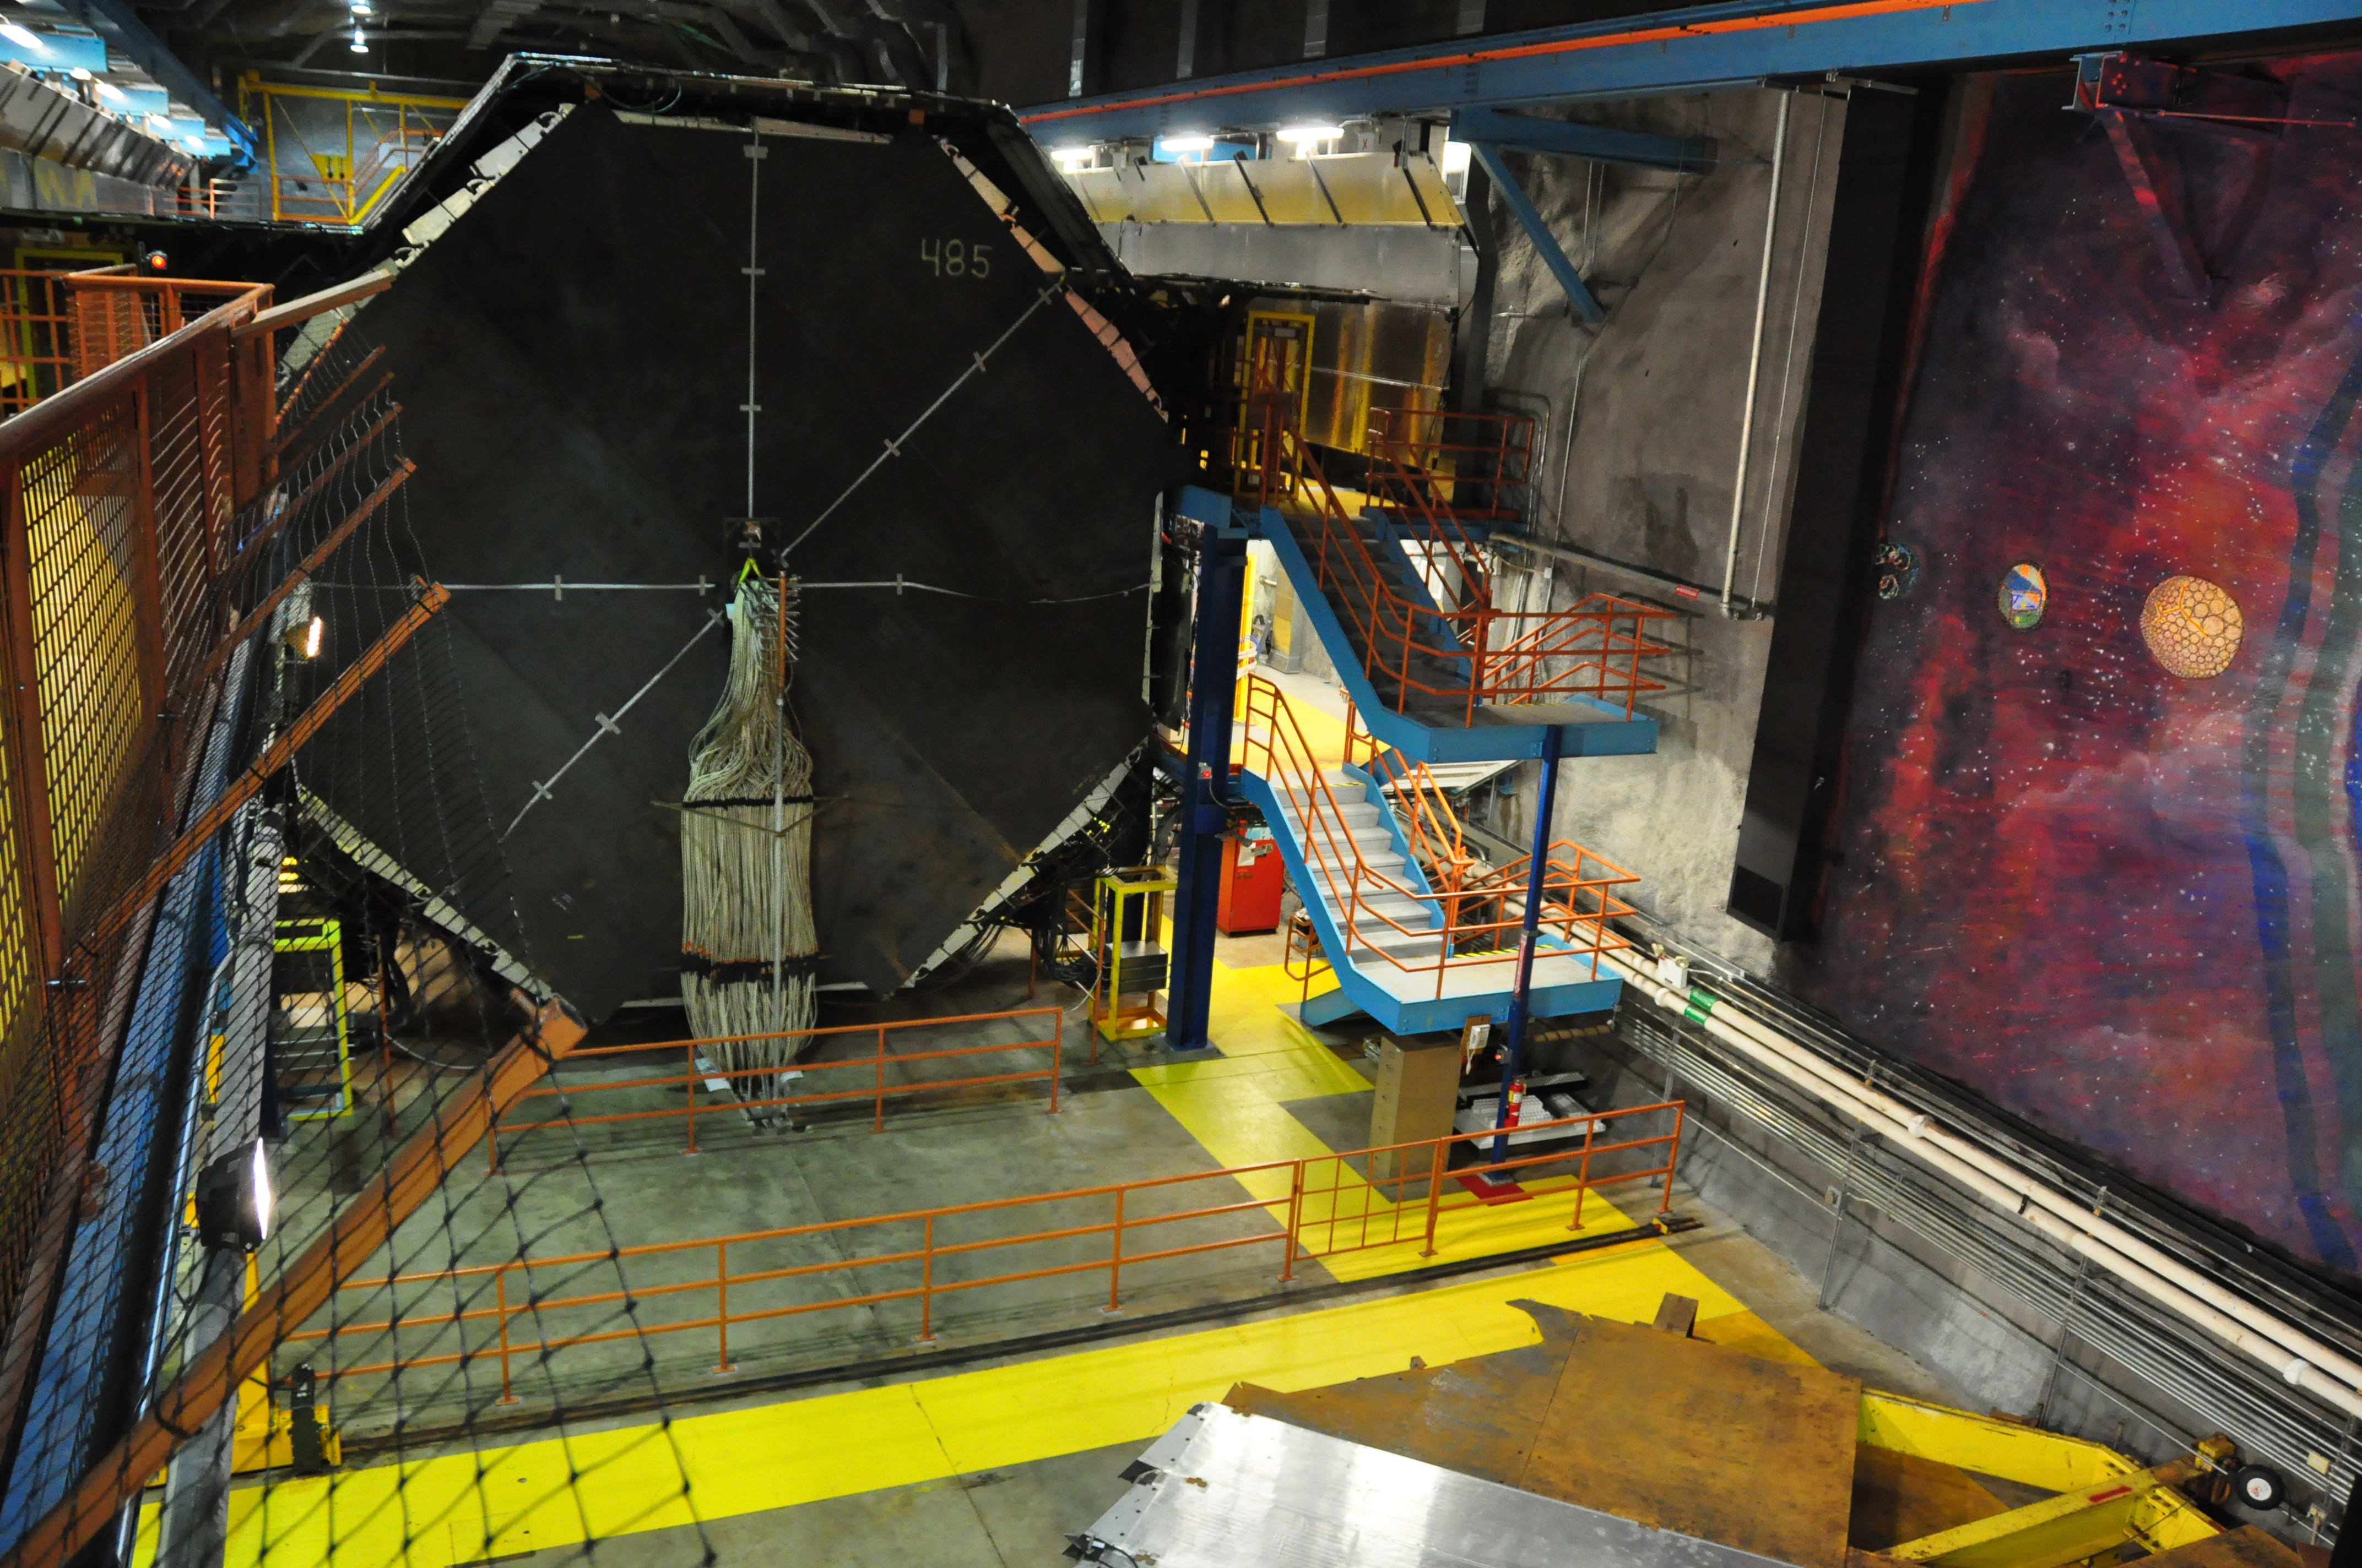
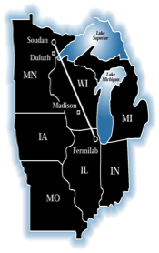
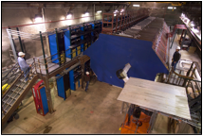
The MINOS(+) Experiment
Tracking sampling calorimeters
steel absorber 2.54 cm thick (1.4 X₀)
scintillator strips 4.1 cm wide (1.1 Moliere radii)
1 GeV muons penetrate 28 layers
Functionally equivalent
same segmentation
same materials
same mean B field (1.3 T)
5 kT
Two detectors mitigate systematic effects
beam flux mis-modeling
Neutrino x-sec uncertainties
L/E ~150-250 km/GeV
Magnetized:
muon energy from range/curvature
distinguish μ⁺ from μ⁻
~1 kT

Slide 4
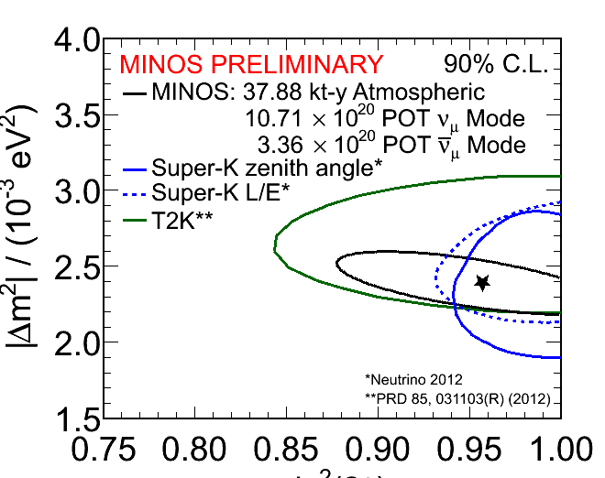
θ₂₃
MINOS have combined atmospheric and beam neutrinos and anti-neutrinos for most precise Δm² and sin²2θ₂₃ < 1.0
Super-K have done full 3-flavor analysis
Information about which octant θ₂₃ in
θ₂₃ is the new θ₁₃ !!!
Global fit (Fogli et al.) prefers sin²θ₂₃< 0.5

Slide 5
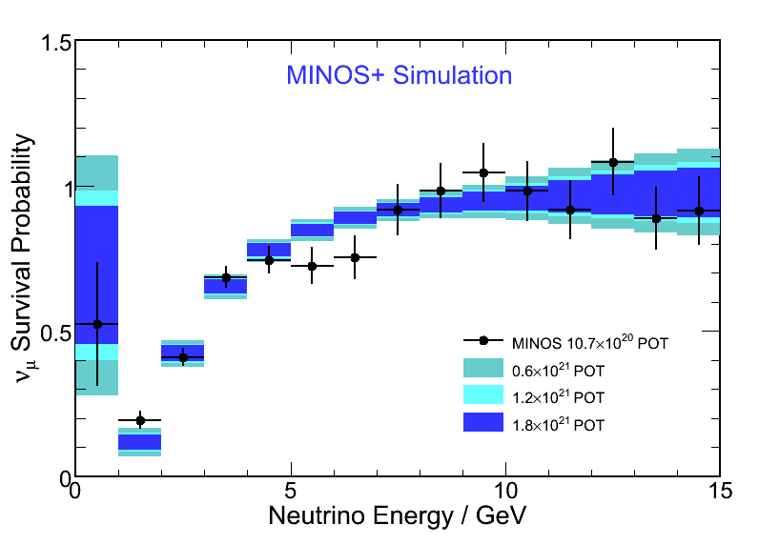
Non-Standard 3x3 Mixing
The overarching reason to run MINOS in the NuMI-NOνA beam is to look for new physics in a previously unexplored region
3000 events/year between 4-10 GeV near oscillation maximum
Unique high statistics experiment with charge sign measurement
different energy region
different systematics (beam, x-sec comp )

Slide 6
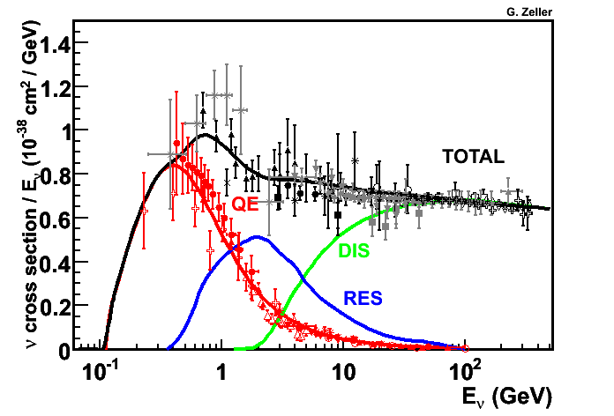
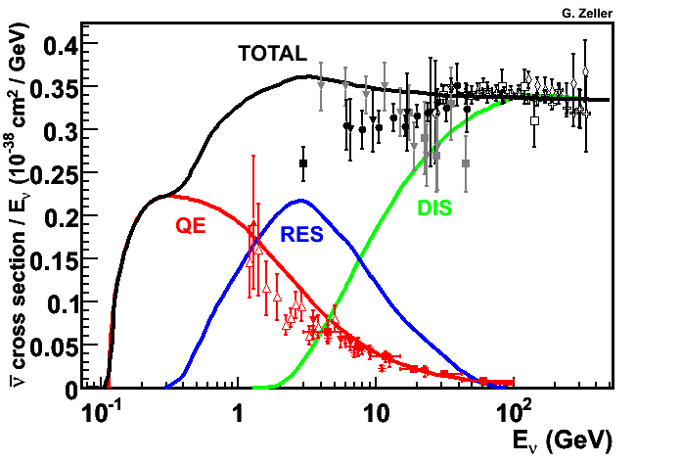
Cross check MINOS in different energy region
The overarching reason to run MINOS in the NuMI-NOνA beam is to look for new physics in a previously unexplored region
3000 events/year between 4-10 GeV near oscillation maximum
Unique high statistics experiment with charge sign measurement
different energy region
different systematics (beam, x-sec combination )

Slide 7
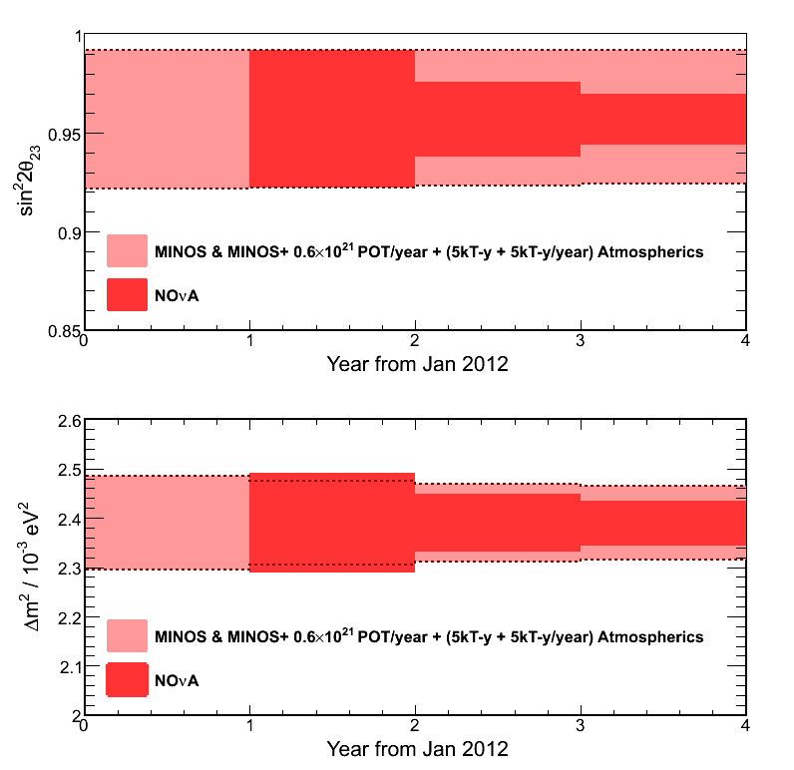
θ₂₃ and Δm²
Very precise measure of Δm²₂₃ can be achieved
Combined with Nova and T2K, ~1% measurement of this parameter
1% measurements of Δm²₃₂ and Δm²₃₁ can give mass hierarchy (http://arxiv.org/pdf/1206.6017v1.pdf)
Some contribution to knowledge of sin²2θ₂₃

Slide 8
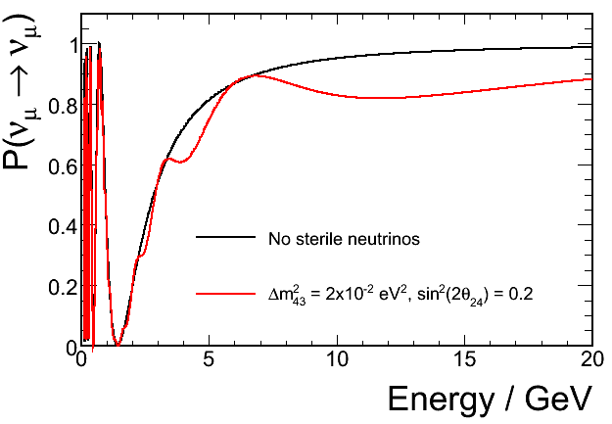
MINOS+
Powerful search for sterile neutrinos
Odd dip will have to wait for MINOS+ for more study
Oscillation spectrum pretty insensitive to primary oscillation parameters in this region

Slide 9
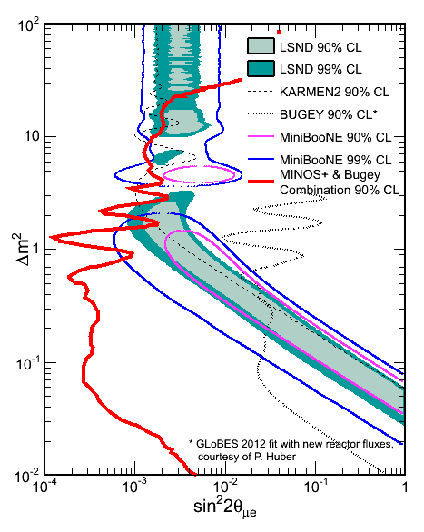
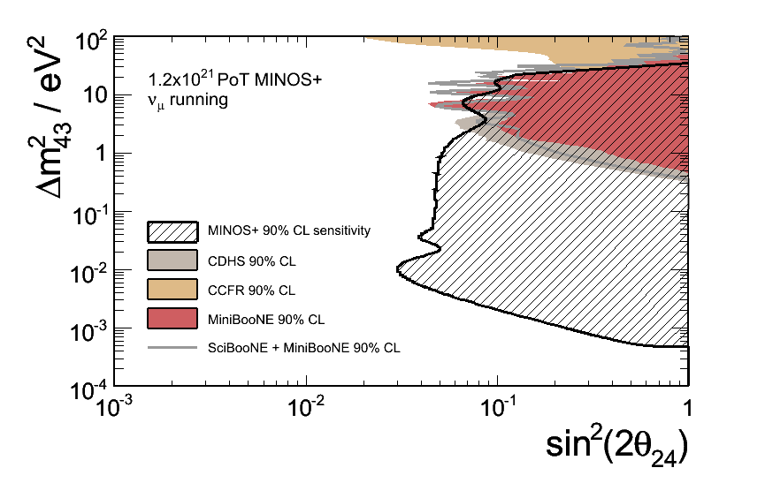
MINOS+ sterile reach
|U_{e4}|² = sin²θ₁₄
|U_{μ4}|² = cos²θ₂₄ * sin²θ₂₄
sin²(2θ_{μe}) = 4|U_{e4}|² * |U_{μ4}|²

Slide 10
NSI & Extra Dimensions
Dimension 5 non-standard contact interactions show up in the region of study
The same ratio could show half micron sized extra dimensions
P.A.N.Machado,H.Nunokawa,R.Zukanovich Funchal, hep-ph/1101.003v1
Alexander Friedland , Cecilia Lunardini, Phys. Rev. D74 :033012, 2006.
J. Kopp, P.A.N. Machado and S.Parke, Phys.Rev.D82:113002 (2010).

Slide 11
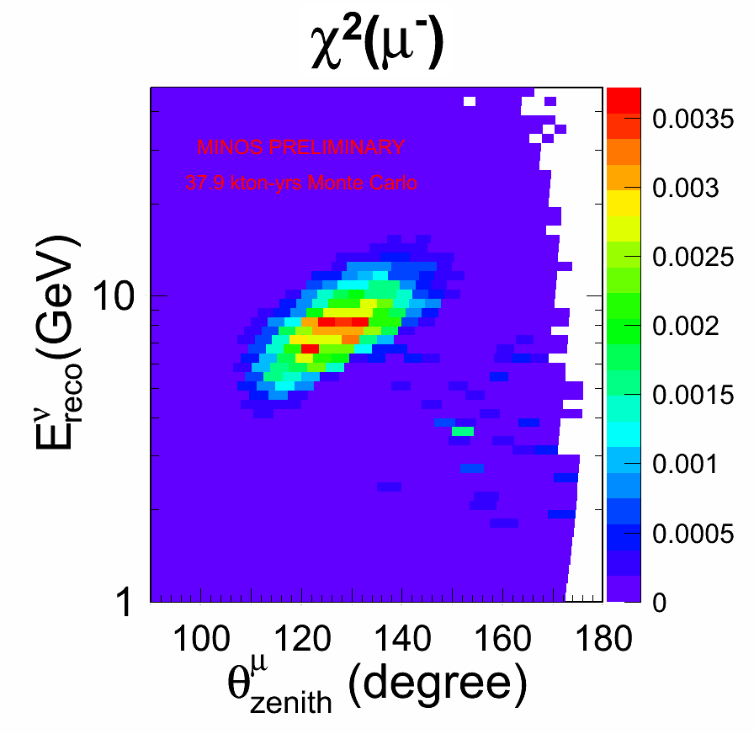
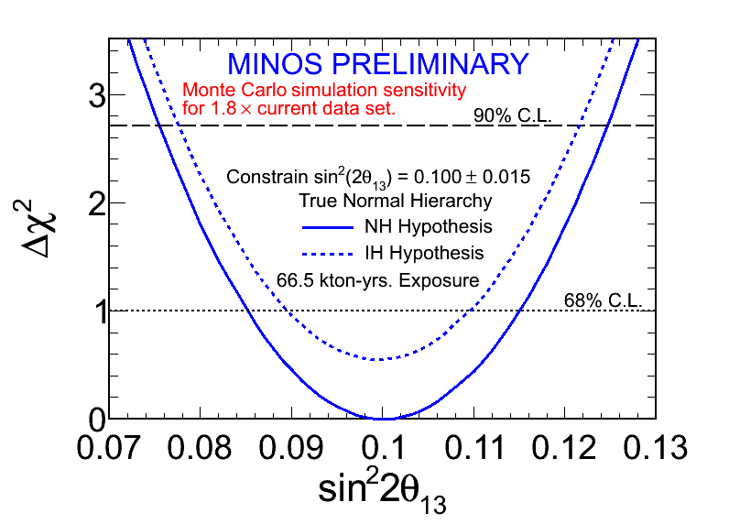
Atmospherics
Magnetic field allows identification of m+ and m-
Complementary to SuperK who ID ne events
Alone not conclusive, but combined with SuperK, could give information on mass hiearchy

Slide 12
Summary
Unique among long baseline neutrino experiments, MINOS+ has high precision and long baseline
MINOS+ will pick up where MINOS leaves off
Large reach in sterile search
Any non-standard effects should be seen with MINOS+
High precision “standard parameter” measurement of Δm²₂₃ may be very important in the future
Another way to the mass hierarchy?

