Slide 1

NEMO-3 and SuperNEMO
A search for zero neutrino double beta decay
Robert L. Flack
University College London
On behalf of the NEMO-3/SuperNEMO collaborations
NOW 2010

Slide 2
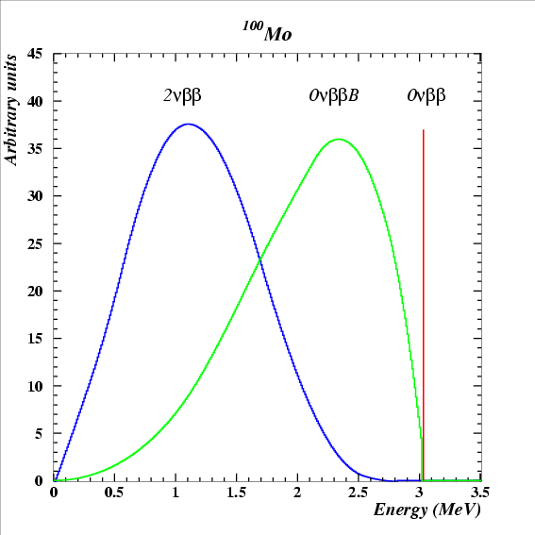
Why event reconstruction is useful
2νββ
Allowed by the standard model
Irreducible background in the search for 0νββ
Input into NME calculations
0νββ
Not allowed by the standard model
Neutrino must be Majorana
New physics mechanisms may contribute e.g Majaron
arXiv: 1005.1241
Majaron
Powerful background rejection tool
If we observe 0νββ then studying the 2e, 1e energy + angular distributions will give information about the production mechanism.

Slide 3
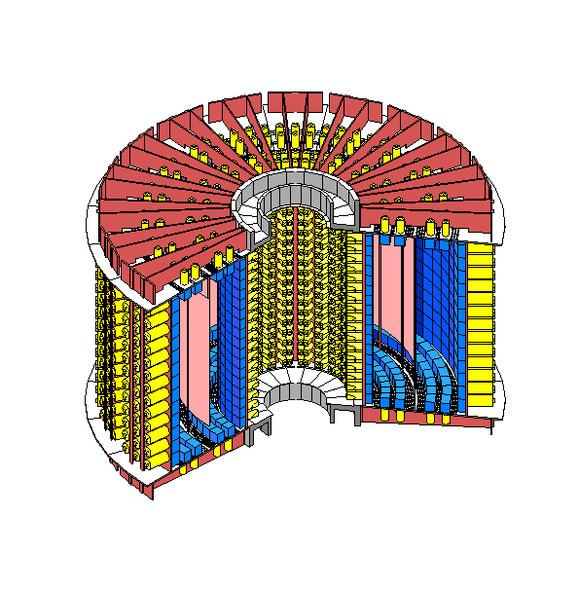
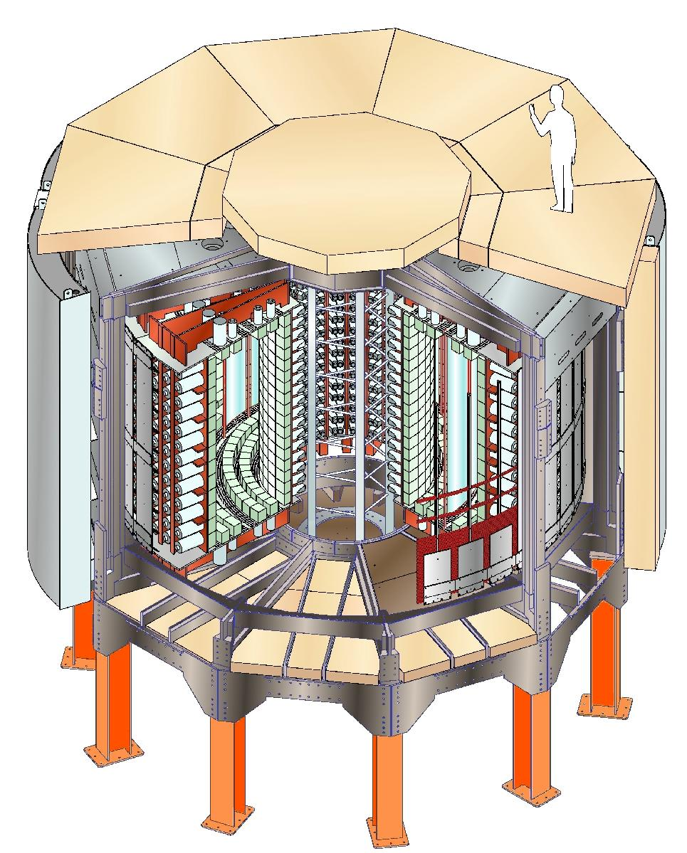
The NEMO-3 detector
Neutrino Ettore Majorana Observatory
Fréjus Underground Laboratory : 4800 m.w.e.
20 sectors
Source: 10 kg of ββ isotopes
cylindrical, S = 20 m², d ~ 60 mg/cm²
Tracking detector:
drift wire chamber operating
in Geiger mode (6180 cells)
Gas: He + 4% ethyl alcohol + 1% Ar + 0.1% H₂O
Calorimeter:
1940 plastic scintillators
coupled to low radioactivity PMTs
3 m
Magnetic field: 25 Gauss
Gamma shield: Pure Iron (d = 18 cm)
Neutron shield: 30 cm water (ext. wall)
40 cm wood (top and bottom)
(since march 2004: water + boron)
B (25 G)
4 m
Particle ID: e⁻, e⁺, γ and α

Slide 4
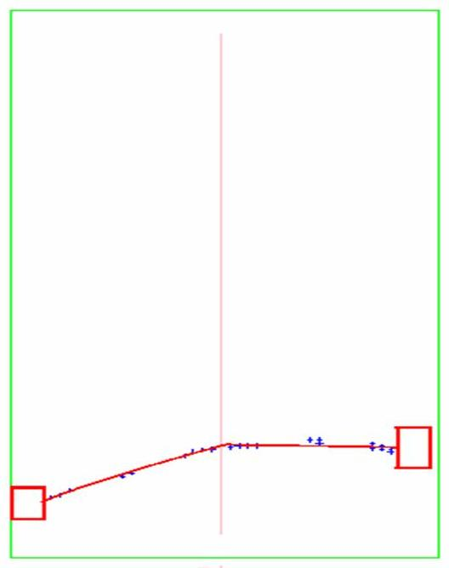
Event reconstruction
Transverse view
Longitudinal view
Vertex of the e⁻e⁻ emission
Source foils
Scintillator
+ PMT
Vertex of the e⁻e⁻ emission
Observables of the final state
  Trajectories of the 2 electrons
  Energies of the 2 electrons
  Time of flight
  Curvature of the tracks in a B-field (+ or -).
Backgrounds are measured using event topology and timing to produce a background model for ββ
NIM A606 (2009) 449-465.

Slide 5
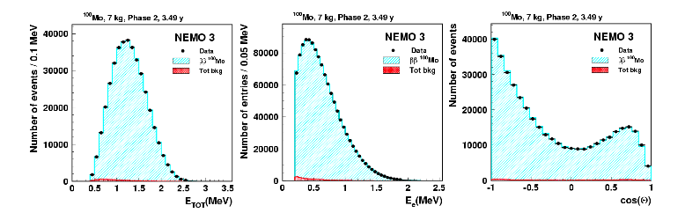
¹⁰⁰Mo 2νββ updated result
T1/2(2ν) = [7.17 ± 0.01(stat) ± 0.54(sys)] × 10¹⁸ yr ⇒ ~3.5 yr, Phase II (low Rn), S/B = 76
M^{2ν}(¹⁰⁰Mo) = 0.126 ± 0.006
This is an update of a previous published result using phase I data
Phys. Rev. Lett. 95 182302 (2005)
T_{1/2}(2νββ) = 7.11 ± 0.02 (stat) ± 0.54 (syst) × 10¹⁸ years, S/B = 40

Slide 6
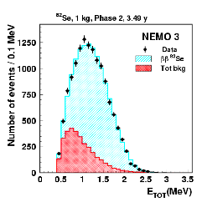
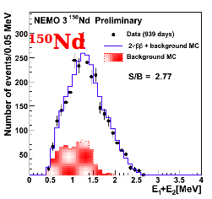
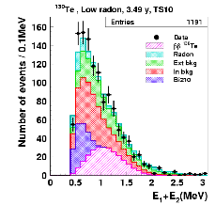
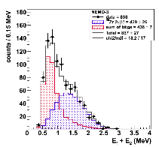
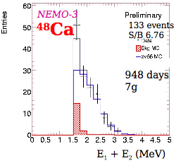
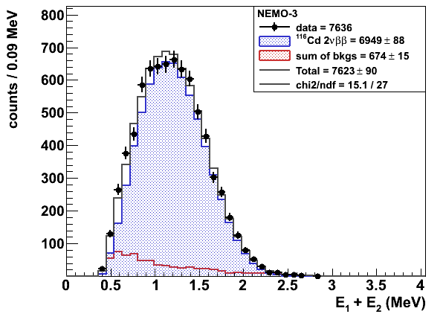
2νββ results for other isotopes (preliminary)
⁸²Se
¹³⁰Te
[9.6±0.1(stat)±1.0(sys)]×10¹⁹ yr
M^{2ν}=0.049±0.004
[9.20±0.25(stat)±0.63(sys)]×10¹⁸ yr
M^{2ν}=0.030±0.002
[7.0^{+1.0}-0.8(stat) ^{+1.1}-0.9(sys)]×10²⁰ yr
M^{2ν}=0.0173±0.0025
⁹⁶Zr
¹¹⁶Cd
[2.35±0.14(stat)±0.16(sys)]×10¹⁹ yr
M^{2ν}=0.049±0.002
[4.4^{+0.5}-0.4(stat)±0.4(sys)]×10¹⁹ yr
M^{2ν}=0.0238±0.0015
[2.88±0.04(stat)±0.16(sys)]×10¹⁹ yr
M^{2ν}=0.0685±0.0025
Many more results available. Excited states, 0ν for different mechanisms and isotopes

Slide 7
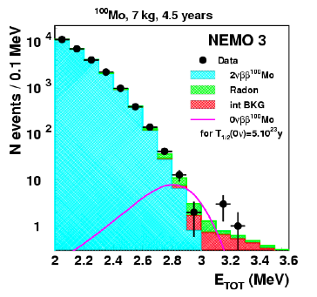
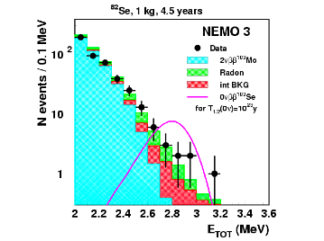
0νββ for ¹⁰⁰Mo(~7kg) and ⁸²Se (~1kg)
[2.6-3.2] MeV: DATA = 14; MC = 10.9±1.3
T1/2(0ν) > 3.2×10²³ yr at 90%CL
<mν> < (0.94 - 2.5) eV
[2.8-3.2] MeV: DATA = 18; MC = 16.4±1.4
T1/2(0ν) > 1.0×10²⁴ yr at 90%CL
<mν> < (0.47 - 0.96) eV
V+A: T1/2(0ν) > 5.4×10²³ yr at 90%CL λ < 1.4×10⁻⁶
Majoron: T1/2(0ν) > 2.1×10²² yr at 90%CL gee < 0.5×10⁻⁴ World’s best result!

Slide 8
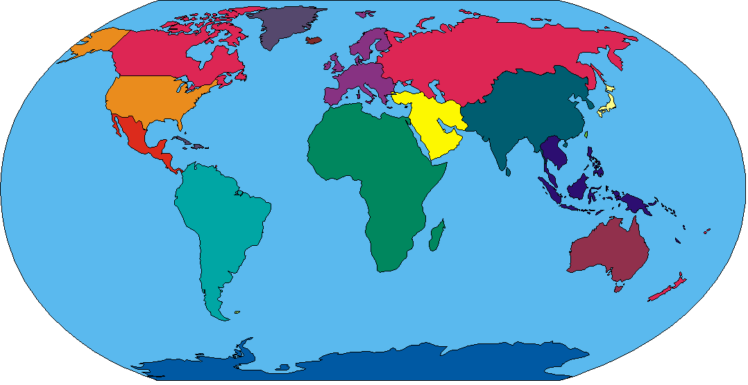
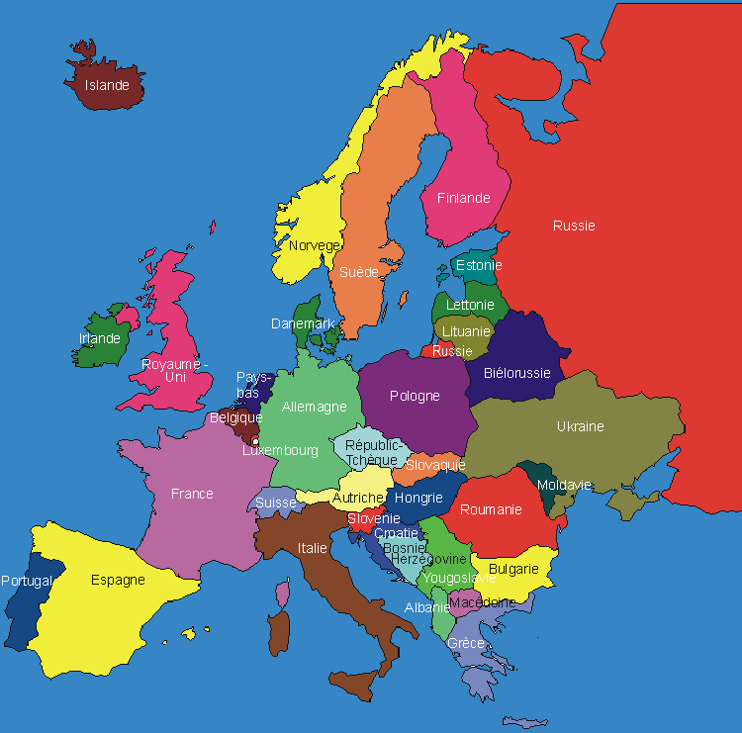
SuperNEMO Collaboration
~ 100 physicists, 10 countries, 27 Institutions
Marocco
Fes U
Japan
U Saga
KEK
U Osaka
USA
MHC
INL
U Texas
UK
UCL
U Manchester
Imperial College
Warwick
Finland
U Jyvaskula
Russia
JINR Dubna
ITEP Mosow
Kurchatov Institute
France
CEN Bordeaux
IReS Strasbourg
LAL ORSAY
LPC Caen
LSCE Gif/Yvette
Marseille
Slovakia
(U. Bratislava)
Spain
U Valencia
U Saragossa
U Barcelona
Czech Republic
Charles U Praha
IEAP Praha

Slide 9
Objectives of the 4 year R&D programme
NEMO-3
SuperNEMO
¹⁰⁰Mo
isotope
⁸²Se or other
7 kg
isotope mass M
100+ kg
18 %
efficiency ε
~ 30 %
²⁰⁸Tl: ~ 100 μBq/kg
²¹⁴Bi: < 300 μBq/kg
Rn: 5 mBq/m³
internal contaminations
²⁰⁸Tl and ²¹⁴Bi in the ββ foil
Rn in the tracker
²⁰⁸Tl ≤ 2 μBq/kg
if ⁸²Se: ²¹⁴Bi ≤ 10 μBq/kg
Rn ≤ 0.15 mBq/m³
8% @ 3MeV
energy resolution (FWHM)
4% @ 3 MeV
T_{1/2}(ββ0ν) > 2 x 10²⁴ y
<m_{ν}> < 0.3 – 0.9 eV
T_{1/2}(ββ0ν) > 1 x 10²⁶ y
<m_{ν}> < 0.04 - 0.11 eV

Slide 10
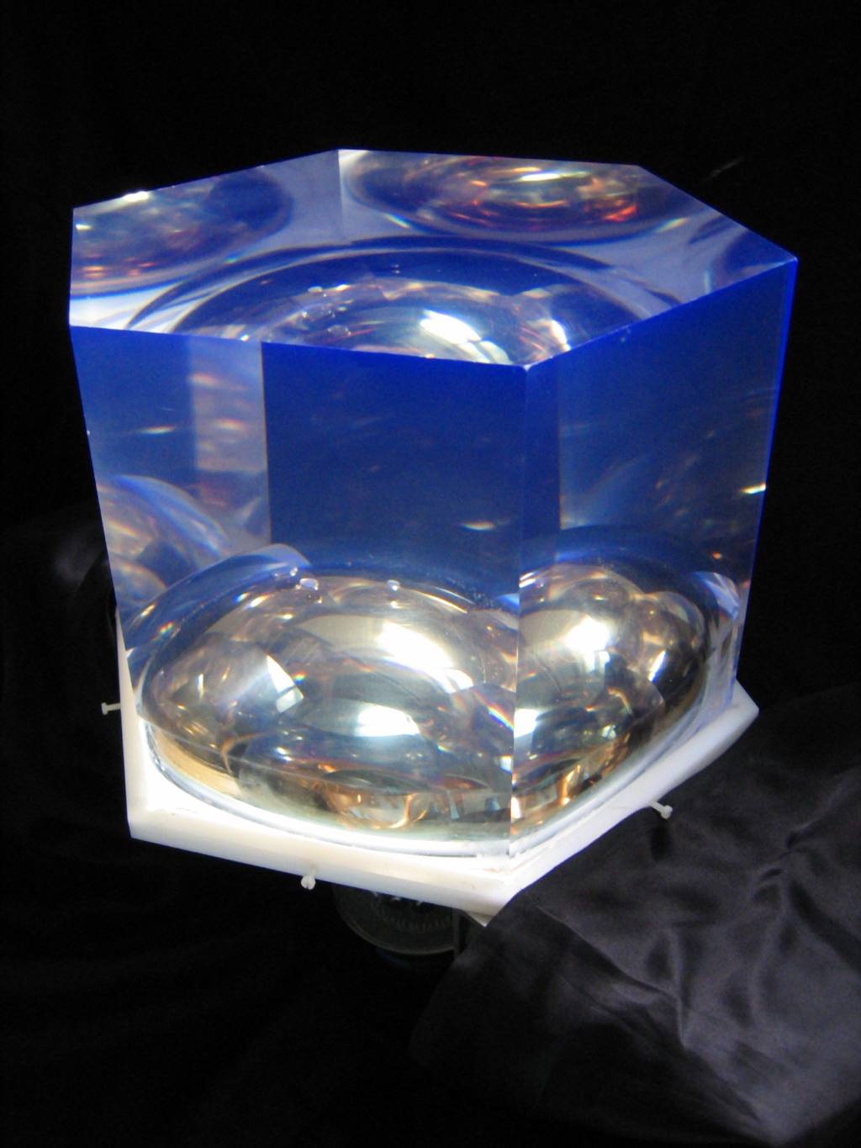
Calorimeter R&D to improve energy and time resolution
Each module will have 550 PMTs + scintillator blocks
Scintillator
Material
Shape
Size
Coating
PMT
QE
Uniformity
Collection efficiency
Radiopurity
Required resolution demonstrated
with 28cm Hex block (≥10cm thick)
directly coupled to 8” PMT
FWHM = 4% @ Qββ = 3 MeV

Slide 11
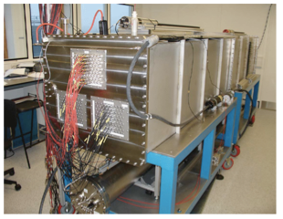
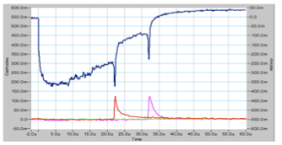
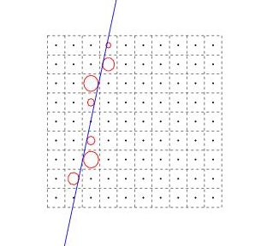
Tracker R&D
To optimise the length, diameter, material for the wire, readout and gas mixture
Constructed several prototype single cells of differing lengths and diameters.
Then progressed to a 9-cell to look at the configuration of the fields and cross-talk.
From this work a 90-cell prototype was constructed.
Cosmic muon used for testing of reconstruction algorithm
Transverse 0.7mm, longitudinal 1cm
Overall cell efficiency of >98%

Slide 12
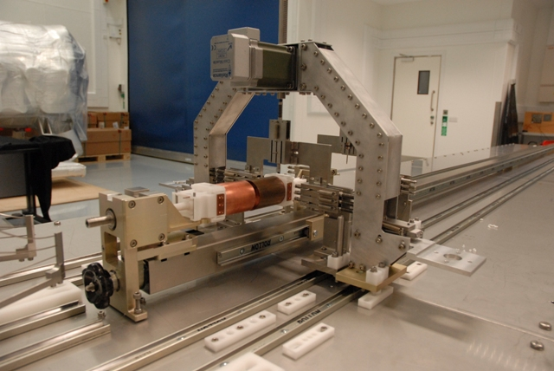
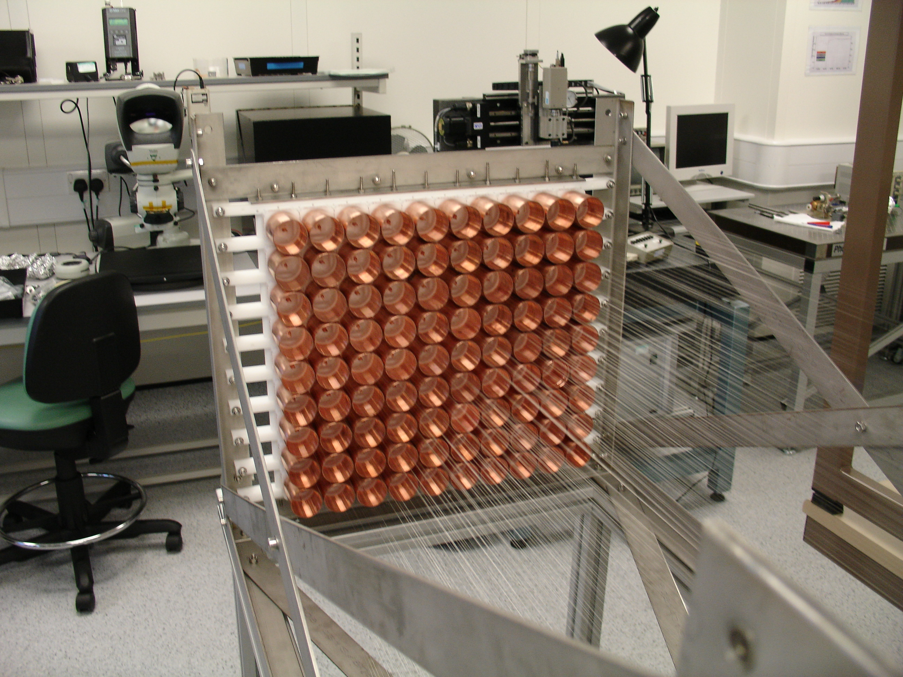
Wiring robot
For the full 20 modules in excess of 0.5M wires will need to be strung.
A wiring robot is being developed at the Mullard Space Science Laboratory.
The wiring will be carried out in a clean-room environment with as little human intervention as possible.
Protoype robot being developed at MSSL
90-cell opened up

Slide 13
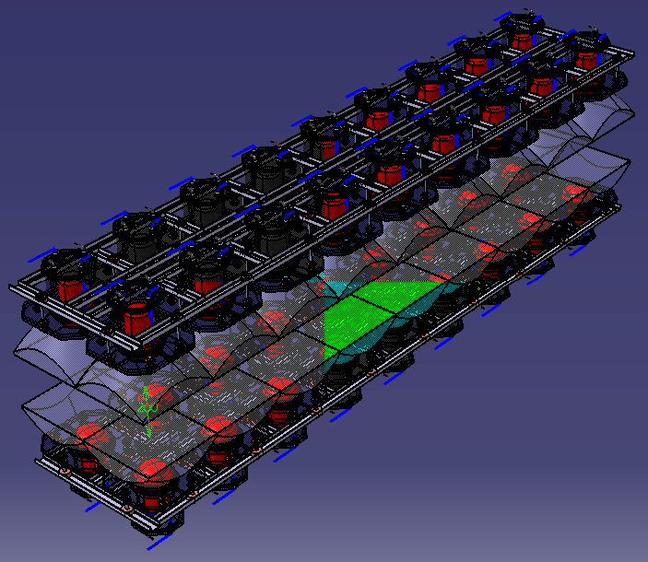
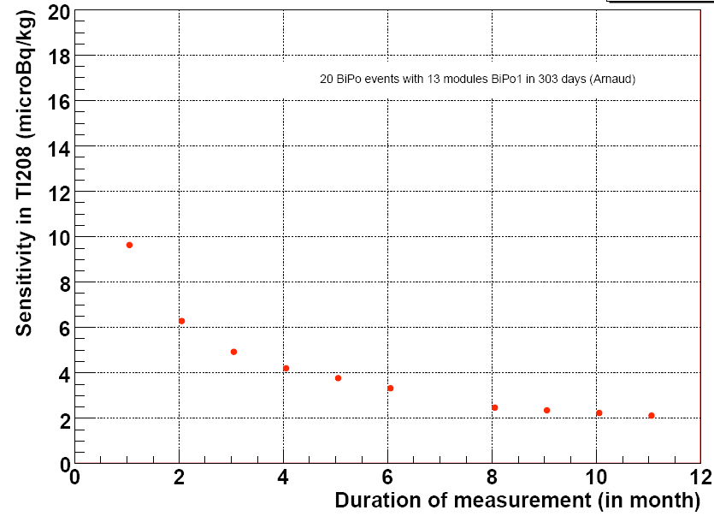
Production of the ββ Source Foil
Preferred candidate for the source is ⁸²Se (others being investigated).
Enrichment of 100 kg by centrifugation is possible.
The density on the foil is 40-50 mg/cm².
Radio-purity: ²⁰⁸Tl < 2 μBq/kg, ²¹⁴Bi < 10 μBq/kg
Chemical and physical purification methods
Dedicated BiPo detector to measure low radio-purity levels

Slide 14
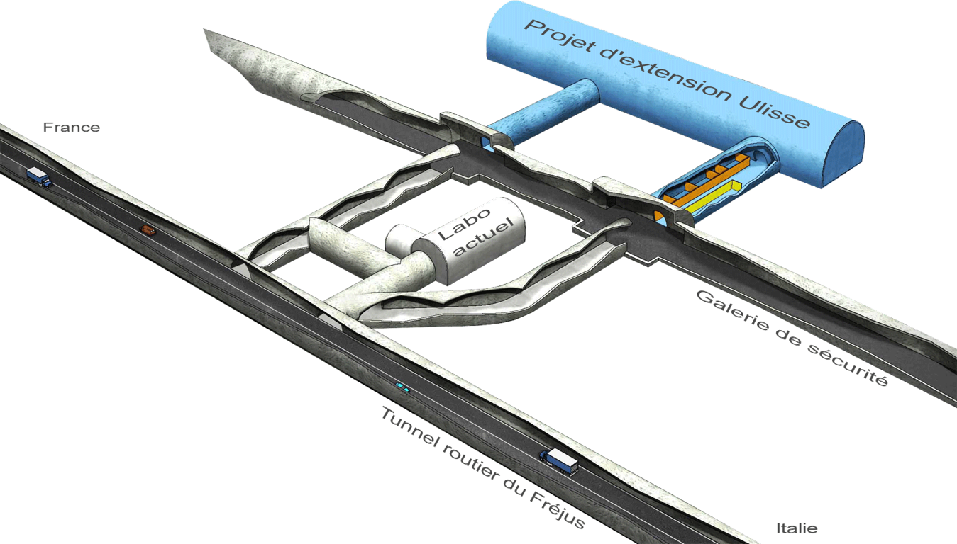
LSM Extension
Schedule
Safety tunnel construction start - Sep 2009
Safety tunnel, end of civil construction - End 2011
Detailed study of LSM extension (ULISSE) - 2010
Deadline for final decision/money commitment - May 2011
Excavation of new Lab completed - mid-2012
Outfitting completed, Lab ready to host experiments - 2013
Minimal scenario: 45,000m³ (100m long), 12M€ excavation + 3M€ outfitting
2^{d} ULISSE workshop in October. 11 LOIs received.

Slide 15
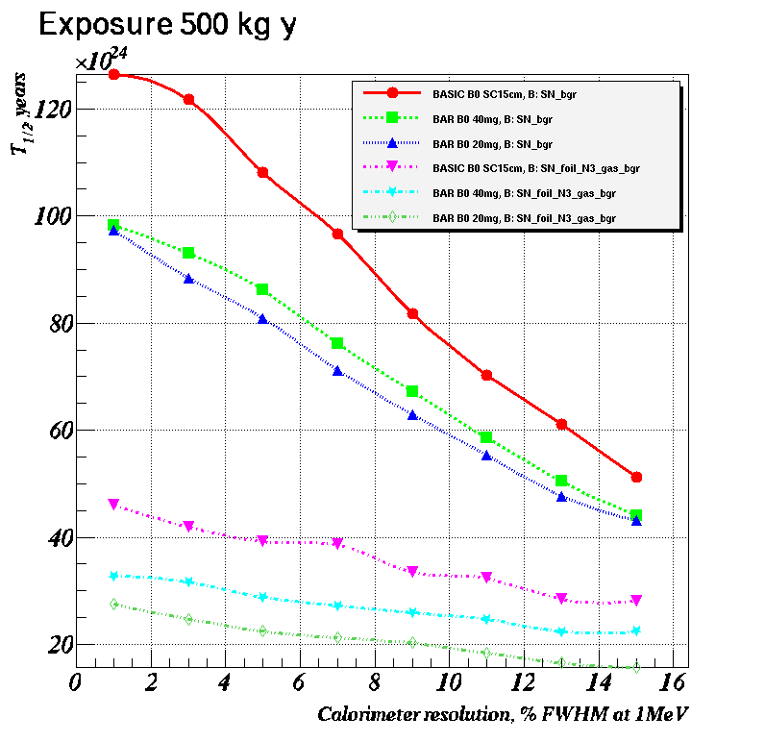
Detector sensitivity
⁸²Se
Using a GEANT-4 based model of the detector combined with NEMO-3 experience.
5yrs with 100kg ⁸²Se:
T_{1/2}(ββ0ν) > 1 x 10²⁶ y
<m_{ν}> < 0.05 - 0.1 eV

Slide 16
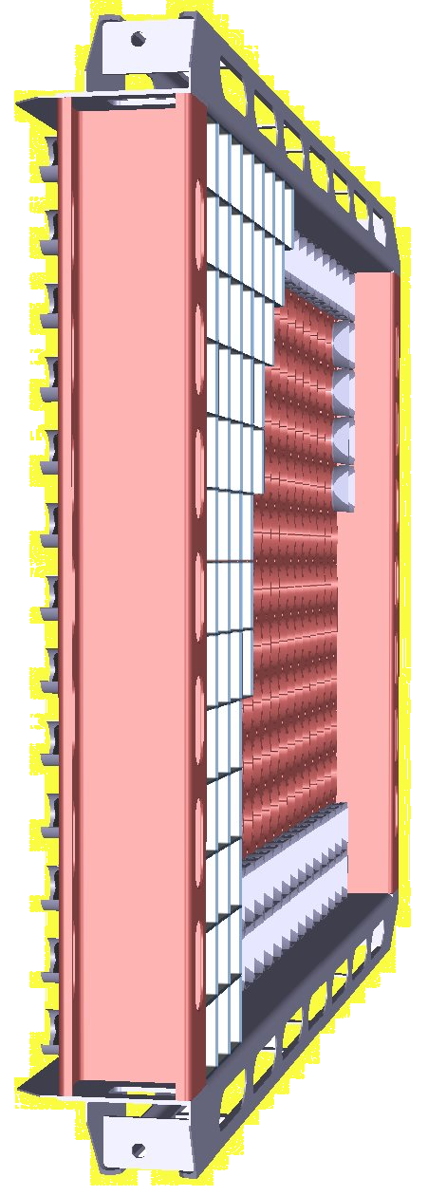
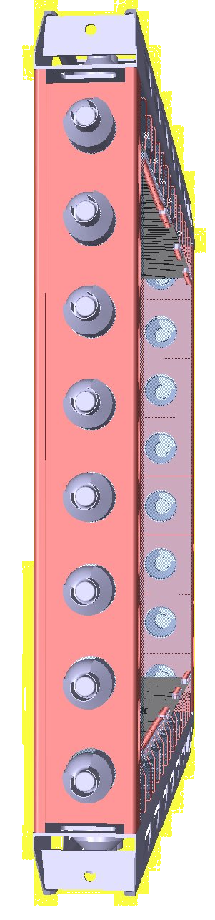
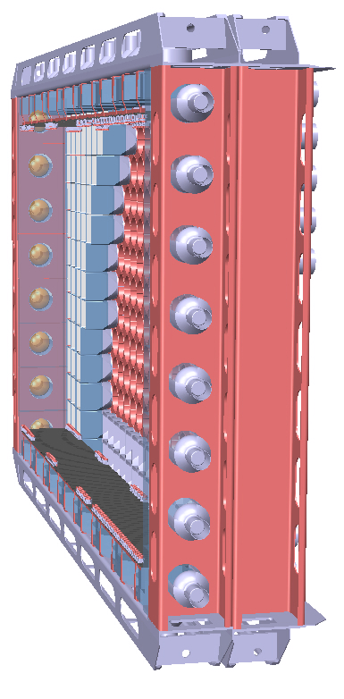
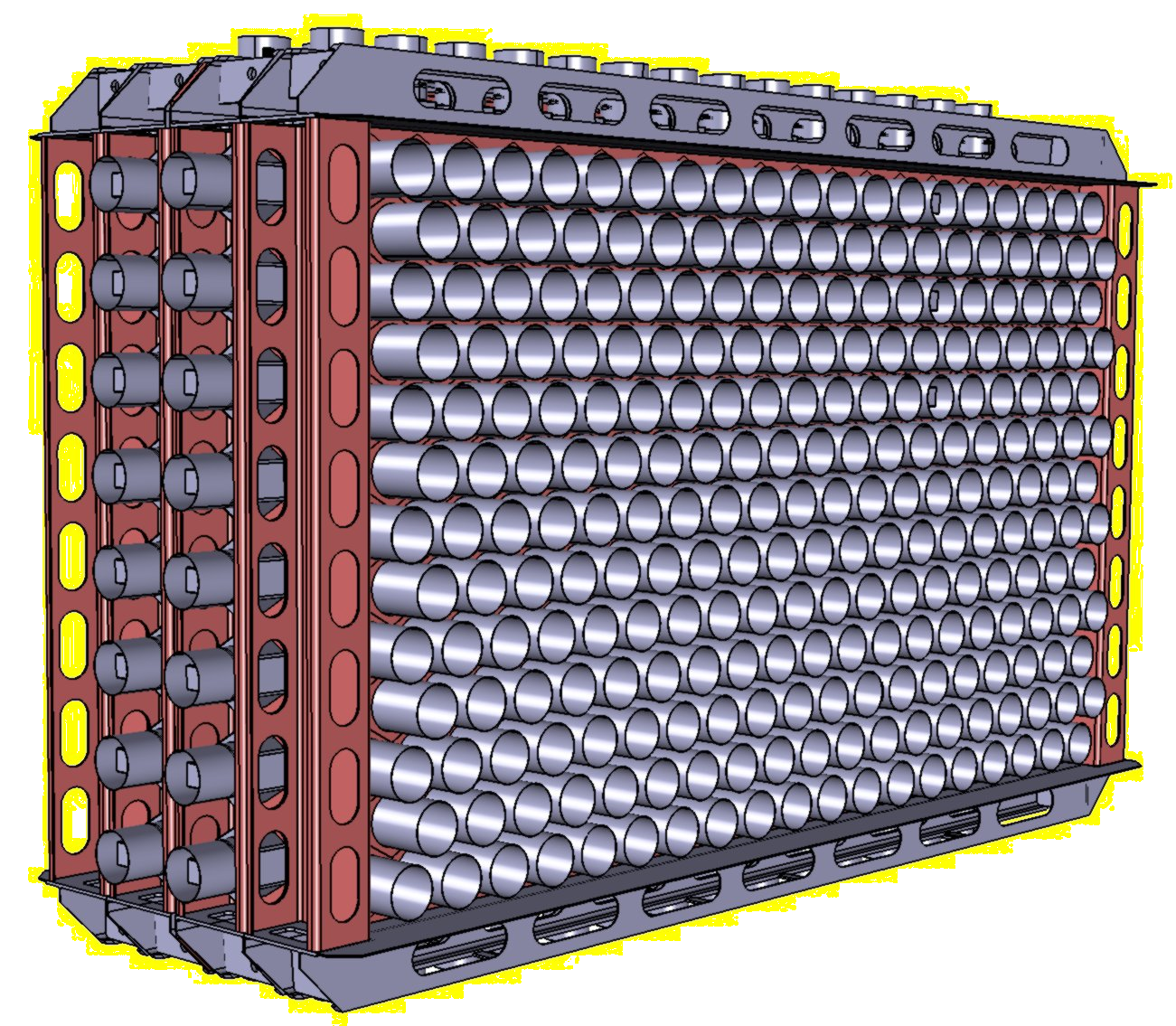
A SuperNEMO module
20 modules having a Planar design:
Each module will have 5kg of enriched isotope
Making a total of 100 kg.
Open
Submodule
Source and calibration
Submodule
calorimeter
Closed
4 m
Source 2.7m
6 m
Submodule
tracker
2 m (assembled, ~0.5m between source and calorimeter)

Slide 17
1st SuperNEMO module - Demonstrator
Demonstrate that mass production is possible.
Study the backgrounds with an emphasise on radon emanation.
Make a competitive physics measurement
0.3 expected bkg events in 2.8 - 3.2 MeV with 7kg of ⁸²Se in 2 yr
Sensitivity by 2015: 6.5∙10²⁴ yr (90% CL)
Equivalent to 3∙10²⁵ yr for ⁷⁶Ge (using phase space ratio only)
or ~4 expected “golden events” if KK claim is correct

Slide 18
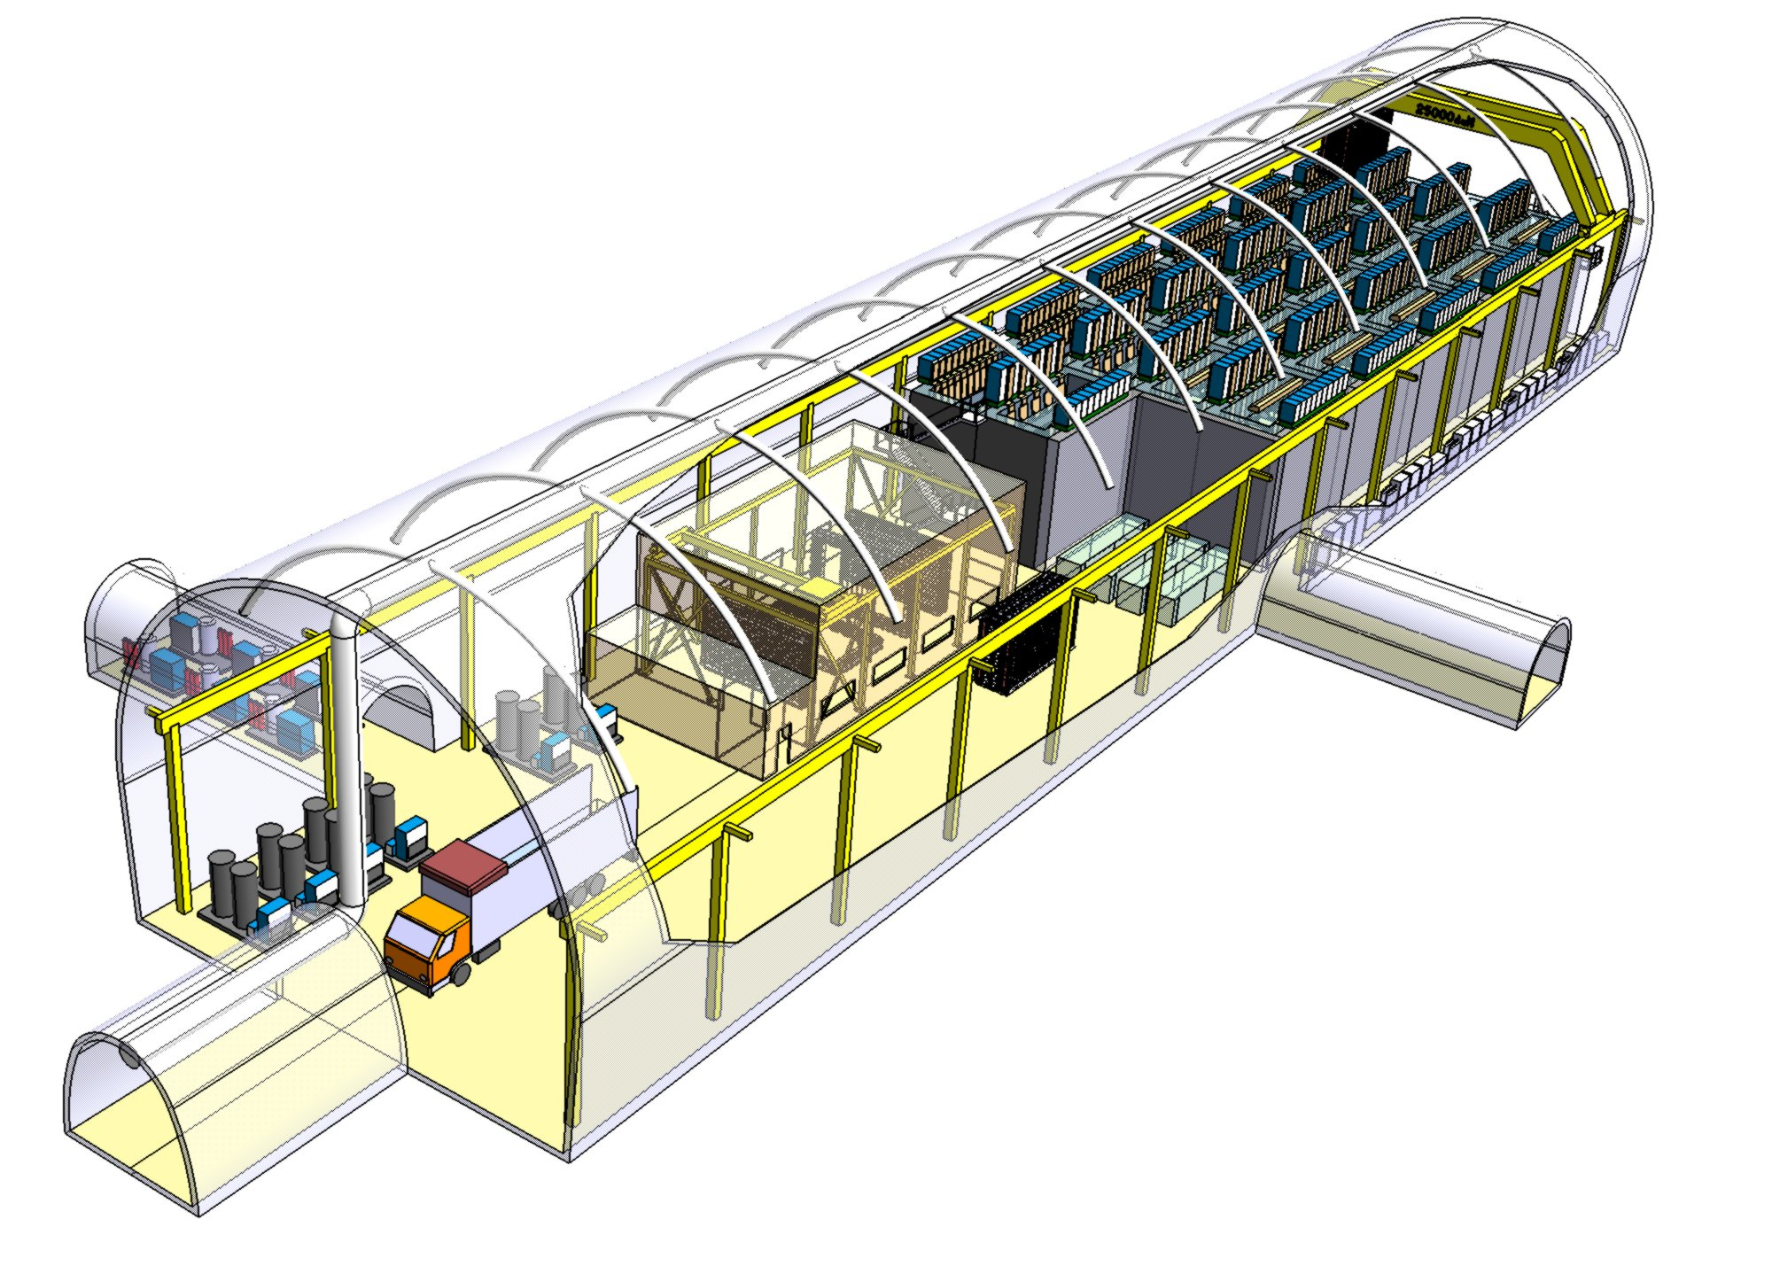
SuperNEMO schedule highlights
NEMO-3 decommissioning - early 2011
Demonstrator construction - 2010-2012
Demonstrator physics run start-up - 2013
Full detector construction start-up - 2014
Target sensitivity (~0.05 eV) - 2019
KK claim to be verified with Demonstrator by 2015

Slide 19
BACKUP

Slide 20
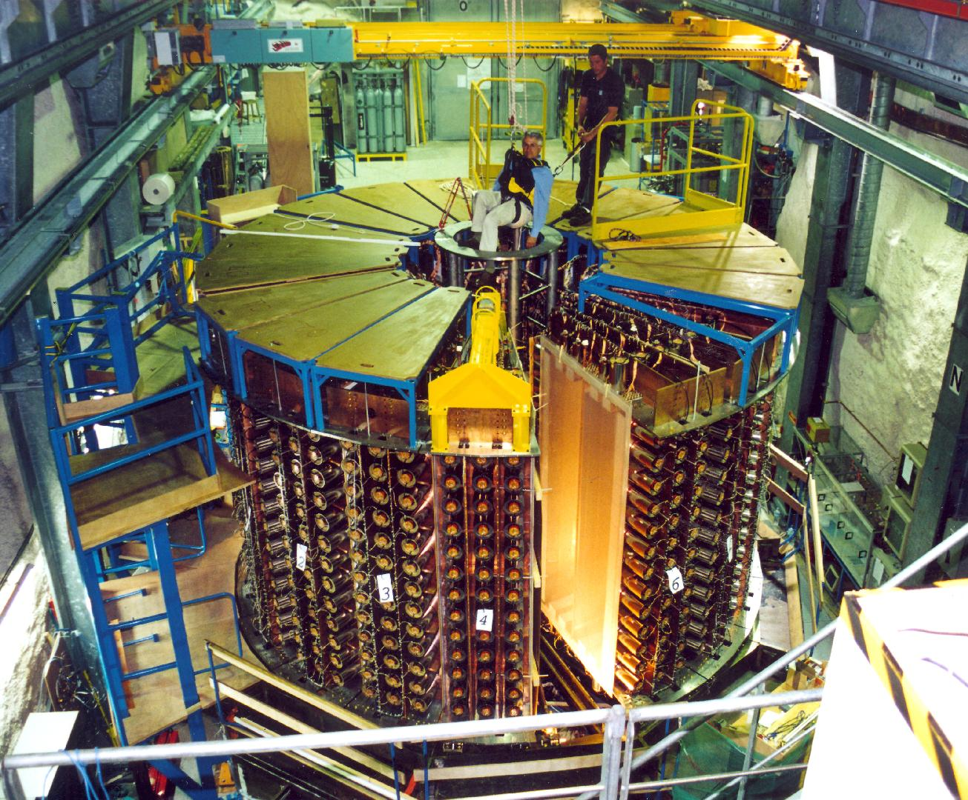
NEMO 3 under construction at the LSM

Slide 21
ββ decay isotopes in NEMO-3 detector
ββ2ν measurement
¹¹⁶Cd 405 g
Q_{ββ} = 2805 keV
⁹⁶Zr 9.4 g
Q_{ββ} = 3350 keV
¹⁵⁰Nd 37.0 g
Q_{ββ} = 3367 keV
⁴⁸Ca 7.0 g
Q_{ββ} = 4272 keV
¹³⁰Te 454 g
Q_{ββ} = 2529 keV
External bkg
measurement
¹⁰⁰Mo 6.914 kg
Q_{ββ} = 3034 keV
⁸²Se 0.932 kg
Q_{ββ} = 2995 keV
^{nat}Te 491 g
Cu 621 g
ββ0ν search
(Enriched isotopes produced by
centrifugation in Russia)

Slide 22
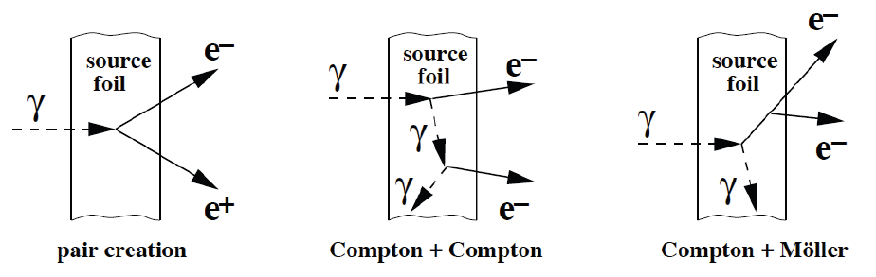
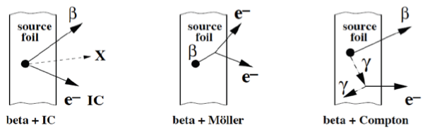
NEMO-3 Backgrounds for ββ
External γ (if the γ is not detected in the scintillators)
Origin: natural radioactivity of the detector or neutrons
Main bkg for ββ2ν but negligeable for ββ0ν
(¹⁰⁰Mo and ⁸²Se Q_{ββ}~ 3 MeV > Eγ(²⁰⁸Tl) ~ 2.6 MeV )
²³²Th (²⁰⁸Tl) and ²³⁸U (²¹⁴Bi) contamination inside the ββ source foil
²²⁰Rn
²¹⁸Po⁺⁺
Radon (²¹⁴Bi) inside the tracking detector
- deposits on the wire near the ββ foil
- deposits on the surface of the ββ foil
Each bkg is measured using the NEMO-3 data

Slide 23
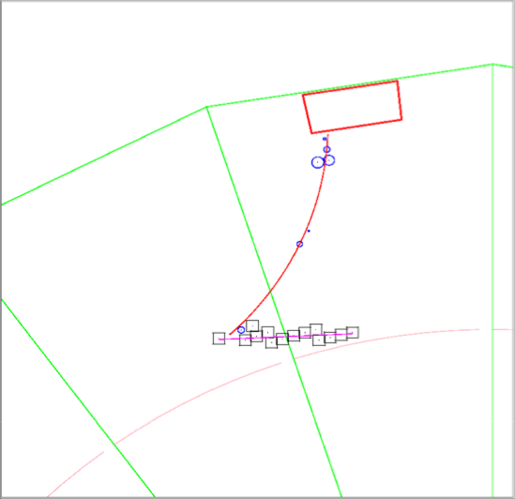
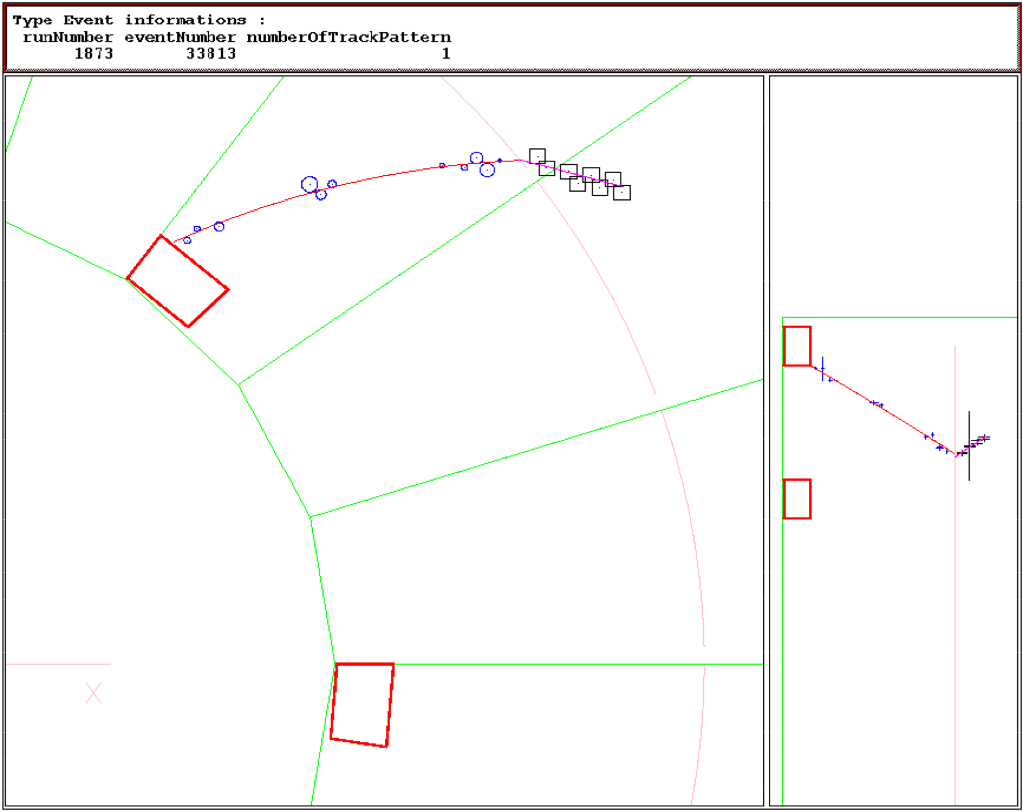
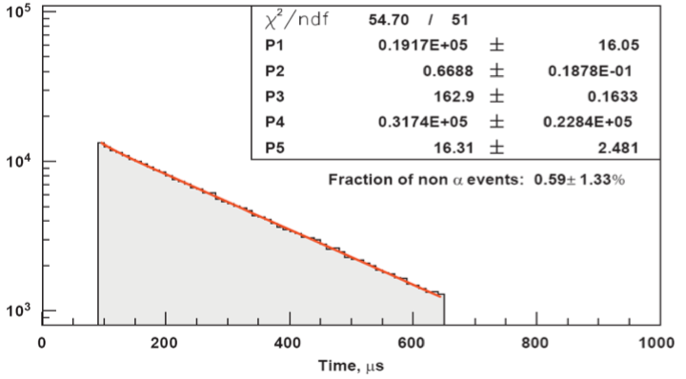
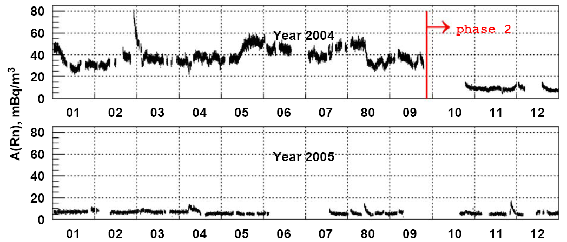
Example: Radon inside the tracking detector
β
α
²¹⁴Bi → ²¹⁴Po → ²¹⁰Pb
Pure sample of ²¹⁴Bi − ²¹⁴Po events
(164 μs)
β⁻
α
²¹⁴Bi → ²¹⁴Po (164 μs) → ²¹⁰Pb
²¹⁴Bi on the wires
β⁻
²¹⁴Bi on the surface of the source foil
delayed
α
T_{1/2}=162.9 μs
Delay time of the α track (μs)
Monitoring of the Radon bkg every day
Phase 1: Feb. 2003 → Sept. 2004
Radon Contamination
Phase 2: Dec. 2004 → Today
A (Radon) ≈ 5 mBq/m³

Slide 24
Radon trapping facility
Radon trapping facility
(First developed for SuperKamiokande)
Phase I : February 2003 – September 2004 (radon background in data)
~ 1 0νββ-like event/y/kg with 2.8 < E₁+E₂ < 3.2 MeV
Phase II : since October 2004 (radon level reduced by a factor of 6)
1 ton of charcoal @ –50ºC, 9 bars
air flux = 150 m³/h
Input: A(²²²Rn) 15 Bq/m³
Output: A(²²²Rn) < 15 mBq/m³ !!!
reduction factor of 1000
Inside the NEMO 3 tent: factor of 100 – 300
Inside NEMO 3: almost factor of 10 A(²²²Rn) ≈ 6 mBq/m³

Slide 25
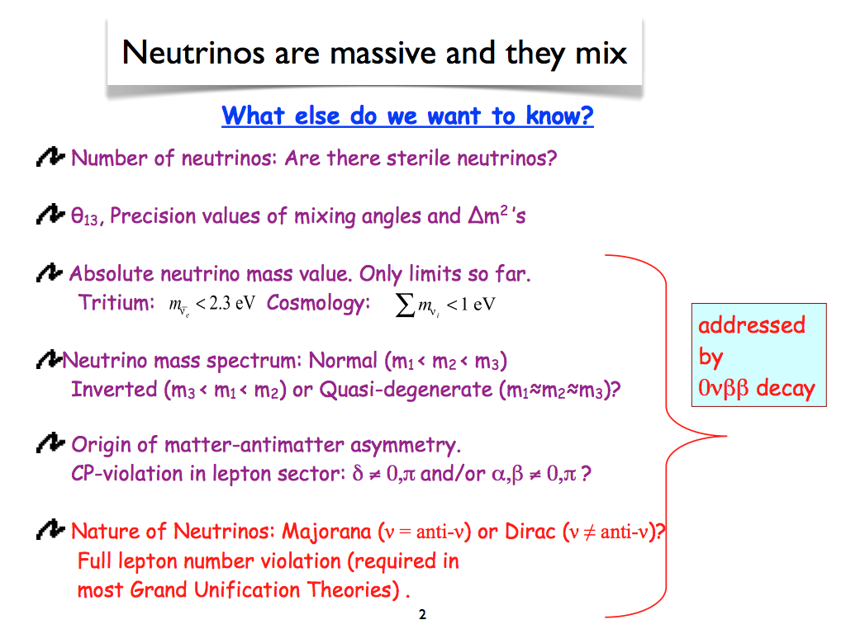

Slide 26


Physics Studies
Full chain of GEANT-4 based software + detector effects
+ NEMO3 experience
⁸²Se
5 yr with 100kg of ⁸²Se:
T1/2 > 10²⁶ yr, <mν> < 50-100 meV at 90%CL
with target detector parameters
Much more than 1 result!
Other mechanisms: V+A, Majoron, etc
Disentangling <mν> and V+A:
arXiv: 1005.1241
ββ0ν(and 2ν) to excited states

Slide 27
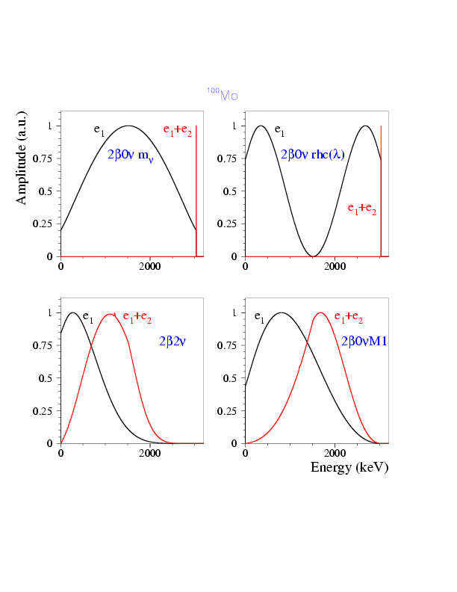
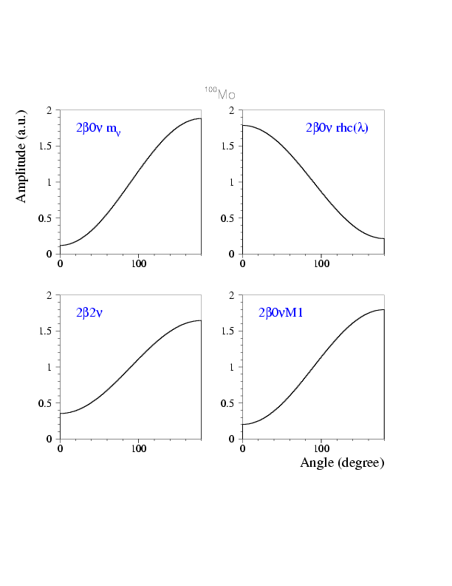

Open-minded search for any 0νββ mechanism
can be due to
,V+A, Majoron, SUSY, H⁻⁻ or a combination of them
〈mν〉
V+A
E1 - single e⁻ energy, keV
Majoron
θ - angle between e₁ and e₂
Topology detection is a more sensitive method for
phenomena with continuous spectra, e.g.
2νββ, 0νββB (Majoron)
Topology can be used to disentangle
underlying physics mechanism

