Slide 1


Particle-Driven Plasma Wakefield Acceleration
James Holloway
University College London, London, UK
PhD Supervisors:
Professor Matthew wing
University College London, London, UK
Professor Peter Norreys
Central Laser Facility, Rutherford Appleton Laboratory, UK

Slide 2
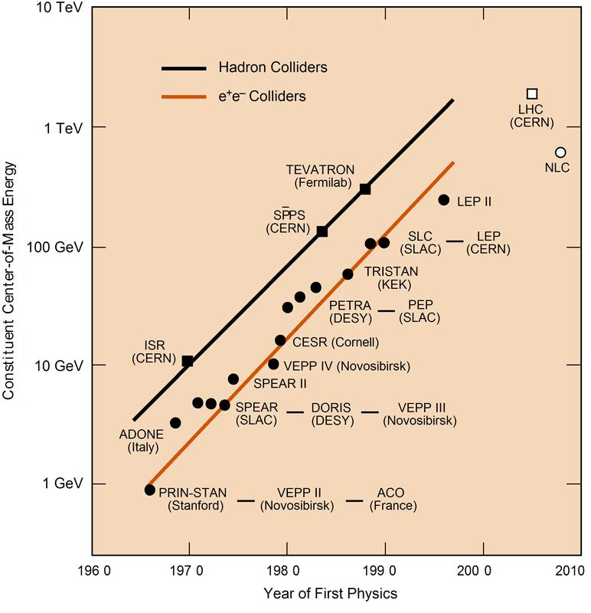
Current RF Accelerators
Accelerate particles within a metal cavity.
Accelerated using an alternating electric field.
Electric fields greater than ~100 MVm⁻¹ will ionize the metal itself.
--> To reach higher particle energies one has to increase the length over which the particles are being accelerated.
Plasmas can support higher electric fields. A plasma of number density
n_{e} = 10¹⁴ cm⁻³ can support electric fields of E = 1 GVm⁻¹.
The Livingston plot shows the switch on time of hadron and lepton
colliders at the energy frontier as a function of achieved energy.
Notes:
Big tunnels are expensive!
To reach peta eV regime would need an accelerate half as long as earth’s circumference!

Slide 3
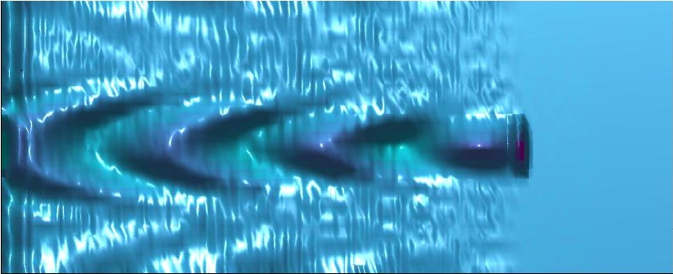
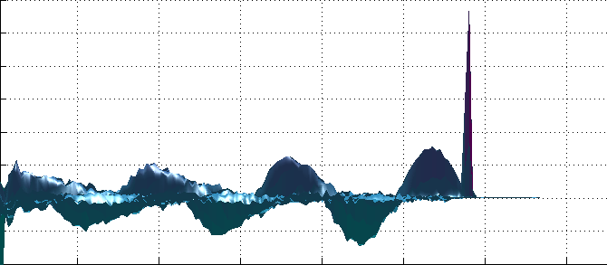
What is PWA?
Novel particle acceleration technique
+
-
+
-
+
+
-
+
+
Short proton beam
Neutral plasma
Proton Beam
Can also drive wakefields with
Electrons
Photons
Positrons
Muons (in principle)
Notes:
Mention electrons are ‘blown out’ instead of sucked in my e- and photons. Wakefield is the same, but shifted by PI in phase

Slide 4
See movie file, Movie_p4.pptx
Notes:
Mention electrons are ‘blown out’ instead of sucked in my e- and photons. Wakefield is the same, but shifted by PI in phase

Slide 5
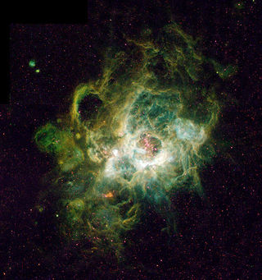
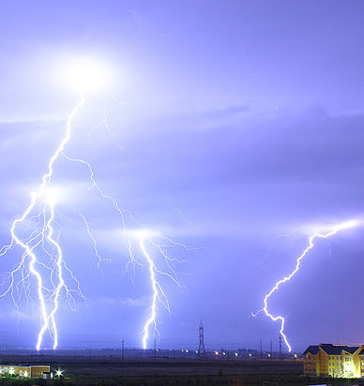
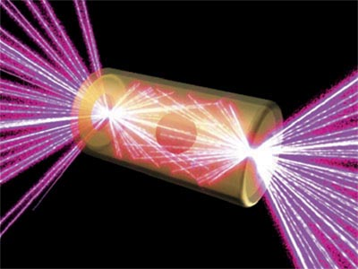
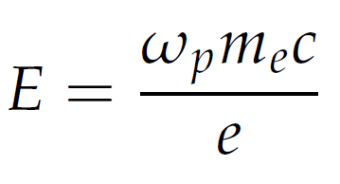
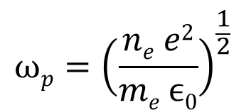
The Plasma
 | Interstellar plasma | Lightning | Inertial confinement fusion
n_{e} (m⁻³) | 10⁵ | 10²⁴ | 10³²
E_{max} (Vm⁻¹) | 30 | 10¹¹ | 10¹⁵
λ_{p} (m) | 3 x 10² | 3 x 10⁻⁵ | 3 x 10⁻⁹
Interstellar plasma
Lightning
Inertial confinement fusion
$$ωp={\left(\frac{ne e2}{me ϵ0}\right)}^{\frac{1}{2}}$$
Plasma frequency
Maximum supportable E field
Notes:
Plasma density dictates the maximum electric field the plasma can support, and the length of the driver required to effectively drive a wakefield.
We simulate at ~ 10^20. -> lambda p = 3mm. Still short!
We simulate cold hydrogen plasma. Sufficient unless you drive high amplitude wakefields.
Ions start to move -> distrupts the wakefield!
Need to then use heavier ions, ie ceasium, argon etc.

Slide 6
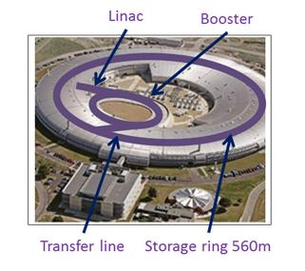
The Diamond Light Source
The Diamond light source at RAL uses a 3 GeV electron beam to generate soft x-rays.
The beam is generated by a 90 KeV electron gun that injects them into the Linac, which brings
it to ~ 100 MeV. The booster then brings it to 3 GeV then finally the storage ring maintains the
energy whilst cooling the beam.
Beam length: σ_{z} = 2.6 cm -> too long to effectively drive a wakefield. (λ_{p} ~ mm).
A proof of principle experiment has been proposed
to micro bunch the beam using the self modulation
instability, with the future intent to use the treated
beam to:
Create a higher energy electron beam
Create a poor mans FEL using betatron
oscillations within the wake
Imprint the modulated density profile of the
Diamond beam onto a proton beam, seeding
the modulation onto the proton beam
The Diamond light source, RAL.

Slide 7
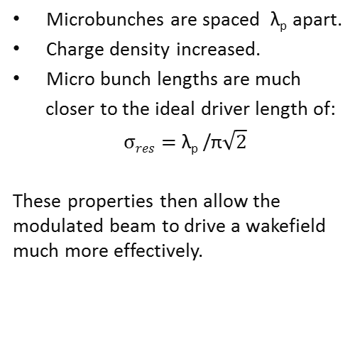
The Self-Modulation Instability
Affects long drive beams.
+
-
+
-
+
+
-
+
+
Long proton beam
Neutral plasma
Microbunches are spaced λ_{p} apart.
Charge density increased.
Micro bunch lengths are much
closer to the ideal driver length of:
$σres=$λ_{p} /π$\sqrt{2}$
These properties then allow the modulated beam to drive a wakefield much more effectively.
+
-
+
-
+
+
-
+
+
Neutral plasma
Self-modulated driver beam
Notes:
Transverse vs longitudinal modulation. Say Ex and Ey are comparible in magnitude, however, lorentz factor in forward direction makes longitudinal modulation a minor contribution.
Talk about focusing / defocusing pohases.

Slide 8
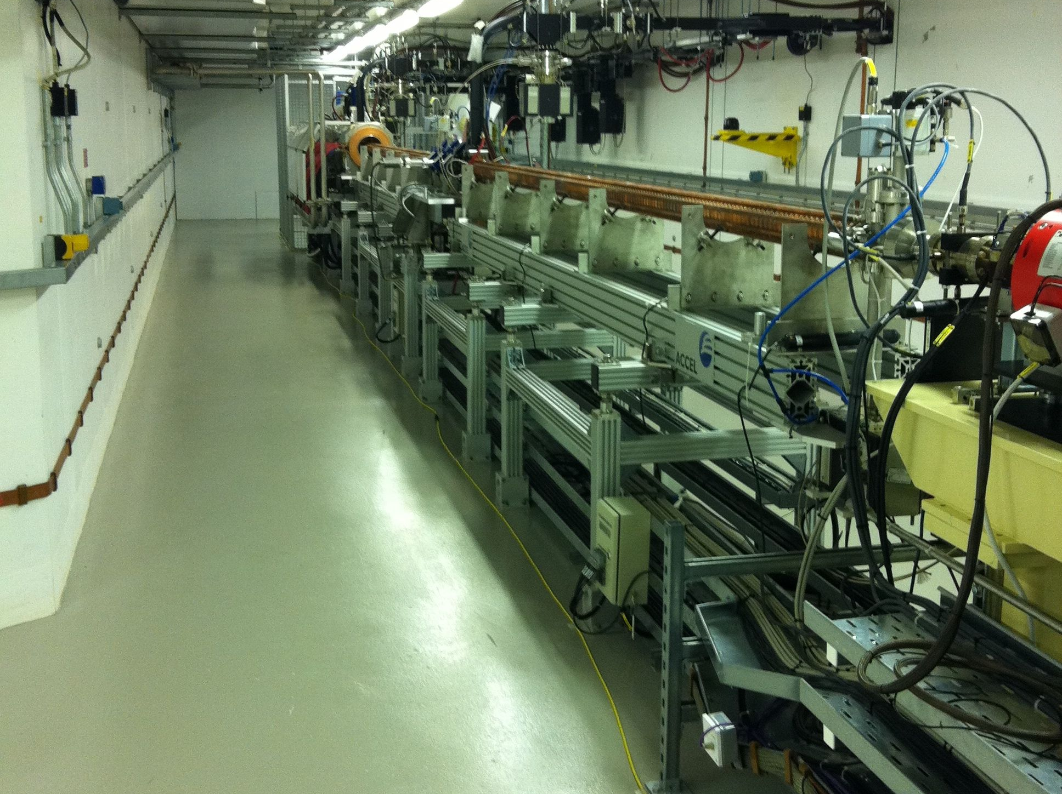
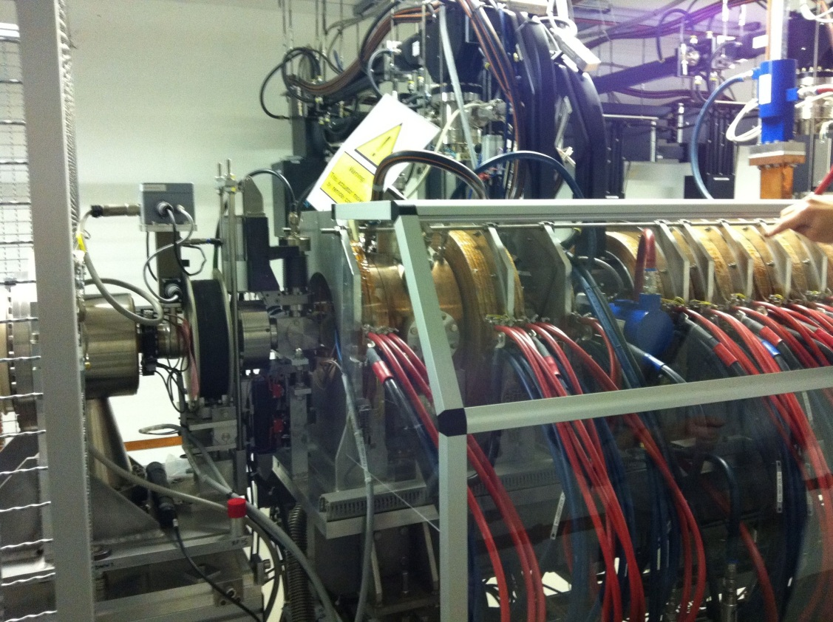
Linac
90 KeV
Pictures by Michael Bloom, Imperial College.

Slide 9
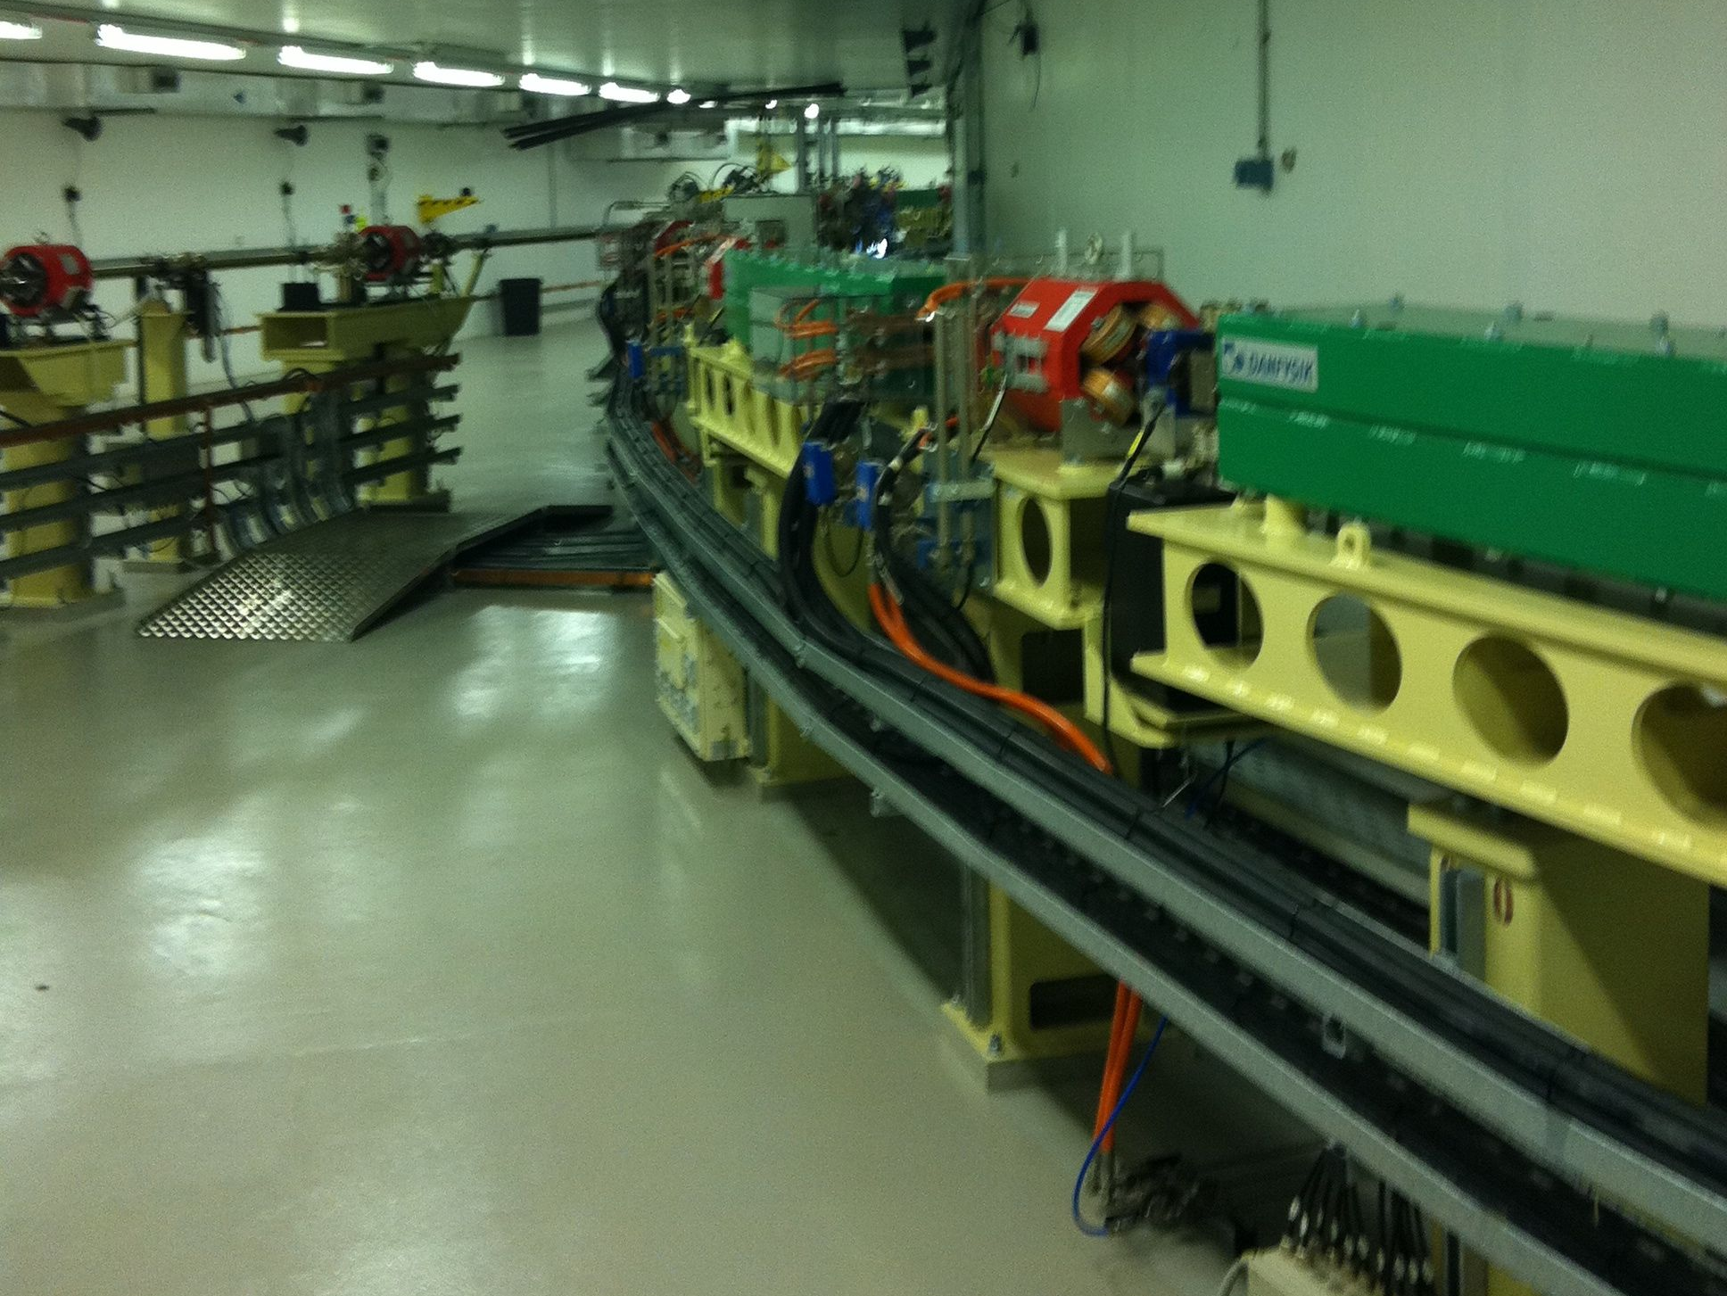
Booster
158m circumference
Pictures by Michael Bloom, Imperial College.

Slide 10
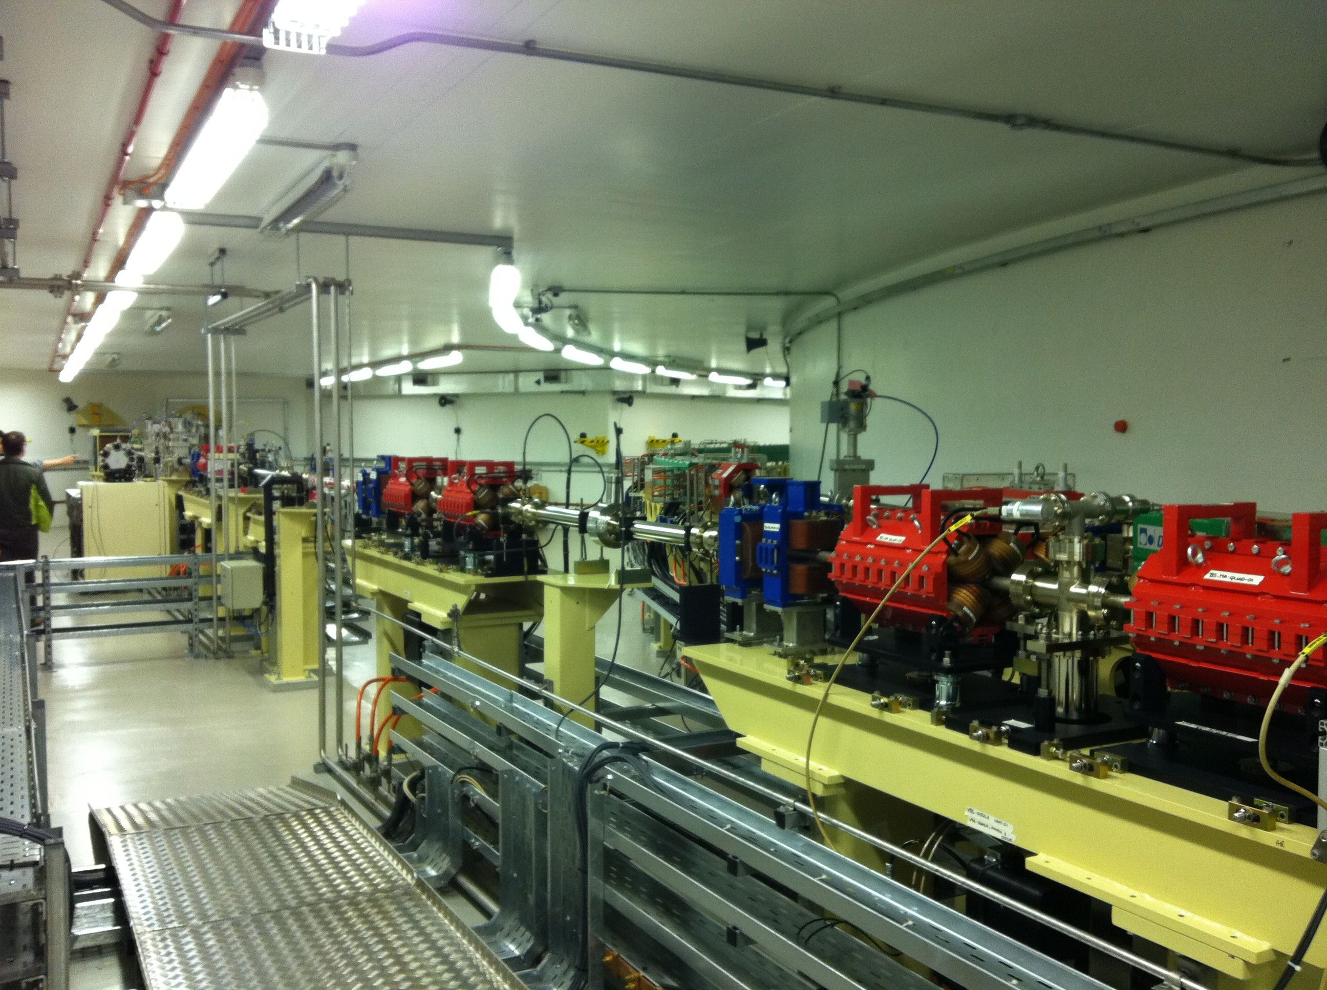
The Diamond Experiment
Serveral slides of tour of Diamond!
Transfer
Line
Pictures by Michael Bloom, Imperial College.

Slide 11
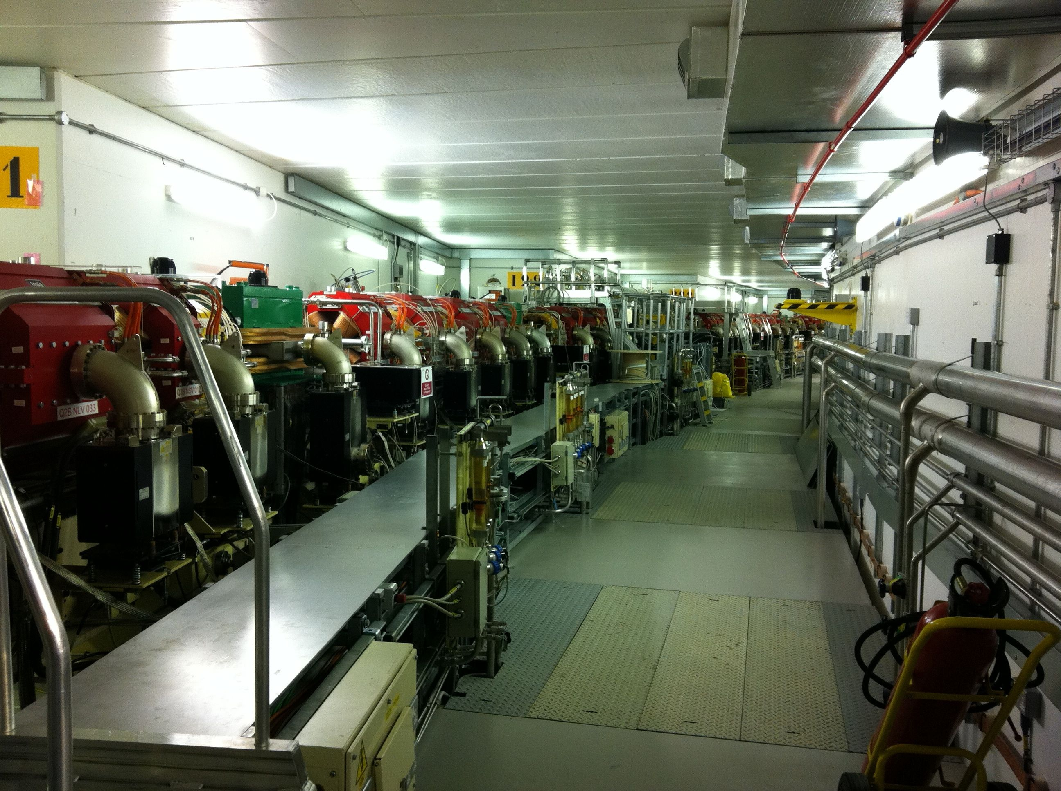
The Diamond Experiment
Serveral slides of tour of Diamond!
Storage Ring
Pictures by Michael Bloom, Imperial College.

Slide 12
Simulations
Simulations so far:
Untreated Diamond beam from the booster
-> Drove a weak wakefield
Cooled beam (2.7 nm rad) from the storage ring
-> Drove a weak wakefield
Radially compressed beam – using quadrupole
-> Filamentation instability dominated
Cut beam
-> Drove a weak wakefield. E = 70 KVm⁻¹
Seeded beam – using an ideal driver
Diamond Booster Parameters
Energy 3 GeV
Geometric emittance 140 nm rad
Rms relative energy spread 0.0007
Rms bunch length 2.6 cm
Charge up to 2 nC
Typical simulation parameters:
4320 x 320 grid. ~ 10⁷ particles
127 cores over 4 days
n_{e} = 1.11 x 10²⁰ m⁻³
-> λ_{p} = 3.17mm

Slide 13
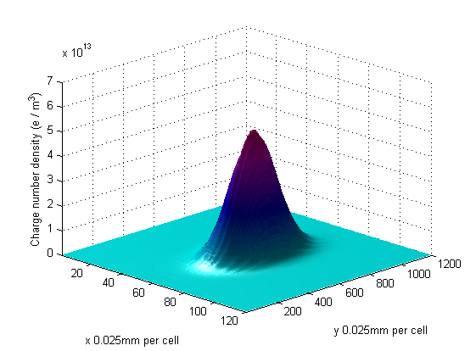
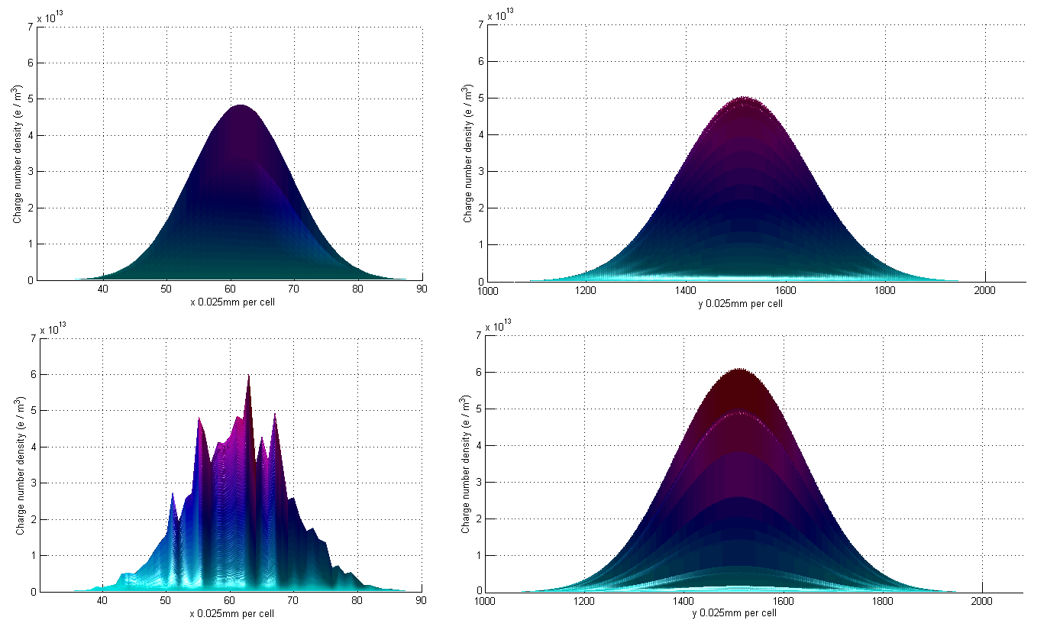
Simulations
The untreated Diamond beam:
Energy 3 GeV
Geometric emittance 140 nm rad
Rms relative energy spread 0.0007
Rms bunch length 2.6 cm
Charge up to 2 nC
Set:
--> σ_{r} = 1.58 mm
T = 1 x 10⁸ K
Rear view Side View
Before:
After:
Mild filimentation
No Micro bunching
Simulation of the untreated Diamond beam.

Slide 14
Simulations
Radially compressed Diamond beam. -> Higher charge density drives a stronger wakefield.
Set:
--> σ_{r} = 0.158 mm
T = 1 x 10¹⁰ K
Filamentation destroys the beam.
Cannot compress smaller than
σ_{r} ~ 1.58 mm.
Simulation of the untreated Diamond beam.

Slide 15
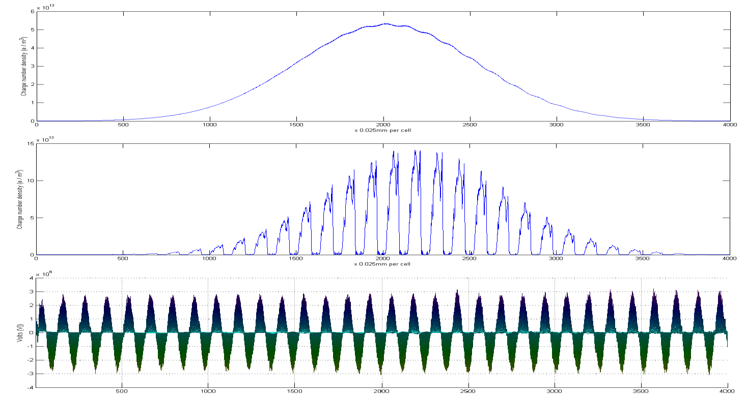
Simulations
Initial wakefield driven by ultra short pulse. σ_{r} = σ_{z} = 0.144 mm. Charge = 102 nC. n_{bpeak} = 5 x 10¹⁸ m⁻³
Diamond beam then propagates in that wakefield and becomes micro bunched.
E = 3 MVm⁻¹
Simulation of the Diamond beam propagating with a wakefield.

Slide 16
Upcoming Simulations
Next set of simulations:
Small parameter scan over intensities of seeding laser pulse
Modulated Diamond bunch into second plasma stage
Modulated Diamond bunch co-propagating with non-modulated proton bunch.
Inject witness electron beam and use motion to calculate synchrotron radiation
Laser Parameters:
λ = 1 μm.
Spot size = ~50 μm Diameter
I = 10¹³ – 10¹⁵ Wcm⁻²
Pulse length ~ 500 fs
If our simulations demonstrate modulation of the Diamond beam is feasible and we
secure the beam time and the funding then this experiment should go ahead in 2012.

Slide 17
Thanks for listening

