Slide 1
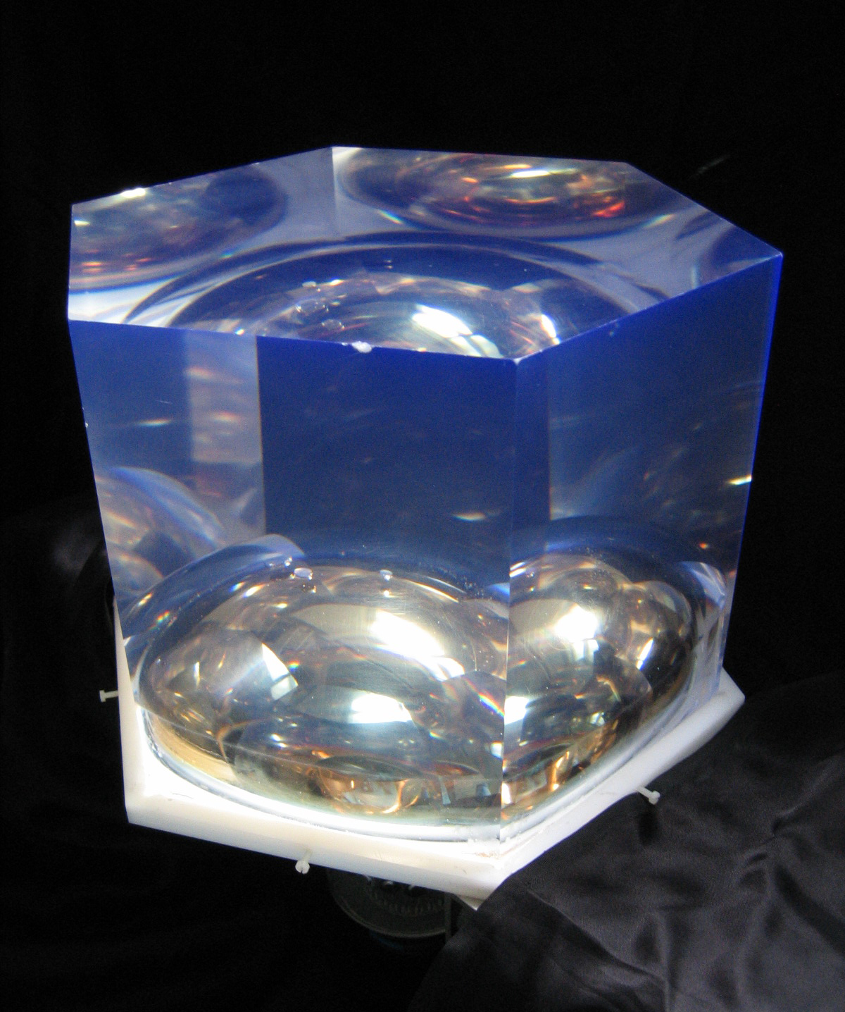
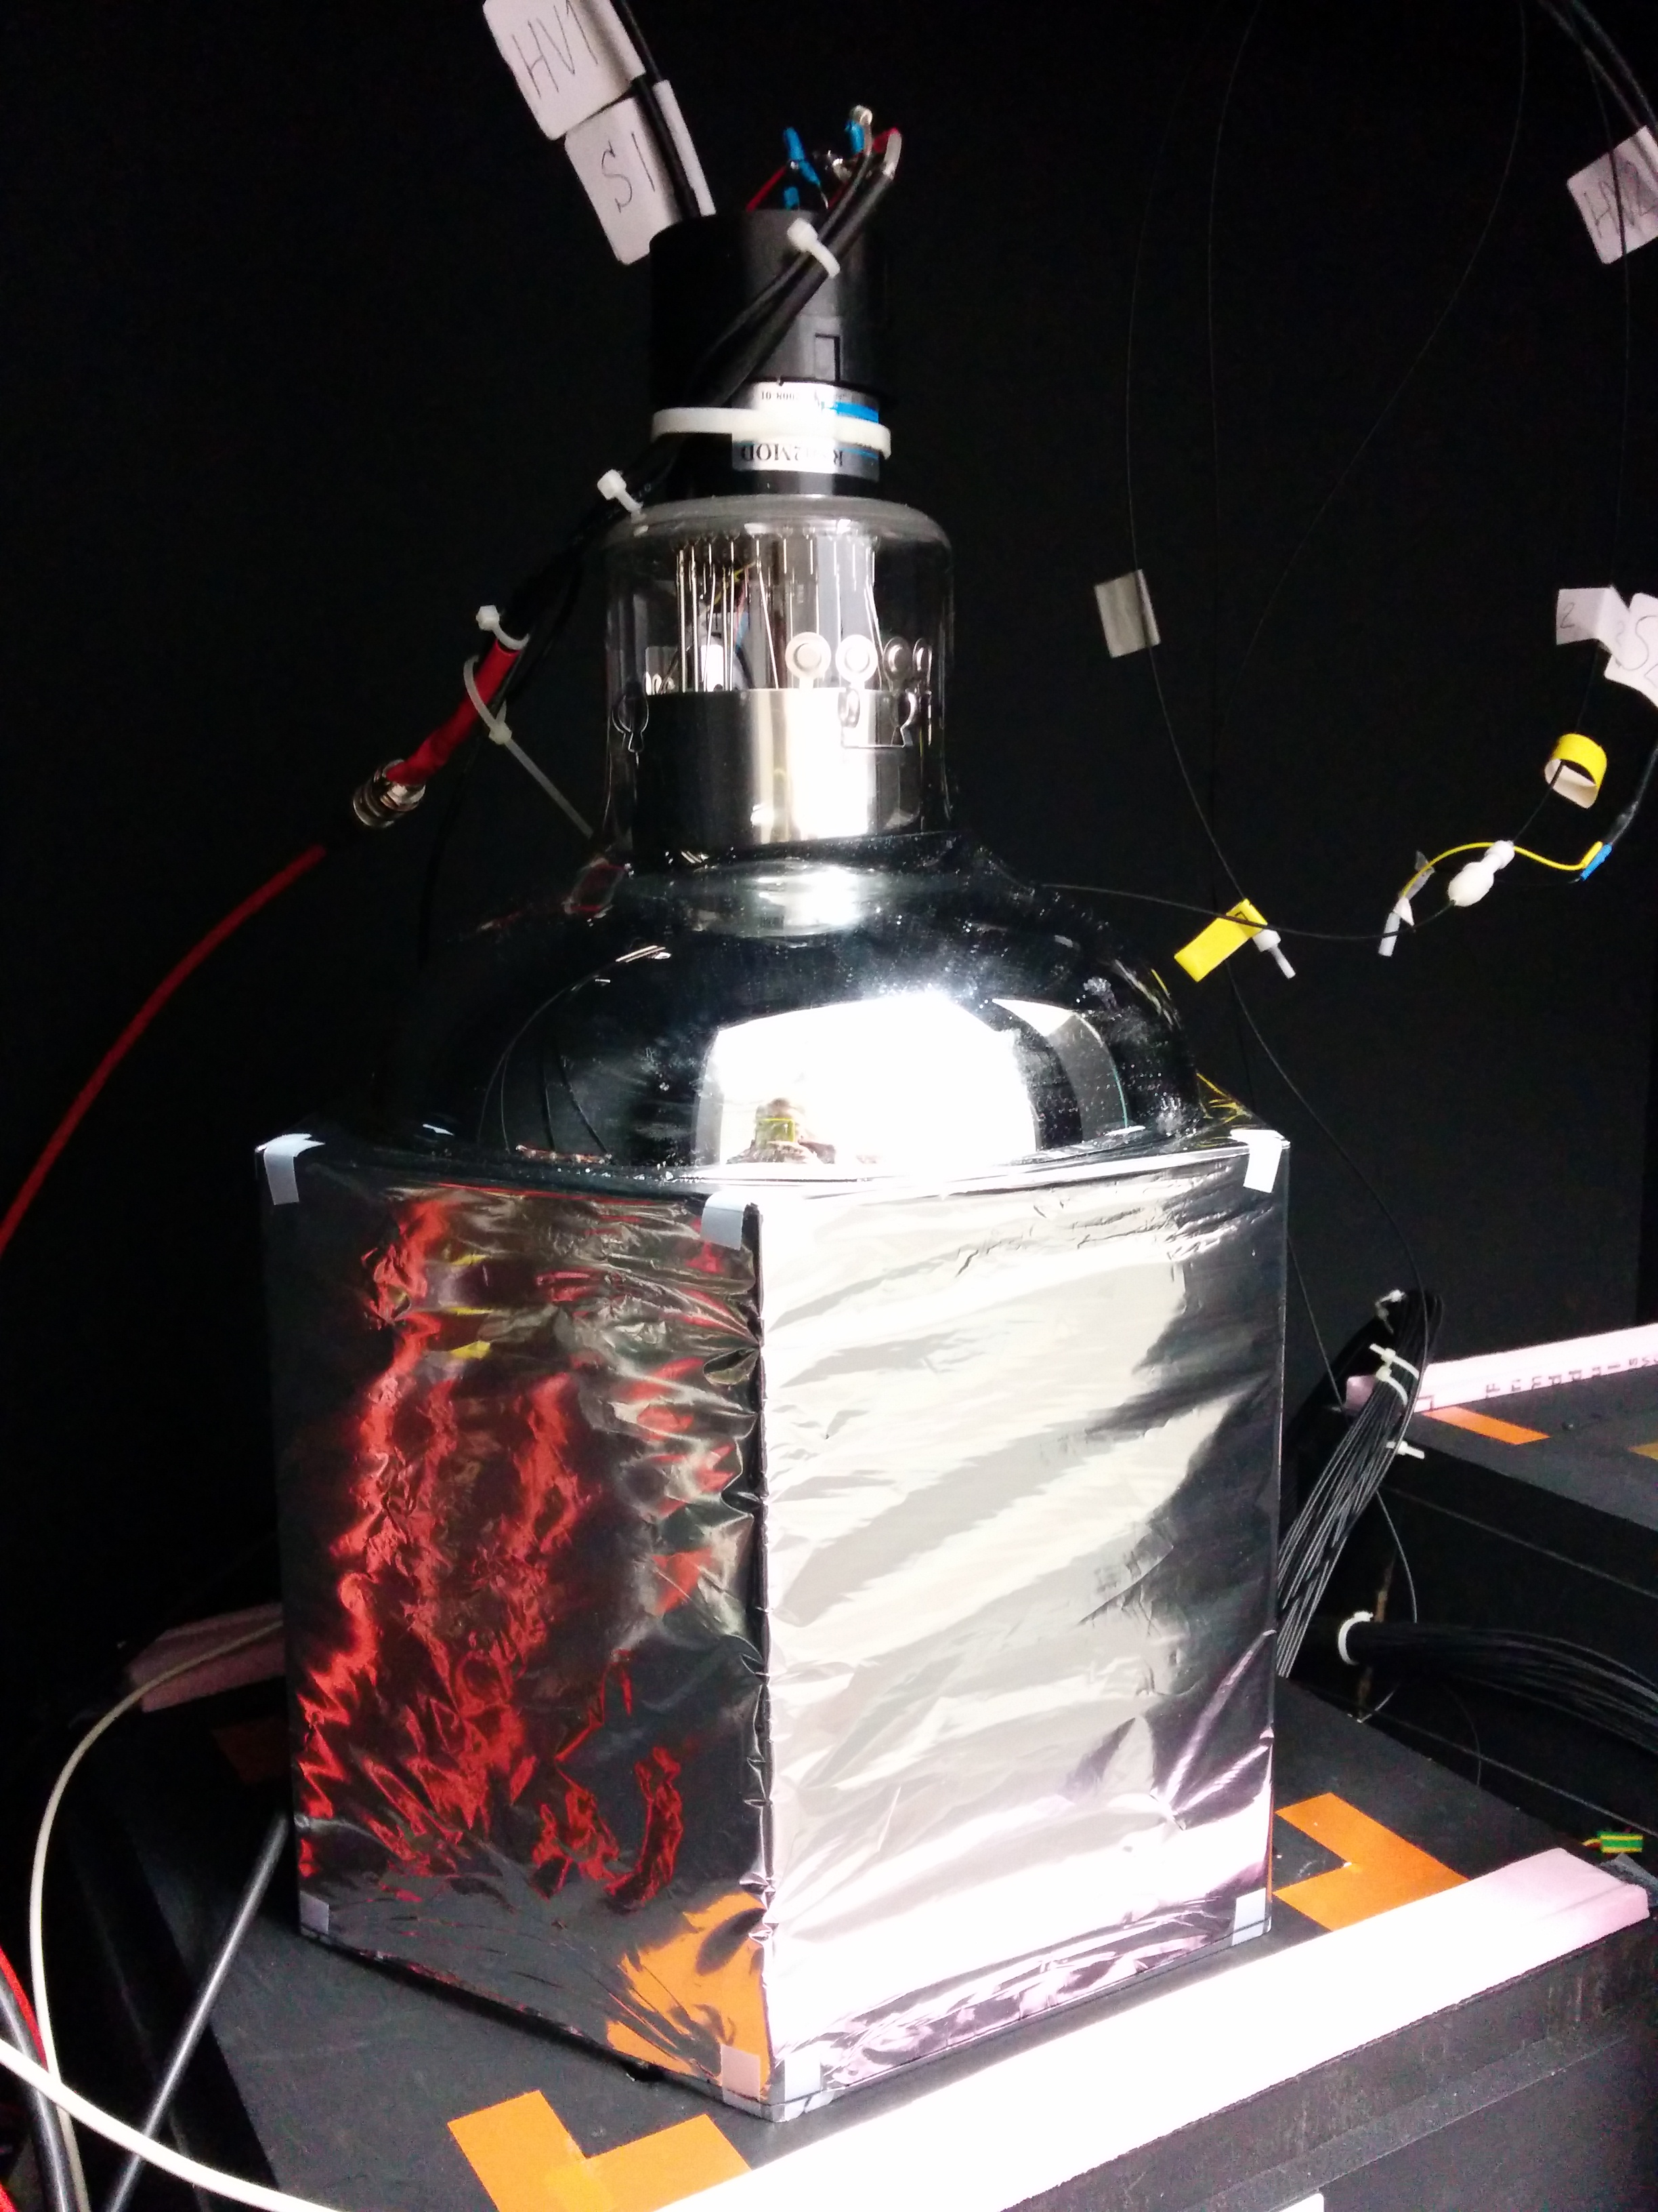
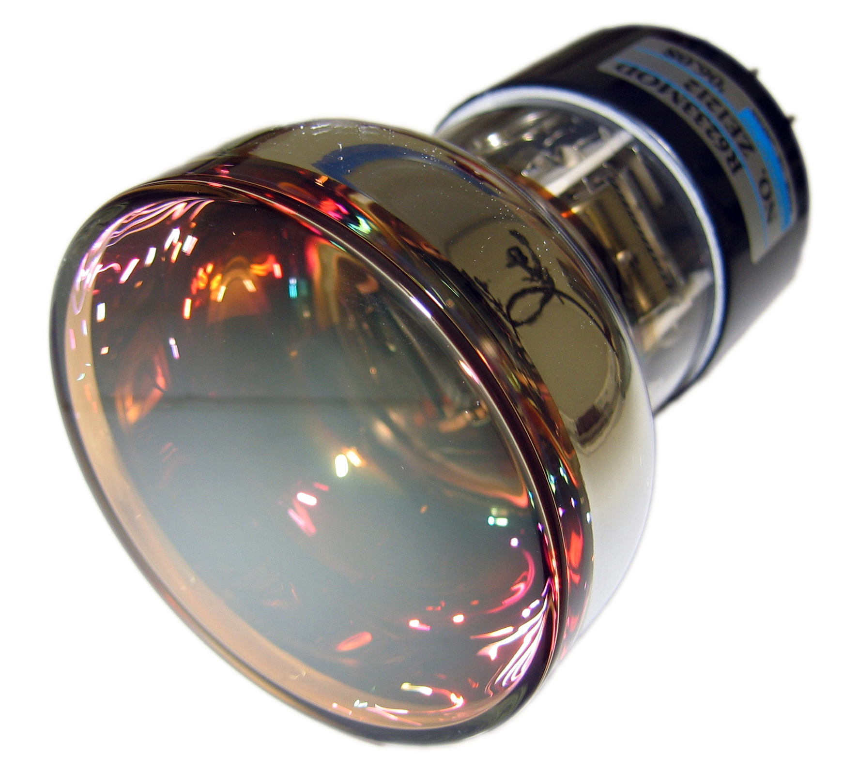
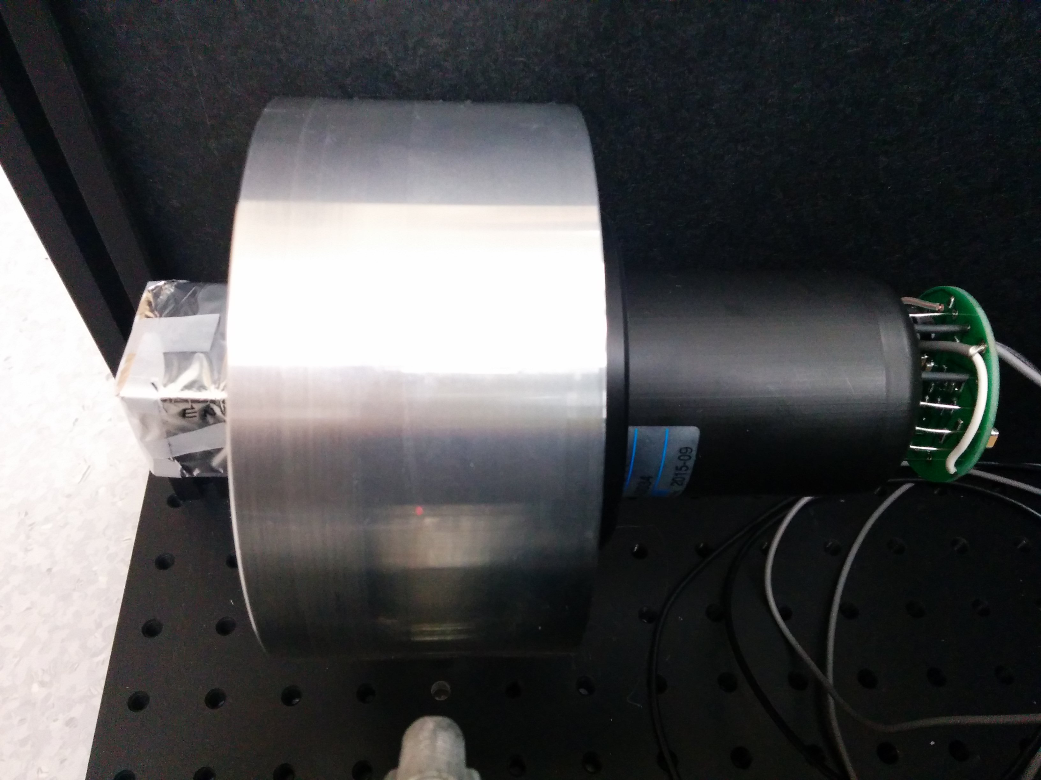
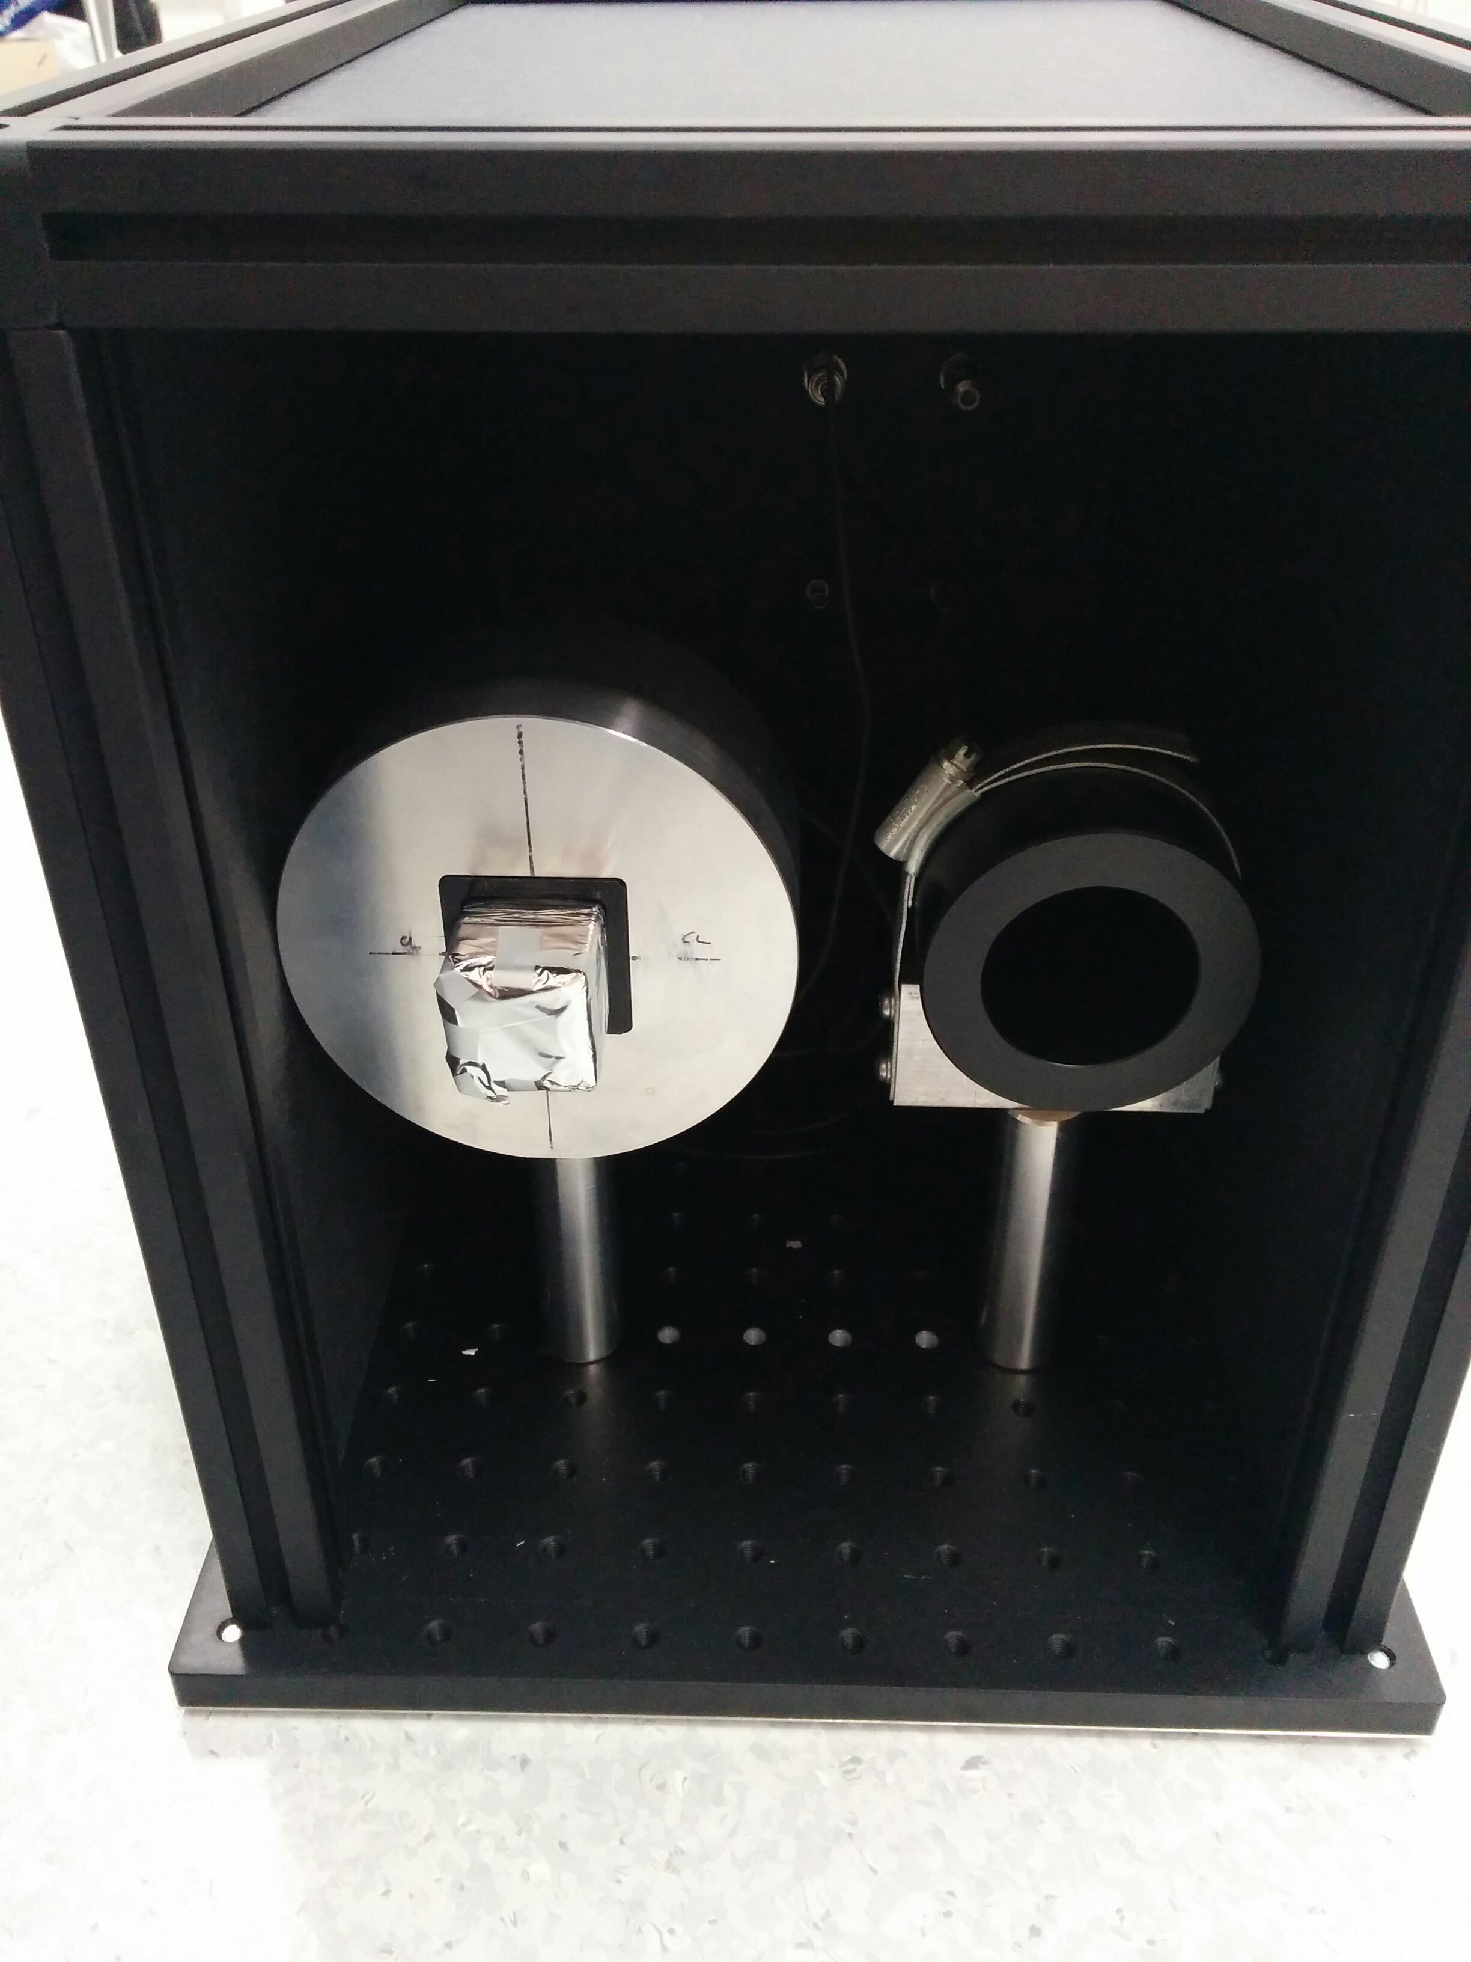
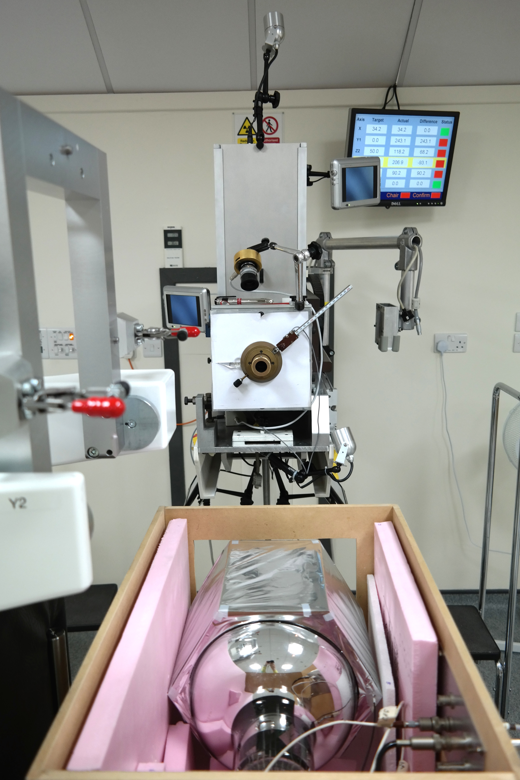
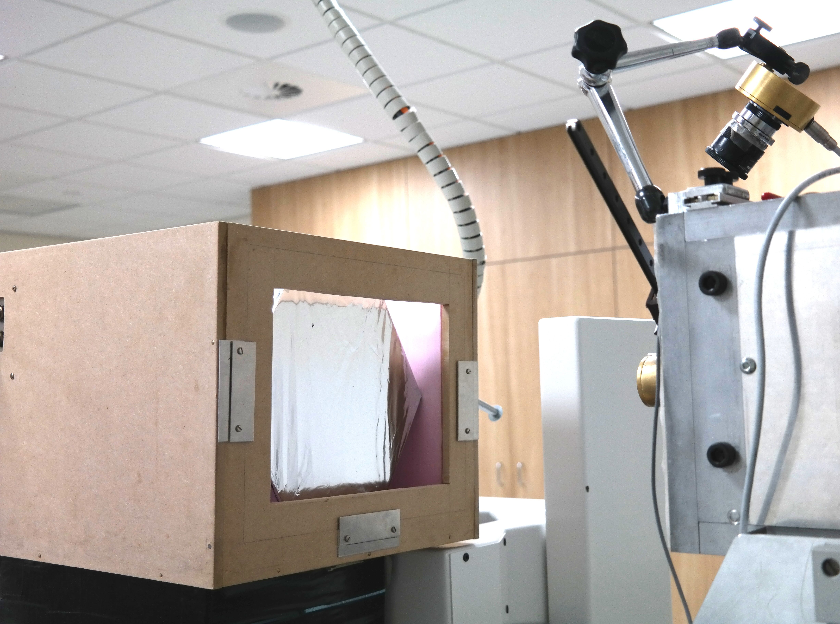
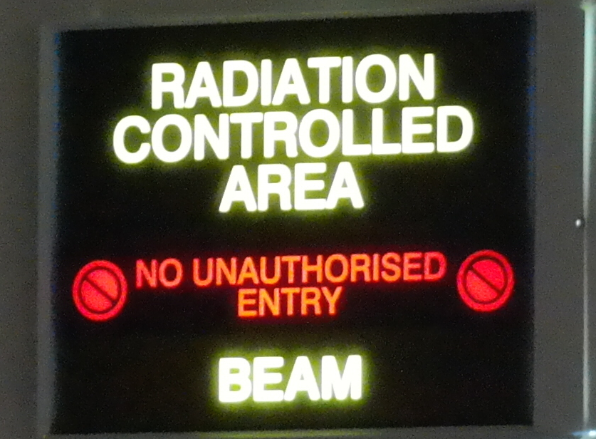
P 219
From SuperNEMO to Proton Therapy: Adapting the SuperNEMO Optical Module for Proton Energy QA
Basharina-Freshville¹, S. Jolly¹, R.Saakyan¹, H.F. Wong¹, R. Amos², A. Kacperek³
¹University College London, Physics & Astronomy, London, UK
²University College London Hospitals, Radiotheraphy Physics, London, UK
³Clatterbridge Cancer Centre, National Eye Proton Therapy Centre, Bebington, UK
Quality Assurance (QA)
At clinical proton therapy facilities, a range of essential daily QA checks are carried out to verify a number of aspects of the clinical beam. Existing techniques for energy QA are largely based around verifying the position of the Bragg Peak at a handful of energies using ionisation chambers. These measurements can be time consuming to set up and carry out.
A detector is under development to improve the accuracy and reduce the measurement time (to around 2-3 minutes) for proton energy QA using an adapted calorimeter module that was designed for the SuperNEMO high energy physics experiment.
Ongoing Work
Development of a <1% σ performance with realistic proton therapy facility rates (1 – 10 MHz)
  Removal of pile up due to fast rates through pulse shape discrimination analysis
Development of a calibration system:
  A yearly range-energy calibration
  A daily gain/light output monitoring system using LEDs and pin diodes
            Development of a conceptual design of a “clinical” QA module:
              Easy mounting/removal from clinical nozzle
The SuperNEMO Optical Module
PVT Scintillator + High Quantum Efficiency PMT, wrapped in reflective material:
Treatment Nozzle
PVT Block
PMT
~50 cm
Mains
+
Nozzle mounted system with ASIC-based component electronics
Signal
High light output
Fast response time (on the order of ns)
Compact – mountable on beam nozzle
Cheap
PVT scintillator is water equivalent:
Results from Clatterbridge
Best energy resolution (ΔE/E) result achieved so far during four test beam visits (at 70 kHz):
PMMA absorbers used to decrease beam energy and measure ΔE/E as a function of proton energy:
Beam Energy, MeV | SCINT stopping distance, mm | WATER stopping distance, mm | SCINT σ of stopping distance, mm | WATER σ of stopping distance, mm
60 | 30.21 | 30.54 | 0.33 | 0.33
200 | 255.4 | 257.1 | 2.48 | 2.44
300 | 505.9 | 509.9 | 4.64 | 4.78
Fitting function:
Convolution of Gaussian and mirror Landau
+ Landau on the right
ΔE/E:
1.17 ± 0.18 % FWHM
0.50 ± 0.07 % σ
dependence!
GEANT4 pencil beam simulations of the SuperNEMO PVT scintillator vs. water equivalent.
Mirror Landau Tail
PRELIMINARY!
Testing at Clatterbridge Cancer Centre 60 MeV Clinical Beam (Bebington, UK)
Optical Module Housing
PMT
PVT Scintillator Block
30 cm
Proton Beam
Patch Panel
HV
CAEN DT5751
Digitiser
Acknowledgements
We would like to acknowledge the support of STFC, who have provided the funding for this project, and NUVIA.
Portable DAQ system

