Slide 1

Proton Calorimetry: From SuperNEMO to Proton Therapy
HOSPITALS
Simon Jolly, Ruben Saakyan, Anastasia Freshville, Hiu Fung Wong, Richard Amos, Andrzej Kacperek

Slide 2
Clatterbridge Cancer Centre
62 MeV Scanditronix cyclotron provides 60 MeV protons (31 mm in water) to treatment room through double scattering.
Beam time provided for research.
We’ve had 2-day shifts every few months.
Already made interesting observations with our equipment about the treatment beam…
Need much lower proton fluence for our measurements than clinical settings.
Rate reduction achieved through:
  Various collimators (0.5–10 mm)
  Ion source gas supply.
  Ion source discharge current.
  Cyclotron sector focussing.
  RF phasing (wouldn’t recommend it…).

Slide 3
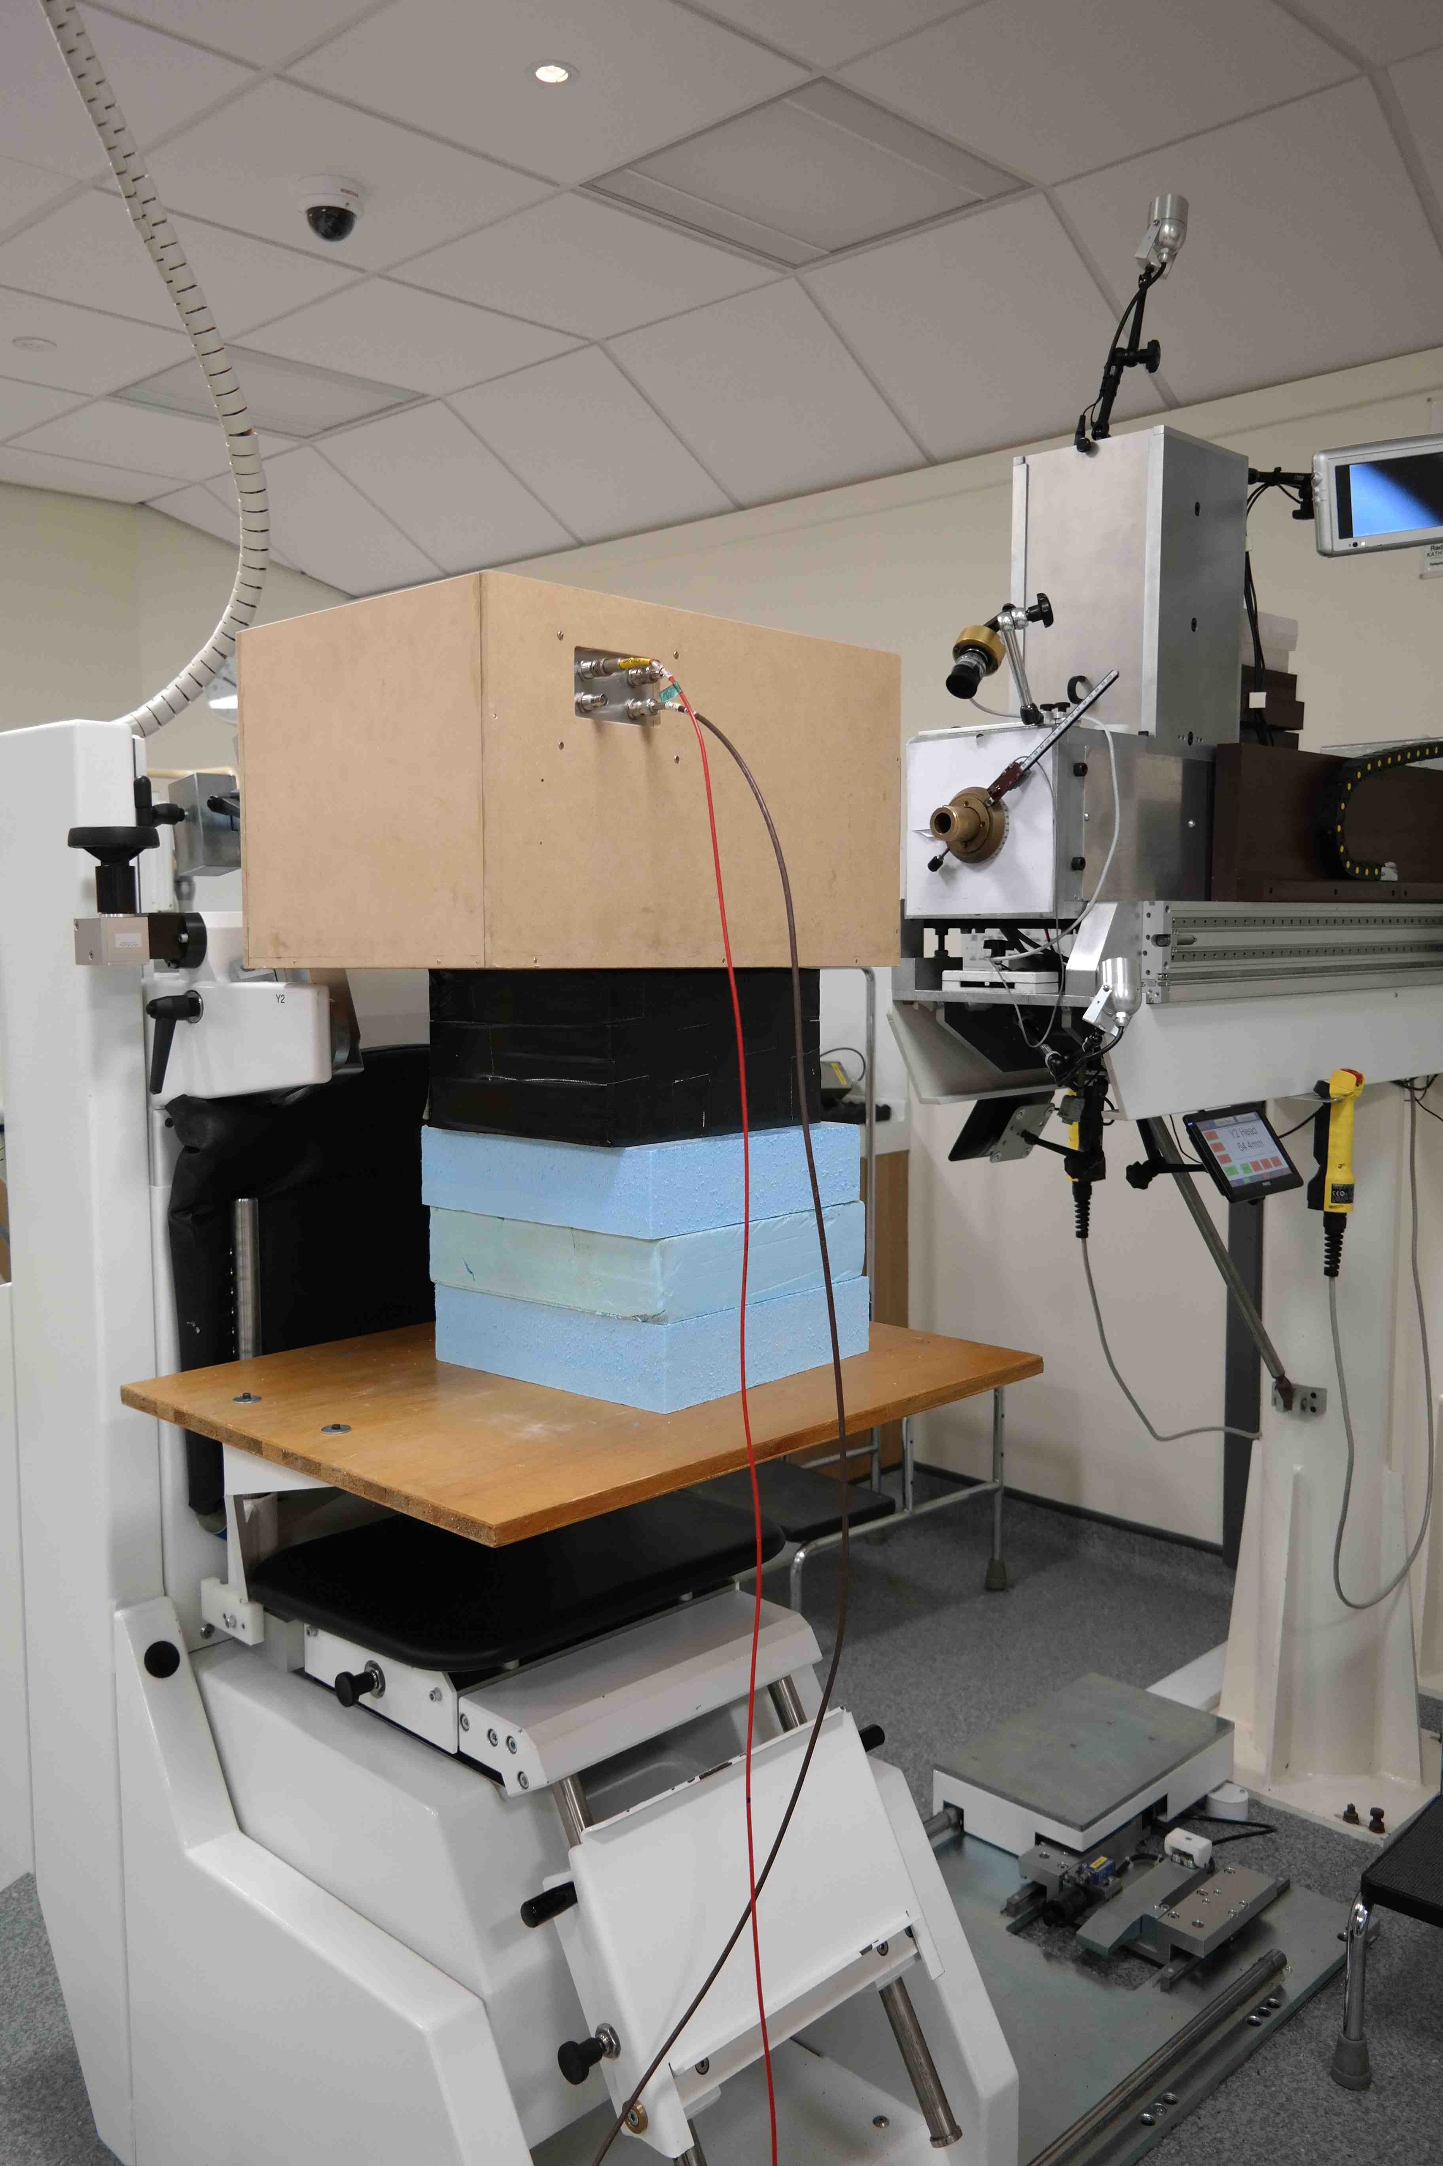
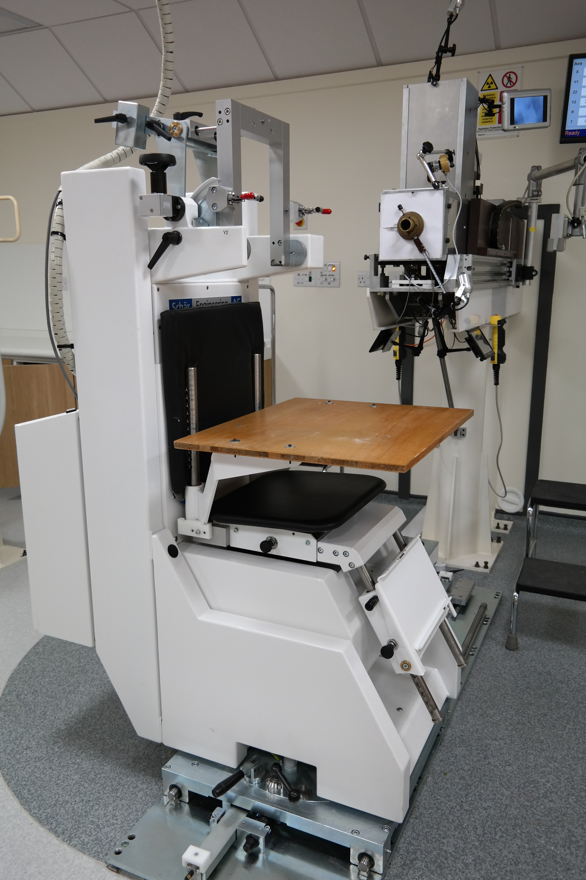
Experimental Tests

Slide 4
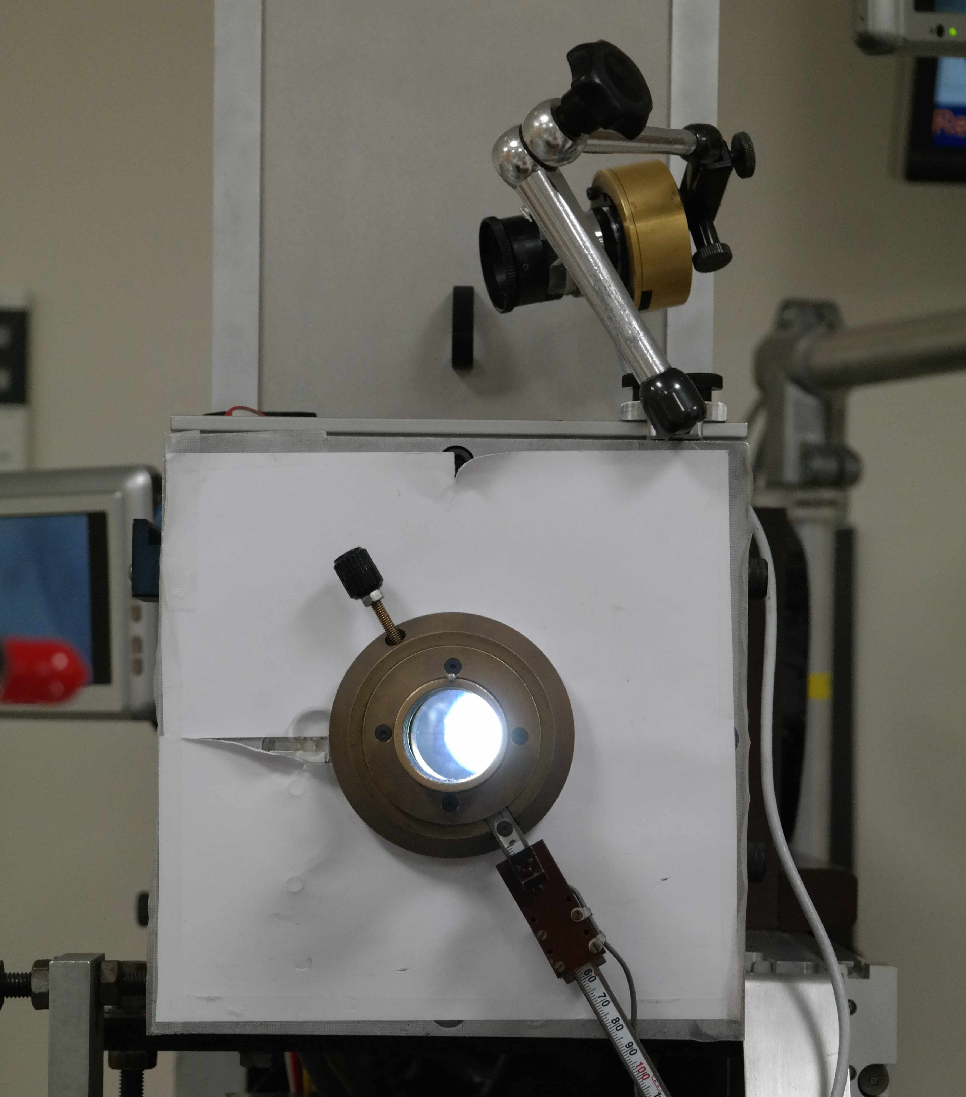
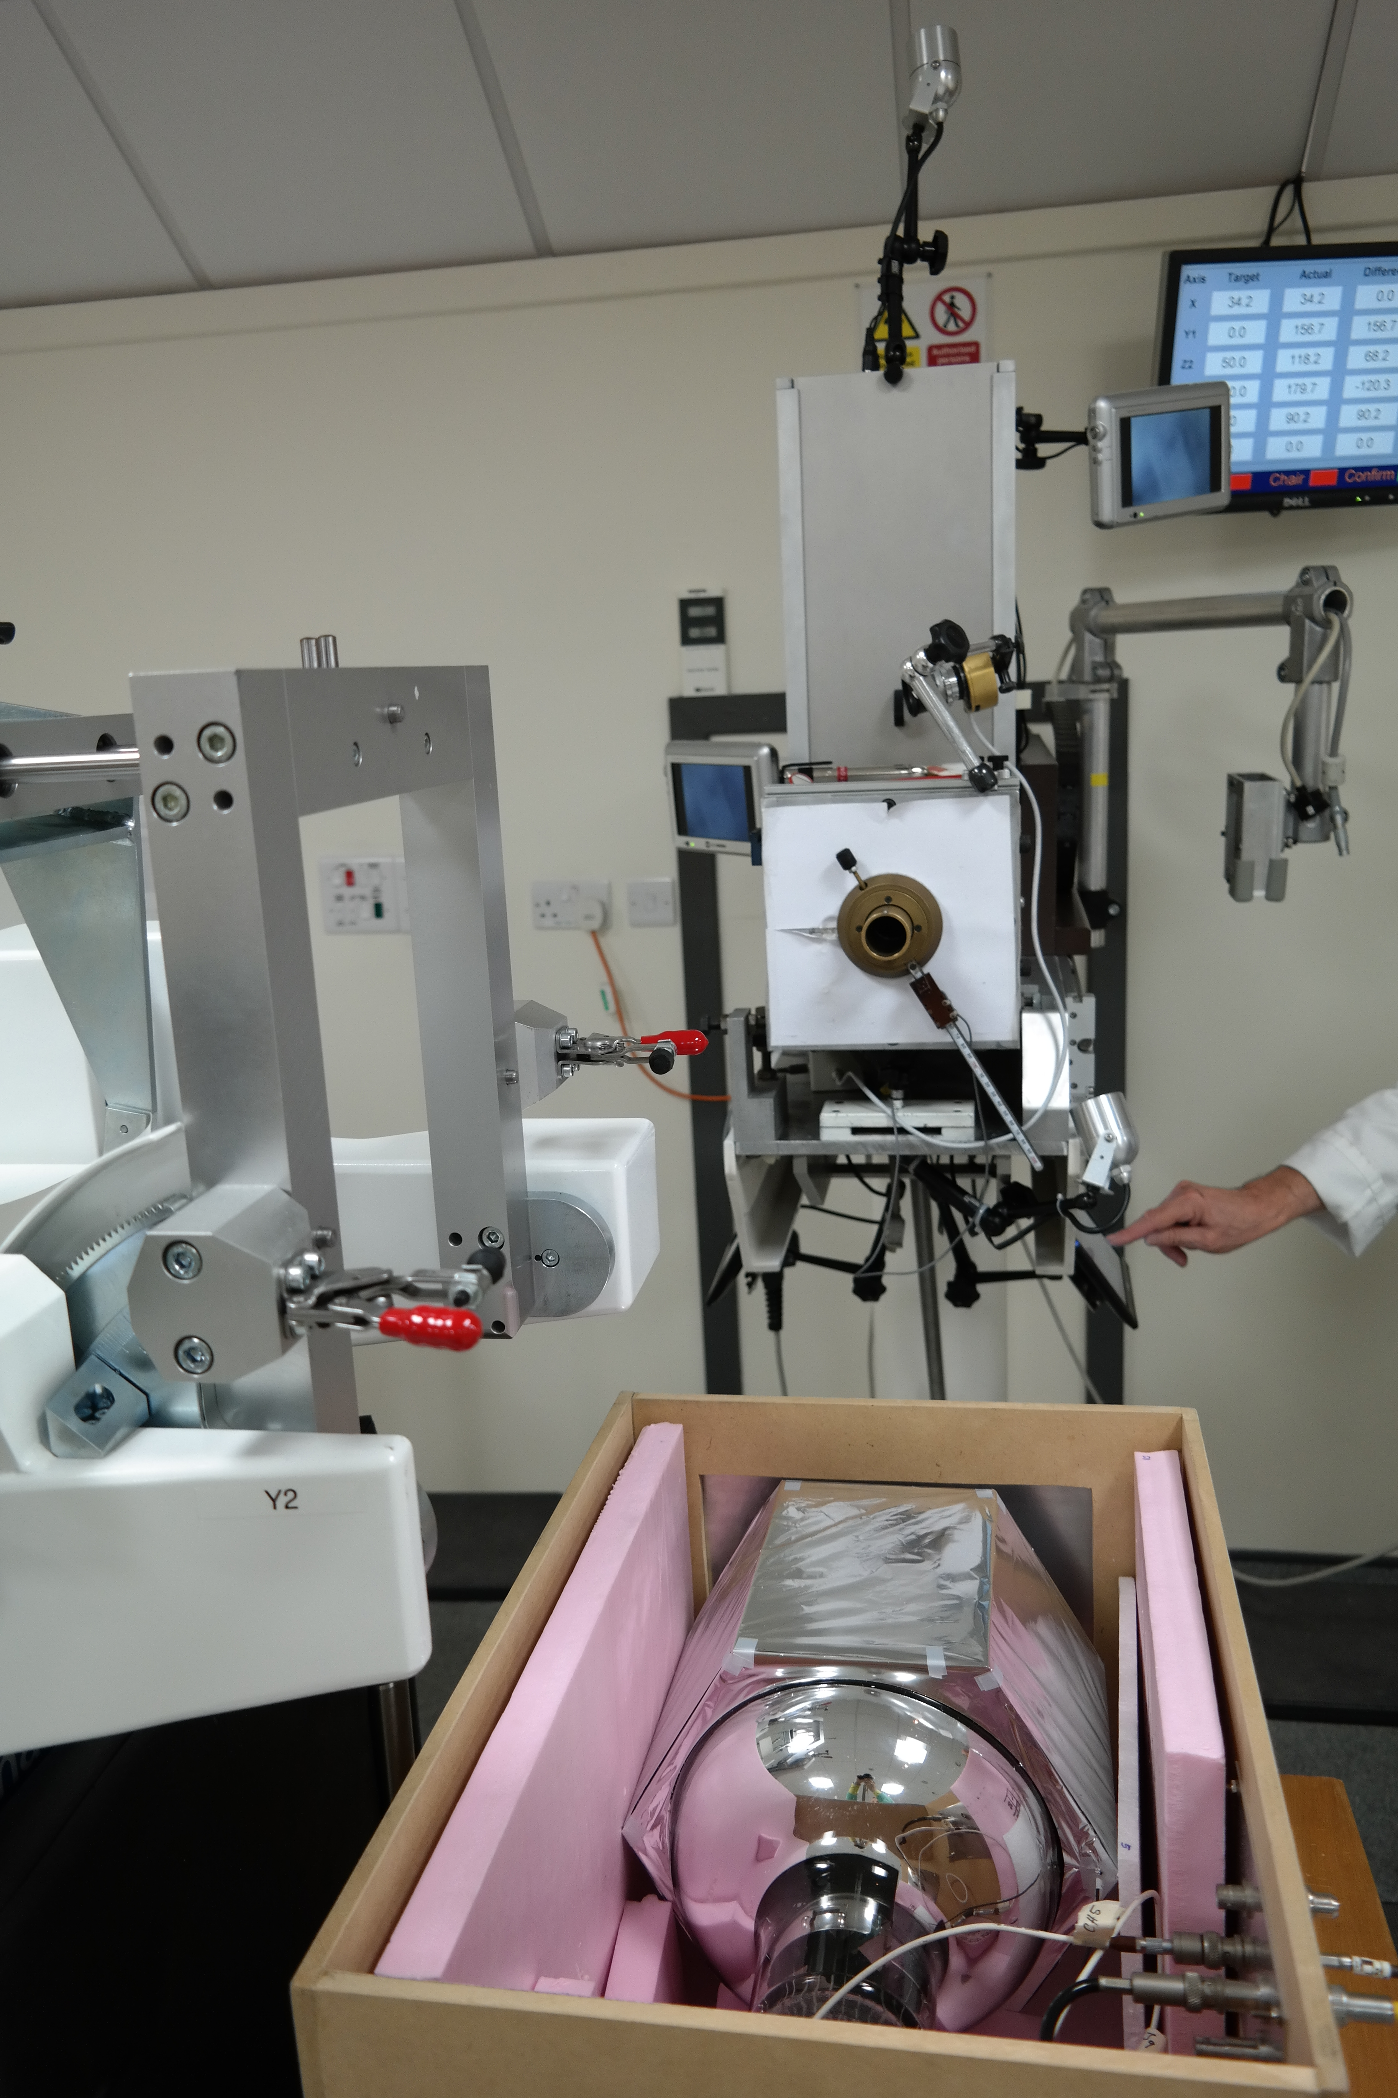
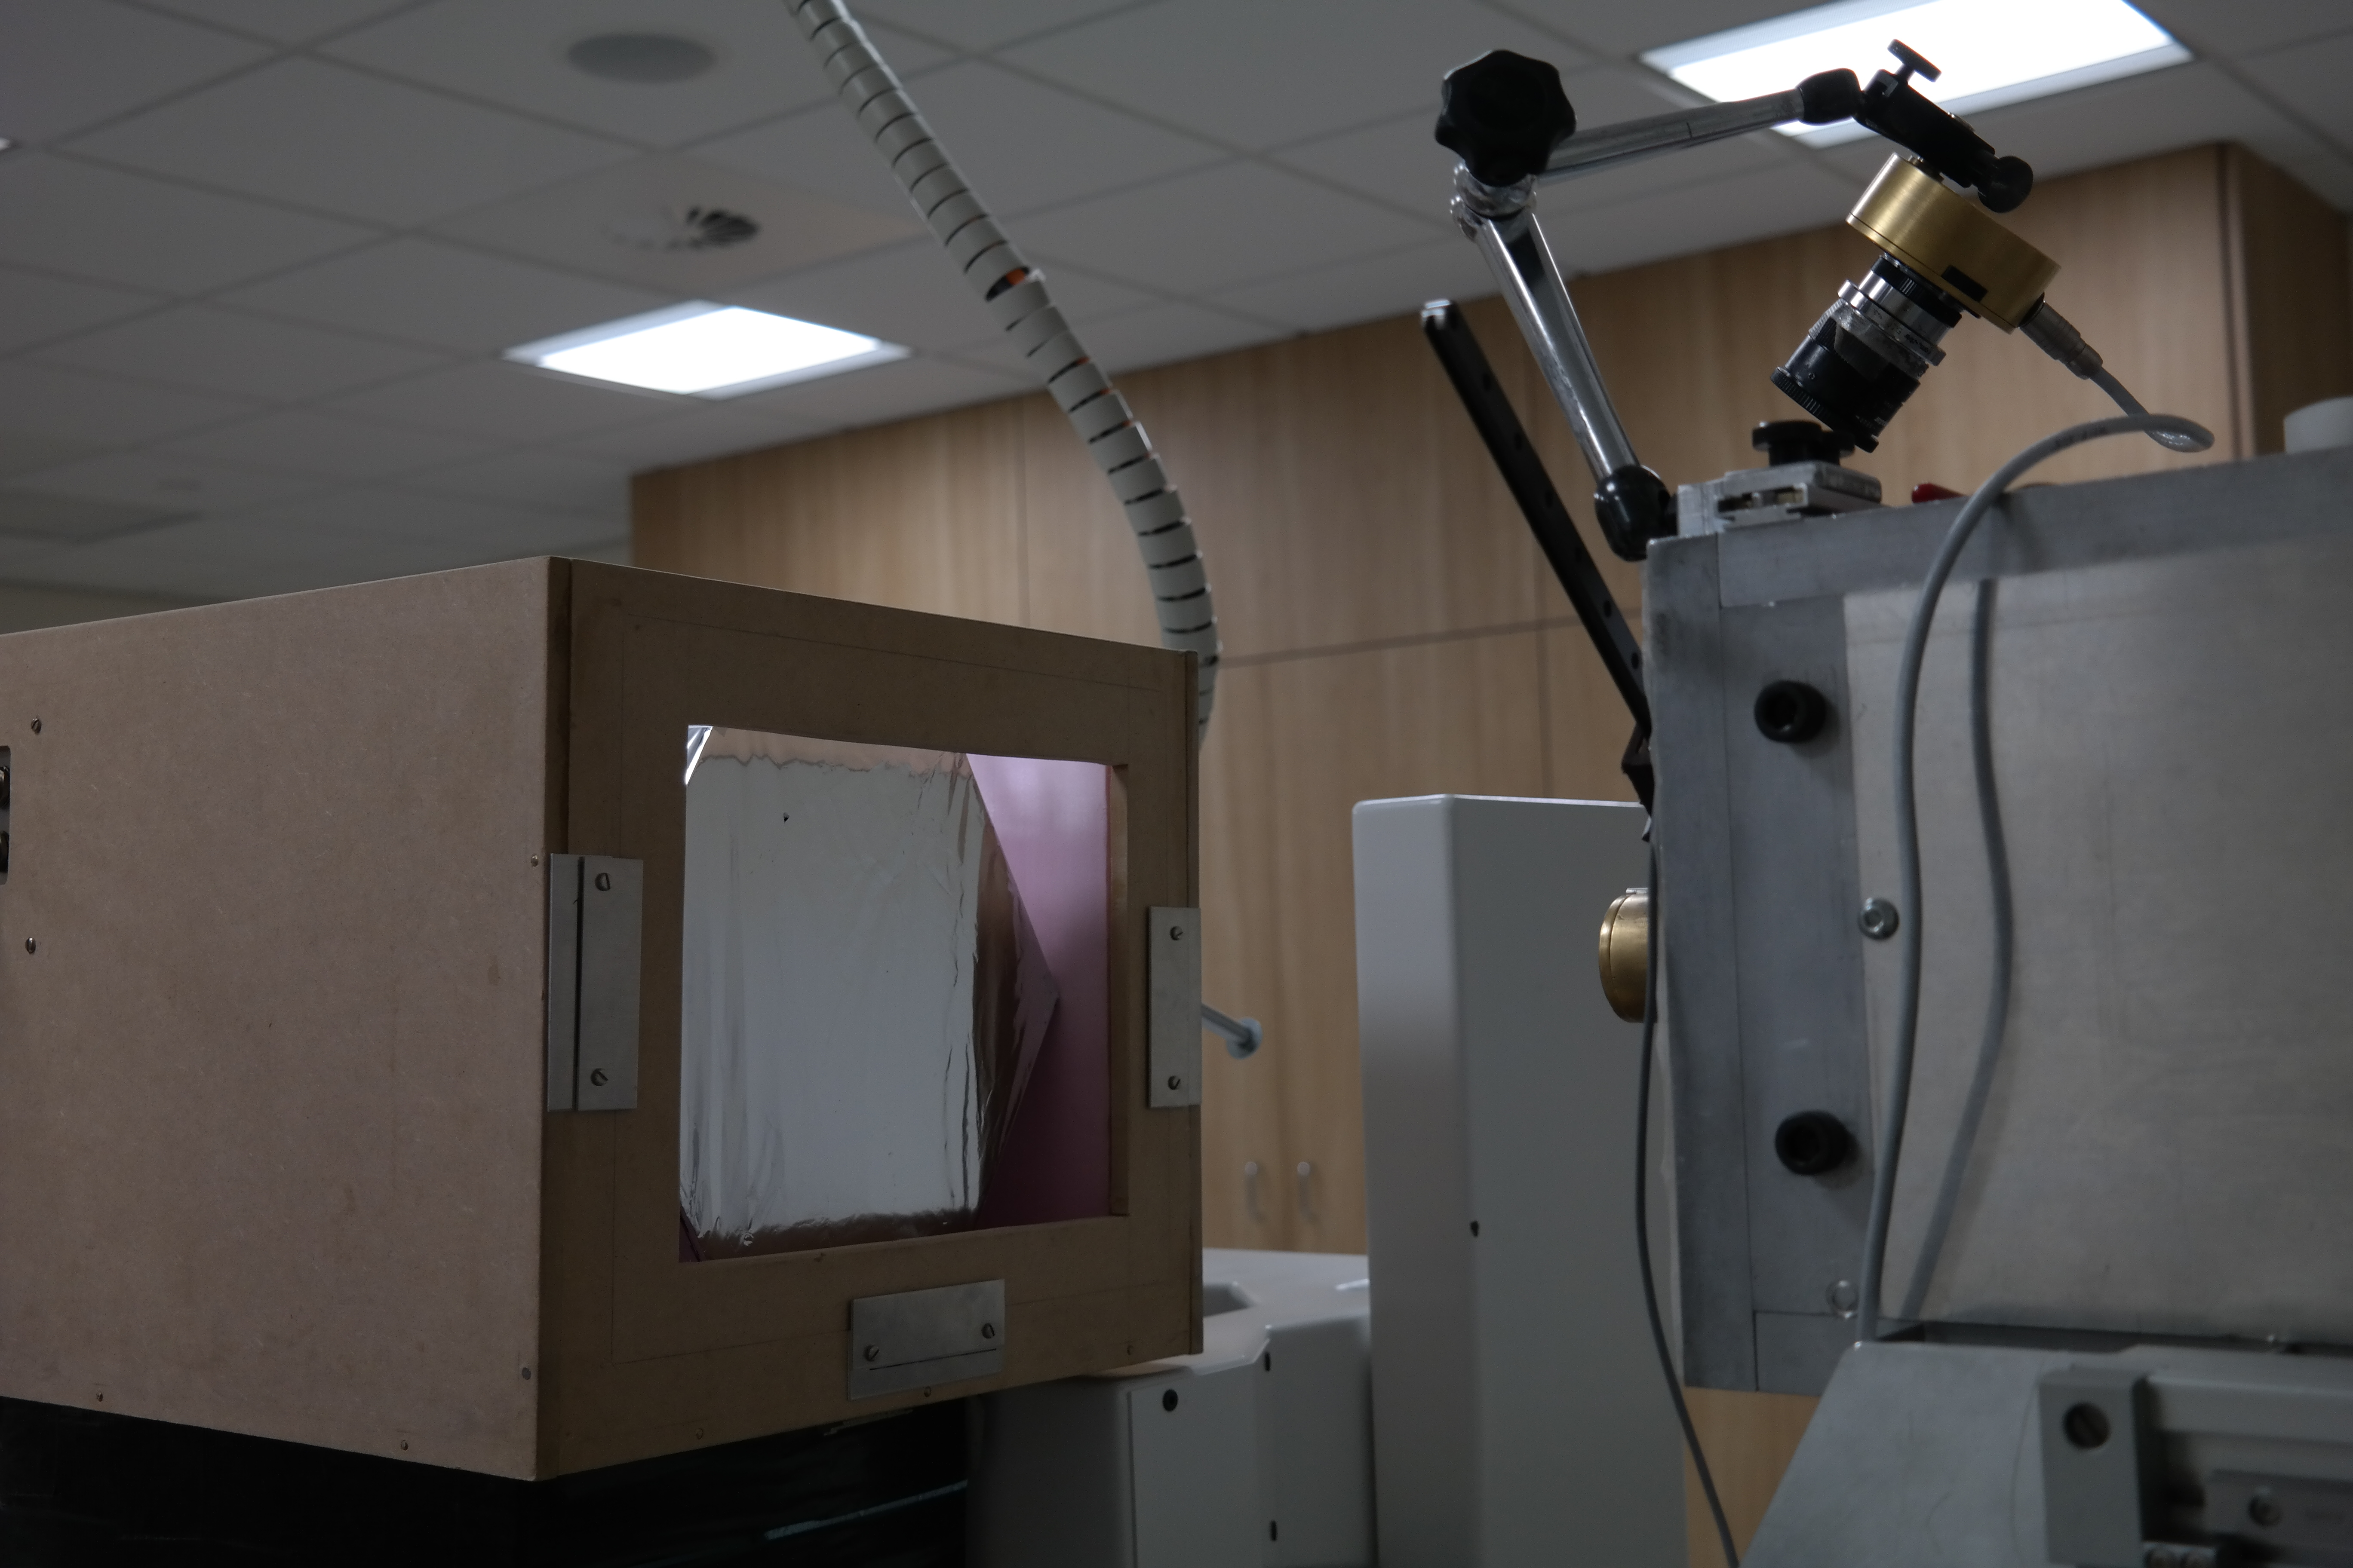
Experimental Tests

Slide 5
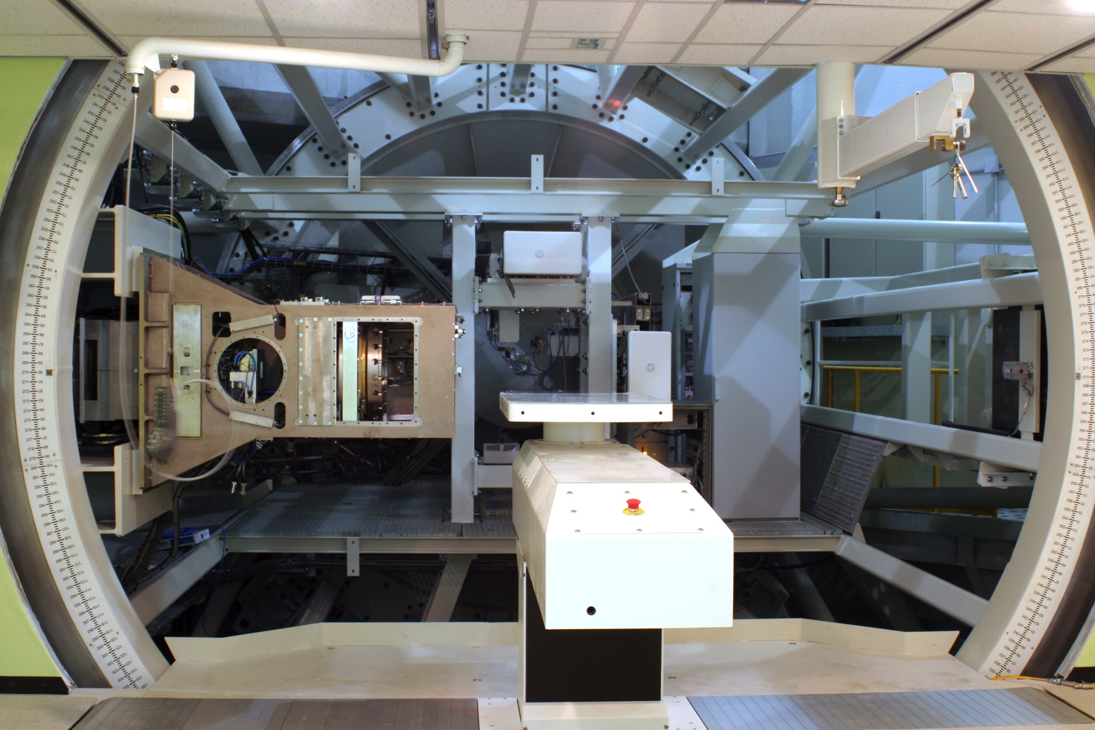
Daily QA System
PVT Block
PMT
~50 cm
Mains
Signal

Slide 6
Nozzle Mounted Assembly
PVT Block
PMT
~50 cm
Mains
Signal

Slide 7
Fast Treatment Plan Verification
Protons
PVT Block
PMT
Tracking layer
Take monolithic block of PVT scintillator.
Add 2D tracking to front face.
Still nozzle-mounted and self-contained (but maybe add 2nd readout cable…)
Read out position and energy of every single proton one by one.
Fast reconstruction of water-equivalent treatment plan.
BUT rate-limited:
  Speed of scintillator/PMT.
  Readout of 2D tracking.
  Clock synchronisation between tracking and calorimetry.
Is plan verification okay with reduced rate?

Slide 8
Bragg Peak Mapping
Protons
PVT helpfully is water equivalent.
Segment block into slices and read out light from each slice individually.
Minimum slice width <1 mm.
Resolution set by slice width and variation in scintillator light output.
Is there any benefit to adding tracking on front face?

Slide 9
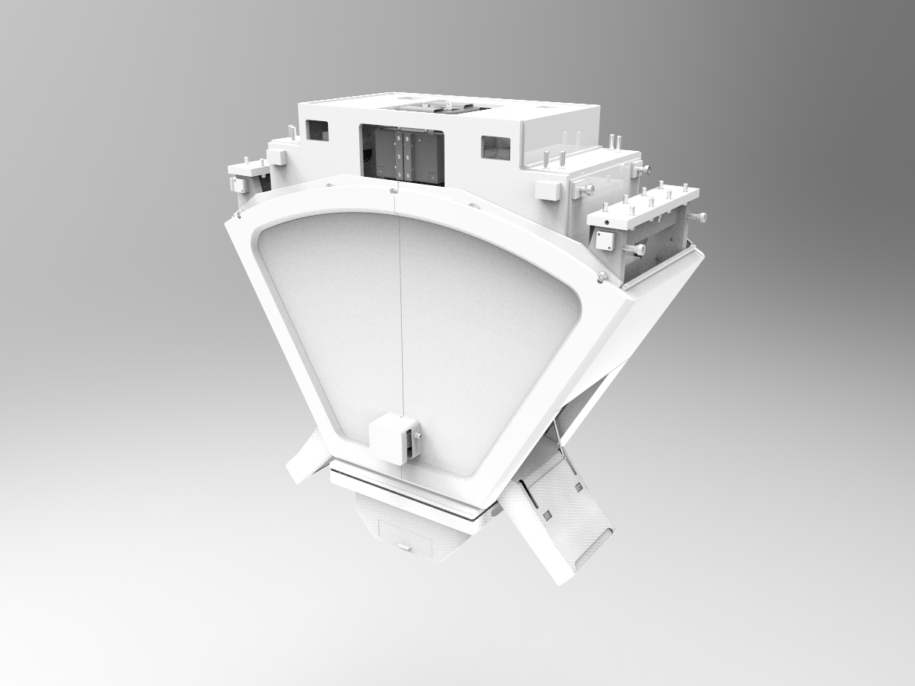

Slide 10
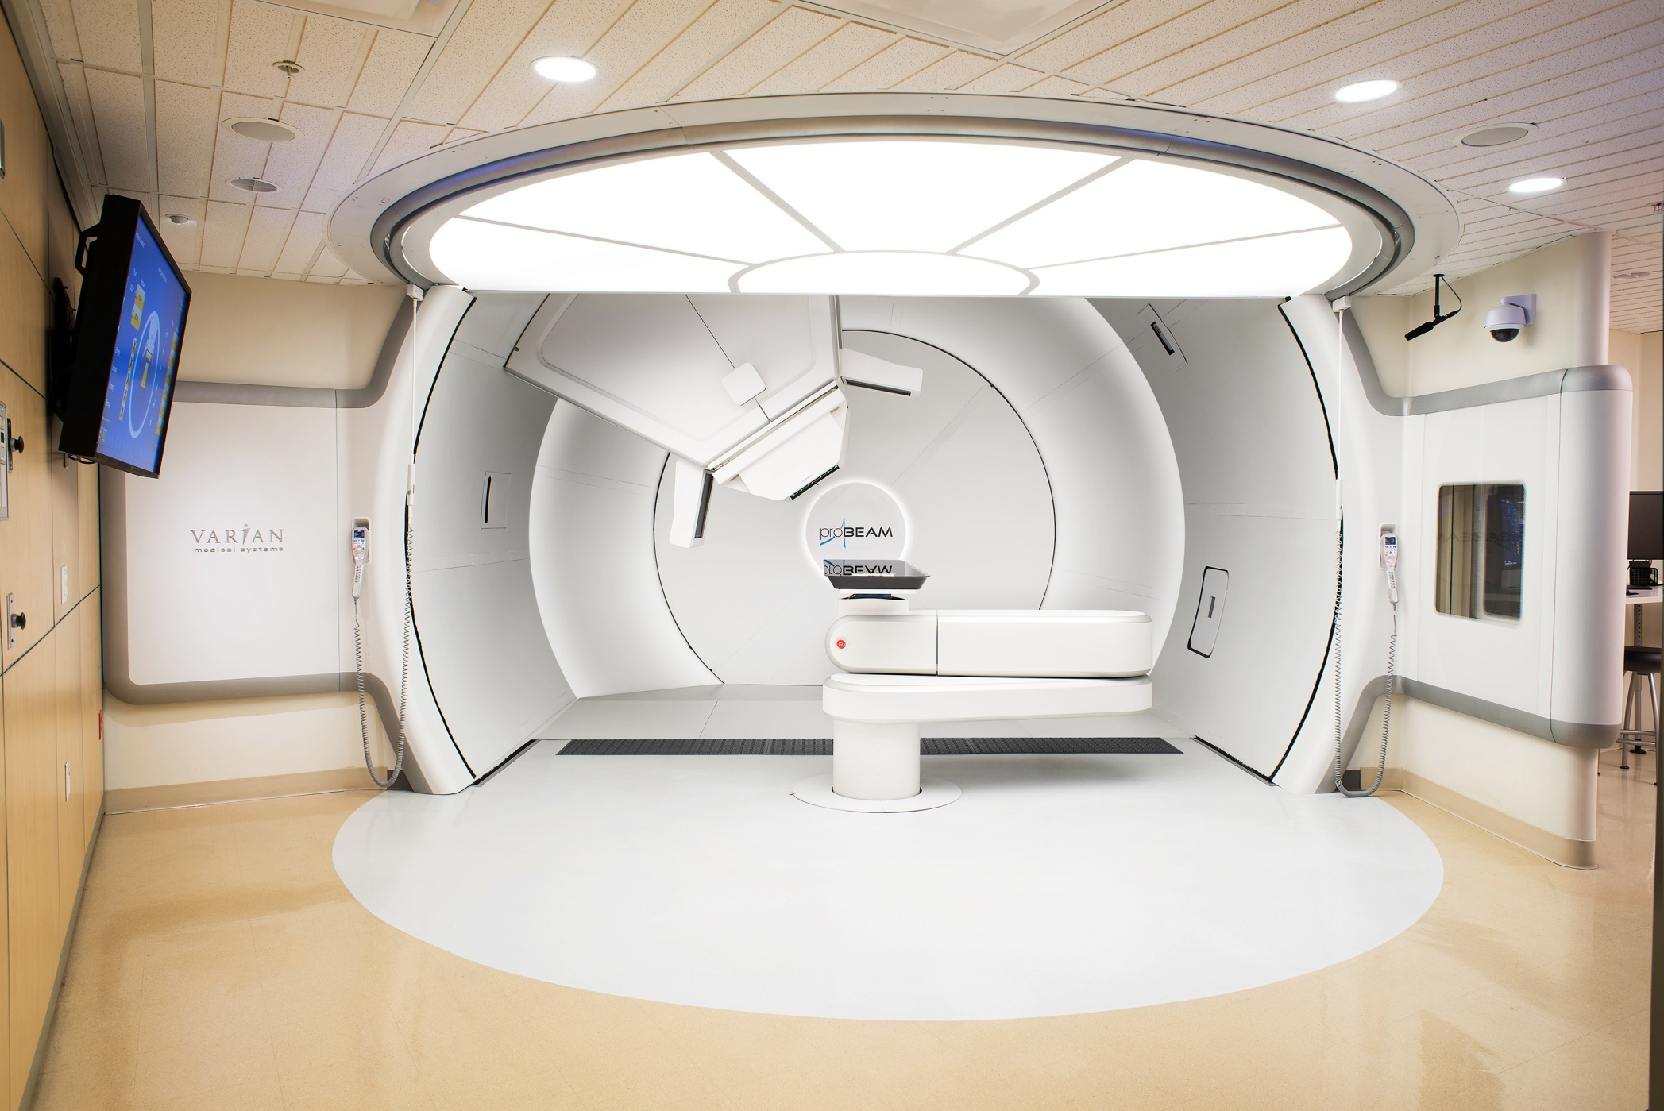

Slide 11
