Slide 1
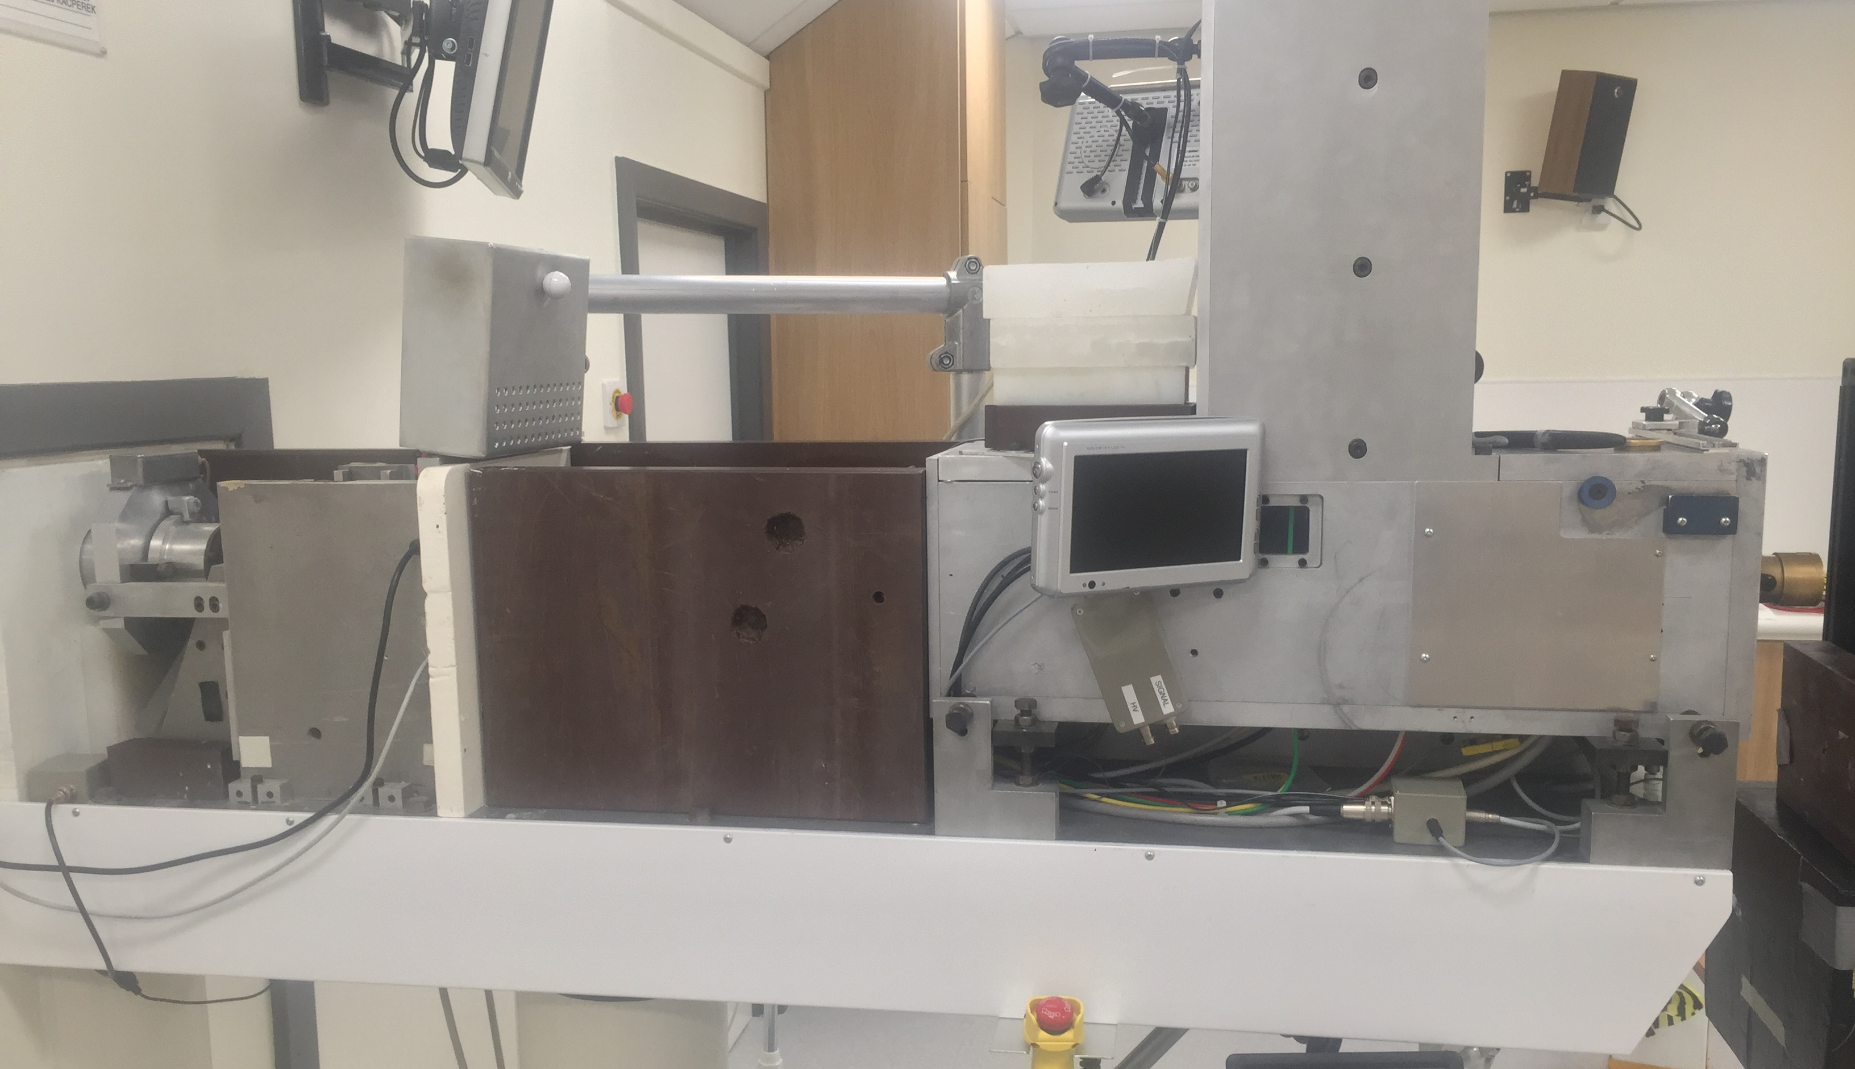
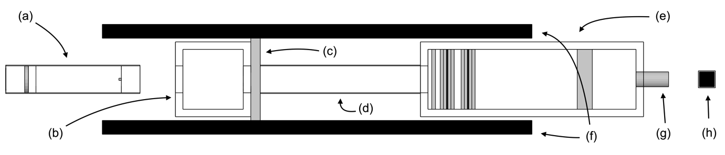
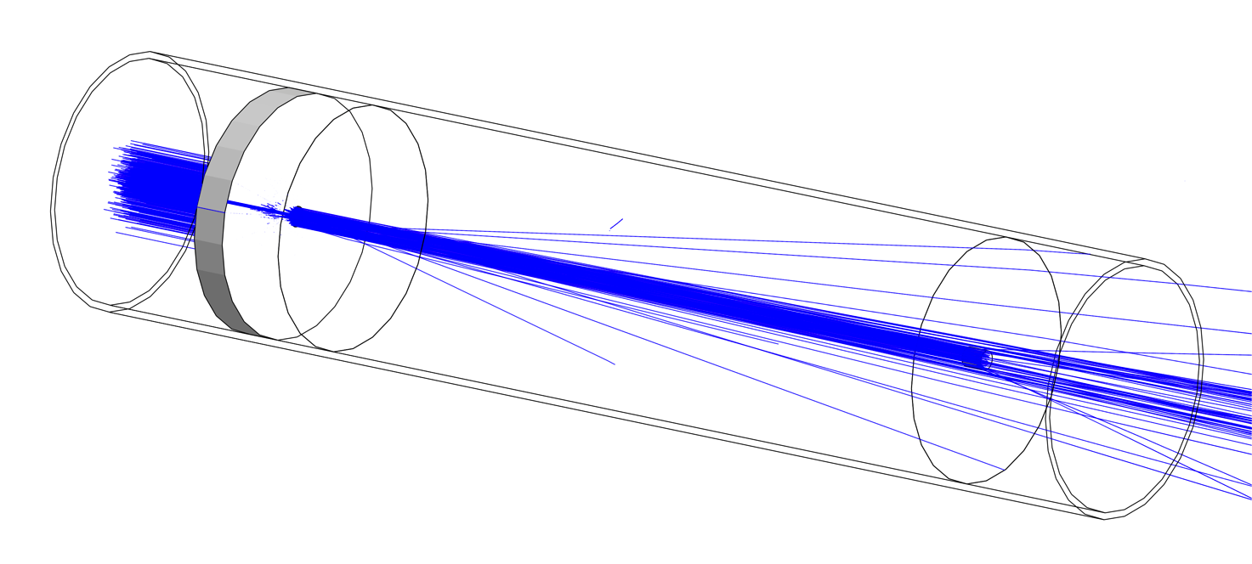
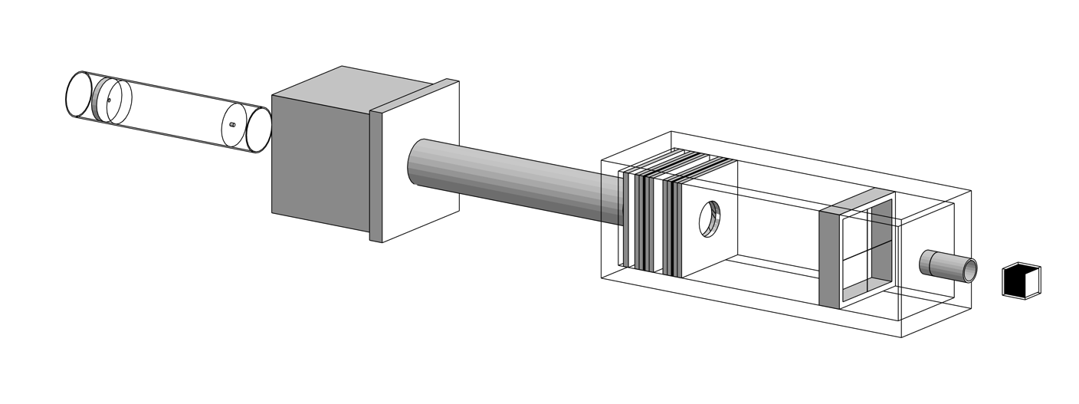
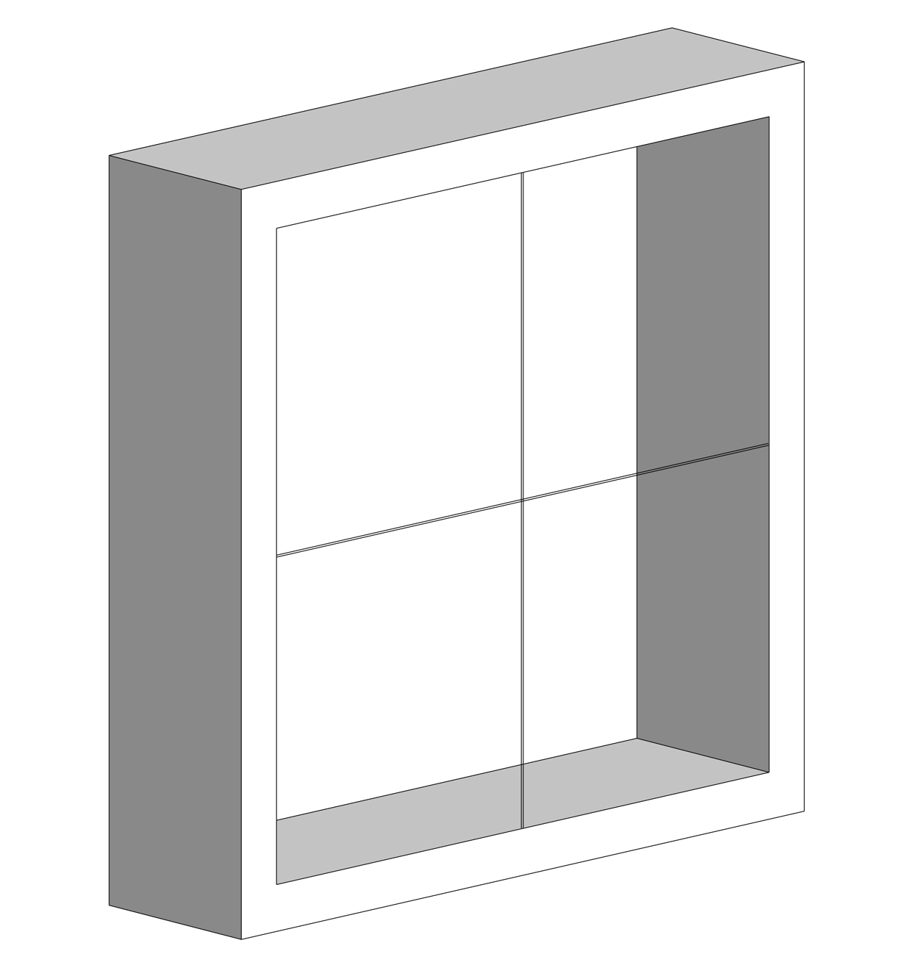
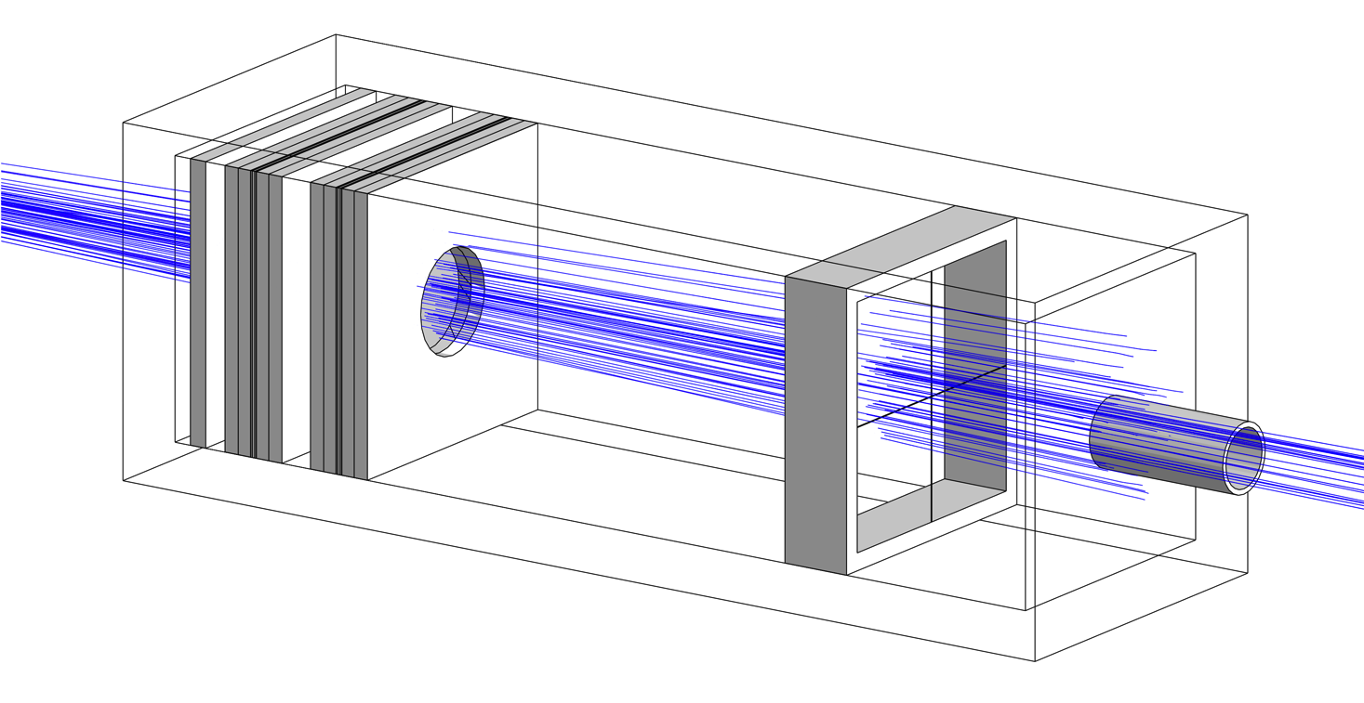
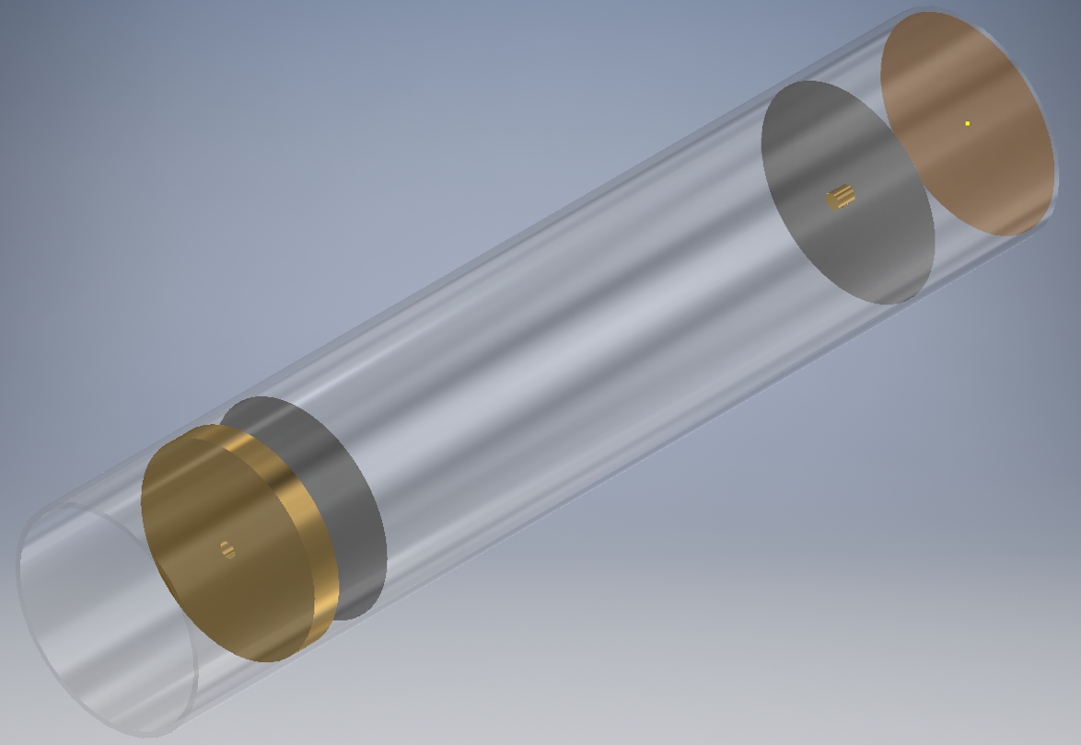
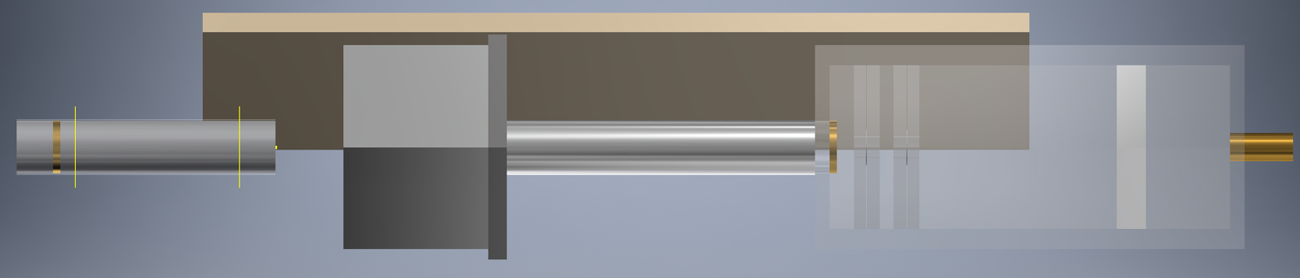
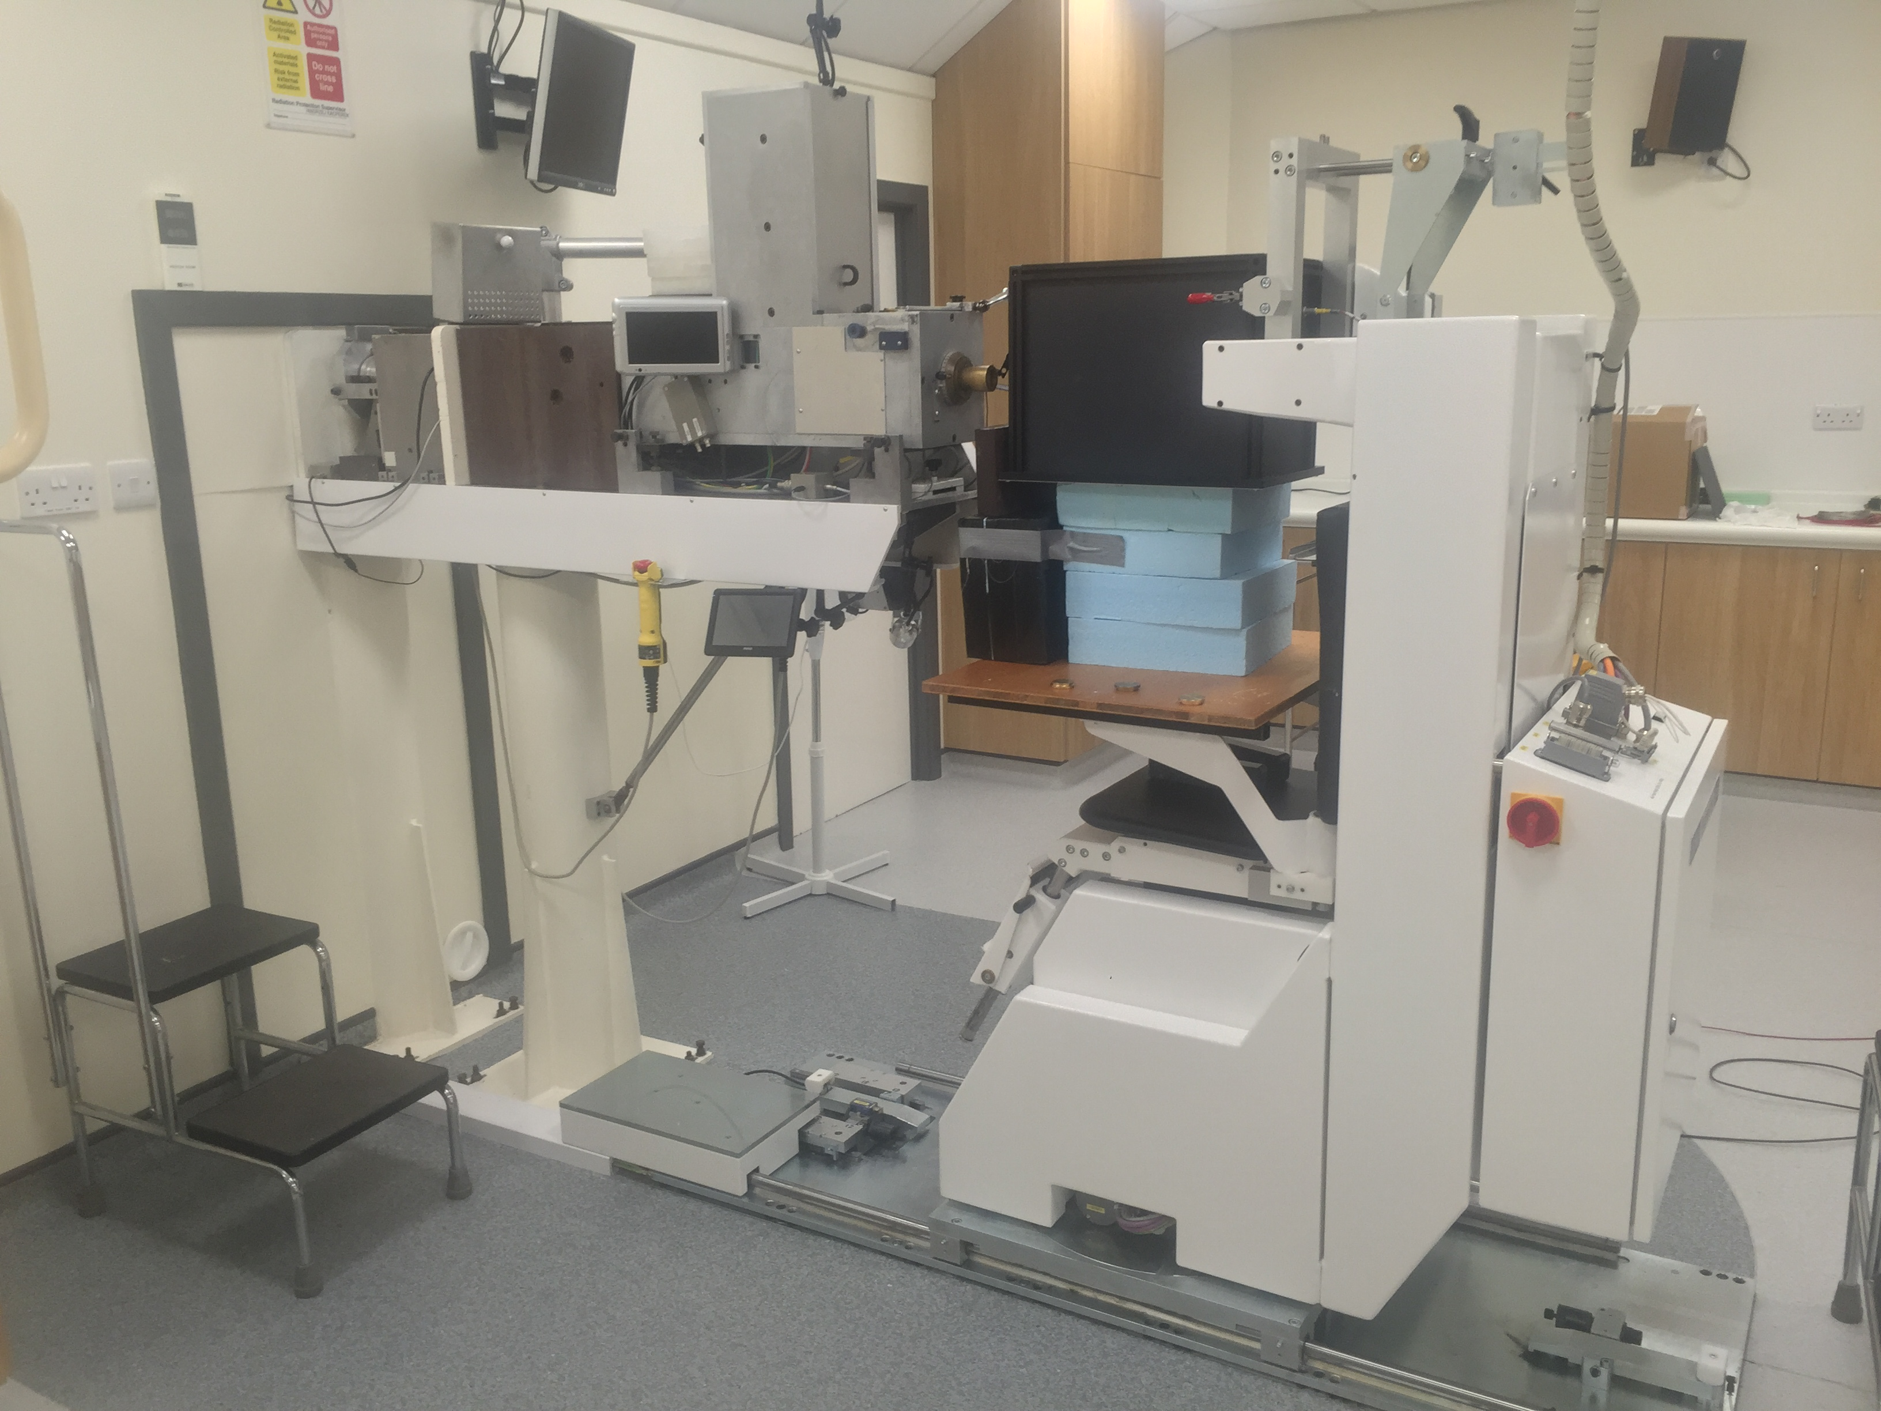
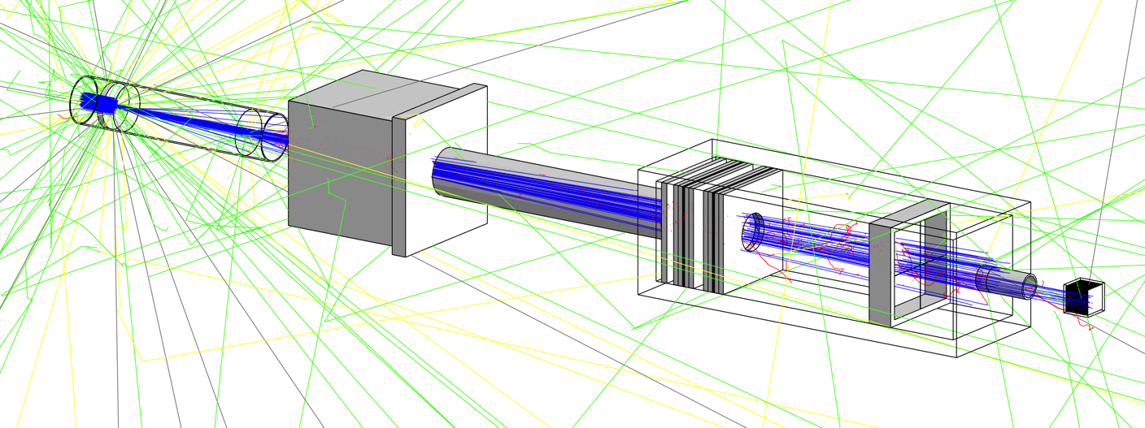
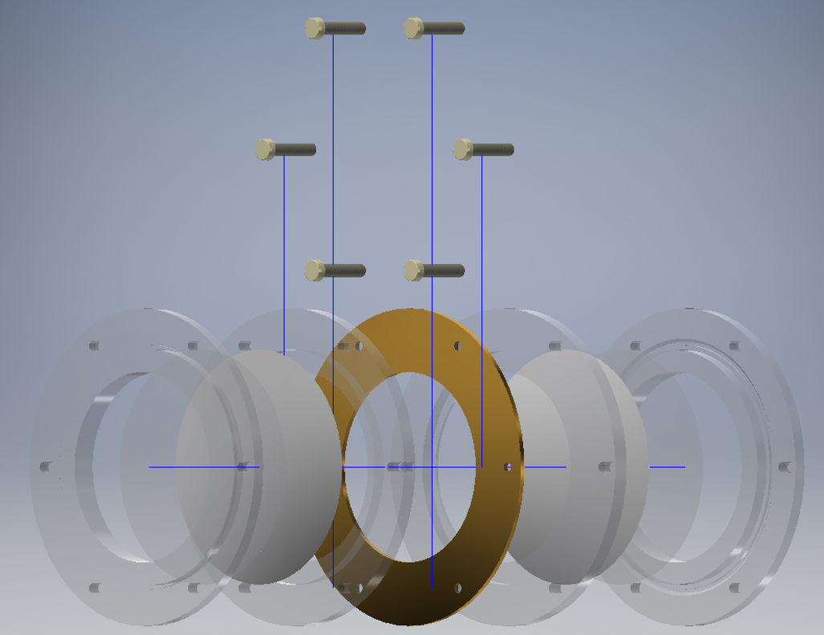
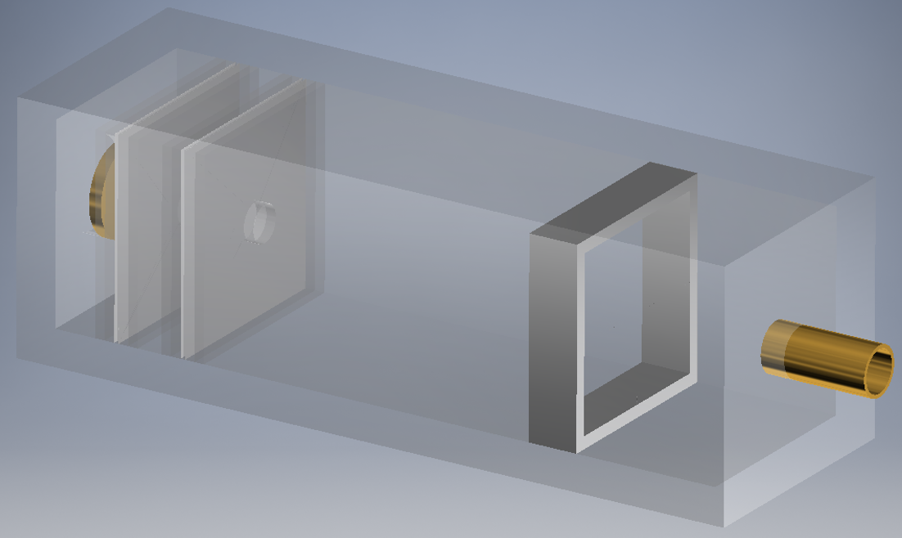
End-to-End Simulations of the Clatterbridge 60 MeV Clinical Proton Beamline
Jacinta Yap, Roland Schnuerer, Javier Resta-Lopez, Carsten Welsch (Cockcroft Institute, University of Liverpool)
Matthieu Hentz, Jordan Silverman, Roisin Stephens, Simon Jolly (University College London)
Stewart Boogert, Lawrence Nevay, William Shields, (John Adams Institute, Royal Holloway, University of London)
Andrzej Kacperek, Brian Marsland (Clatterbridge Cancer Centre)
Email: jacinta.yap@cockcroft.ac.uk, s.jolly@ucl.ac.uk
Abstract
The world’s first hospital proton beam therapy facility, based at Clatterbridge Cancer Centre in the United Kingdom, has successfully provided treatment for ocular tumours over the past 30 years. A 60 MeV beam of protons is produced by a Scanditronix cyclotron and transported to the passive delivery system which enables the precise delivery of uniform dose at the target site. In addition to the long history of clinical usage, the proton beam also supports a rich programme of experimental work in the scope of particle therapy. As such, there is a need for the full characterisation of the beam with an accurate and reliable simulation model. We present ongoing work of the development of complete end-to-end simulations of the Clatterbridge beamline, from the extraction point of the cyclotron all the way to the clinical nozzle. Initially built using the Geant4 simulation toolkit, these simulations have been expanded to included detailed CAD models of the treatment beamline by taking advantage of the superior geometry modelling and accelerator design and beam transport capabilities of the Beam Delivery Simulation (BDSIM) code. Results are presented of comprehensive simulations of the treatment beamline built in Geant4, alongside recent advances achieved through the use of BDSIM.
Notes:
1

