Slide 1

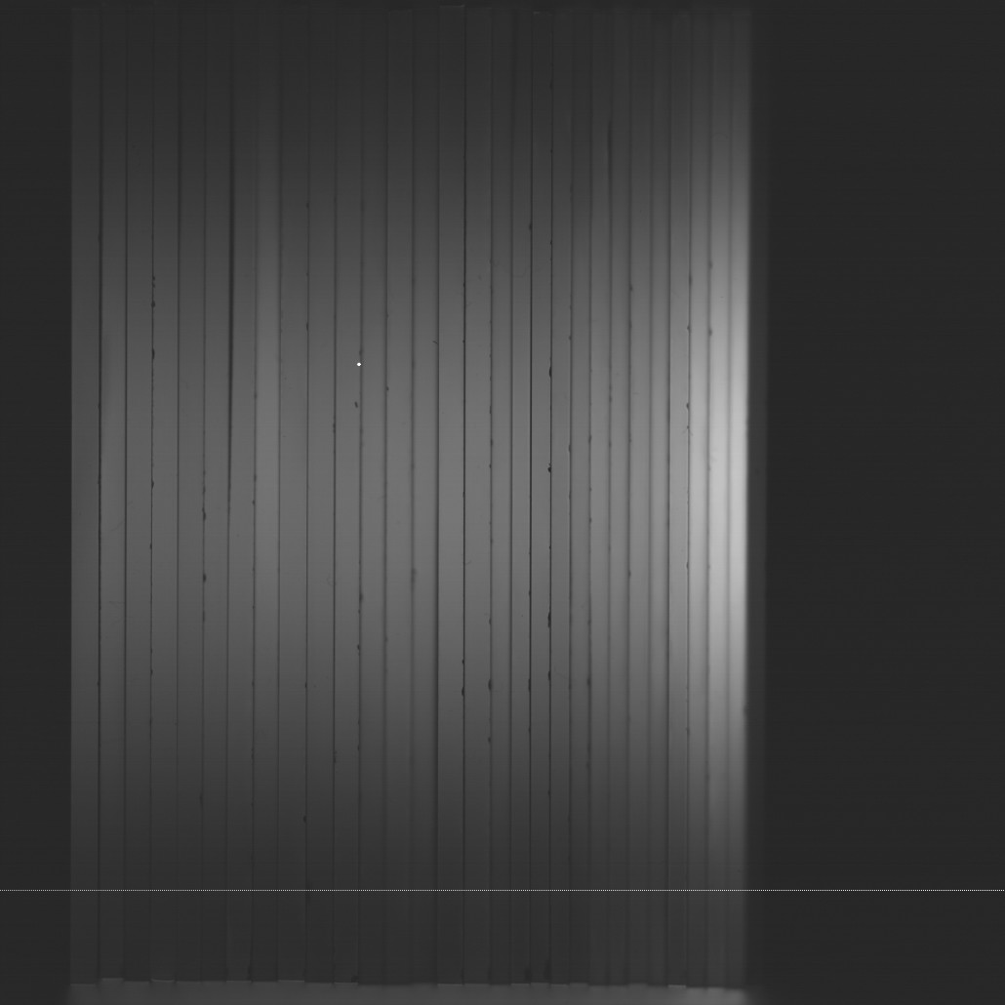
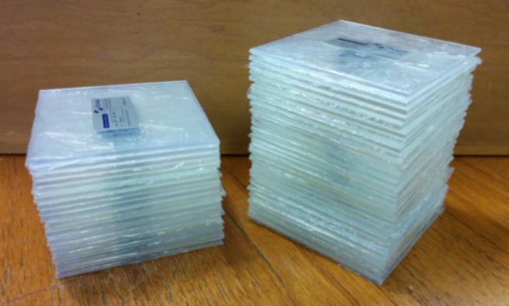
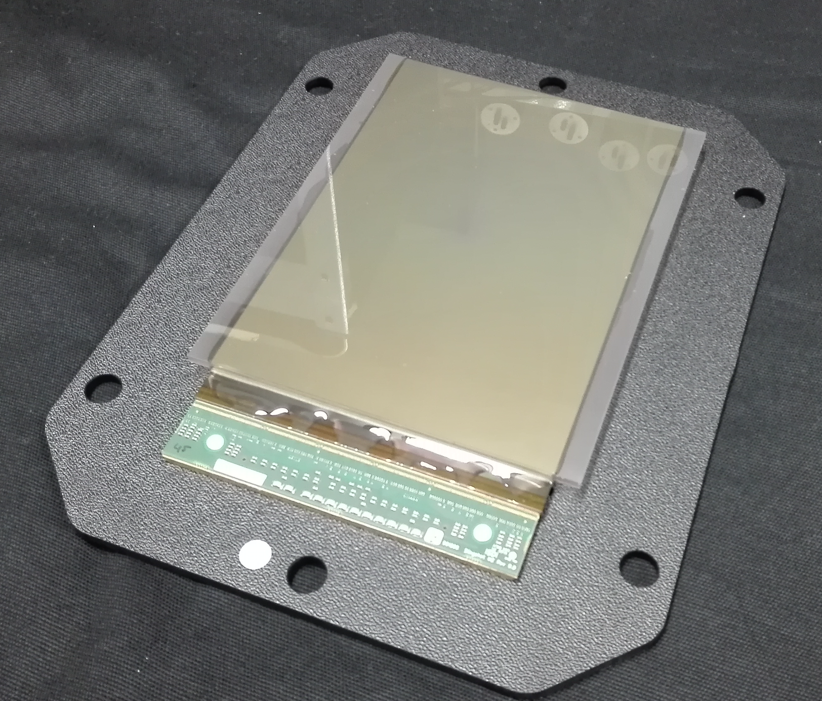
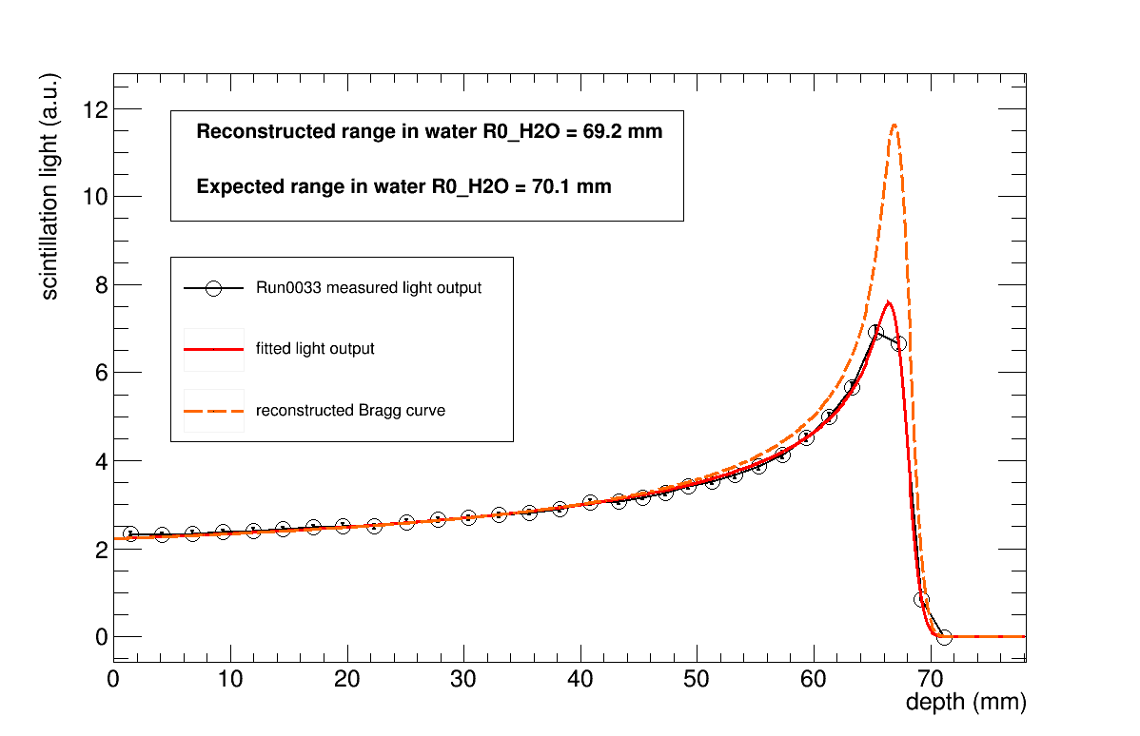
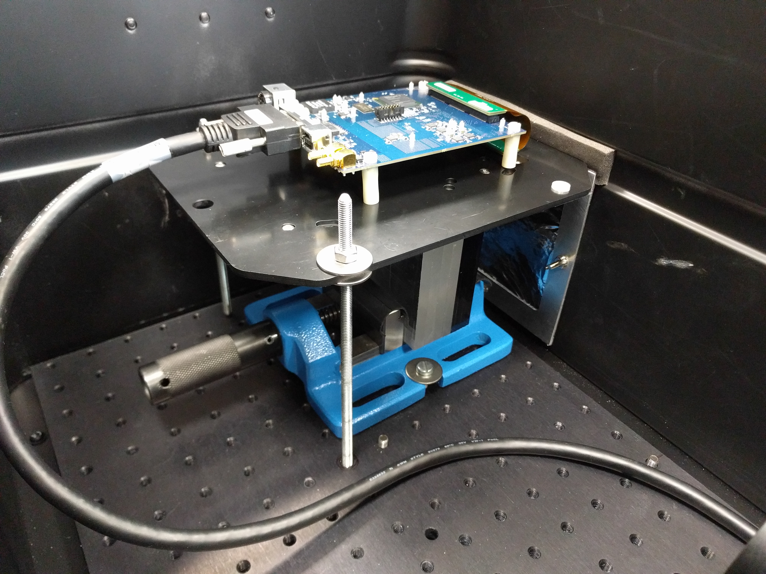
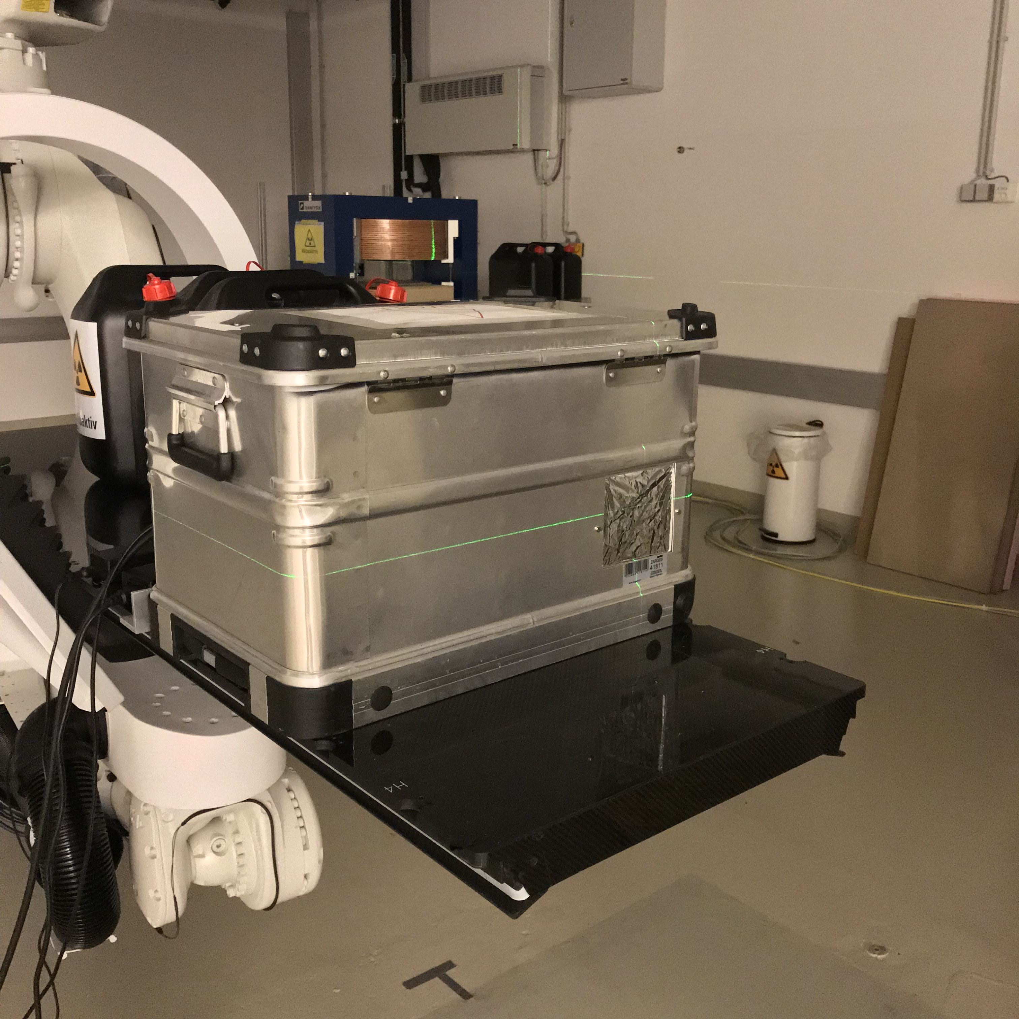
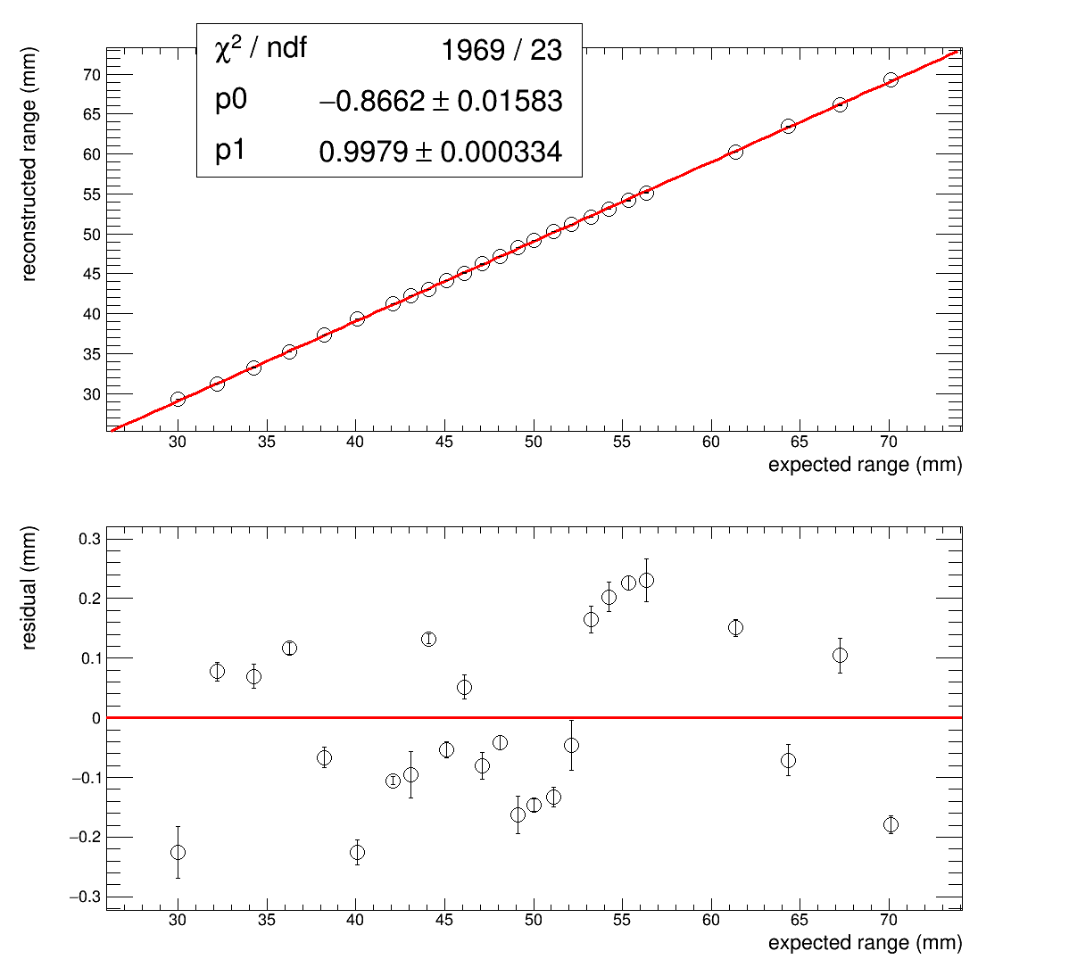
A Scintillator-Based Range Telescope for Proton Therapy
Laurent Kelleter, Anastasia Basharina-Freshville, Derek Attree, Richard Amos, Ruben Saakyan, Simon Jolly
Email: laurent.kelleter@ucl.ac.uk, s.jolly@ucl.ac.uk
University College London | Department of Physics & Astronomy |
Gower Street | London | WC1E 6BT | UK
Motivation
The Proton beam is fully absorbed in the scintillator stack.
Each scintillator sheet is read out individually.
Light output is “quenched” (Birk's law).
The precise knowledge of the range of a proton beam is crucial for an accurate treatment because of the steep fall-off at the end of a Bragg curve. Proton beam range measurements are carried out as part of the daily quality assurance in proton therapy centres. We are developing a range telescope based on water-equivalent plastic scintillator. The resulting detector aims to be as fast and precise as a Multi-Layer Ionisation Chamber at only a fraction of the cost.
Detector Principle
Proton beam
Quenched light output
Bragg curve
MedAustron Beam Test Results
Figure 1: Principle of a range telescope.
Prototype Setup
1
2
Figure 3: Quenched light output for two different beam energies.
3
4
Figure 2:
1) 30x2mm and 20x3mm thick scintillator sheets (10 x 10cm²).
2) 15 x 10cm² Monolithic Active Pixel Sensor (CMOS).
3) Scintillator stack fixed in vice with pixel sensor on top.
4) Prototype in light-tight enclosure on treatment couch.
Figure 4: Fit of a quenched Bragg curve to the integrated light output and reconstruction of a pristine Bragg curve.
Prototype range telescope developed and tested.
Able to do range reconstruction using a new model of a quenched Bragg curve.
Water-equivalent range reconstructed within ±0.15 mm.
Pixel sensor proves principal but is overkill.
Investigate readout solution with one photodiode per sheet and custom DAQ.
Data analysis currently offline in ROOT: develop online data analysis tool.
Build a working clinical prototype at 250 MeV.
Conclusion & Future Plans
Figure 5: Reconstructed vs. expected ranges and residuals.
This project has received funding from the European Union’s Horizon 2020 research and innovation programme under the Marie Sklodowska-Curie grant agreement No 675265, OMA – Optimization of Medical Accelerators.
Notes:
1

