Slide 1
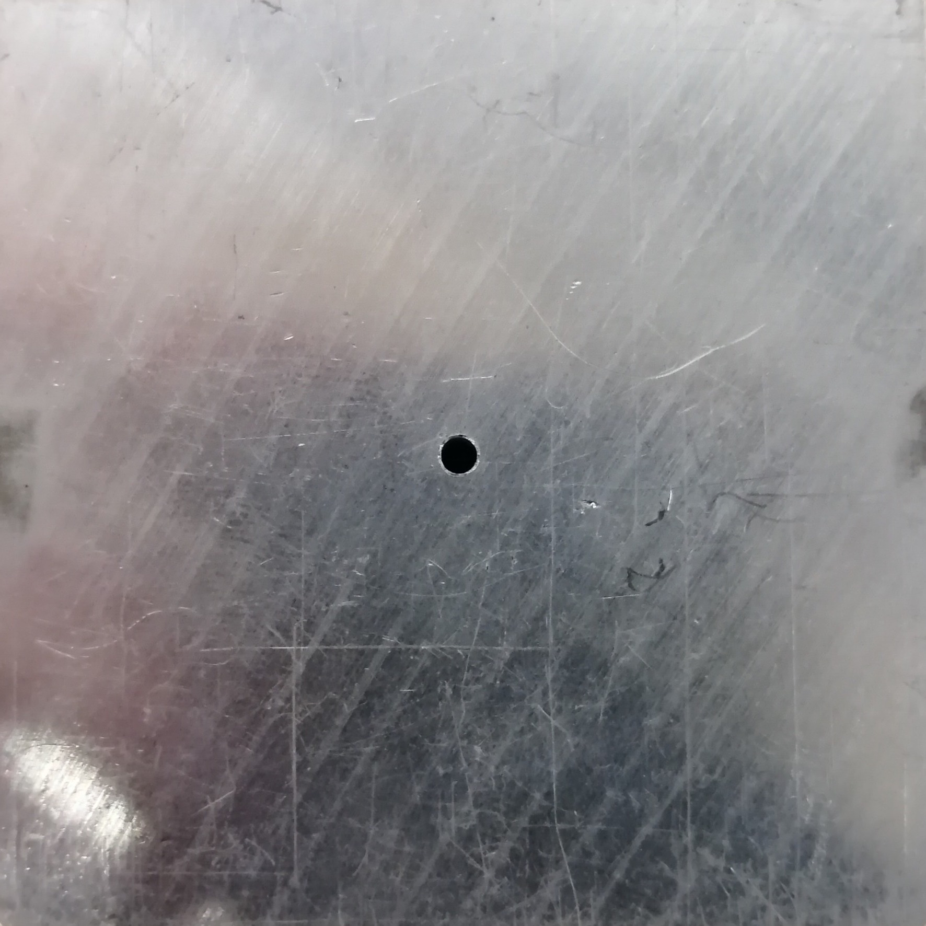
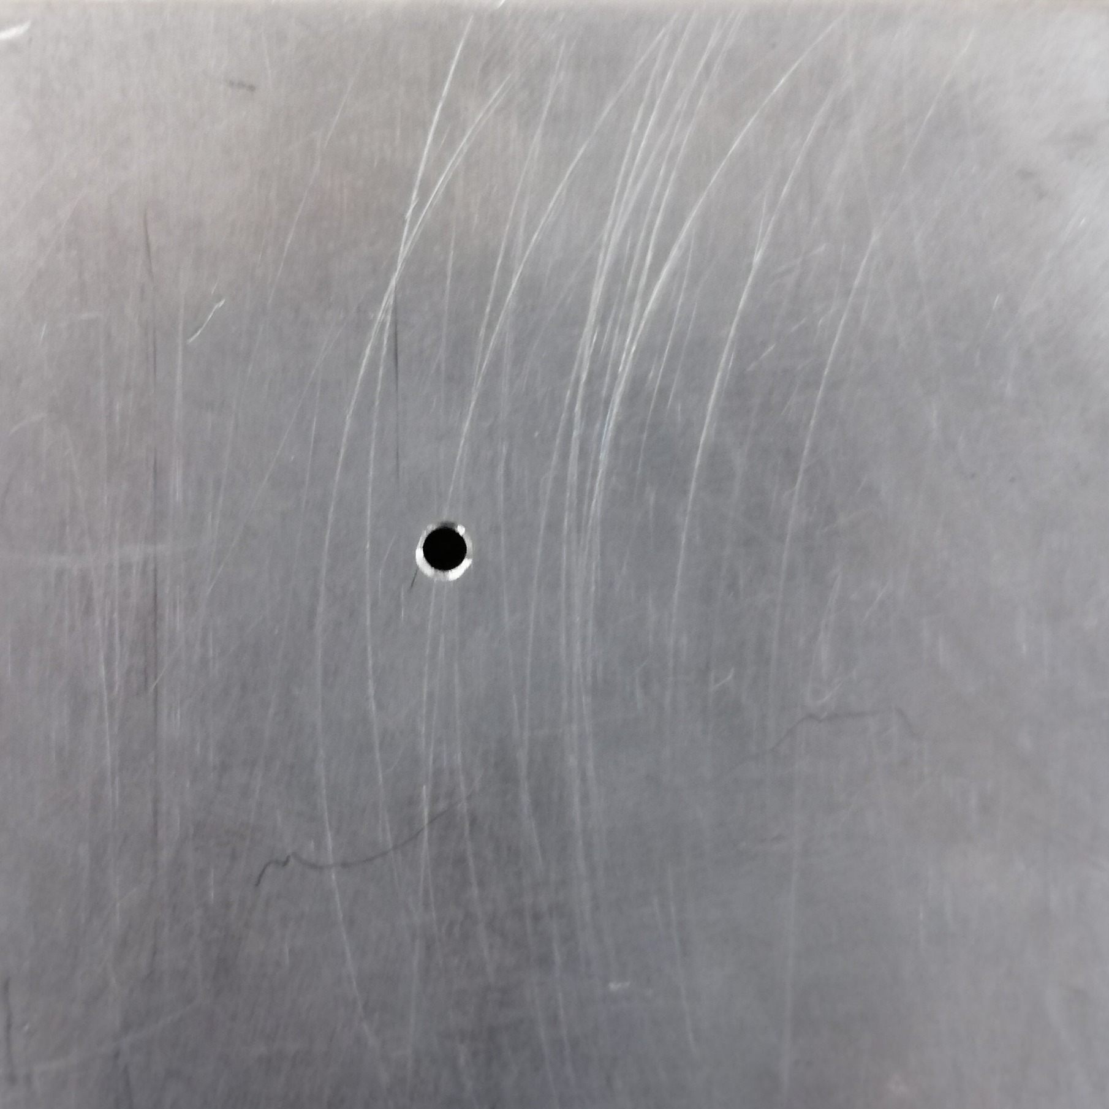
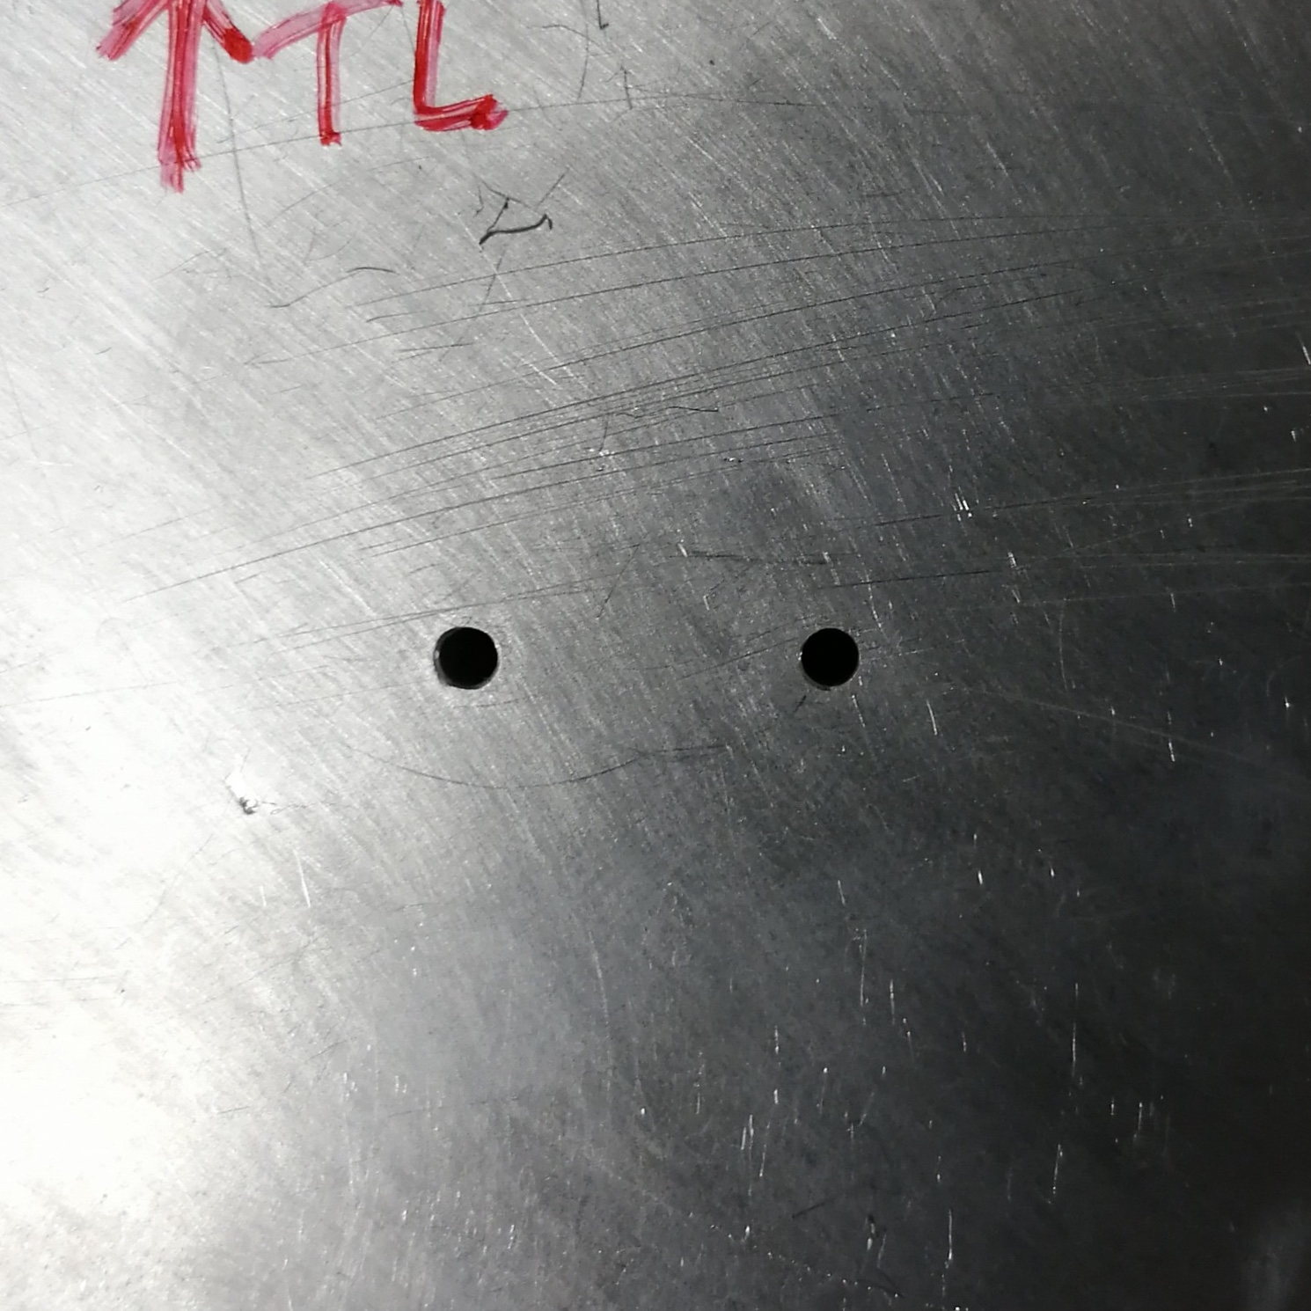
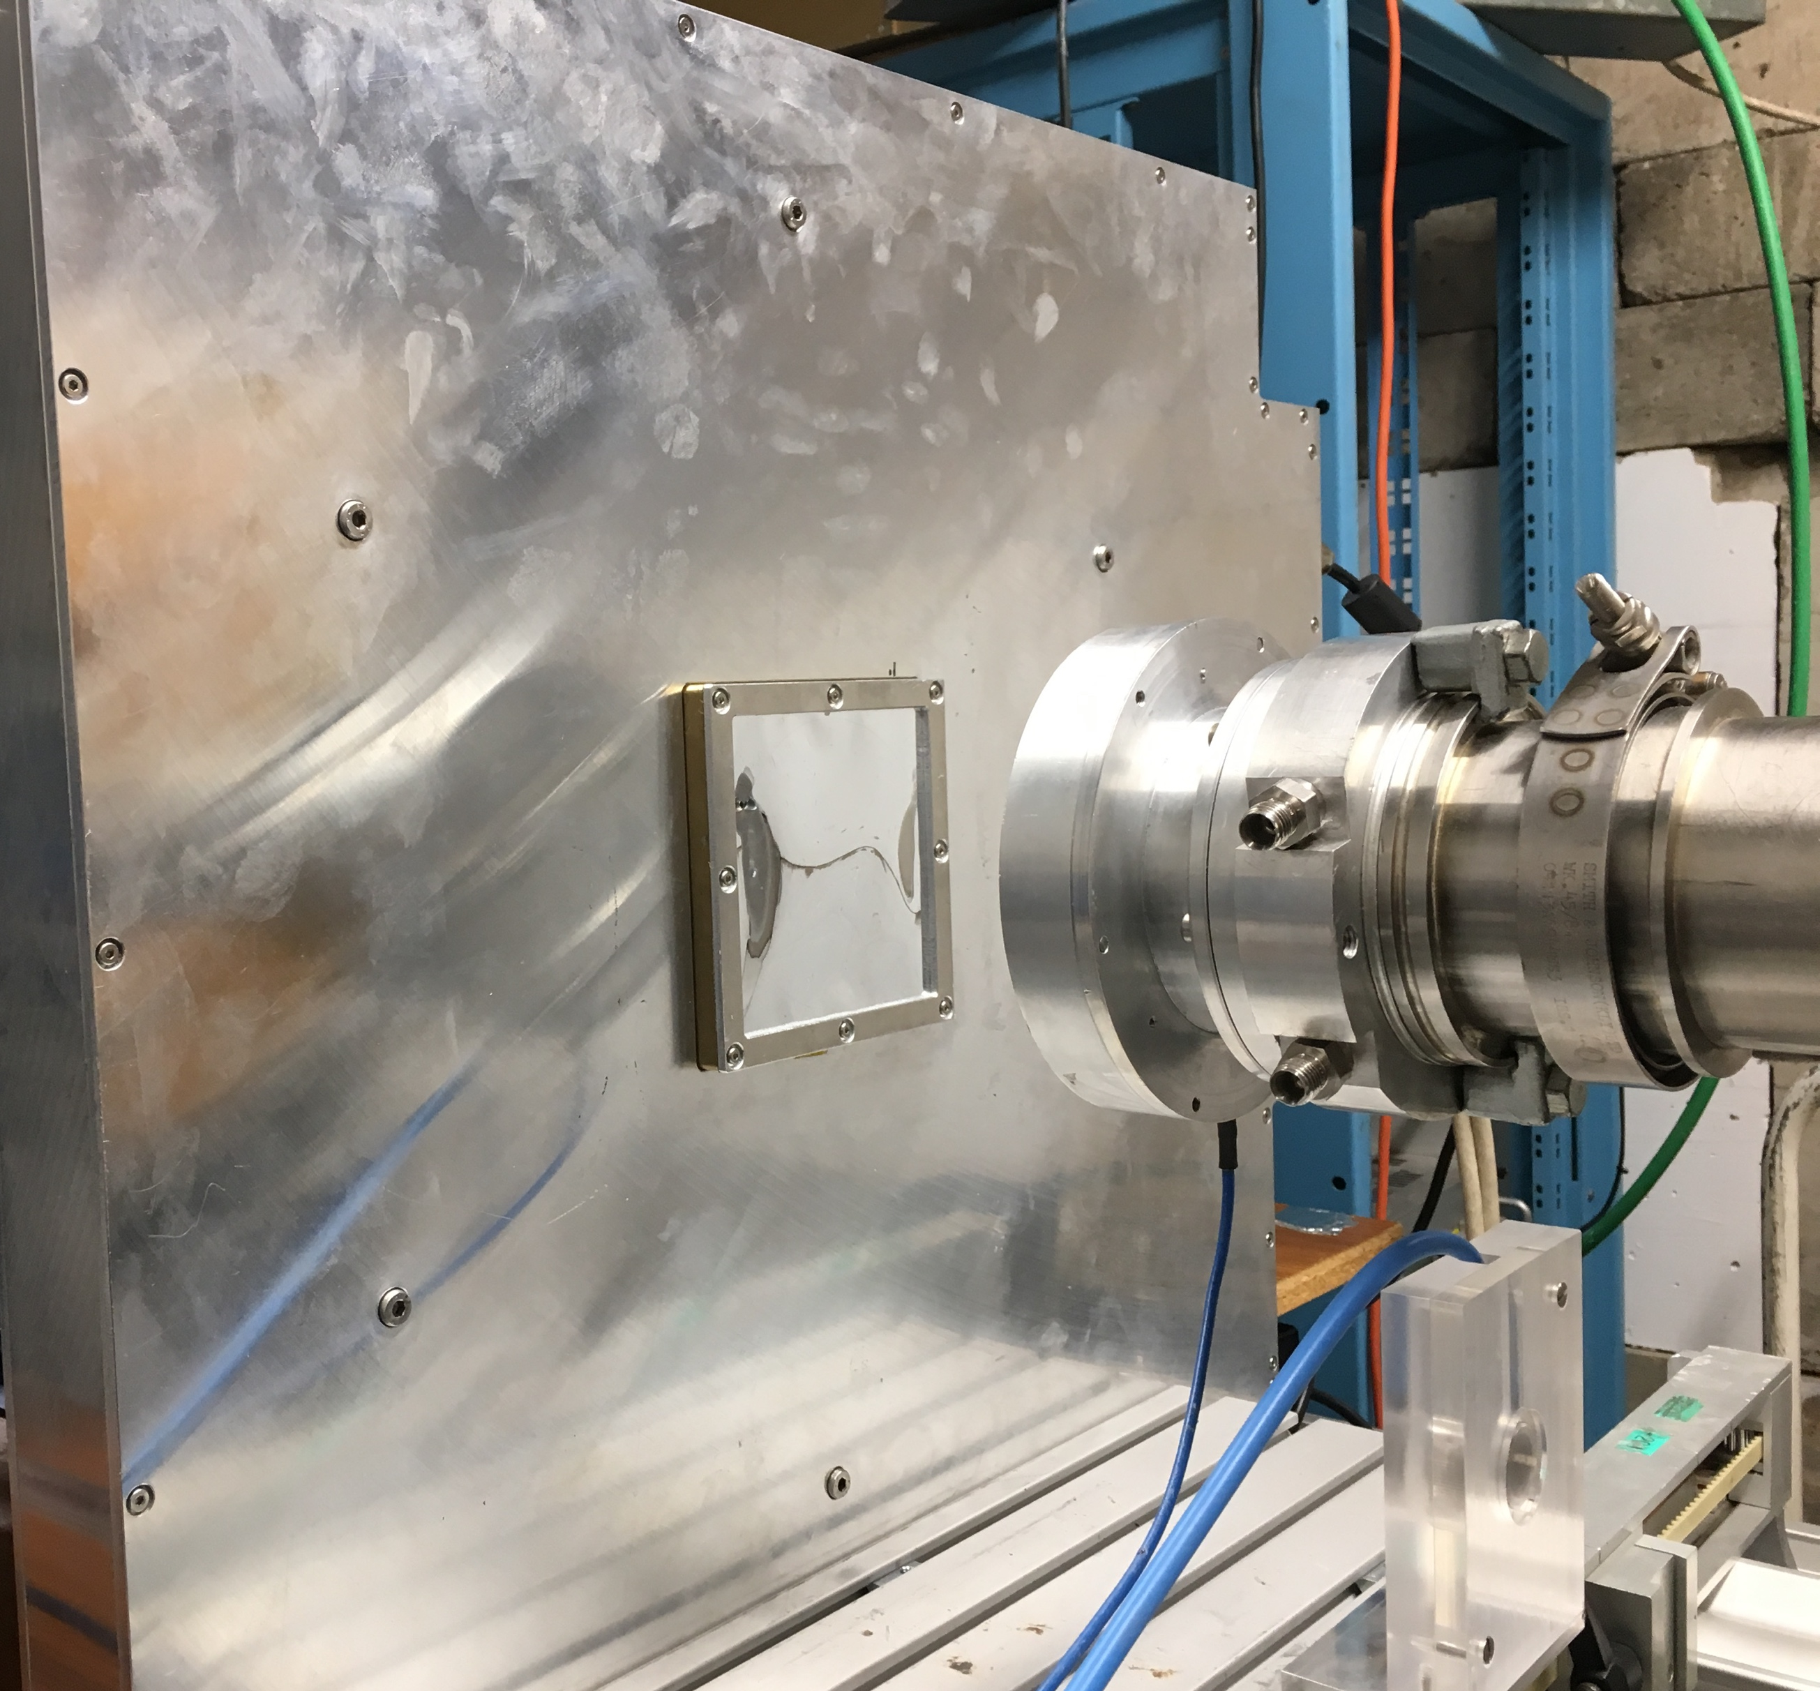
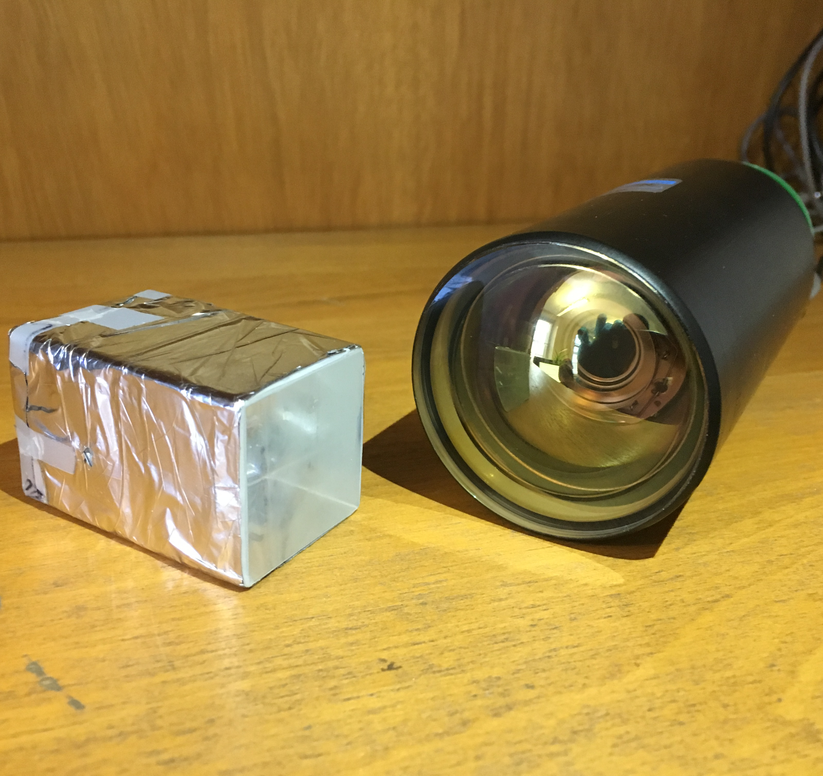
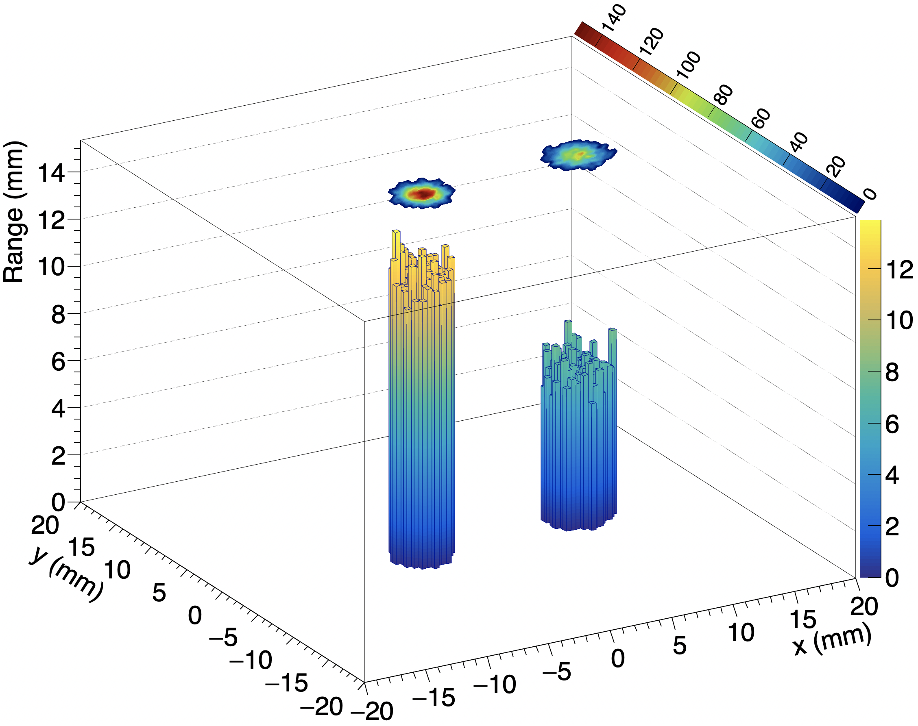








Development of a Detector for Fast Treatment Plan Verification
Saad Shaikh¹, Raffaella Radogna, Laurent Kelleter, Simon Jolly (University College London)
Tony Price² (University of Birmingham)
Email:¹saad.shaikh.15@ucl.ac.uk, ²t.price@bham.ac.uk
University College London | Department of Physics & Astronomy |
Gower Street | London | WC1E 6BT | UK
Motivation
Birmingham 36 MeV Beam Test Results
Treatment plan verification (TPV), or patient-specific quality assurance (patient QA), requires detailed information about the volumetric dose deposition within an instrumented volume, to ensure the accurate delivery of dose for a given treatment plan. Current methods of patient QA are time-consuming, necessitating the repeated scanning of water phantoms. A collaboration between the High Energy Physics group at University College London and the Physics Dept. at the University of Birmingham is developing a prototype system for fast patient QA.
Fig 3. Different 2 mm collimator configurations tested with 0–6 mm thick sheets of PMMA absorber. Collimator pair (right) tested with one hole covered with 4 mm PMMA.
Single-module plastic scintillator-based calorimeters developed at UCL for the SuperNEMO high energy physics experiment to measure single proton energy.
Silicon trackers developed at Birmingham for the PRaVDA proton CT project to reconstruct 2D proton position.
Potential for reconstructing the 3D dose deposition for individual protons and therefore build up the complete volumetric dose distribution for a given treatment plan.
Simple prototype to provide proof-of-concept by correlating position and energy measurements across detectors.
Black: Caen digitiser ADC spectrum
Red: Reconstructed oscilloscope spectrum
Detector Principle
Fig 4. Reconstructed proton energy spectrum for half-covered collimator pair configuration. Black line shows spectrum as recorded by the Caen digitiser and the blue line shows spectrum from the LeCroy oscilloscope.
Simple Prototype Setup
Fig 1. Single PRaVDA tracker module, located upstream of the single-module calorimeter.
Fig 2. Calorimeter: 3 × 3 × 5 cm scintillator block wrapped in mylar foil and Hamamatsu R13089 PMT.
Control Room
HV Control Laptop
Caen NDT1470
HV Supply
Control Laptop 1
Experiment Room
Fig 5. Reconstructed deposition in 3D for the half-covered collimator pair configuration. The range is calculated from the average proton energy, by applying a power law. The superimposed 2D plot shows the XY intensity profile for each spot. Only bins with more than 20 protons are shown. Total number of matched protons was ~17000.
Enclosure
Mylar Window
Control Room
Wireless Hub
Ethernet Switcher
Incoming Protons
Conclusion & Future Plans
Caen DT5751 Digitiser
Photomultiplier Tube
3 cm Plastic Scintillator
PRaVDa Silicon Tracker
Single-proton measurements made by the tracker were successfully correlated with energy measurements made by the calorimeter, and position and energy distributions for a variety of collimator configurations were reconstructed.
Further measurements with higher beam rates and improved detector triggering are planned.
Control Laptop 2
Teledyne LeCroy HDO6104
Oscilloscope
Square-Wave Trigger Pulse
Fig 3. Schematic diagram of experimental set up. The LeCroy oscilloscope acquisition is triggered by a trigger pulse from the tracker module whenever a hit is recorded in 2 of the 3 (X,U,V) layers. The output of the PMT is also independently measured by the Caen digitiser.
This work was supported by the STFC Global Challenge Network+ in Advanced Radiotherapy
The silicon tracker development was supported by the Wellcome Trust Translational Award Scheme.
Notes:
1

