Slide 1
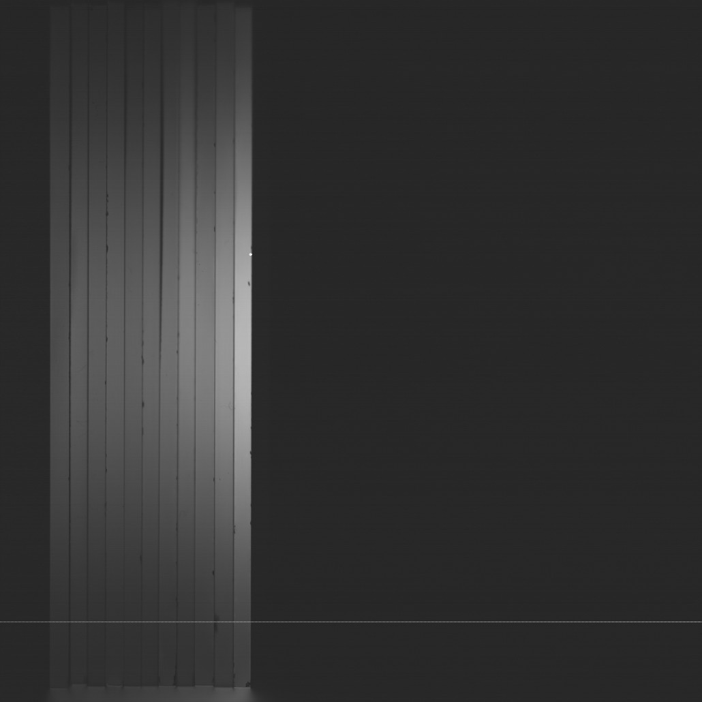
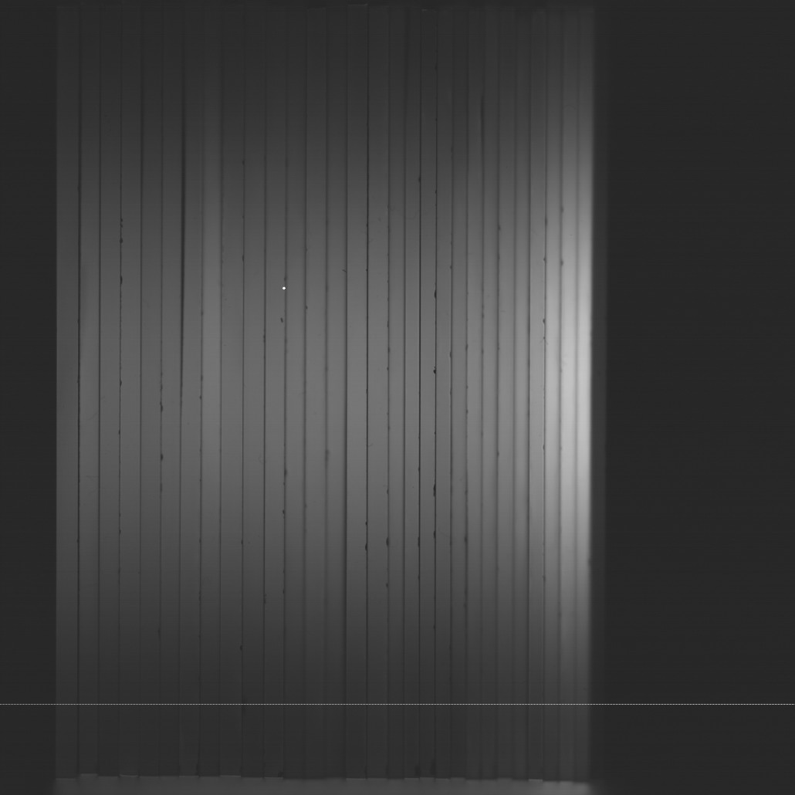
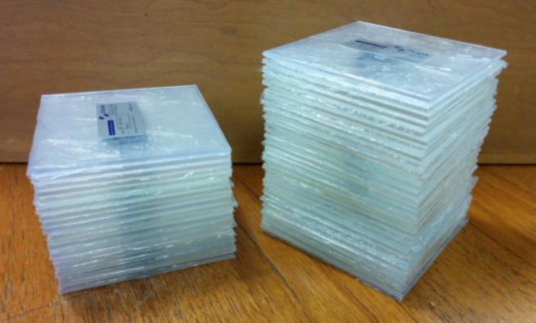
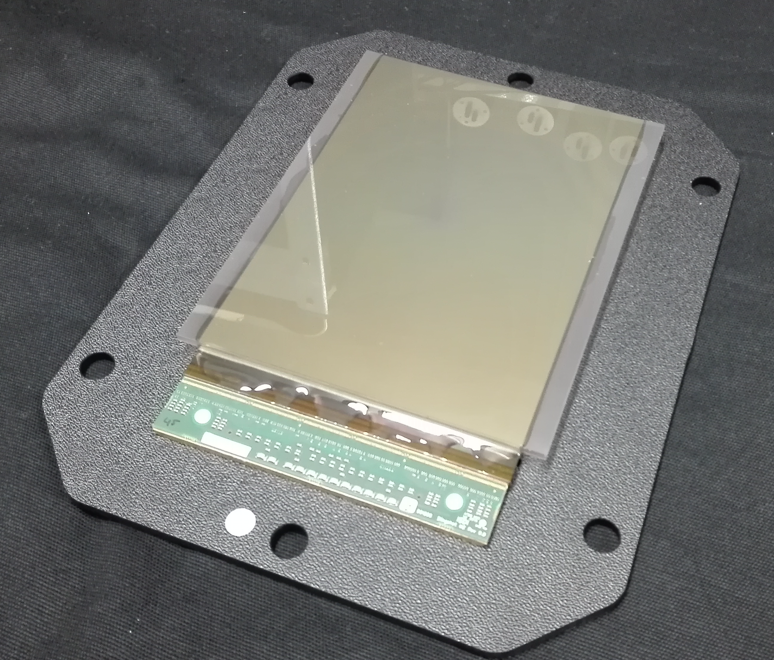
A Scintillator-Based Range Telescope for Proton Therapy
Laurent Kelleterª, Derek Attreeª, Raffaella Radognaª, Ruben Saakyanª, Joao Seco^{b}, Lennart Volz^{b}, Simon Jollyª
ªUniversity College London | Department of Physics & Astronomy |
Gower Street | London | WC1E 6BT | UK
Contact: laurent.kelleter@ucl.ac.uk, s.jolly@ucl.ac.uk
^{b}German Cancer Research Centre (DKFZ) |
Im Neuenheimer Feld 280 | 69120 Heidelberg | Germany
Motivation
The use of sheets instead of a single block of scintillator allows to remove parallax artefacts.
The proton beam is fully absorbed in the scintillator stack.
A snapshot of the quenched light output is taken.
The range is reconstructed from the depth-light curve.
Proton range measurements are routinely carried out as part of the quality assurance in proton therapy centres. We are developing a range telescope based on thin water-equivalent plastic scintillator sheets, conceptually similar to a Multi-Layer Ionisation Chamber (MLIC). The resulting detector aims to perform range measurements of clinical proton beams within the time of beam delivery, independent of dose rate.
Detector Principle
Proton beam
Quenched light output
Bragg curve
HIT Beam Test Results
60 MeV
100 MeV
Figure 1: Principle of a scintillator-based range telescope.
Proton beam
Prototype Setup
1
2
Figure 3: Snapshot of the quenched light output for two different beam energies.
Figure 2:
1) 30x2mm and 20x3mm thick scintillator sheets (10x10cm²).
2) 15x10cm² CMOS sensor for light detection.
The detector performs fast and reliable proton range measurements with an estimated reconstruction uncertainty of ±0.04 mm which is competitive with commercial MLIC.
The CMOS pixel sensor proves principal but is overkill. We are therefore developing a readout solution with one photo diode per sheet and a custom data acquisition system.
The detector has also been tested with ion beams. An ion range reconstruction algorithm is under development.
Further possible applications include the measurement of the residual helium beam range in a proposed mixed-beam therapy in which a carbon beam is used for treatment and a simultaneously accelerated helium beam is used for on-line radiography of the patient. Mixed-beam measurements with this detector will be presented by Lennart Volz on Thursday in the session on 4D Treatment and Delivery.
Conclusion & Future Plans
Figure 4: Novel quenched Bragg curve fit to the measured depth-light curve. The official Bragg curve is a data-validated Fluka simulation performed by Andrea Mairani and Katia Parodi in 2008.
Figure 5: Difference between measured (fitted) and official range (80% fall-off). The average difference is 0.04mm.
This project has received funding from the European Union’s Horizon 2020 research and innovation programme under the Marie Sklodowska-Curie grant agreement No 675265, OMA – Optimization of Medical Accelerators. The authors would like to thank the Heidelberger Ionenstrahl-Therapie-zentrum (HIT) for the possibility to test the detector at the HIT facility.
Notes:
1

