Slide 1
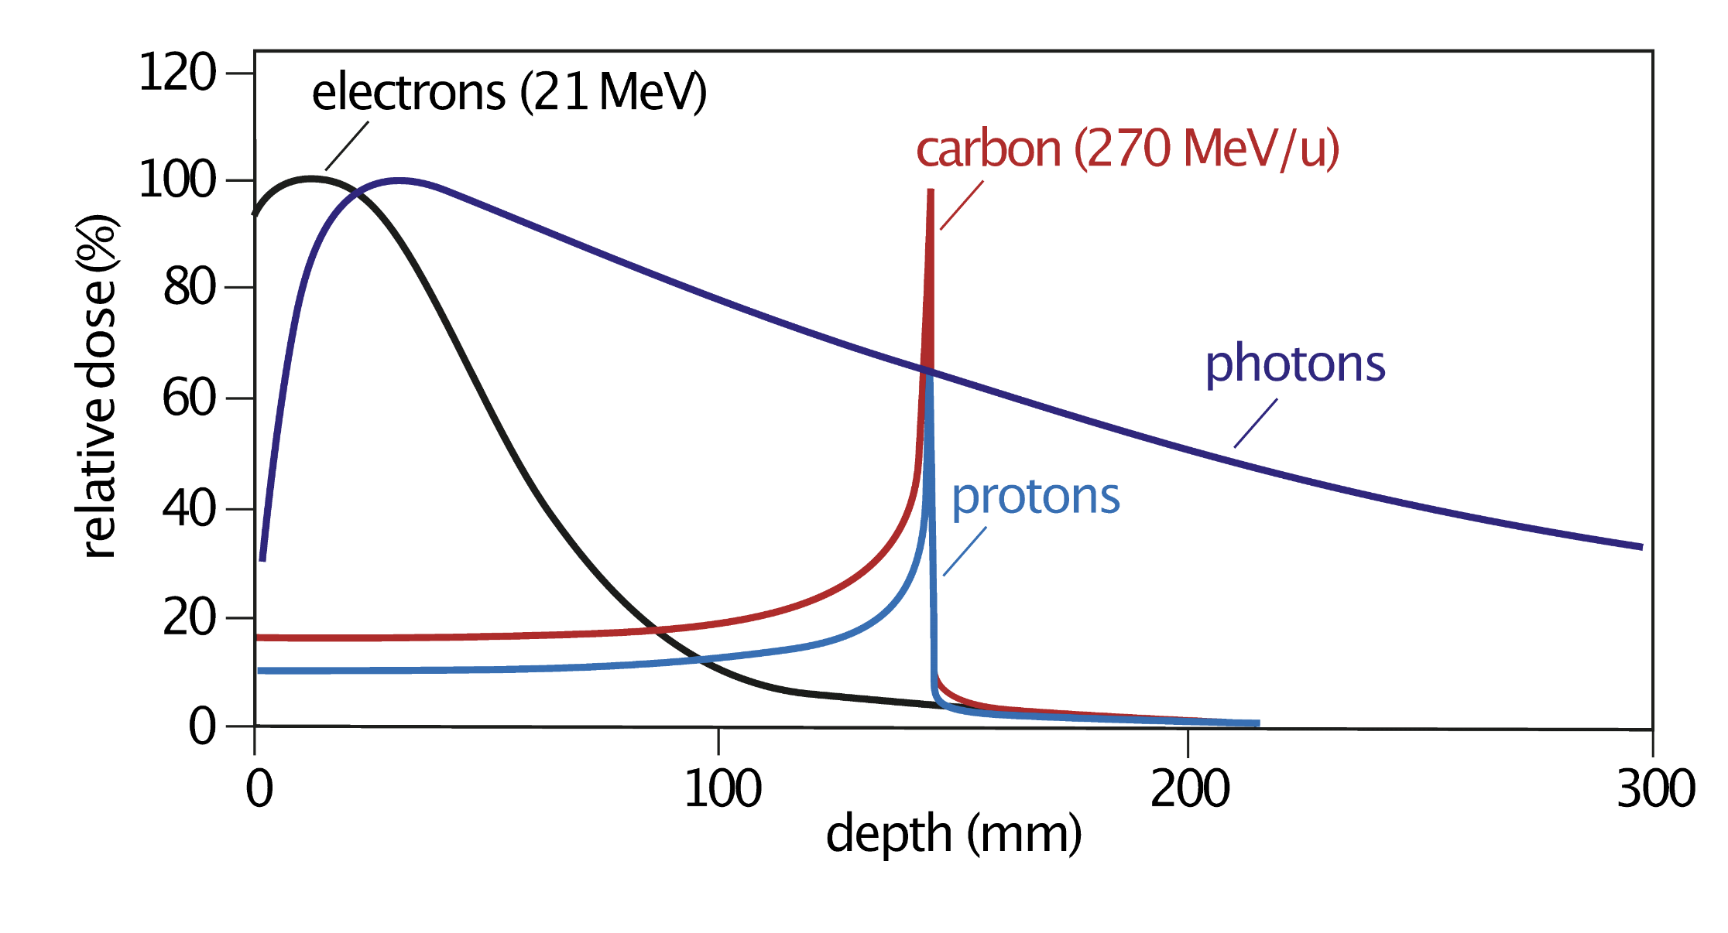
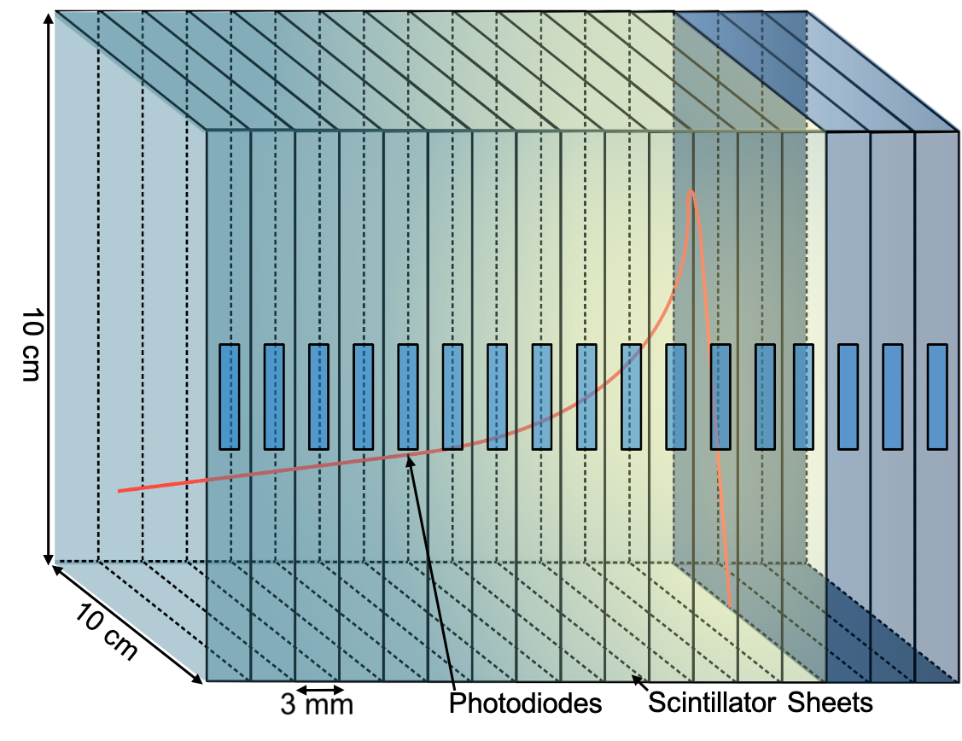
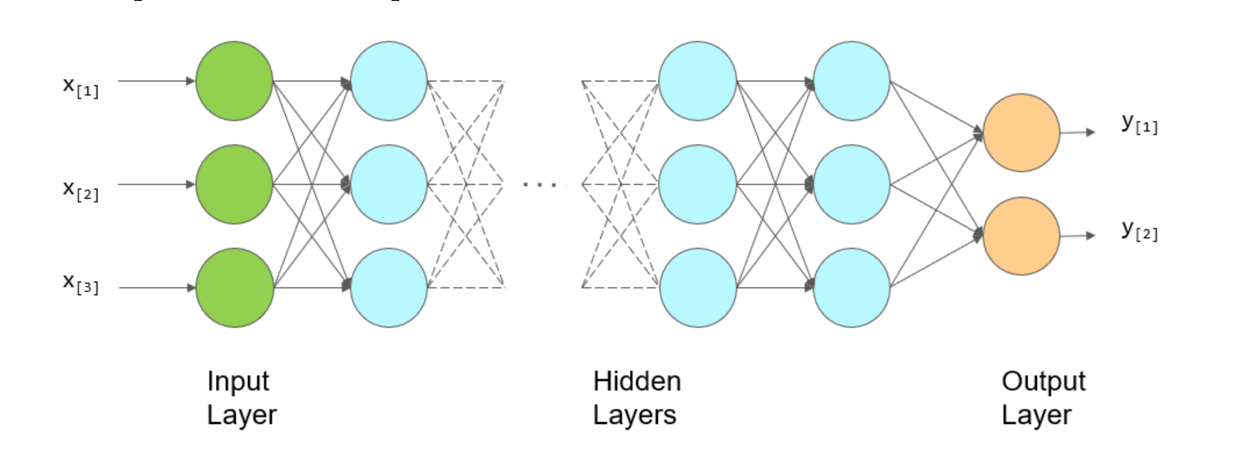
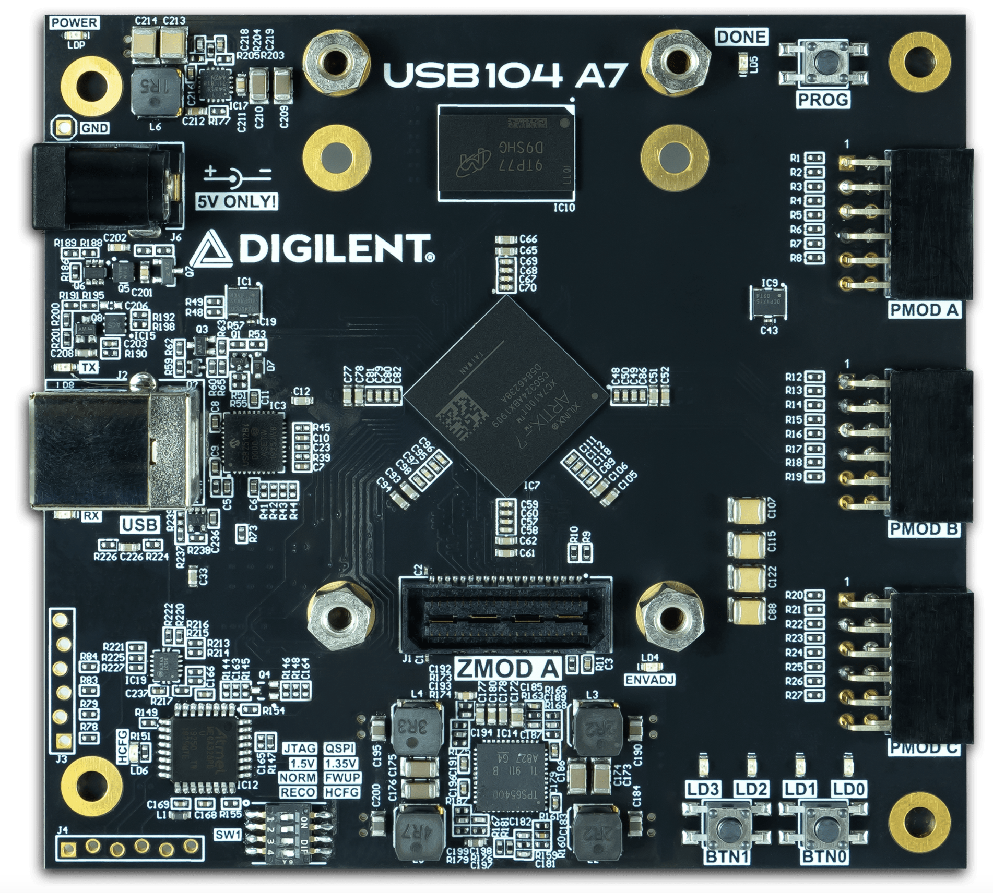
Hadron Beam Therapy Quality Assurance Device - FPGA Optimisation and Machine Learning
Febian Febian¹, Sonia Escribano-Rodriguez, Simon Jolly
University College London
Email:¹ febian.Febian.19@ucl.ac.uk
Motivation
FPGA Curve Fitting
Hadron beam therapy targets tumours/cancers precisely, minimizing damage to healthy tissue.
Accurate range verification during QA is crucial but involves a trade-off between speed and accuracy.
Heavier ions add complexity due to fragmentation, making Bragg curve fitting difficult due to no exact mathematical model
This project aims to speed up QA process with FPGA and Machine Learning for efficient Bragg curve reconstruction.
Currently, Curve fitting is processed separately using C++ script after the DAQ is completed in FPGA.
Next, the processing and fitting will be implemented in the FPGA directly, improving the fit rate.
Fig 1. Relative Depth – Dose Curve of Photons, Electrons and showing the local energy deposition Protons and Carbon Ions (Bragg Curve)
Our Device
Fig 4. Fit result for 90 MeV proton beam. The black crosses show the measured light output from each sheet, the blue curve shows the fitted depth-light curve, the green curve shows the reconstructed Bragg curve, and the magenta curve shows the reference curve.
Our prototype uses polystyrene-based scintillator sheets, a material that emits light when hit by charged particles.
Stacked and optically isolated scintillator sheets sample proton energy deposition, with each sheet light measured by photodiodes and adjusted for quenching corrections.
Photodiodes are coupled to a 32-channel ADCs for zero-deadtime measurements at ~6kHz, read out by FPGA.
An analytical model [2] is used to fit the depth-light curve and reconstruct the Bragg curve to recover the range.
Machine Learning
Machine learning (ML) algorithm allows a machine to learn from data and make predictions or decisions without explicit programming.
Currently, Ionisation chamber is used in range verification for Carbon Ion therapy which could take 1-2 hours to set and analyse [3].
Goals:
  Applying ML into Bragg curve fitting for protons.
  Applying ML into Bragg curve fitting for carbon ions.
  Deploying ML algorithm to FPGA to speed up the process even further.
Aim:
Speed up the fitting process without reducing accuracy.
Fig 2. A diagram of the scintillator stack illustrating the detector's principle. Protons enter the stack from the left, with the red curve depicting a typical proton depth energy-depth characteristics.
FPGA DAQ
A Field-Programmable Gate Array (FPGA) is an integrated circuit that allows for flexible digital circuit design. Its key advantages are
High parallelism
Reconfigurability
Low latency
Fig 5. A schematic diagram representing the Deep Learning algorithm, Feedforward Neural Network (FNN). FNNs or Multi-Layer Perceptrons (MLPs), are well-suited for curve fitting because they are universal function approximators. Their layered structure, combined with non-linear activation functions, enables them to learn complex, arbitrary relationships between input and output data without requiring a predefined mathematical model [4].
Fig 3. FPGA board in development, USB104, utilising zmod port to improve integration process, processing speed, signal stability and lowering the noise.
References:
[1] L. Kelleter et al. “A Scintillator-based Range Telescope for Particle Therapy”. In: Physics in Medicine & Biology 65.16 (Aug. 2020). doi: 10.1088/1361-6560/ab9415.
[2] L. Kelleter and S. Jolly. “A Mathematical Expression for Depth-Light Curves of Therapeutic Proton Beams in a Quenching Scintillator”. In: Medical Physics 47.5 (Feb. 2020), pp. 2300–2308. doi: 10. 1002/mp.14099.
[3] Y. C. Keat and W. A. Kamil. “Validation of the Dose Distributions with Monte Carlo Simulations for Carbon Ion Cancer Therapy”. In: J. of Biomed. & Clin. Sci. Dec 2017 Vol 2 (2), 1-7.
[4] Y. Guo, X. Cao, B.Liu, and M. Gao, “Solving Partial Differential Equations Using Deep Learning and Physical Constraints, In: Appl. Sci. 2019, 10, 5917; doi:10.3390/app10175917

