Slide 1
Clatterbridge 21st - 22nd December 2015 ADC Data Analysis
Anastasia Basharina-Freshville
(University College London)

Slide 2
Summary of Measurements Made
Optical module setup used:
  2” Hamamatsu R13089-100-11 PMT with negative HV active divider base (made by Hamamatsu)
  3 cm x 3 cm x 5 cm cuboid ENVINET enhanced scintillator
  Coupled with BC-630 Saint Gobain silicone optical gel (refractive index = 1.465)
  http://www.crystals.saint-gobain.com/uploadedFiles/SG-Crystals/Documents/Organic%20Product%20Accessories%20Data%20Sheet.pdf
Monday the 21st December 2015:
  Most measurements carried out at -1100 V
  Energy scan with PMMA plates of various thicknesses carried out at rates of 14 kHz – 150 kHz (beam current upped in order to increase rates for thick PMMA plates) for gates of 100 ns and 200 ns
  Measurements with different gates (20 – 250 ns) at various rates (with ~550 kHz being the highest)
  Lots of waveform data collected
  Peak current estimate at -1100 V (for an amplitude of 2.2 V and a width of ~20 ns):
  44 mA

Slide 3
Summary of Measurements Made
Tuesday the 22nd December 2015:
  Measurements carried out at -950 V after indications of PMT saturation from data collected on the 21st of December
  Energy scan with PMMA plates of various thicknesses carried out at rates of ~70 kHz (as measured with 0 mm of PMMA) for gates of 100 ns and 200 ns
  Some waveform data collected
  Beam tests carried out (rates up to 600 – 700 kHz), with the following parameters studied:
    Arc current
    Dose rate
    Focusing angle

Slide 4
2” PMT with Hamamatsu Base + 3 cm x 3 cm Enhanced Cuboid Scintillator: -1100 V
2 mm collimator
Rates: ~14 kHz

Slide 5
Energy as a Function of Energy Resolution: -1100 V
NOTE:
Systematic errors taken from previous data
Still need to be properly estimated for this data set

Slide 6
Linearity/Energy Scan: -1100 V
All 7 points (1 with 0 PMMA and 6 with various (standard) PMMA thicknesses)
  1st degree polynomial fit over all points
1 rogue point for the 49.09 MeV (9.8 mm single PMMA plate) energy for each gate
It looks as though we inserted the wrong PMMA plate for this particular point
Exclude this point from further analysis for the -1100 V energy scan
  6 point analysis

Slide 7
Linearity: -1100 V
6 points (excluding the 49.09 MeV/9.8 mm PMMA point)
  1st degree polynomial fit over all points
p0 (the intercept) should give us an estimate of quenching in the scintillator
From simulations we expect: ~20.6 MeV
From previous measurements (Dec 2014) we expect: ~19.7 MeV
Previous measurements also show p0 to be roughly consistent for different gates
Indication of a problem?
BUT! This is a different scintillator (ENVINET vs EJ-200) so quenching could be different!

Slide 8
Linearity: -1100 V
6 points (excluding the 49.09 MeV/9.8 mm PMMA point)
  2nd degree polynomial fit over all points
p0 more reasonable but slightly overestimated

Slide 9
Linearity: -1100 V
6 points (excluding the 49.09 MeV/9.8 mm PMMA point)
  First four points (32.1 – 43.62 MeV): 1st degree polynomial
  Then extrapolate fit over the rest of the range
12.28 %
11.74 %

Slide 10
Linearity: -1100 V
6 points (excluding the 49.09 MeV/9.8 mm PMMA point)
  First three points (32.1 – 38.28 MeV): 1st degree polynomial
  Then extrapolate fit over the rest of the range
19.51 %
-9.92 %
-9.72 %
17.73 %

Slide 11
Quenching Estimate: -1100 V
6 points (excluding the 49.09 MeV/9.8 mm PMMA point)
  “Combined” 1st + 2nd degree polynomial fit
Fitting procedure:
1: 1st degree polynomial (32-44 MeV)
2: 2nd degree polynomial (44-60 MeV)
3. Parameters extracted from 1 and 2 put into “combined” 1st degree and 2nd degree polynomial over entire range
Quenching = pol1 const + pol2 const
(Remember: 20.57 MeV from simulations)
2
1
Gate (ns) | Quenching (MeV)
200 | 24.49 ± 0.21
100 | 26.56 ± 0.22

Slide 12
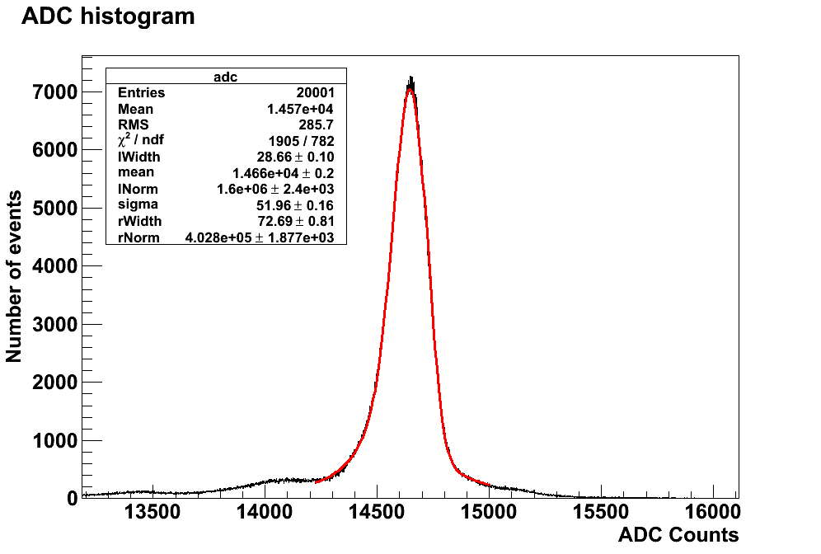
Best Results Achieved at -1100 V
2 mm collimator, 200 kHz rate (maximum rate at which we get a “fittable” ADC spectrum), 100 ns gate
BUT remember it looks like we’re saturating the PMT!
We have three measurements at various points during this day for this “setting” (gate, collimator and stable beam), although for different rates:
Systematic error from these measurements:
± 0.04 %
Also need to get systematic error due to the fit
ΔE/E:
0.833 ± 0.003_{stat} ± 0.041_{syst} % FWHM
0.83 ± 0.04 % FWHM
Rate (kHz) | ΔE/E (FWHM)
14 | 0.860 ± 0.003 %
150 | 0.914 ± 0.002 %
200 | 0.833 ± 0.002 %
New features/bumps appearing in tails (see next slide for low rate comparison)

Slide 13
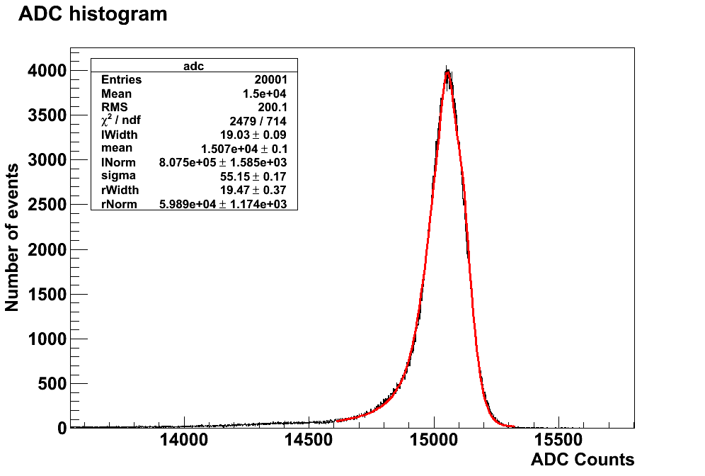
Low Rate Run Spectrum at -1100 V
2 mm collimator, 14 kHz (low) rate, 100 ns gate
ΔE/E:
0.86 + 0.04 % FWHM

Slide 14
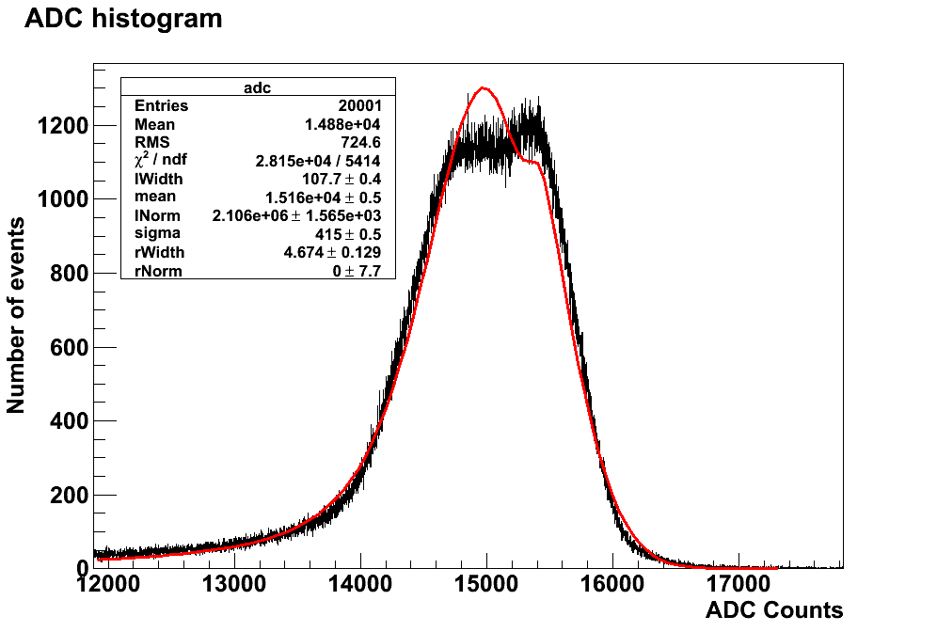
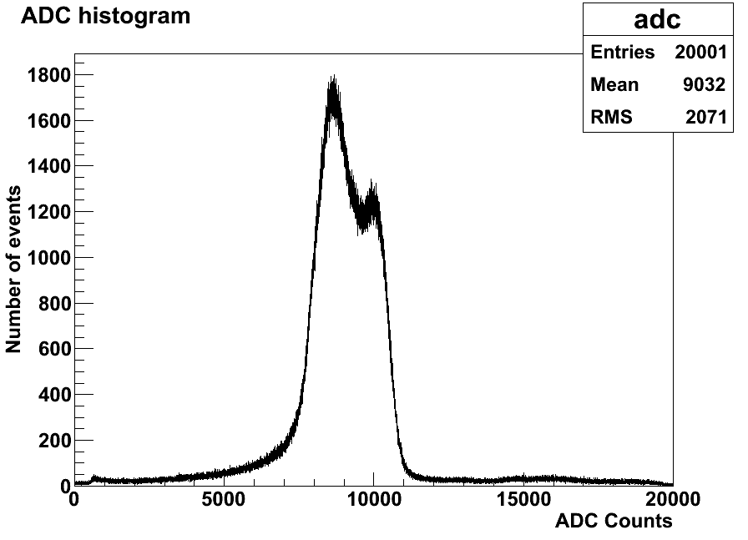
“Unfittable” Spectra at Highest Rates for -1100 V
2 mm collimator, 100 ns gate
400 kHz:
450 - 550 kHz:

Slide 15
Energy as a Function of Energy Resolution: -950 V
NOTE:
Systematic errors taken from previous data
Still need to be properly estimated for this data set

Slide 16
Linearity/Energy Scan: -950 V
1st degree polynomial fit over all points
p0 looks slightly better for estimation of the quenching in the scintillator (cf 20.6 MeV from simulations and 19.7 MeV from Dec 2014 data)
Linearity looks better
Can we declare this a “linear”?
Have a look at the same plots as for -1100 V for completeness.
HV (V) | Gate, ns | Χ²/NDF
-1100 | 200 | 303
-1100 | 100 | 267
-950 | 200 | 43
-950 | 100 | 35

Slide 17
Linearity: -950 V
2nd degree polynomial fit over all points

Slide 18
Linearity: -950 V
First four points (32.1 – 43.62 MeV): 1st degree polynomial
Then extrapolate fit over the rest of the range
Energy, MeV | Gate, ns | Devia-tion
60 | 200 | 0.92 %
54.5 | 200 | -1.61 %
49.09 | 200 | -2.15 %
43.62 | 200 | -1.58 %
60 | 100 | 0.51 %
54.5 | 100 | -1.91 %
49.09 | 100 | -2.27 %
43.62 | 100 | -1.61 %
Deviation from linearity mostly < 2% - can we use this to say we’re linear as well as the χ²/NDF value from the pol1 fit?
Still need to estimate an accurate systematic error for the mean! We could be within systematics.

Slide 19
Systematic Error for the Mean
For the mean, “repeat” measurements dominate the systematic error (rather than obtaining an error due to the fit)
We don’t have any “repeat” measurements at -950 V, except for when the beam dropped during running
Use the three repeat runs from -1100 V to get a rough idea
  2 mm collimator, 100 ns gate, 60 MeV point (no PMMA)
Systematic error from these measurements: ± 205 ADC counts
We are within (this rough estimate) of the systematic!
Currently, mean error in fit macros used is ± 20
  Redo plots/fits with a larger systematic error
Rate (kHz) | ΔE/E (FWHM)
14 | 15069
150 | 14699
200 | 14659

Slide 20
Quenching Estimate: -950 V
Fitting procedure:
1: 1st degree polynomial (32-44 MeV)
2: 2nd degree polynomial (44-60 MeV)
3. Parameters extracted from 1 and 2 put into “combined” 1st degree and 2nd degree polynomial over entire range
Quenching = pol1 const + pol2 const
(Remember: 20.57 MeV from simulations)
“Combined” 1st + 2nd degree polynomial fit
2
1
Gate (ns) | Quenching (MeV)
200 | 14.28 ± 0.28
100 | 13.06 ± 0.29
We seem to be linear, but we’re not getting as accurate an estimate of quenching compared to measurements with the hexagonal OM
p0/quenching from pol1 fit: ~ 13 MeV

Slide 21
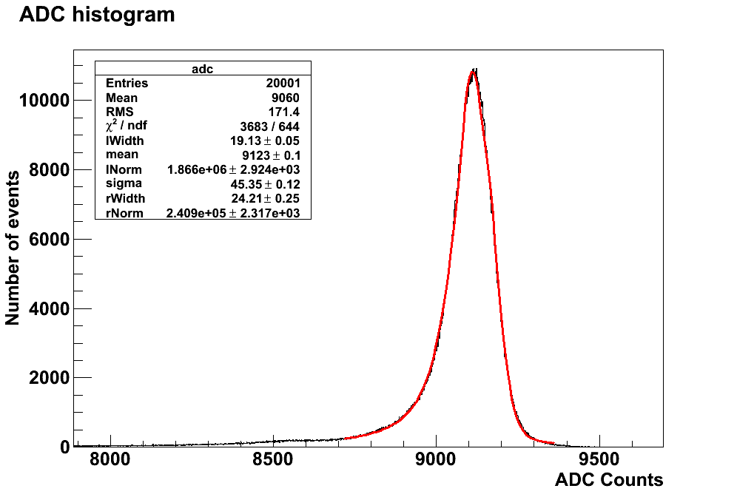
Best Results Achieved at -950 V
2 mm collimator, 70 kHz rate, 100 ns gate
We have three measurements with a 100 ns gate and 0 mm PMMA at -950 V for similar rates:
Systematic error from these measurements:
± 0.01 %
Also need to get systematic error due to the fit!
Rate (kHz) | ΔE/E (FWHM)
30 | 1.197 ± 0.002 %
50-60 | 1.175 ± 0.003 %
70 | 1.168 ± 0.003 %
ΔE/E:
1.168 ± 0.003_{stat} ± 0.015_{syst} % FWHM
1.17 ± 0.02 % FWHM

Slide 22
To Do (Part 1)
Check linearity of the module with an LED at UCL
  Design test bench
    We don’t have a fibre going into the scintillator.
    Would it be sufficient to shine the LED right “onto” the block?
    Find the right LED to buy:
      ~ 350 nm and also the lowest available wavelength
      Needs to be uniform, stable and have no time drift
    Make some alterations to our black box to get the LED inside it in order to have a self contained system? Although the SuperNEMO dark cupboard in D27 is currently available.
Look at ways of “unfolding” the data to be able to compensate for any non-linear effects
Measure the rise times of the two 2” PMTs with the different bases to see which is fastest
  Would it be worth testing the second 2” PMT (with the UCL made base) at Clatterbirdge?
For the next measurement at Clatterbridge:
  Go up to higher rates with “normal” beam operating conditions at an HV of -950 V

Slide 23
Simon’s Beam Tests: Rate Measurement Extrapolation
We discovered that we could use the scattering foil current (displayed on a monitor in the control room) to monitor the rate of the beam without having to use the scope for measurements
  Someone else did these “extrapolations” (so I’m not sure how they were being done at the time), but we also confirmed a correlation between the rate measured on the scope and the scattering foil current
pol2 fit
Due to parasitic capacitance of the PMT?
Did we use a linear relationship to estimate the rate from the scattering foil current?
  Should be sufficient for a rough rate measurement
  Very useful for future Clatterbridge visits!

Slide 24
Simon’s Beam Tests: Rate Measurement Extrapolation
Similar relationship between:
  rate measured on scope and dose rate
  rate measured on scope and arc current (which is how the beam was controlled for these tests)

Slide 25
Simon’s Beam Tests: Summary
Run Number | Rate | Beam Focusing Angle (°C) | Notes | Mean (ADC Counts) | ΔE/E at FWHM
26 - 31 | 600 – 700 kHz | 64.1 | 0.2 cc/min gas, 1.01 – 1.3 mA arc current | N/A | Unable to fit spectra
34 | 700 kHz E | 64.1 | 0.2 cc/min gas, 1.04 mA arc current, chosen as “standard” run to compare focusing angle tests to |  | Unable to fit spectra
35 | 500 kHz E | 65.4 |  | 7593 ± 0.4 | 4.312 ± 0.024 %
36 | 400 kHz E | 66.5 | This run that doesn’t follow the focusing angle/mean trend | 12182 ± 0.19 | 1.752 ± 0.004 %
37 | 200 kHz | 67.6 |  | 8888 ± 0.1 | 1.127 ± 0.004 %
38 | 100 kHz | 68.5 |  | 8940 ± 0.1 | 1.146 ± 0.004 %
39 |  | 69.5 |  | 9029 ± 0.1 | 1.158 ± 0.003 %
40 |  | 71.5 |  | 9303 ± 0.1 | 1.271 ± 0.004 %
41 |  | 73.5 |  | 10694 ± 0.3 | 1.085 ± 0.008 %
42 | 20 kHz | 71.5 |  | 9281 ± 0.2 | 1.172 ± 0.006 %
43 |  | 73.5 |  | 10690 ± 0.4 | 1.160 ± 0.010 %
44 |  | 66.5 | Also not quite “on trend”. Does something strange happen at 66.5 °C focusing angle? | 8822 ± 0.3 | 1.047 ± 0.016 %
45 |  | 65.4 |  | 7324 ± 0.5 | 4.136 ± 0.020 %
46 |  | 67.6 |  | 8874 ± 0.2 | 1.104 ± 0.006 %
47 | 1.2 kHz | 73.5 |  | 10562 ± 0.5 | 1.225 ± 0.013 %
1
2
3
For the most, it looks like there is a relationship between the focusing angle and the mean
  As the focusing angle increases, the ADC mean increases
We are still able to get a good ΔE/E when increasing the focusing angle

Slide 26
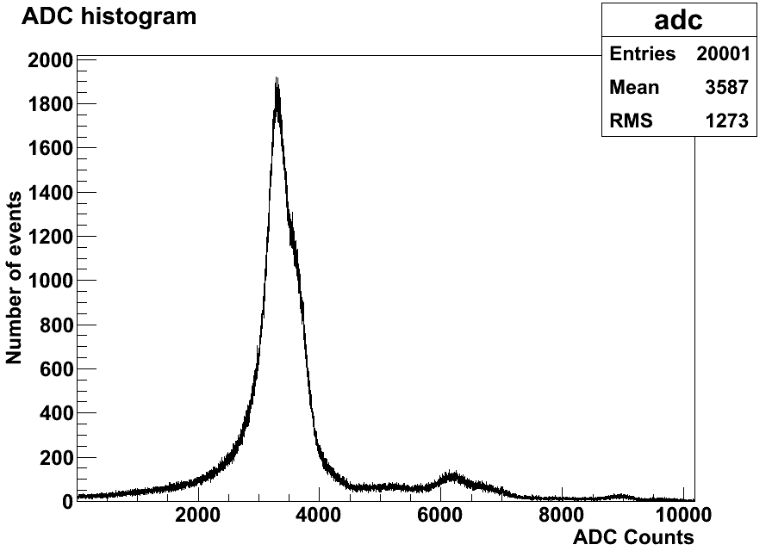
Simon’s Beam Tests: Run 26
Run 26:
  1.3 mA arc current, 0.2 cc/min gas, 64.1 °C focusing angle, 700 kHz
  Unable to fit
1

Slide 27
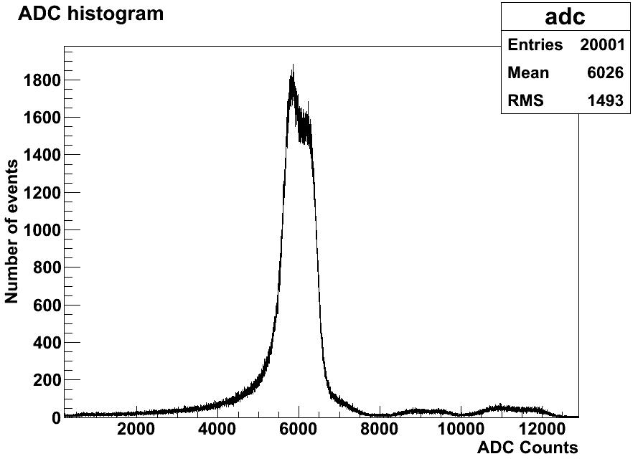
Simon’s Beam Tests: Run 34
Run 34:
  1.04 mA arc current, 0.2 cc/min gas, 64.1 °C focusing angle, 700 kHz
  Unable to fit
2

Slide 28
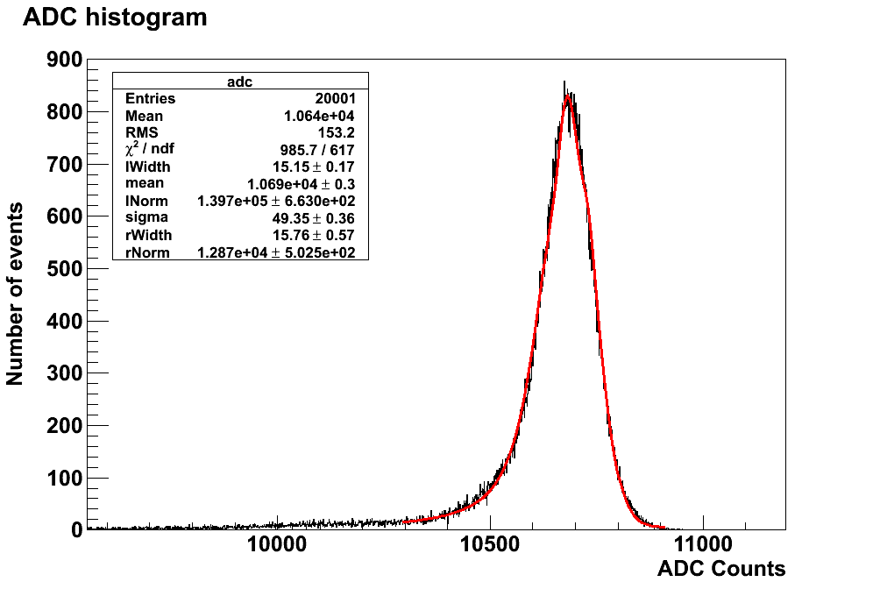
Simon’s Beam Tests: Run 41
Run 41:
  73.5 °C focusing angle
3
ΔE/E:
1.085 + 0.008 % FWHM

Slide 29
To Do (Part 2)
For the next measurement at Clatterbridge:
  Go down from standard focusing angle (during the December 2015 test beam we only went up)
Waveform analysis!
  Try to get the same ADC spectrum from the “ADC mode” and from the “wavelength mode” for runs taken next to each other
    Understand how the baseline is calculated etc.
  Once that is understood use software to select single pulse wavelengths for higher rate runs
  Think about which other criteria we can use for the cuts
  Compare with Hiu’s analysis
Complete ²⁵²Cf neutron measurements with lead shielding

