Slide 1
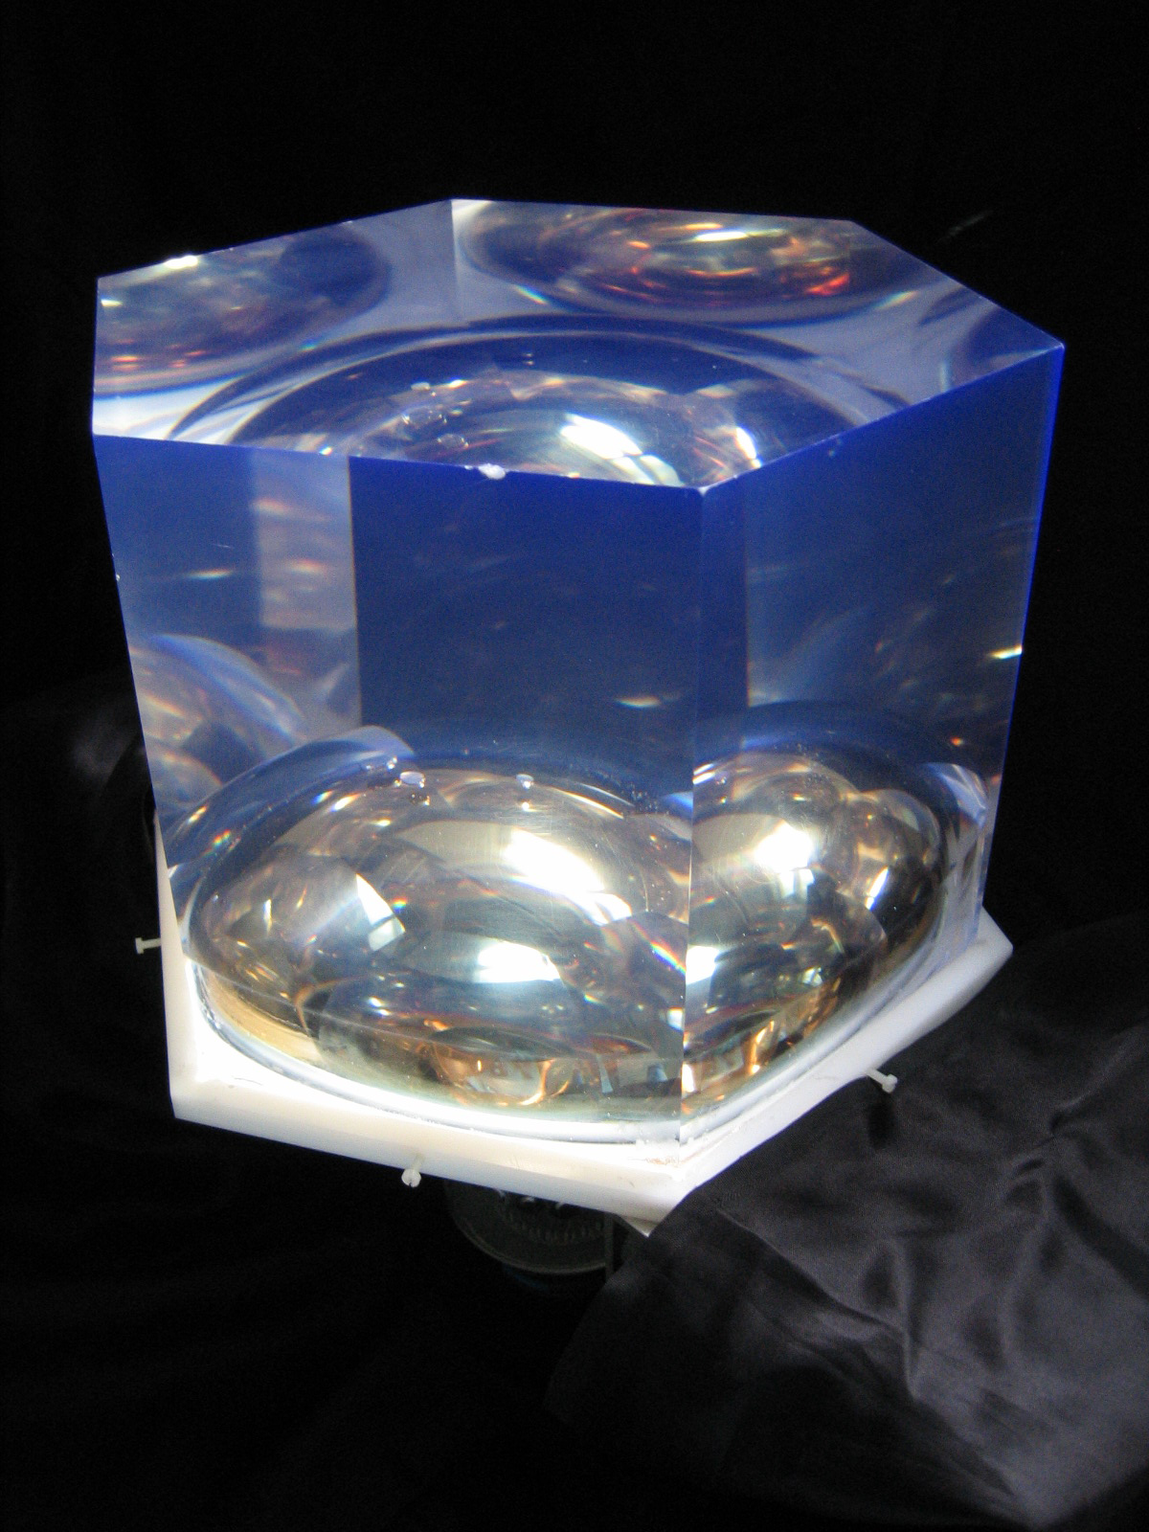
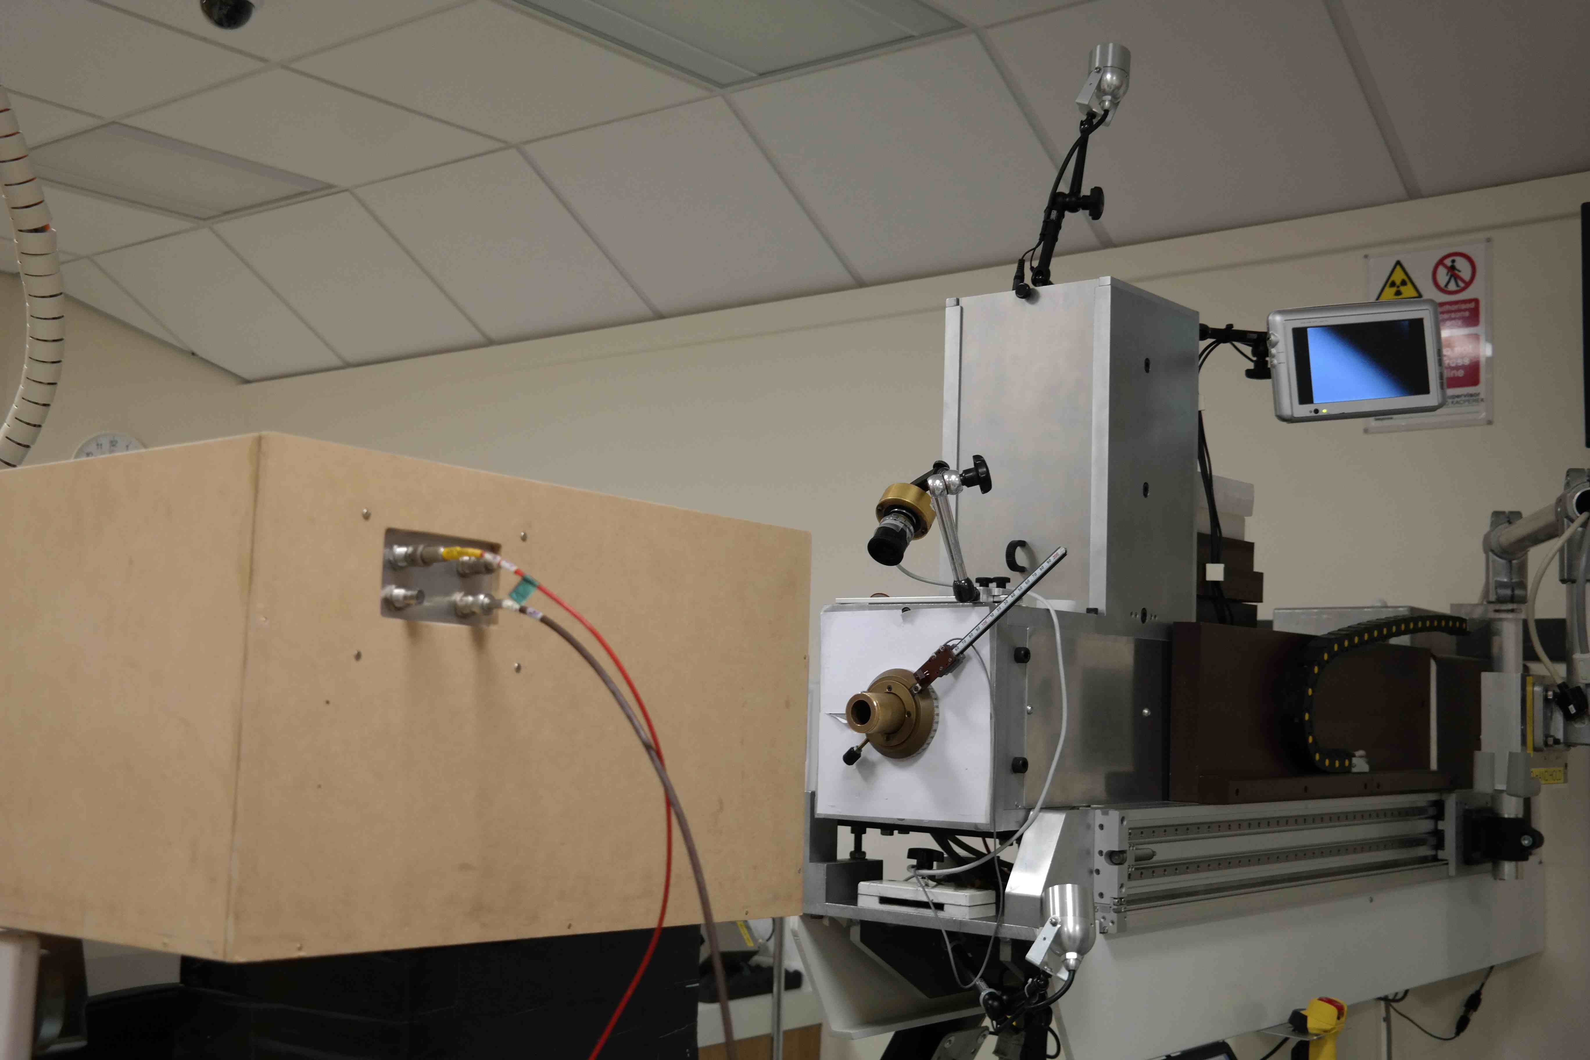
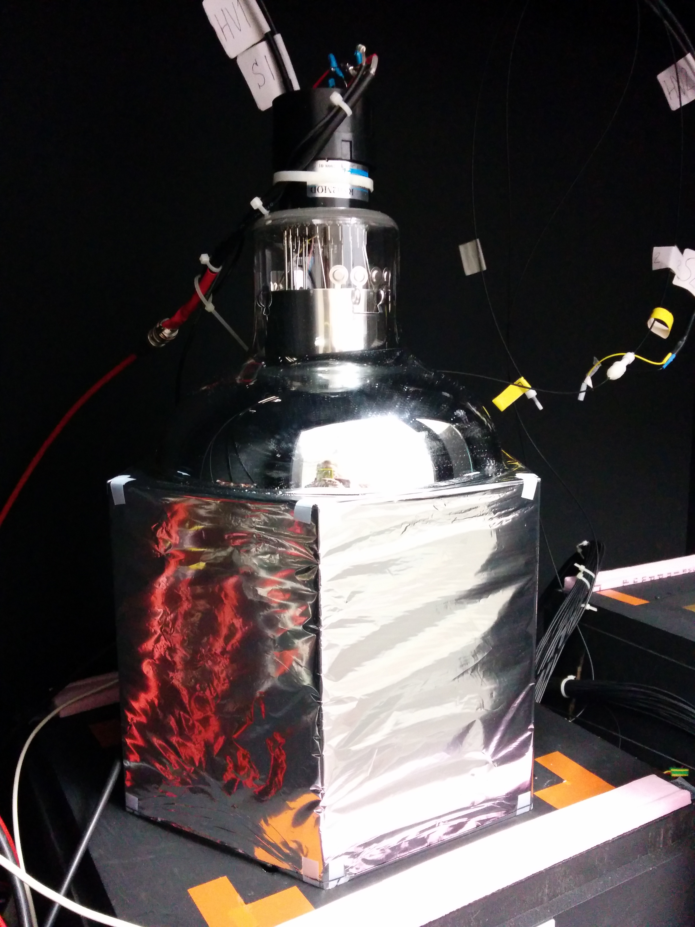
From SuperNEMO to Proton Therapy: Adapting the SuperNEMO Optical Module for Proton Therapy QA
Anastasia Basharina-Freshville
(University College London)
Notes:
We’ve had a few seminars on PT. This one is different - based on actual *data* from working PT facility using technology developed at UCL for particle physics experiment.

Slide 2
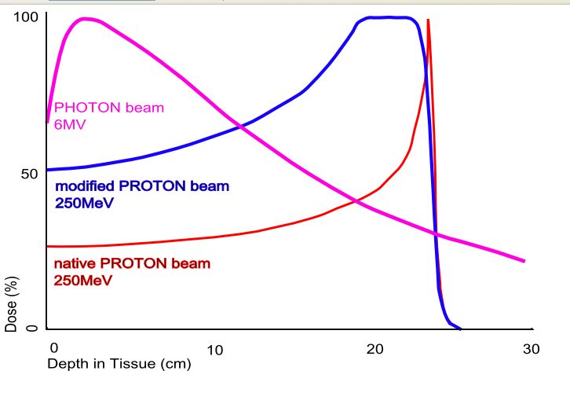
Why Proton Therapy?
More precise form of radiotherapy
  Precise tuning of the delivered dose to the patient through careful selection of proton beam energy
  Due to energy loss profile of protons
  And much smaller beam spot sizes
Important for areas where we particularly want to avoid large doses of radiation to healthy tissue:
  Head and neck
  Central nervous system
  In children
http://samhs.org.au/Virtual%20Museum/xrays/Braggs-peak-rxth/braggpeakrxth.htm
Notes:
Protons have:
A low entrance dose
A high Bragg peak region dose
No exit dose

Slide 3
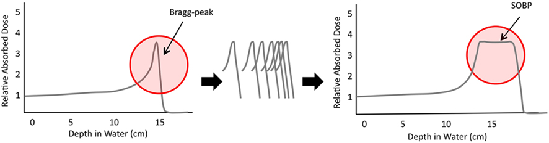
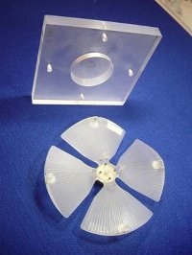
Why Proton Therapy?
Front. Oncol., 06 September 2011 | doi: 10.3389/fonc.2011.00024
Range shifter and modulator used for a Spread Out Bragg Peak
Alters beam energy to provide a uniform dose over the depth of the tumor
http://www.clatterbridgecc.nhs.uk/professionals/physicsdepartment/cyclotron/
Notes:
SOBP = Spread out Bragg Peak. Alignment of many Bragg peaks allows creation of the SOBP, allowing deposition of radiation in a specific location (and a larger tumor than using one Bragg peak).

Slide 4
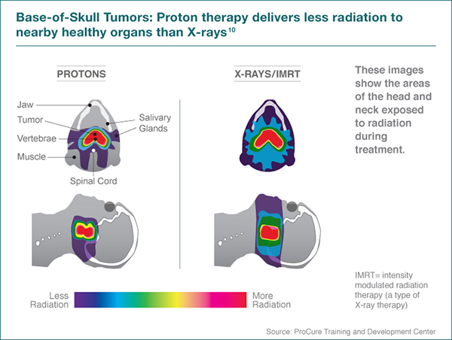
http://www.seattlecca.org/diseases/proton-therapy-head-neck-cancers.cfm

Slide 5
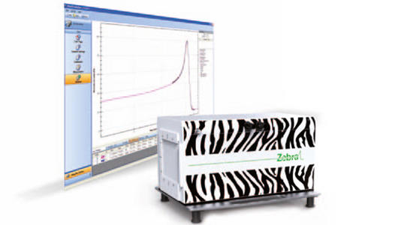
Proton Therapy Challenges (1)
Precise measurements of beam energy and energy spread
  Target: ~1% level energy resolution
  (in terms of σ)
Quality Assurance (QA):
  Range verification is of great importance!
  Two methods currently used:
    A single dose monitor to look at 3-5 different
    beam ranges/energies, ~ 1 hour daily
    “Zebra”: a multi-layer ionisation chamber,
    <1 minute to acquire data
    BUT: expensive and not nozzle-mounted
Our starting points!
http://www.iba-dosimetry.com/complete-solutions/radiotherapy/particle-therapy-dosimetry/zebra-with-omnipro-incline
Notes:
Range (used in medical physics)/energy (used by us) verification is of utmost importance to make sure the patient gets the correct dose.
This is carried out daily and takes ~1 hour in the morning. It is done with a single dose monitor, looking at 3-5 different beam energies/ranges (there is not enough time to map out the Bragg peak).
Unless the “Zebra” system is used, which is a multi-layer ionisation chamber, which takes less than a minute to run, but costs £250,000 and is bulky.

Slide 6
Proton Therapy Challenges (2)
  Proton imaging
  Requires an increase in imaging resolution compared to X-ray based systems due to localisation of proton dose delivery
  Currently use a conversion factor to convert from X-Ray based imaging systems to proton therapy treatment plans, which introduces imprecision and range uncertainty
  Currently, the patient is imaged away from the treatment – any movement of the patient’s anatomy introduces further imprecision
Notes:
X-ray CT images do not provide information on the proton-specific absorption characteristics of tissue surrounding the treatment volume, therefore an algorithm must be used for conversion, introducing uncertainty into something that has to be extremely precise to work well and not cause damage
The patient is imaged away from the treatment – therefore any movement in anatomy (even breathing) introduces further uncertainty

Slide 7
Proposed Solutions
Calorimetry approach for:
  Beam energy and spread measurements,
  Measuring range for QA:
    measure energy and convert to range using a single scintillator + PMT for QA in < 1 minute, which is affordable and nozzle mounted
    measure range directly using a segmented scintillator with a readout on every slice
Proton imaging:
  Image with > 300 MeV proton beam, which will emerge from the body without significant energy deposition
  Tomography approach:
    A series of tracking layers upstream and downstream of the patient
    Accurate calorimeter for energy measurements
    Target: ~0.5 – 1% σ for 300 MeV imaging protons
The focus of this seminar
Notes:
Emphasise that we have two different ways of doing QA:
Single scintillator + PMT: measure energy and convert to range (so energy is a way of looking at the range)
Sandwiched design with individual readout per slice: measure range directly

Slide 8
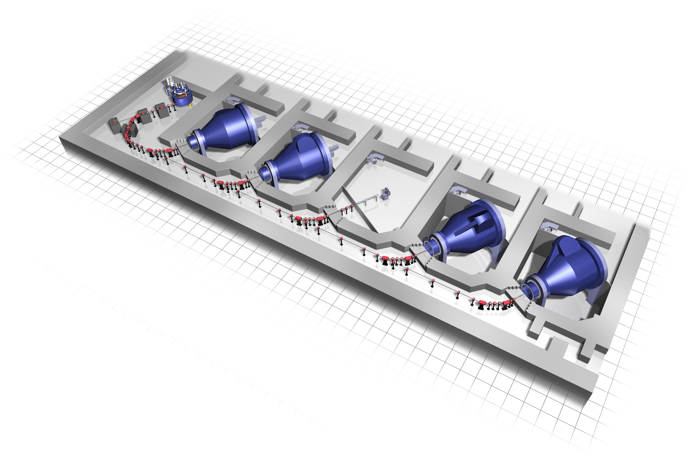
UCLH Proton Therapy Centre
Treatment Room
Accelerator
Gantries
http://www.varian.com/us/oncology/proton/technology.html
Use a particle accelerator (cyclotron) to
get a 250 MeV proton beam
Delivered to the patient through a gantry, which has to be big
enough to deliver the beam from any angle: must be 3 stories tall!
Three gantries
Construction has started (summer 2015)
First patient treatment: 2019
Can we work on some of the challenges before then?
Notes:
Remember: do NOT mention research room!

Slide 9

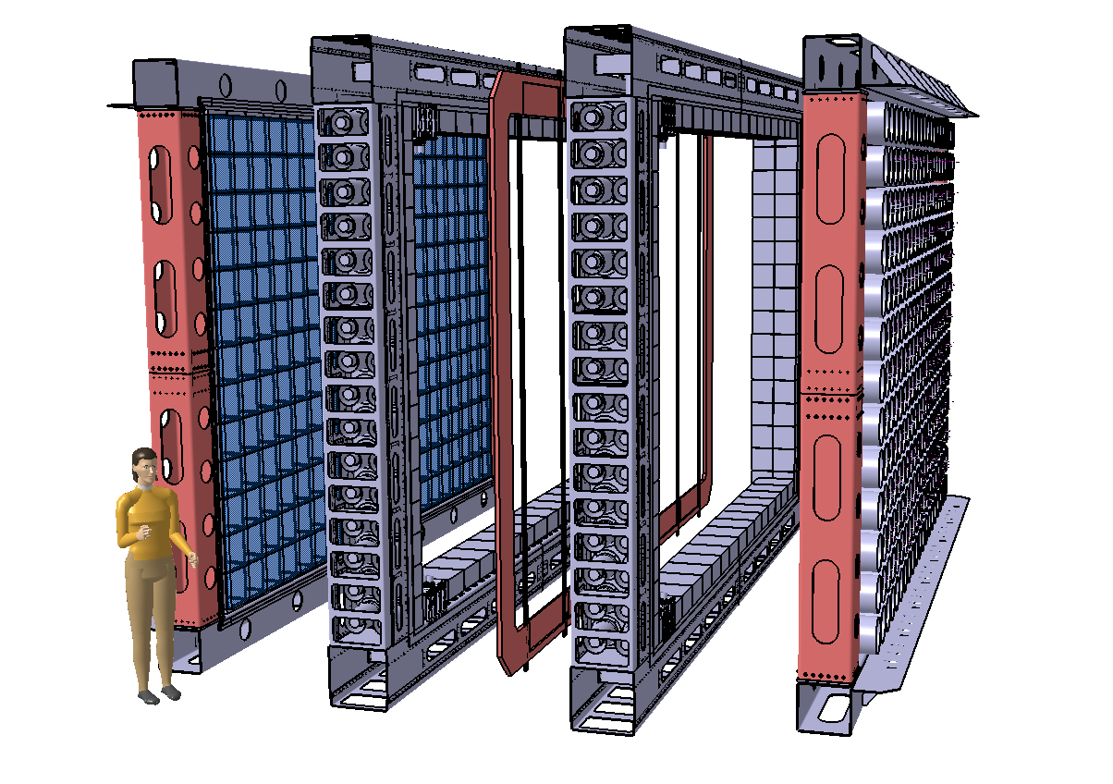
SuperNEMO
Neutrinoless double beta decay detector using NEMO3’s tracker-calorimeter technique
Target sensitivity: T_{½} > 10²⁶ years → <m_{ν}> <0.04 – 0.1 eV
Modular detector with a planar geometry
1 module (of 20) consists of:
Source foil:
- 5 kg (total of 100 kg) of 40 mg/cm² (4 x 2.7 m²)
- ⁸²Se (high Q_{ββ}, long T_{1/2}^{2vββ}, proven enrichment technology): starting baseline
- ¹⁵⁰Nd and ⁴⁸Ca being considered depending on enrichment possibilities
Tracker: ~2000 drift cells in Geiger mode
→ particle identification (for background suppression)
Calorimeter: ~550 scintillator blocks + PMTs
→ energy and time of flight measurements of particles
Passive shielding surrounding each module
4 m
6 m
2 m (assembled, ~0.5 m between source and calorimeter)
Notes:
82Se is the starting baseline design, but as the source is not the detector (as you have in other neutrinoless double beta decay experiments) there is a possibility of using other sources.

Slide 10
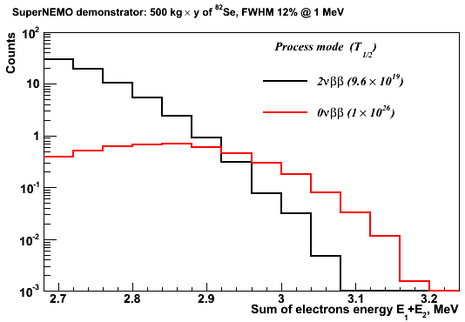
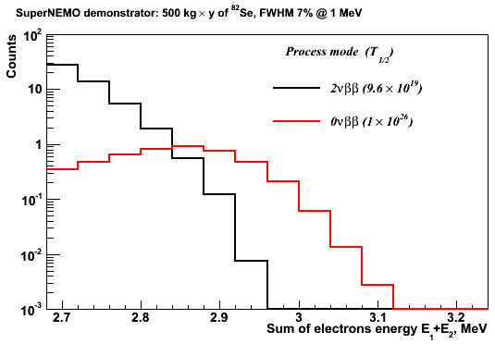
From NEMO3 to SuperNEMO
Energy resolution is one of the main challenges (factor of 2 improvement):
SuperNEMO scintillator has to be organic plastic scintillator
(high light yield, low electron back-scattering, high radiopurity, fast timing)
→ Can 3% σ at 1 MeV be reached for organic solid plastic scintillator?
First step in SuperNEMO R&D: secured STFC funding for energy resolution R&D
NEMO3:
SuperNEMO:
Notes:
From NEMO3 to SuperNEMO: light output improved by a factor of 4
Not liquid scintillator: because of difficulty of mechanical design and energy loss of electrons in the entrance window of the liquid scintillator container, also the resolution wasn’t better than with a solid scintillator

Slide 11


Energy Resolution
σ sigma of distribution
E mean of distribution
N_{pe} number of photo-electrons
N_{ph}/E_{e.} number of photons per unit energy
ε^{light} light collection efficiency
QE^{PMT} quantum efficiency of the photo-cathode
ε^{PMT} PMT collection efficiency
Three experimental objectives:
scintillator light output
Physically translates to:
Scintillator: material, surface treatment, geometry
Reflector: material, reflectivity coefficient, specular/diffusive
Optical coupling quality: material, geometry, light guides
Photomultiplier Tubes (PMTs): quantum efficiency (QE), collection efficiency, gain of the first dynode
Combined in an “optical module”:
scintillator wrapped in reflective material coupled to a PMT

Slide 12
SuperNEMO Calorimeter Test Bench
Excite scintillator with a monochromatic electron source (approximates the delta function) → any smearing of distribution is due to detector properties
UCL:
²⁰⁷Bi source: 976 keV and 482 keV K-shell conversion electrons
Fit: deconvolution of X-rays, γs, L-shell and M-shell conversion electrons
Bordeaux:
⁹⁰Sr spectrometer: ⁹⁰Sr beam passed through a magnetic field to select monochromatic electrons of known energy
Fit: Gaussian

Slide 13
SuperNEMO Calorimeter R&D: Simulations
Full calorimeter simulations:
  GENBB event generator
  Physics simulations with GEANT4 (optical photon transport in scintillator detectors)
The model accounts for wavelength dependence of optical properties, all of which have been experimentally measured, of the:
  scintillators (self absorption and re-emission)
  reflective wrappings
  photomultipliers (QE)
  optical coupling materials
  refractive index of optical materials

Slide 14
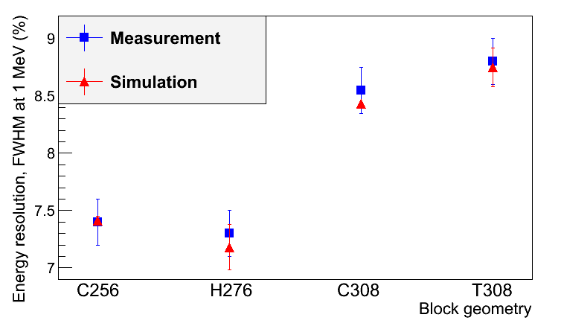
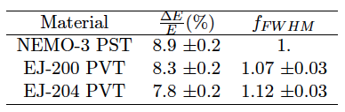
SuperNEMO Calorimeter R&D: Scintillators
Block shape studies:
Material: polystyrene (PST) vs. polyvinyl toluene (PVT)
Close collaboration with manufacturers (JINR Dubna, ISM Kharkiv, ENVINET, ELJEN) for contents of:
  PPO scintillating agent
  POPOP wavelength shifter
Surface finishing: polished vs. depolished
  All surfaces depolished (machine finish), with the face with the hemispherical cutout polished
C256: cubic 256² x 190 mm²
H276: hexagonal 276 mm diameter
with 12 mm minimum depth
C308: cubic 308² x 190mm²
T308: cubic 308² x 190mm² with tapered sides
Notes:
PVT: higher light yield and longer light attenuation length, but it’s more brittle than PST and therefore harder to machine and handle
Note: Numbers in table are relative changes, to single out particular parameters (R&D done in lots of different order)

Slide 15
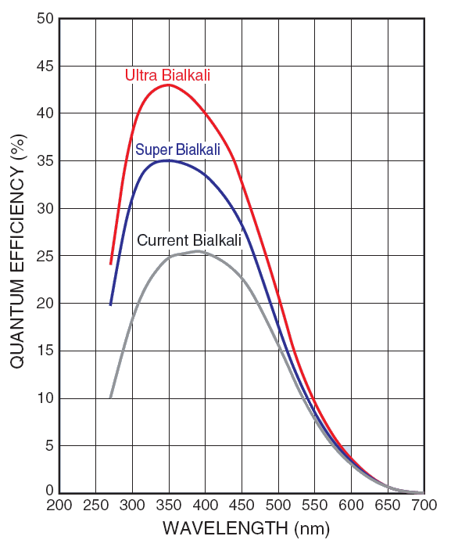
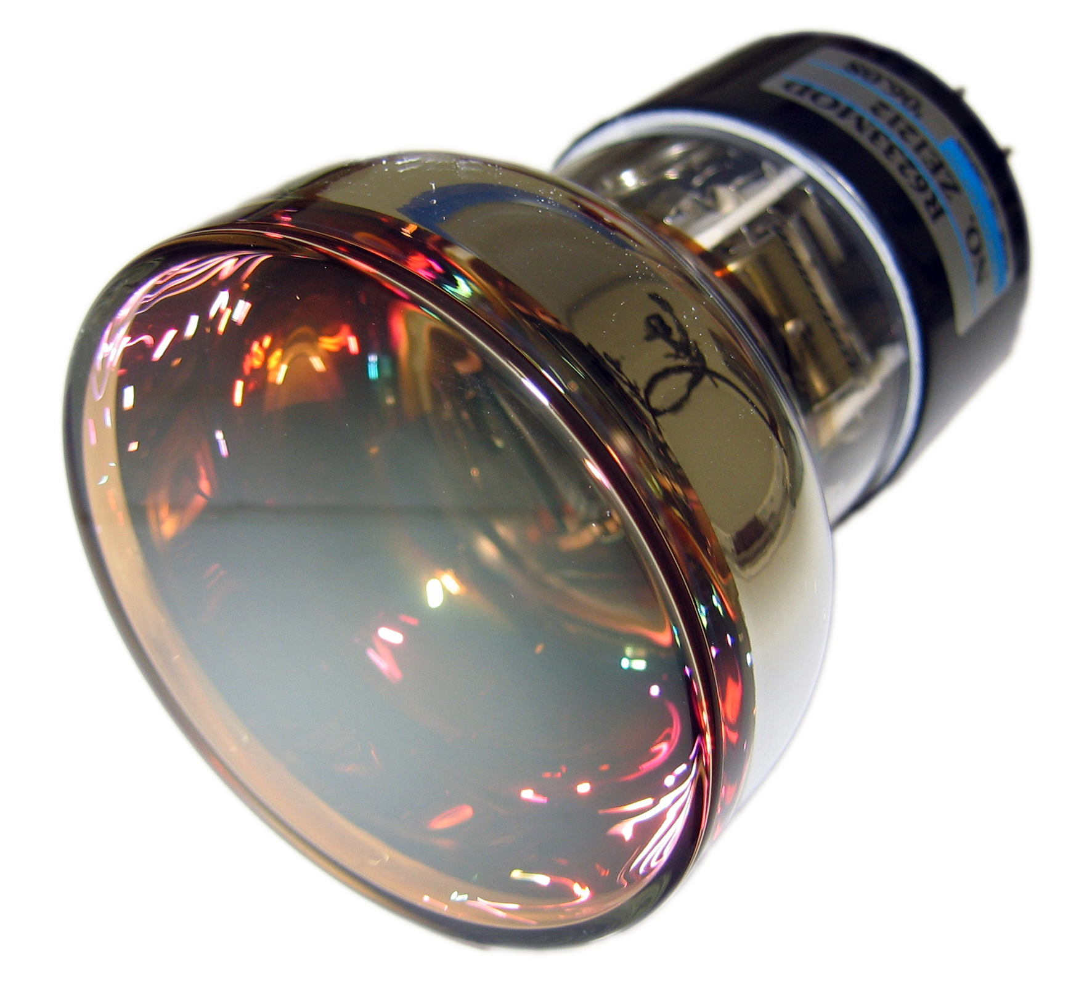
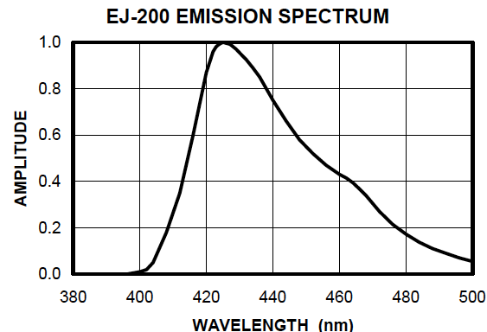
SuperNEMO Calorimeter R&D: PMTs
Photocathode QE:
Collection efficiency (close collaboration with Hamamatsu on 8” R5912-MOD tube):
  Number of dynode stages reduced from 10 to 8
  Voltage divider optimisation
  Improved from <70% to ~80%
Hamamatsu QE Profile:
Bi-alkali alloy development for photocathode material has achieved QE > 40%
Selection of PMT to optimise QE to the emission spectra of the scintillator
Notes:
Voltage divider optimisation:
Increase HV between the cathode and the first dynode (by 2)
Increase HV between the first and second dynodes (by 1.5)

Slide 16
SuperNEMO Calorimeter R&D: PMTs
Photocathode uniformity:
  Close collaboration with Hamamatsu to improve photocathode uniformity across the entire surface of the PMT
Timing:
  Reducing the number of dynode stages improves the timing of the PMT by reducing the time transition spread (TTS)
Gain and Linearity (a big achievement!):
  Reducing the number of dynode stages and optimising the voltage divider decreases the gain: ~1 x 10⁵
  → Good linearity (< 2% for very high light levels – 50 mA peak current) whilst good gain of the 1st dynode and therefore high collection efficiency
Notes:
Gain: one of the highlights
Mention that other experiments are also considering them now

Slide 17
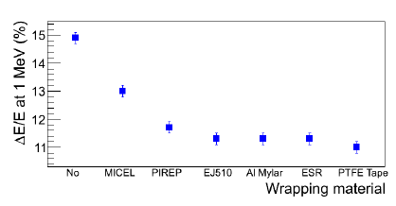
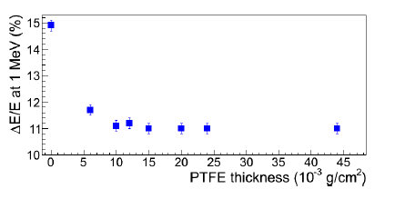
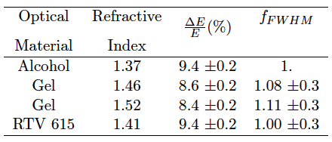
SuperNEMO Calorimeter R&D: Reflective Material & Coupling
Reflective material:
  High reflectivity, radiopure, low Z and low density (to reduce backscattering)
Optical coupling:
  Good optical coupling between scintillator and PMT essential for uniform and complete light collection
  Direct coupling of PMT to hemispherical cutout in scintillator gave the biggest impact in energy resolution improvement.
PST C308
PST C308
Notes:
For now we are planning to use RTV 615 – good radiopurity and viscosity. But work is still ongoing to find something with a closer matching refractive index.
Scintillator refractive index: 1.58
PMT refractive index: 1.47

Slide 18
SuperNEMO Calorimeter R&D: Summary

Slide 19
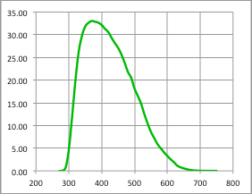
Optimised SuperNEMO Optical Module Design
EJ-200 hexagonal PVT block:
276 mm diameter
193 mm deep, minimum thickness between PMT and scintillator: 100 mm
R5912-MOD Hamamatsu 8” PMT:
Maximum quoted QE: 33%
32% QE at 400 nm
QE (%)
Wrapping:
Sides: 75 μm of PTFE (Teflon) ribbon
Sides and entrance face: 12 μm of Mylar
Wavelength (nm)
Notes:
Note: Since then a couple more improvements (now at 7.2%)

Slide 20
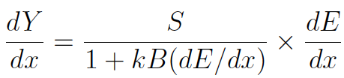
Back to Proton Therapy…
With this fantastic energy resolution of 3.2% σ at 1 MeV can we apply the SuperNEMO optical module technology to proton therapy beam monitoring and proton imaging?
Challenges: from SuperNEMO (electrons) to a proton beam
Very high intensity of events at a proton beam (~25 MHz):
  A proton beam delivers a random number of protons per bucket, which will worsen the energy resolution measured
  We require 1 proton per bucket for a good detector response
Scintillator quenching for protons:
  For a plastic scintillator, the scintillator response is nonlinear with the amount of energy deposited in it
  Amount of deviation → “quenching”
  Characterised by Birk’s law:
  Becomes important for large dE/dx and ionisaion density → important for protons, which have a large dE/dx when they slow down
Energy range:
  SuperNEMO optimised for electrons from 0.5 – 4 MeV for double beta decay
  For proton therapy we require ~O(100 MeV)
dY/dx light yield per unit path length
dE/dx energy lost by particle per unit path length
kB relates density of ionisation to energy loss
= 0.207 mm/MeV
S absolute scintillation efficiency

Slide 21
Step 1: GEANT4 Simulations
A pencil proton beam (60 MeV) simulated, positioned 70 cm underneath the entrance face of the scintillator block
Scintillator modeled as a square block (256 mm x 256 mm x 120 mm) with scintillator composition fully described
Quenching of scintillation light in plastic scintillator for protons
Energy deposited smeared according to Poissonian fluctuations in the number of generated photo-electrons
The number of photo-electrons per MeV taken from test bench data (SuperNEMO calorimeter R&D): 982 photo-electrons per MeV
(for an energy resolution of 3.2% σ at 1MeV)
Notes:
Physics list for simulations presented here: User-defined (with EMLIvermore Physics)
Now we use: QGSP_BIC_HP for hadrons and EMLivermore Physics for electromagnetic processes (with an input of 8.5% FWHM, as measured). The new resolution result is 1.53% (very simiar to the 1.48% presented here)

Slide 22
Step 1: GEANT4 Simulations
Input:
982 p.e. at 1 MeV extrapolated
to 39.3 MeV
Uncertainty on range: 0.3 mm → 1%
Our target!
Use 0.63 % σ as proxy
Quenching from simulations:
  Simulated mean: 39.3 MeV
  Quenching: 35% for 60 MeV protons
Energy resolution from simulations:
  σ: 0.247, μ: 39.28
  σ/E: 0.63 % σ
Notes:
GEANT now implements a solution for quenching when the user provides Birk’s constant for the material.
For a 30cm range we want 0.3 – 0.5 mm accuracy, which is 1%, as simulations show. This is our goal. We actually measure energy resolution, which is 0.63 % sigma, which corresponds to an uncertainty of 1% on range.

Slide 23
Step 1: GEANT4 Simulations
60 MeV protons range out at 30.2 mm in the scintillator
Notes:
Energy deposition vs. depth of scintillator block, with Bragg Peak clearly seen

Slide 24
Step 1: GEANT4 Simulations
Proton Stopping Distance
Simulations of SuperNEMO scintillator vs Water Equivalent
  Pencil beam simulations
  The SuperNEMO scintillator is water equivalent for stopping distance and spread
    One to one conversion for water phantoms used in medical physics
    An advantage for direct range verification using the “segmented” design
Proton Beam Energy, MeV | Mean stopping distance, SCINT (mm) | Mean stopping distance, WATER (mm) | σ stopping distance, SCINT (mm) | σ stopping distance, WATER (mm)
60 | 30.21 | 30.54 | 0.33 | 0.33
200 | 255.4 | 257.1 | 2.48 | 2.44
300 | 505.9 | 509.9 | 4.64 | 4.78
Notes:
Our detector = water, so this is a big advantage for direct range verification using the segmented design.
Usually you would need a conversion or to use a passive water phantom, but with our design we can do it simultaneously.

Slide 25
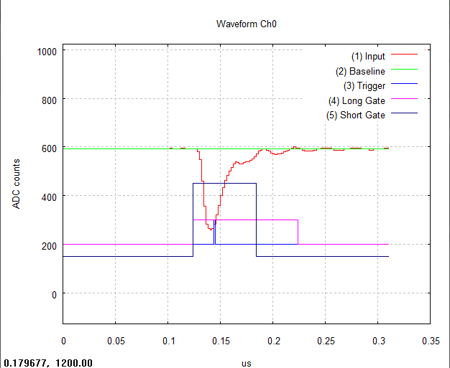
Step 2: Equipment Setup
CAEN DT5751 Digitiser:
Dual-gate signal integration
→ Pulse shape analysis
→ Neutron/gamma discrimination

Slide 26
Step 3: ²⁰⁷Bi Test at UCL
Optical module resurrected after some years: re-measure energy resolution!
  New test bench at UCL: a thin scintillator introduced into set up, which triggers DAQ only when an electron passes through it
  → Gammas removed, fit simplified to triple Gaussian of 976 keV and 482 keV peaks
²⁰⁷Bi Spectrum at 1400V
976 keV conversion electron peak
482 keV conversion electron peak
After:
correction for energy lost in thin scintillator
conversion to MeV
σ/E: 3.6 ± 0.2 % σ at 1 MeV
  σ: 148
  μ: 3460
Notes:
A lot of handling, therefore a little bit of aging, but still within the errors

Slide 27
Step 4: Clatterbridge Cancer Centre
Only currently operational proton beam treatment centre in the UK
Home to the Douglas Cyclotron → produces 60 MeV proton beam for the treatment of ocular melanomas (penetration of 60 MeV protons: 30.5 mm in water)
Double scattering beam technique:
Beam accelerated to single energy
Beam passes through range-shifter wheel that modulates the proton beam energy to reach front/back of target volume
Scatterer enlarges beam to cover whole volume
Collimator shapes outer edge of beam to target area
Notes:
The Clatterbrdige beam is smaller than the target, therefore you need a scatter to enlarge the beam.

Slide 28
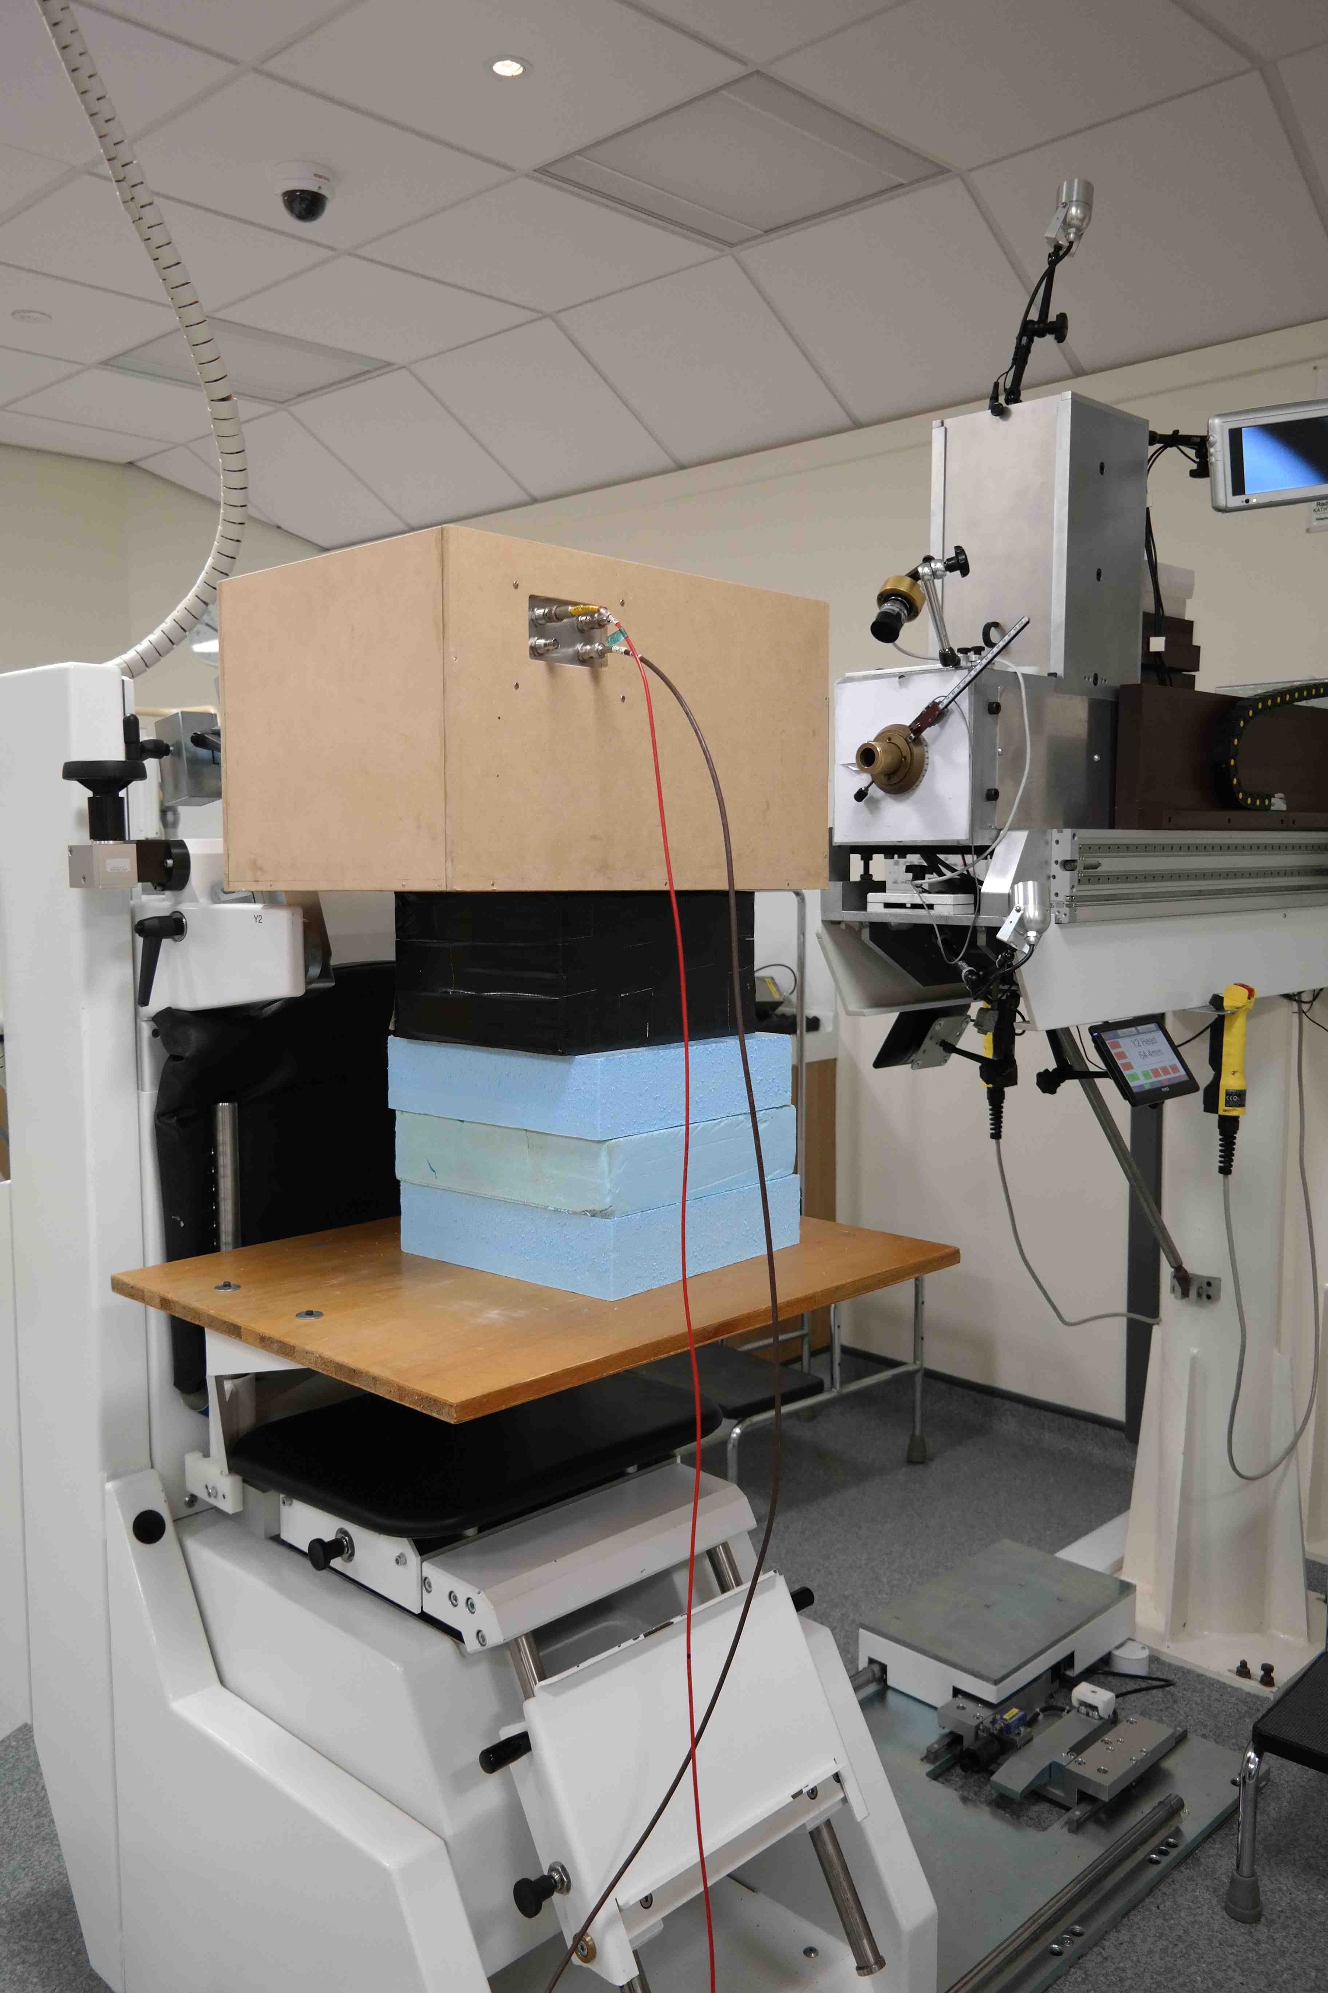
Step 4: Clatterbridge Cancer Centre
Eight full days in total of proton beam access granted to UCL from 2013 - 2016

Slide 29
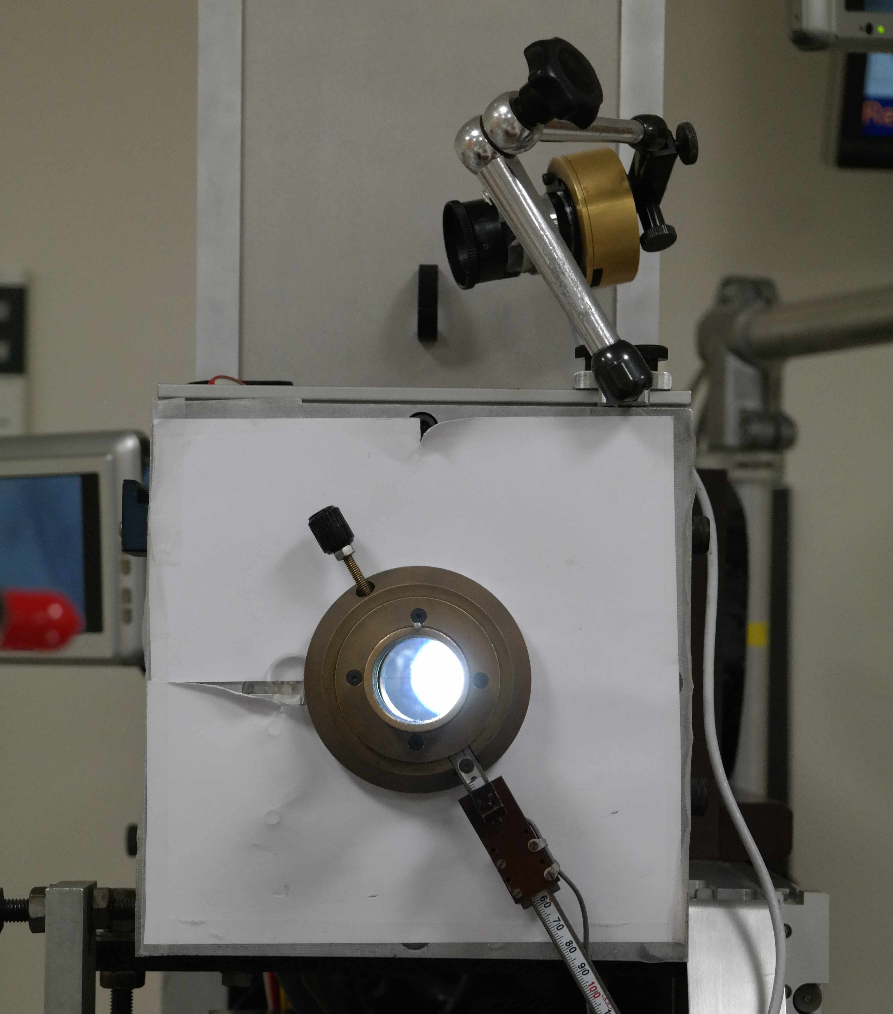
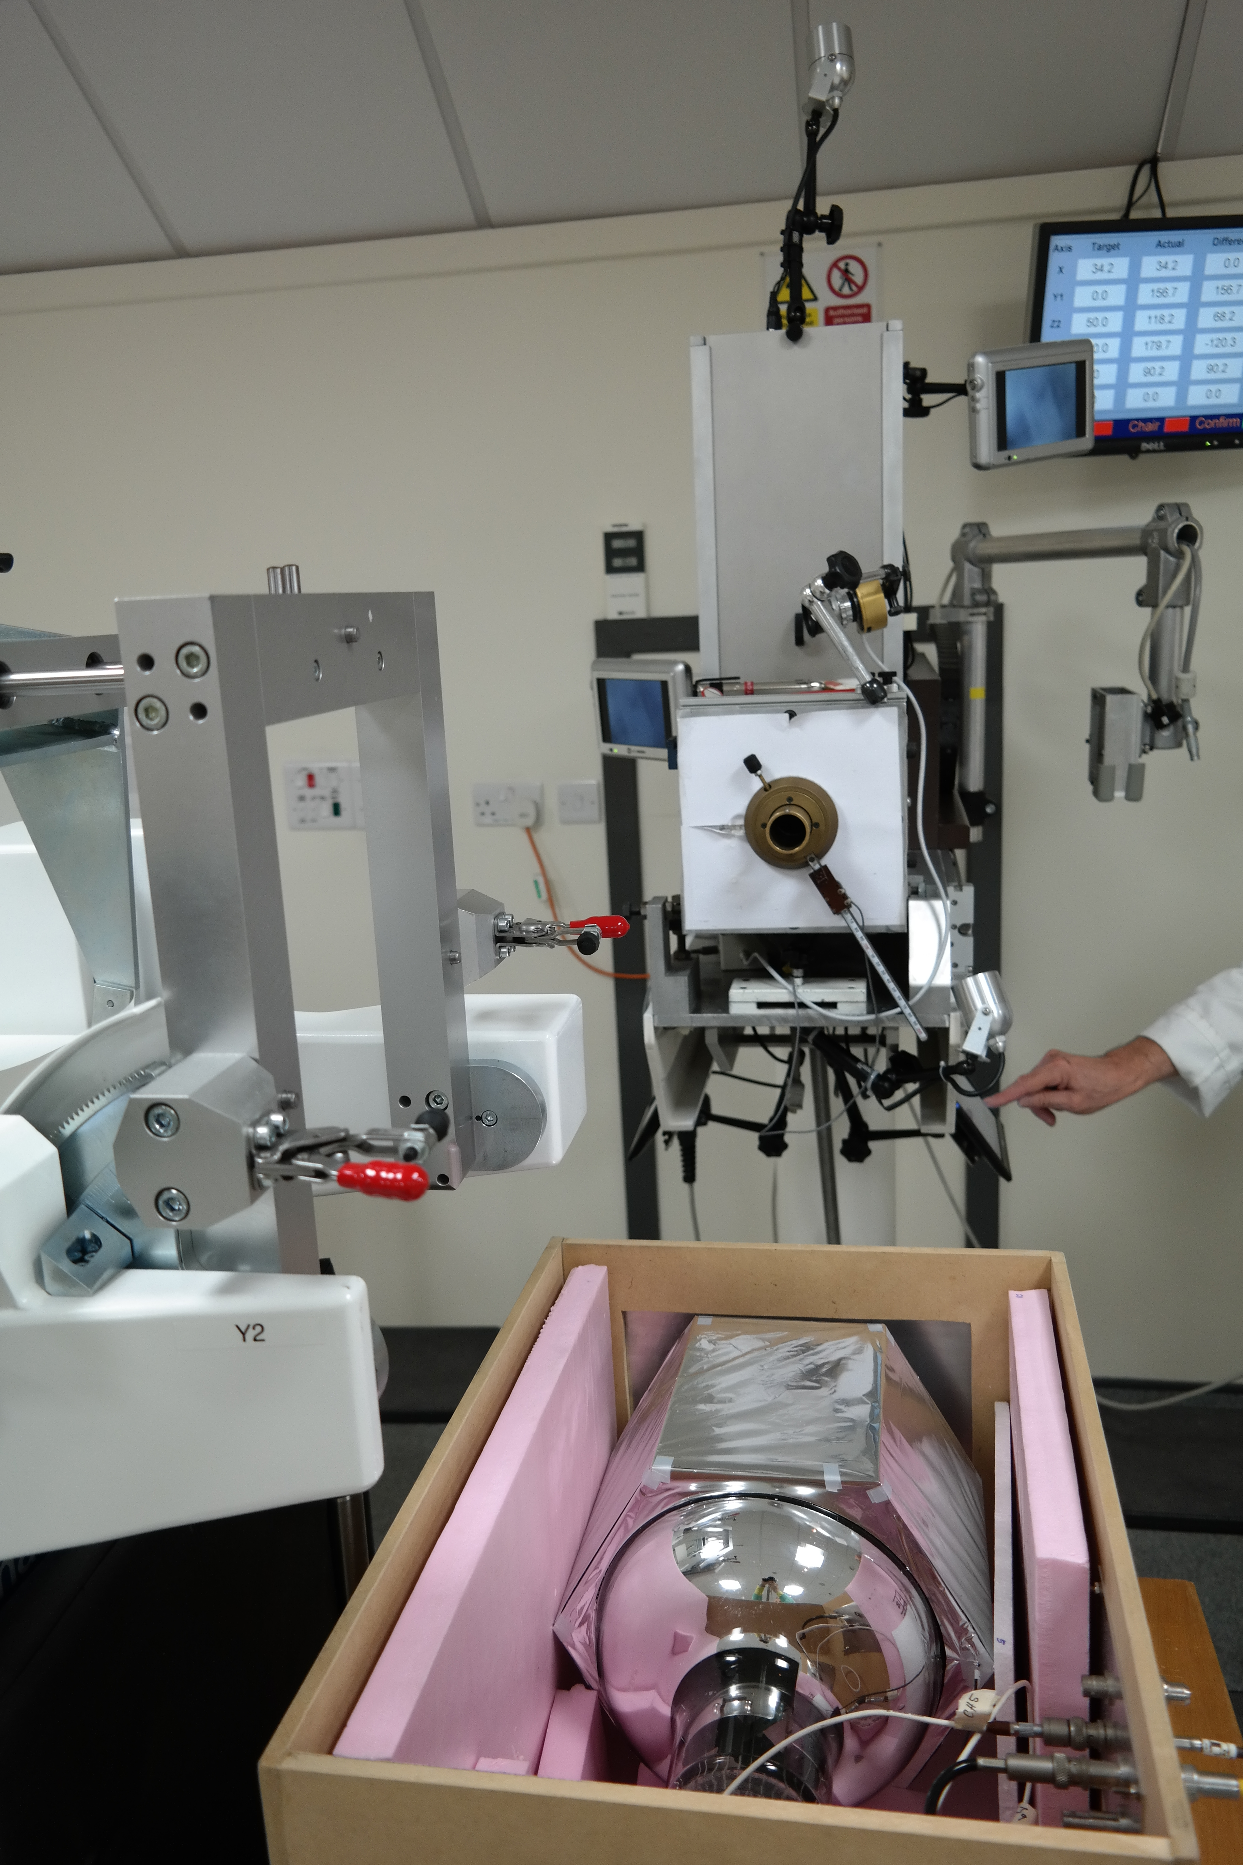
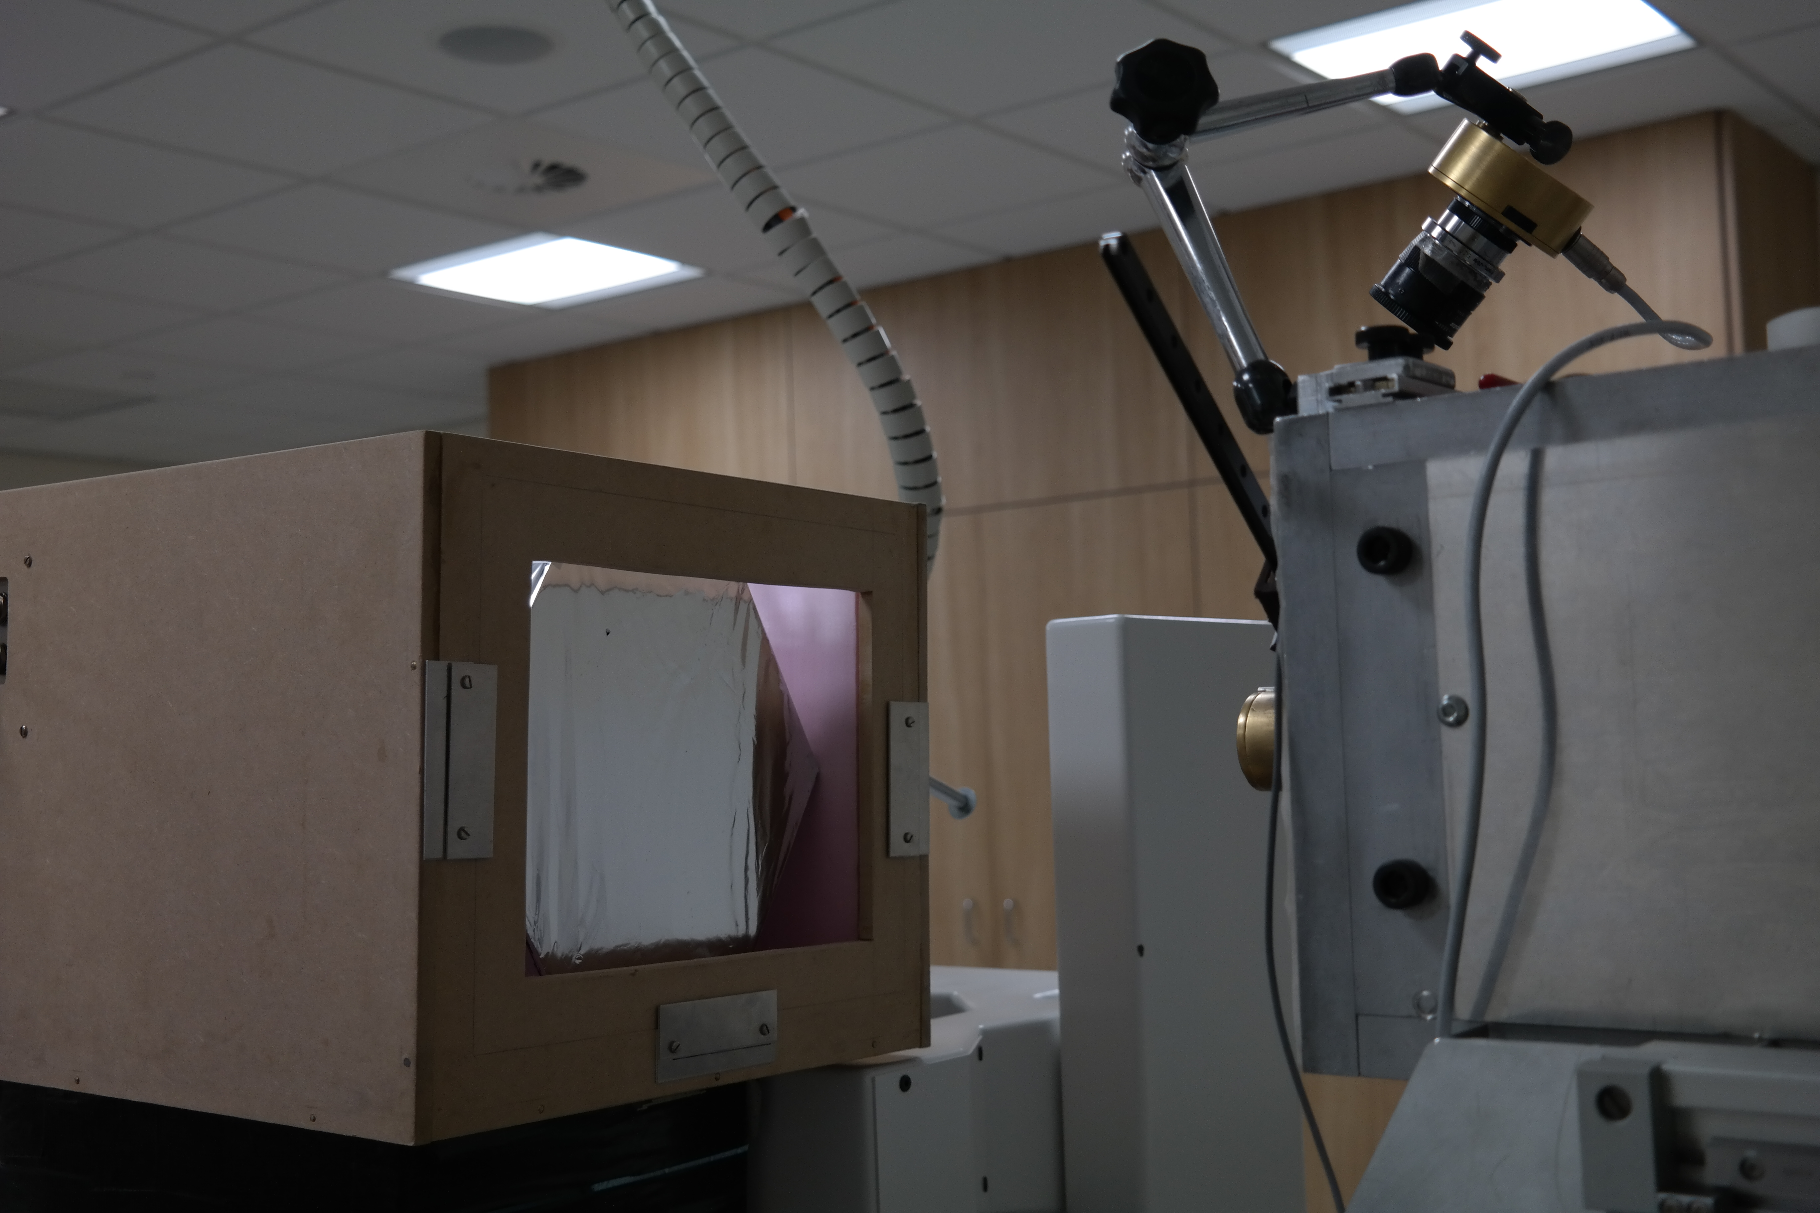
Step 4: Clatterbridge Cancer Centre

Slide 30
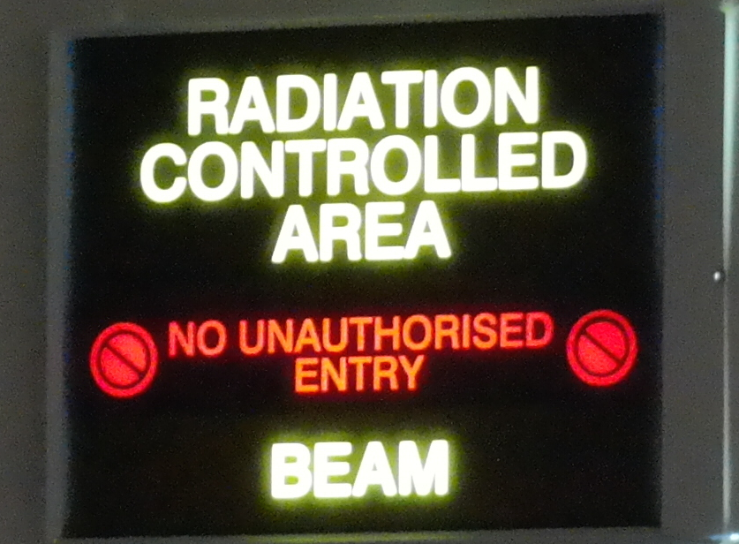
Step 4: Clatterbridge Cancer Centre

Slide 31
Step 4: Clatterbridge Cancer Centre
The proton rate from the beam was carefully controlled by
  Inserting brass collimators with varying diameters
  (0.5 mm – 10 mm) into the beam nozzle
  (~30 cm upstream of the optical module)
  Adjustment of the ion source gas supply
  Adjustment of the cyclotron RF phase
Resulting distribution:
Notes:
For our runs: no discharge current on the gas source bottle, protons are mostly produced by multiple scattering

Slide 32
Step 4: Clatterbridge Cancer Centre
Fitting function:
Convolution of Gaussian and mirror Landau
+ Landau on the right
→ σ/E: 0.67 ± 0.11 % σ (for ~40 MeV due to quenching!)
Compared to 0.63 % σ
from simulations
Mirror Landau Tail
Notes:
Mirror Landau Tail:
Landau tail from fluctuations of energy loss of charged particle by ionisation traversing a thin layer of material (The beam interacting with anything before the scintillator - the Mylar wrapped around the scintillator entrance face, air etc.)
Mirror Landau: due to some energy being lost in the Mylar (energy lost in the foil moves the distribution to lower energies)
Gaussian and Landau convolution: Fluctuation of energy loss from delta-electrons, happens at BEGINNING of event (therefore mirror). Delta-electrons are produced when a freed electron after ionisation has enough energy to cause further ionisation. These delta-electrons have a huge range of energy, therefore you see a very long Landau tail. The ones that escape without further interaction are seen as missing energy. Note: This also happens inside of the detector, but since we see all of the interactions in there all of the energies are summed up and this evens out by the time we look at the total energy deposit.
Landau on the right: We have large fluctuations of delta-electrons. PERAHPS lowest energy delta-electrons experience quenching because the ionisation density is so high, therefore we have some missing energy. This happens at the END of event.

Slide 33
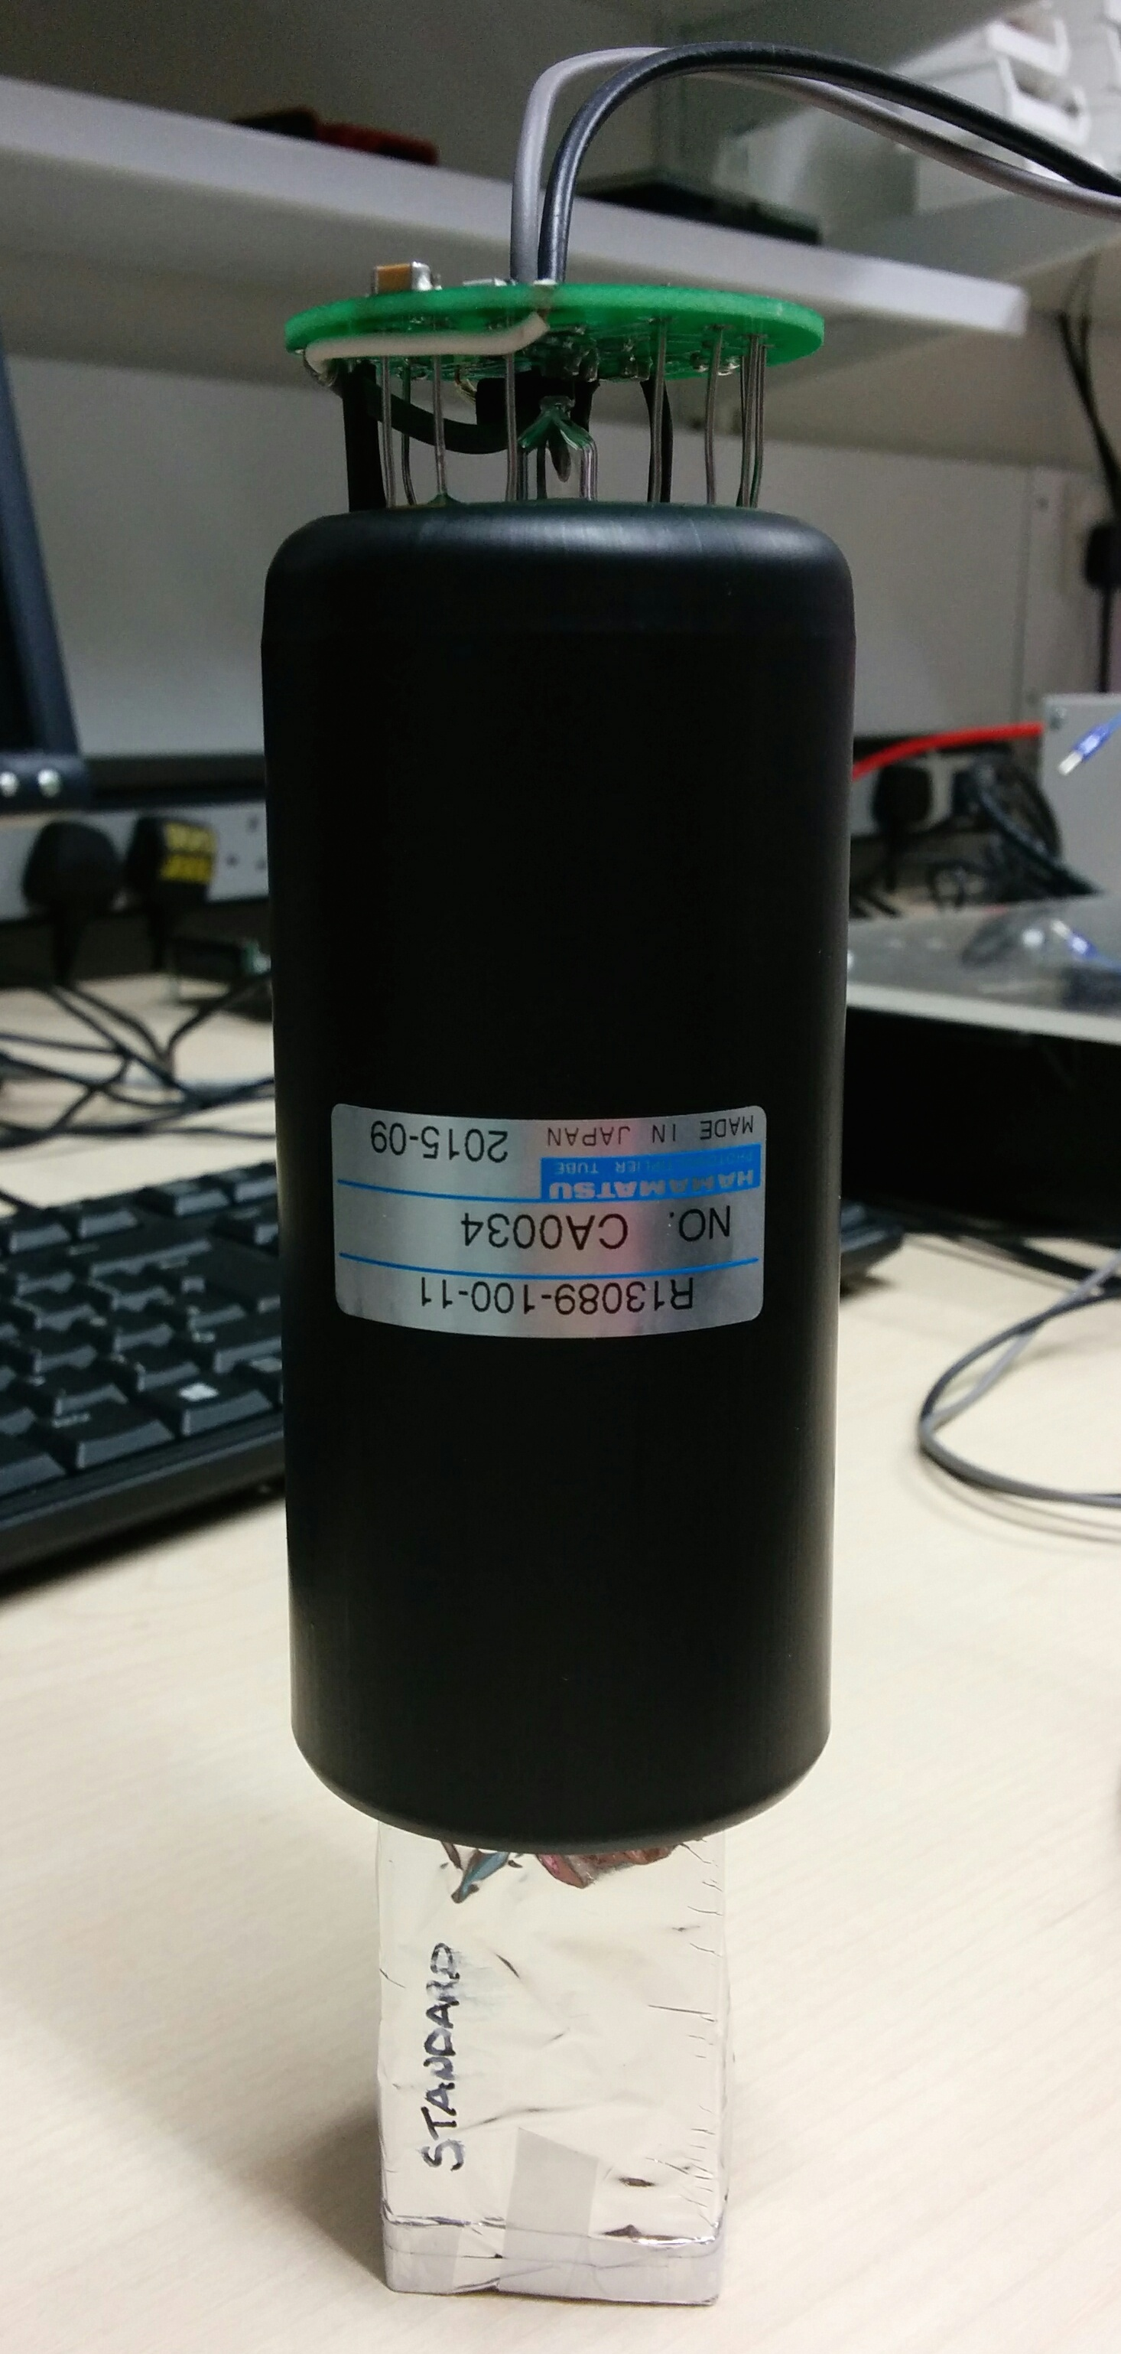
Step 5: Make the Technology Smaller & Faster
We have already achieved the target energy resolution: 0.7 % σ
The next step is to do this for very high rates of 1 – 10 MHz with a compact design:
  Reduce the size of the PMT and the scintillator to improve timing and make the design nozzle-mountable
  -VE HV PMT base to remove decoupling capacitor (not fast enough discharge)
2” Hamamatsu R13089-100-11 PMT with negative HV active divider base
  3 cm x 3 cm x 5 cm cuboid ENVINET/NUVIA PS standard scintillator
  Coupled with BC-630 Saint Gobain silicone optical gel
Wrapped in 75 μm of PTFE (Teflon) ribbon on the sides and 12 μm of Mylar on the sides and entrance face
Treatment Nozzle
Notes:
For our runs: no discharge current on the gas source bottle, protons are mostly produced by multiple scattering

Slide 34
Step 5: Make the Technology Smaller & Faster
→ σ/E: 0.89 ± 0.11 % σ (for ~40 MeV due to quenching!)
at 25 kHz
We are still at our < 1 % σ target!
Notes:
Energy resolution here could be worse due to the scintillator being PS instead of PVT – consistent with 207Bi test bench measurements.
For our runs: no discharge current on the gas source bottle, protons are mostly produced by multiple scattering

Slide 35
Energy Dependence on Resolution
Energy of protons incident on scintillator varied by placing absorbers (PMMA plates and calibration wheel) of known thickness ~1.8 m upstream of the optical module
dependence!
Notes:
Comment regarding poor fit, answer:
The “badness” of the fit is dominated by low energy points. These are not as well measured/fitted because of the beam going through a large amount of PMMA and hence causing a lot of scattering etc./making the beam fuzzy.

Slide 36
Linearity: -900 V
We want to run the PMT at higher voltages (can run at up to 1500V) as this will increase the PMT’s collection efficiency and will improve the energy resolution
BUT we have a LOT of light (tens of thousands of photo-electrons) so we need to make sure we are not saturating the PMT
  Look at linearity
For - 900V:
Deviation from linearity < 2%!

Slide 37
Beam Uniformity Measurements
0.5 mm Ø collimator
Uniform 8 mm away from the centre
16 mm away from the centre is 1mm away from the beam edge
  Currently trying to understand these edge effects
Okay to use collimators to reduce rates!
Notes:
For now we can conclude that the beam is uniform and that reducing rates using a collimator whilst keeping nominal beam operating conditions is a valid method to get the beam down to measurable rates.

Slide 38
Radiation Damage Assessment
Total estimated radiation dose received by 2” OM: 0.25 Gy
No noticeable difference in resulting energy resolution so far.
Date | HV Supply | DAQ | σ/E (%)
27/07/16 | Portable | UCL | 3.16 ± 0.03
28/07/16 | UCL | UCL | 3.14 ± 0.03
Clatterbridge Test Beam: 02-03/08/16
04/08/16 | UCL | UCL | 3.08 ± 0.03
Notes:
²⁰⁷Bi tests carried out at -1700 V:
before test beam: 27-29/07/2016
after test beam: 04/08/2016

Slide 39
Rates
We have achieved our target of < 1 % σ for rates up to 250 kHz
BUT for ~ 500 kHz upwards:
“Pile up” at higher rates:
More than one proton arriving in the ADC integration window

Slide 40
Handling Pile Up: Wavefrom Analysis
DT5751 Digitiser operates in two modes:
  ADC (automatic integration)
  Waveform
Strategy:
  Collect waveform data
  Baseline subtract and fit waveforms
  Use Χ²/NDF to distinguish between single and pile up pulses
Χ²/NDF = 23
Χ²/NDF = 2922

Slide 41
Rate - 20 kHz
Χ²/NDF cut | Number of events | ADC mean, ADC counts | σ/E FWHM, %
None | 104974 | 6524 ± 0.9 | 0.90 ± 0.01
< 33 | 53473 | 6522 ± 0.7 | 0.89 ± 0.01
ADC equivalent: run 029
None | 1963124 | 6628 ± 0.1 | 0.900 ± 0.003
x 10³

Slide 42
Rate - 500 kHz
Χ²/NDF cut | Number of events | ADC mean, ADC counts | ΔE/E FWHM, %
None | 273409 | Unable to fit spectrum
< 33 | 118449 | Unable to fit spectrum
ADC equivalent: run 049
None | 2011560 | Unable to fit spectrum
Why don’t we see the narrow spectrum we expect?!
Currently investigating/work in progress!
Notes:
Possible PMT effect? Gain dependence on frequency when it changes suddenly.

Slide 43
Future Plans
We have already achieved the target energy resolution for rates < 250 kHz:
0.89 ± 0.11 % σ
  But clinical facilities operate at much higher rates of ~ 10⁹ – 10¹⁰ protons/sec
  We need to reach these rates for a feasible QA system
  R&D for a new multi-layer scintillator design to verify the range directly:
    Segment block into slices and read out light from entire spill (not single proton) from each slice individually
    Map out the Bragg Peak
    No need for energy-range conversion, measure range directly
  Possible application for fast treatment plan verification
Protons
Notes:
No need for conversion from energy to range, measure the range directly
The protons in this active detector have the same range as in water (an advantage)
This design works better for high rates because we don’t need to read out the single protons, but instead integrate the entire spill from the beam over a couple of ms (therefore sum up all of the 10^10 protons)

Slide 44
Future Plans
Further development of single optical module:
  Energy-range verification tests at Clatterbridge
  Test OM in 250 MeV beam with a larger scintillator
  Given the amount of light we have (~30,000 photo-electrons), consider using alternative photo-detectors:
    High QE, low and stable gain
    Removes any non-linearity
    CCD, SiPM, etc.
  Continue close collaboration with Hamamatsu to develop a new kind of PMT:
    Reduce number of dynode stages and reduce the gain
    Combine good timing, QE and energy resolution of PMTs with dynamic range and linearity of CCDs for use with high light levels

Slide 45
Summary & Conclusions
An optical module inspired by the SuperNEMO experiment has measured the 60 MeV proton beam at Clatterbridge with an energy resolution of:
An important result for the future of proton beam monitoring and proton imaging
Lots to do!!!
  Further Clatterbridge test beams to optimise current optical module
  250 MeV test beams to see how our detector handles higher energies
  R&D for a direct energy verification segmented scintillator QA system
0.89 ± 0.11 % σ
(for 40 MeV “visible” energy)
This has reached the target energy resolution of
< 1 % σ

Slide 46
Acknowledgements
UCL participation in this work:
Simon Jolly, Ruben Saakyan, Derek Attree,
Anastasia Basharina-Freshville
A HUGE thank you to Andrzej Kacperek and the fantastic team at Clatterbridge for all of their expertise and help!

Slide 47
Back Up Slides

Slide 48
First Test Beam Details
The proton rate from the beam was carefully controlled by:
  Inserting brass collimators with varying diameters (0.5 mm – 10 mm) into the beam nozzle (~30 cm upstream of the optical module)
  Adjustment of the ion source gas supply
  Adjustment of the discharge current
  Adjustment of the cyclotron RF phase
Over the four days of test beam the dependence of measurements on the following parameters was studied:
  Collimator diameter size (0.5 mm – 10 mm)
  Beam settings
  Operating voltage of the PMT (800 V, 900 V)
    Increasing HV increases collection efficiency of the PMT and therefore
    achieves a better energy resolution
    Note: standard operating HV for this PMT is 1500V, but due to such
    high light levels ( 100,000 photons → 30,000 photo-electrons) reduce HV
  Integrating window of acquisition on the CAEN digitiser
  (50 ns, 100 ns, 200 ns): sensitive to pile up effects
Notes:
For our runs: no discharge current on the gas source bottle, protons are mostly produced by multiple scattering

Slide 49
8” PMT + Hexagonal Scintilator: 0.67 ± 0.11 % σ

Slide 50
8” PMT + Hexagonal Scintilator: 0.67 ± 0.11 % σ

Slide 51
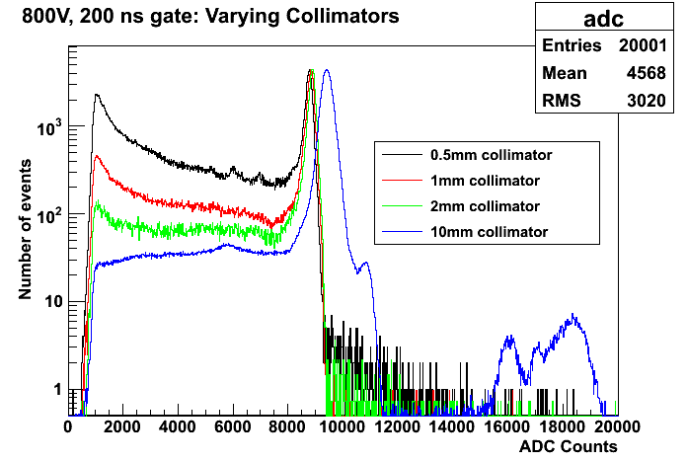
Pile Up: Varying Collimators
Protons scattering off the collimator increases with diameter decrease
To avoid pile up:
Optimal collimator: 2mm diameter
Keep integrating window small to only collect 1st proton pulse
More than 1 proton per bucket for larger diameter collimators, causing peak to widen

Slide 52
Considering Measuring Parameters
PMT HV (V) | Acquisition window (ns) | Collimator diameter (mm) | Energy resolution, % FWHM
800 | 50 | 2 | 1.6 ± 0.18
800 | 100 | 2 | 1.58 ± 0.27
800 | 200 | 2 | 2.11 ± 0.42
900 | 50 | 2 | 1.1 ± 0.13
900 | 100 | 2 | 0.97 ± 0.16
900 | 200 | 2 | 1.27 ± 0.19
800 | 200 | 3 | 2.32 ± 0.43
800 | 200 | 4 | 2.16 ± 0.41
Reducing the acquisition gate from 200ns to 100ns shows considerable improvement (ensures we only look at 1 proton).
But we don’t win anything with a 50ns gate.
At 900 V:
Improved energy resolution but are we linear at 900 V?
(See later)
Further confirmation that 2mm diameter collimator is optimal for reducing intensity
Our optimal parameters for measurements are:
PMT HV: 800 V
Acquisition window: 100 ns
Collimator diameter: 2 mm

Slide 53
Energy Dependence on Resolution
Energy of protons incident on scintillator varied by placing absorbers (PMMA plates) of known thickness ~1.8 m upstream of the optical module
dependence!
Notes:
Evidence (from such a good chi^2), that the errors are overestimated for the 200ns gate. This could be because of the pile up we see with the 200ns gate, which is not included in the model of the fit.

Slide 54
Intrinsic Energy Resolution of Optical Module
How much of the measured energy resolution is due to the proton beam and how much is due to the “intrinsic” energy resolution of the detector?
From MC (1.48%) we already know that most of the energy resolution measured with the proton beam (1.58 ± 0.27) is from the intrinsic resolution of detector:
  Use MC and data to put a limit on the energy spread of the 60 MeV Clatterbridge beam:
Also tests carried out at UCL:
  Pulse PMT with a 400nm LED at an amplitude and width that will give a peak at the same ADC counts as the proton beam spectra
  Fit the acquired spectra with a Gaussian and extract energy resolution
  Proton energy spread: 0.65 ± 0.66 % FWHM
  or limit on spread: FWHM (60 MeV): <1.56% at 90% CL
BUT: LED is operating at very “high” parameters (~8V and 40ns width), therefore the width is very sensitive to noise and the LED distribution would be better monitored with a device such as a pin diode
→ future measurement!
Notes:
To place limit on energy spread of beam:
We can trust our MC simulation (input from a measurement at 1 MeV), and from the MC we can see that with the measurement we are close to the intrinsic energy resolution of the detector. The simulation uses a pencil beam, therefore any difference between the two is due to the proton beam spread. However, the difference will be 0 (if we input 8.5% into the simulation as what we actually measure (rather than 7.5%) the energy resolution will slightly worsen), therefore use the error to look at the limit.
For a 90% CL, we want 1.64 * sigma, therefore 1.64 * 0.27 = 0.44 %
Therefore limit < .044% at 90% CL.

Slide 55
Intrinsic Energy Resolution of Optical Module
Similar at 60 MeV
Proton beam energy resolution much worse than intrinsic energy resolution at lower energies due to scattering of protons

Slide 56
Linearity: 800 V
We want to run the PMT at higher voltages (can run at up to 1500V) as this will increase the PMT’s collection efficiency and will improve the energy resolution: 0.97 ± 0.16 % FWHM from measurements (900V, 100 ns gate)
BUT we have a LOT of light (tens of thousands of photo-electrons): can we trust this result?
  Look at linearity
1.54 %
1.69 %
1.99 %
For 800V:
Deviation from linearity < 2%!

Slide 57
Measuring Quenching
Fitting linearity curves gives us a measurement of scintillator quenching:
Fitting procedure:
1: 1st degree polynomial (32-44 MeV)
2: 2nd degree polynomial (44-60 MeV)
3. Parameters extracted from 1 and 2 put into “combined” 1st degree and 2nd degree polynomial over entire range
Quenching = pol1 const + pol2 const
(Remember: 20.57 MeV from simulations)
2
1
Gate (ns) | Quenching (MeV)
50 | 19.69 ± 0.12
100 | 19.67 ± 0.12
200 | 19.69 ± 0.13
Notes:
Work in progress on errors (make sure root is calculating the chi^2 from the errors for the x axis, it may automatically take the y axis errors)

Slide 58
Linearity: 900 V
9.67 %
10.19 %
12.27 %
For 900V:
Deviation from linearity > 10%
Can non-linearity be accurately accounted for?
Notes:
Work in progress on errors (make sure root is calculating the chi^2 from the errors for the x axis, it may automatically take the y axis errors)

Slide 59
“Unfolding”: Getting a Grip on Non-Linearity
For our 900 V data we see non-linearity > 10 %
BUT can we take into account non-linearity of our equipment to “unfold” the true energy resolution?
We want to be able to do this:
  To potentially increase HV even further (to 1000 V or above) to increase collection efficiency and hence improve the energy resolution
  For proton imaging: requires protons > 300 MeV, which will give a huge amount of light and non-linearity will be inevitable
Work currently on-going to determine the best way to:
  Convert the data from ADC counts to MeV (“visible energy” due to quenching)
  Fit the visible energy data to extract the “unfolded” energy resolution (with non-linearity taken out)
  Compare results for 800 V and 900 V

