Slide 1
  For each acquisition:
    Identify baseline using a constant + gauss fit
    Perform baseline subtraction
    Fit with [0]*Landau(x, [1], [2])
    Filter by Chi-Squared per NDF
    Perform integration
    Add result to histogram

Slide 2
Identifying Baseline and Landau Fit

Slide 3
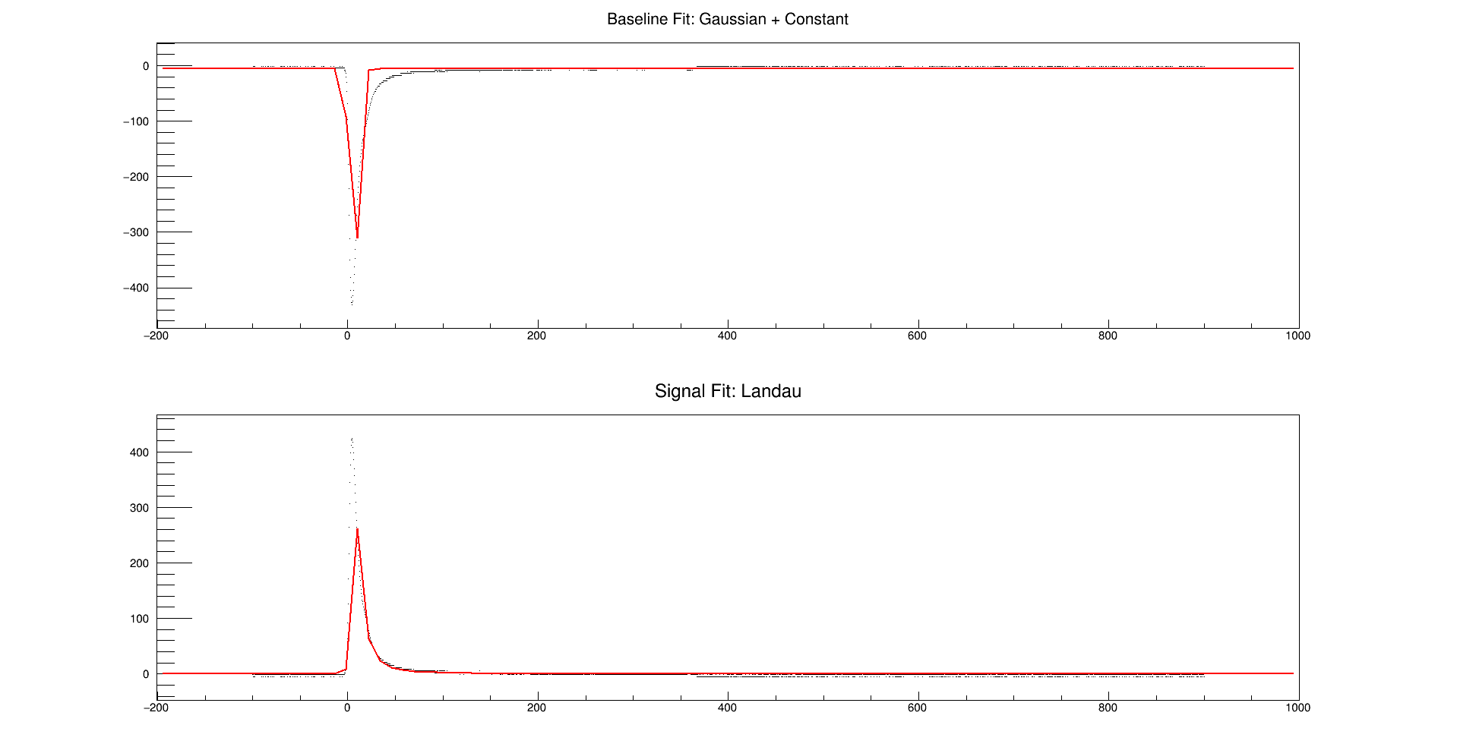
Reasonable: Acq #308 from 17:12 on 2/8/16 (100 kHz 1.98mm collimator)

Slide 4
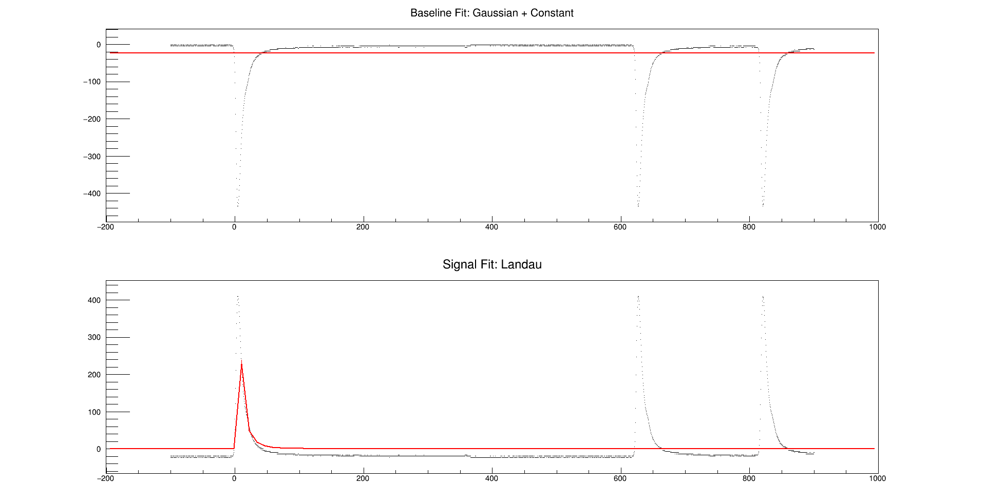
Useless: Acq #456 from 17:12 on 2/8/16

Slide 5
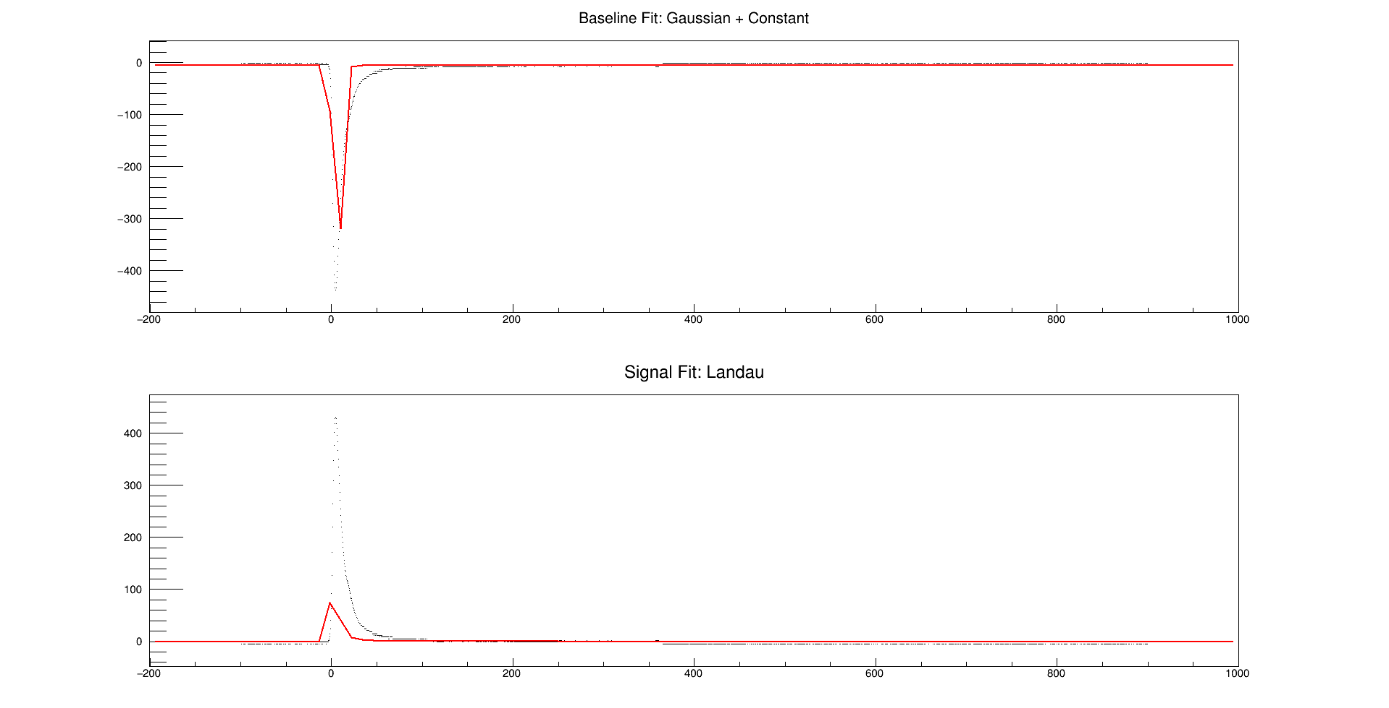
Mysteriously Bad: Acq #38 from 17:12 on 2/8/16

Slide 6
Chi-Squared Filter

Slide 7
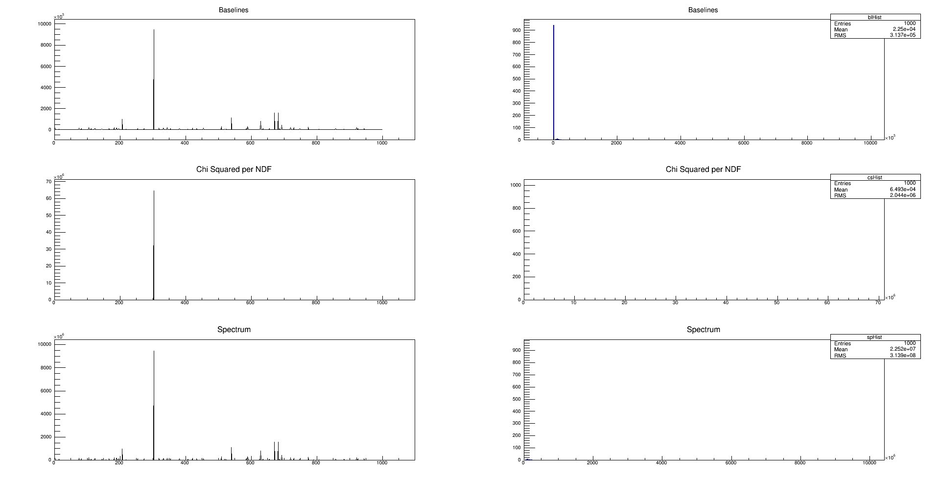
Using Acquisitions from 16:33 on 2/8/16: NO FILTER

Slide 8
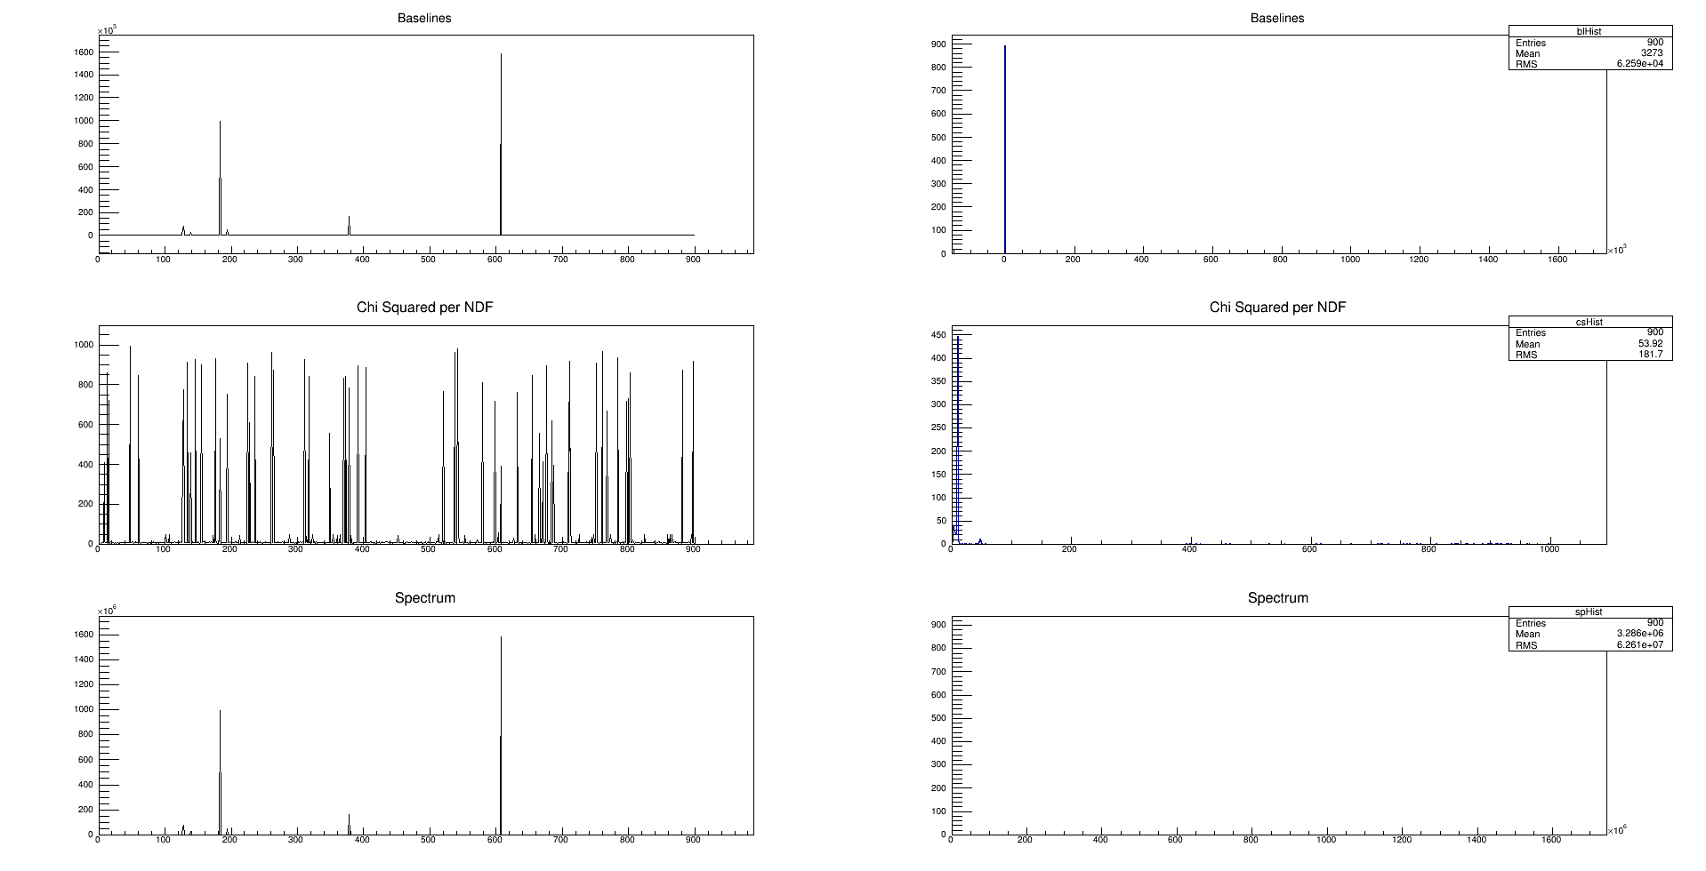
Using Acquisitions from 16:33 on 2/8/16: CHI2/NDF <= 1000

Slide 9
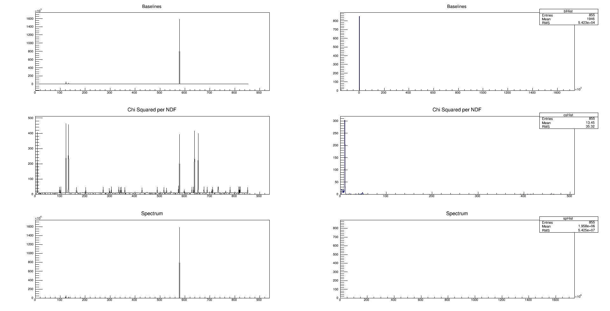
Using Acquisitions from 16:33 on 2/8/16: CHI2/NDF <= 500

Slide 10
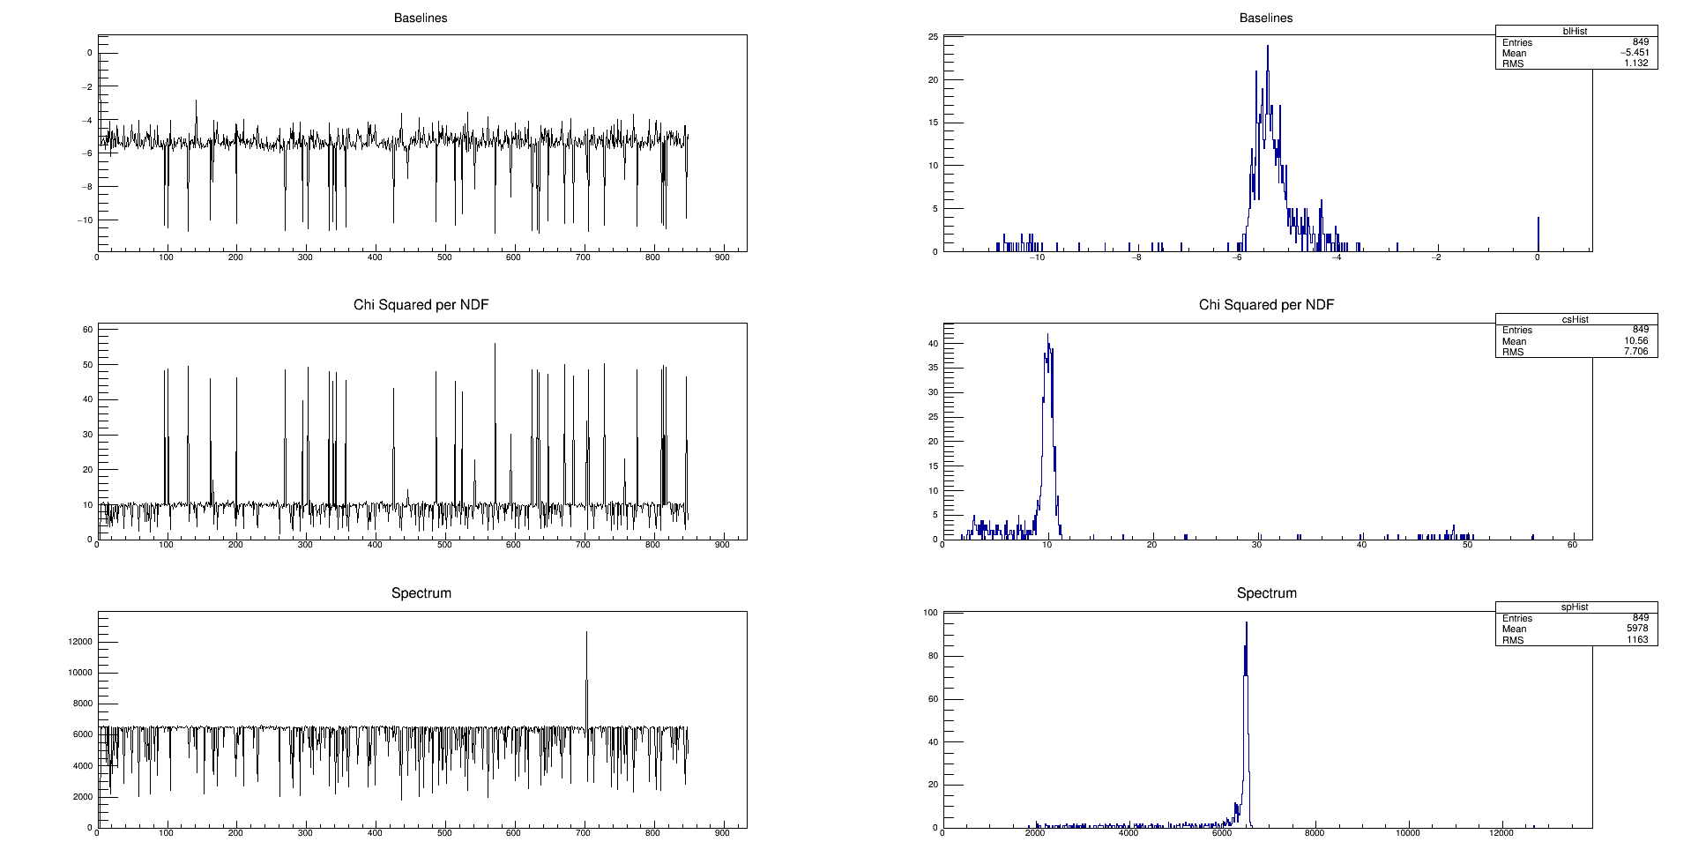
Using Acquisitions from 16:33 on 2/8/16: CHI2/NDF <= 250

Slide 11
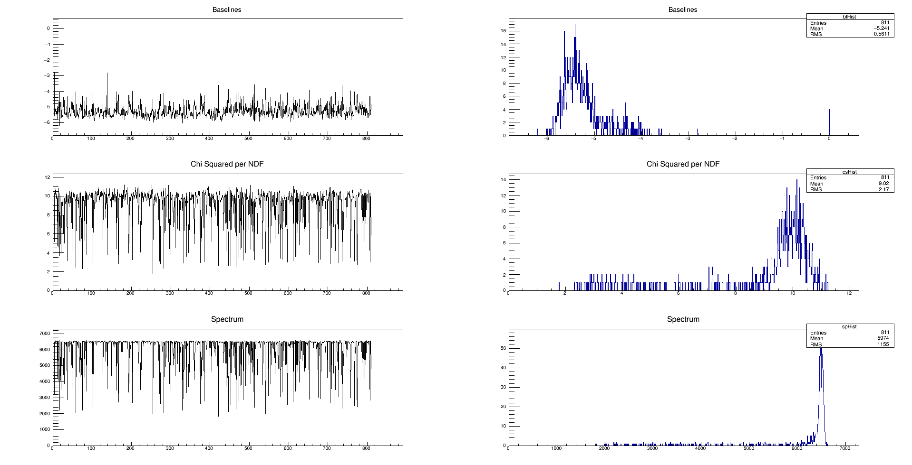
Using Acquisitions from 16:33 on 2/8/16: CHI2/NDF <= 13

Slide 12
Waveform Integration
As shown here, performed using the integration method from ROOT’s TH1 class on the function providing the signal fit.
Even for the better fits, the TF1 function poorly approximates the waveform, so integrate directly.

