Slide 1
A Calorimeter for Proton Therapy
Laurent Kelleter
University College London
MTR Meeting Munich
November 2017

Slide 2
Introduction
Background:
  M. Sc. Particle Physics (RWTH Aachen)
  Master project at intersection of HEP an Proton Beam Therapy (PBT)
Work within OMA:
  Training:
    Schools on Medical Accelerators, High-Energy Physics (HEP) and Soft Skills
    Conferences on Acc. Physics, PBT and MC simulations
    Participated in two beam tests in PBT Centres
  Side project: Dose build-up in PBT
    In collaboration with Medical Physics & Bioengineering
    Purely simulation
  Main focus: A calorimeter for PBT

Slide 3
Quality Assurance (QA) in PBT
Daily QA: Verify beam range at isocentre
Commercial solutions (e.g. IBA Zebra) are expensive
Manual scanning is slow (~1hr)
Detector requirements:
  Precise: Energy resolution < 1% σ
  Fast: one billion protons s⁻¹
Technology transfer from HEP?

Slide 4
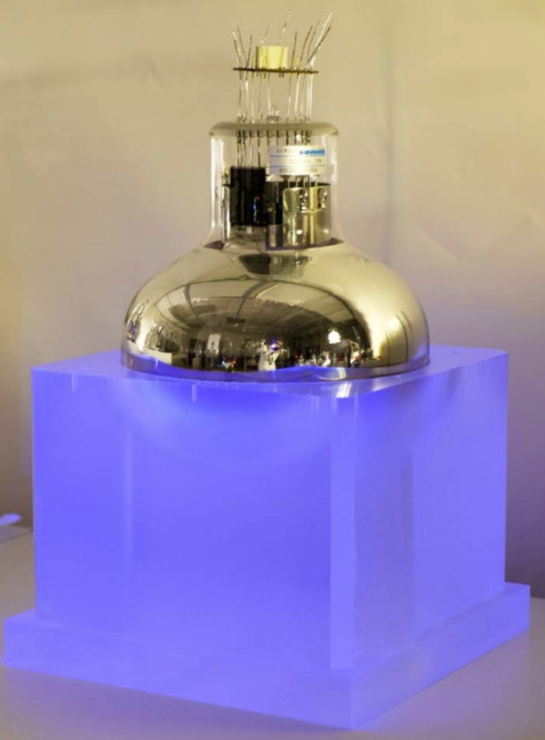
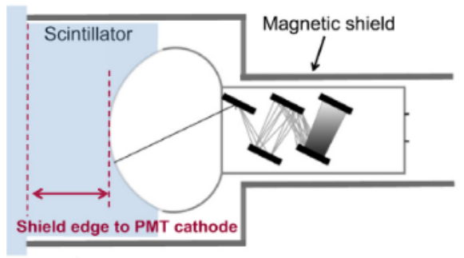
SuperNEMO Calorimeter
SuperNEMO aims to measure a hypothetical neutrino- less double-beta decay
Calorimeter developed at UCL
Plastic scintillator & photomultiplier tube
  Energy resolution of 7% FWHM (for 1 MeV electrons)
  Pulse length ~100 ns (maximum rate 10 million protons s⁻¹)
  Water equivalent scintillator
https://arxiv.org/pdf/1707.06823.pdf

Slide 5
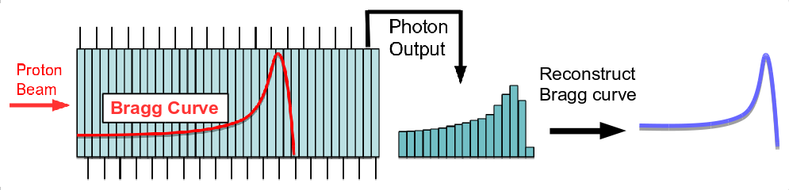
Range Telescope
Cut scintillator in segments (sheets)
Read out each sheet individually
Integrate signal from many protons
Reconstruct Bragg curve from photon output
Measure range instead of energy

Slide 6
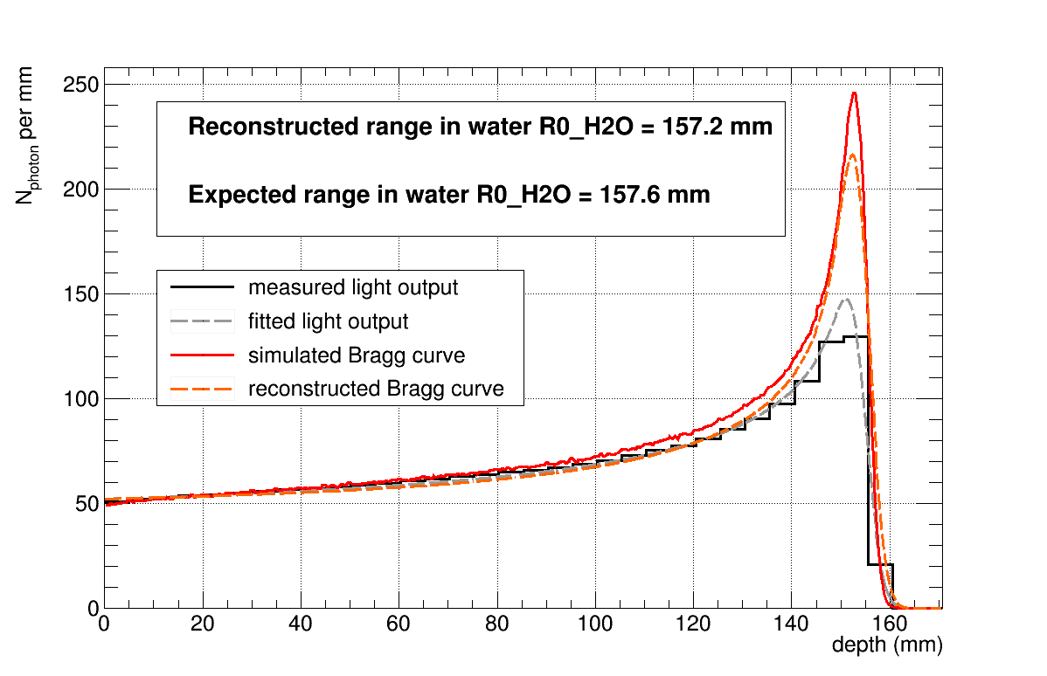
Proton Range Reconstruction
Quenching: scintillation light production not linear to energy deposition
Developed model of a “quenched Bragg curve”
Three parameters: range, range straggling and intensity
Figure: Geant4 simulation of a range telescope

Slide 7
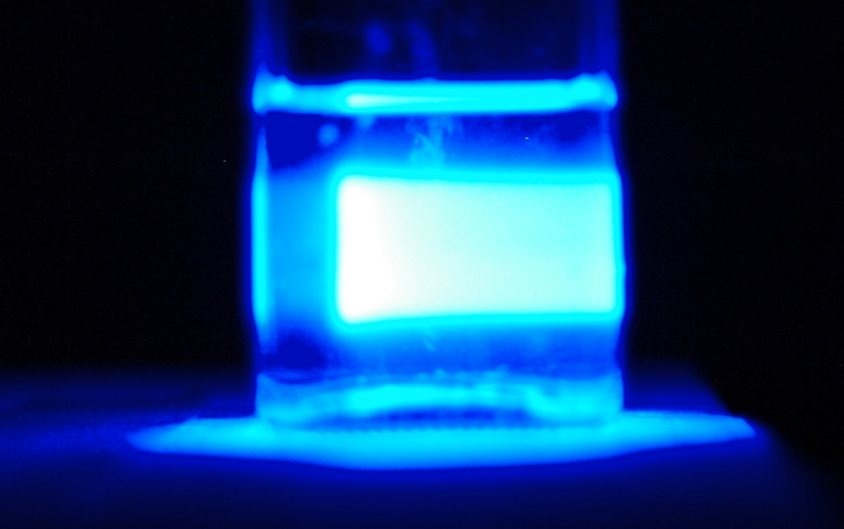
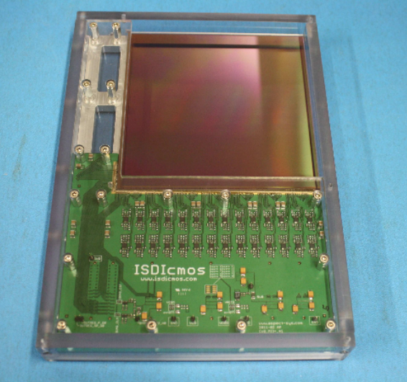
Building a Range Telescope
Large number of channels requires expensive read-out system
Solution: “Monolithic Active Pixel Sensor” (MAPS)
Take “picture” of scintillation photon depth curve
MAPS
Scintillator block
Beam
http://eprints.lincoln.ac.uk/13879/

Slide 8
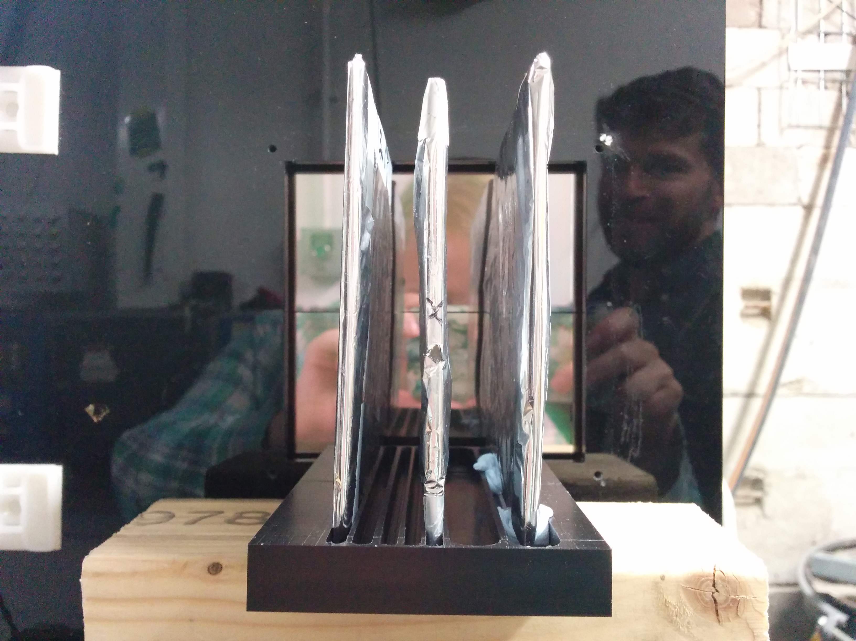
Birmingham Beam Test
28 MeV proton beam: 7.8 mm range in water
Measurement with two scintillator sheets (3 and 4 mm thick)
Two PRaVDA Priapus MAPS (10x5 cm²)
Image taken by MAPS
(10⁸ protons s⁻¹, 1 s integration time)
MAPS
Beam
Beam
Scintillator sheets

Slide 9
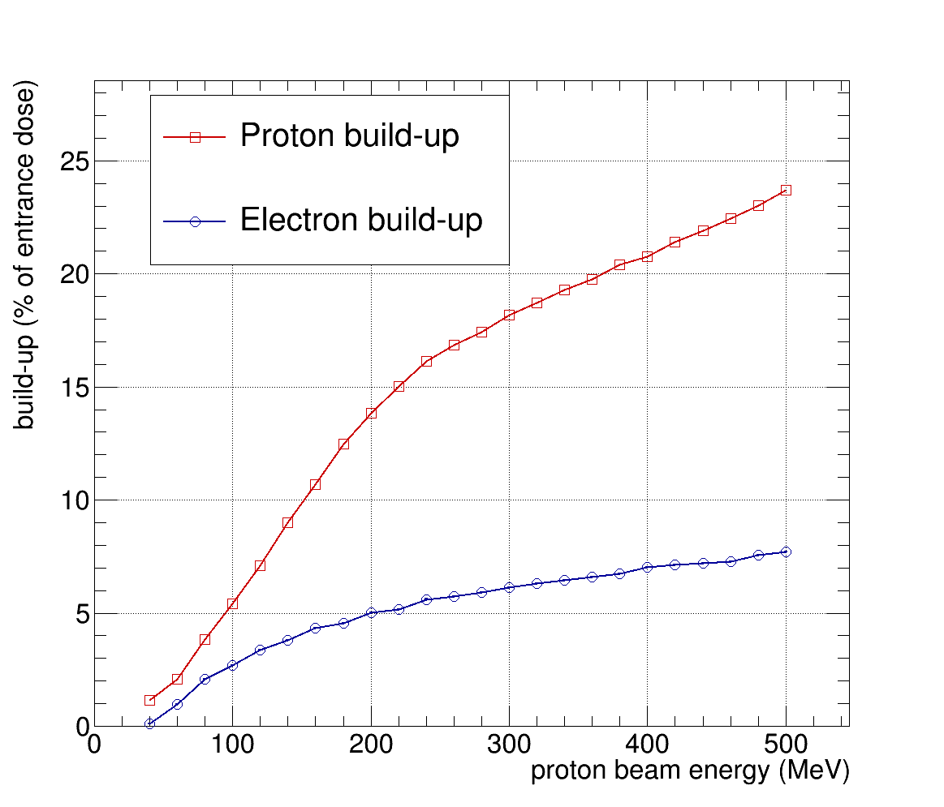
Dose Build-up in PBT
Goal: Quantize dose build-up (BU) in PBT using Geant4
Distinguish between electron and proton build-up
Express BU as dose difference normalized to entrance dose
Electron build-up
Proton build-up
Figure 1: 200 MeV proton beam in a block of water
Figure 2: Dose build-up vs. beam energy

Slide 10
Conclusion
Summary
  Beam tests with single-module detector show limitations
  Range telescope optimized in Geant4
  Developed model for range reconstruction
  Found solution for cheap readout of large number of channels (MAPS)
  First beam test shows promising results
Outlook
  Improve software of read-out with MAPS
  Build larger prototype
  Make radiation hardness tests with scintillator
Impact
  Extensive training at intersection of HEP and PBT
  Prospect of building a commercial device for PBT

Slide 11
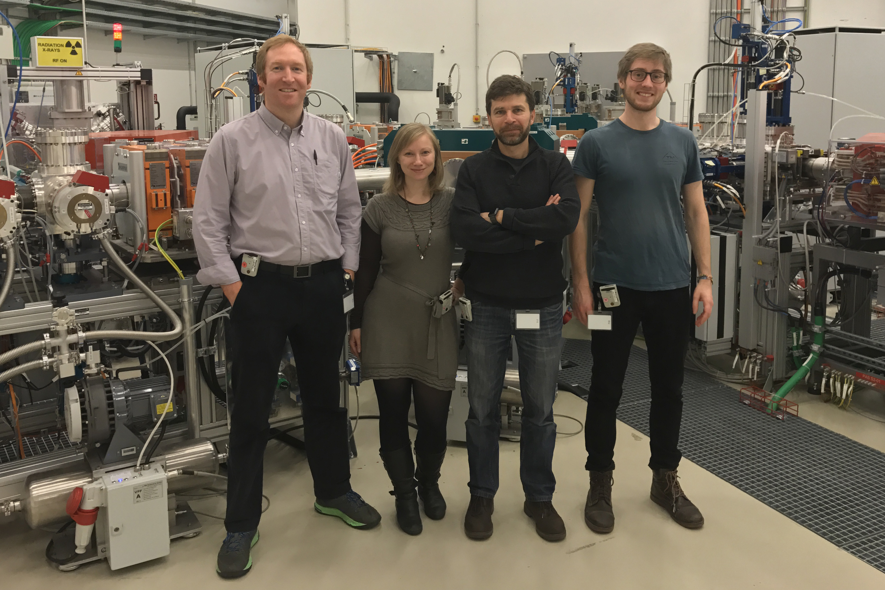
Thank you for your attention
This project has received funding from the European Union’s Horizon 2020 research and innovation programme under the Marie Sklodowska-Curie grant agreement No 675265, OMA – Optimization of Medical Accelerators.

