Slide 1
ENLIGHT 2018:
University College London
Simon Jolly
Richard Amos
Gary Royle

Slide 2
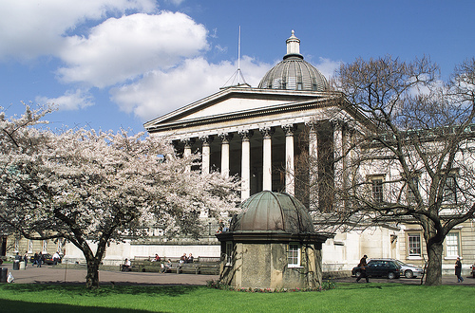
University College London
7th highest ranked university in the world for research.
Most highly cited university in Europe for medical research.
45,000 research staff and students.
Annual research income £530M.
Over 300 PIs in cancer research.

Slide 3
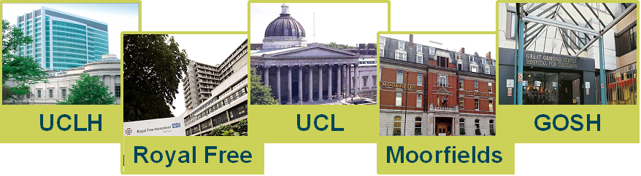

UCL Partners
Largest academic health sciences partnership in Europe.
Largest neurosurgical centre in Europe.
Largest sarcoma service in Europe.
3rd largest paediatric cancer clinic in the world.

Slide 4
Core Cancer Research Themes
Biotherapeutics
Mechanistic understanding of response and resistance in models and humans
Evolutionary dynamics of immune-tumour interactions
Micro-environment, biotherapies, treatment response, adaptive therapies
Large scale, efficient production of personalised therapies
Conformal radiotherapy, proton therapy, associated technology
Proof of concept of precision combinations
Cancer Evolution
Imaging and monitoring
Personalised drug manufacture
Targeted therapies
Combination trials

Slide 5
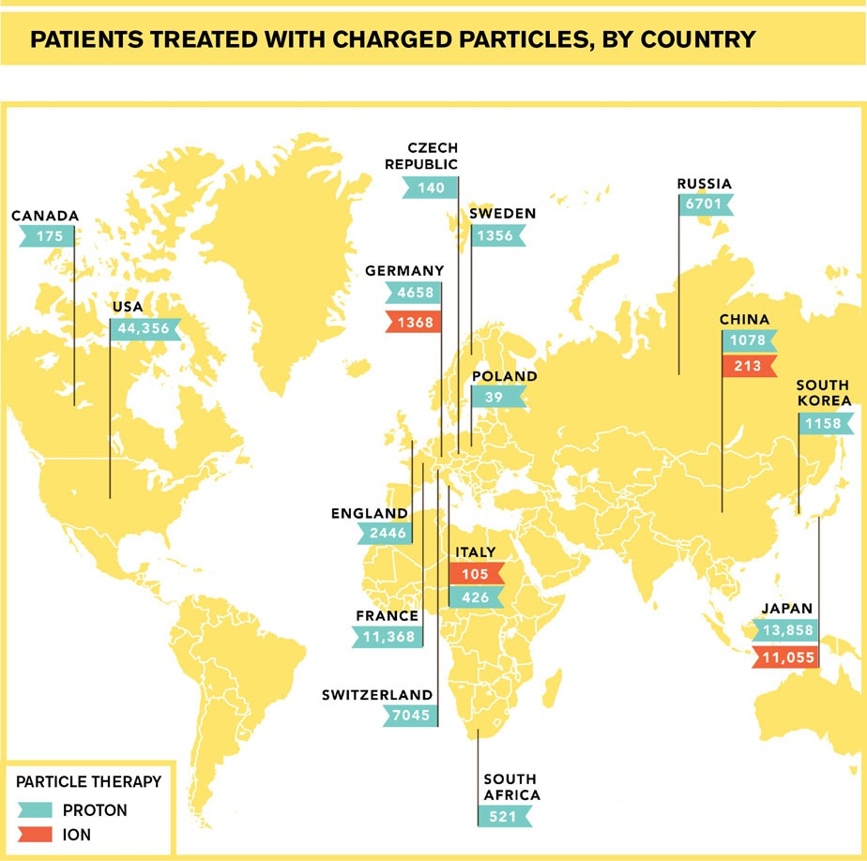
Proton Therapy Around The World
To date, all PBT patients treated in the UK are for eyes (choroidal melanoma).
Clatterbridge 1989: world’s first hospital based cyclotron
Over 3000 patients
Excellent Results:
  95% local control
  90% preservation of eye
  80% preservation sight
Complex service.
Durability of expensive equipment

Slide 6
Clatterbridge Cancer Centre

Slide 7


UK Overseas PBT Programme
Since 2008 NHS England has approved:
  345 Adults
  791 Children
Quality Inspections – 3 Overseas Centres
Commissioning via Evidence Based Policies
All cases reviewed by National Expert Panel
  Outcomes tracking programme
Adult:
  Base of Skull & Spinal Chordoma
  Base of Skull Chondrosarcoma
  Spinal & Paraspinal Bone and Soft Tissue Sarcomas (Non Ewing’s)
Paediatric:
  Base of Skull & Spinal Chordoma
  Base of Skull Chondrosarcoma
  Spinal & Paraspinal ‘adult type’ Bone and Soft Tissue Sarcomas
  Rhabdomyosarcoma
  Orbit
  Parameningeal & Head & Neck
  Pelvis
  Ependymoma
  Ewing’s Sarcoma
  Retinoblastoma
  Pelvic Sarcoma
  Optic Pathway and other selected Low Grade Glioma
  Craniopharyngioma
  Pineal Parenchymal Tumours (not Pineoblastoma)
  Esthesioneuroblastoma

Slide 8
NHS PBT: Recent History
2007 Cancer Reform Strategy
  Recommended Treatment Overseas and Explore Business Case UK based centre(s).
2008 Overseas Programme
  Within NHS Highly Specialised Commissioning.
2010 the ‘Trust Beauty Contest’:
  The Christie Hospital, Manchester.
  UCLH, London.
2011 Strategic Outline Case England.
Ministerial Approval.
2015 Full Business Case Approved.

Slide 9
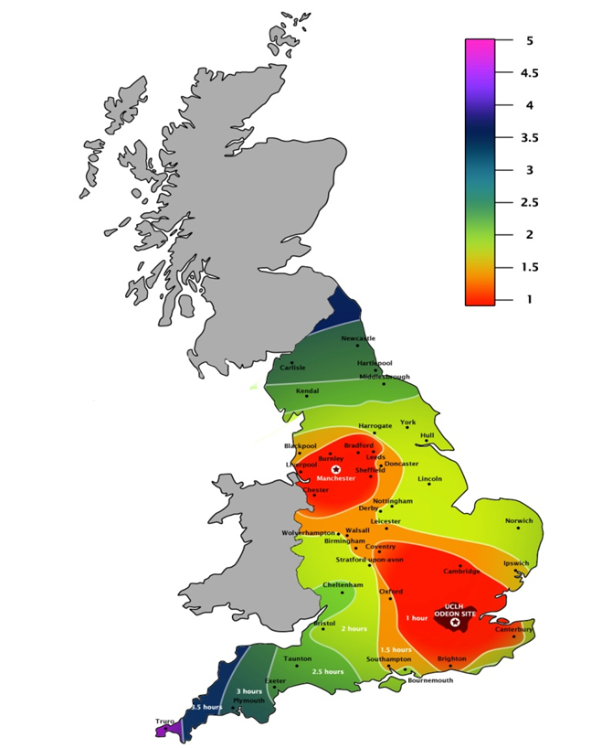


NHS England PBT Service
New national service on two sites:
  Manchester – 3 treatment rooms
  London – 3 treatment rooms
Pencil beam scanning only: 70–245 MeV.
Full 360º rotating gantries.
Joint Equipment Procurement
Christie Started building July 2015:
  Cyclotron delivery 22/06/2017
  On Track for first patient 101/08/2018
UCLH Started building December 2015:
  First patient planned for September 2020
First patients:
  Manchester: 2018
  London: 2020

Slide 10
NHS England Patient Mix
Cancers approved for proton therapy in England
(Total = 1,666)
Paediatric:
  Chordoma
  Chondrosarcoma
  Rhabdomyosarcoma
    Parameningeal
    Pelvic
    Orbit
    H&N
  Osteosarcoma
  Ewing’s
  PPNET
  Ependymoma
  Low Grade Glioma
  Optic pathway Glioma
  Craniopharyngioma
  Medulloblastoma
  Hodgkins
  Retinoblastoma
Adult:
  Choroidal Melanoma
  Ocular / Orbital
  Chordoma
  Chondrosarcoma
  Para-spinal Sarcoma
  Paranasal Sinuses
  Meningioma
  Acoustic Neuroma
  Craniospinal RT – pineal
  Teenage & Young Adult
  Atypical Cases Common Indications
Ocular (9%)
Head and Neck (20%)
Brain (16%)
Complex cases (20%)
Paediatric (17%)
Sarcoma (18%)

Slide 11
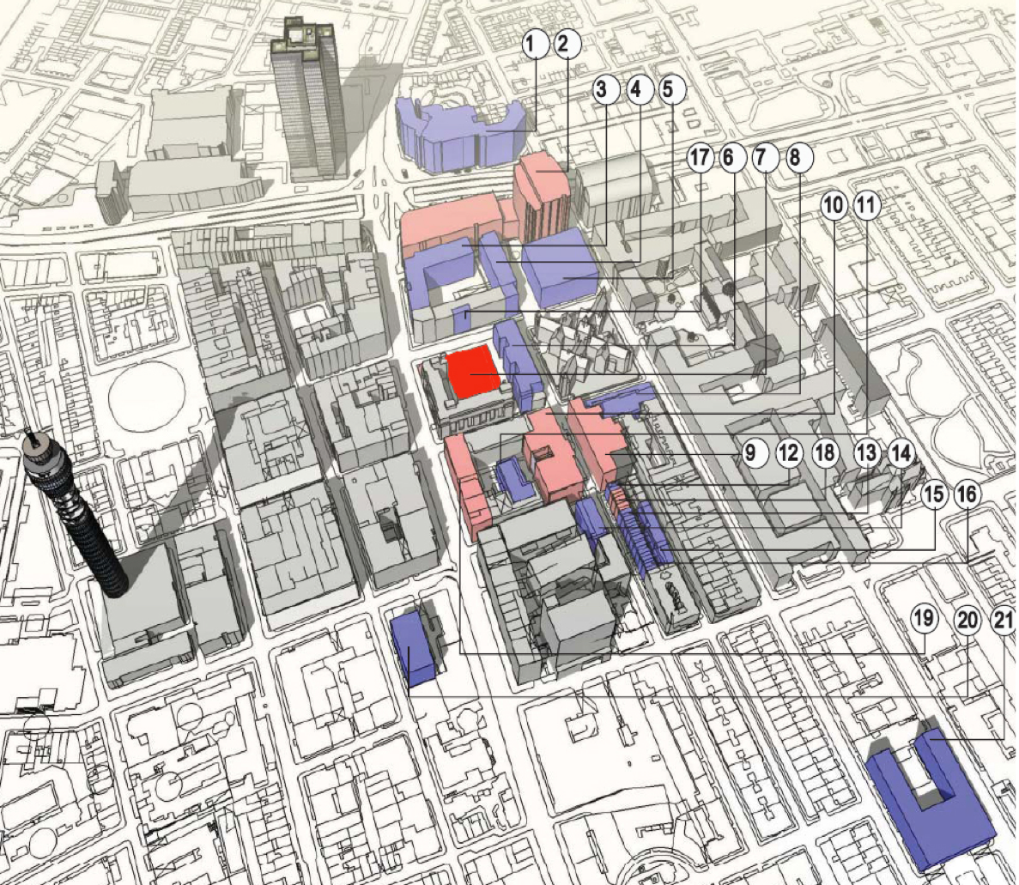
UCL Cancer Campus
UCLH CAMPUS
UCL CAMPUS
Clinical cancer
Proton centre

Slide 12
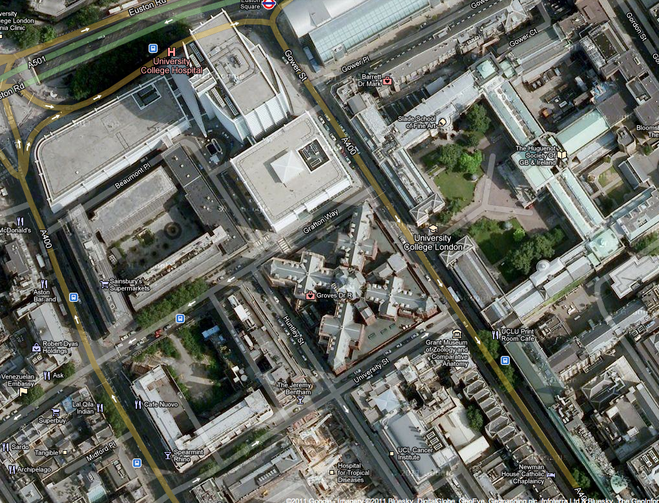
UCLH Proton Beam Therapy Site
New facility will be on existing UCLH site, next to Tottenham Court Road.
Linked to UCLH via walkways to allow easy patient transfer.
Due to open 2020 (2 years after The Christie).
Varian cyclotron and 4 360º gantries.
UCLH
Cruciform Building
UCL
Spearmint Rhino
New proton therapy site
Jeremy Bentham
Rosenheim Building

Slide 13
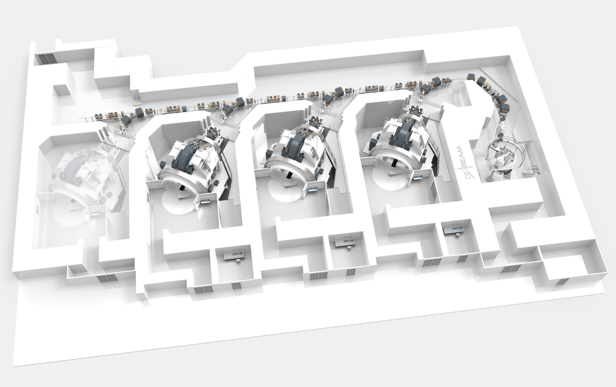
UCLH Proton Therapy Facility
Beamline Corridor
Cyclotron
Gantry
Treatment Rooms
Images courtesy of Varian/UCLH

Slide 14
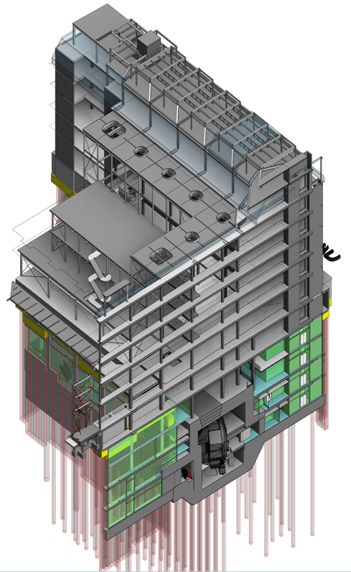
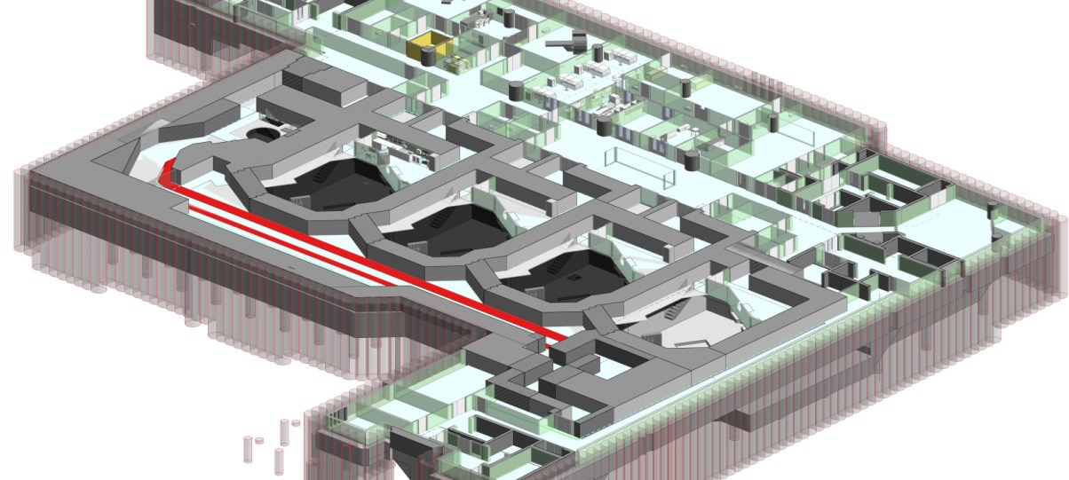
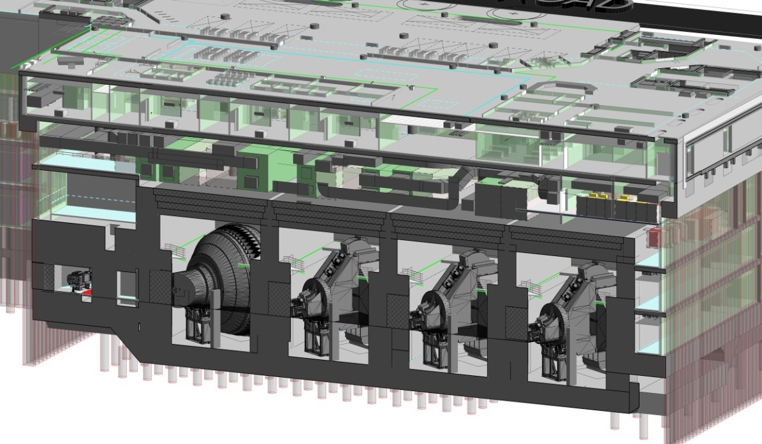
UCLH PBT Construction
P. Zakrzewska et al., Proceedings of PTCOG 54. Int J Particle Ther. 2015;2(1):331-332

Slide 15
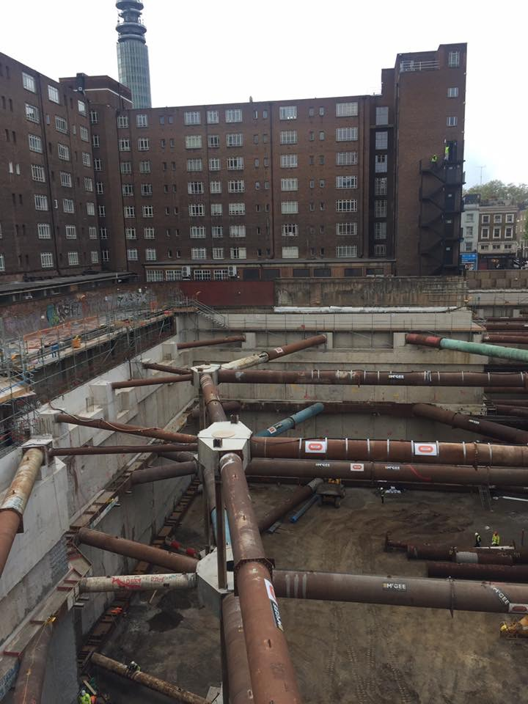
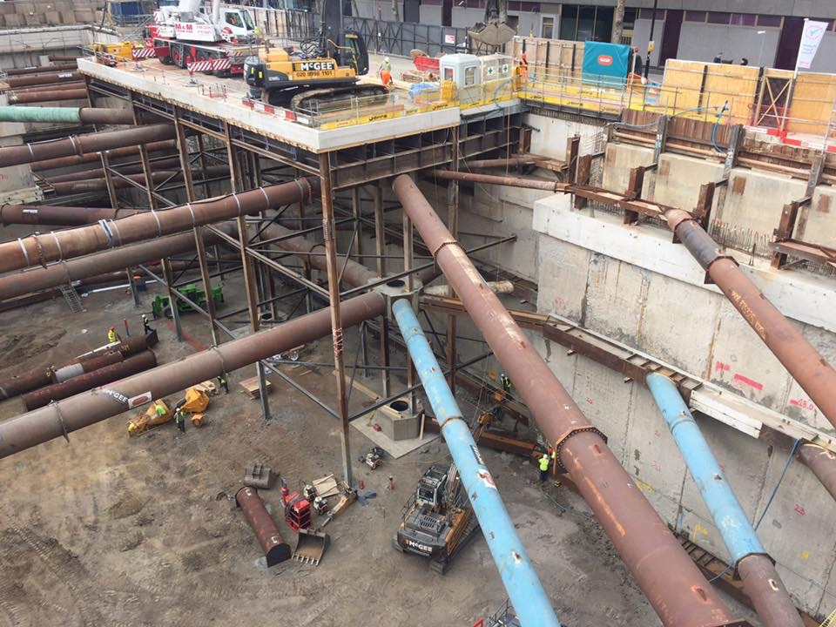
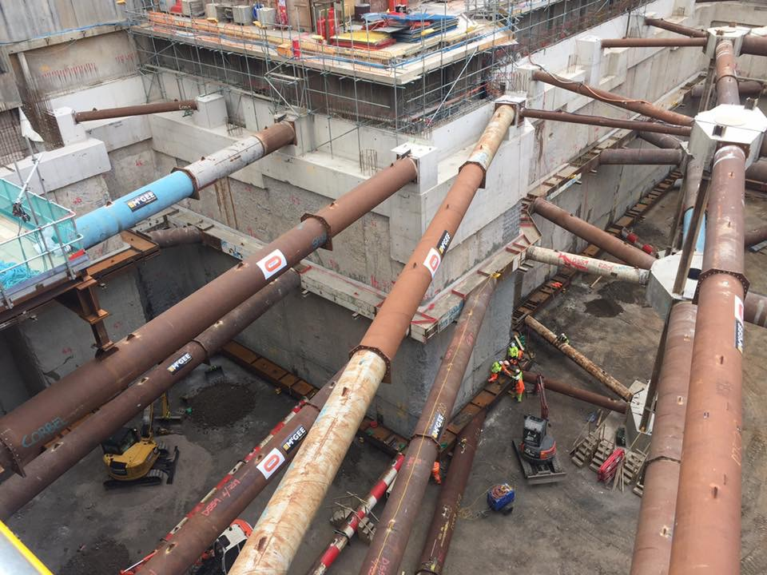
UCLH PBT: The Big Dig…

Slide 16
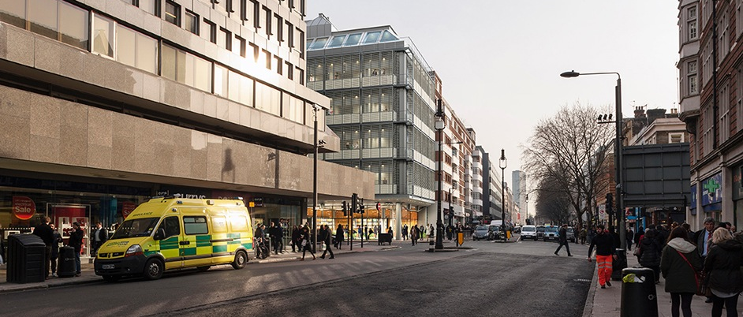
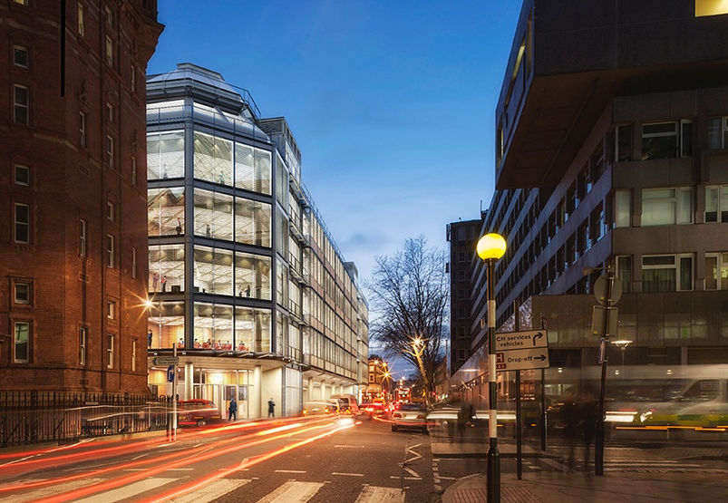
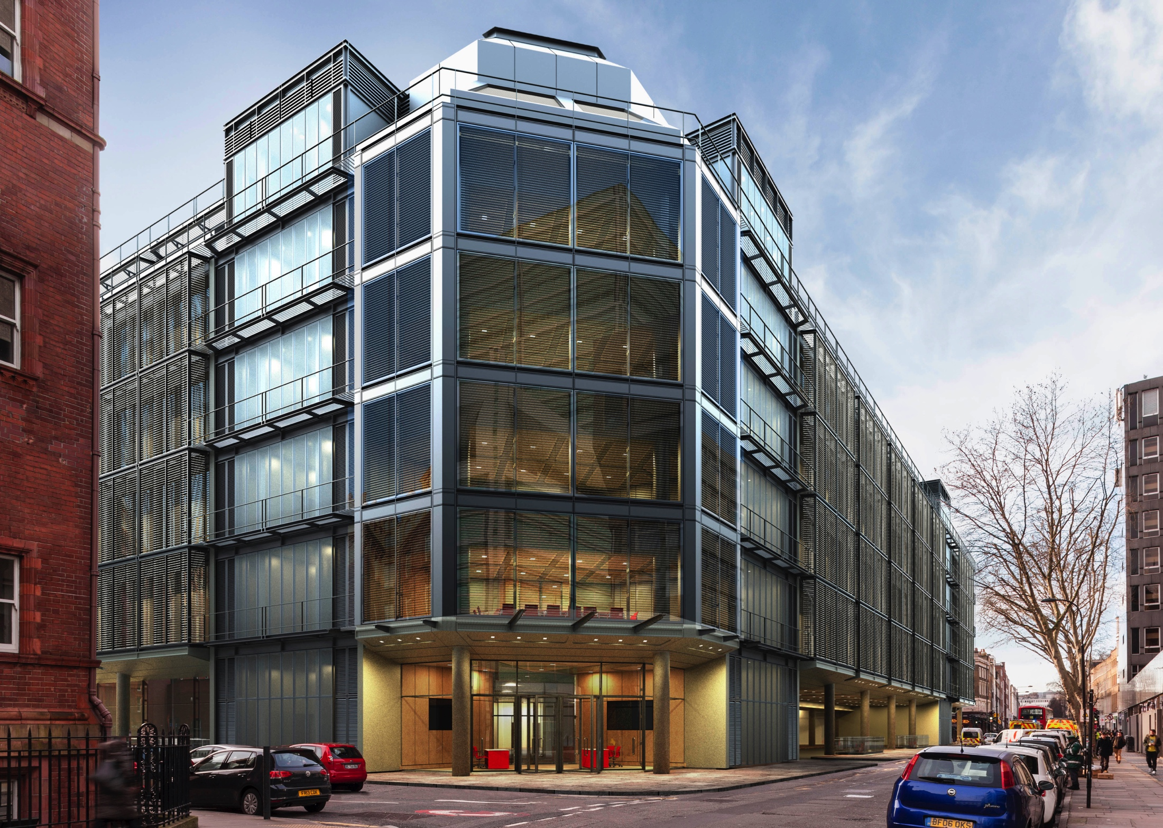
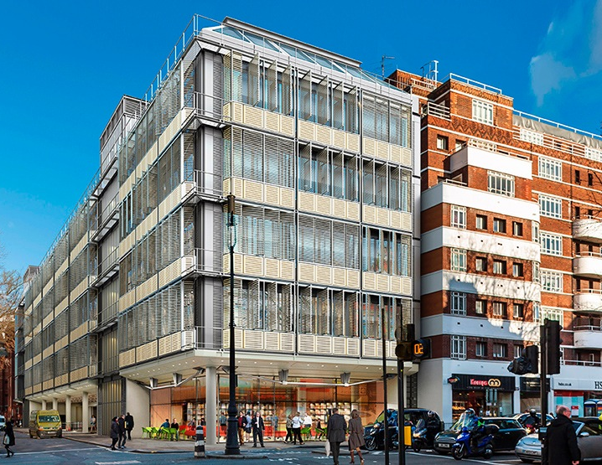
Onwards to 2020…

Slide 17
Spare Slides

Slide 18
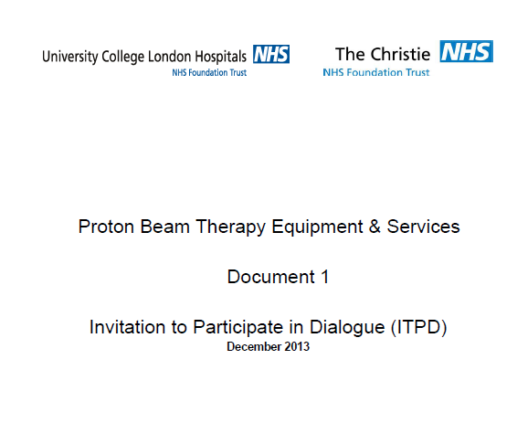
Overview of NHS Procurement
Competitive Process
OJEU tender under European procurement laws
Pre-qualifying questionnaire (PQQ)
Invitation to participate in competitive dialogue process
Three vendors:
  Invitation to Submit Outline Solution (ISOS)
Two vendors:
  Invitation to Submit Final Solution (ISFS)
Preferred bidder status
Full business case approval
Overall evaluation:
  Technical 70%
  Financial 30%
    Capital 15%
    Maintenance contracts 15%

Slide 19
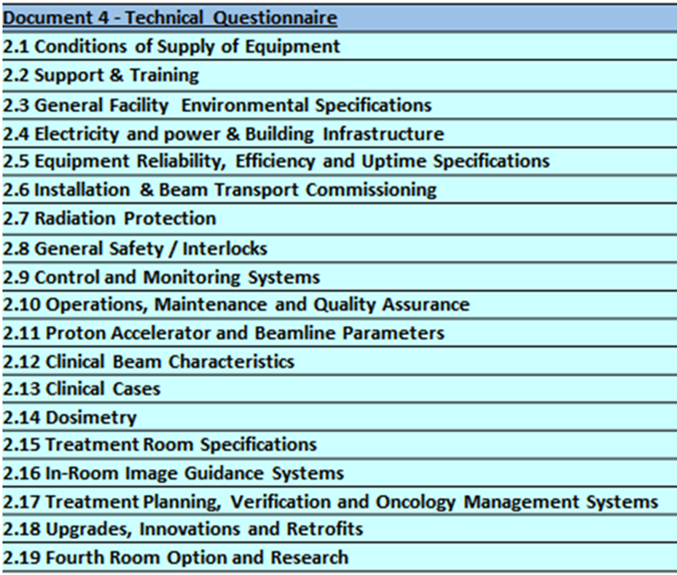
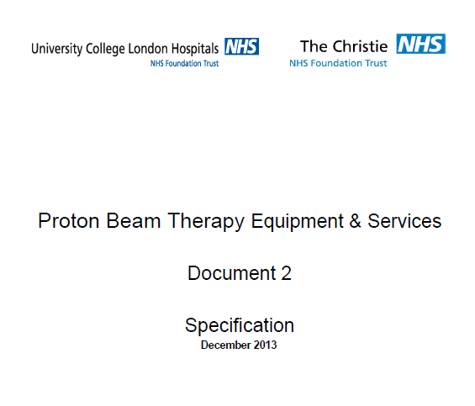
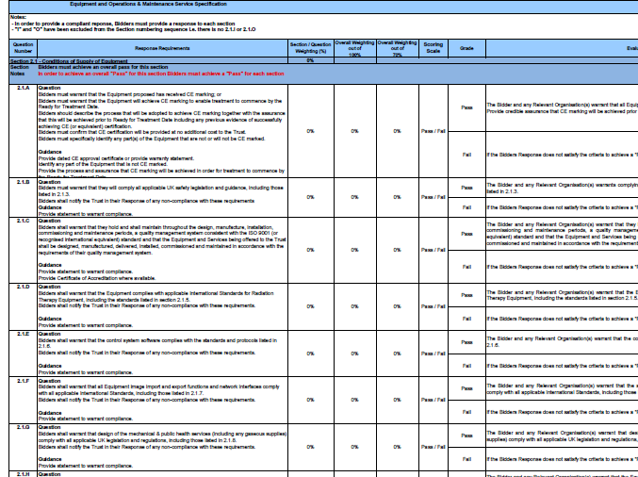
NHS Procurement Scoring
130 Questions:
31 Pass/Fail
35 For information only (needed for compliant bid)
64 Scored
  4 - Excellent confidence
  3 - Very good confidence
  2 - Good confidence
  1 - Minor concerns
  0 - Major concerns

Slide 20
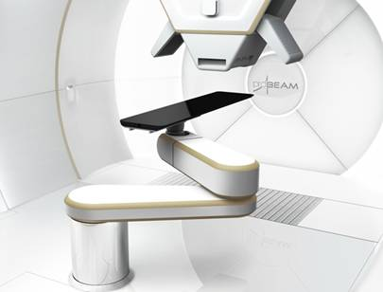
UCLH Operational Expectations
Facility opening times:
24 Hours/day
Clinical time:
  5 days per week
  14 Hours per day
Outside treatment hours:
  Quality Assurance Checks
  Maintenance Requirements
  Research

Slide 21
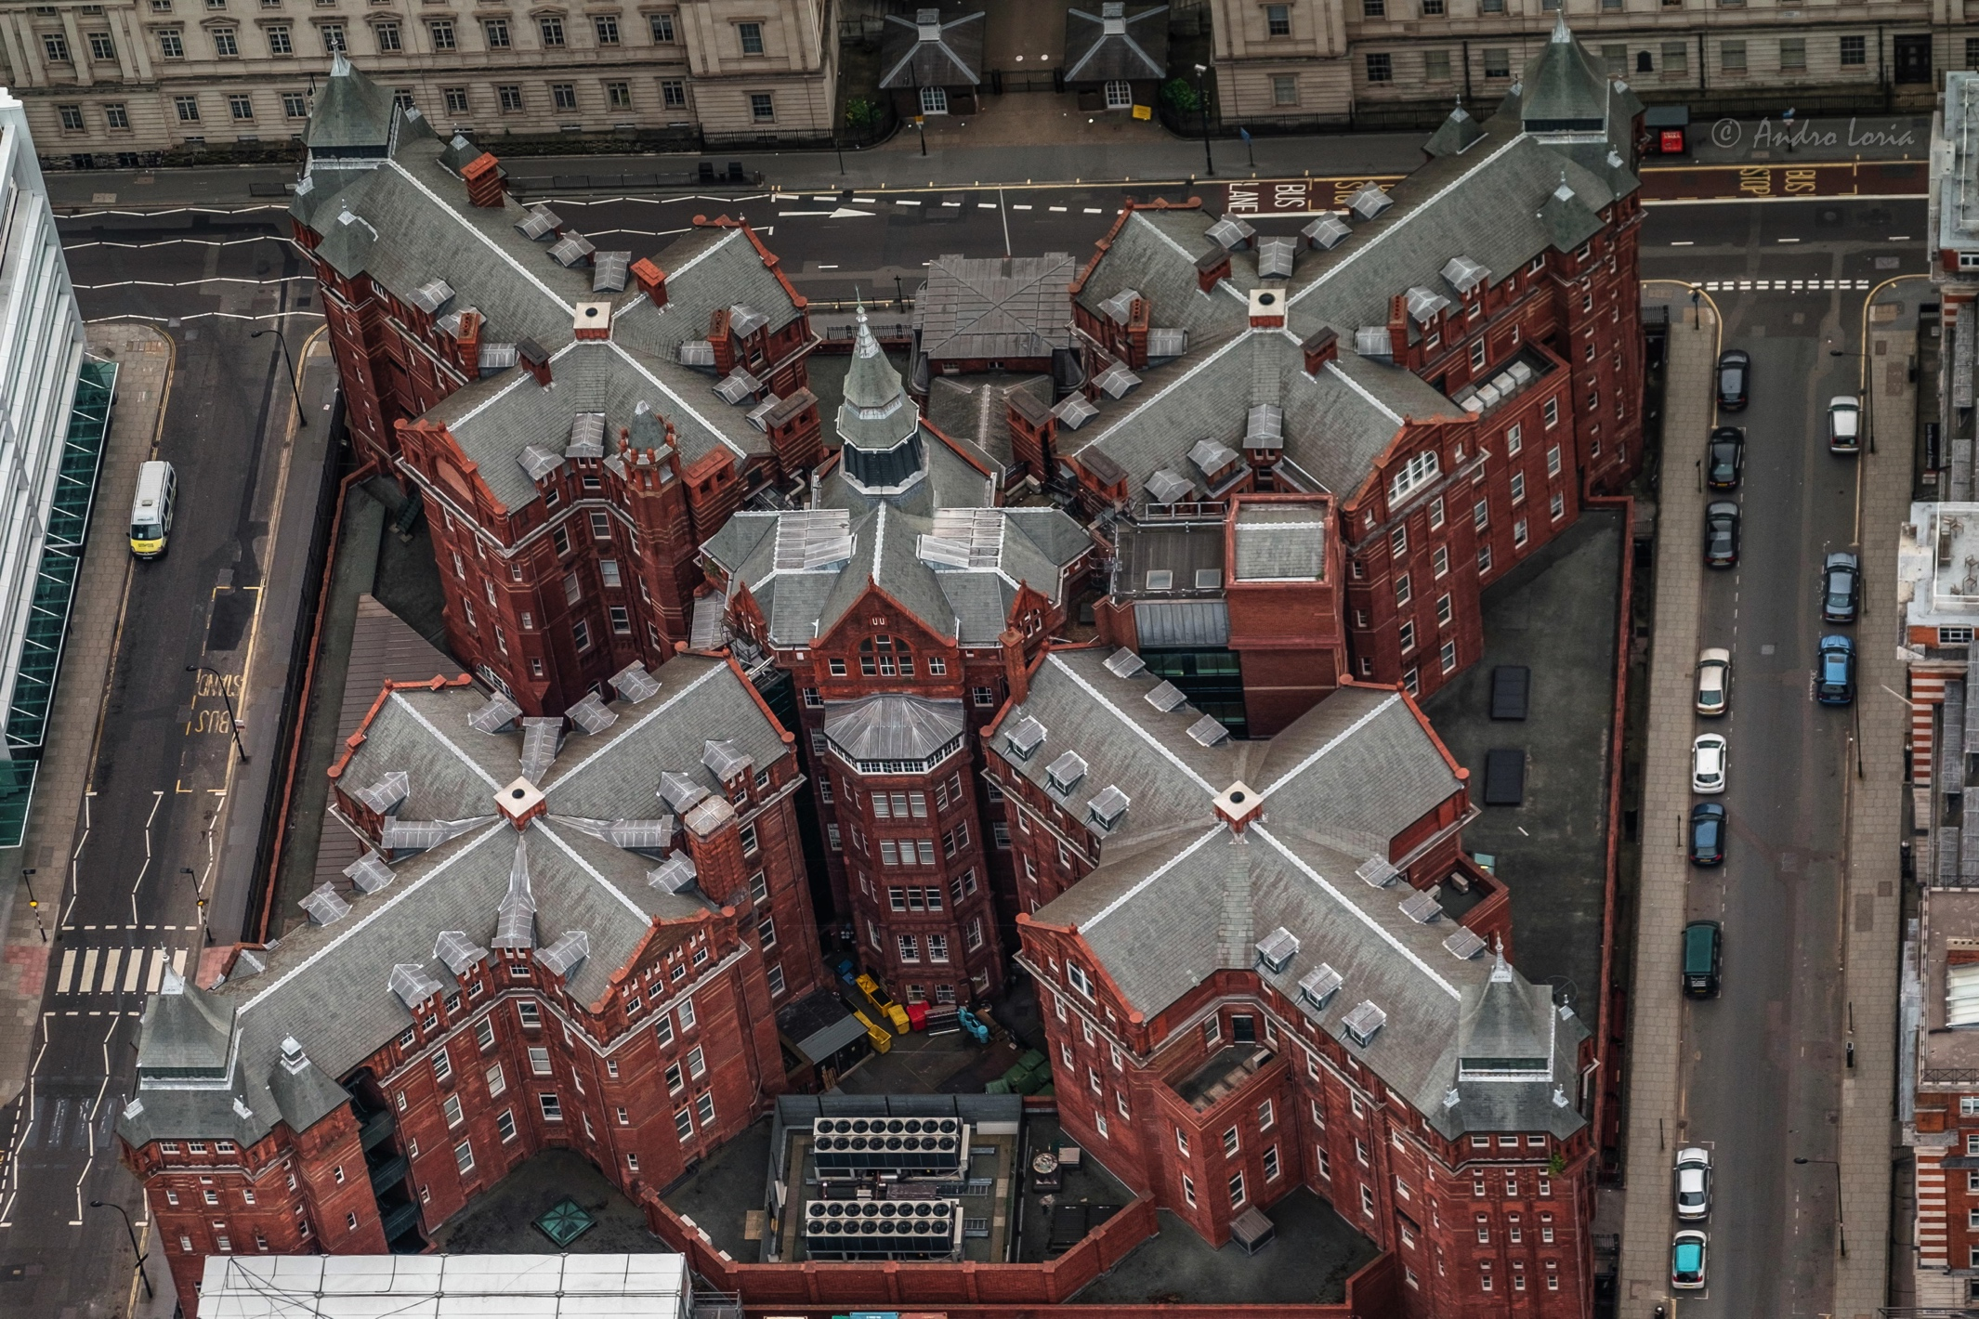
University College London

