Slide 1
Proton Calorimetry for Proton Therapy
Simon Jolly, Ruben Saakyan, Anastasia Freshville, Laurent Kelleter
University College London

Slide 2
HEP at UCL
The High Energy Physics Group at University College London is one of the largest in the UK:
  19 academic staff.
  27 research and technical staff.
  32 PhD students.
Research covers a wide range of experiment and theory.
ATLAS experiment at the LHC.
Neutrinos:
  SuperNEMO.
  MINOS.
  NOvA.
  CHIPS.
  Ultra-High Energy Neutrino experiments.
Dark Matter:
  LUX.
  LZ.
Accelerators:
  Proton therapy.
  Linear collider.
  XFEL.
Muon experiments:
  Muon g-2.
  Mu2e.
Generic detector R&D.

Slide 3

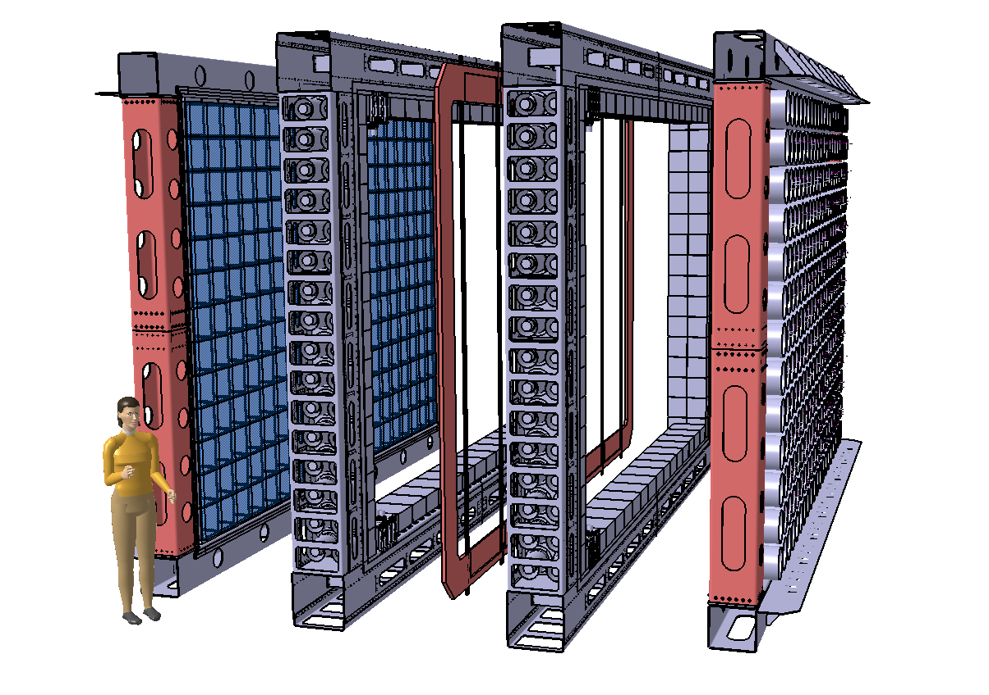
SuperNEMO
Neutrinoless double beta decay detector using NEMO3’s tracker-calorimeter technique
Target sensitivity: T_{½} > 10²⁶ years → <m_{ν}> <0.04 – 0.1 eV
Modular detector with a planar geometry
1 module (of 20) consists of:
Source foil:
  5 kg (total of 100 kg) of 40 mg/cm² (4 x 2.7 m²)
  ⁸²Se (high Q_{ββ}, long T_{1/2}^{2vββ}, proven enrichment technology): starting baseline
  ¹⁵⁰Nd and ⁴⁸Ca being considered depending on enrichment possibilities
Tracker: ~2000 drift cells in Geiger mode
→ particle identification (for background suppression)
Calorimeter: ~550 scintillator blocks + PMTs
→ energy and time of flight measurements of particles
Passive shielding surrounding each module
4 m
6 m
2 m (assembled, ~0.5 m between source and calorimeter)

Slide 4
SuperNEMO Calorimeter Development
SuperNEMO calorimeter consists of 550 Optical Modules (wrapped scintillator block + PMT).
Needed to achieve improved resolution:
Scintillator needed to be organic plastic:
  High light yield.
  Low electron back-scattering.
  High radiopurity.
  Fast timing.
Extensive R&D programme resulted in final design:
  ElJen EJ-200 polyvinyltoluene (PVT) scintillator.
  Hamamatsu 8” PMT (32% QE at 400 nm).
  Hexagonal scintillator block directly coupled to hemispherical PMT face.
  Teflon + Mylar wrapping.

Slide 5
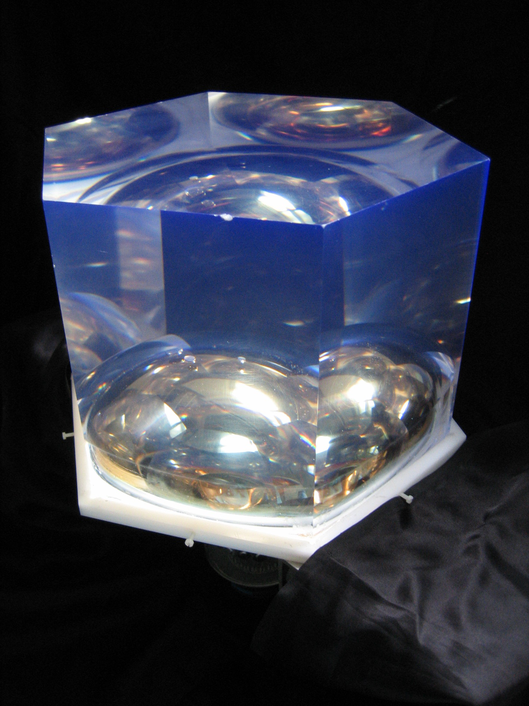
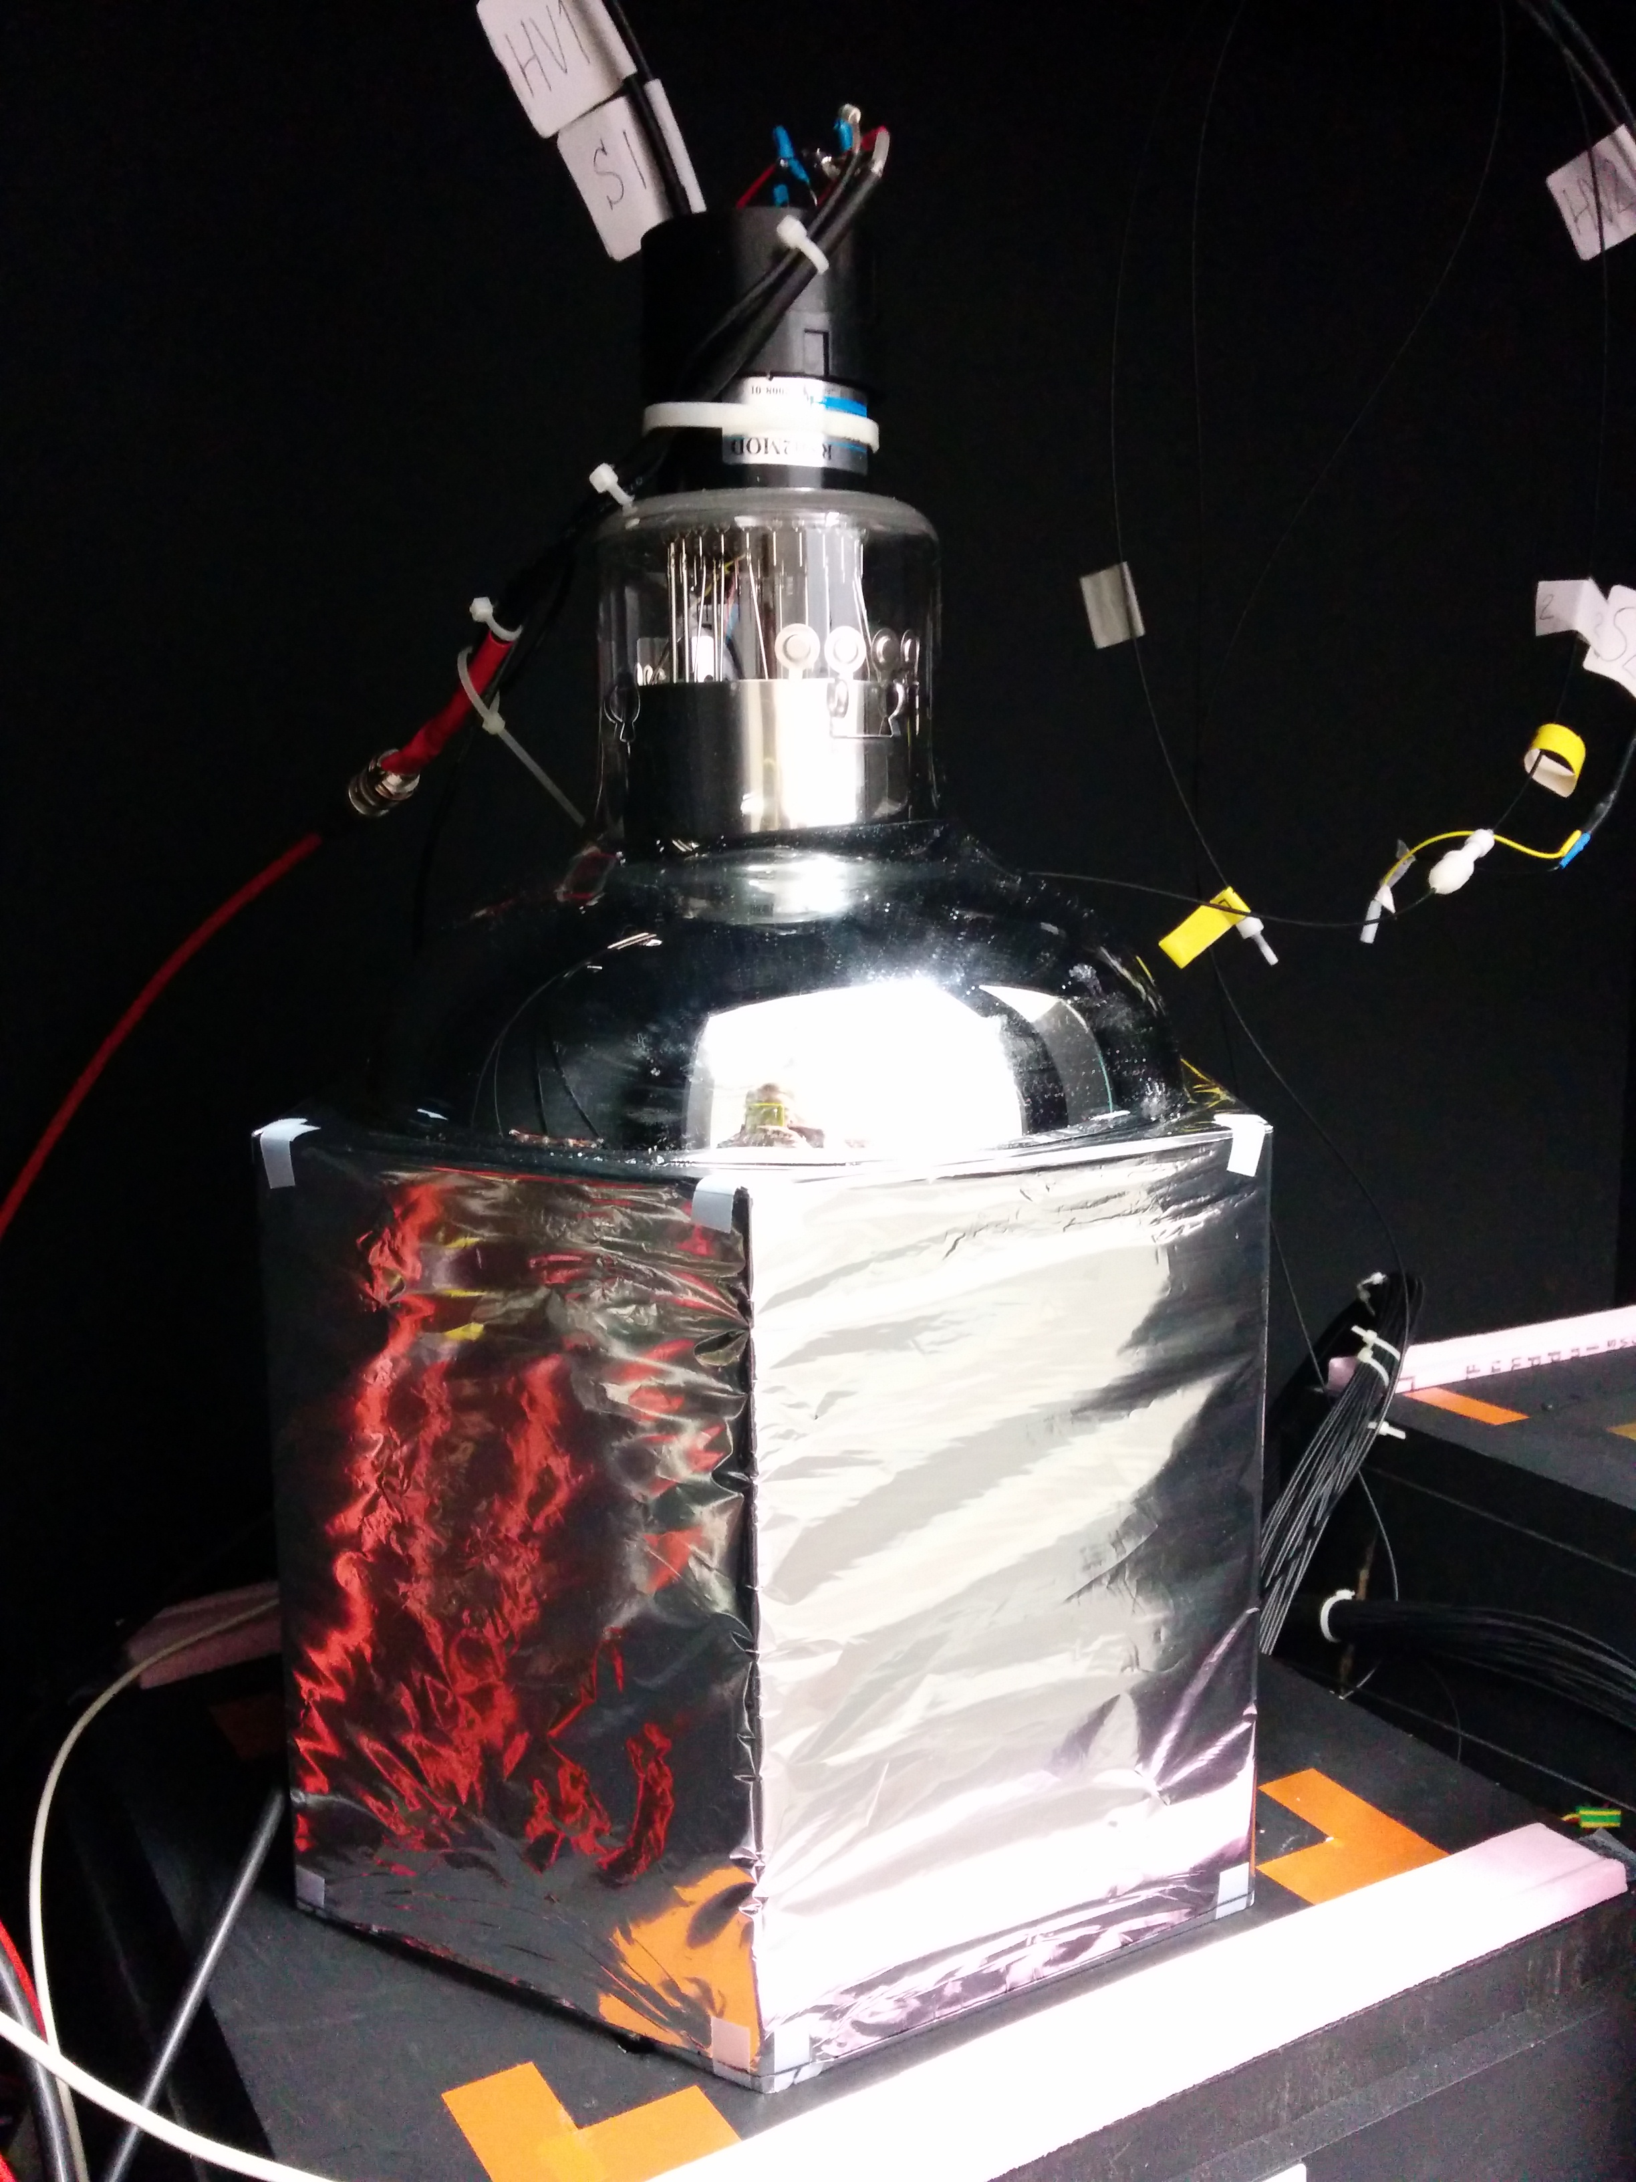
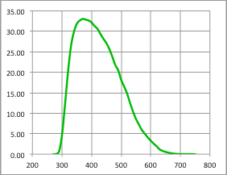
Optimised Optical Module
EJ-200 hexagonal PVT block:
276 mm diameter
193 mm deep, minimum thickness between PMT and scintillator: 100 mm
R5912-MOD Hamamatsu 8” PMT:
Maximum quoted QE: 33%
32% QE at 400 nm
QE (%)
Wrapping:
Sides: 75 μm of PTFE (Teflon) ribbon
Sides and entrance face: 12 μm of Mylar
Wavelength (nm)

Slide 6
So What…?
With this fantastic energy resolution of 7.5% FWHM at 1 MeV can we use a SuperNEMO Optical Module for PBT energy measurement?
Very high intensity of events at a proton beam (10’s MHz):
  A proton beam delivers a random number of protons per bucket, which will worsen the energy resolution measured.
  We require 1 proton per bucket for a good detector response.
  But time constant of scintillator (1 ns) makes this possible.
Scintillator quenching for protons:
  For a plastic scintillator, the scintillator response is nonlinear with the amount of energy deposited in it.
  Amount of deviation → “quenching”.
  Characterised by Birk’s law:
  Becomes important for large dE/dx and ionisation density → important for protons, which have a large dE/dx when they slow down.
Energy range:
  SuperNEMO optimised for electrons from 0.5 – 4 MeV for double beta decay.
  For proton therapy we require ~O(100 MeV).
dY/dx light yield per unit path length
dE/dx energy lost by particle per unit path length
kB relates density of ionisation to energy loss
= 0.207 mm/MeV
S absolute scintillation efficiency

Slide 7
Simulated Stopping Distance
Simulations of SuperNEMO scintillator vs Water Equivalent:
PVT is “water equivalent” for stopping distance and spread, as is PS.
One to one conversion for water phantoms.
Is this important to radiotherapy physics…?
Proton Beam Energy, MeV | Mean stopping distance, SCINT (mm) | Mean stopping distance, WATER (mm) | σ stopping distance, SCINT (mm) | σ stopping distance, WATER (mm)
60 | 30.21 | 30.54 | 0.33 | 0.33
200 | 255.4 | 257.1 | 2.48 | 2.44
300 | 505.9 | 509.9 | 4.64 | 4.78

Slide 8
Proton Stopping Power
Treatment plans constructed using X-ray CT.
Electron density is NOT the same as proton stopping power.
Hounsfield unit conversion factor introduces range uncertainty.

Slide 9
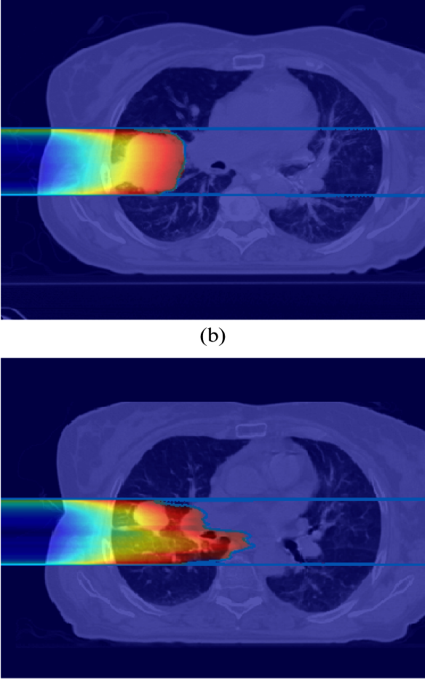
Range Uncertainty (T. Lomax)
Tumour shrinkage after 5 weeks

Slide 10
Proton CT (N. Allinson, PRaVDA)
Use proton imaging to reduce range uncertainties in treatment planning:
  Measure proton entry and exit positions and trajectories with trackers.
  Measure energy with Residual Energy Resolving Detector (range telescope or calorimeter).
  Calculate proton most likely path to reconstruct image.

Slide 11
Proton CT Image Reconstruction

Slide 12
Proton Calorimetry
For Proton CT, need to read out proton energy quickly and accurately:
  Energy resolution <1% 𝜎.
  Rate 1–10 MHz for reasonable imaging time.
Detector requirements overlap with range QA:
  Daily measurements are faster but less comprehensive: really just want to verify that the energy of the beam specified by the control system has the correct range in water (Water Equivalent Path Length).
  Morning range QA normally verifies a few energies at known depths:
    Proton counting in water-equivalent phantom.
    Setup and measurement can be time consuming…
  Requirements for improved QA system:
    Better than 1% σ resolution across all energies.
    Easier system setup and faster data acquisition and readout.
See if SuperNEMO calorimeter works for protons…

Slide 13
Clatterbridge Cancer Centre
62 MeV Scanditronix cyclotron provides 60 MeV protons (31 mm in water) to treatment room through double scattering.
Beam time provided for research.
We’ve had 2-day shifts every few months.
Already made interesting observations with our equipment about the treatment beam…
Need much lower proton fluence for our measurements than clinical settings.
Rate reduction achieved through:
  Various collimators (0.5–10 mm)
  Ion source gas supply.
  Ion source discharge current.
  Cyclotron sector focussing.
  RF phasing (wouldn’t recommend it…).

Slide 14
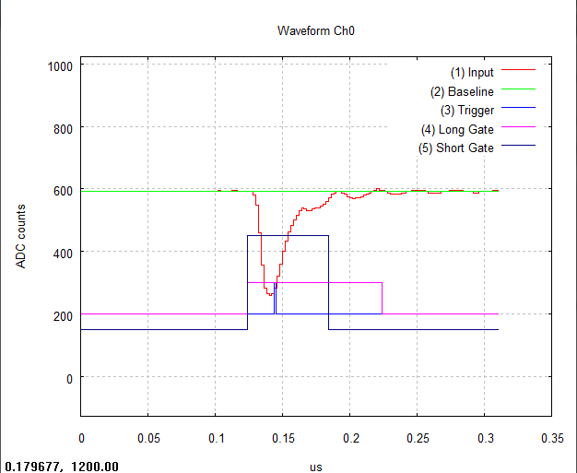
Equipment Setup
CAEN DT5751 Digitiser:
Dual-gate signal integration
→ On-the-fly pulse shape analysis
→ Neutron/gamma discrimination

Slide 15
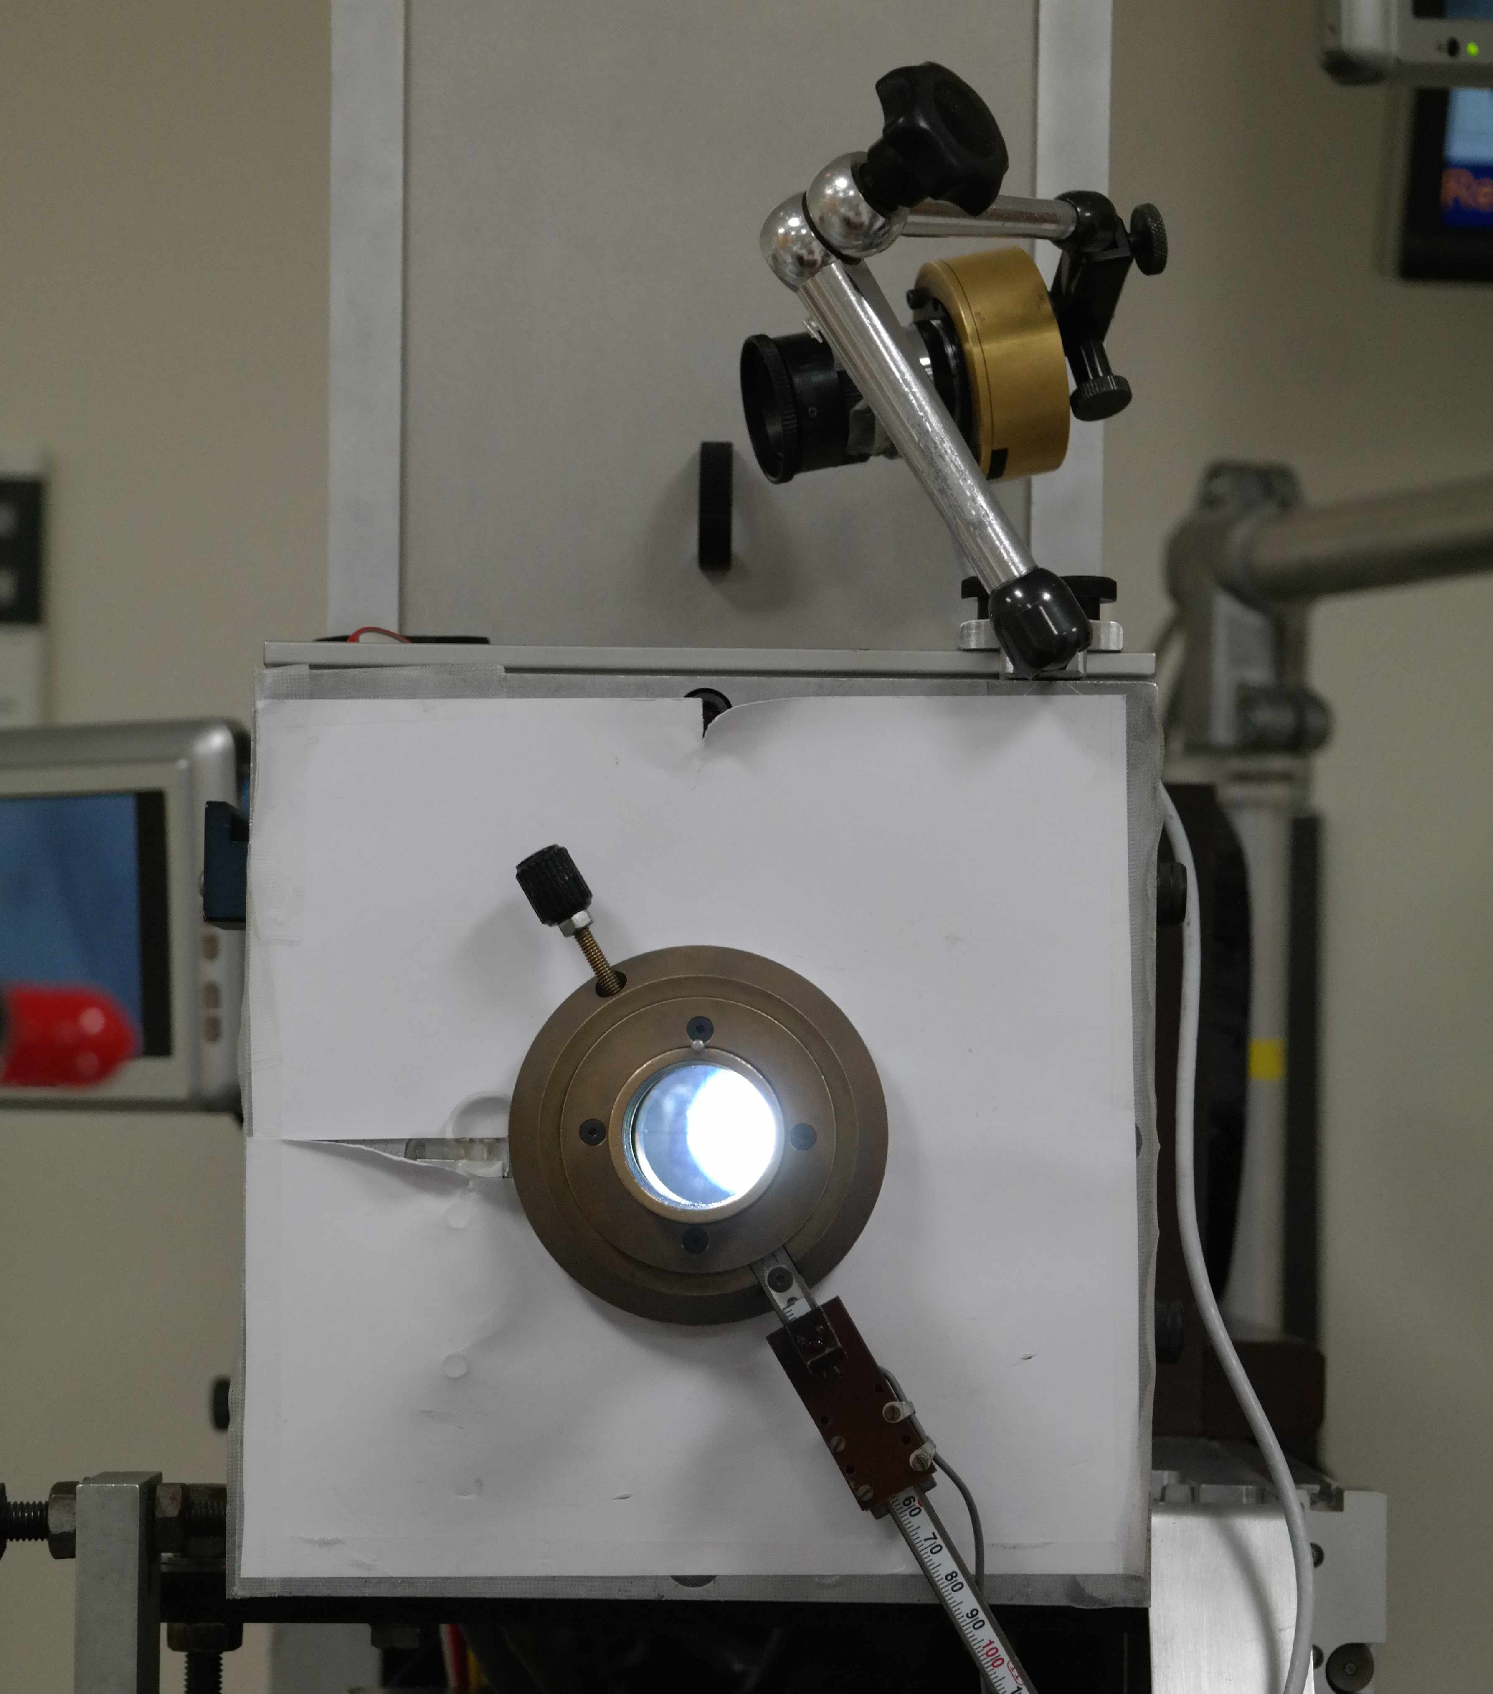
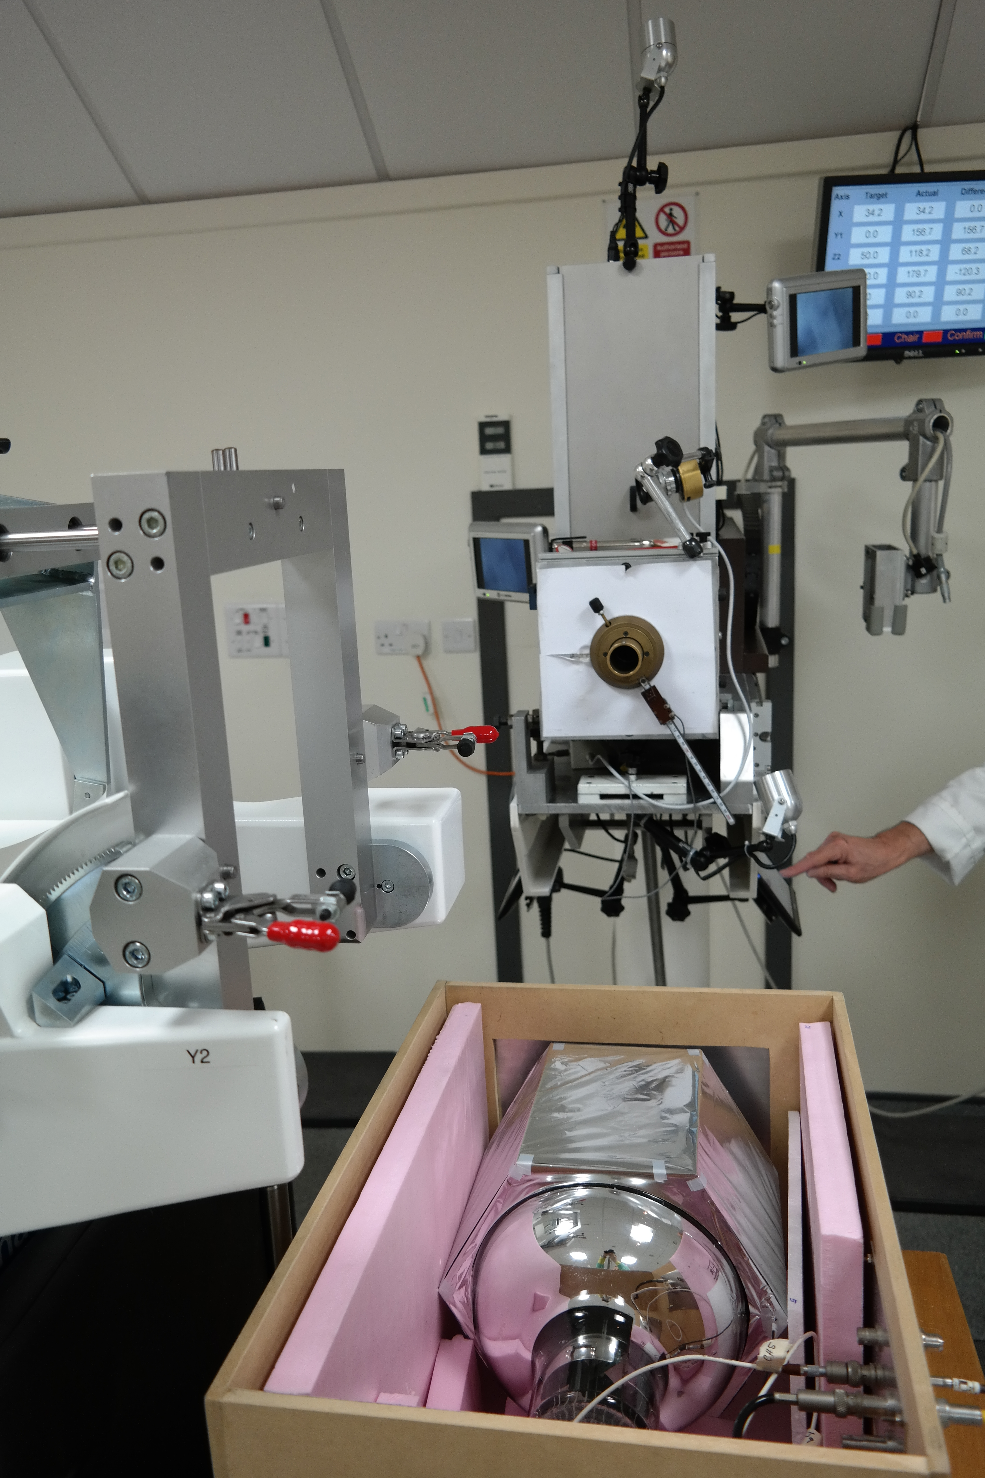
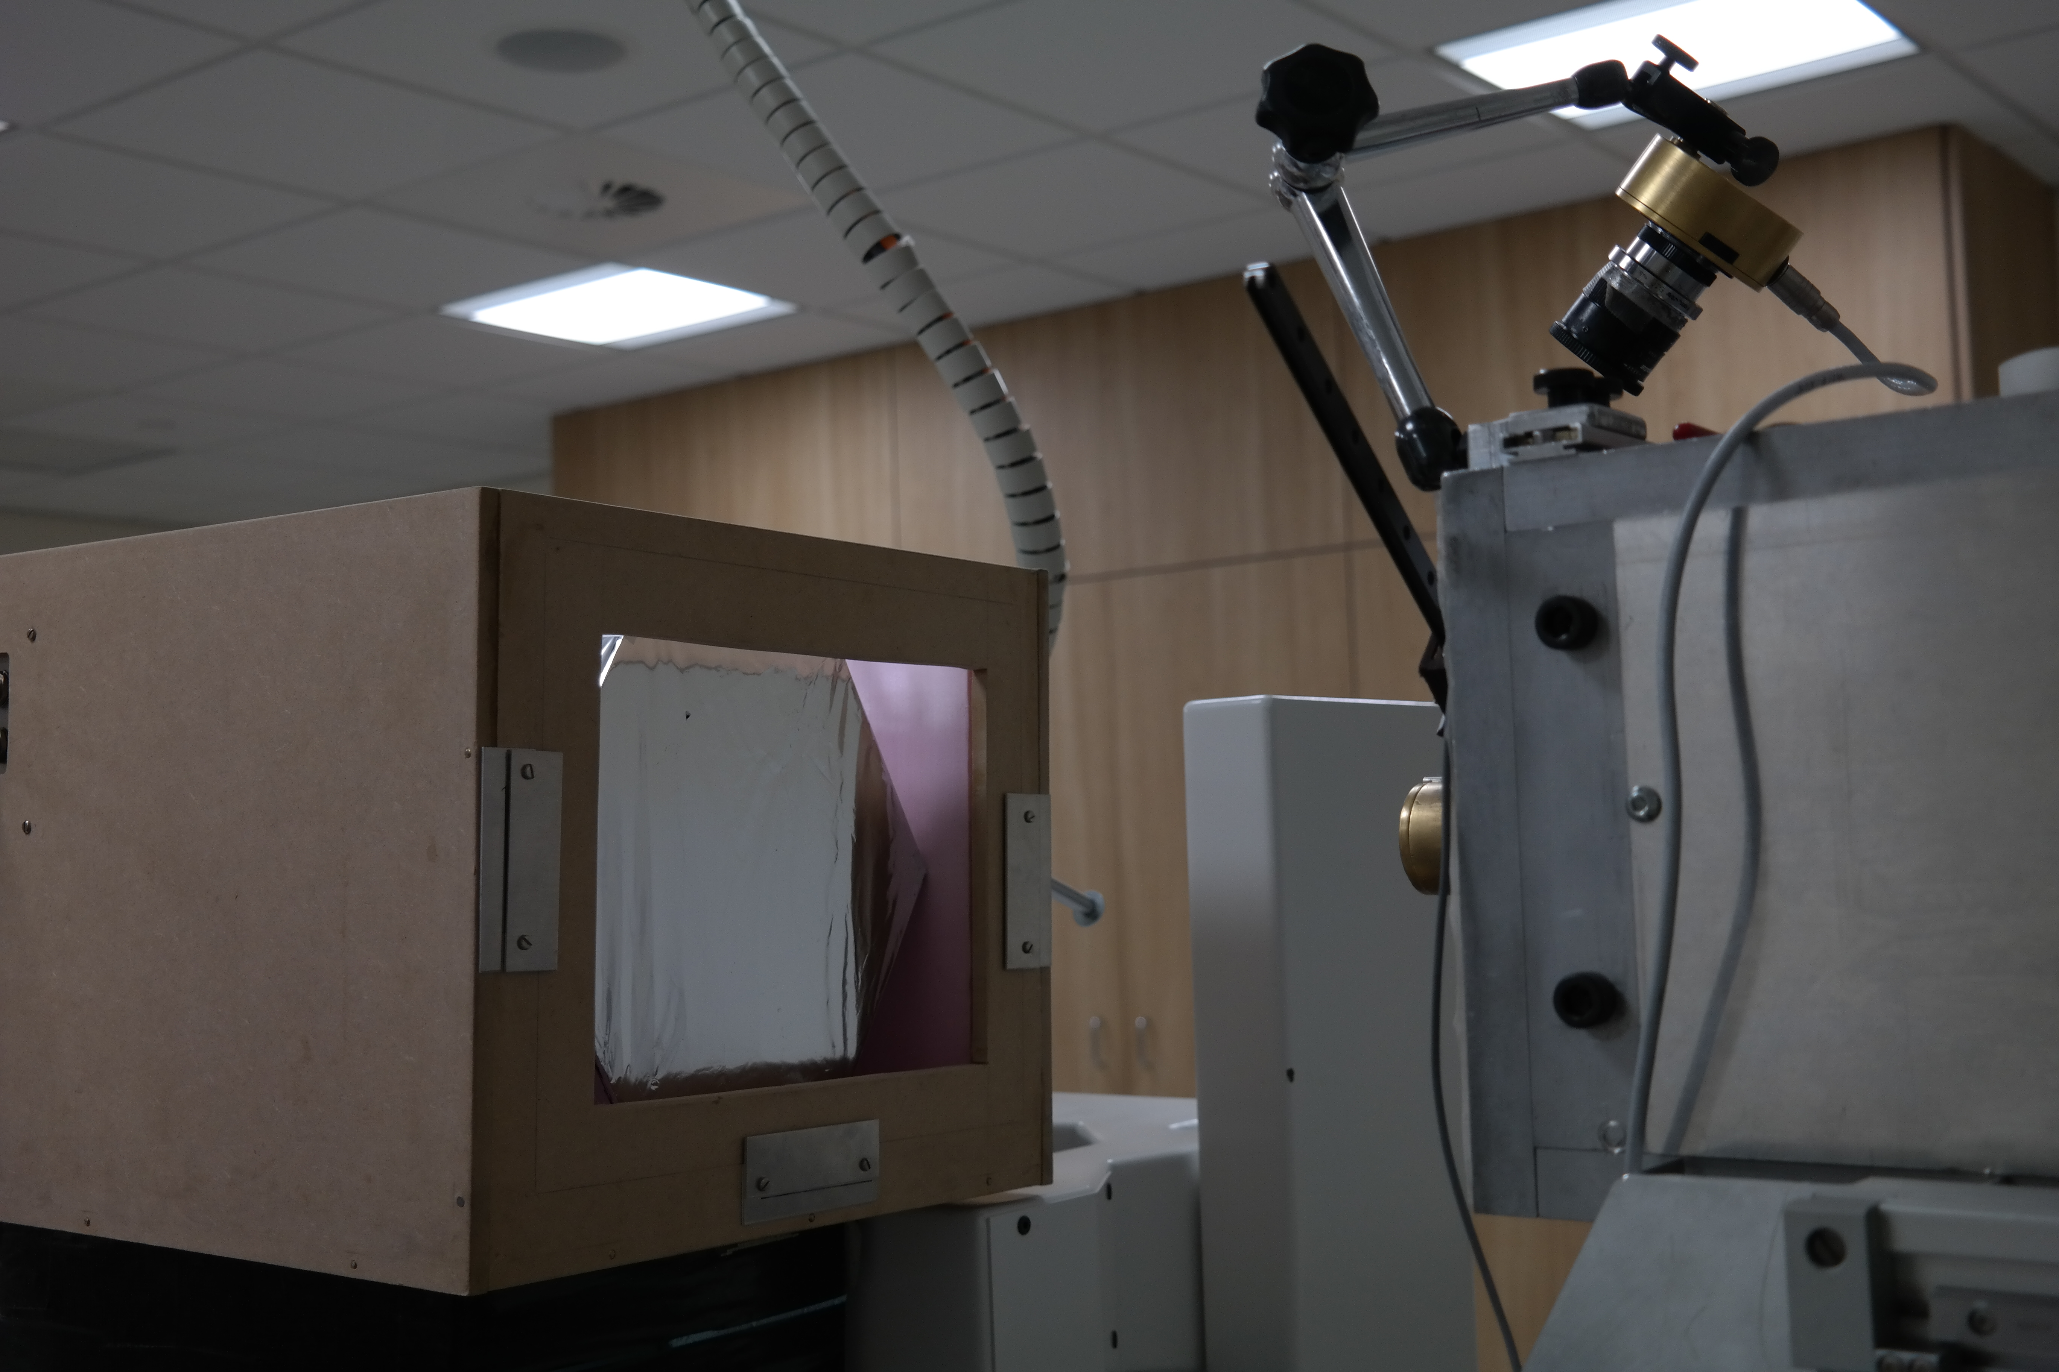
Experimental Tests

Slide 16
Results: Fitted Data
Fitting function:
Convolution of Gaussian
and mirror Landau
+ Landau on the right
→ ΔE/E: 1.58 ± 0.27 % FWHM (for ~40 MeV due to quenching!)
Compared to 1.48 % FWHM
from simulations
Mirror Landau Tail

Slide 17
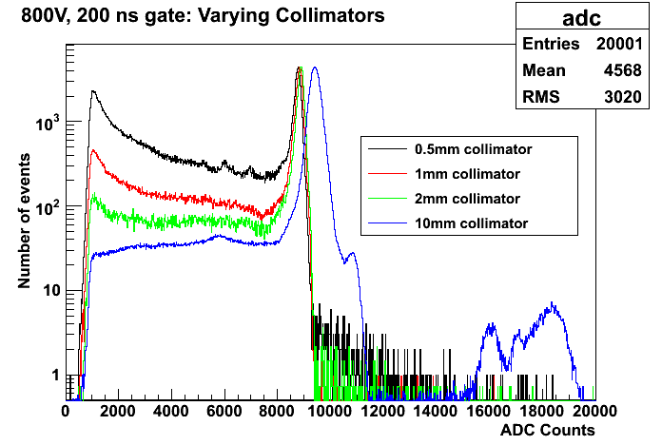
High Rate Tests: Pulse Pile-Up
Protons scattering off the collimator increases with diameter decrease
To avoid pile up:
Optimal collimator: 2mm diameter
Keep integrating window small to only collect single proton pulse
More than 1 proton per bucket for larger diameter collimators, causing peak to widen

Slide 18
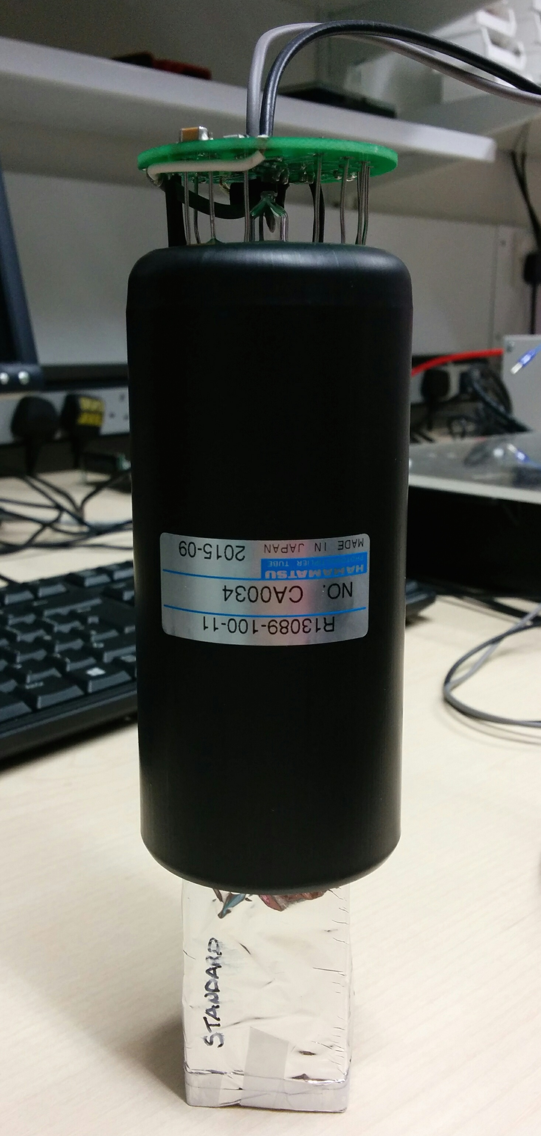
A Smaller, Faster Detector
We have already achieved the target energy resolution: 0.7% σ with
The next step is to do this for very high rates of 1–10 MHz with a compact design:
Reduce the size of the PMT and the scintillator to improve timing and make the design nozzle-mountable.
Negative HV PMT base to remove decoupling capacitor (not fast enough discharge).
2” Hamamatsu R13089-100-11 PMT with negative HV active divider base
  3 cm x 3 cm x 5 cm cuboid ENVINET/NUVIA PolyStyrene standard scintillator
  Coupled with BC-630 Saint Gobain silicone optical gel
Wrapped in 75 μm of PTFE (Teflon) ribbon on the sides and 12 μm of Mylar on the sides and entrance face

Slide 19
Small Module Results
→ σ/E: 0.89 ± 0.11 % σ
at 25 kHz
We are still at our < 1 % σ target!

Slide 20
Resolution: Energy Dependence
Energy of protons incident on scintillator varied by placing absorbers (PMMA plates and calibration wheel) of known thickness ~1.8 m upstream of the optical module.
dependence!

Slide 21
Resolution: Linearity
We want to run the PMT at higher voltages (can run at up to -1500V) as this will increase the PMT’s collection efficiency and will improve the energy resolution.
BUT we have a LOT of light (tens of thousands of photo-electrons) so we need to make sure we are not saturating the PMT.
Look at linearity:
For -900V:
Deviation from linearity < 2%!

Slide 22
Beam Test Conclusions
What have we learned?
The scintillator performs just as well for single protons as it does for electrons!
Making the module smaller does what it’s supposed to:
  Improves timing (good measurements up to around 300kHz, compared to 1 kHz for original 8” module),
  No detrimental effect on resolution.
But…
  We still can’t handle rates approaching 1 MHz.
  Despite Hamamatsu’s promises to the contrary, we think the PMTs have a frequency-dependent gain.
Interesting discoveries about Clatterbridge beam:
  Nonlinear time distribution of protons (bunches of bunches...).
  Close to nozzle edge, energy falls off.
  Building complete simulation to compare to Clatterbridge/UCL measurements:

Slide 23
So What…?
Our goal was originally to develop a calorimeter to act as the energy measurement stage for a proton CT system:
  Needed better than 1% resolution and rates in the region of 1–10 MHz.
  Managed to achieve the resolution; rates limited by electronics.
  Work will continue: discussions with PRaVDA and Loma Linde.
Clinical steer to provide fast energy/range QA tool to work at clinical rate.
Needs a change in design philosophy: also take advantage of water equivalence of plastic scintillator.
Treatment Nozzle

Slide 24
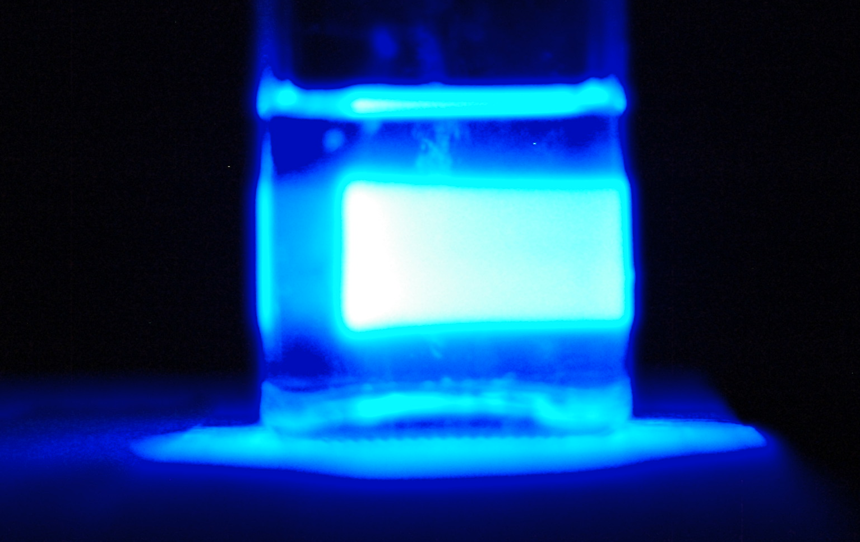
A Real Bragg Peak In Liquid Scintillator

Slide 25
Segmented Calorimeter
Protons
PVT and PS are both helpfully water equivalent.
Segment block into slices and read out light from each slice individually.
Integrate signal from many protons: very large output from 10¹⁰/s.
Minimum slice width will depend on manufacture: aiming for < 2 mm.
Use photodiodes for readout: poor light detectors but stable and cheap with large dynamic range.
Resolution set by slice width and variation in scintillator light output.

Slide 26
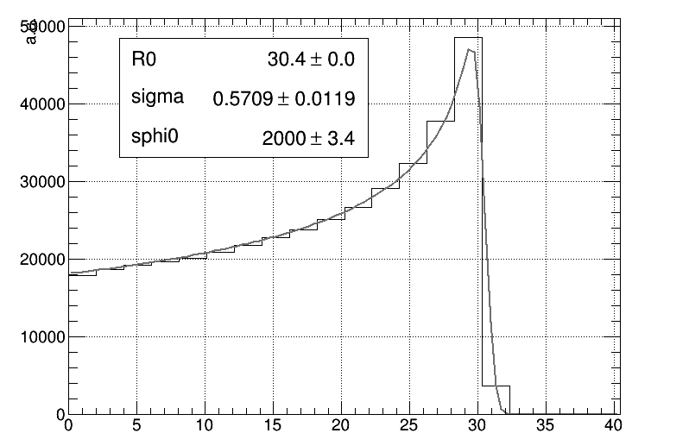
Segmented Calorimeter Design
Laurent Kelleter has built preliminary model in Geant4:
  2 mm slices of plastic scintillator with mylar wrapping.
  Currently integrating photodiode readout.
STFC IPS grant application currently pending approval: working with NUVIA a.s. in Czech Republic to produce our scintillator sheets: manufacturing challenging!
Need to characterise light quenching to reconstruct Bragg curve: pencil beams only.
Fit to measured curve drastically improves mean range measurement: do you need range or range spread…?
dY/dx | light yield per unit path length
dE/dx | energy lost by particle per unit path length
kB | relates density of ionisation to energy loss = 0.207 mm/MeV
S | absolute scintillation efficiency
Dose deposited
Light emitted

Slide 27
Fast Treatment Plan Verification
Protons
Tracking layer
Take segmented calorimeter: add 2D tracking to front face.
Still nozzle-mounted and self-contained.
Read out X/Y profile and integrated range of individual pencil beams.
Detector read out fast enough to match minimum spot dwell time (3–20 ms).
Fast reconstruction of water-equivalent treatment plan.

Slide 28
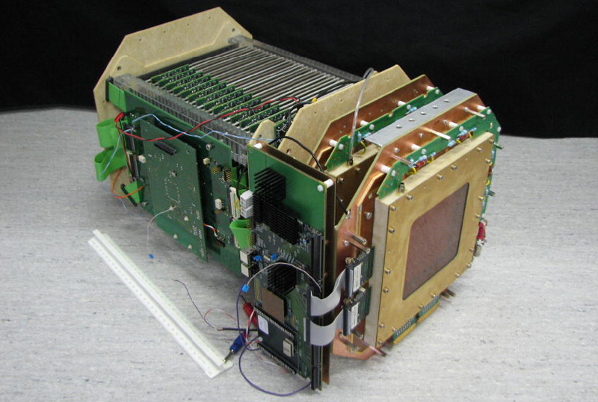
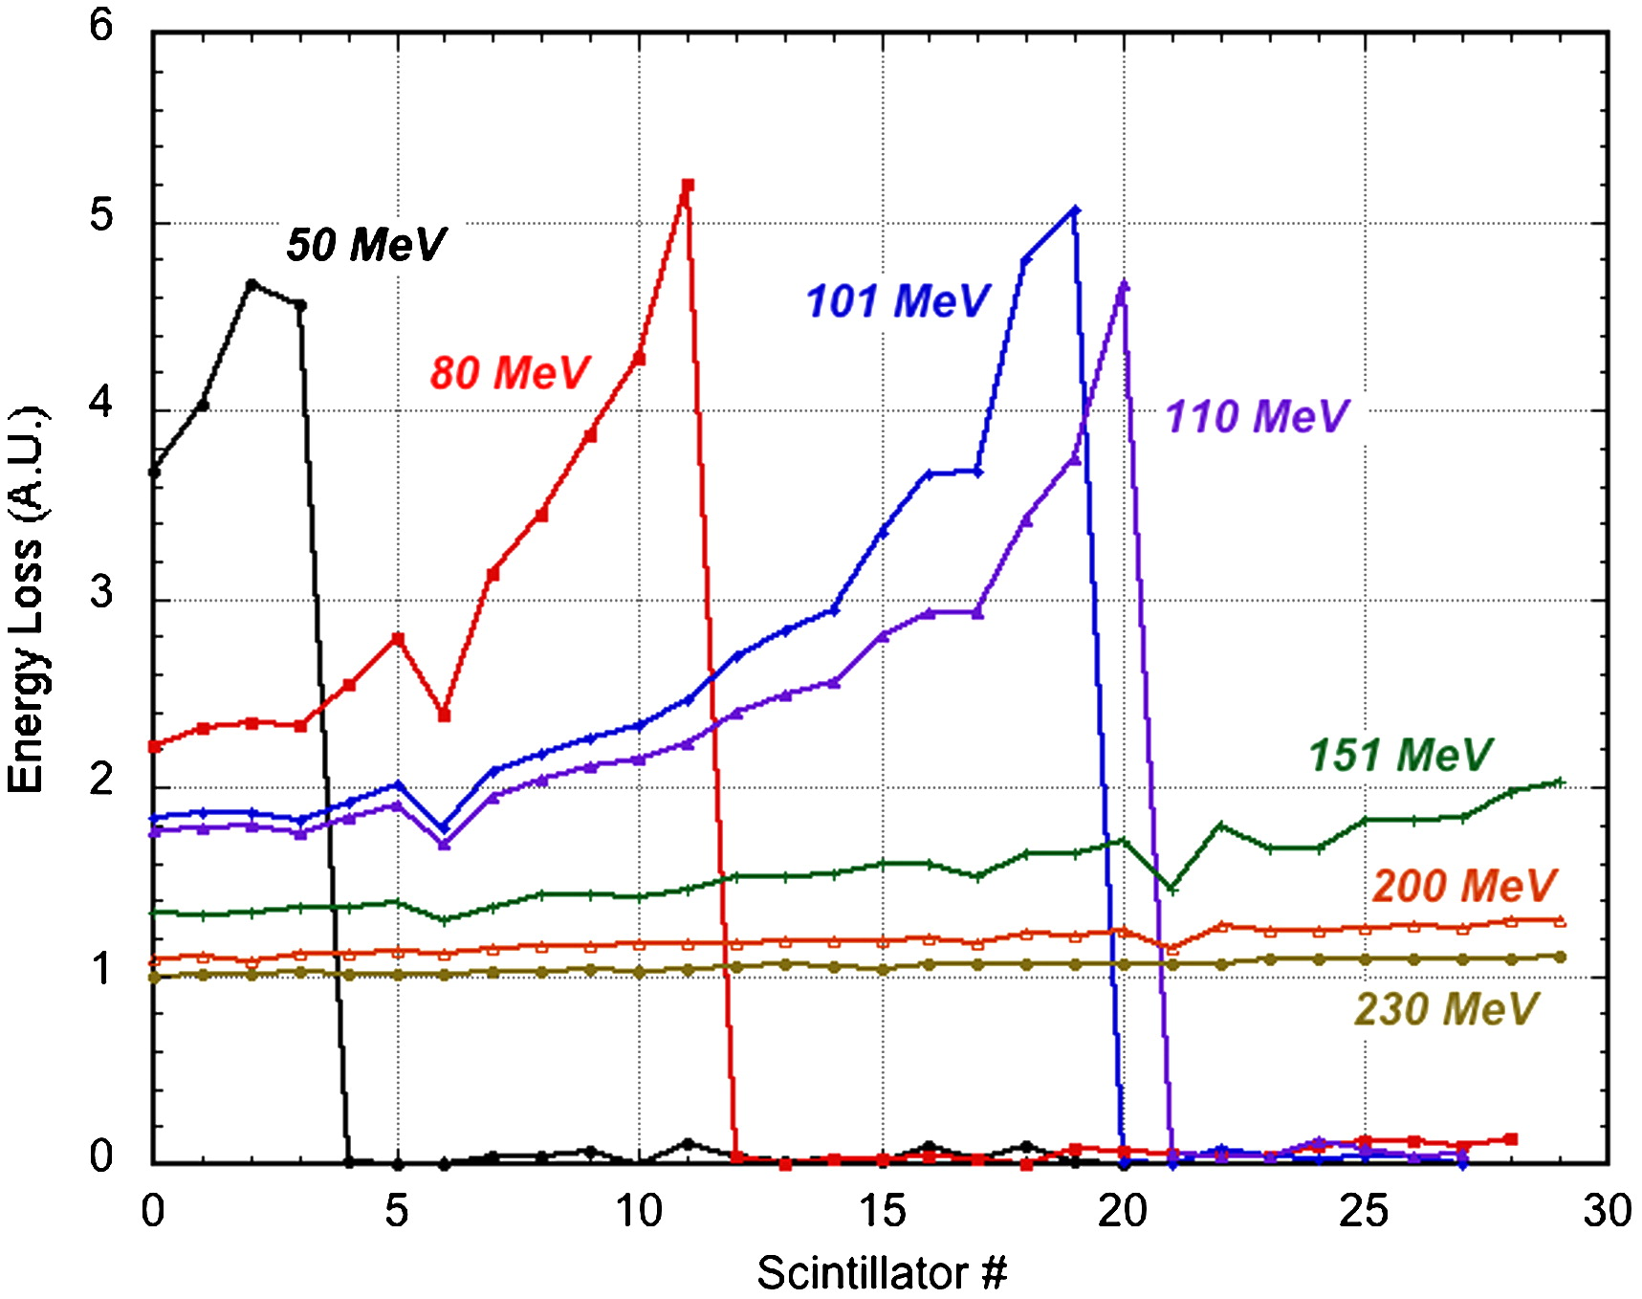
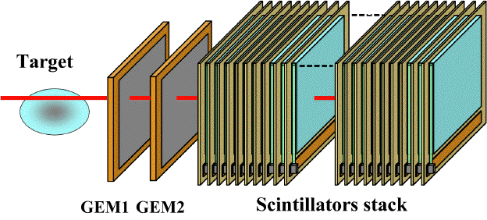
TERA: Proton Range Radiography
Don’t need to prove the principle using scintillator sheets: TERA have done it for us!
Proton Range Radiography:
  Gas Electron Multiplier (GEM) tracking.
  2 mm PVT scintillator sheets fibre coupled to Silicon PhotoMultipliers.
Can’t use this exact setup:
  Designed for single protons for pCT.
  They get “good enough” proton range by looking at end-of-range only.
  SiPMs expensive, high gain devices: not appropriate for high light output with full beam intensity.

Slide 29
Future Plans
Continue development of single calorimeter module for proton CT and lower rate applications:
  Well characterised.
  The fewer channels the better: single block also means more light per proton per detector.
Work on segmented calorimeter design to produce water equivalent path length detector:
  Resolution better than 2 mm: much better with appropriate fit.
  “Immediate” readout (a few seconds).
  Need >150 sheets for 32 cm: start with 20 sheets and do fast measurement at Clatterbridge.
Full design aims to be gantry mounted: can characterise multiple fields.
Fast treatment plan verification very promising, but needs work to get segmented calorimeter working before adding tracking:
  Tracking and range measurement need to be fast enough to read out data with suitable resolution within spot dwell time.
  Needs electronics to synchronise.

Slide 30
Acknowledgements
UCL
  Ruben Saakyan
  Anastasia Basharina-Freshville
  Laurent Kelleter
  Matthieu Hentz
  Andreas Christou
  Adam Knoetze
  Roisin Stephens
  Derek Attree
UCLH
  Richard Amos
  Paul Doolan
Clatterbridge
  Andrzej Kacperek
  Andy Wray
  Ian Taylor
  Brian Marsland
The Christie/Manchester
  Ran Mackay
  Hywel Owen
  Karen Kirkby
PSI
  Tony Lomax
  Marco Schippers

Slide 31
Spare Slides

Slide 32
Geant4 Simulations
A pencil proton beam (60 MeV) simulated, positioned 70 cm from the entrance face of the scintillator block.
Scintillator modeled as a square block (256 mm x 256 mm x 120 mm) with scintillator composition fully described.
Quenching of scintillation light in plastic scintillator for protons.
Energy deposited smeared according to Poissonian fluctuations in the number of generated photo-electrons.
The number of photo-electrons per MeV taken from test bench data (SuperNEMO calorimeter R&D): 982 photo-electrons per MeV (for an energy resolution of 7.5% FWHM at 1 MeV).

Slide 33

Simulation Results
Input:
982 p.e. at 1 MeV extrapolated
to 39.3 MeV
Quenching from simulations:
  Simulated mean: 39.3 MeV
  Quenching: 35% for 60 MeV protons
Energy resolution from simulations:
  σ: 0.247, μ: 39.28
  ΔE/E: 1.48 % FWHM

Slide 34
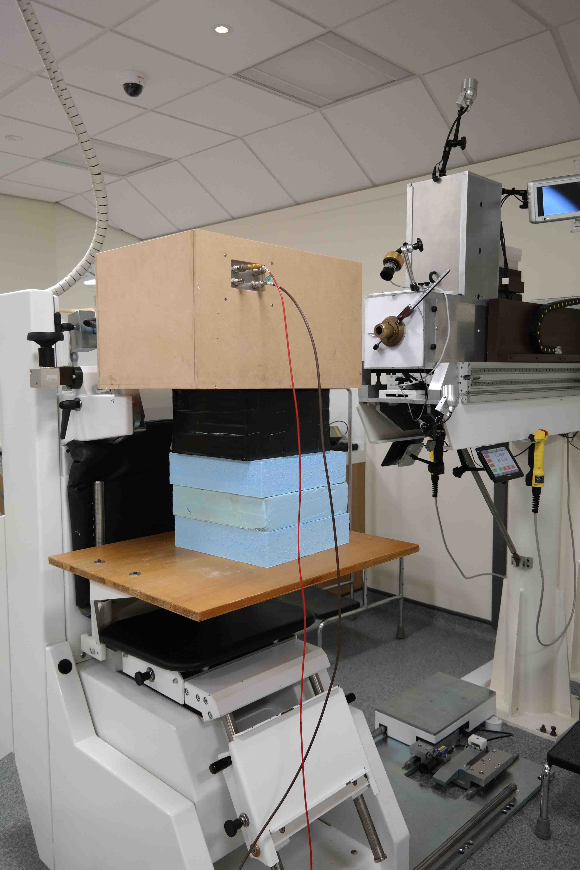
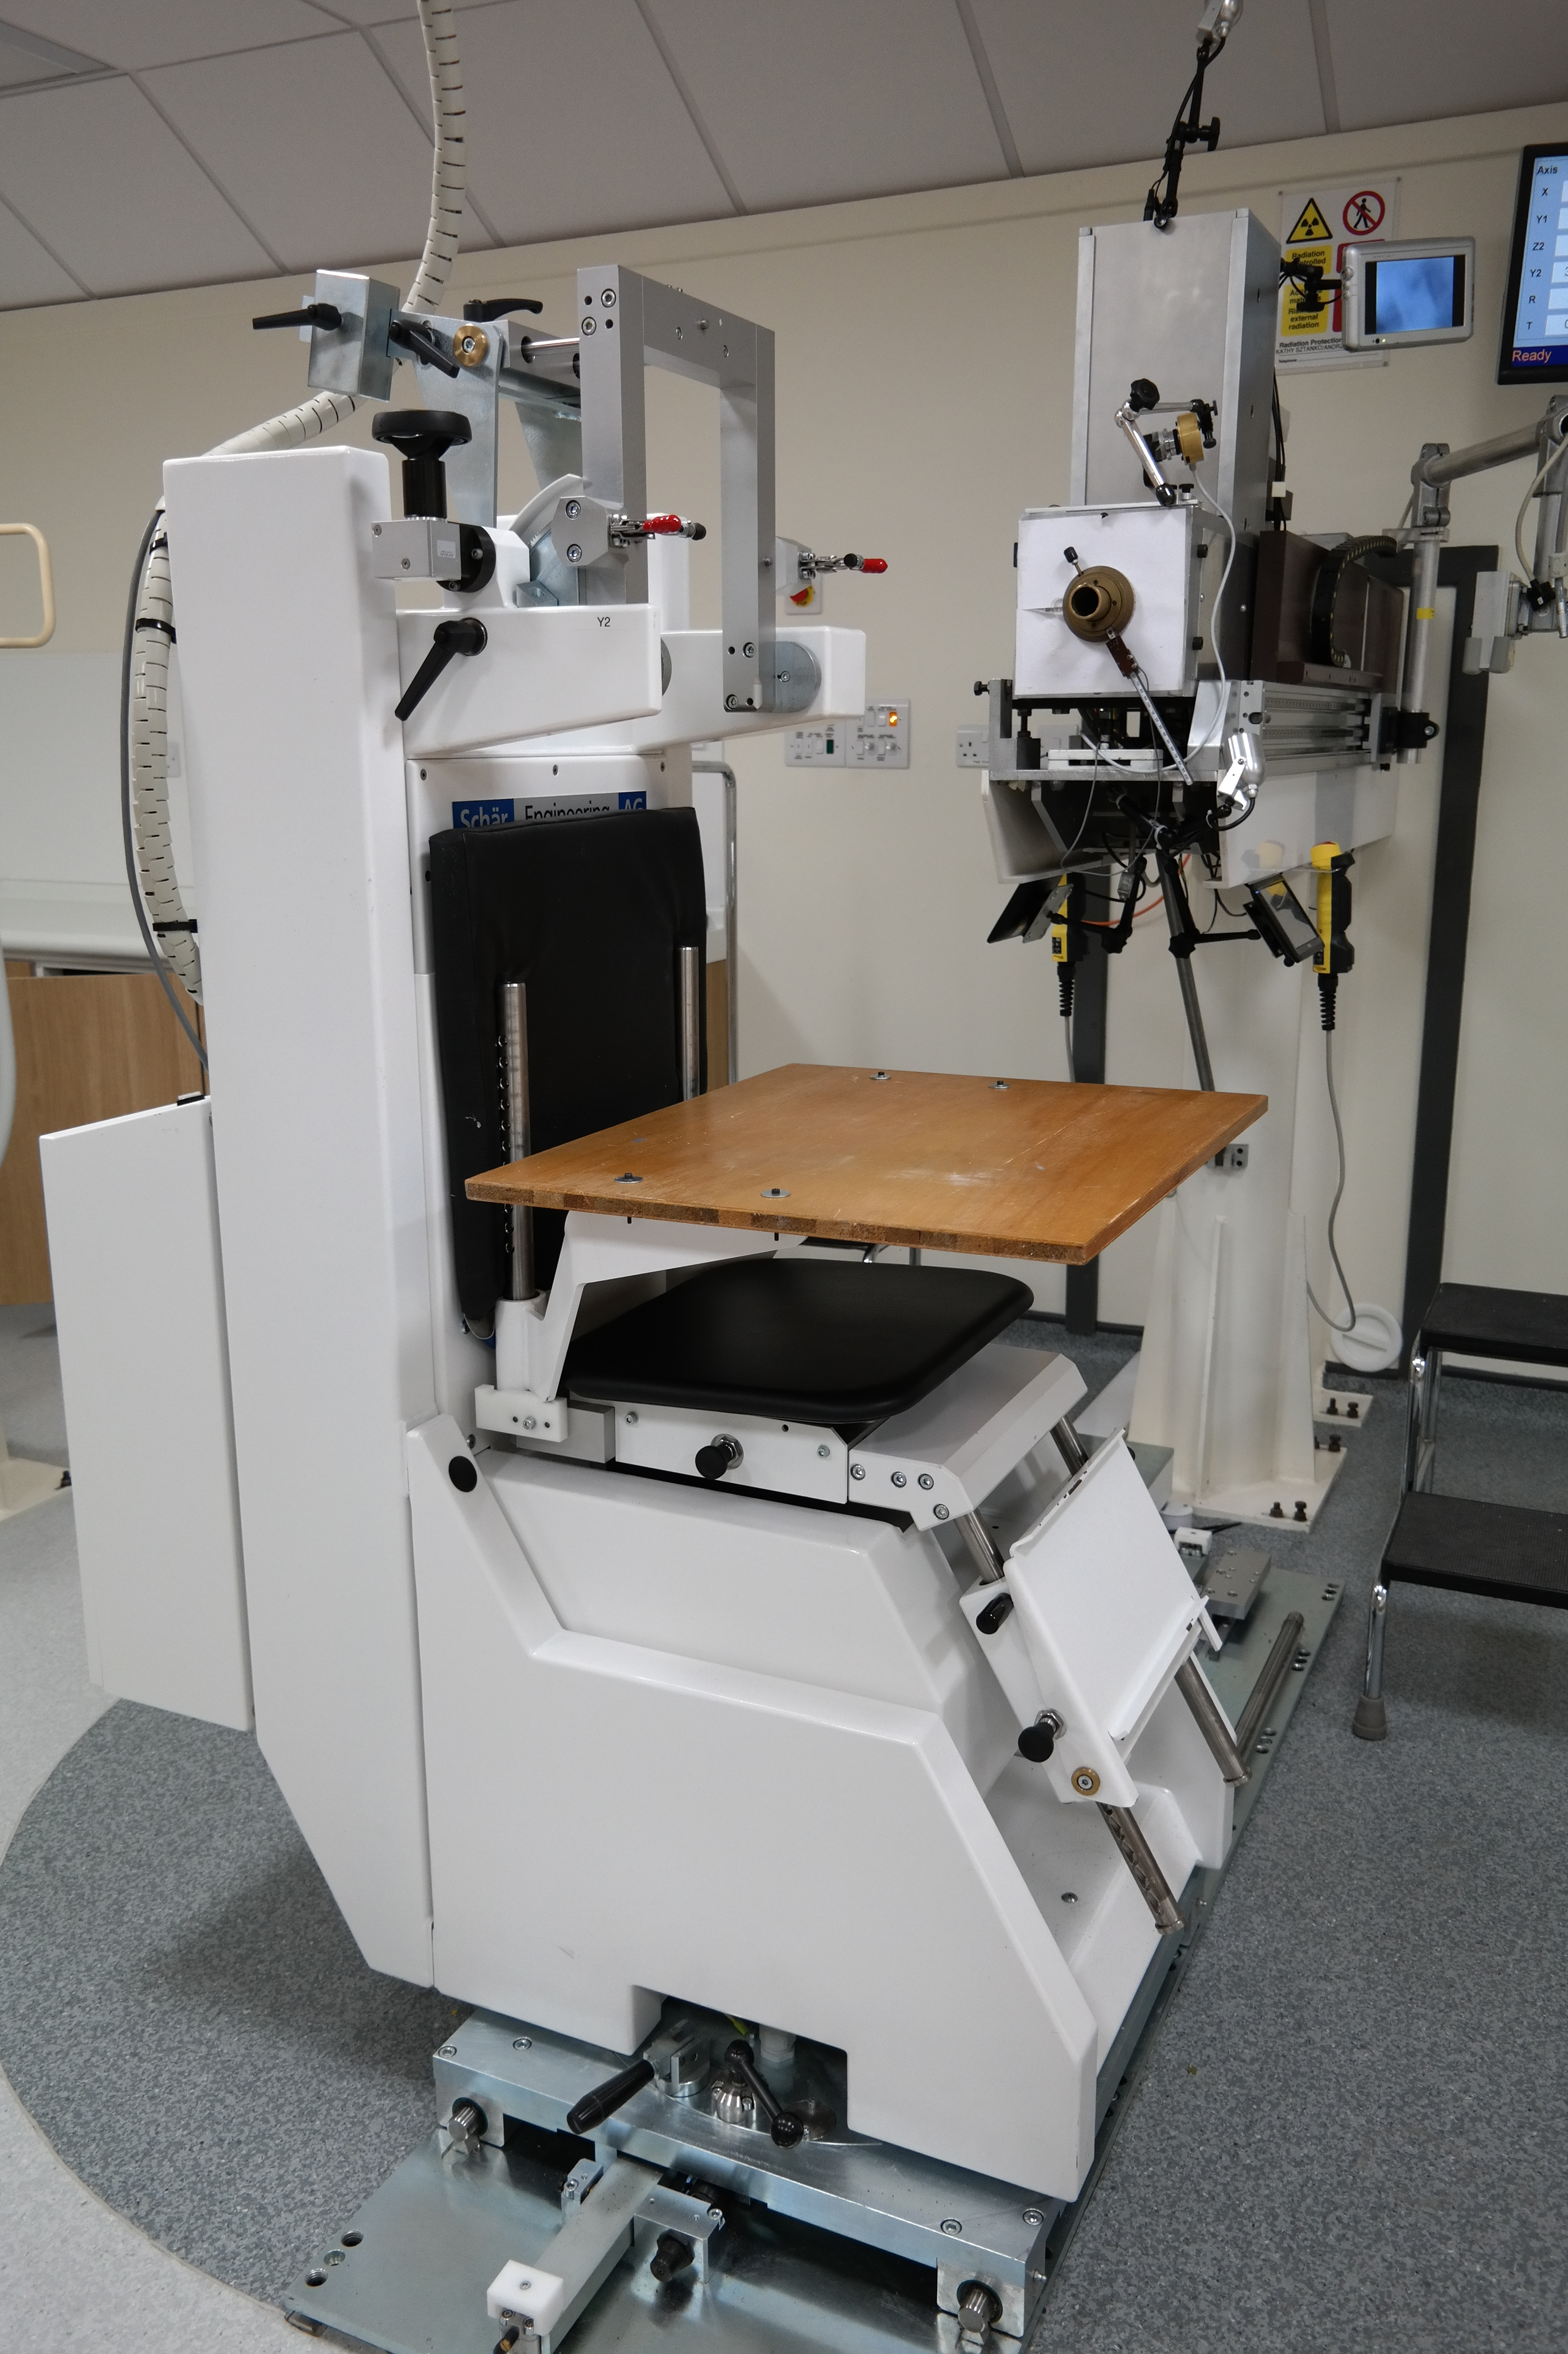
Experimental Tests

Slide 35
Results: Raw Data

Slide 36
Resolution: Energy Dependence
Energy of protons incident on scintillator varied by placing absorbers (PMMA plates) of known thickness ~1.8 m upstream of the optical module
dependence!

Slide 37
Radiation Damage
Total estimated radiation dose received by 2” OM: 0.25 Gy.
Date | HV Supply | DAQ | σ/E (%)
27/07/16 | Portable | UCL | 3.16 ± 0.03
28/07/16 | UCL | UCL | 3.14 ± 0.03
Clatterbridge Test Beam: 02-03/08/16
04/08/16 | UCL | UCL | 3.08 ± 0.03
No noticeable difference in resulting energy resolution so far.

