Slide 1
Proton Calorimetry for Range Quality Assurance
Simon Jolly, Ruben Saakyan, Anastasia Freshville, Laurent Kelleter, Richard Amos
University College London

Slide 2
Proton Beam Therapy
A range of QA checks are necessary for safe PBT treatment:
Daily.
Weekly.
Monthly.
Daily checks carried out before treatment:
Most time spent verifying range is correct for given energy.
These range QA checks can take more than an hour for a few measurements.
Equipment is bulky and slow (setup or measurement).
A better detector should make the same measurements more quickly and more accurately…

Slide 3
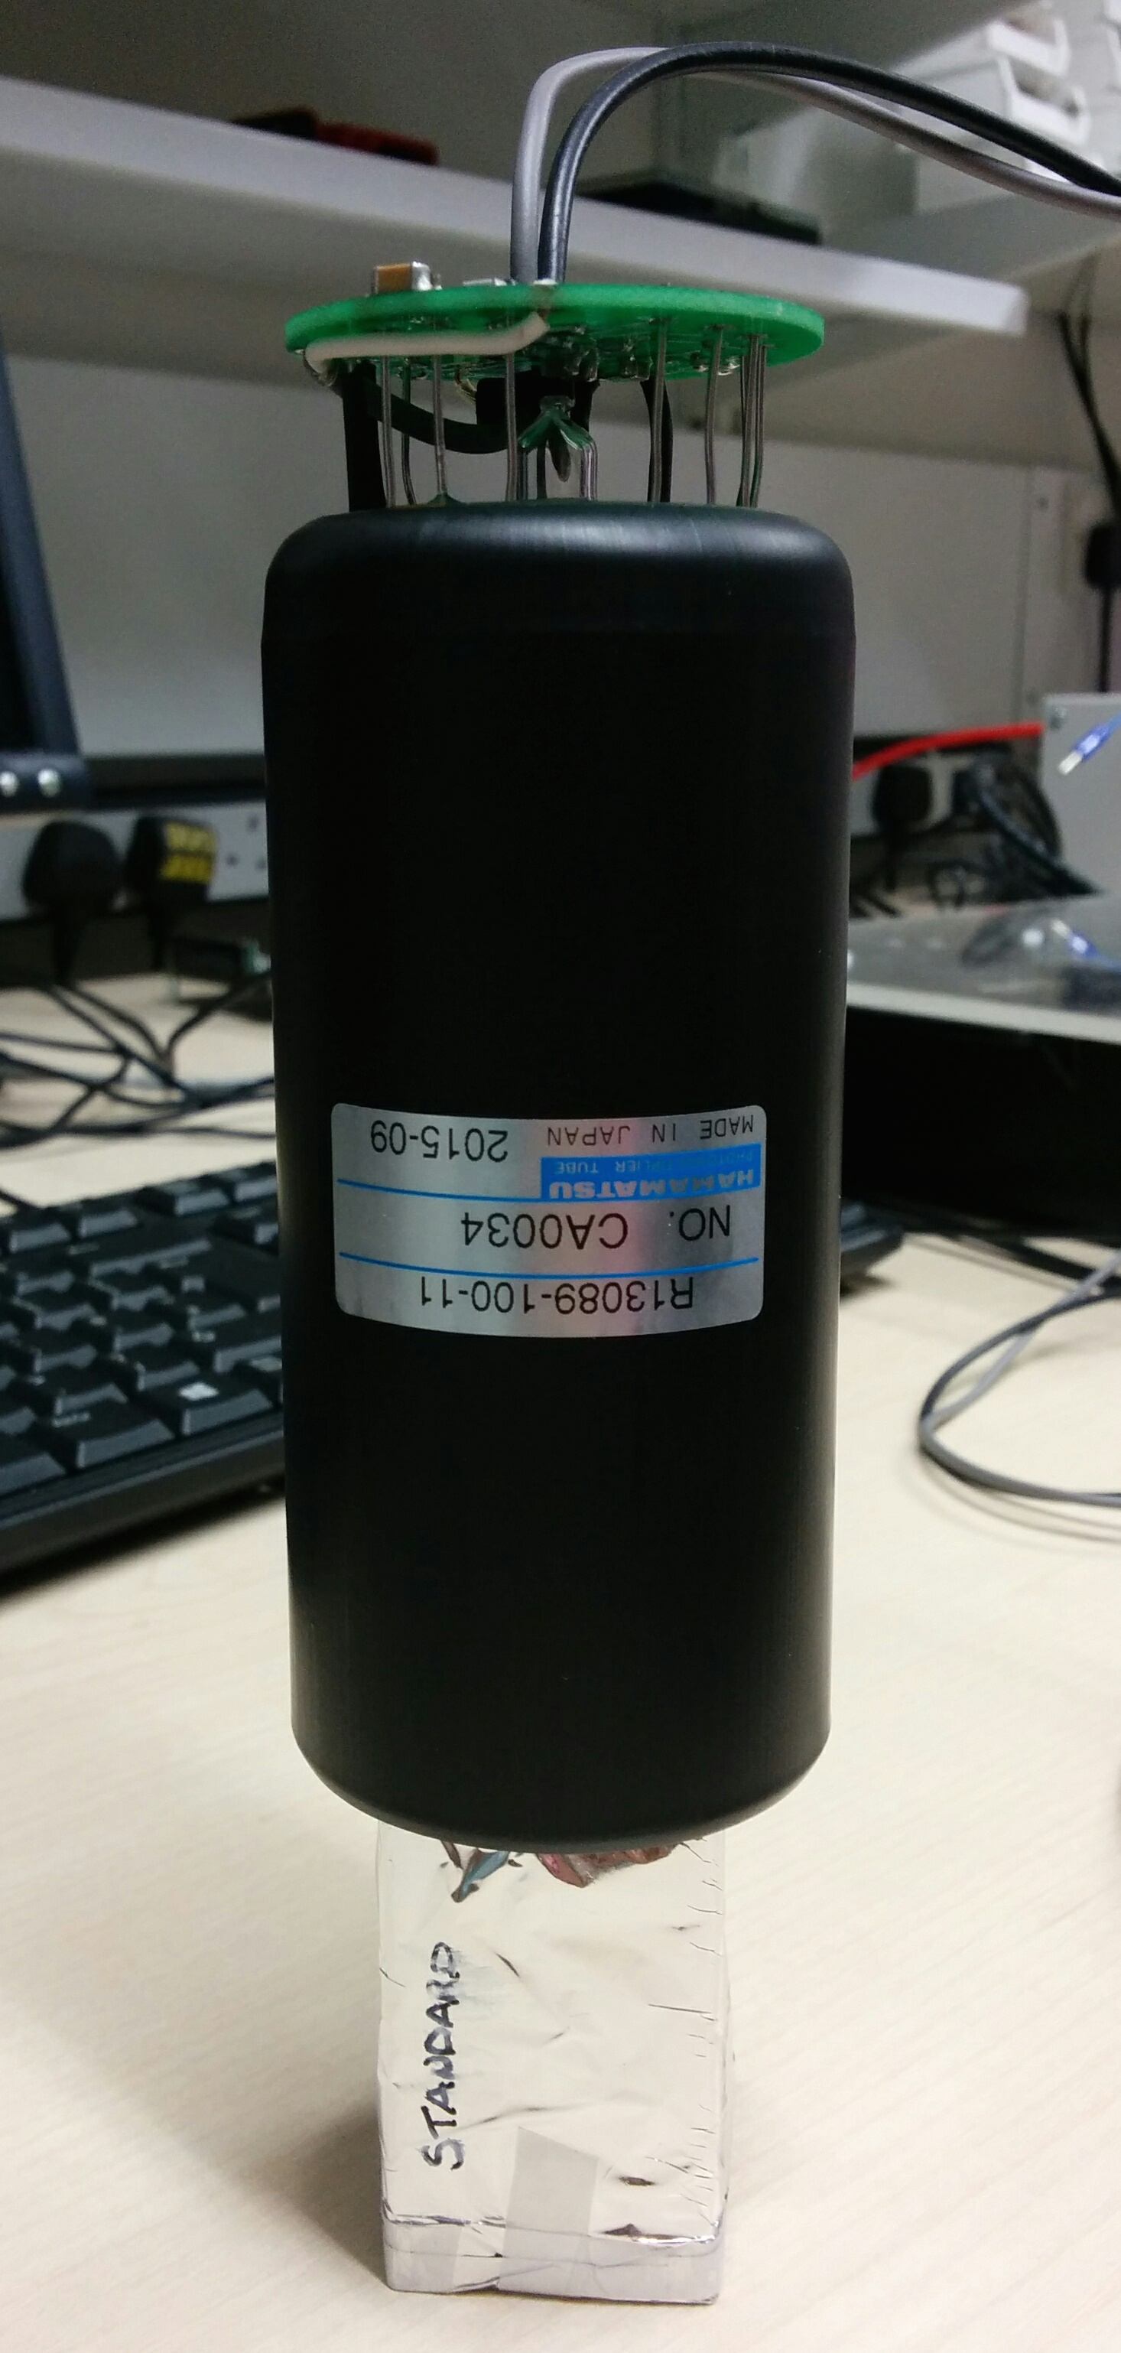
Single Module Proton Calorimeter
Single module calorimeter based on SuperNEMO Optical Module.
High light output with excellent energy and timing resolution (nanoseconds).
Reduced size of PolyStyrene scintillator block to match 60 MeV beam at Clatterbridge: 3 x 3 x 5 cm.
Target resolution: < 1% σ (originally from pCT).
Measure individual protons and reconstruct energy spectrum.
Preliminary tests showed excellent resolution (0.7% σ) but slow: pile-up above 20 kHz.
Needed to reduce proton fluence well below clinical rate with collimators.
Good for pCT, not optimal for range QA…
2” Hamamatsu R13089-100-11 PMT with negative HV active divider base
3 cm x 3 cm x 5 cm cuboid ENVINET/NUVIA PolyStyrene standard scintillator
Coupled with BC-630 Saint Gobain silicone optical gel
Wrapped in 75 μm of PTFE (Teflon) ribbon on the sides and 12 μm of Mylar on the sides and entrance face

Slide 4
Small Module Results
Spectrum obtained with the Clatterbridge 60 MeV proton beam.
Best energy resolution (σ/E) result achieved so far during four test beam visits (at 70 kHz).
This result was achieved with a 2” PMT and a 3 cm x 3 cm x 5 cm plastic scintillator
Fitting function:
Convolution of Gaussian and mirror Landau + Landau on the right
ΔE/E:
0.50 ± 0.07 % σ
Mirror Landau Tail

Slide 5
MedAustron 250 MeV Tests
Having tested detector at 60 MeV, needed to make high energy test to examine performance and test linearity:
Longer, 40 cm scintillator block to absorb 250 MeV protons.
Same PMT and readout.
Through OMA, MedAustron offered us 2 nights of beam tests:
62 MeV up to 252 MeV.
Able to drop rate down with chopper adjustment: ran 1 kHz–1 MHz.
Custom collimators to reduce intensity and beam size.

Slide 6
MedAustron Setup

Slide 7
MedAustron Results
Still seeing excellent energy resolution up to 252 MeV.
Best resolution 0.2% σ.
But also still seeing rate issues:
PMT current limit from too much light!
Detector not fast enough for 10¹⁰ p/s clinical rate.

Slide 8
Simulated Stopping Distance
Simulations of SuperNEMO scintillator vs Water Equivalent:
PolyVinyl Toluene is “water equivalent” for stopping distance and spread, as is Polystyrene.
One to one conversion for water phantoms.
We can take advantage of this for range QA measurements: water equivalent + high light output + excellent energy resolution
Proton Beam Energy, MeV | Mean stopping distance, SCINT (mm) | Mean stopping distance, WATER (mm) | σ stopping distance, SCINT (mm) | σ stopping distance, WATER (mm)
60 | 30.21 | 30.54 | 0.33 | 0.33
200 | 255.4 | 257.1 | 2.48 | 2.44
300 | 505.9 | 509.9 | 4.64 | 4.78

Slide 9
Segmented Calorimeter
Protons
Segment block into slices and read out light from each slice individually.
Integrate signal from many protons: very large output from 10¹⁰/s.
Minimum slice width will depend on manufacture: aiming for < 3 mm.
Use simple, stable light detection: photodiodes/pixel sensors.
Resolution set by slice width and variation in scintillator light output.
Light enough to be nozzle-mounted: measurements from multiple gantry angles.

Slide 10
Segmented Calorimeter Design
Laurent Kelleter has built preliminary model in Geant4:
2 mm slices of plastic scintillator with mylar wrapping.
Included quenching in Bortfeld formula: fit to light output.
STFC IPS grant application with NUVIA a.s. in Czech Republic to produce our scintillator sheets: manufacturing challenging!
Need to characterise light quenching to reconstruct Bragg curve: pencil beams only.
Fit to measured curve drastically improves mean range measurement with estimate of spread.
dY/dx | light yield per unit path length
dE/dx | energy lost by particle per unit path length
kB | relates density of ionisation to energy loss = 0.207 mm/MeV
S | absolute scintillation efficiency
Dose deposited
Light emitted

Slide 11
Segmented Calorimeter Tests
Carried out beam tests of 2 sheet prototype of segmented calorimeter:
3 mm and 4 mm Nuvia plastic scintillator sheets.
PRaVDA Priapus MAPS pixel sensor (10 cm x 5 cm).
Birmingham cyclotron provided 28 MeV proton beam with clinical fluence.

Slide 12
Conclusions
Single module limited by current in PMT:
Massive light output good for S/N and hence resolution, but drives too much current through PMT at high rates.
Investigating methods of reducing PMT gain or increasing current:
“Boosted” PMT with extra HV.
Measure signal from within dynode chain.
Working to convince Hamamatsu to produce a low gain PMT (~1,000) for us: will allow measurements above 10 MHz with same sub-% resolution.
Segmented range calorimeter work progressing:
Moved from photodiodes to pixel sensor for light readout: thanks PRaVDA!
Preliminary test at Birmingham cyclotron showed a Bragg peak! Well, a peak…
Fitting with quenched Bortfeld formula works below 250 MeV.
Higher energy tests with more sheets planned: waiting on Nuvia…
Next steps will be to build 60 MeV prototype range calorimeter and test on clinical beamline:
Radiation hardness.
High rate quenching.
Collaboration has been key at all stages:
Clinical input from Richard Amos, Tony Lomax, Stuart Green and many others.
We are not a member of PRaVDA, but our collaboration with PRaVDA has been extremely fruitful:
Pixel sensors.
Fast treatment plan verification.
OMA network provided us access to MedAustron:
First external collaborators to use research room.
During next visit will make low fluence measurements for them.
Industrial collaborations growing:
Nuvia for plastic scintillator.
ISDI for pixel sensors.
Cosylab for DAQ and medical device commercialisation.

Slide 13
Fast Treatment Plan Verification
Protons
Tracking layer
Take segmented calorimeter: add 2D tracking to front face.
Still nozzle-mounted and self-contained.
Read out X/Y profile and integrated range of individual pencil beams.
Detector read out fast enough to match minimum spot dwell time (3–20 ms).
Fast reconstruction of water-equivalent treatment plan.

