Slide 1
Calorimetry for Proton Therapy
Simon Jolly
University College London

Slide 2
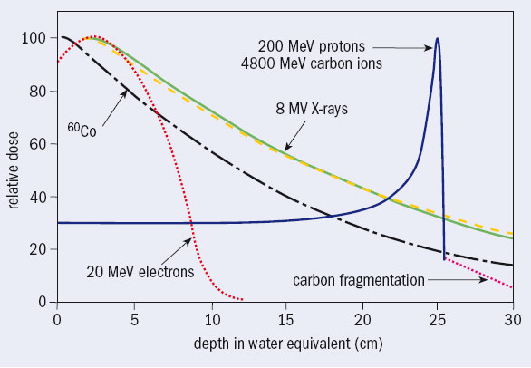
Proton Beam Therapy
Unlike X-rays, charged particles stop!
Electrons, being lighter, scatter and spread out.
Protons deposit most dose at the end of their path: the Bragg Peak.
This property is both the advantage and the disadvantage of proton therapy.
Protons stop, but you need to know where…

Slide 3
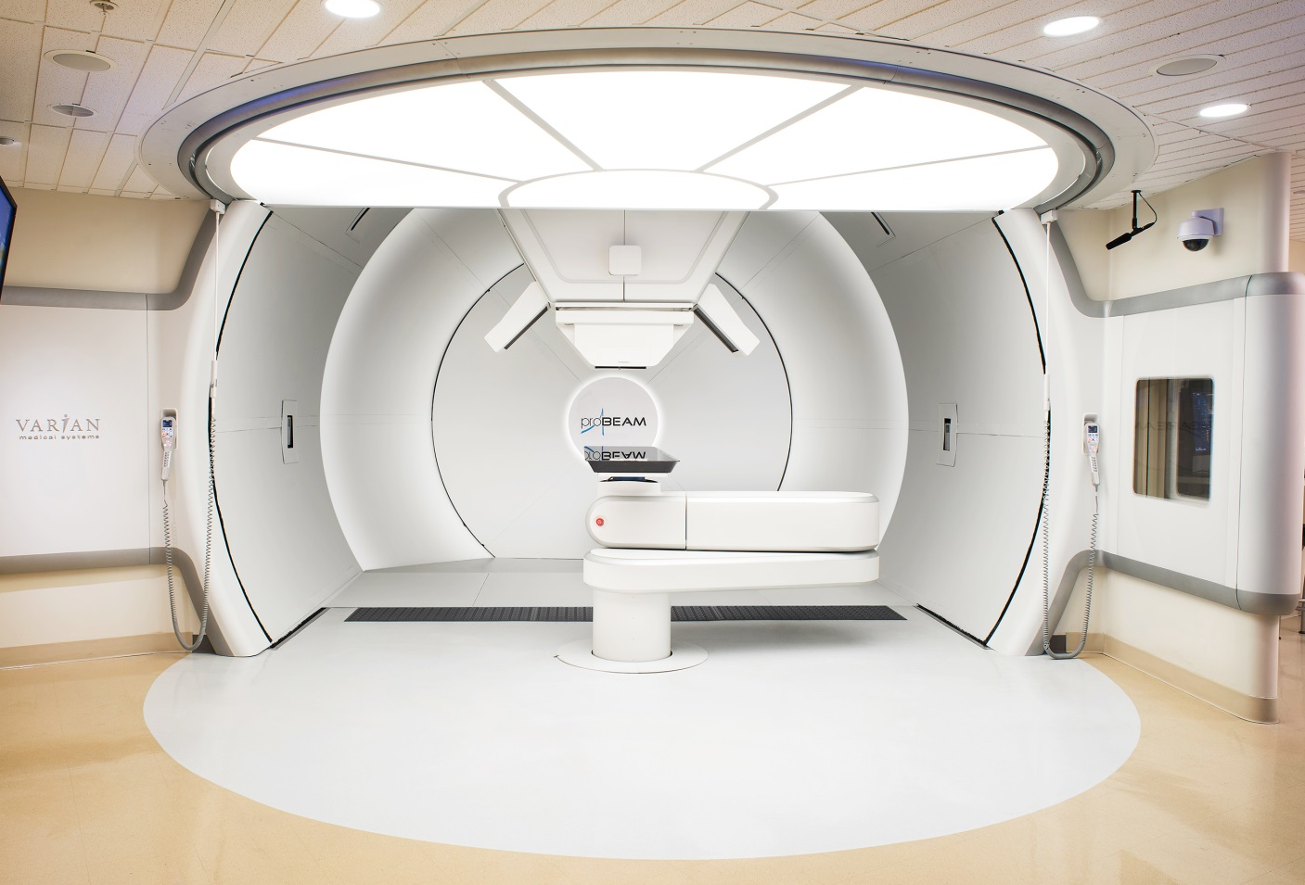
Proton Beam Therapy
A range of QA checks are necessary for safe PBT treatment:
Daily.
Weekly.
Monthly.
Daily checks carried out before treatment:
Most time spent verifying range is correct for given energy.
These range QA checks can take more than an hour for a few measurements.
Equipment is bulky and slow (setup or measurement).
A better detector should make the same measurements more quickly and more accurately…

Slide 4

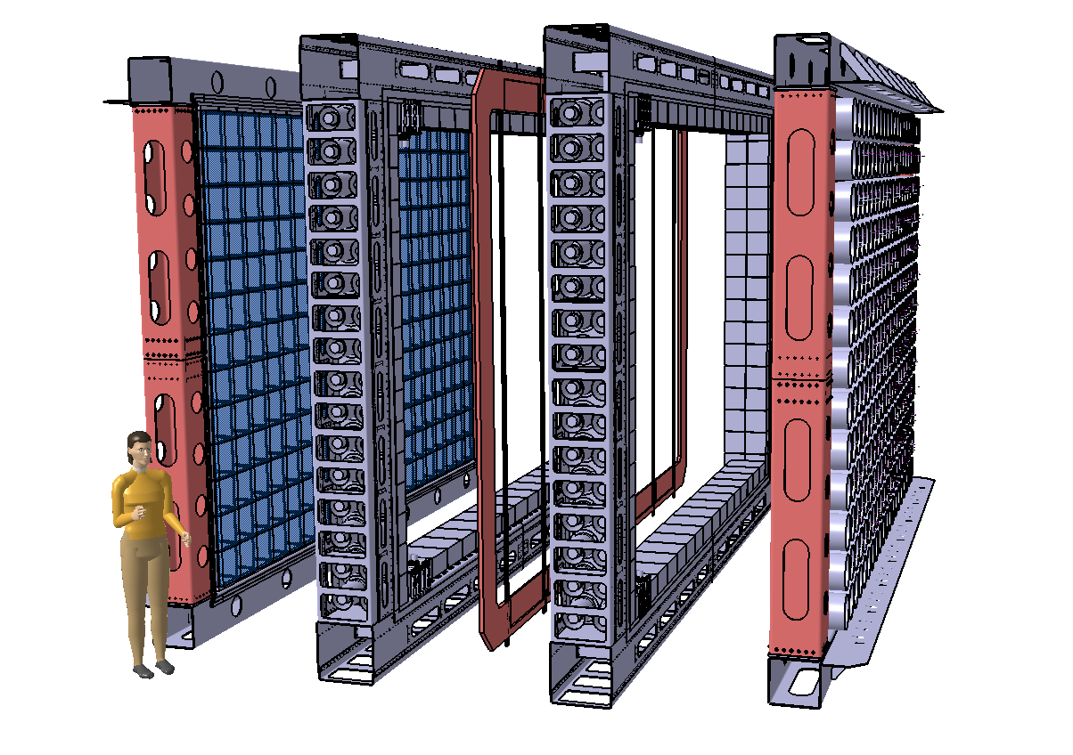
SuperNEMO
Neutrinoless double beta decay detector using NEMO3’s tracker-calorimeter technique Target sensitivity: T_{½} > 10²⁶ years → <m_{ν}> <0.04 – 0.1 eV
Modular detector with a planar geometry
1 module (of 20) consists of:
Source foil:
5 kg (total of 100 kg) of 40 mg/cm² (4 x 2.7 m²)
⁸²Se (high Q_{ββ}, long T_{1/2}^{2vββ}, proven enrichment technology): starting baseline
¹⁵⁰Nd and ⁴⁸Ca being considered depending on enrichment possibilities
Tracker: ~2000 drift cells in Geiger mode → particle identification (for background suppression)
Calorimeter: ~550 scintillator blocks + PMTs → energy and time of flight measurements of particles
Passive shielding surrounding each module
4 m
6 m
2 m (assembled, ~0.5 m between source and calorimeter)

Slide 5
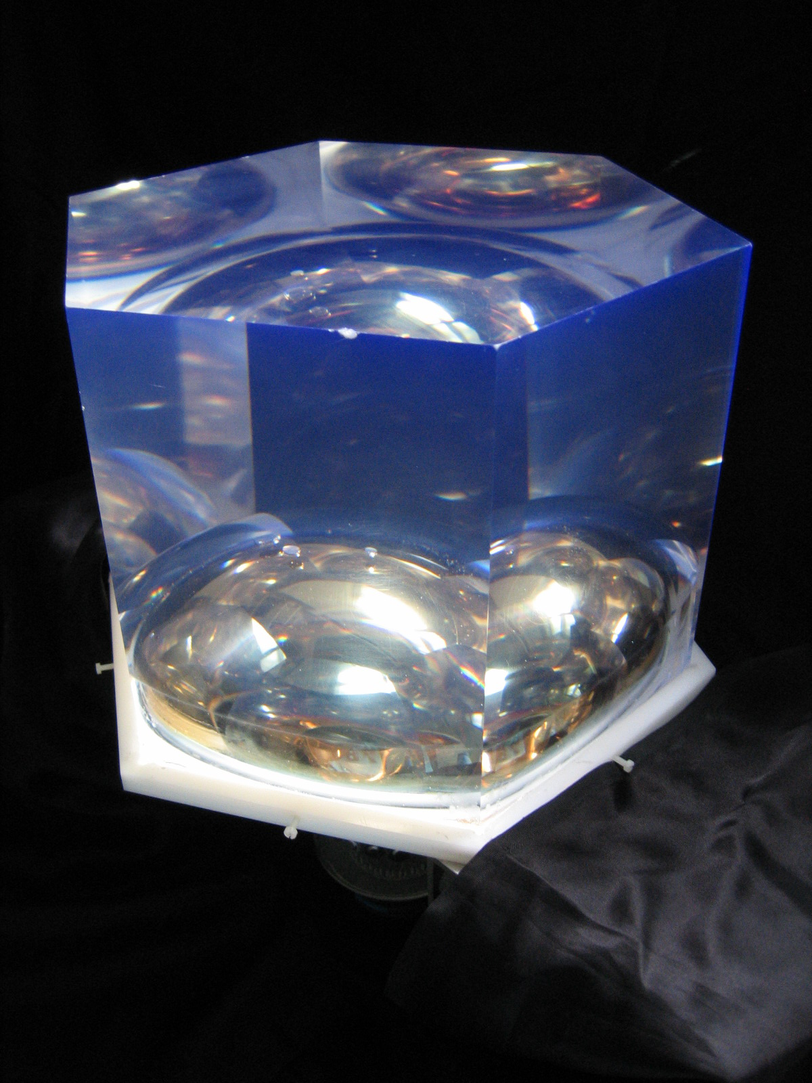
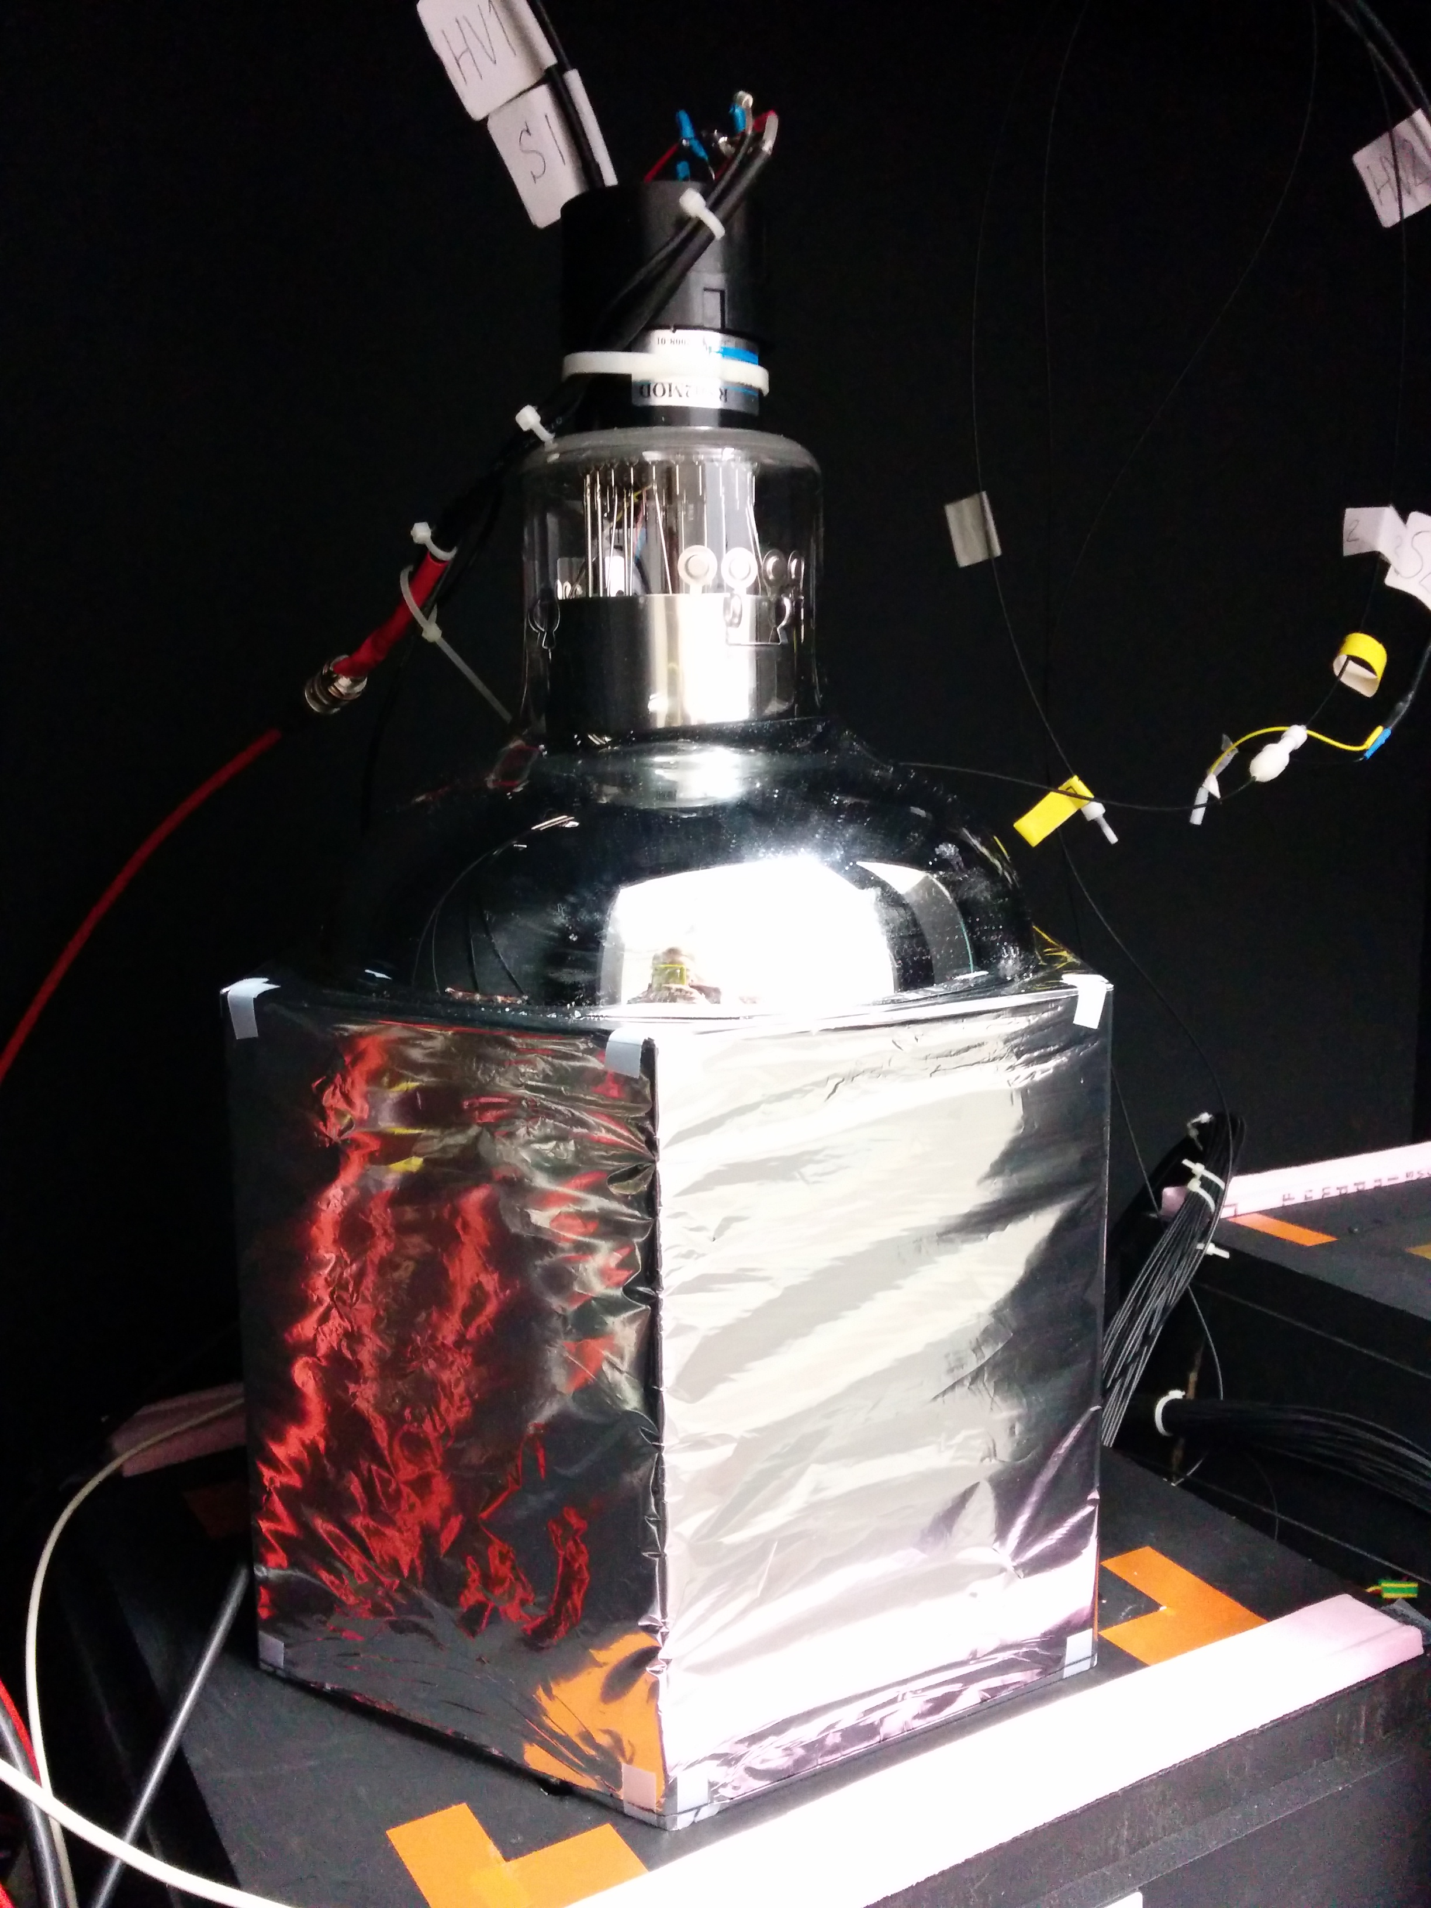
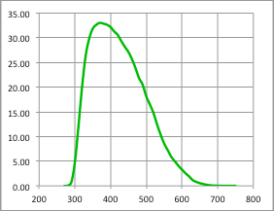
SuperNEMO Optical Module
EJ-200 hexagonal PVT block:
276 mm diameter
193 mm deep, minimum thickness between PMT and scintillator: 100 mm
PVT: 1 ns time constant
R5912-MOD Hamamatsu 8” PMT:
Maximum quoted QE: 33%
32% QE at 400 nm
QE (%)
Wrapping:
Sides: 75 μm of PTFE (Teflon) ribbon
Sides and entrance face: 12 μm of Mylar
Wavelength (nm)

Slide 6
Proton Calorimetry
For Proton CT, need to read out proton energy quickly and accurately:
Energy resolution <1% 𝜎.
Rate 1–10 MHz for reasonable imaging time.
Detector requirements overlap with range QA:
Daily measurements are faster but less comprehensive: really just want to verify that the energy of the beam specified by the control system has the correct range in water (Water Equivalent Path Length).
Morning range QA normally verifies a few energies at known depths:
Proton counting in water-equivalent phantom.
Setup and measurement can be time consuming…
Requirements for improved QA system:
Better than 1% σ resolution across all energies.
Easier system setup and faster data acquisition and readout.
See if SuperNEMO calorimeter works for protons…

Slide 7
Clatterbridge Cancer Centre
62 MeV Scanditronix cyclotron provides 60 MeV protons (31 mm in water) to treatment room through double scattering.
Beam time provided for research.
We’ve had 2-day shifts every few months.
Already made interesting observations with our equipment about the treatment beam…
Need much lower proton fluence for our measurements than clinical settings.
Rate reduction achieved through:
Various collimators (0.5–10 mm)
Ion source gas supply.
Ion source discharge current.
Cyclotron sector focussing.
RF phasing (wouldn’t recommend it…).

Slide 8
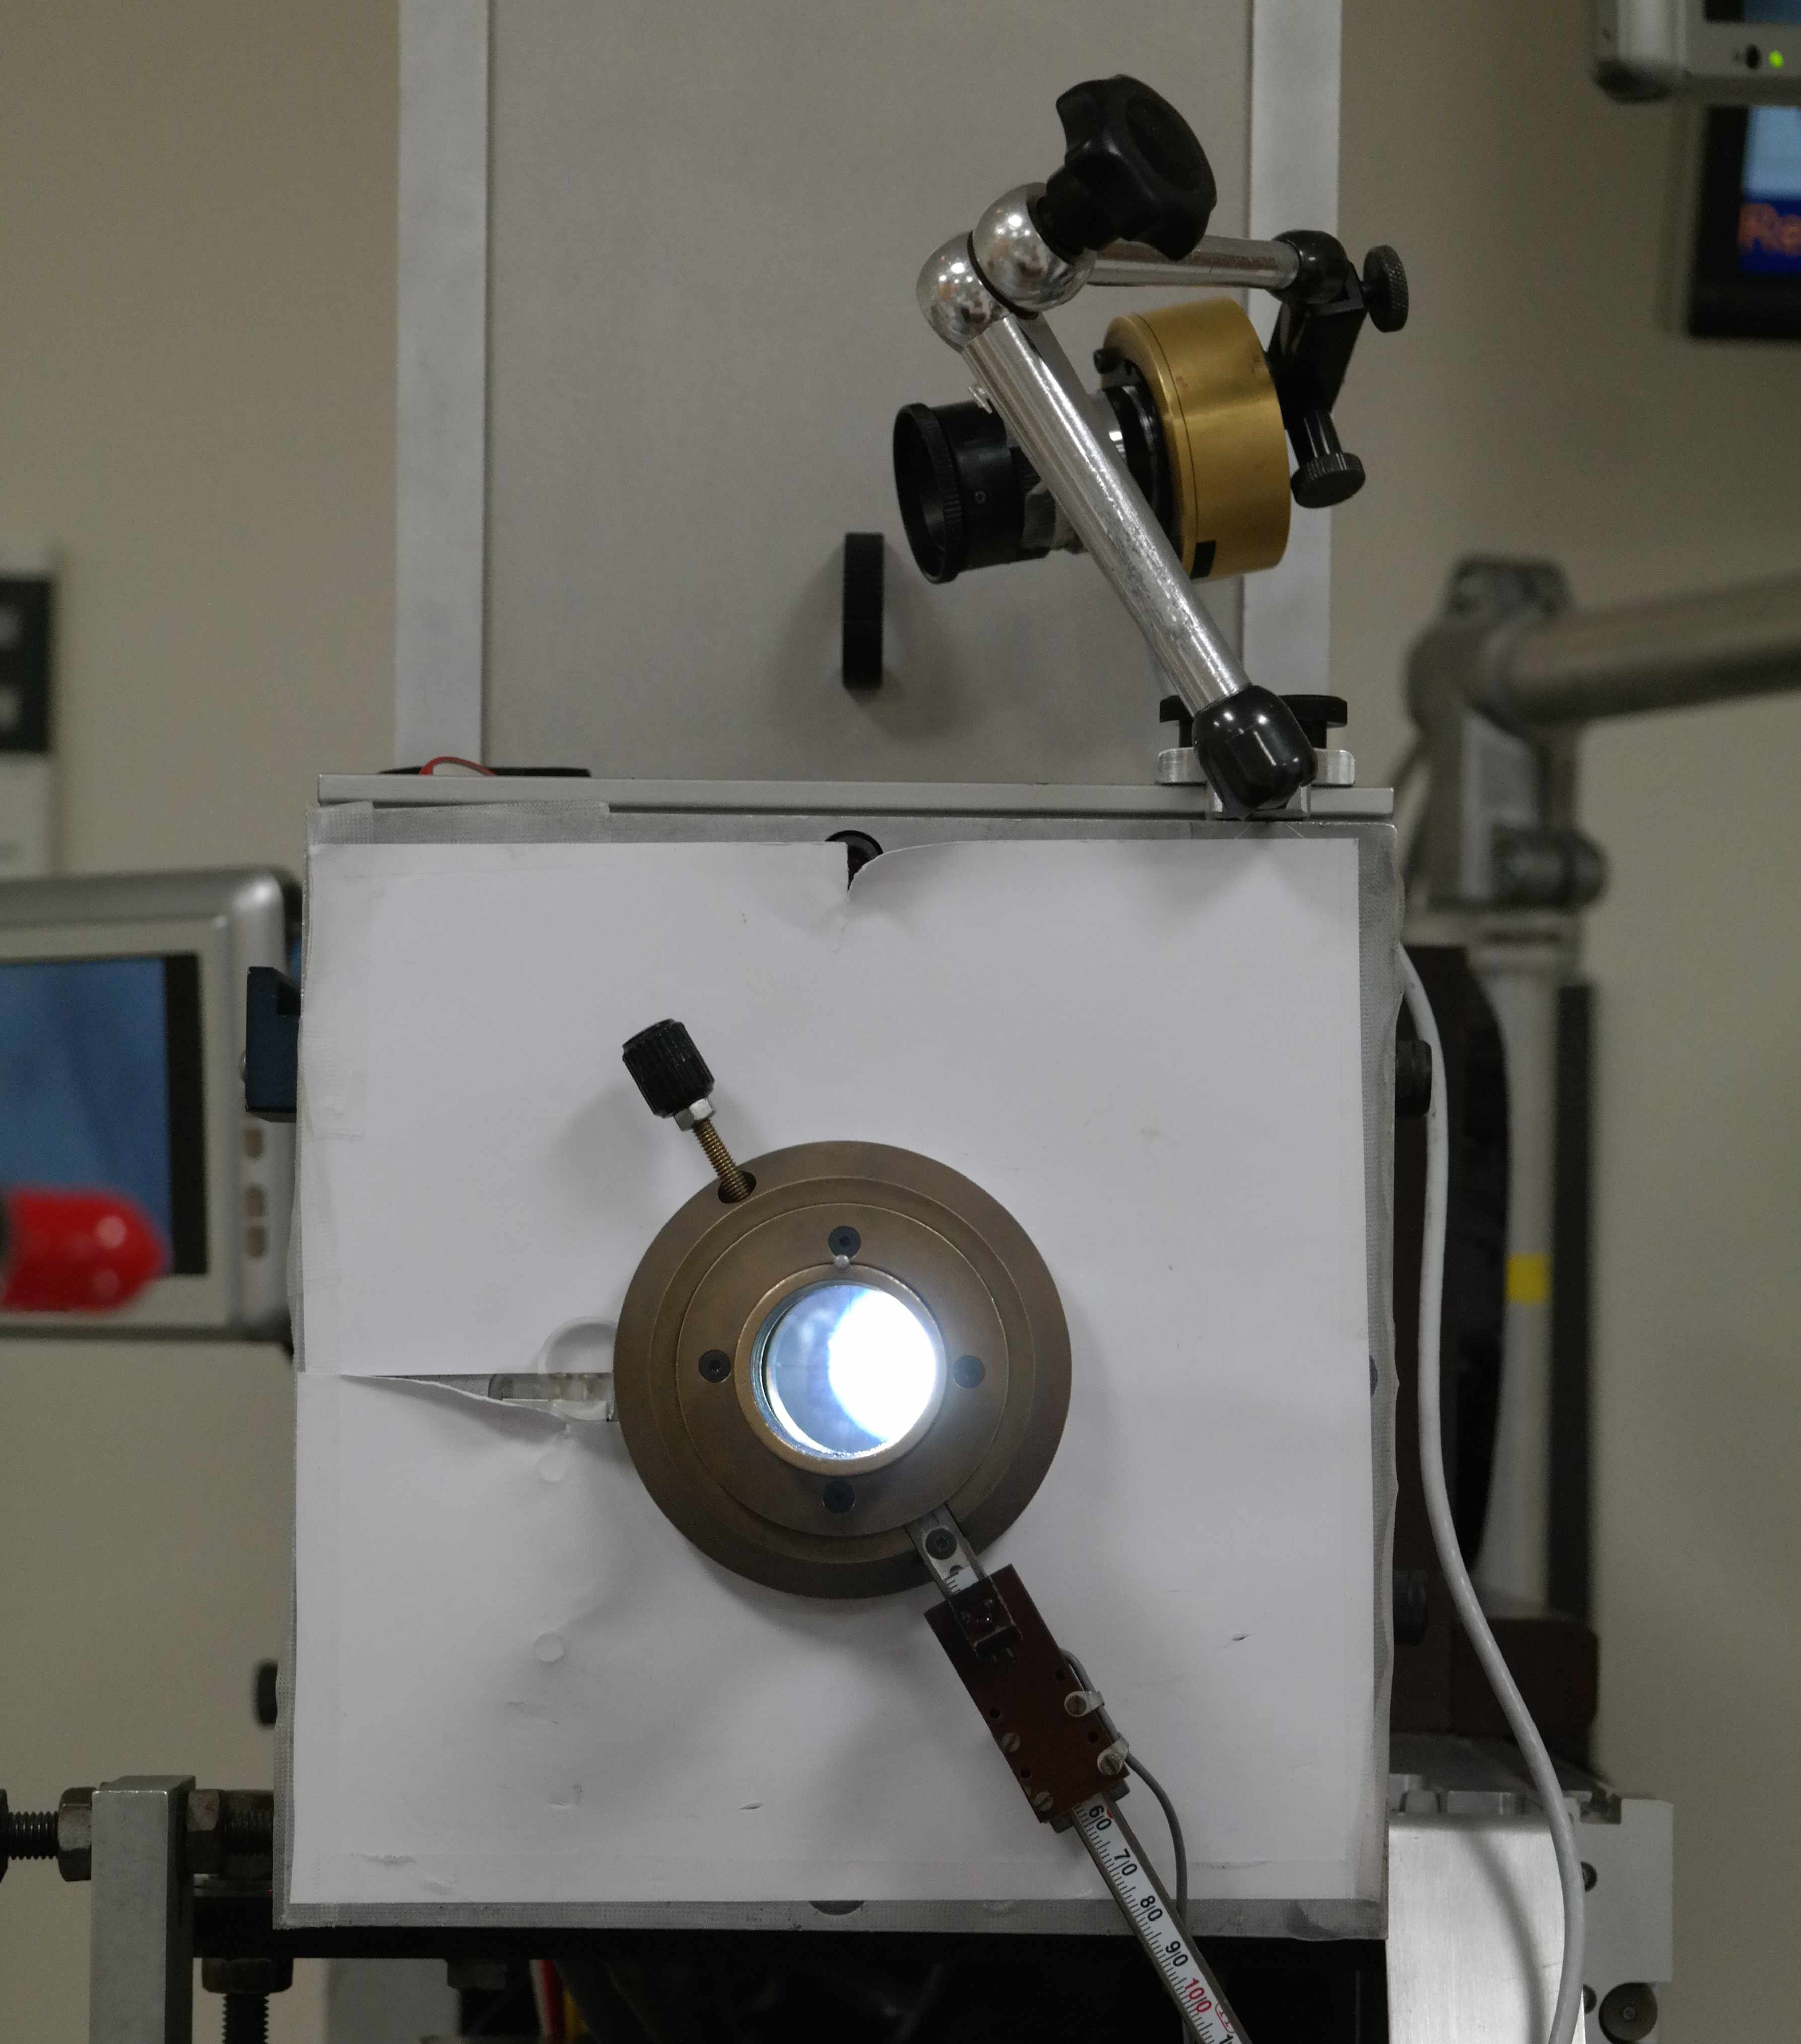
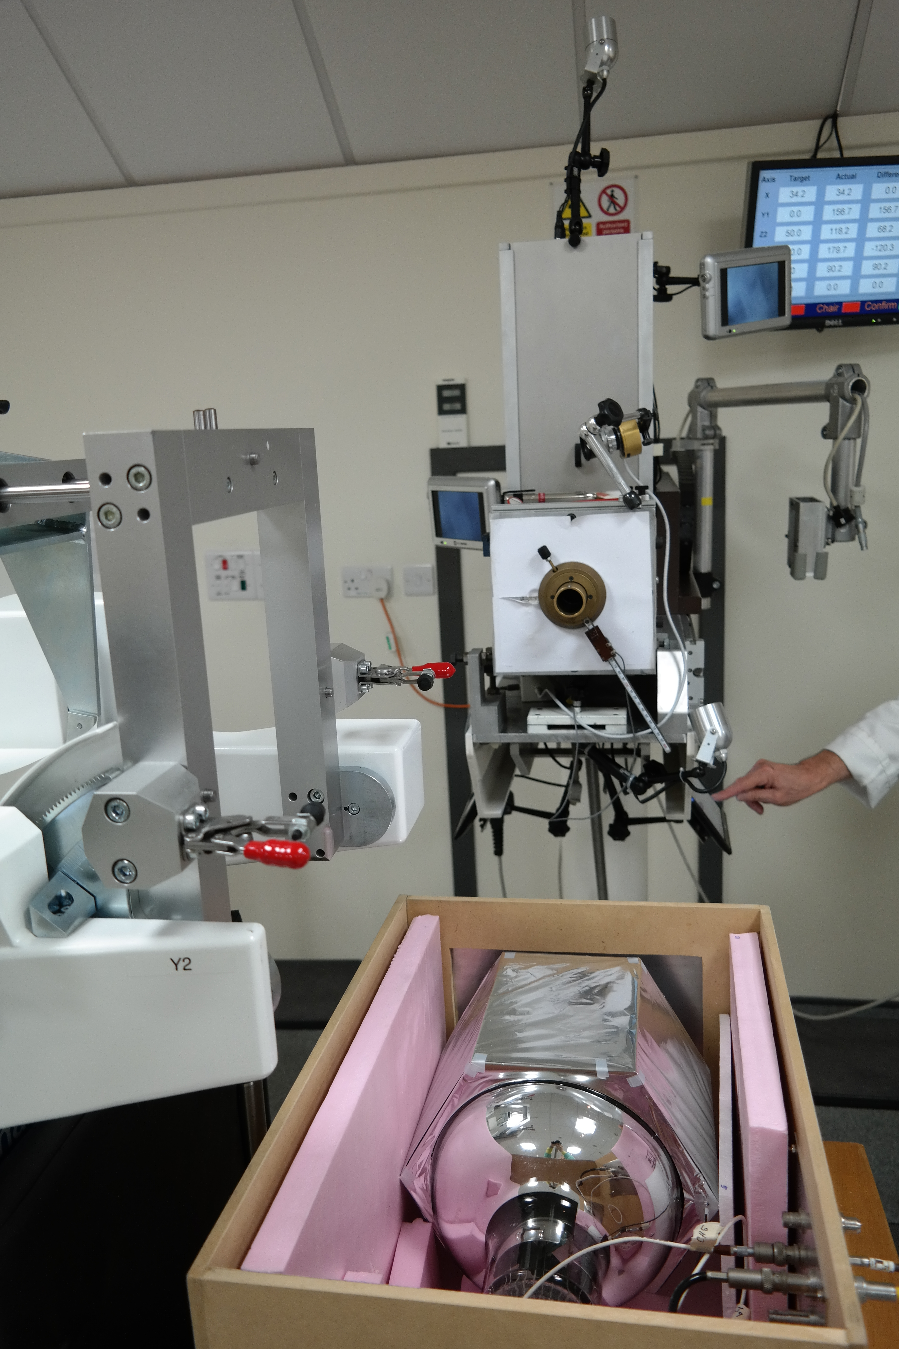
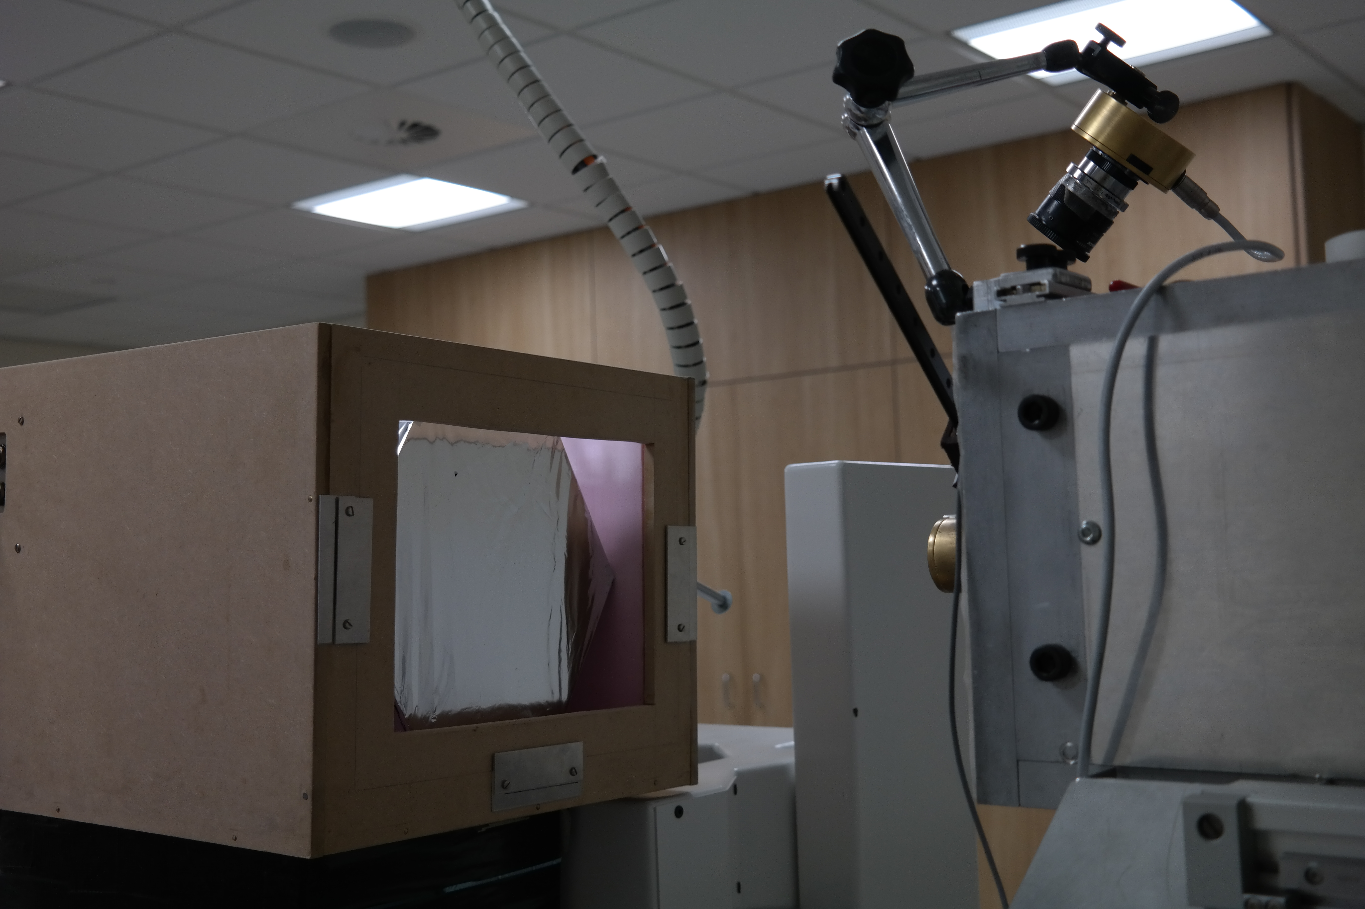
Experimental Tests

Slide 9
Results: Fitted Data
Fitting function:
Convolution of Gaussian
and mirror Landau + Landau on the right
→ ΔE/E: 1.58 ± 0.27 % FWHM (for ~40 MeV due to quenching!)
Compared to 1.48 % FWHM from simulations
Mirror Landau Tail

Slide 10
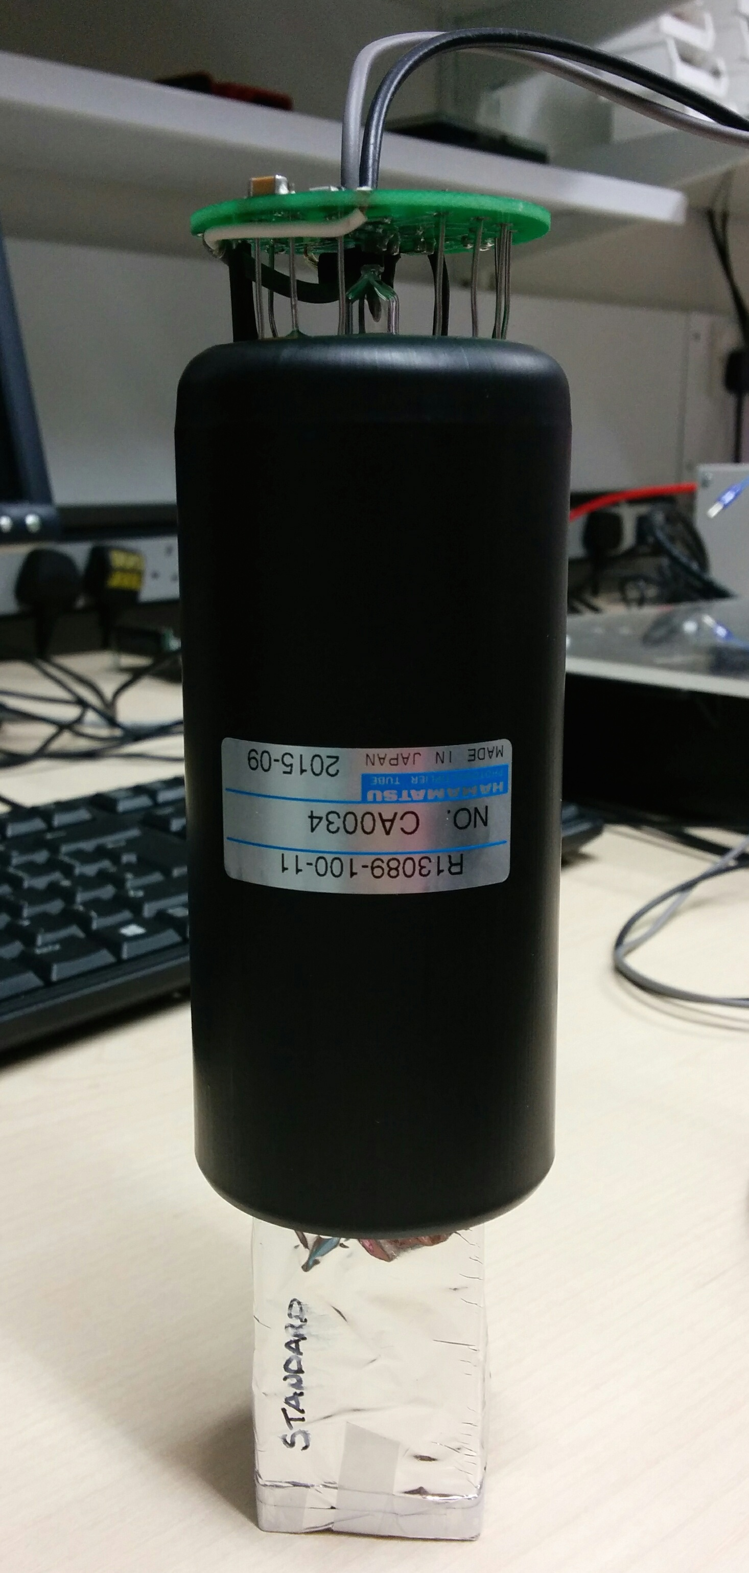
A Smaller, Faster Detector
We have already achieved the target energy resolution: 0.7% σ with 2 kHz rate.
The next step is to do this for very high rates of 1–10 MHz with a compact design:
Reduce the size of the PMT and the scintillator to improve timing and make the design nozzle-mountable.
Negative HV PMT base to remove decoupling capacitor (not fast enough discharge).
2” Hamamatsu R13089-100-11 PMT with negative HV active divider base
3 cm x 3 cm x 5 cm cuboid ENVINET/NUVIA PolyStyrene standard scintillator
Coupled with BC-630 Saint Gobain silicone optical gel
Wrapped in 75 μm of PTFE (Teflon) ribbon on the sides and 12 μm of Mylar on the sides and entrance face

Slide 11
Small Module Results
Spectrum obtained with the Clatterbridge 60 MeV proton beam.
Best energy resolution (σ/E) result achieved so far during four test beam visits (at 70 kHz).
This result was achieved with a 2” PMT and a 3 cm x 3 cm x 5 cm plastic scintillator
Fitting function:
Convolution of Gaussian and mirror Landau + Landau on the right
ΔE/E:
0.50 ± 0.07 % σ
Mirror Landau Tail

Slide 12
Resolution: Energy Dependence
Energy of protons incident on scintillator varied by placing PMMA absorbers of known thickness ~1.8 m upstream of the optical module.
Measure σ/E as a function of proton energy
dependence!
PRELIMINARY!

Slide 13
Beam Test Conclusions
What have we learned?
The scintillator performs just as well for single protons as it does for electrons!
Making the module smaller does what it’s supposed to:
Improves timing (good measurements up to around 300kHz, compared to 1 kHz for original 8” module),
No detrimental effect on resolution.
But…
Single module can’t handle rates approaching 1 MHz.
Despite Hamamatsu’s promises to the contrary, we think the PMTs have a frequency-dependent gain.
Interesting discoveries about Clatterbridge beam:
Nonlinear time distribution of protons (bunches of bunches...).
Close to nozzle edge, energy falls off.
Built beamline simulation to compare to Clatterbridge/UCL measurements:

Slide 14
MedAustron 250 MeV Tests
Having tested detector at 60 MeV, needed to make high energy test to examine performance and test linearity:
Longer, 40 cm scintillator block to absorb 250 MeV protons.
Same PMT and readout.
Through OMA, MedAustron offered us 2 nights of beam tests:
62 MeV up to 252 MeV.
Able to drop rate down with chopper adjustment: ran 1 kHz–1 MHz.
Custom collimators to reduce intensity and beam size.

Slide 15
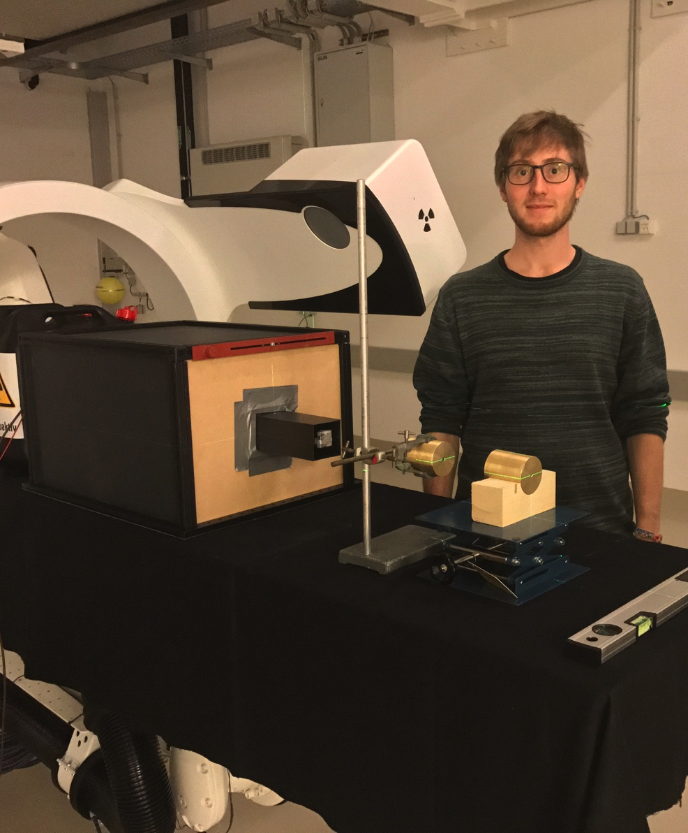
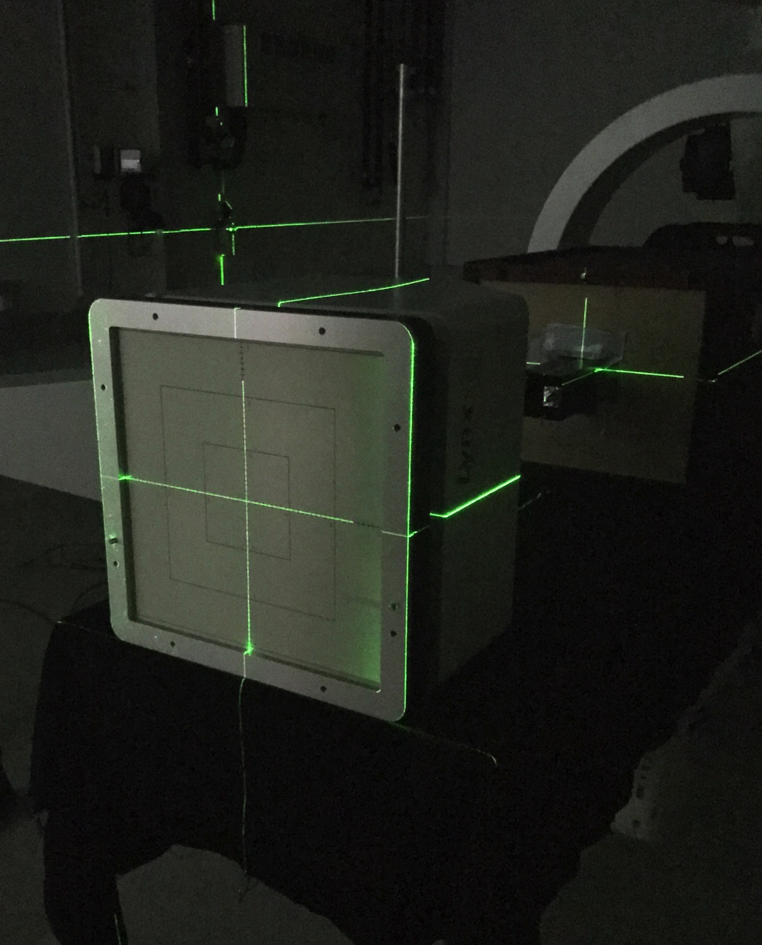
MedAustron Setup

Slide 16
MedAustron Results
Still seeing excellent energy resolution up to 252 MeV.
Best resolution 0.2% σ.
But also still seeing rate issues:
PMT current limit from too much light!
Detector not fast enough for 10¹⁰ p/s clinical rate.

Slide 17
Simulated Stopping Distance
Simulations of SuperNEMO scintillator vs Water Equivalent:
PolyVinyl Toluene is “water equivalent” for stopping distance and spread, as is Polystyrene.
One to one conversion for water phantoms.
We can take advantage of this for range QA measurements: water equivalent + high light output + excellent energy resolution.
Proton Beam Energy, MeV | Mean stopping distance, SCINT (mm) | Mean stopping distance, WATER (mm) | σ stopping distance, SCINT (mm) | σ stopping distance, WATER (mm)
60 | 30.21 | 30.54 | 0.33 | 0.33
200 | 255.4 | 257.1 | 2.48 | 2.44
300 | 505.9 | 509.9 | 4.64 | 4.78

Slide 18
Segmented Calorimeter
Protons
PVT and PS are both helpfully water equivalent.
Segment block into slices and read out light from each slice individually.
Integrate signal from many protons: very large output from 10¹⁰/s.
Minimum slice width will depend on manufacture: aiming for < 2 mm.
Use simple, stable light detection: photodiodes/pixel sensors.
Resolution set by slice width and variation in scintillator light output.

Slide 19
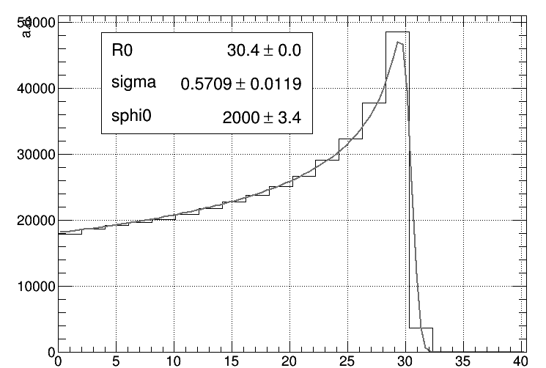
Segmented Calorimeter Design
Laurent Kelleter has built preliminary model in Geant4:
2 mm slices of plastic scintillator with mylar wrapping.
Currently integrating photodiode readout.
STFC IPS grant application with NUVIA a.s. in Czech Republic to produce our scintillator sheets: manufacturing challenging!
Need to characterise light quenching to reconstruct Bragg curve: pencil beams only.
Fit to measured curve drastically improves mean range measurement: do you need range or range spread…?
dY/dx | light yield per unit path length
dE/dx | energy lost by particle per unit path length
kB | relates density of ionisation to energy loss = 0.207 mm/MeV
S | absolute scintillation efficiency
Dose deposited
Light emitted

Slide 20
Segmented Calorimeter Tests
Carried out beam tests of 2 sheet prototype of segmented calorimeter:
3 mm and 4 mm Nuvia plastic scintillator sheets.
PRaVDA Priapus MAPS pixel sensor (10 cm x 5 cm).
Birmingham cyclotron provided 28 MeV proton beam with clinical fluence.

Slide 21
Fast Treatment Plan Verification
Protons
Tracking layer
Take segmented calorimeter: add 2D tracking to front face.
Still nozzle-mounted and self-contained.
Read out X/Y profile and integrated range of individual pencil beams.
Detector read out fast enough to match minimum spot dwell time (3–20 ms).
Fast reconstruction of water-equivalent treatment plan.

Slide 22
Future Plans
Work on segmented calorimeter design to produce water equivalent path length detector:
Resolution better than 2 mm: much better with appropriate fit.
“Immediate” readout (a few seconds).
Need >150 sheets for 32 cm: start with 20 sheets and do fast measurement at Clatterbridge.
Light detection and DAQ biggest detector challenge.
Full design aims to be gantry mounted: can characterise multiple fields.
Fast treatment plan verification very promising, but needs work to get segmented calorimeter working before adding tracking:
Tracking and range measurement need to be fast enough to read out data with suitable resolution within spot dwell time.
Needs electronics to synchronise.

